Slide 1

Energy Storage Devices

Slide 2
Objective of Lecture
Describe the construction of a capacitor and how charge is stored.
Introduce several types of capacitors
Discuss the electrical properties of a capacitor
  The relationship between charge, voltage, and capacitance
    Charging and discharging of a capacitor
  Relationship between voltage, current, and capacitance; power; and energy
  Equivalent capacitance when a set of capacitors are in series and in parallel

Slide 3
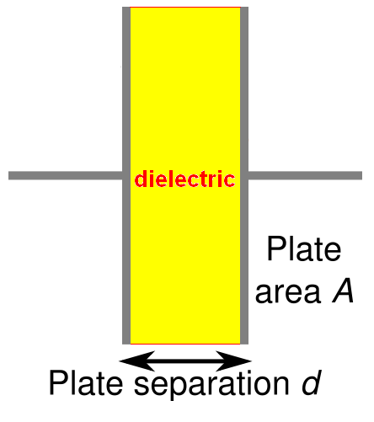
Capacitors
Composed of two conductive plates separated by an insulator (or dielectric).
  Commonly illustrated as two parallel metal plates separated by a distance, d.
  C = ε A/d
  where ε = ε_{r} ε_{o}
  ε_{r} is the relative dielectric constant
  ε_{o} is the vacuum permittivity

Slide 4
Effect of Dimensions
Capacitance increases with
  increasing surface area of the plates,
  decreasing spacing between plates, and
  increasing the relative dielectric constant of the insulator between the two plates.

Slide 5
Types of Capacitors
Fixed Capacitors
  Nonpolarized
    May be connected into circuit with either terminal of capacitor connected to the high voltage side of the circuit.
      Insulator: Paper, Mica, Ceramic, Polymer
  Electrolytic
    The negative terminal must always be at a lower voltage than the positive terminal
      Plates or Electrodes: Aluminum, Tantalum

Slide 6
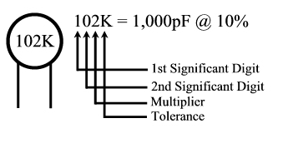

Nonpolarized
Difficult to make nonpolarized capacitors that store a large amount of charge or operate at high voltages.
  Tolerance on capacitance values is very large
    +50%/-25% is not unusual
PSpice Symbol
http://www.marvac.com/fun/ceramic_capacitor_codes.aspx

Slide 7
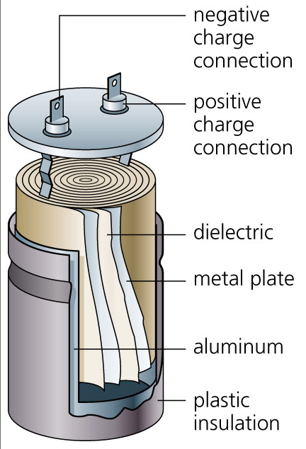
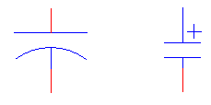
Electrolytic
Pspice Symbols
Fabrication
http://www.digitivity.com/articles/2008/11/choosing-the-right-capacitor.html

Slide 8
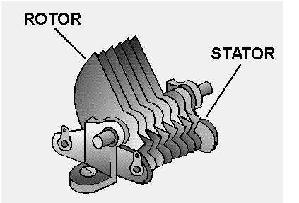

Variable Capacitors
Cross-sectional area is changed as one set of plates are rotated with respect to the other.
PSpice Symbol
http://www.tpub.com/neets/book2/3f.htm

Slide 9
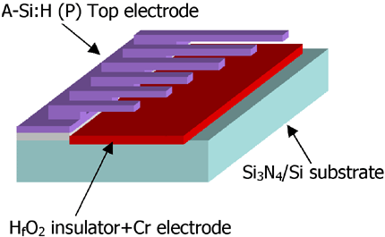
MEMS Capacitor
MEMS (Microelectromechanical system)
  Can be a variable capacitor by changing the distance between electrodes.
  Use in sensing applications as well as in RF electronics.
http://www.silvaco.com/tech_lib_TCAD/simulationstandard/2005/aug/a3/a3.html

Slide 10
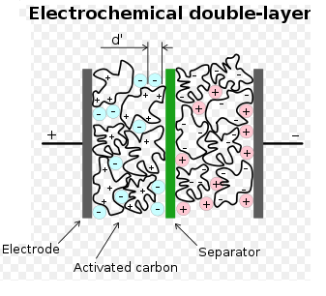
Electric Double Layer Capacitor
Also known as a supercapacitor or ultracapacitor
  Used in high voltage/high current applications.
    Energy storage for alternate energy systems.
http://en.wikipedia.org/wiki/File:Supercapacitor_diagram.svg

Slide 11
Electrical Properties of a Capacitor
Acts like an open circuit at steady state when connected to a d.c. voltage or current source.
Voltage on a capacitor must be continuous
  There are no abrupt changes to the voltage, but there may be discontinuities in the current.
An ideal capacitor does not dissipate energy, it takes power when storing energy and returns it when discharging.

Slide 12
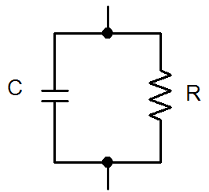
Properties of a Real Capacitor
A real capacitor does dissipate energy due leakage of charge through its insulator.
  This is modeled by putting a resistor in
  parallel with an ideal capacitor.

Slide 13
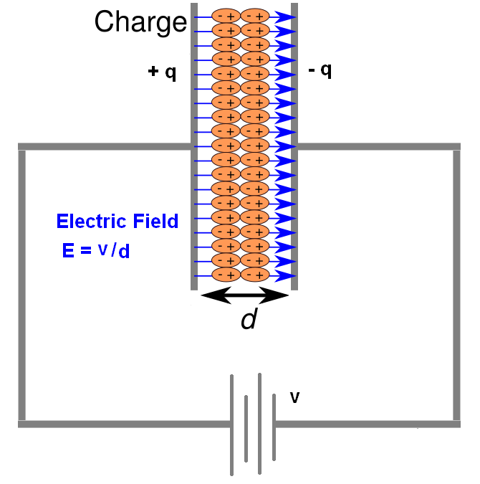
Energy Storage
Charge is stored on the plates of the capacitor.
Equation:
Q = CV
Units:
Farad = Coulomb/Voltage
Farad is abbreviated as F

Slide 14
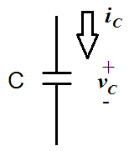
Sign Conventions
The sign convention used with a capacitor is the same as for a power dissipating device.
  When current flows into the positive side of the voltage across the capacitor, it is positive and the capacitor is dissipating power.
  When the capacitor releases energy back into the circuit, the sign of the current will be negative.

Slide 15
Charging a Capacitor
At first, it is easy to store charge in the capacitor.
As more charge is stored on the plates of the capacitor, it becomes increasingly difficult to place additional charge on the plates.
  Coulombic repulsion from the charge already on the plates creates an opposing force to limit the addition of more charge on the plates.
    Voltage across a capacitor increases rapidly as charge is moved onto the plates when the initial amount of charge on the capacitor is small.
    Voltage across the capacitor increases more slowly as it becomes difficult to add extra charge to the plates.

Slide 16
Adding Charge to Capacitor
The ability to add charge to a capacitor depends on:
  the amount of charge already on the plates of the capacitor
  and
  the force (voltage) driving the charge towards the plates (i.e., current)

Slide 17
Discharging a Capacitor
At first, it is easy to remove charge in the capacitor.
  Coulombic repulsion from charge already on the plates creates a force that pushes some of the charge out of the capacitor once the force (voltage) that placed the charge in the capacitor is removed (or decreased).
As more charge is removed from the plates of the capacitor, it becomes increasingly difficult to get rid of the small amount of charge remaining on the plates.
  Coulombic repulsion decreases as charge spreads out on the plates. As the amount of charge decreases, the force needed to drive the charge off of the plates decreases.
    Voltage across a capacitor decreases rapidly as charge is removed from the plates when the initial amount of charge on the capacitor is small.
    Voltage across the capacitor decreases more slowly as it becomes difficult to force the remaining charge out of the capacitor.

Slide 18
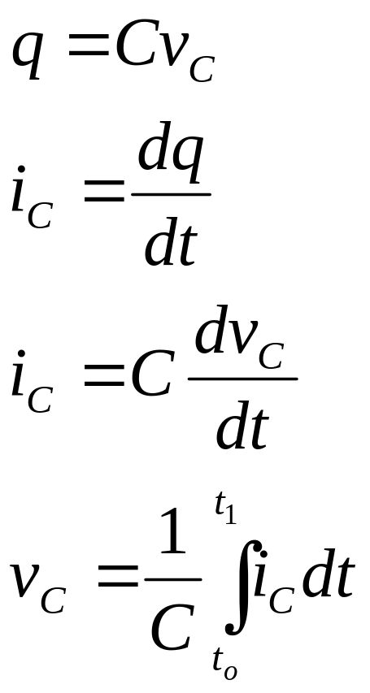
Current-Voltage Relationships

Slide 19
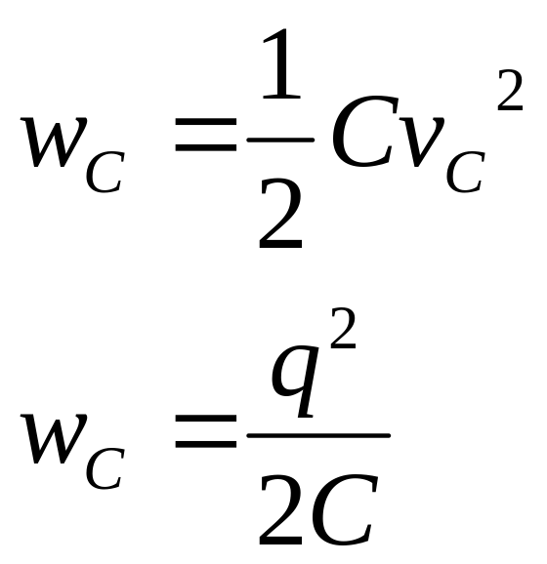
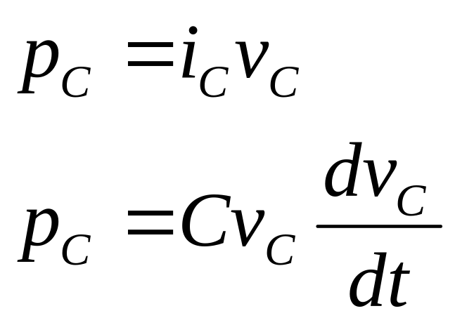
Power and Energy

Slide 20
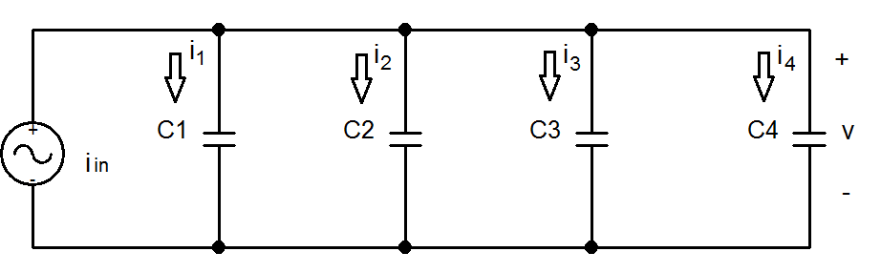
Capacitors in Parallel

Slide 21
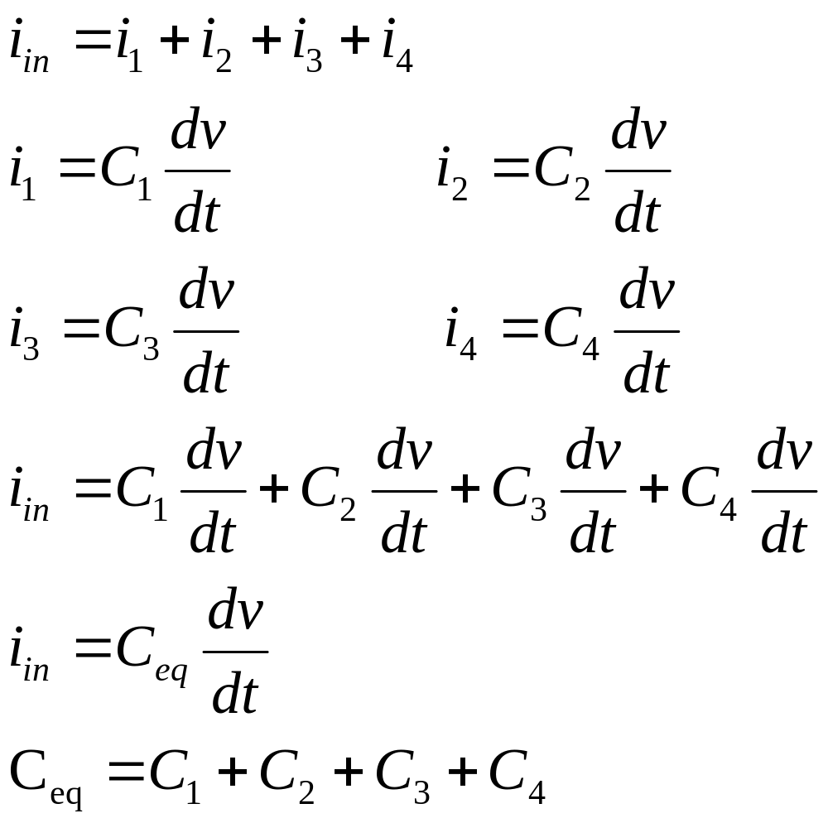
C_{eq} for Capacitors in Parallel

Slide 22
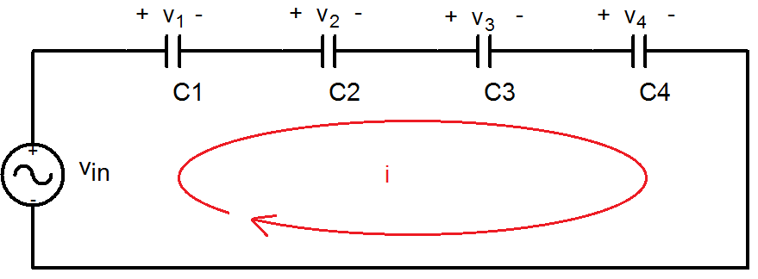
Capacitors in Series

Slide 23
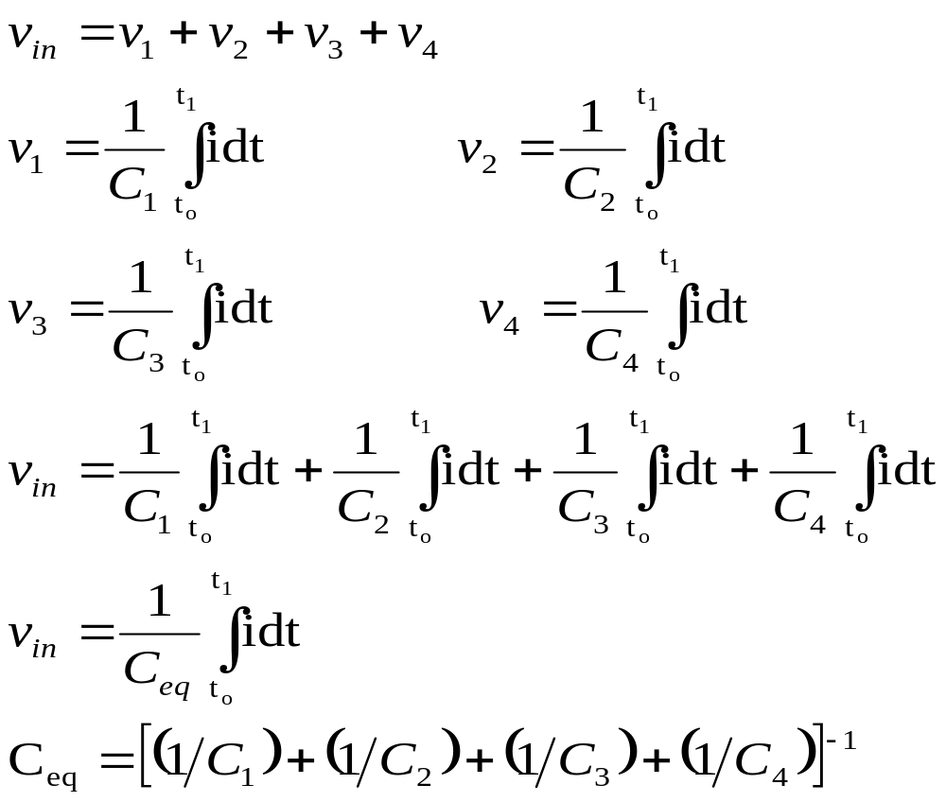
C_{eq} for Capacitors in Series

Slide 24
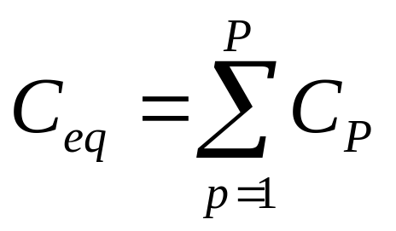
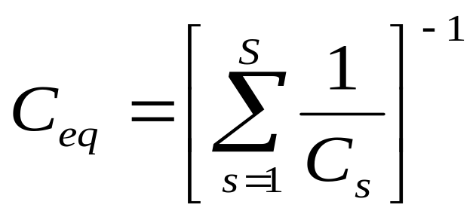
General Equations for C_{eq}
Parallel Combination
Series Combination
If P capacitors are in parallel, then
If S capacitors are in series, then:

Slide 25
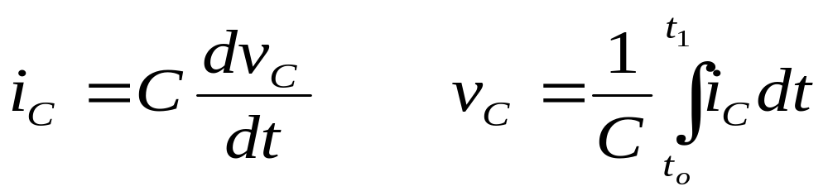
Summary
Capacitors are energy storage devices.
An ideal capacitor act like an open circuit at steady state when a DC voltage or current has been applied.
The voltage across a capacitor must be a continuous function; the current flowing through a capacitor can be discontinuous.
The equations for equivalent capacitance for
  capacitors in parallel capacitors in series

