Slide 1

Series RLC Network

Slide 2
Objective of Lecture
Derive the equations that relate the voltages across a resistor, an inductor, and a capacitor in series as:
  the unit step function associated with voltage or current source changes from 1 to 0 or
  a switch disconnects a voltage or current source into the circuit.
Describe the solution to the 2nd order equations when the condition is:
  Overdamped
  Critically Damped
  Underdamped

Slide 3
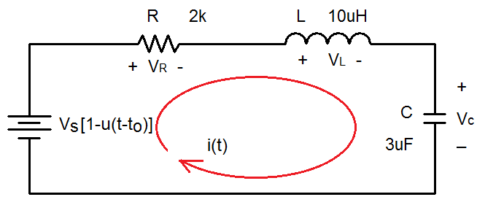
Series RLC Network
With a step function voltage source.

Slide 4
Boundary Conditions
You must determine the initial condition of the inductor and capacitor at t < t_{o} and then find the final conditions at t = ∞s.
  Since the voltage source has a magnitude of 0V at t < t_{o}
    i(t_{o}⁻) = i_{L}(t_{o}⁻) = 0A and v_{C}(t_{o}⁻) = Vs
    v_{L}(t_{o}⁻) = 0V and i_{C}(t_{o}⁻) = 0A
  Once the steady state is reached after the voltage source has a magnitude of Vs at t > t_{o}, replace the capacitor with an open circuit and the inductor with a short circuit.
    i(∞s) = i_{L}(∞s) = 0A and v_{C}(∞s) = 0V
    v_{L}(∞s) = 0V and i_{C}(∞s) = 0A

Slide 5
Selection of Parameter
Initial Conditions
  i(t_{o}⁻) = i_{L}(t_{o}⁻) = 0A and v_{C}(t_{o}⁻) = Vs
  v_{L}(t_{o}⁻) = 0V and i_{C}(t_{o}⁻) = 0A
Final Conditions
  i(∞s) = i_{L}(∞s) = 0A and v_{C}(∞s) = oV
  v_{L}(∞s) = 0V and i_{C}(∞s) = 0A
Since the voltage across the capacitor is the only parameter that has a non-zero boundary condition, the first set of solutions will be for v_{C}(t).

Slide 6
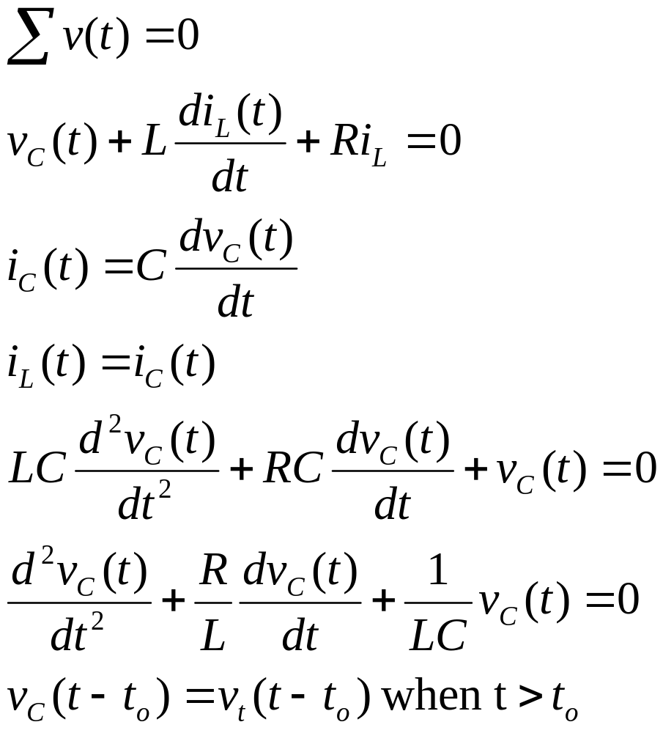
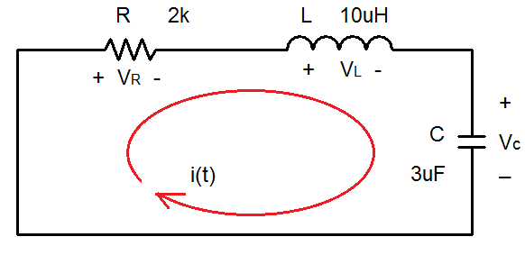
Kirchhoff’s Voltage Law

Slide 7
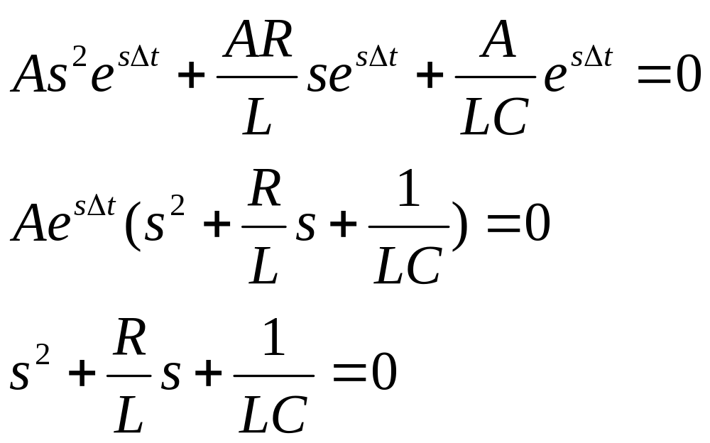
General Solution
Let v_{C}(t) = Ae^{sΔt}

Slide 8
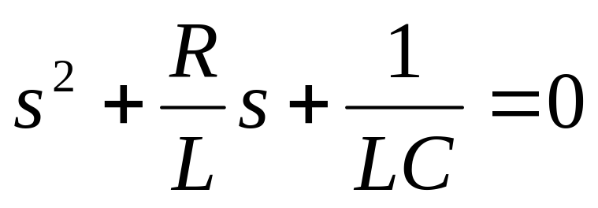
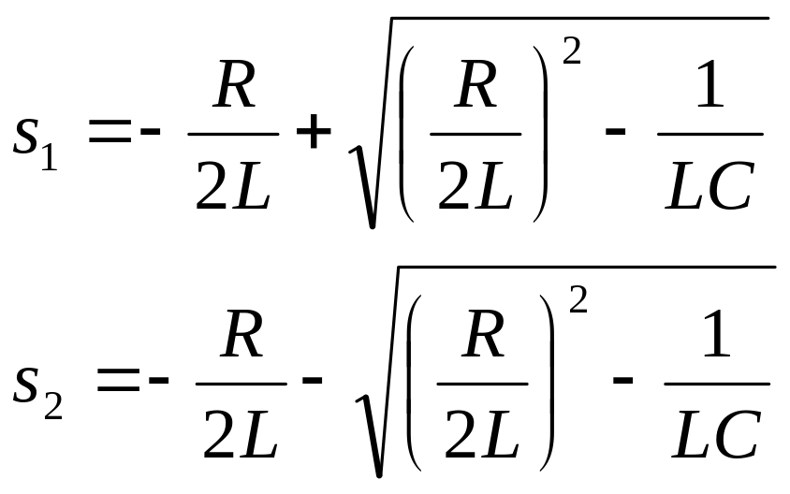
General Solution (con’t)

Slide 9
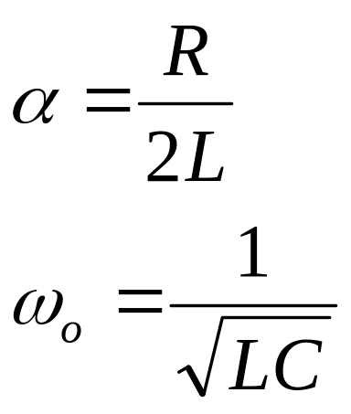
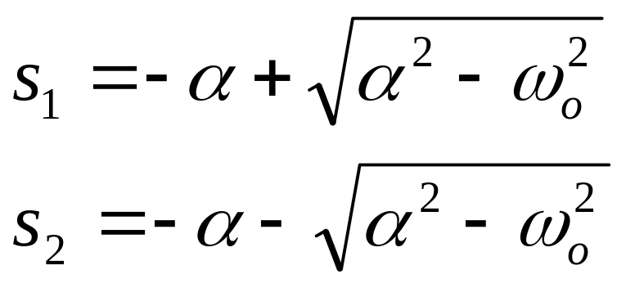
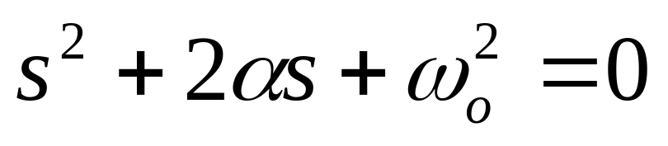
General Solution (con’t)

Slide 10
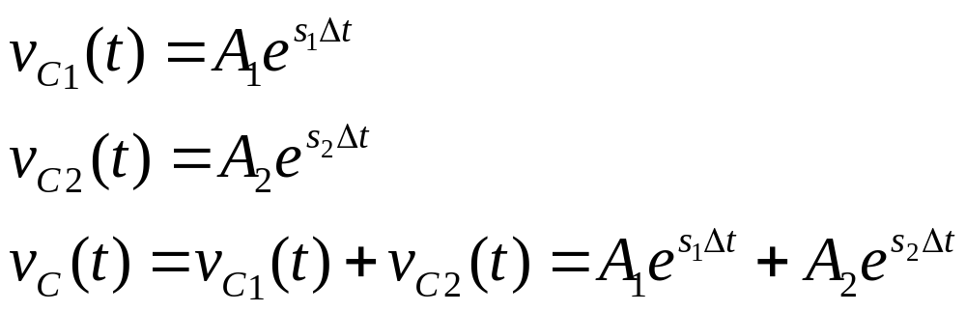
General Solution (con’t)

Slide 11
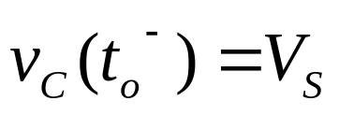
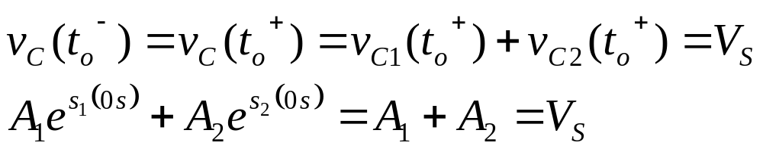
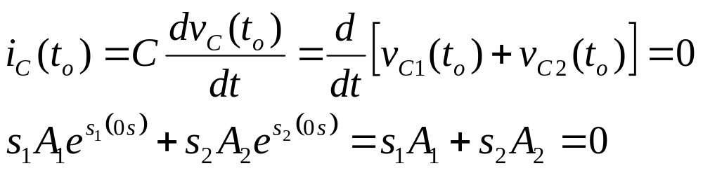
Solve for Coefficients A₁ and A₂
Use the boundary conditions at t_{o}⁻ and t = ∞s to solve for A1 and A2.
  Since the voltage across a capacitor must be a continuous function of time.
  Also know that

Slide 12
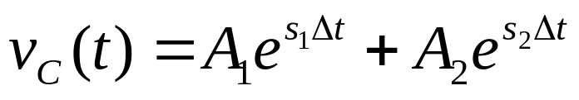
Overdamped Case
α > ω_{ο}
  implies that C > 4L/R²
  s₁ and s₂ are negative and real numbers

Slide 13
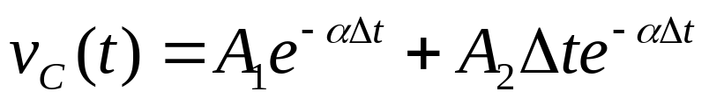
Critically Damped Case
α = ω_{ο}
  implies that C = 4L/R²
  s₁ = s₂ = - α = -R/2L

Slide 14
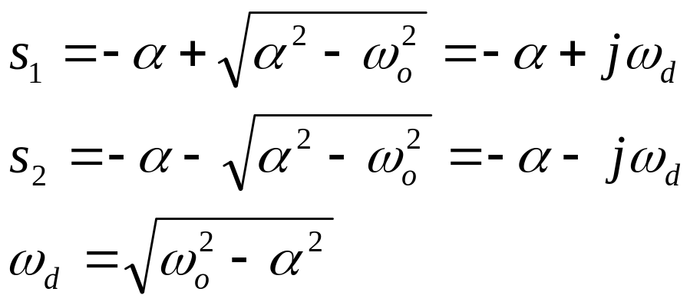

Underdamped Case
α < ω_{ο}
  implies that C < 4L/R²
  , i is used by the mathematicians for imaginary numbers

Slide 15
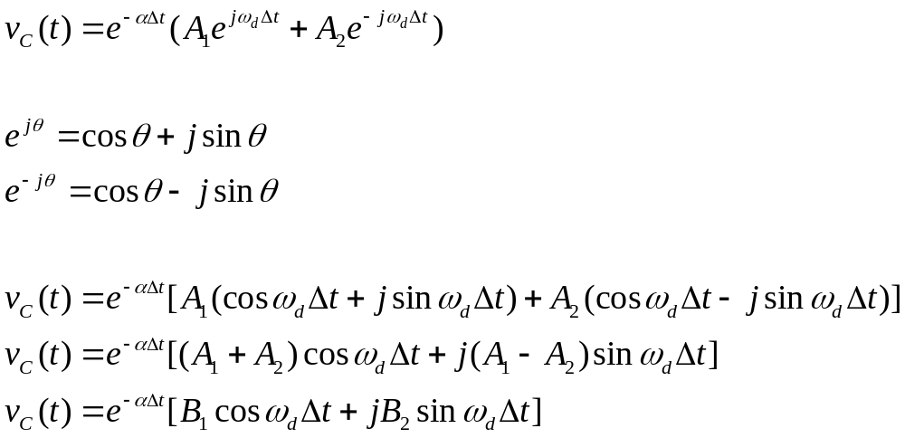
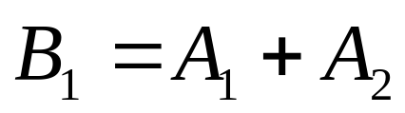
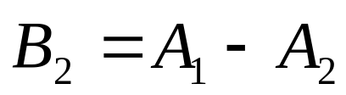

Slide 16
Angular Frequencies
ω_{o} is called the undamped natural frequency
  The frequency at which the energy stored in the capacitor flows to the inductor and then flows back to the capacitor. If R = 0Ω, this will occur forever.
ω_{d} is called the damped natural frequency
  Since the resistance of R is not usually equal to zero, some energy will be dissipated through the resistor as energy is transferred between the inductor and capacitor.
    α determined the rate of the damping response.

Slide 17
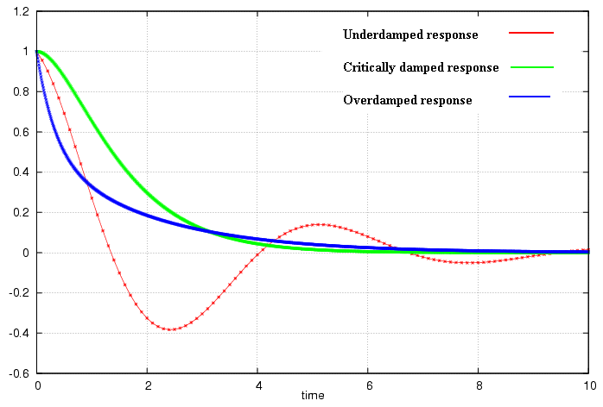

Slide 18
Properties of RLC network
Behavior of RLC network is described as damping, which is a gradual loss of the initial stored energy
  The resistor R causes the loss
  α determined the rate of the damping response
    If R = 0, the circuit is loss-less and energy is shifted back and forth between the inductor and capacitor forever at the natural frequency.
  Oscillatory response of a lossy RLC network is possible because the energy in the inductor and capacitor can be transferred from one component to the other.
    Underdamped response is a damped oscillation, which is called ringing.

Slide 19
Properties of RLC network
Critically damped circuits reach the final steady state in the shortest amount of time as compared to overdamped and underdamped circuits.
  However, the initial change of an overdamped or underdamped circuit may be greater than that obtained using a critically damped circuit.

Slide 20
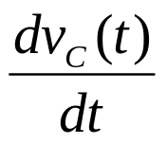

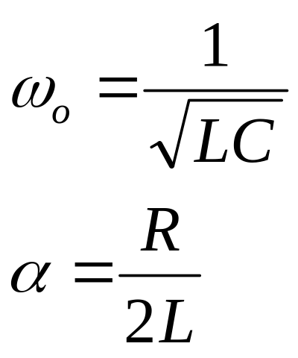
Set of Solutions when t > t_{o}
There are three different solutions which depend on the magnitudes of the coefficients of the and the terms.
  To determine which one to use, you need to calculate the natural angular frequency of the series RLC network and the term α.

Slide 21
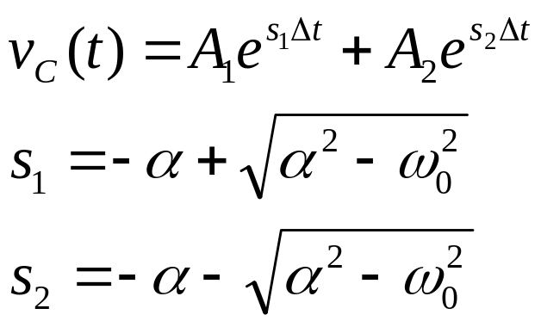
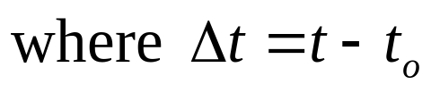
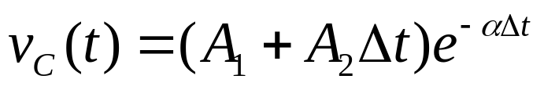
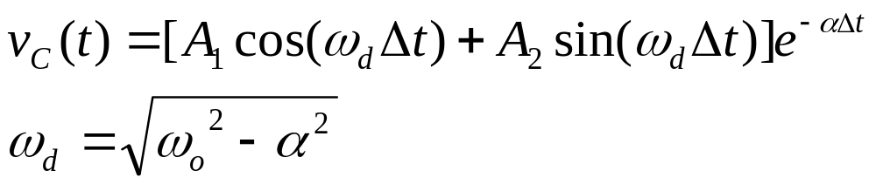
Transient Solutions when t > t_{o}
Overdamped response (α > ω_{o})
Critically damped response (α = ω_{o})
Underdamped response (α < ω_{o})

Slide 22
Find Coefficients
After you have selected the form for the solution based upon the values of ω_{o} and α
  Solve for the coefficients in the equation by evaluating the equation at t = t_{o}⁻ and t = ∞s using the initial and final boundary conditions for the voltage across the capacitor.
    v_{C}(t_{o}⁻) = Vs
    v_{C}(∞s) = oV

Slide 23
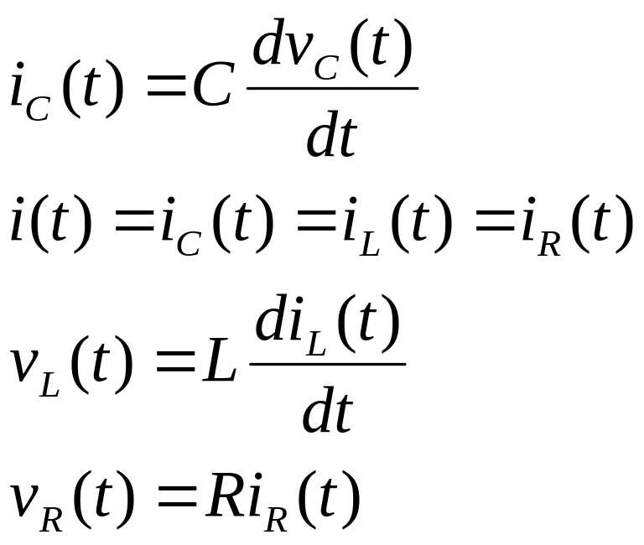
Other Voltages and Currents
Once the voltage across the capacitor is known, the following equations for the case where t > t_{o} can be used to find:

Slide 24
Solutions when t < t_{o}
The initial conditions of all of the components are the solutions for all times -∞s < t < t_{o}.
  v_{C}(t) = Vs
  i_{C}(t) = 0A
  v_{L}(t) = 0V
  i_{L}(t) = 0A
  v_{R}(t) = 0V
  i_{R}(t) = 0A

Slide 25
Summary
The set of solutions when t > t_{o} for the voltage across the capacitor in a RLC network in series was obtained.
  Selection of equations is determine by comparing the natural frequency ω_{o} to α.
  Coefficients are found by evaluating the equation and its first derivation at t = t_{o}⁻ and t = ∞s.
  The voltage across the capacitor is equal to the initial condition when t < t_{o}
Using the relationships between current and voltage, the current through the capacitor and the voltages and currents for the inductor and resistor can be calculated.

Slide 26
Parallel RLC Network

Slide 27
Objective of Lecture
Derive the equations that relate the voltages across a resistor, an inductor, and a capacitor in parallel as:
  the unit step function associated with voltage or current source changes from 1 to 0 or
  a switch disconnects a voltage or current source into the circuit.
Describe the solution to the 2nd order equations when the condition is:
  Overdamped
  Critically Damped
  Underdamped

Slide 28
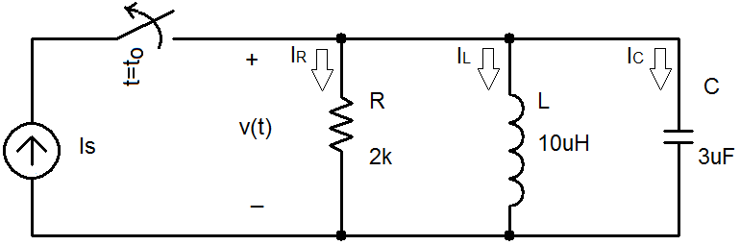
RLC Network
A parallel RLC network where the current source is switched out of the circuit at t = t_{o}.

Slide 29
Boundary Conditions
You must determine the initial condition of the inductor and capacitor at t < t_{o} and then find the final conditions at t = ∞s.
  Since the voltage source has a magnitude of 0V at t < t_{o}
    i_{L}(t_{o}⁻) = Is and v(t_{o}⁻) = v_{C}(t_{o}⁻) = 0V
    v_{L}(t_{o}⁻) = 0V and i_{C}(t_{o}⁻) = 0A
  Once the steady state is reached after the voltage source has a magnitude of Vs at t > t_{o}, replace the capacitor with an open circuit and the inductor with a short circuit.
    i_{L}(∞s) = 0A and v(∞s) = v_{C}(∞s) = 0V
    v_{L}(∞s) = 0V and i_{C}(∞s) = 0A

Slide 30
Selection of Parameter
Initial Conditions
  i_{L}(t_{o}⁻) = Is and v(t_{o}⁻) = v_{C}(t_{o}⁻) = 0V
  v_{L}(t_{o}⁻) = 0V and i_{C}(t_{o}⁻) = 0A
Final Conditions
  i_{L}(∞s) = 0A and v(∞s) = v_{C}(∞s) = oV
  v_{L}(∞s) = 0V and i_{C}(∞s) = 0A
Since the current through the inductor is the only parameter that has a non-zero boundary condition, the first set of solutions will be for i_{L}(t).

Slide 31
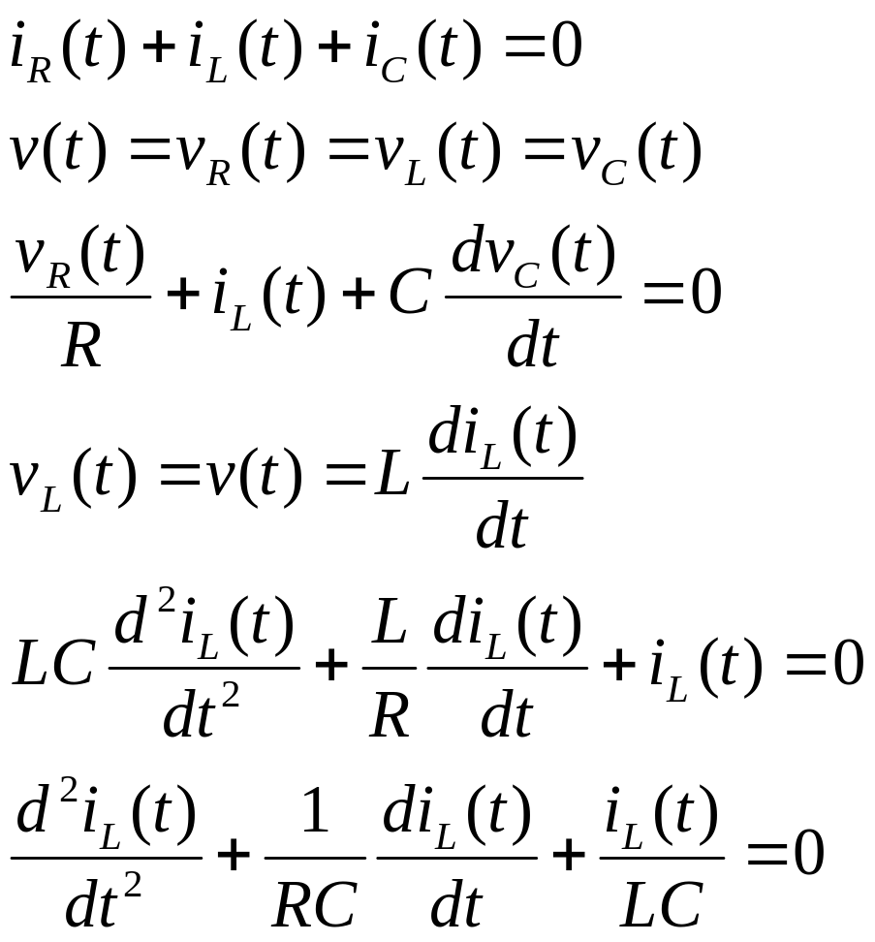
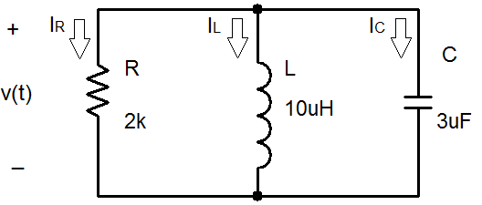
Kirchoff’s Current Law

Slide 32
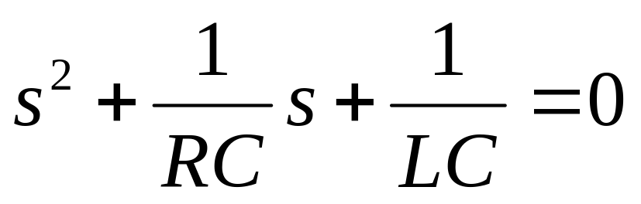
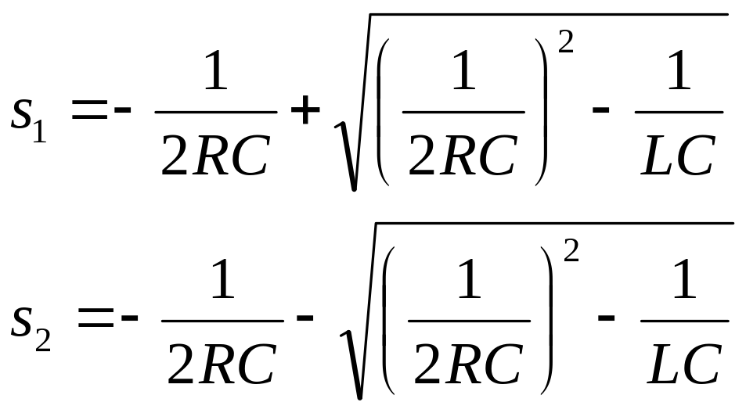
General Solution

Slide 33
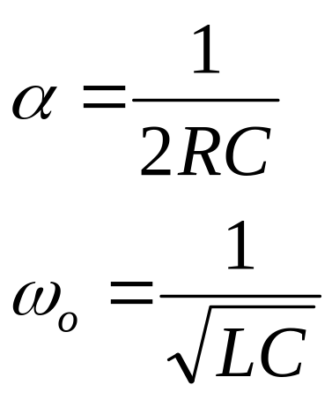
Note that the equation for the natural frequency of the RLC circuit is the same whether the components are in series or in parallel.

Slide 34
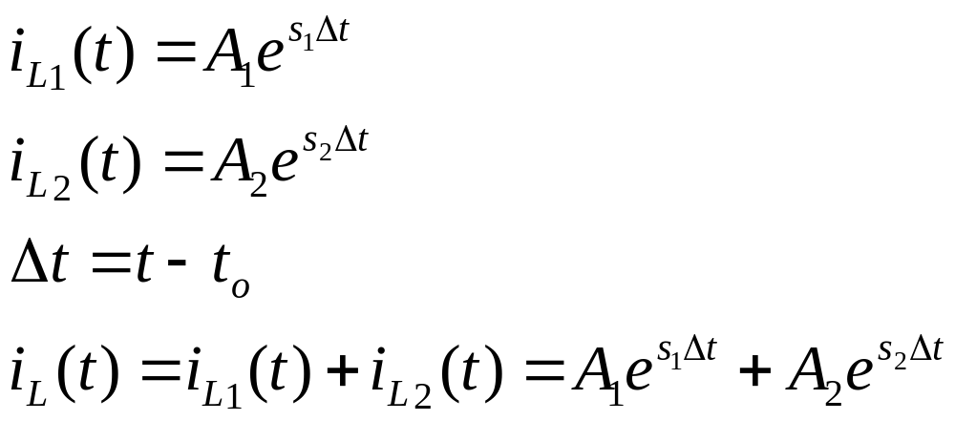
Overdamped Case
α > ω_{ο}
  implies that L > 4R²C
  s₁ and s₂ are negative and real numbers

Slide 35
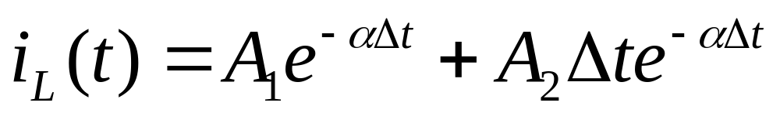
Critically Damped Case
α = ω_{ο}
  implies that L = 4R²C
  s₁ = s₂ = - α = -1/2RC

Slide 36
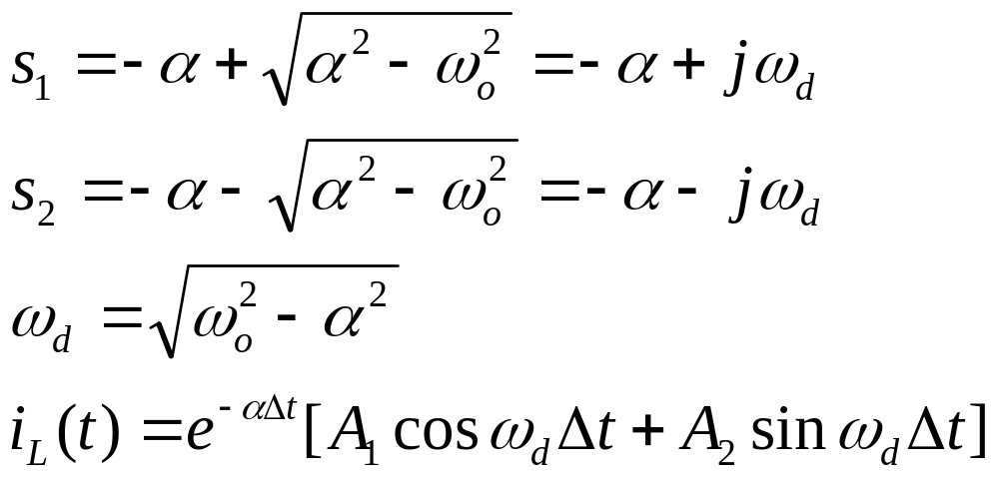
Underdamped Case
α < ω_{ο}
  implies that L < 4R²C

Slide 37
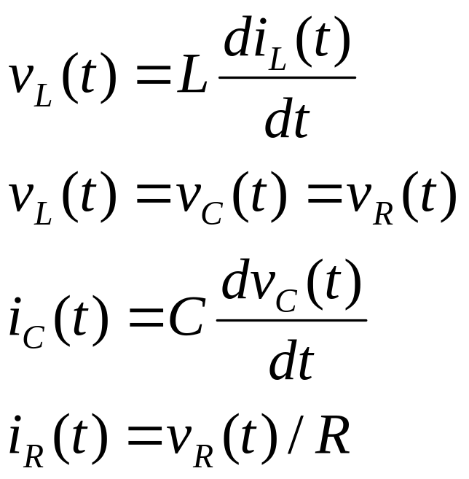
Other Voltages and Currents
Once current through the inductor is known:

Slide 38
Summary
The set of solutions when t > t_{o} for the current through the inductor in a RLC network in parallel was obtained.
  Selection of equations is determine by comparing the natural frequency ω_{o} to α.
  Coefficients are found by evaluating the equation and its first derivation at t = t_{o}⁻ and t = ∞s.
  The current through the inductor is equal to the initial condition when t < t_{o}
Using the relationships between current and voltage, the voltage across the inductor and the voltages and currents for the capacitor and resistor can be calculated.

