Slide 1
Operational Amplifiers
EE 204

Slide 2
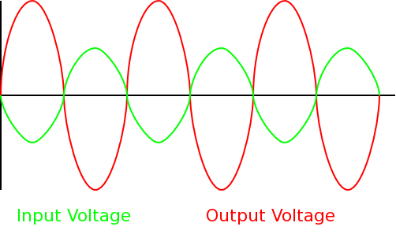
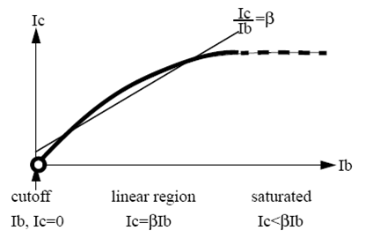
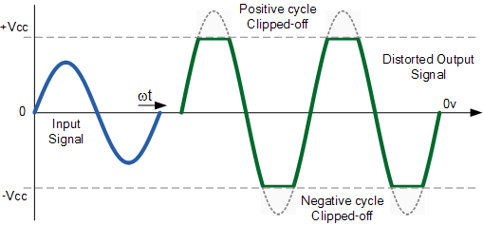
BJT Applications
BJT Amplifier

Slide 3
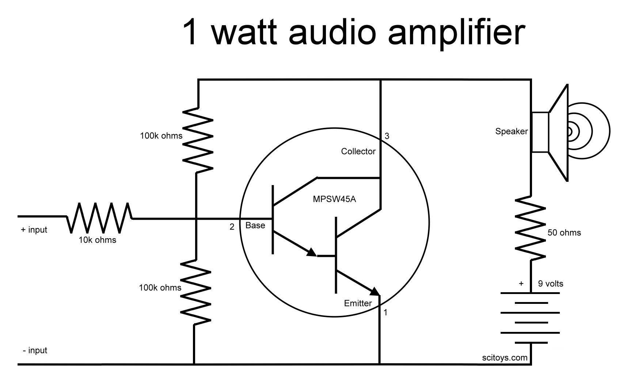
BJT Applications
Transistor is a switch (most common application)
BJT Amplifier (second most common…)

Slide 4
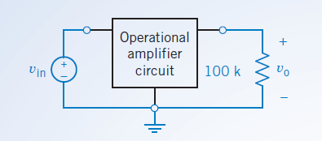
What is an Op-Amp
Op-Amp or operational amplifier a modular circuit that is designed to work with other circuit elements (in boom boxes, speakers, cell phones, biomedical apps, sensors, heart rate monitors, power circuits, computers)
The simplest model of the operational amplifier is the ideal operational amplifier. (there are several models to define a “realistic op-amp)
Circuits that contain ideal operational amplifiers are analyzed by writing and solving node equations.
Operational amplifiers can be used to build circuits that perform mathematical operations.
Summing Amplifier
Difference Amplifier
Current to voltage converter
Voltage controlled Current Source

Slide 5
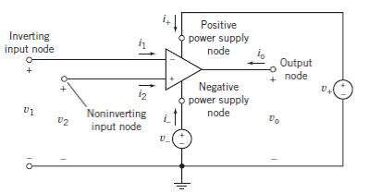
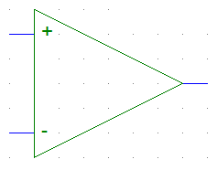
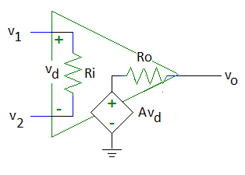
Symbol and Equivalent Circuit
v_{d} = v₂ – v₁
A is the open-loop voltage gain

Slide 6

Ideal vs Real Op-Amp
Real Op-Amps have limits. Since they are made of transistors they can be saturated.
For an ideal Op-Amp we assume a three basic things (no saturation)
In real life you can find out the operating (linearity values from manufacturer)
Parameter | Variable | Typical Ranges | Ideal Values
Open-Loop Voltage Gain | A | 10⁵ to 10⁸ | ∞
Input Resistance | Ri | 10⁵ to 10¹³ Ω | ∞ Ω
Output Resistance | Ro | 10 to 100 Ω | 0 Ω
Supply Voltage | Vcc/V⁺ -Vcc/V⁻ | 5 to 30 V -30V to 0V | N/A N/A

Slide 7
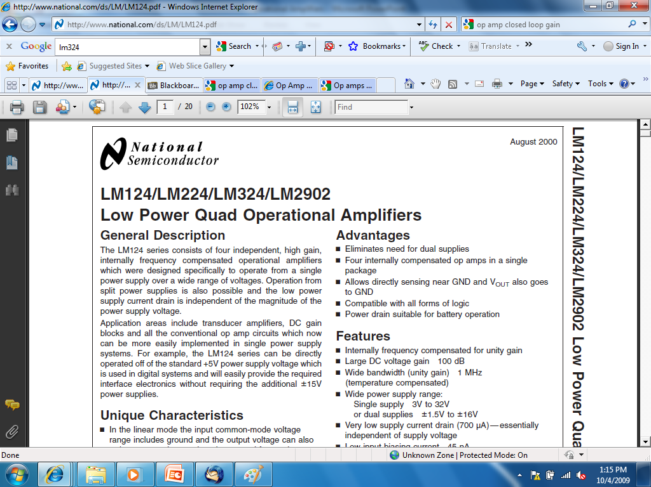

Slide 8
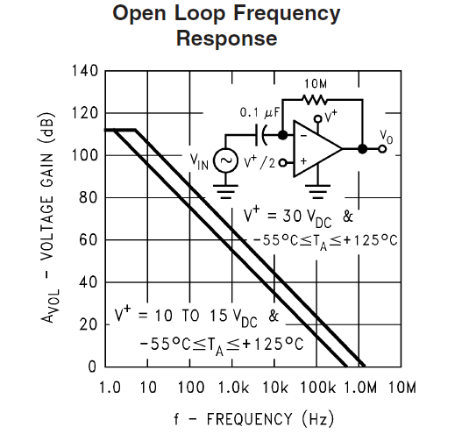
Caution – A is Frequency Dependent
http://www.national.com/ds/LM/LM124.pdf

Slide 9
Ideal Op-Amp
Ri = ∞ Ω
Therefore, i₁ = i₂ = 0A
Ro = 0 Ω
Usually, v_{d} = 0V so v₁ = v₂
The op amp forces the voltage at the inverting input terminal to be equal to the voltage at the non-inverting input terminal if there is some component connecting the output terminal to the inverting input terminal.
Rarely is the op amp limited to V⁻ < v_{o} < V⁺.
The output voltage is allowed to be as positive or as negative as needed to force v_{d} = 0V..

Slide 10
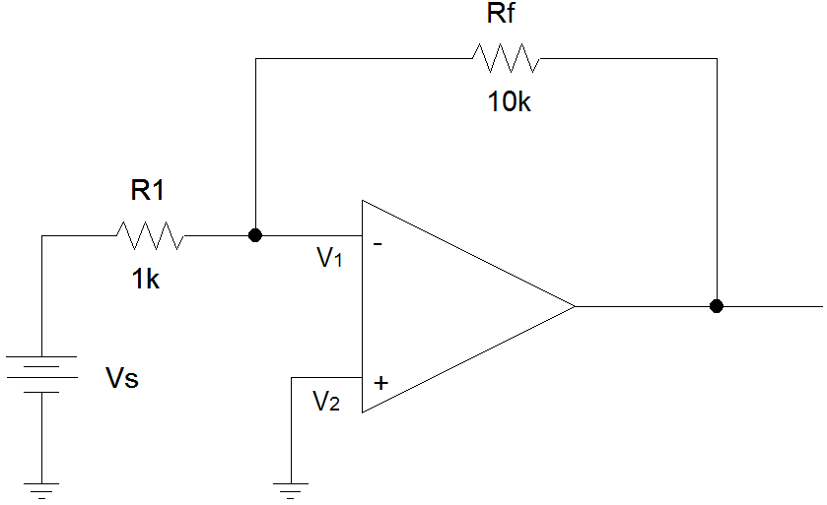
Example #1: Inverting Amplifier
i_{f}
i_{s}
i₁ = 0
i
V+ = 15V
V- = -10V
i₂ = 0

Slide 11
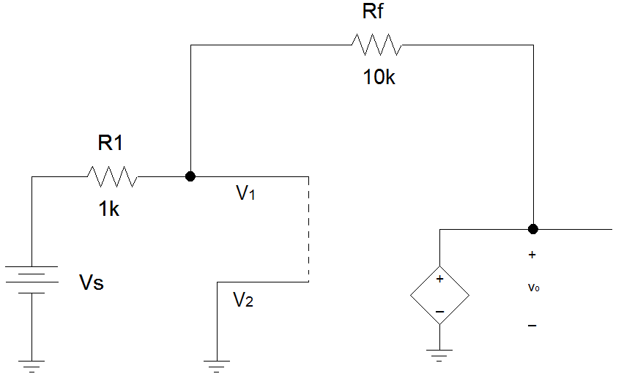
Example #1 (con’t)
Closed loop gains are dependent on the values of R1 and Rf.
Therefore, you have to calculate the closed loop gain for each new problem.
i_{f}
i_{s}
i₁ = 0
i
i₂ = 0
V+ = 15V
V- = -10V

Slide 12
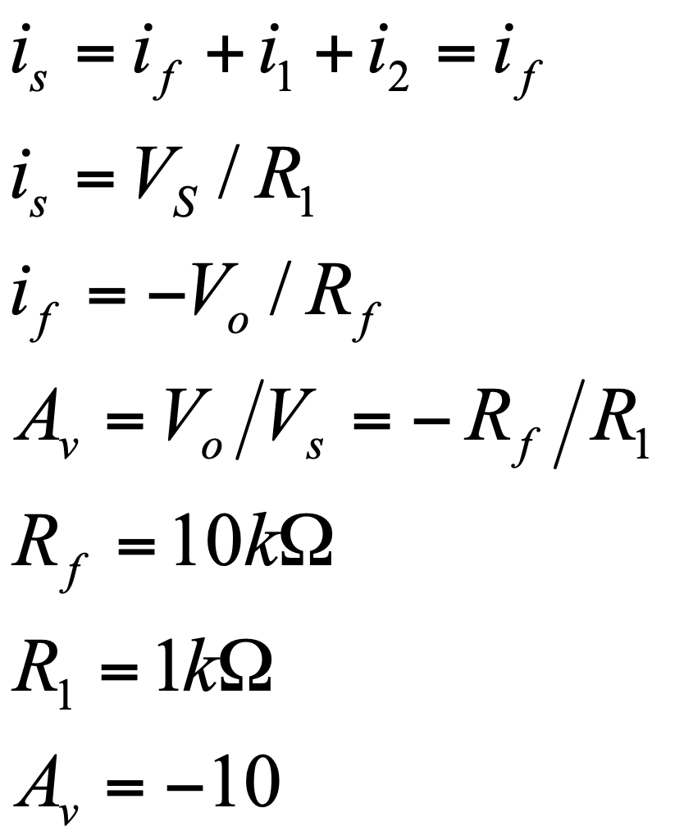
Example #1 (con’t)
i_{f}
i_{s}
i₁ = 0
i
i₂ = 0
vo

Slide 13
Example #1 (con’t)
Since A_{V} = -10
If Vs = 0V, V0 = -10(0V) = 0V
If Vs = 0.5V, Vo = -10(0.5V) = -5V
If Vs = 1V, Vo = -10(1V) = -10V
If Vs = 1.1V, Vo = -10(1.1V) < V⁻, Vo = -10V
If Vs = -1.2V, V0 = -10(-1.2V) = +12V
If Vs = -1.51V, Vo = -10(-1.51V) > V⁺, Vo = +15V

Slide 14
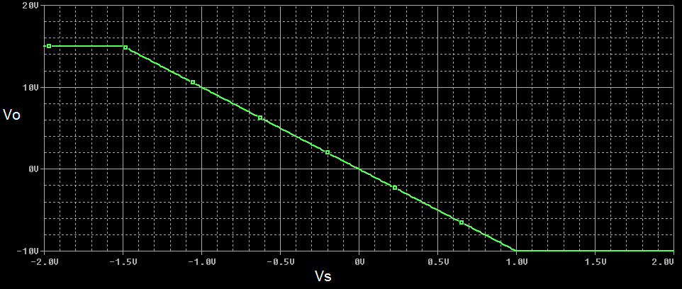
Example #1 (con’t)
Slope of the voltage transfer characteristic in the linear region is equal to A_{V}.

Slide 15
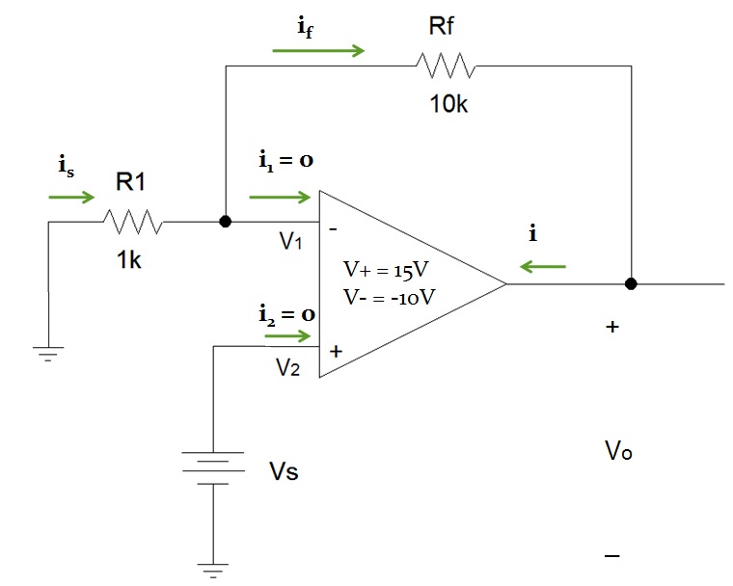
Example #2: Noninverting Amplifier

Slide 16
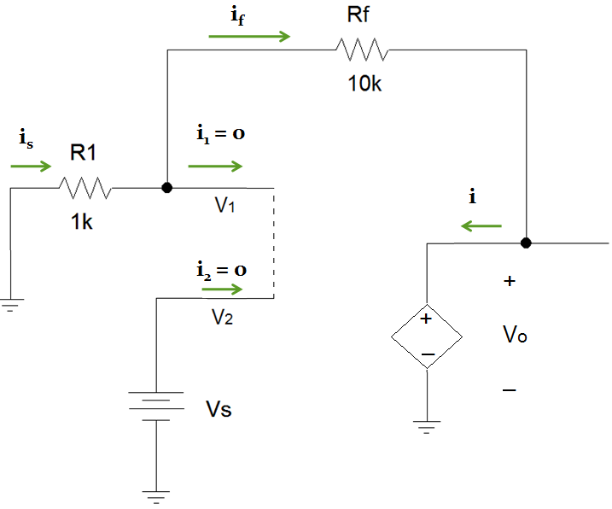

Example #2 (con’t)

Slide 17
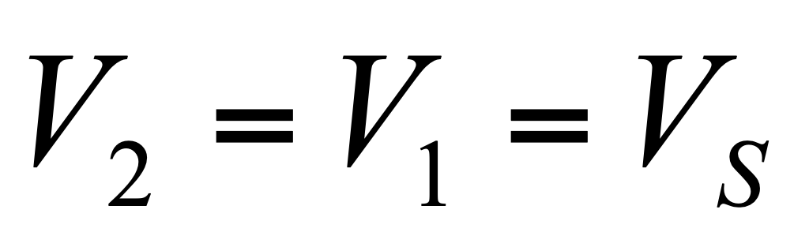
Example #2 (con’t)

Slide 18
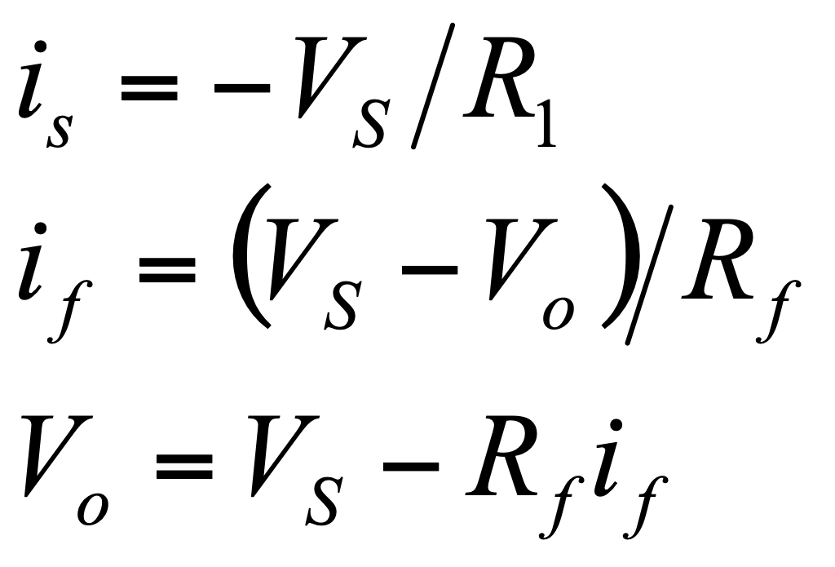
Example #2 (con’t)

Slide 19
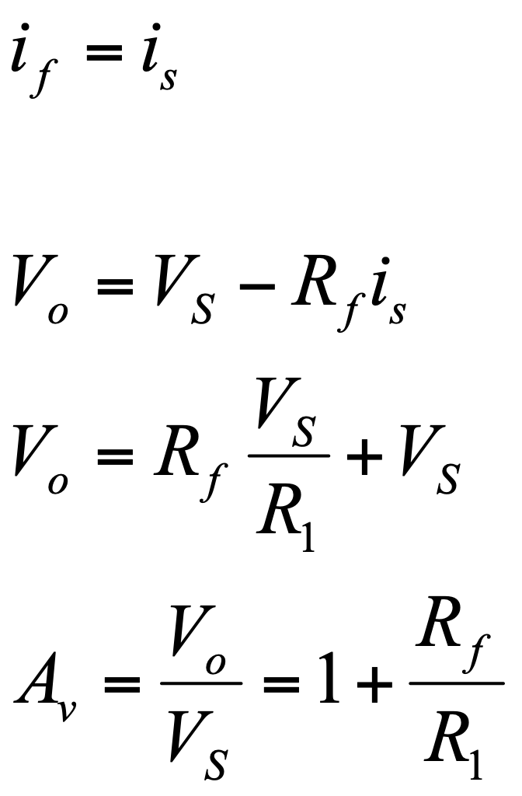
Example #2: Noninverting Amplifier

Slide 20
Example #2 (con’t)
A_{V} = +11
If Vs = 0V, V0 = 11(0V) = 0V
If Vs = 0.5V, Vo = 11(0.5V) = +5.5V
If Vs = 1.6V, Vo = 11(1.6V) > V⁺,
Vo = +15V
If Vs = -0.9V, V0 = 11(-0.9V) = -9.9V
If Vs = -1.01V, Vo = 11(-1.01V) > V⁺
Vo = +15V

Slide 21
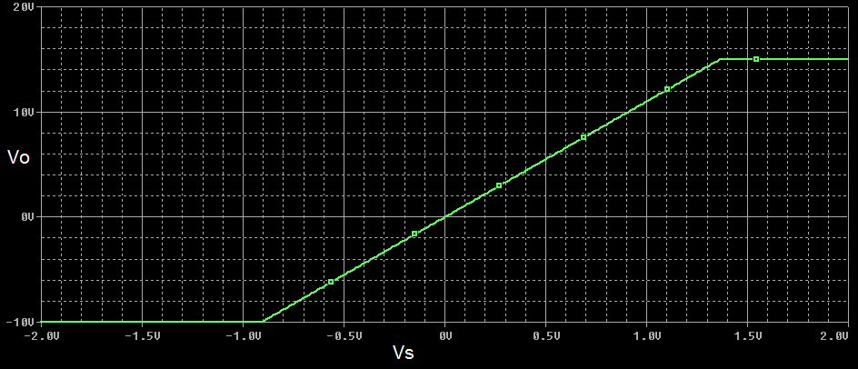
Example #2 (con’t)
Voltage transfer characteristic
Slope of the voltage transfer characteristic in the linear region is equal to A_{V}.

Slide 22
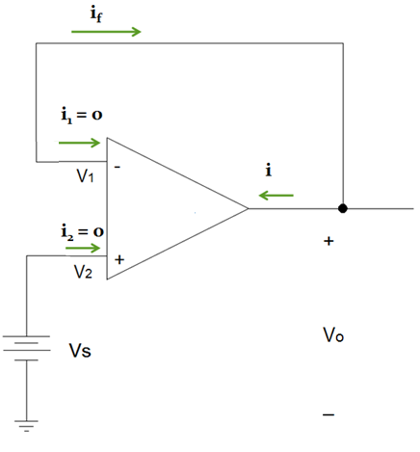
Example #3: Voltage Follower
A voltage follower is a noninverting amplifier where R_{f} = 0Ω and R₁ = ∞Ω.
V_{o} /V_{s} = 1 +R_{f}/R₁ = 1 + 0 = 1

Slide 23
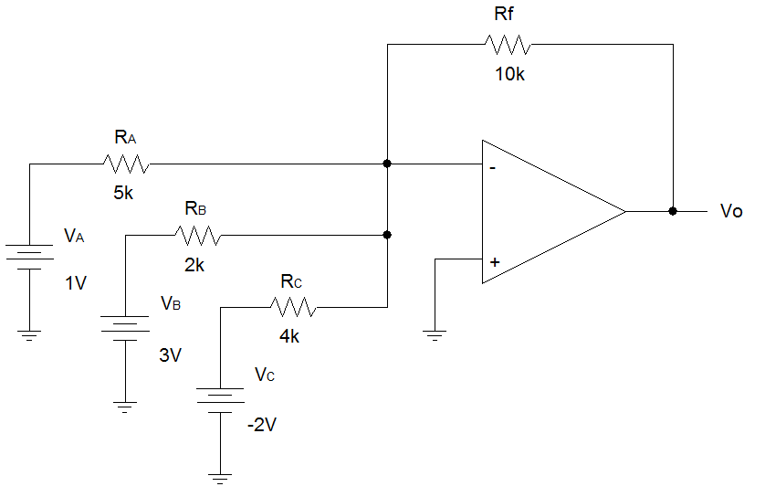
Example #4: Summing Amplifier
V⁺ = 30V
V⁻=-30V
A summing amplifier is an inverting amplifier with multiple inputs.

Slide 24
Example #4 (con’t)
i_{f}
i_{A}
i₁ = 0
i_{B}
v₁
i₂ = 0
v₂
i_{C}
We apply superposition to obtain a relationship between Vo and the input voltages.

Slide 25
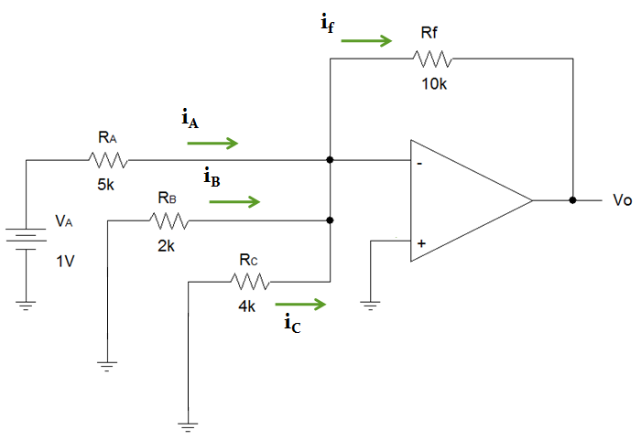
Example #4 (con’t)
A virtual ground

Slide 26
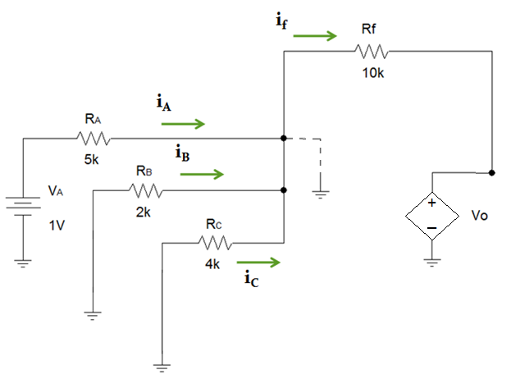
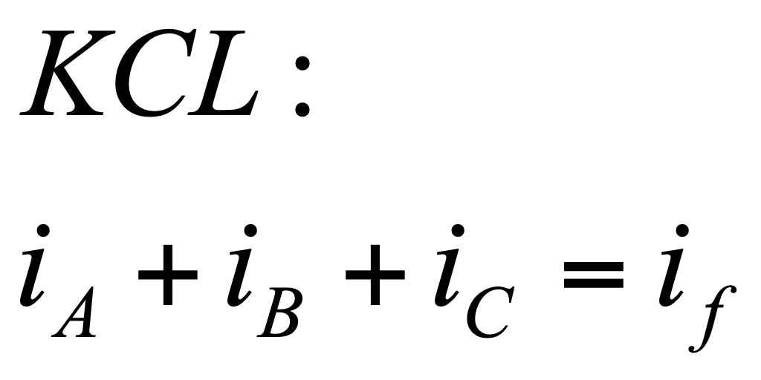
Example #4 (con’t)

Slide 27
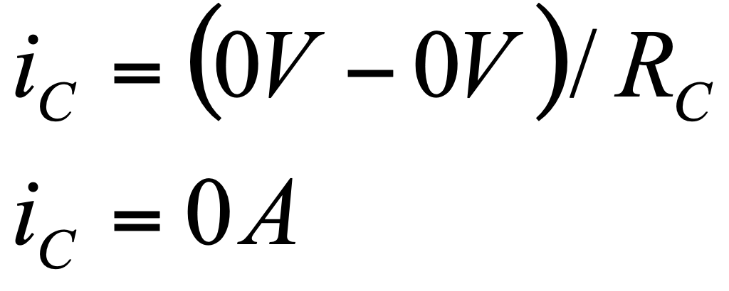
Example #4 (con’t)
Note that the voltages at both nodes of R_{C} are 0V.

Slide 28
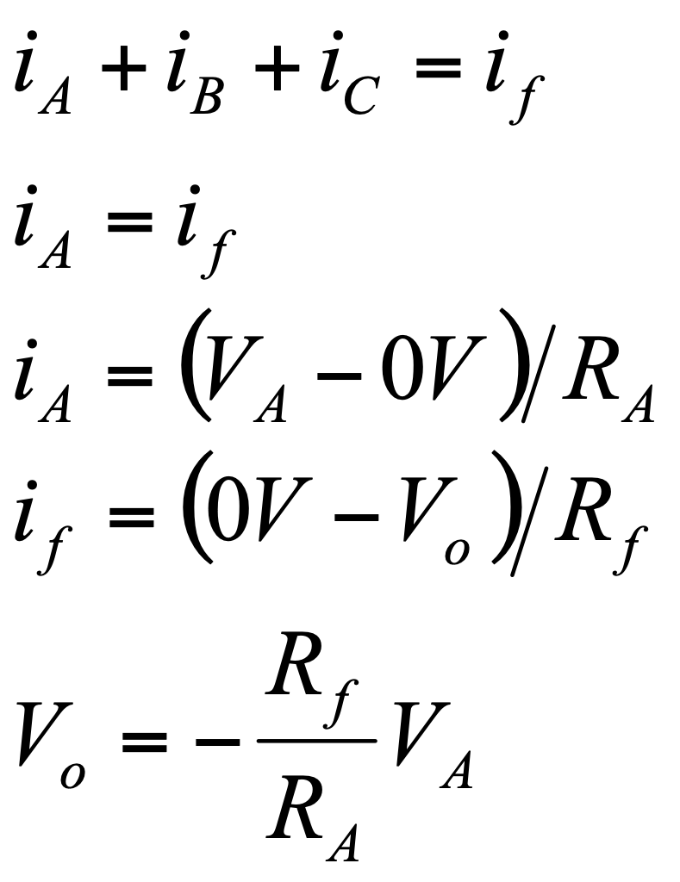
Example #4 (con’t)

Slide 29
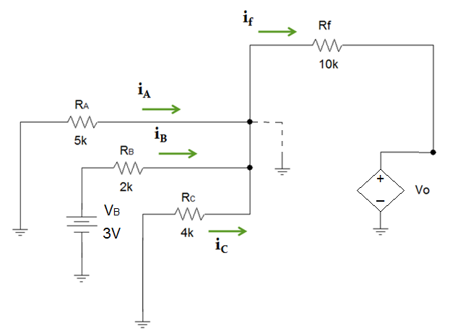
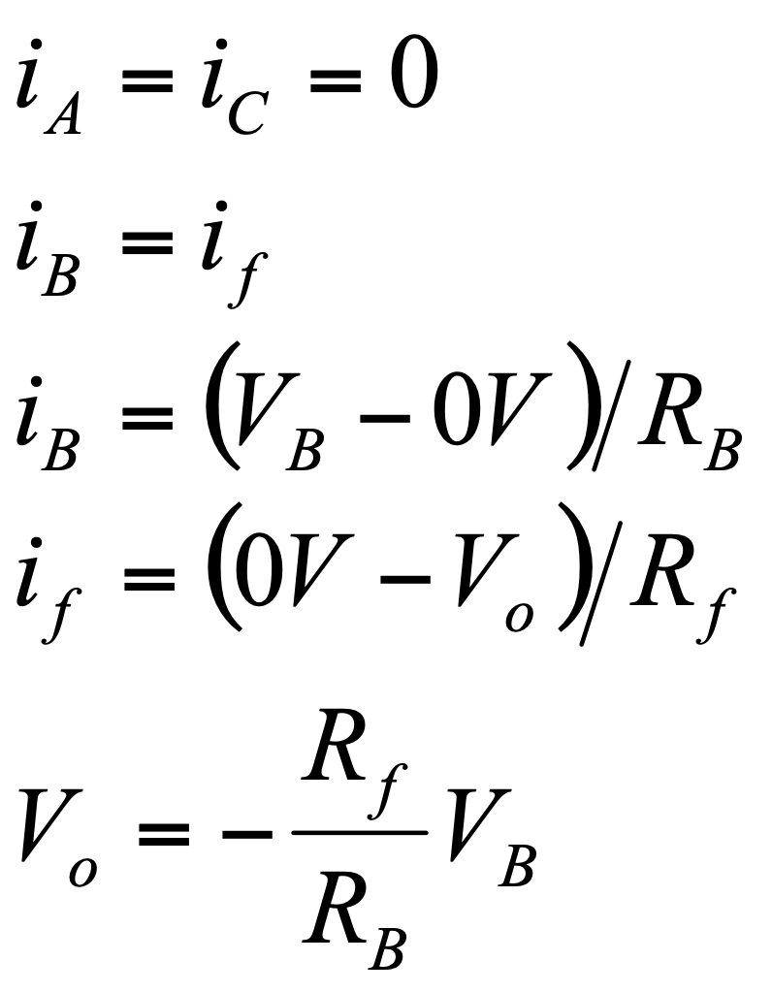
Example #4 (con’t)

Slide 30
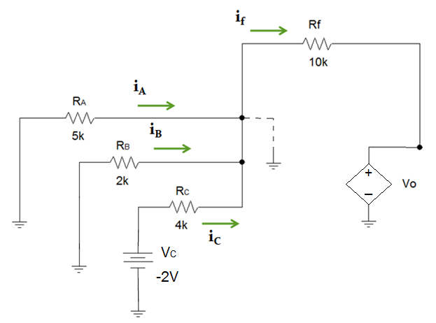
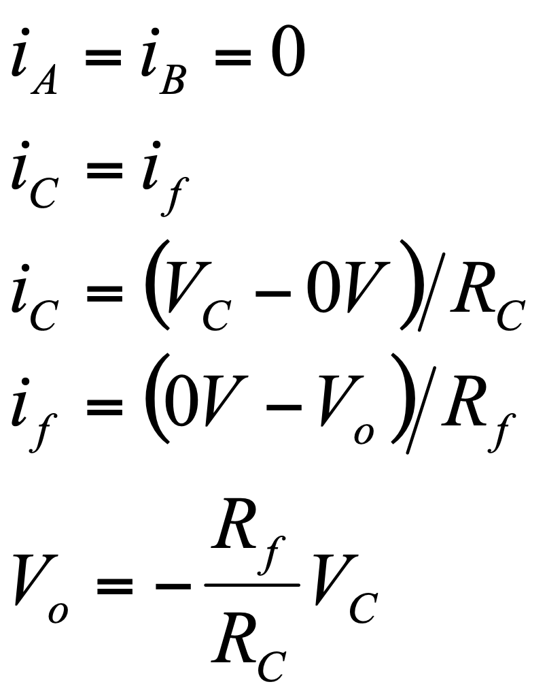
Example #4 (con’t)

Slide 31
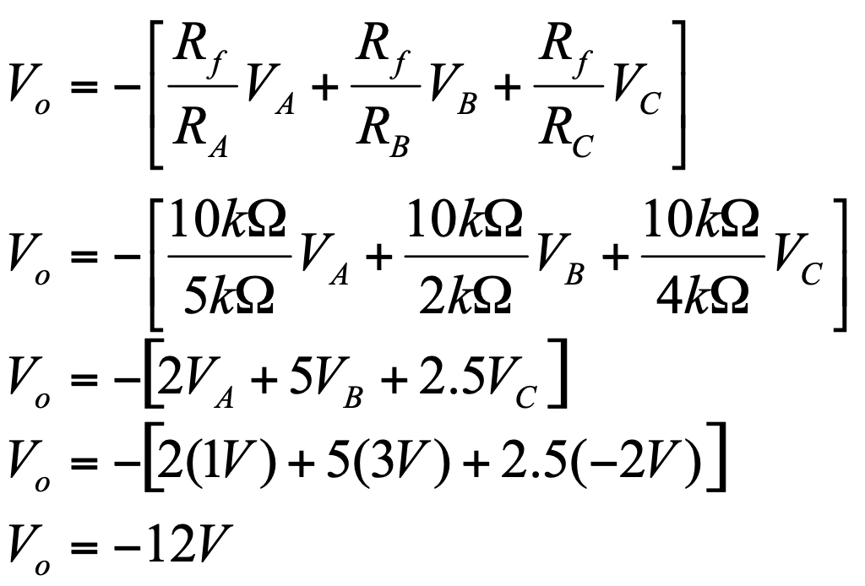
Example #4 (con’t)

Slide 32
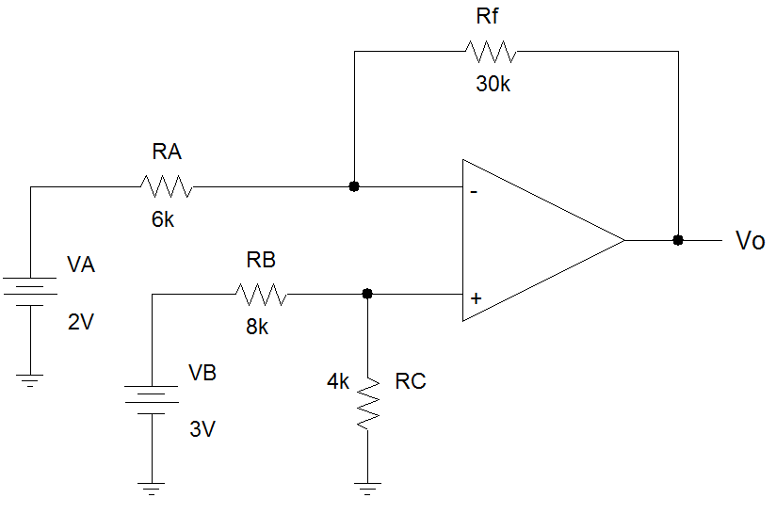
Example #5: Difference Amplifier

Slide 33
Example #5 (con’t)
i_{f}
i_{A}
i₁ = 0
v₁
i_{B}
i₂ = 0
i_{C}
v₂

Slide 34
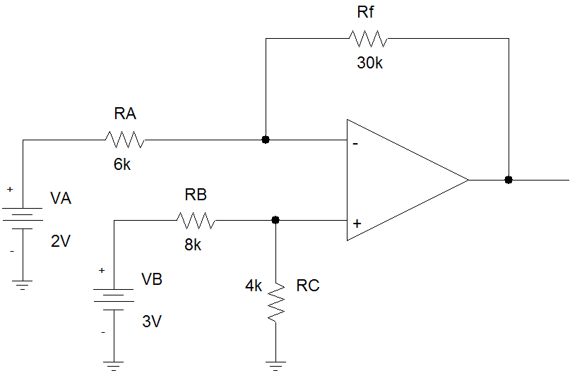
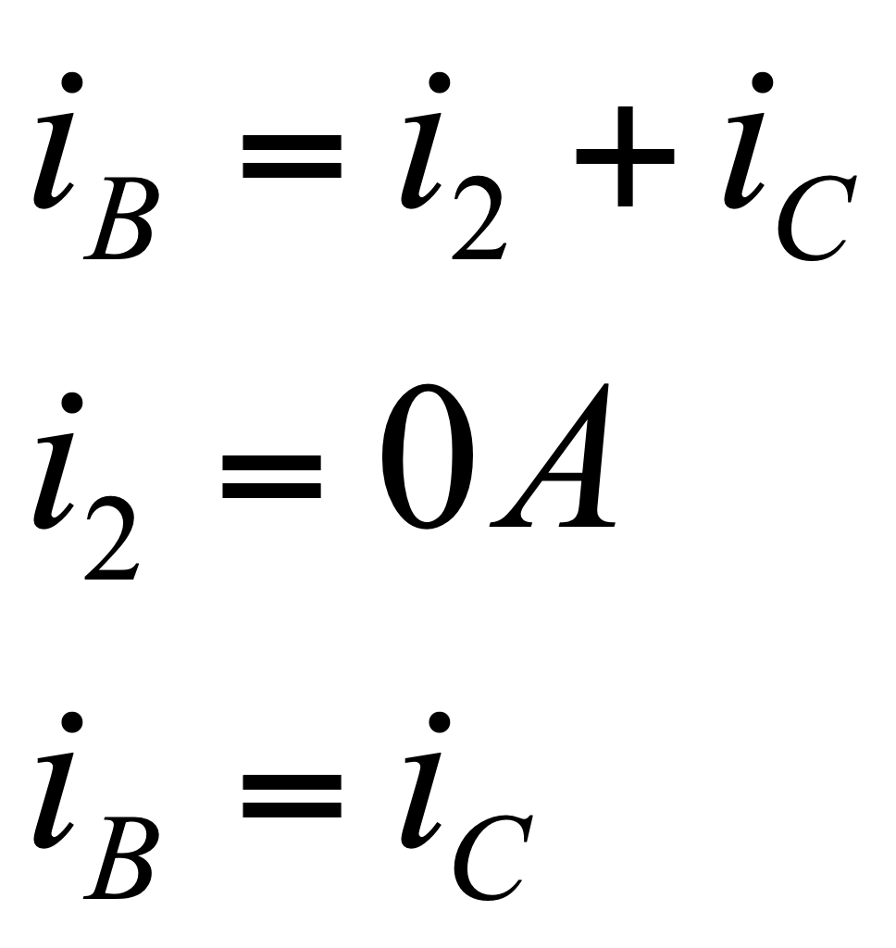
Example #5 (con’t)
i_{f}
i_{A}
i₁ = 0
v₁
i_{B}
i₂ = 0
i_{C}
v₂

Slide 35
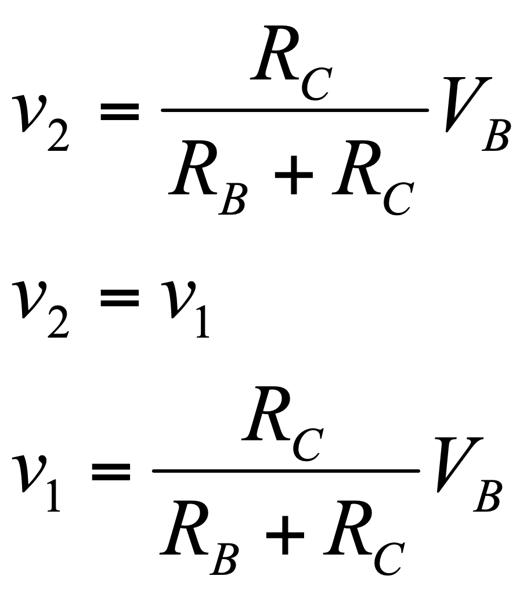
Example #5 (con’t)
i_{f}
i_{A}
i₁ = 0
v₁
i_{B}
i₂ = 0
i_{C}
v₂

Slide 36
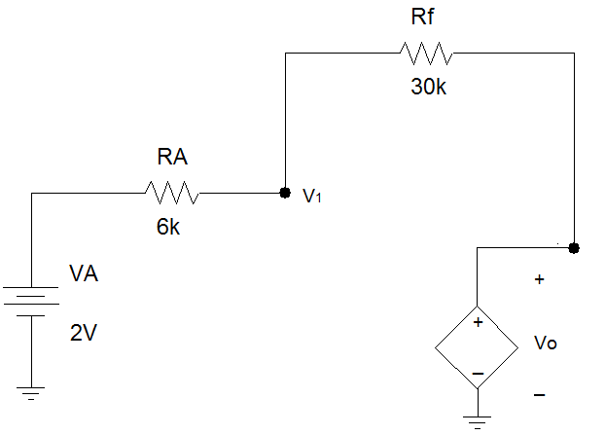
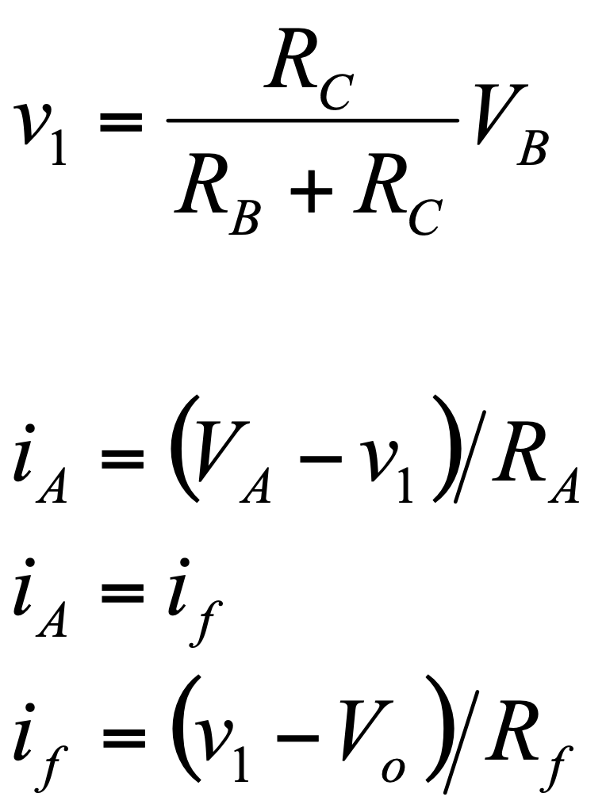
Example #5 (con’t)
i_{f}
i_{A}

Slide 37
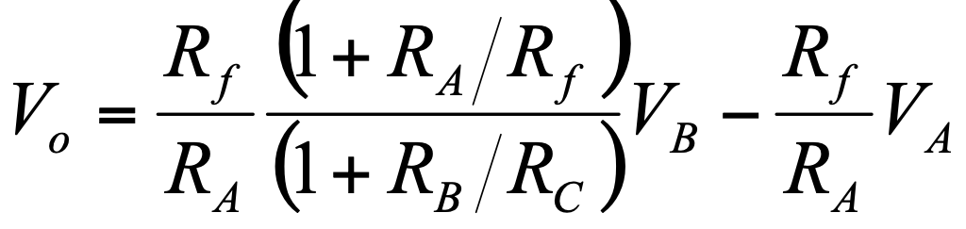
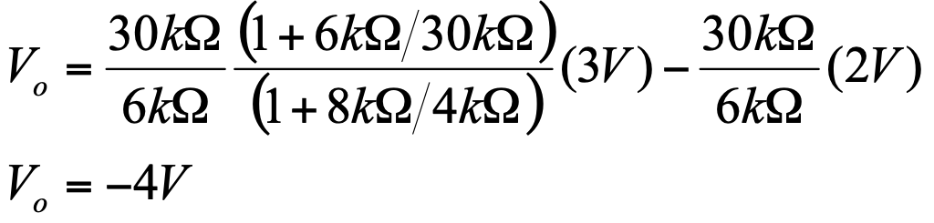
Example #5 (con’t)

Slide 38
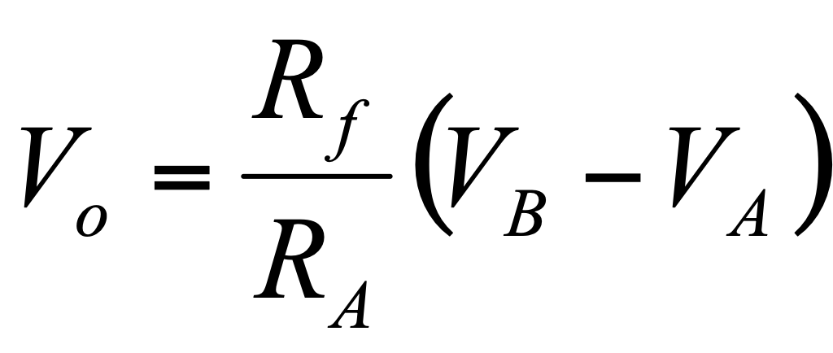
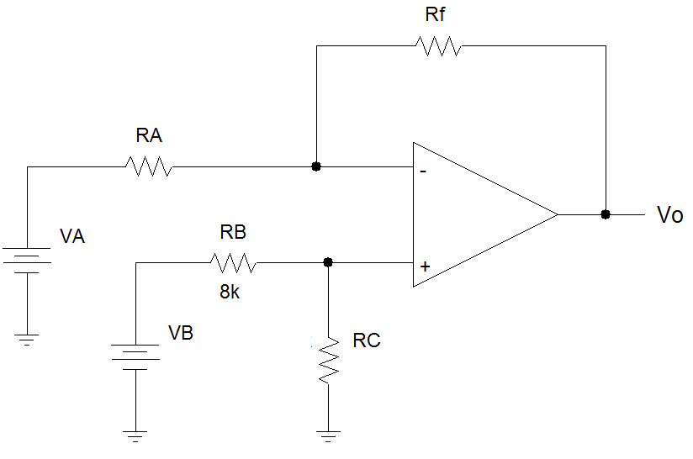
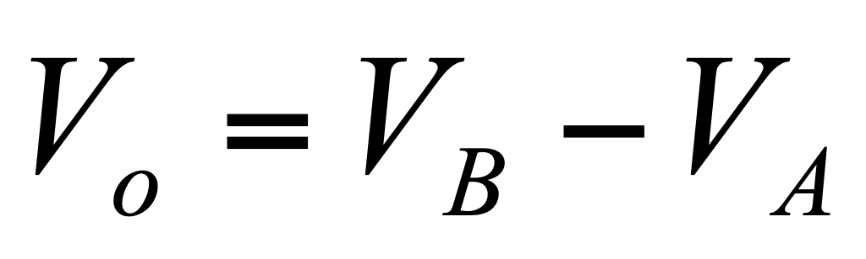
Example #5 (con’t)
If R_{A}/R_{f} = R_{B}/R_{C}
And if R_{A} = R_{f}

Slide 39
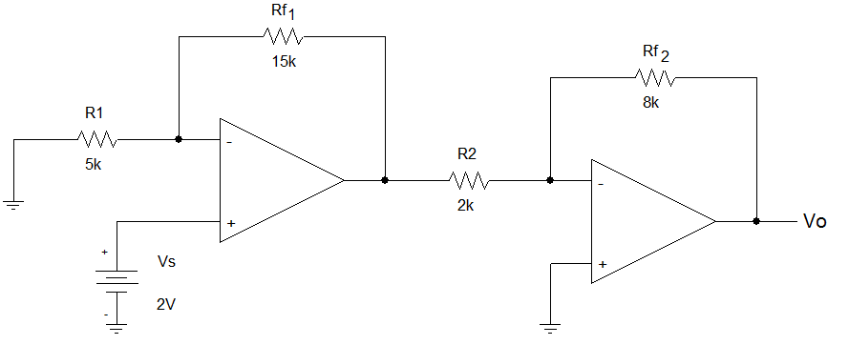
Example #6: Cascading Op Amps

Slide 40
Example #6 (con’t)
Treat as two separate amplifier circuits

Slide 41
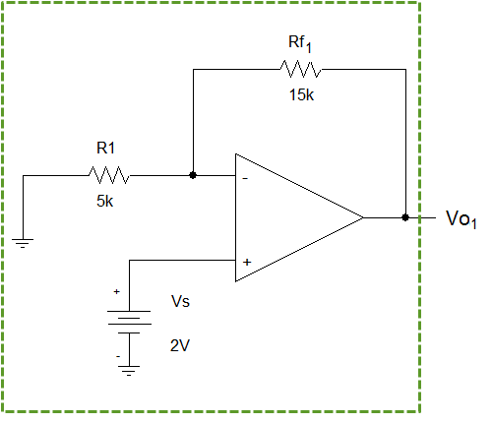
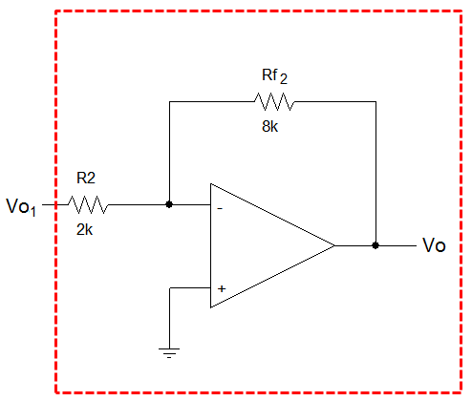
Example #6 (con’t)
First Circuit

Slide 42
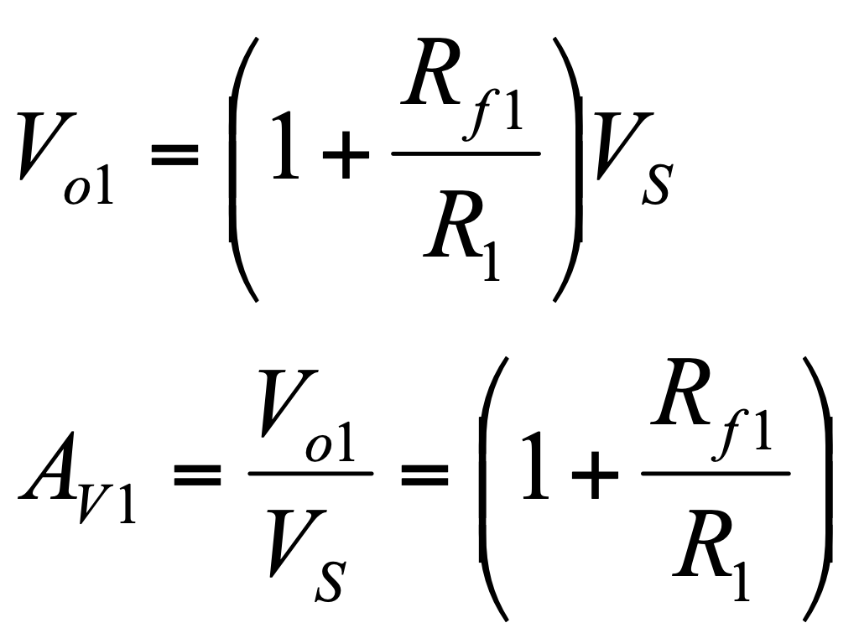
Example #6 (con’t)
It is a noninverting amplifier.

Slide 43
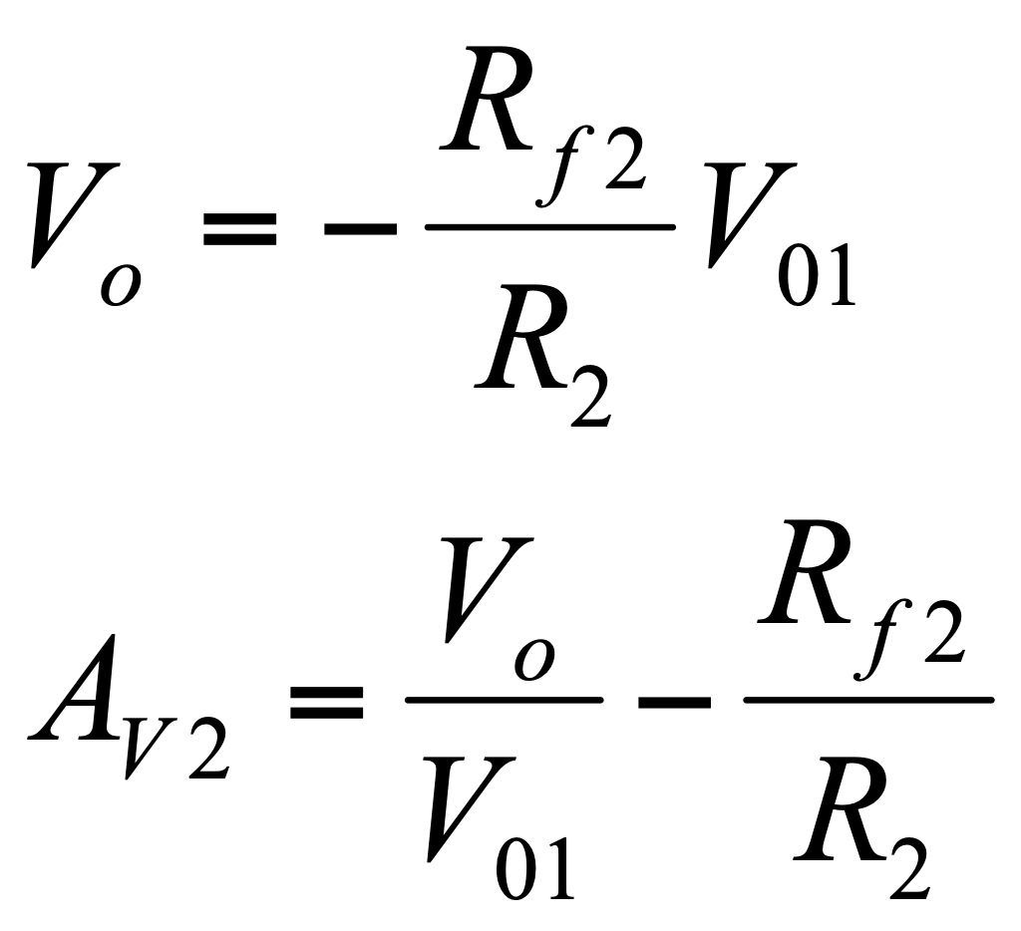
Example #6 (con’t)
It is a inverting amplifier.

Slide 44
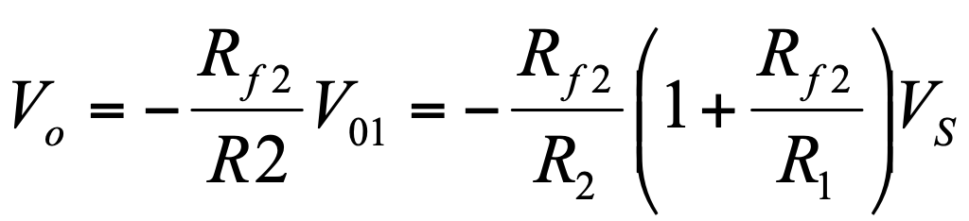
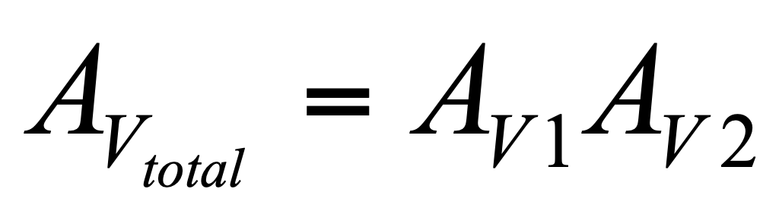
Example #6 (con’t)
The gain of the cascaded amplifiers is the multiplication of the two individial amplifiers

Slide 45
Summary
The ‘almost ideal’ op amp model:
Ri = ∞Ω.
i₁ = i₂ = 0A; v₁ = v₂
Ro = 0Ω.
No power/voltage loss between the dependent voltage source and v_{o}.
The output voltage is limited by the voltages applied to the positive and negative rails.
V⁺ ≥ v_{o} ≥ V⁻
This model can be used to determine the closed loop voltage gain for any op amp circuit.
Superposition can be used to solve for the output of a summing amplifier.
Cascaded op amp circuits can be separated into individual amplifiers and the overall gain is the multiplication of the gain of each amplifier.

Slide 46
Design Problems
6-1
6-2
6-3
6-5

