Slide 1
Operational Amplifiers
EE 204

Slide 2
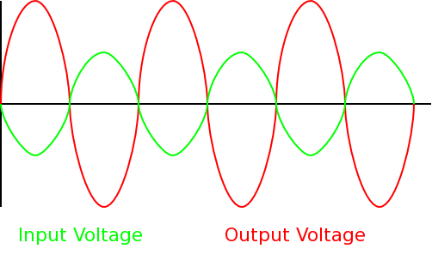
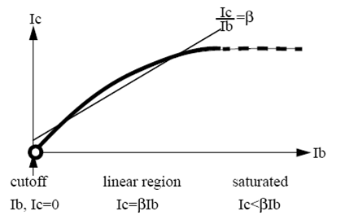
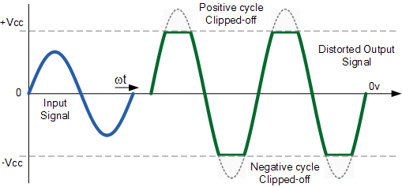
BJT Applications
BJT Amplifier

Slide 3
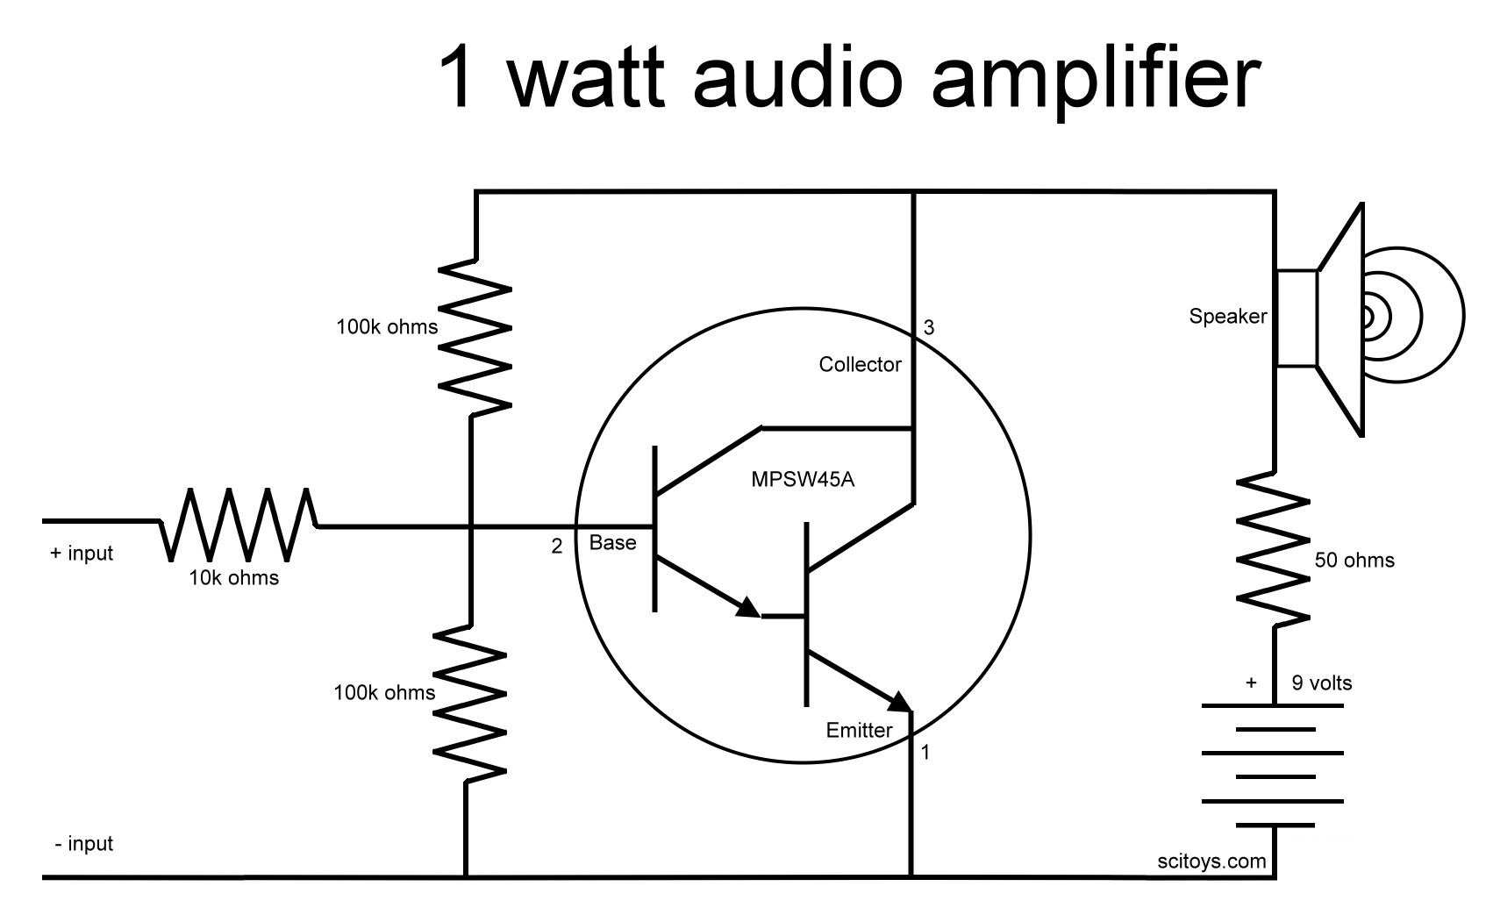
BJT Applications
Transistor is a switch (most common application)
BJT Amplifier (second most common…)

Slide 4
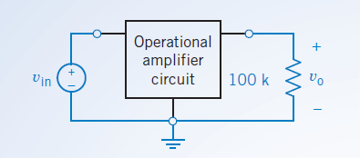
What is an Op-Amp
Op-Amp or operational amplifier a modular circuit that is designed to work with other circuit elements (in boom boxes, speakers, cell phones, biomedical apps, sensors, heart rate monitors, power circuits, computers)
The simplest model of the operational amplifier is the ideal operational amplifier. (there are several models to define a “realistic op-amp)
Circuits that contain ideal operational amplifiers are analyzed by writing and solving node equations.
Operational amplifiers can be used to build circuits that perform mathematical operations.
Summing Amplifier
Difference Amplifier
Current to voltage converter
Voltage controlled Current Source

Slide 5
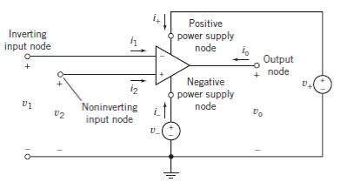
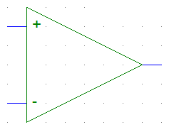
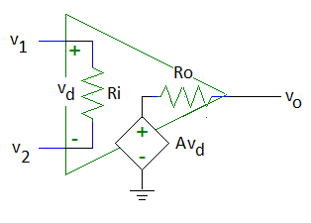
Symbol and Equivalent Circuit
v_{d} = v₂ – v₁
A is the open-loop voltage gain

Slide 6

Ideal vs Real Op-Amp
Real Op-Amps have limits. Since they are made of transistors they can be saturated.
For an ideal Op-Amp we assume a three basic things (no saturation)
In real life you can find out the operating (linearity values from manufacturer)
Parameter | Variable | Typical Ranges | Ideal Values
Open-Loop Voltage Gain | A | 10⁵ to 10⁸ | ∞
Input Resistance | Ri | 10⁵ to 10¹³ Ω | ∞ Ω
Output Resistance | Ro | 10 to 100 Ω | 0 Ω
Supply Voltage | Vcc/V⁺ -Vcc/V⁻ | 5 to 30 V -30V to 0V | N/A N/A

Slide 7
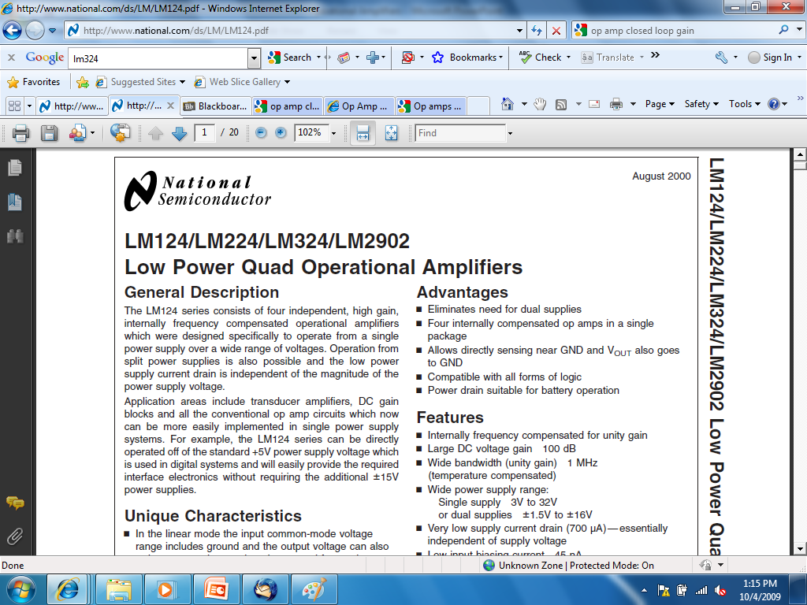

Slide 8
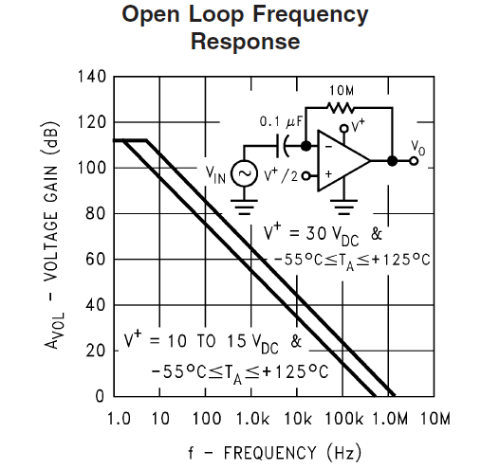
Caution – A is Frequency Dependent
http://www.national.com/ds/LM/LM124.pdf

Slide 9
Ideal Op-Amp
Ri = ∞ Ω
Therefore, i₁ = i₂ = 0A
Ro = 0 Ω
Usually, v_{d} = 0V so v₁ = v₂
The op amp forces the voltage at the inverting input terminal to be equal to the voltage at the non-inverting input terminal if there is some component connecting the output terminal to the inverting input terminal.
Rarely is the op amp limited to V⁻ < v_{o} < V⁺.
The output voltage is allowed to be as positive or as negative as needed to force v_{d} = 0V..

Slide 10
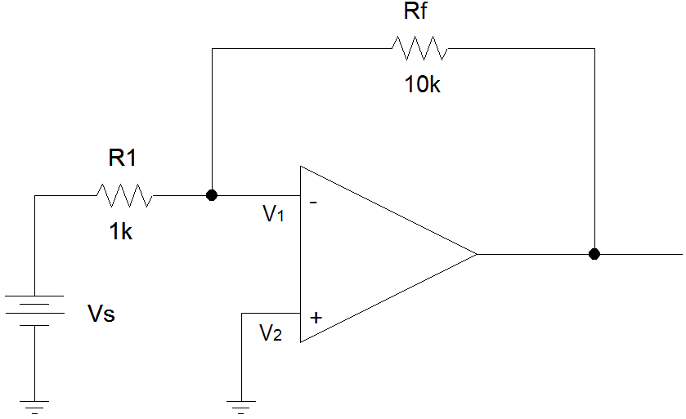
Example #1: Inverting Amplifier
i_{f}
i_{s}
i₁ = 0
i
V+ = 15V
V- = -10V
i₂ = 0

Slide 11
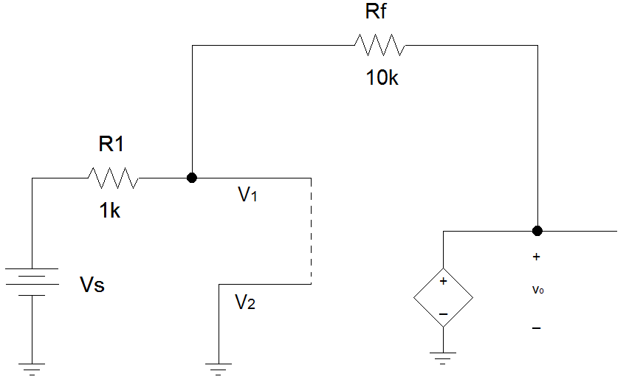
Example #1 (con’t)
Closed loop gains are dependent on the values of R1 and Rf.
Therefore, you have to calculate the closed loop gain for each new problem.
i_{f}
i_{s}
i₁ = 0
i
i₂ = 0
V+ = 15V
V- = -10V

Slide 12
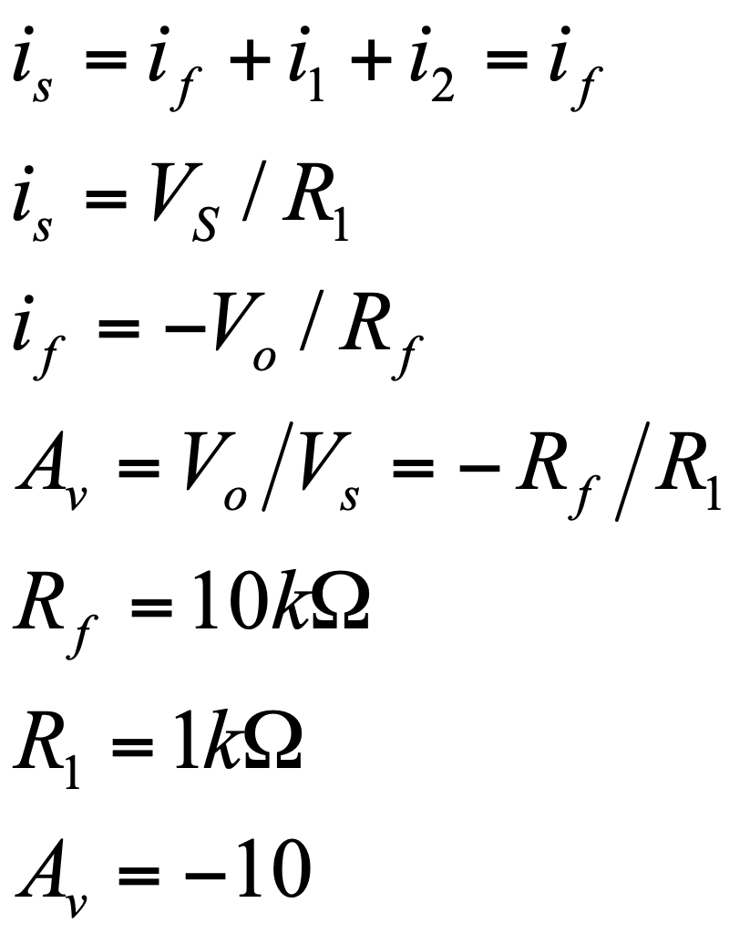
Example #1 (con’t)
i_{f}
i_{s}
i₁ = 0
i
i₂ = 0
vo

