Slide 1
RC and RL Circuits
First Order Circuits

Slide 2
Objective of Lecture
Explain the operation of a RC circuit in dc circuits
As the capacitor stores energy when voltage is first applied to the circuit or the voltage applied across the capacitor is increased during the circuit operation.
As the capacitor releases energy when voltage is removed from the circuit or the voltage applied across the capacitor is decreased during the circuit operation.
Explain the operation of a RL circuit in dc circuit
As the inductor stores energy when current begins to flow in the circuit or the current flowing through the inductor is increased during the circuit operation.
As the inductor releases energy when current stops flowing in the circuit or the current flowing through the inductor is decreased during the circuit operation.

Slide 3
Natural Response
The behavior of the circuit with no external sources of excitation.
There is stored energy in the capacitor or inductor at time = 0 s.
For t > 0 s, the stored energy is released
Current flows through the circuit and voltages exist across components in the circuit as the stored energy is released.
The stored energy will decays to zero as time approaches infinite, at which point the currents and voltages in the circuit become zero.

Slide 4
RC Circuit
Suppose there is some charge on a capacitor at time t = 0s. This charge could have been stored because a voltage or current source had been in the circuit at t<0s, but was switched off at t = 0s.
We can use the equations relating voltage and current to determine how the charge on the capacitor is removed as a function of time.
The charge flows from one plate of the capacitor through the resistor R1 to the other plate to neutralize the charge on the opposite plate of the capacitor.

Slide 5
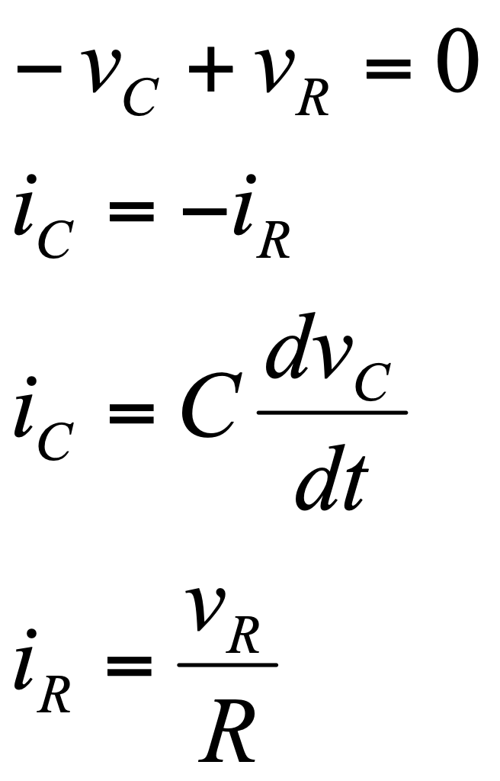
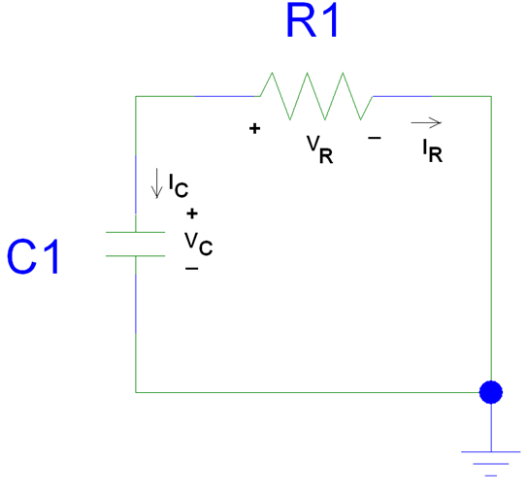
Equations for RC Circuit

Slide 6
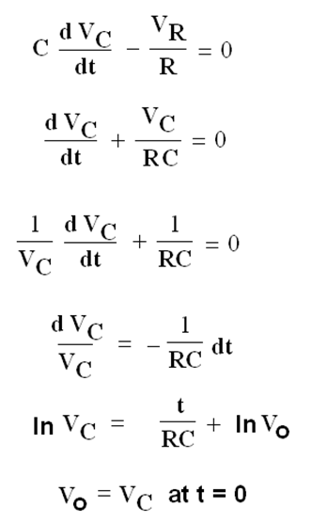

Slide 7
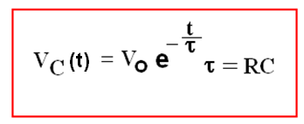
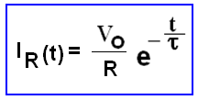
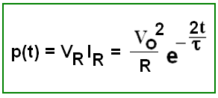
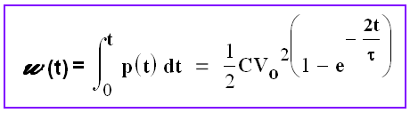

Slide 8
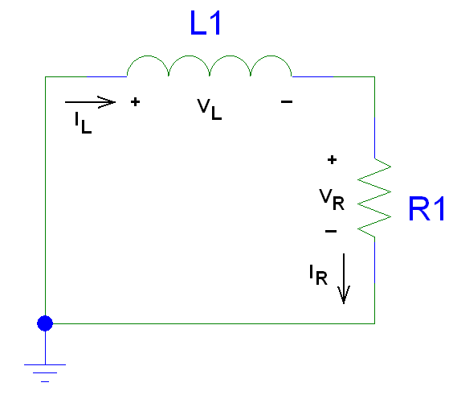
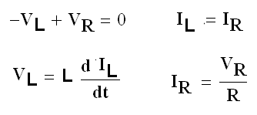
RL Circuits

Slide 9
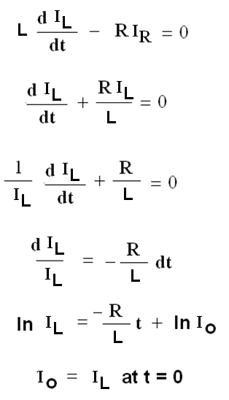

Slide 10
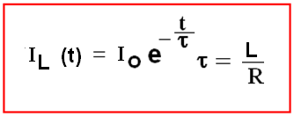
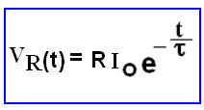
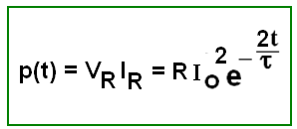
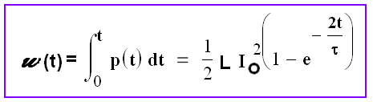

Slide 11
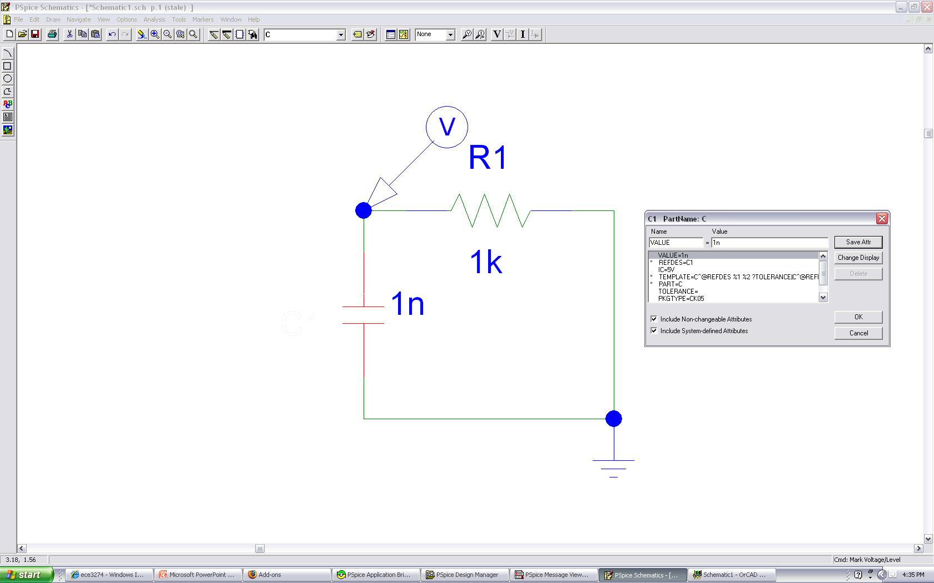

Slide 12
Initial Condition
Can be obtained by inserting a d.c. source to the circuit for a time much longer than τ and then remove it at t = 0.
Capacitor
Open Circuit Voltage
Inductor
Short Circuit Current

Slide 13
Time constant
The time required for the voltage across the capacitor or current in the inductor to decay by a factor of 1/e or 36.8% of its initial value.

Slide 14
Singularity Functions
Are discontinuous or have discontinuous derivatives.
Also known as switching functions.

Slide 15
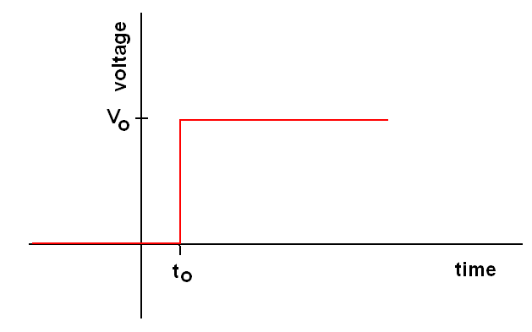
Unit Step Function
0 t < t_{o}
u(t-t_{o}) =
1 t > t_{o}
V(t) = V_{o} u(t-t_{o})

Slide 16
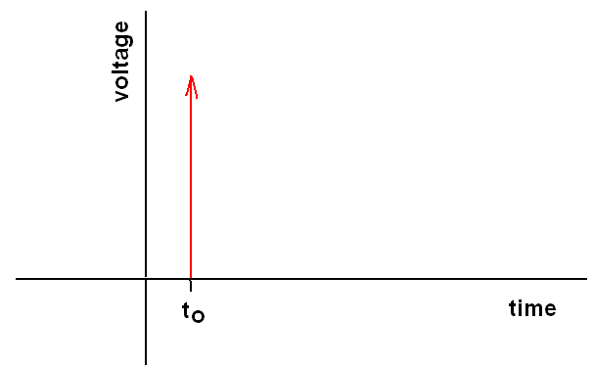
Unit Impulse Function
Derivative of a unit step function
0 t < t_{o}
d(t-t_{o}) = Undefined t = t_{o}
0 t > t_{o}
∫ δ(t-t_{o}) dt = 1
t_{o}⁺
t_{o}⁻

Slide 17
Integration of Unit Functions
∫ f(t) δ(t-t_{o}) dt = f(t_{o}), the value of f(t) at t = t_{o}
A unit ramp function:
r(t) = ∫ u(t-t_{o}) dt
t
-∞

Slide 18
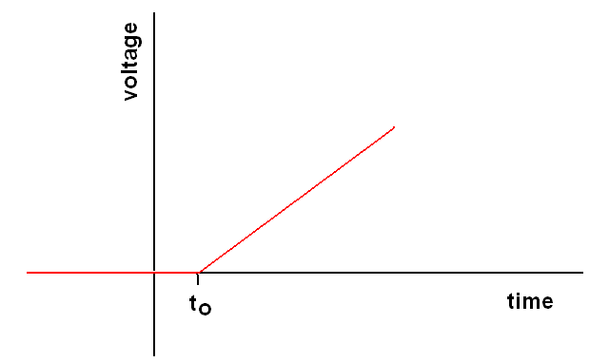
Unit Ramp Function
t
r(t) = ∫ u(t-t_{o}) dt = t u(t)
0 t < t_{o}
r(t) =
(t- t_{o}) t > t_{o}
-∞

Slide 19
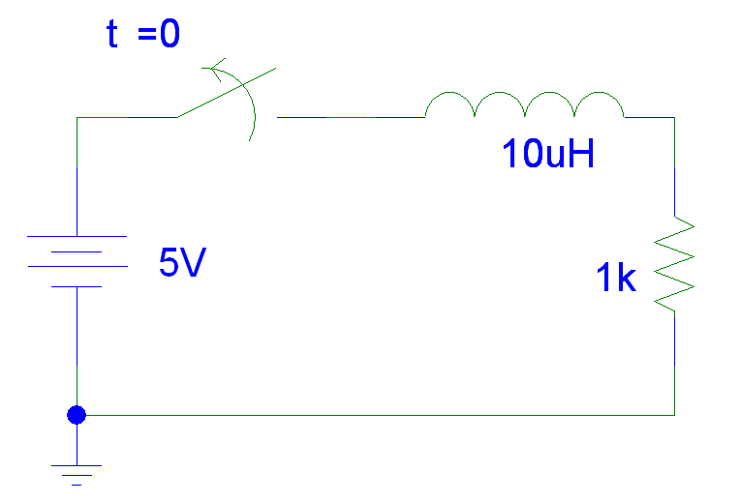
t < 0
V_{L} = 0V
V_{R} = 5V
I_{L} = I_{R} = 5mA
V(t) = 5V [1 - u(t)]

Slide 20
t > 0
t = L/R = 10μH/1kΩ = 10 ns
I_{L} = I_{R} =i(0)e^{-t/τ} = 5mA e^{-t/10ns}
V_{R} = 1kΩ I_{R} = 5V e^{-t/10ns}
V_{L} = L dI_{L}/dt = -5V e^{-t/10ns}
Note V_{R} + V_{L} = 0 V
V(t) = 5V [1 - u(t)]

Slide 21
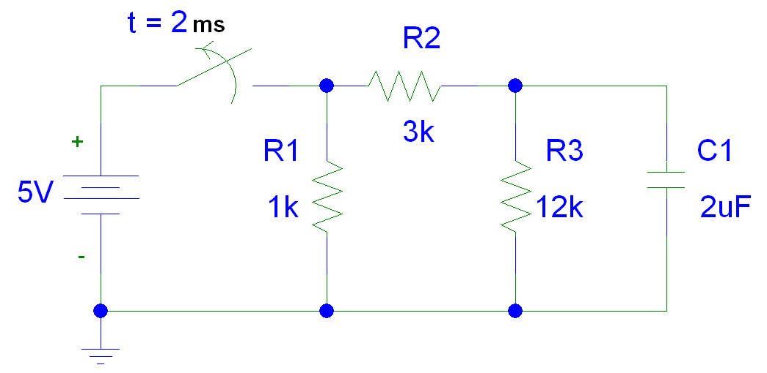
V(t) = 5V [1 - u(t - 2ms)]

Slide 22
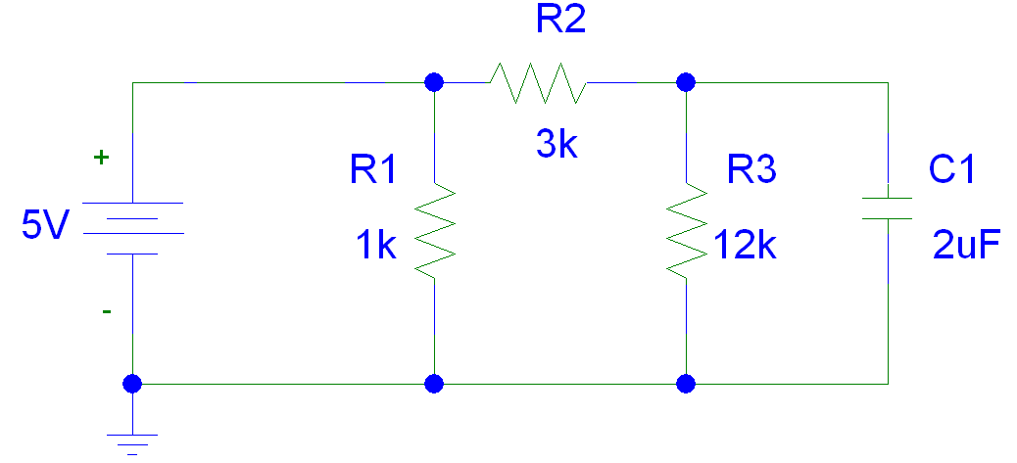
t < 2ms

Slide 23
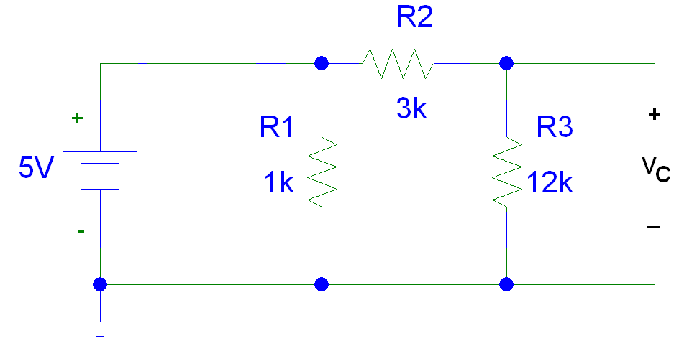
t < 2ms
C1 is an open.
The voltage across the capacitor is equal to the voltage across the 12kΩ resistor.
V_{C} = [12kΩ /15kΩ] 5V = 4V

Slide 24
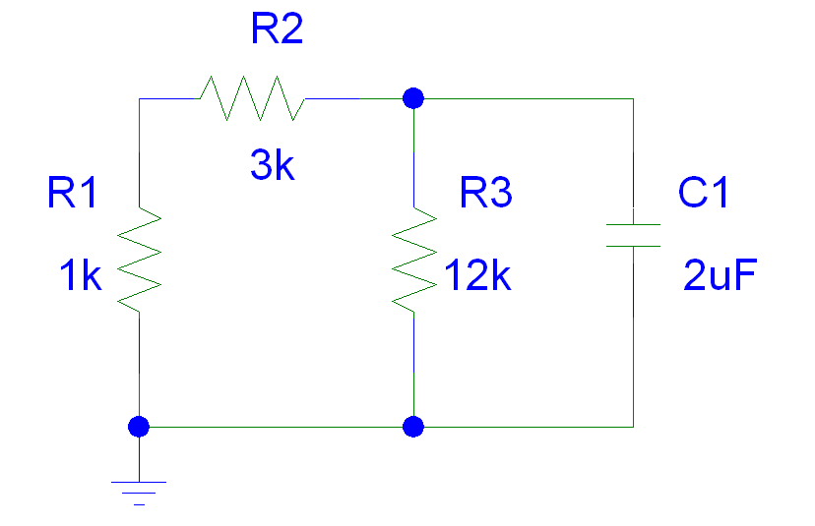
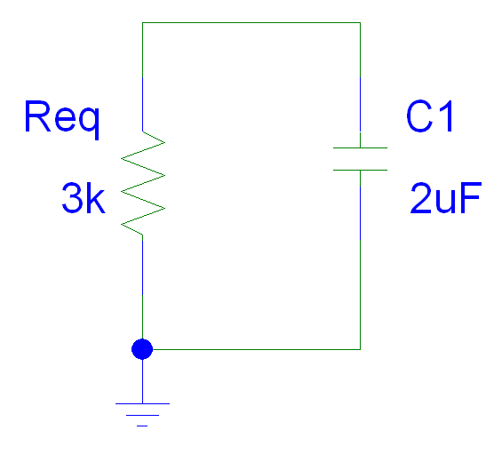
t > 2ms

Slide 25
t > 2ms
= R_{eq}C = 3kΩ(2μF) = 6 ms
V_{C} = V_{C}(2ms)e^{-(t-2ms)/τ} = 4V e^{-(t-2ms)/6ms}
V_{R} = V_{C}
I_{C} = C dV_{c}/dt = 2μF(-4V/6ms) e^{-(t-2ms)/6ms}
= -1.33 e^{-(t-2ms)/6ms} mA
I_{R} = - I_{C} = 1.33 e^{-(t-2ms)/6ms} mA
Note I_{R} + I_{C} = 0 mA

