Slide 1
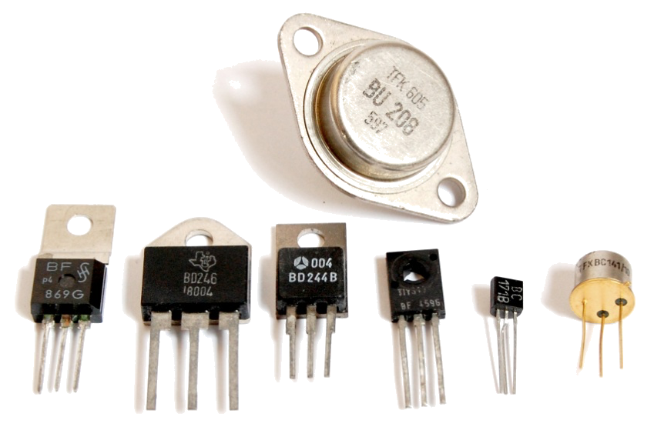
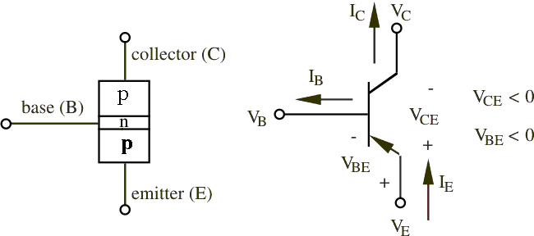
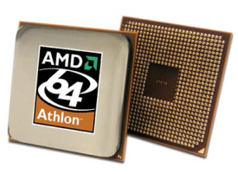
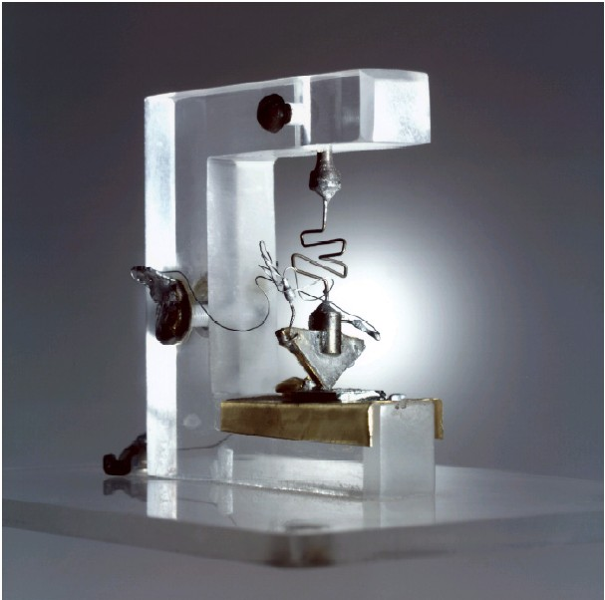
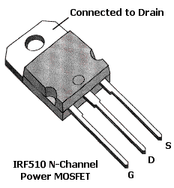
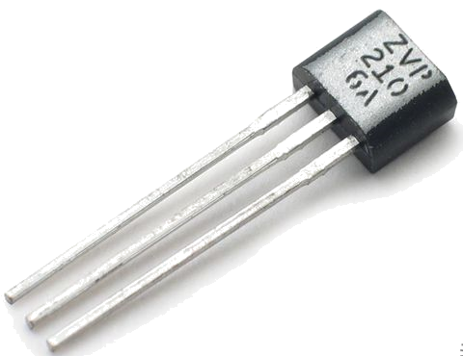

Transistors
Transistors of various type & size
BJT (PNP) Electrical Diagram Representation
First Transistor Model, 1947
Used in all modern electronics
FET Transistor
BJT Transistor
Notes:
You’ve all seen the transistor before, but instead of regurgitation, provide student perspective….

Slide 2
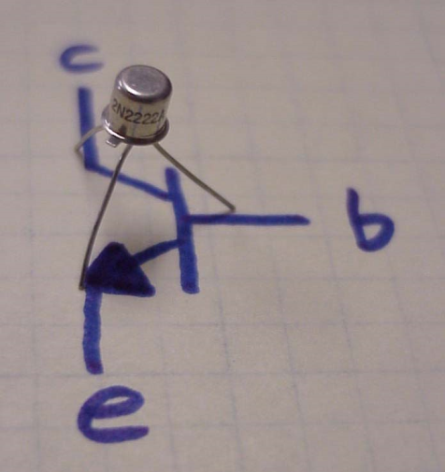
tran·sis·tor
a semiconductor device that amplifies, oscillates, or switches the flow of current between two terminals by varying the current or voltage between one of the terminals and a third. (www.dictionary.com)
www.coltecnica.com

Slide 3
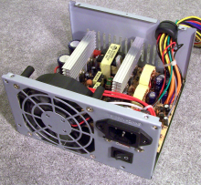

Basic Purpose
[1] To electronically switch (no moving parts) a signal on or off (high/low)
[2] To amplify signals
Role in Modern Electronics
Basic building blocks for all modern electronics
Microprocessors, Microcontrollers, Computers, Digital watches, Digital Logic Circuits, Cell Phones….
Motor Controllers
Microprocessor
PC & Cell Phones
Headphones
Notes:
ROADMAP OF BUILD TRANSISTOR -> PROPERTIES

Slide 4
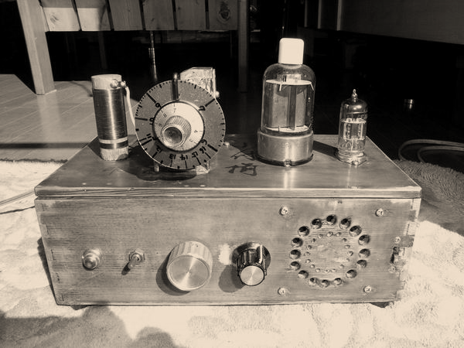
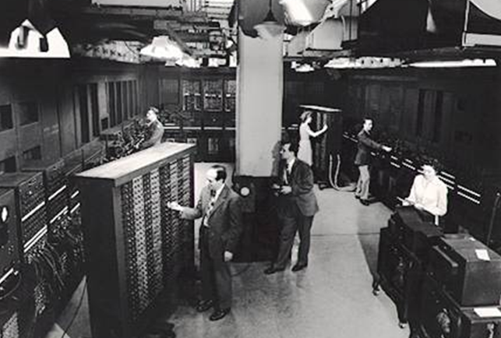
Reason for Transistor’s Invention:
Early 20th century, vacuum tube were used as signal amplifiers & switches.
Use of vacuum tube* resulted in extremely large, fragile, energy inefficient, and expensive electronics.
Evolution of electronics required device that was small, light weight, robust, reliable, cheap to manufacture, energy efficient…
*Vacuum tube advantages: operation at higher voltages (10K region vs. 1K region of transistors); high power, high frequency operation (over-the-air TV broadcasting) better suited for vacuum tubes; and silicon transistors more vulnerable to electromagnetic pulses than vacuum tubes
Vacuum Tube Radios
ENIAC : 17, 468 vacuum tubes

Slide 5
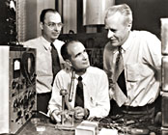
Invention
In 1947, John Bardeen, Walter Brattain, and William Schockly, researchers at Bell Lab, invented Transistor.
They found Transistor Effect: “when electrical contacts were applied to a crystal of germanium, the output power was larger than the input.”
Awarded the Nobel Prize in physics (1956)
Revolutionized portability and efficiency of electronic devices
John Bardeen, Walter Brattain, and William Schockly
First model of Transistor, 1947

Slide 6
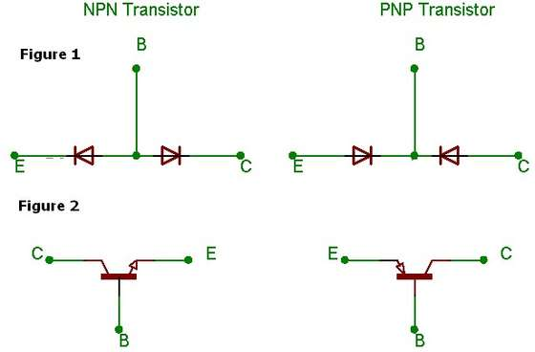
Model of a transistor
Bipolar transistors are constructed of a three-layer semiconductor “sandwich,” either PNP or NPN. As such, transistors register as two diodes connected back-to-back when tested with a multimeter's “resistance” or “diode check” function

Slide 7
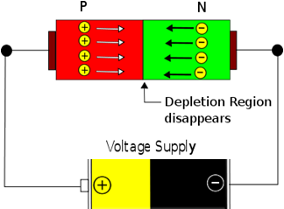
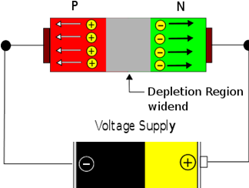
Electrical Switching on P-N Junction
Applying External Voltage…
…of Forward Biasing polarity facilitates motion of free electrons
…of Reverse Biasing polarity impedes motion of free electrons
Forward Biasing
Reverse Biasing
Circuit is “On”
Current is Flowing
Circuit is “Off”
Current not Flowing

Slide 8
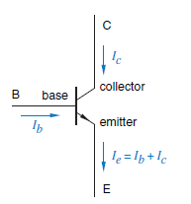
BJT introduction
BJT = Bipolar Junction Transistor
A BJT consists of two back-to-back p-n junctions.
The three regions are the emitter(E),base(B),and collector(C).
The middle region, the base is very thin. Since the base is thin, most carriers from emitter injected into base diffuse into collector.

Slide 9
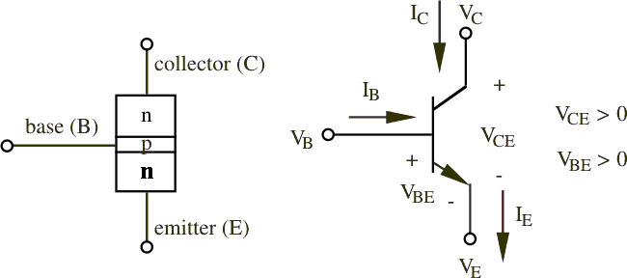
BJT schematic
NPN
NPN:
BE forward biased
BC reverse biased
PNP
PNP:
BE reverse biased
BC forward biased

Slide 10
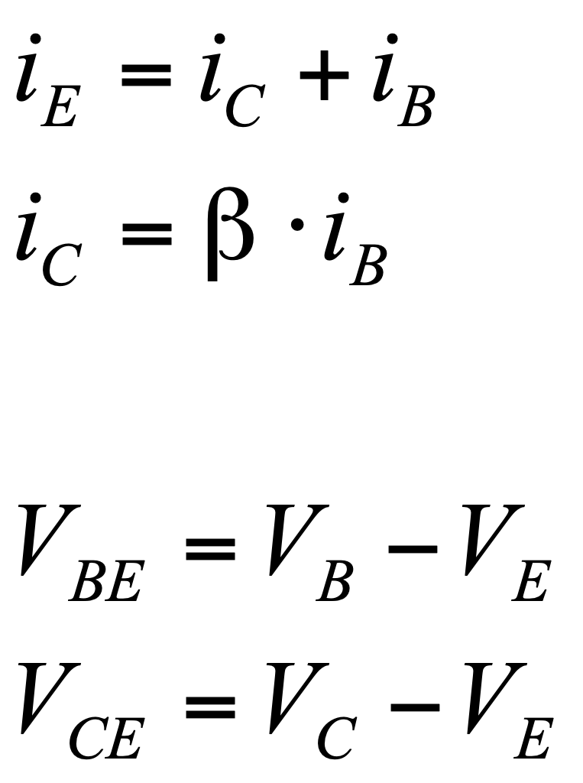
BJT formulae
Current control
NPN
β is the amplification factor and ranges from 20 to 200
It is dependent on temperature and voltage
Notes:
Suggestion: state the qualitative definition behind these equations: when ib =0, when ib !=0, etc, what happens?

Slide 11
BJT formulae
Emitter is more heavily doped than the collector.
Therefore,
V_{C} > V_{B} > V_{E}
for NPN transistor
NPN
Notes:
Why do more heavily doped (less electrons, more electrons) are of less/more voltage? Write it on the slide. Change the font. Change the background. b/c e is heavily doped…lower potential

Slide 12
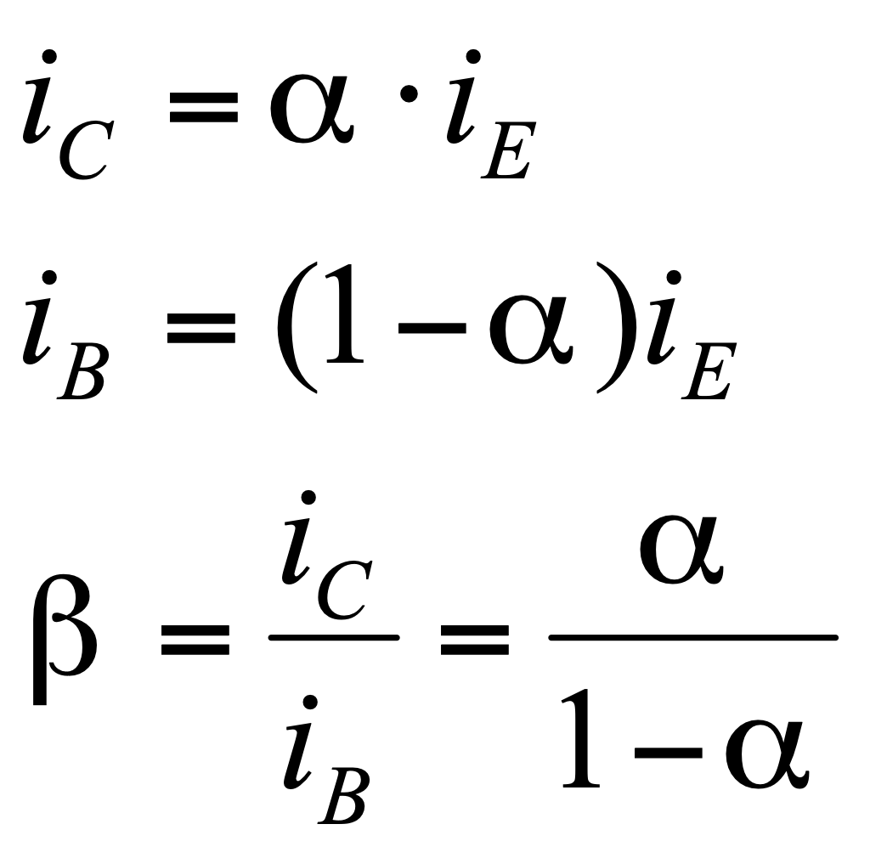
BJT formulae
NPN
α is the fraction of electrons that diffuse across the narrow base region
1 – α is the fraction of electrons that recombine with holes in the base region to create base current

Slide 13
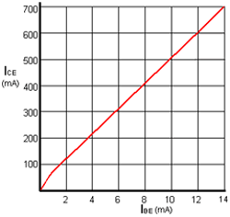
BJT Characteristic Curves
Transfer Characteristic
The graph of I_{CE} / I_{BE} shown (right) is called the Transfer Characteristic
The slope of the graph shows the β
Characteristic curves (graphs) can be drawn to show other parameters of a transistor, and are used both to detail the performance of a particular device and as an aid to the design of amplifiers.

Slide 14
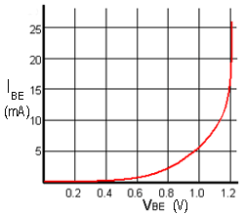
BJT Characteristic Curves
Input Characteristic
The Input Characteristic is the base emitter current I_{BE} against base emitter voltage V_{BE}(I_{BE}/V_{BE}) shows the input Conductance of the transistor.
The steepness of this particular curve when the V_{BE} is above 1 volt shows that the input conductance is very high, and there is a large increase in current (in practice, usually enough to destroy the transistor!) for a very small increase in V_{BE}.
Therefore the input RESISTANCE must be low.

Slide 15
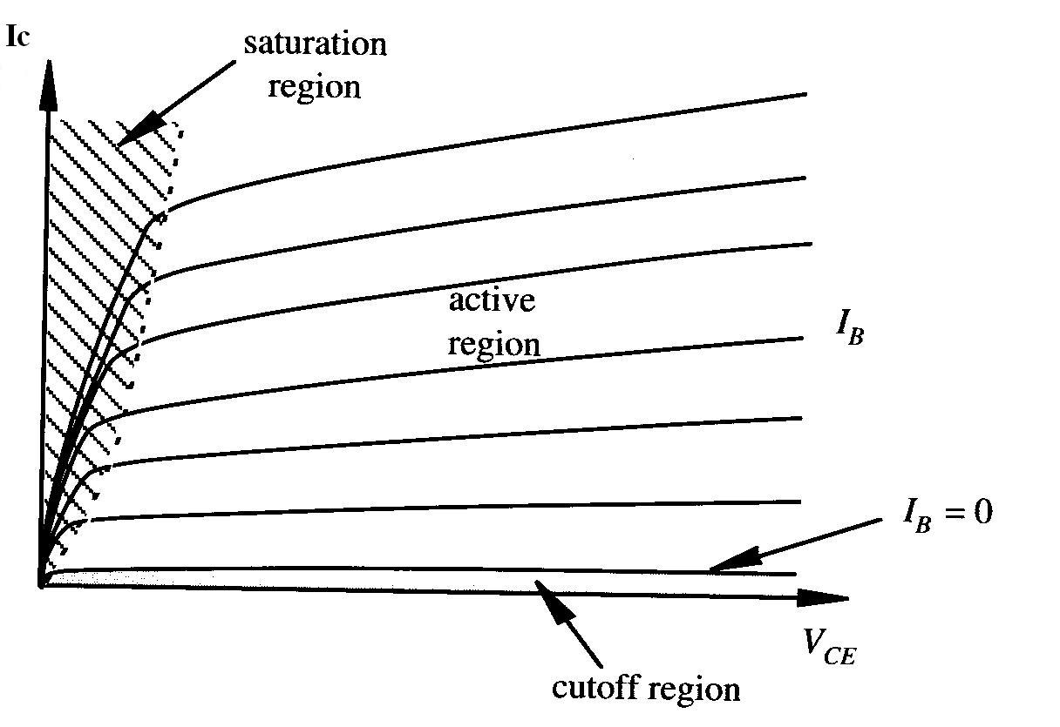
BJT Characteristic Curves
Output Characteristic
The slope gives the value of output conductance (and by implication output resistance).
The near horizontal parts of the graph lines show that a change in collector emitter voltage V_{CE} has almost no effect on collector current in this region, just the effect to be expected if the transistor output had a large value resistor in series with it.
Therefore the graph shows that the output resistance of the transistor is high.

Slide 16
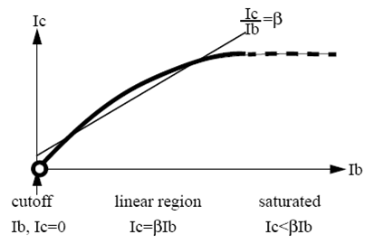
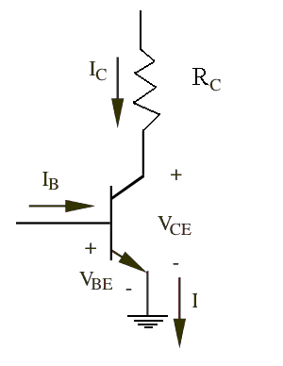
BJT operating regions
Operating Region | Parameters | Mode
Cut Off | V_{BE} < V_{cut-in} V_{CE} > V_{supply} I_{B} = I_{C} = 0 | Switch OFF
Linear | V_{BE} = V_{cut-in} V_{sat} < V_{CE} < V_{supply} I_{C} = β*I_{B} | Amplification
Saturated | V_{BE} = V_{cut-in}, V_{CE} < V_{sat} I_{B} > I_{C,max}, I_{C,max} > 0 | Switch ON

Slide 17
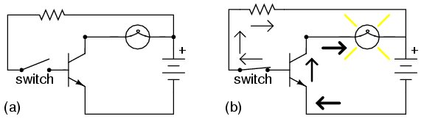
The Transistor as A Switch
While there are limitations as to what we can switch on and off, transistor switches offer lower cost and substantial reliability over conventional mechanical relays.
The secret to making a transistor switch work properly is to get the transistor in a saturation state

Slide 18
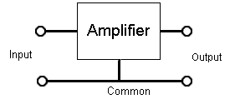
The Transistor as A Amplifier
Transistor Connections
Because an amplifier must have two input and two output terminals, a transistor used as an amplifier must have one of its three terminals common to both input and output as shown on the right. The choice of which terminal is used as the common connection has a marked effect on the performance of the amplifier.
There are three connection modes:
Comm0n Emitter Mode
Common Collector Mode
Common Base Mode

Slide 19
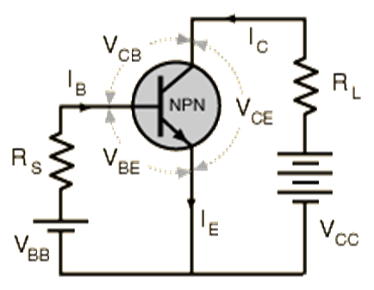
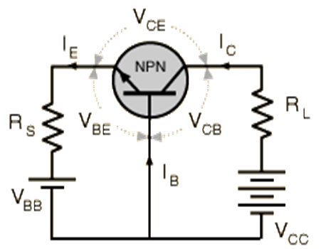
The Transistor as A Amplifier
Summary of the three types transistor connection
Parameter | Common Emitter | Common Collector | Common Base
Voltage gain Av | High (about 100) | Unity (1) | Medium (10-50)
Current Gain | High (50 - 800) | High (50 -800) | Less than unity (<1)
Input Impedance | Medium (about 3 to 5k) | High (several k) | Low (about 50R)
Output Impedance | Medium, Approx = Load resistor value | Low (a few ohms) | High (about 1M)

Slide 20
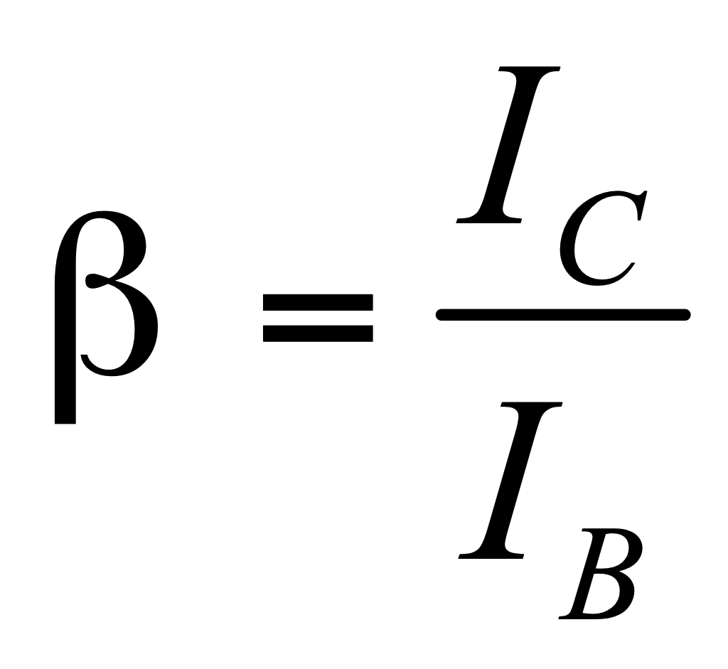
Several Comments about Transistor
Bipolar transistor consists of two PN junctions, with two types: NPN and PNP
BJT is a current control device.
The ratio of currents leads to one of the most important parameters of a transistor, which is its “current gain”, often referred to as its “Beta”.
BJT itself does not generate extra energy for amplifying, it just uses small current change to control big current change, which comes from the power supply.

Slide 21
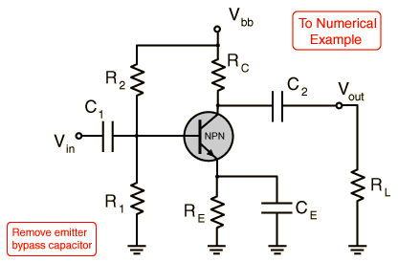
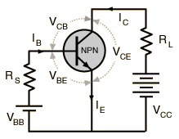
The Common Emitter Amplifier
NPN Transistor
- Both the signal source and the load share the emitter lead as a common connection point
- The common emitter configuration lends itself to voltage amplification and is the most common configuration for transistor amplifiers.

