Slide 1
Week 4
Introduction to Electric Circuits

Slide 2
Agenda
Node Analysis (Text 4.1 - 4.4)
Node Analysis with voltage sources
Node Analysis with current sources and voltage sources (independent and dependent sources)
Mesh Analysis
Mesh Analysis with voltage sources
Mesh Analysis with current sources and voltage sources (independent and dependent sources)
LTSpice verifications
(DESIGN PROBLEM CONCEPT TO RECALL: BOUNDARY CONDITIONS)
Reference: UW, UH

Slide 3
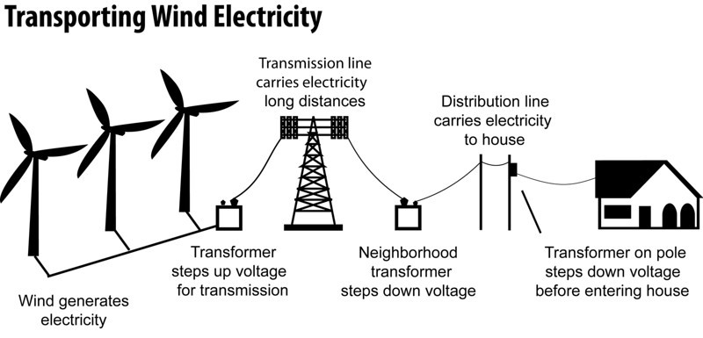
Node Analysis Applications

Slide 4
Ground work
Node: a place where two or more components meet
Essential Node: a place where three or more components meet
Reference Node: A special essential node that we choose as a reference point for voltages
Super node: A combination of two or more nodes

Slide 5
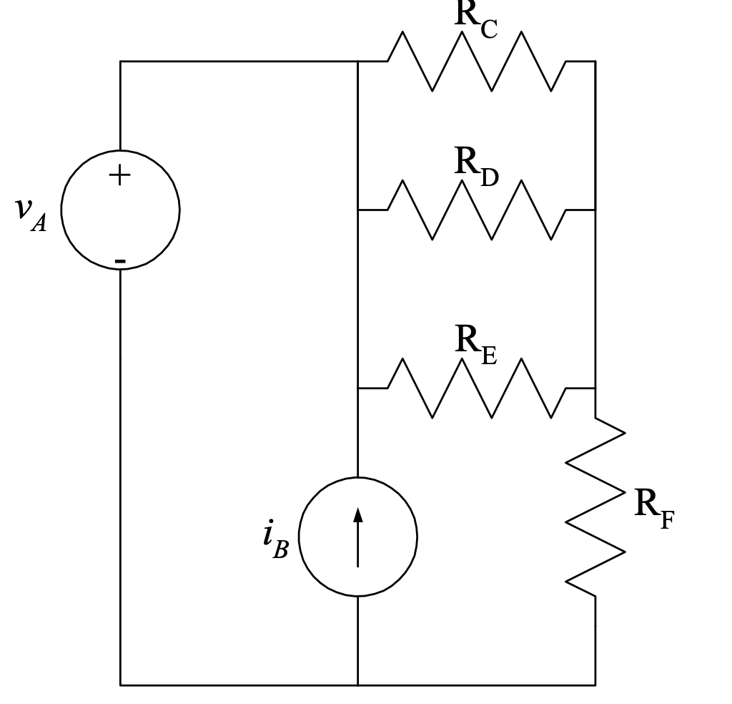
Node Analysis: Basics
Main point to remember: A Node is where two or more components meet. No matter how many wires are connected.

Slide 6
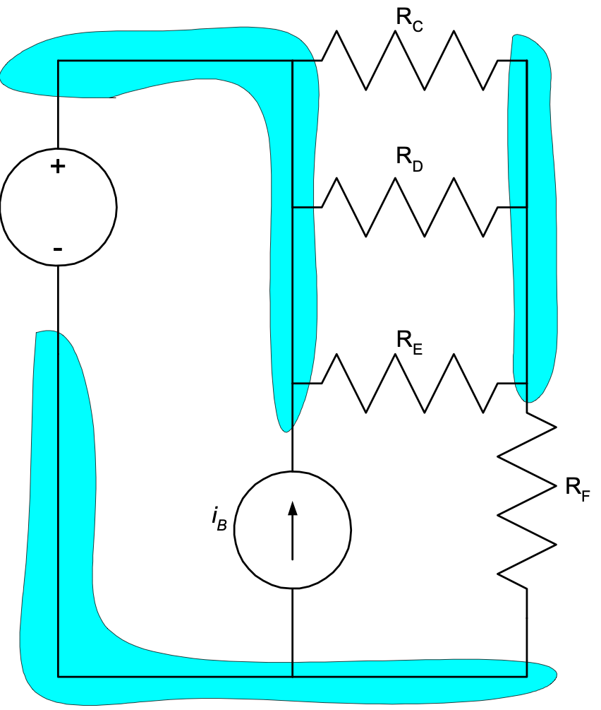
Node Analysis: Basics
Main point to remember: A Node is where two or more components meet. No matter how many wires are connected.
In the example circuit schematic given here, there are three nodes. These nodes are shown in dark blue here.
Some students count more than three nodes in a circuit like this. When they do, it is usually because they have considered two points connected by a wire to be two nodes.

Slide 7
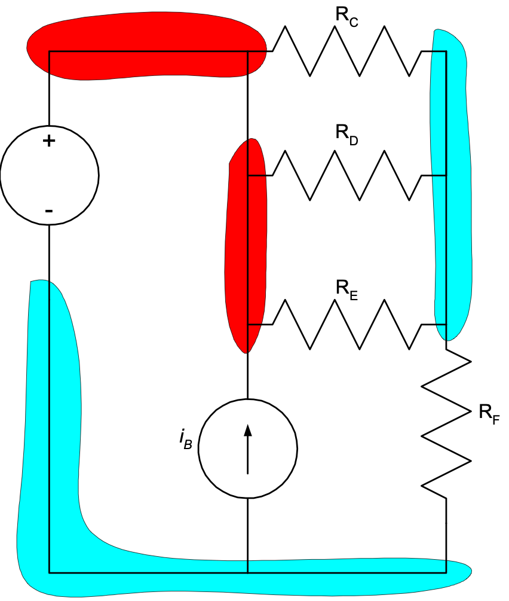
Node Analysis: Basics
Main point to remember: A Node is where two or more components meet. No matter how many wires are connected.
In the example circuit schematic given here, there are three nodes. These nodes are shown in dark blue here.
Some students count more than three nodes in a circuit like this. When they do, it is usually because they have considered two points connected by a wire to be two nodes.
So this would be wrong

Slide 8
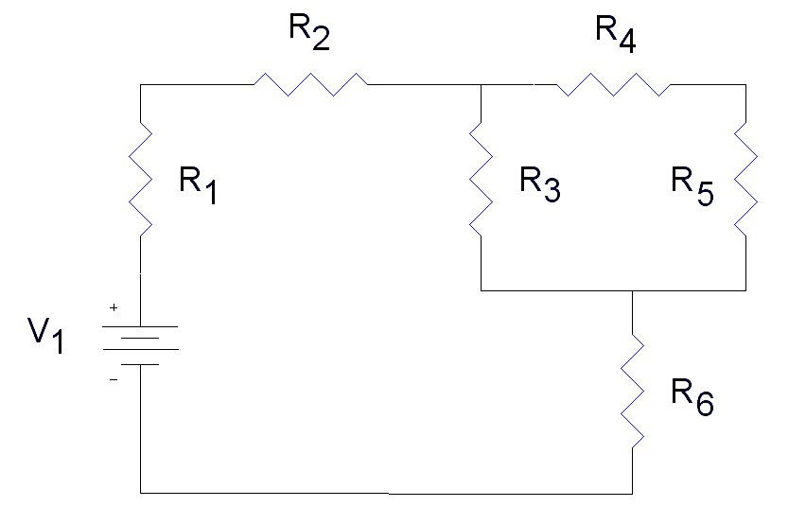
Node Analysis: Step 1
Pick one node as reference node
It’s voltage will be defined/assumed to be zero

Slide 9
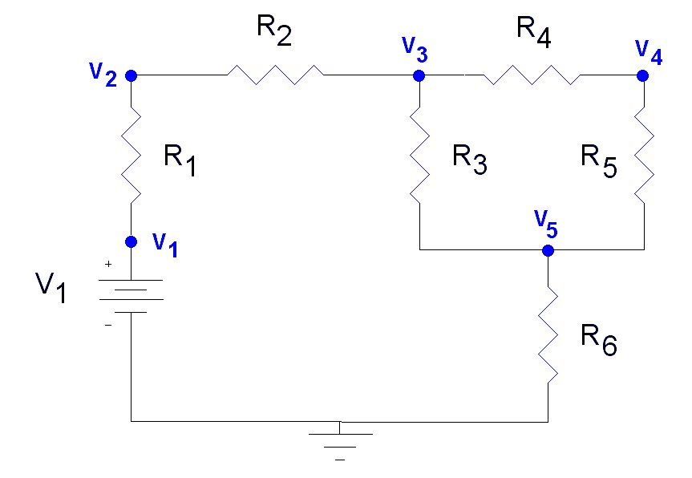
Node Analysis: Step 2
Label the other nodes (Place where two or more components meet)

Slide 10
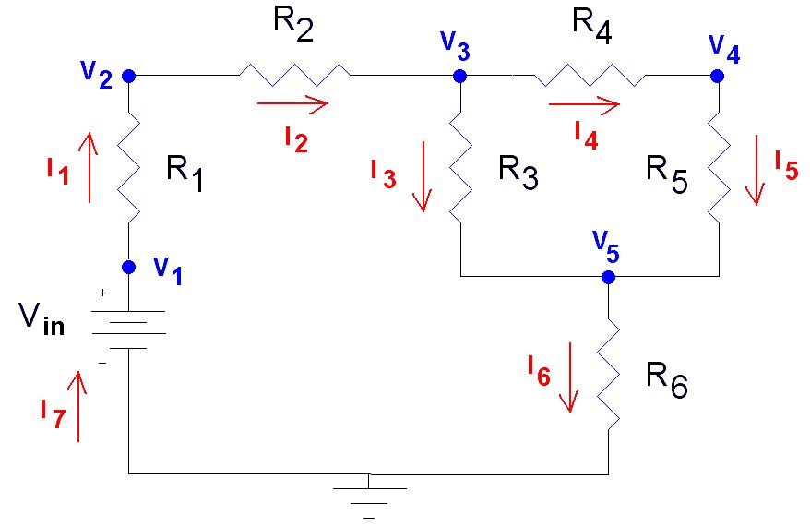
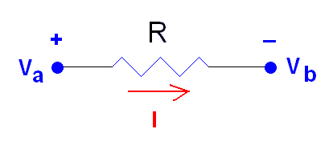
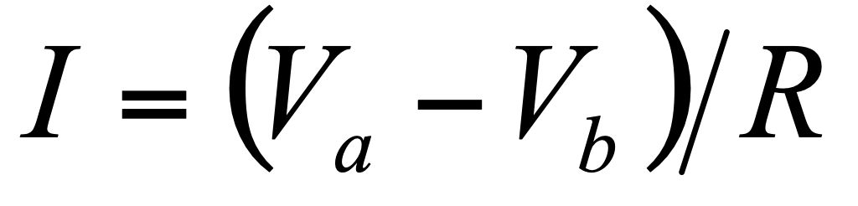
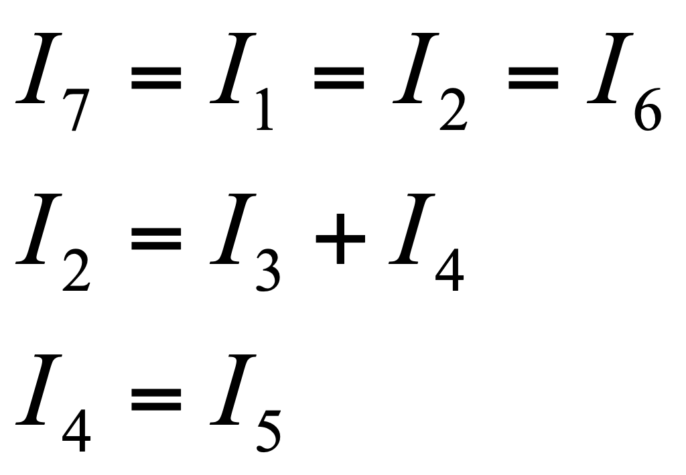
Node Analysis: Step 3
Label the current through each node and use Ohm’s law and KCL for current equations at the nodes

Slide 11
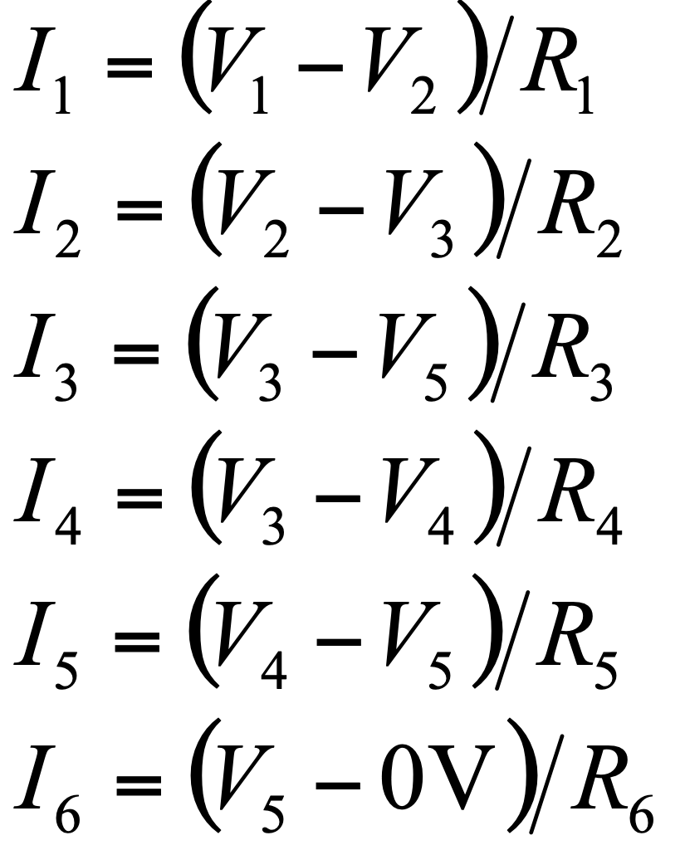
Node Analysis: Step 4
No equation for i7 as it is same as i1, net source current and solve for Node voltages.

Slide 12
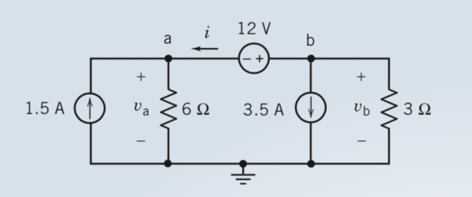
Example: from text
Find Va and Vb
We will solve as in the book
Two nodes based analysis using a and b, then super node ab.

Slide 13
Example: from text
is
ia
ib
Find Va and Vb
We will solve as in the book
Two nodes based analysis using a and b, then super node ab.

Slide 14
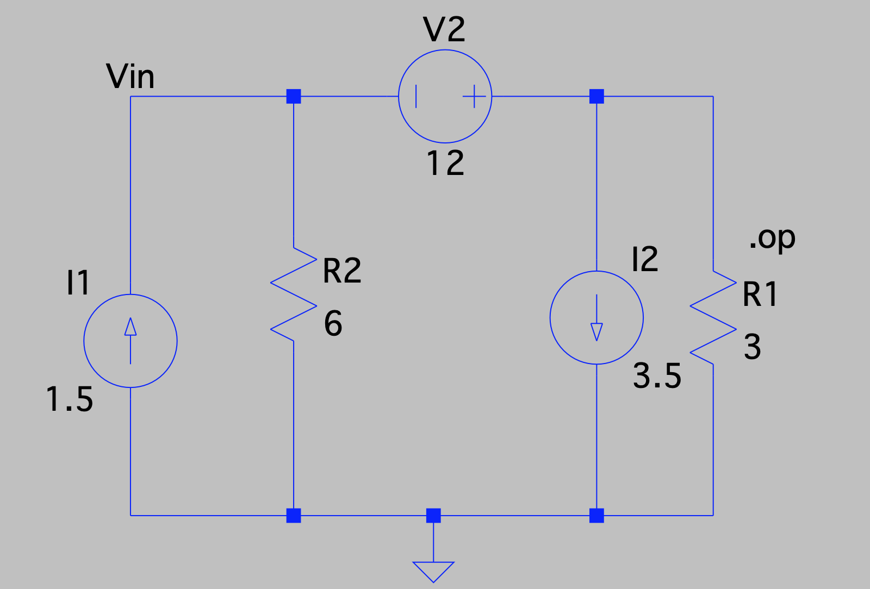
Verifying Answer
LT spice circuit

Slide 15
Self Reading
Node voltage analysis using dependent voltage sources.
We will discuss it in class on need basis (Section 4.4 from book)

Slide 16
Mesh Current Analysis
Provide step-by-step instructions for mesh analysis, which is a method to calculate voltage drops and mesh currents that flow around loops in a circuit.
Text Chapter sections 4.4 to Chapter 4.7

Slide 17
What is Mesh Analysis Methodology
Technique to find voltage drops around a loop using the currents that flow within the loop, Kirchoff’s Voltage Law, and Ohm’s Law
First result is the calculation of the mesh currents
Which can be used to calculate the current flowing through each component
Second result is a calculation of the voltages across the components
Which can be used to calculate the voltage at the nodes.

Slide 18
What is a Mesh
Mesh – the smallest loop around a subset of components in a circuit
Multiple meshes are defined so that every component in the circuit belongs to one or more meshes

Slide 19
Step 1: Identify All Meshes

Slide 20
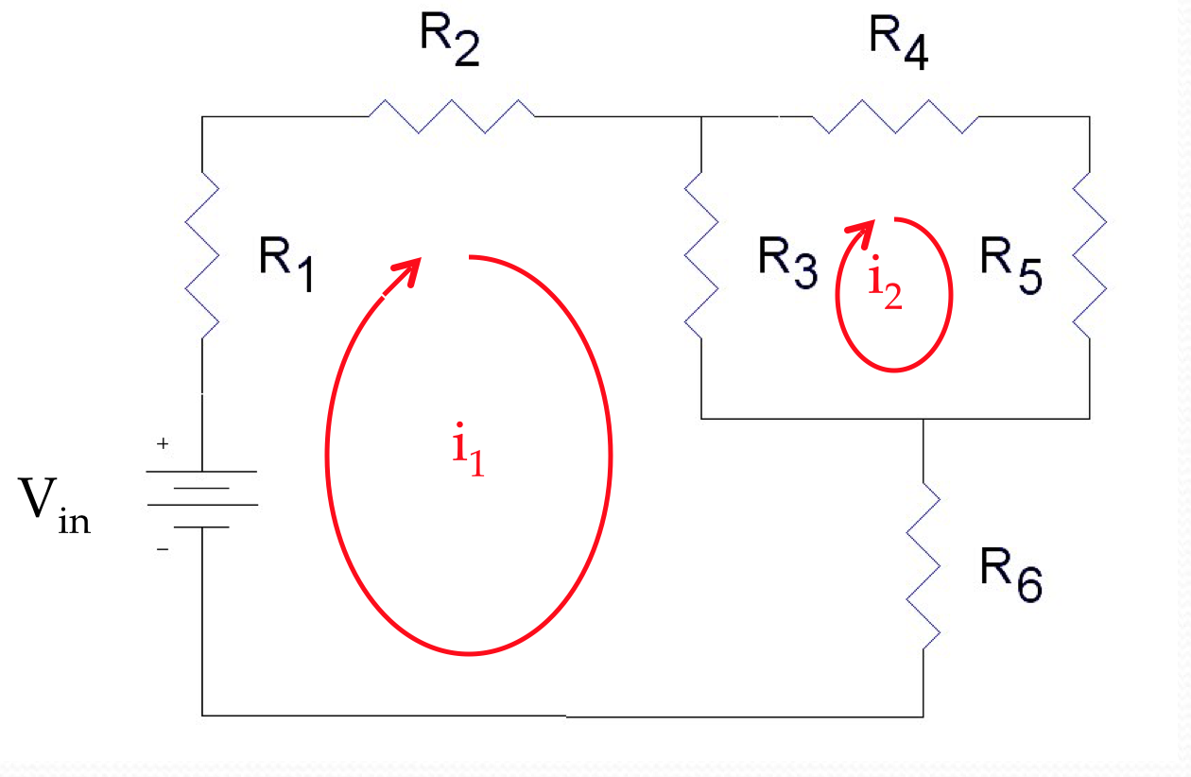
Step 2: Label all currents

Slide 21
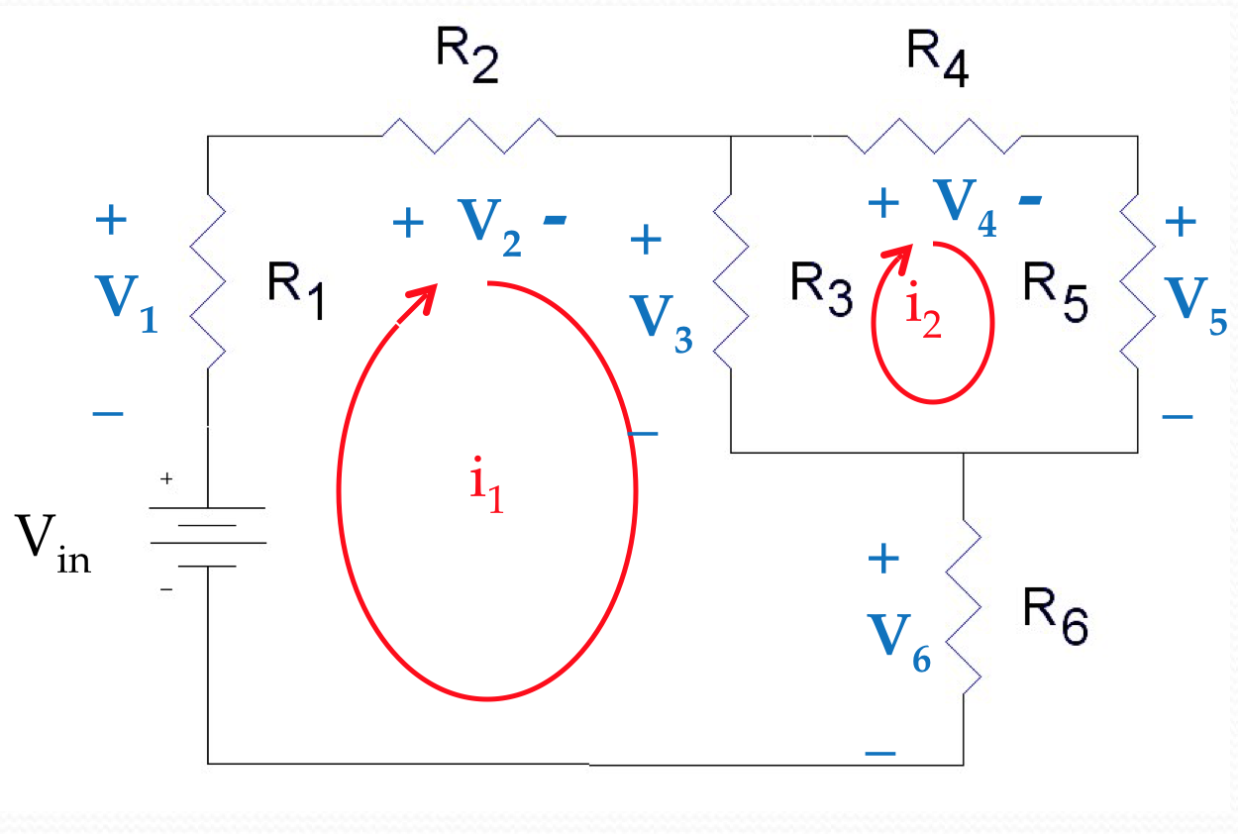
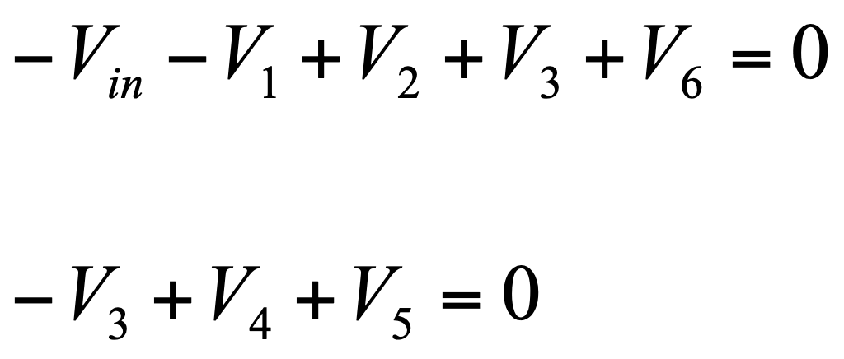
Step 3: Label all voltages

Slide 22
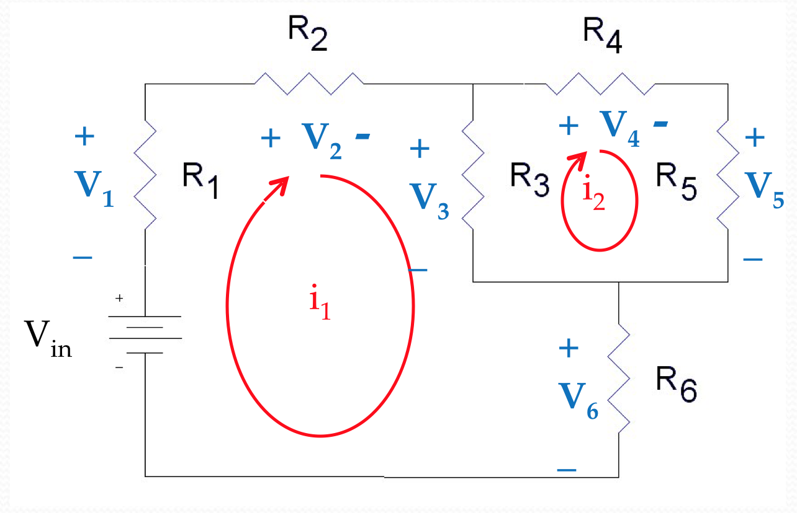
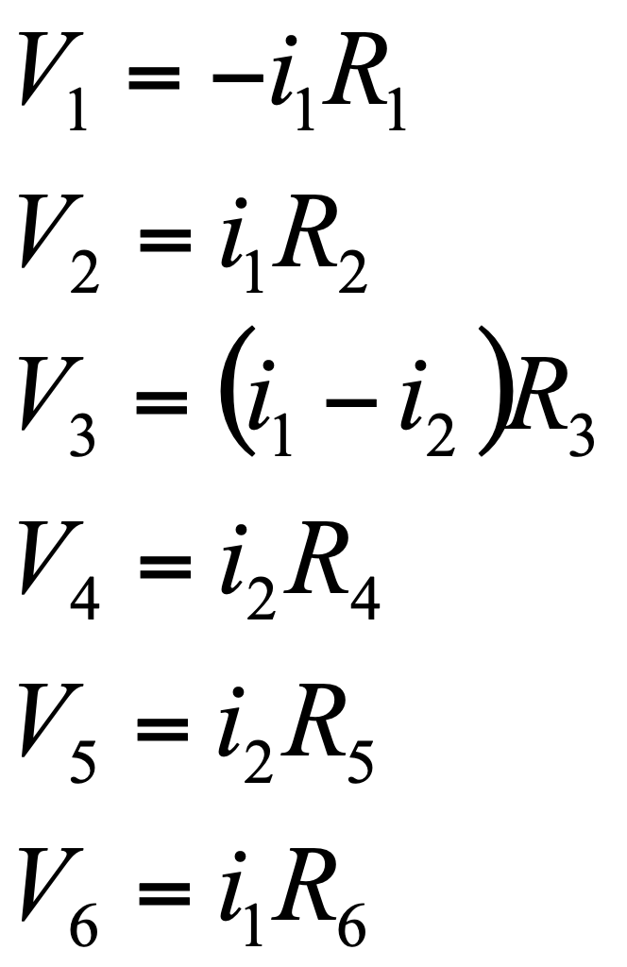
Step 4: Start solving for currents

Slide 23
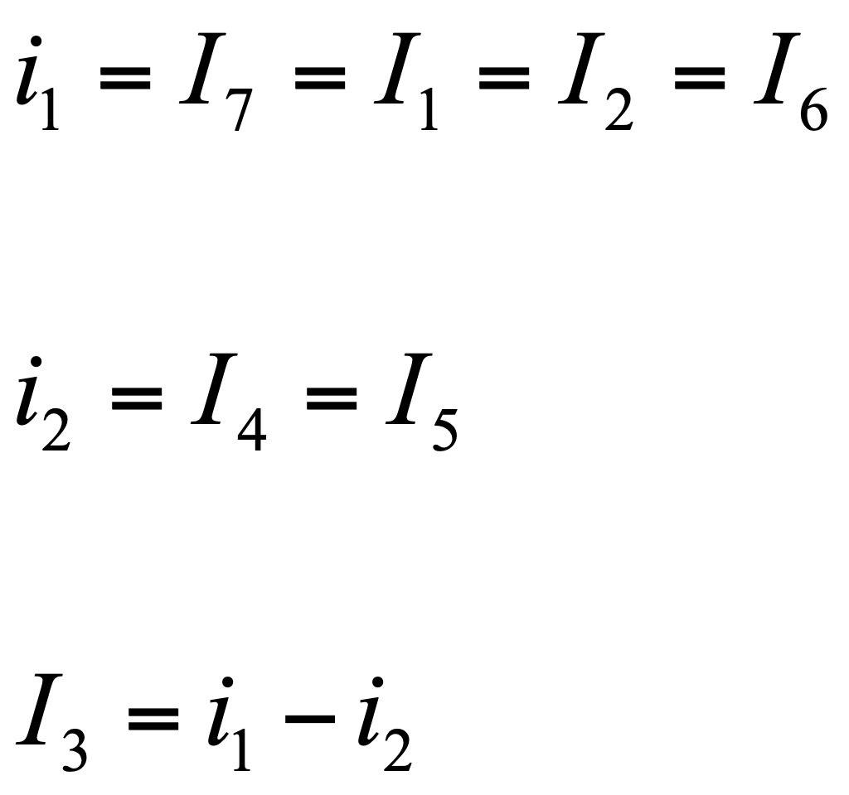
Step 5: Solve for Mesh Currents
Write mesh currents as individual components currents
Once mesh currents are known we can find voltage across components.

Slide 24
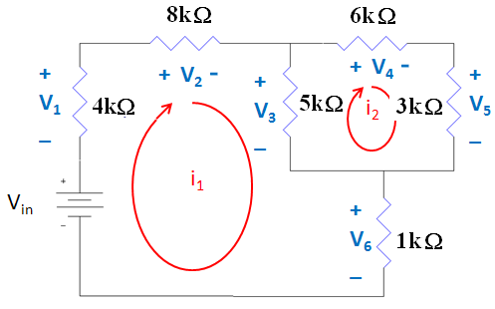
Example further

Slide 25
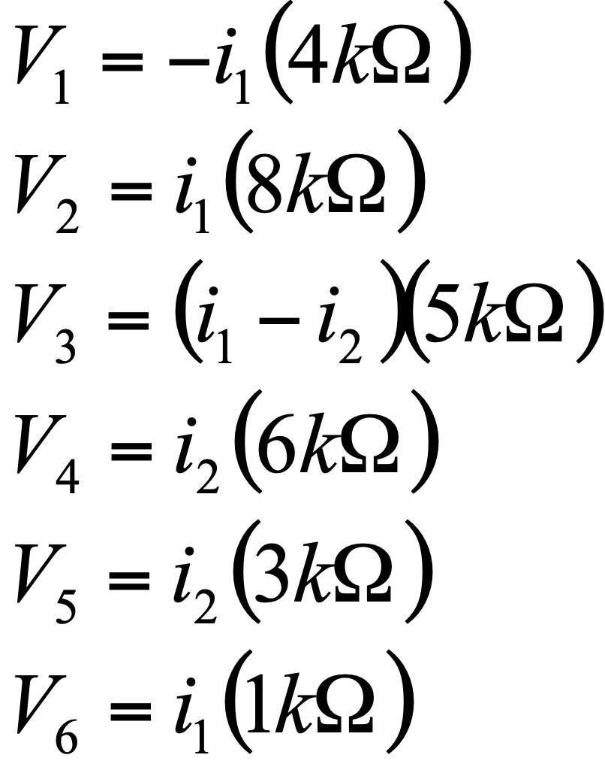
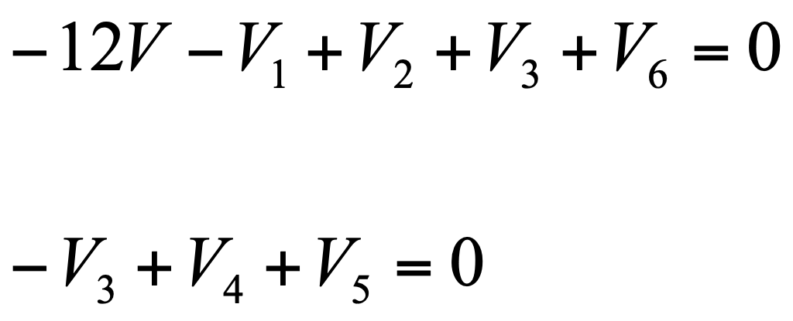
From previous analysis

Slide 26
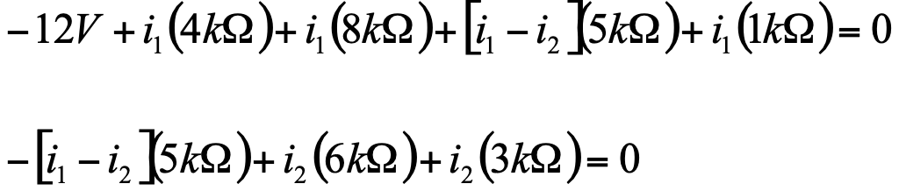
Rearranging
Mesh Currents | (μA)
i₁ | 740
i₂ | 264

Slide 27
Final Values
Voltage across resistors | (V)
V_{R1} = -i₁R₂ | -2.96
V_{R2} = i₂ R₂ | 5.92
V_{R3} =(i₁ – i₂) R₃ | 2.39
V_{R4} = i₂ R₄ | 1.59
V_{R5} = (V₄ – V₅) | 0.804
V_{R6} = (V₅ – 0V) | 0.740
Currents | (μA)
I_{R1} = i₁ | 740
I_{R2} = i₁ | 740
I_{R3} = i₁- i₂ | 476
I_{R4} = i₂ | 264
I_{R5} = i₂ | 264
I_{R6} = i₁ | 740
I _{Vin} = i₁ | 740

Slide 28
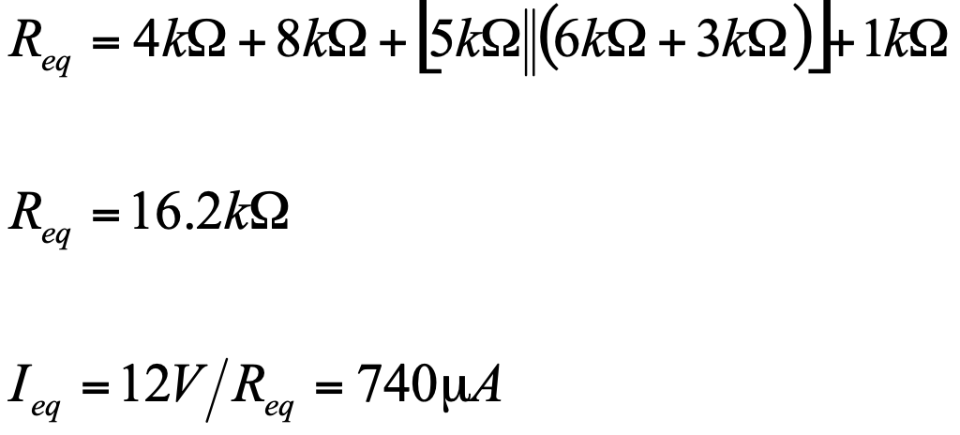
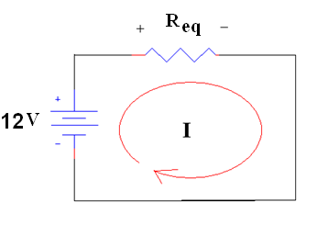
Verification

