Slide 1
Week 5
Introduction to Electrical Circuits

Slide 2
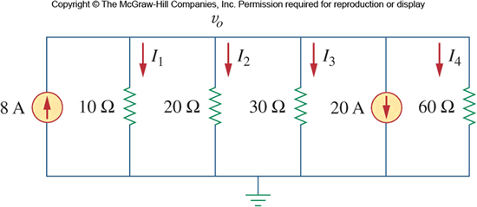
Appendix - I
Should You Use Nodal Analysis or Mesh Analysis?
Recommendation:
Use nodal analysis for circuits with fewer nodes than meshes, and use mesh analysis for circuits with fewer meshes than nodes.
How many nodes does this circuit have?
How many meshes?

Slide 3
Appendix - II
For advancement in circuit analysis use all skills you obtain.
Graph theory
Take advantage of topology
Node-voltage approach
Aim to find all tree voltages initially
Loop-current approach
Aim to find all branch currents initially
Note: From Node and Mesh Analysis, the final homework assignment is posted on Canvas. Last problem requires you to use LTSpice to simulate the circuit and verify the results. Please submit your LTSpice Image file and the resulting values using DC .op analysis (same as I did in class demo)

Slide 4
Agenda
Source Transformations
Thevenin’s Theorem
Norton’s Equivalent Circuit
Superposition
Maximum Power Transfer
LTSpice Simulation of Equivalent Circuits
(Ref: This section is directly based on material from chapter 5 of text, UW, and VirginiaTech EE department resources)

Slide 5
Source Transformation
We primarily deal with two kind of sources :
Voltage and Current Sources
For our analysis we have always thought of them to be ideal.
Voltage source was supposed to be with no internal resistance, so it
Supplied its rated voltage value over time.
Its voltage stayed same as the power supplied from this source increased.
Current source was supposed to exhibit no leakage
It supplied constant/same value of current always in our circuit
Its current stayed same as the power supplied from this source increased.

Slide 6
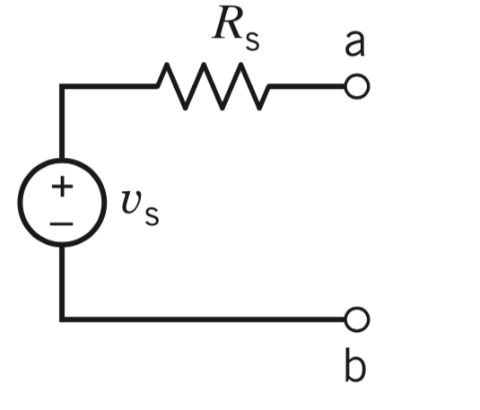
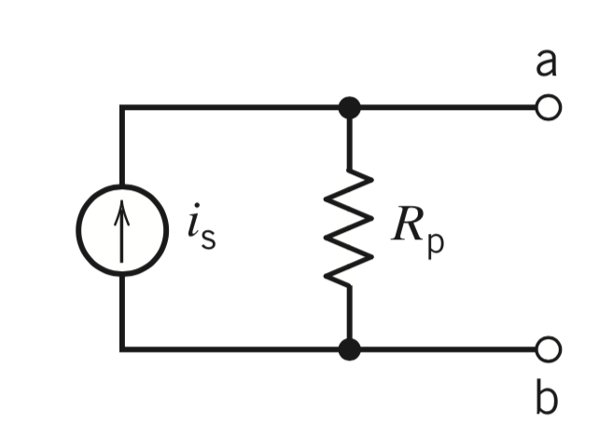
Source Transformation
Realistic or practical voltage source has some inherent resistance.
Because it impedes the current and decreases the voltage drop across terminals it can be viewed as an ideal source with series resistance
Realistic or practical current source has current leakage.
Because it decreases current with increasing power, it can be viewed as an ideal source with parallel resistance.
The best part - these are interchangeable
(Hence “transformation”)

Slide 7
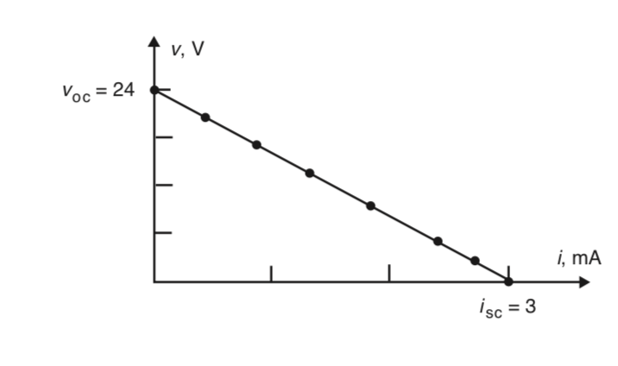
Source Transformation: Step 1
Find out the series resistance of the non-ideal source.
This is typically done by calculating voltage at open circuit condition first.
Then moving on from open circuit to maximum current value where voltage across the terminals of the source becomes negligible.
The slope of the V-I curve gives us the resistance value.

Slide 8
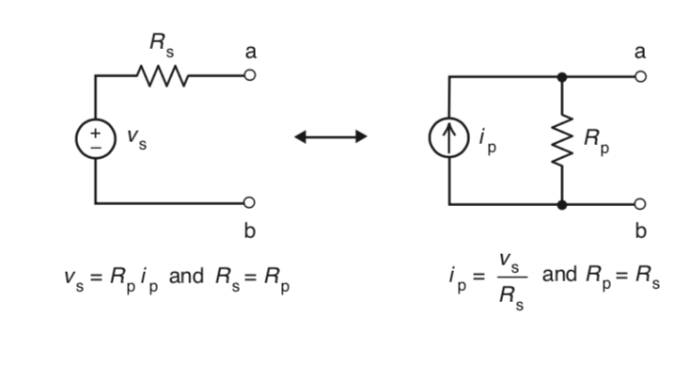
Source Transformation: Step 2
Compute the value of source current by dividing the labeled/open circuit voltage with this computed resistance.
This becomes the new source current.
Put the same resistance value in parallel with this source.

Slide 9
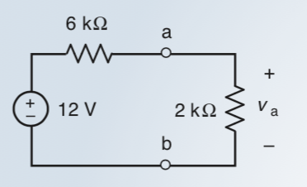
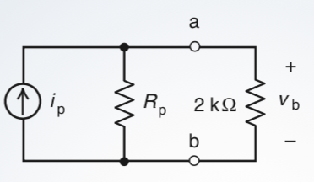
Source Transformation: In Class Exercise
Take a Voltage source with 2k Ohm resistance connected to its terminals. We know it’s internal resistance is 6k Ohm
Convert it to a current source, and then compare Va and Vb

Slide 10
Thévenin’s Theorem
A linear two-terminal circuit can be replaced with an equivalent circuit of an ideal voltage source, V_{Th}, in series with a resistor, R_{Th}.
V_{Th} is equal to the open-circuit voltage at the terminals.
R_{Th} is the equivalent or input resistance when the independent sources in the linear circuit are turned off.

Slide 11
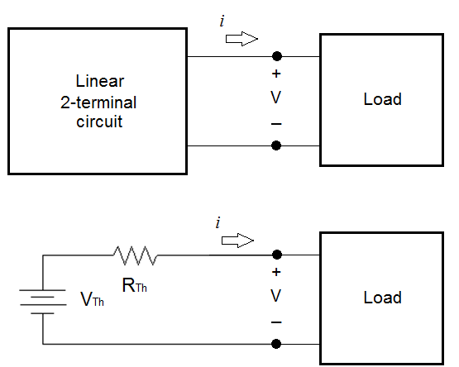
Circuit Schematic: Thévenin’s Theorem

Slide 12
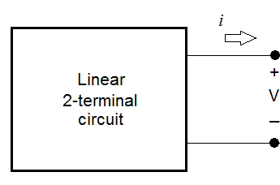
Definitions for Thévenin’s Theorem
Linear circuit is a circuit where the voltage is directly proportional to the current (i.e., Ohm’s Law is followed).
Two terminals are the 2 nodes/2 wires that can make a connection between the circuit to the load.

Slide 13
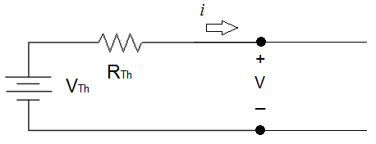
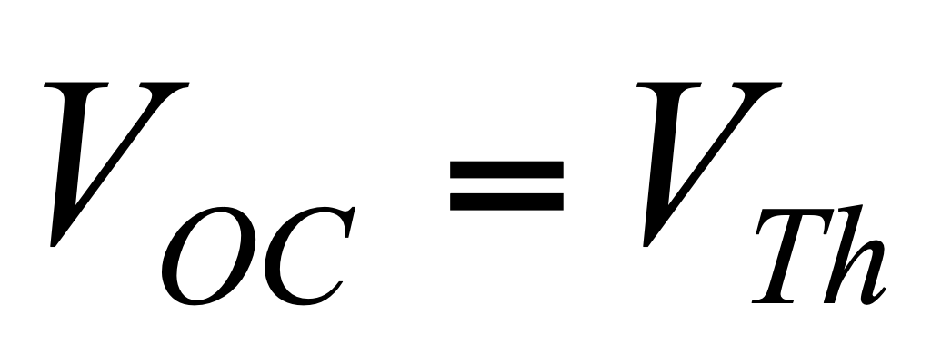
Definitions for Thévenin’s Theorem
+
V_{oc}
_
Open-circuit voltage V_{oc} is the voltage, V, when the load is an open circuit (i.e., R_{L} = ∞Ω).

Slide 14
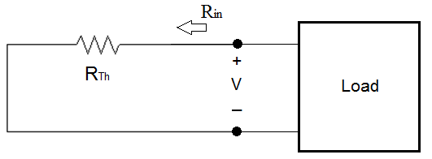
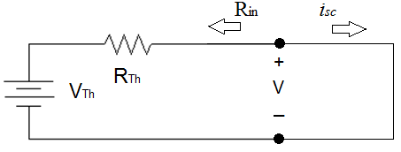
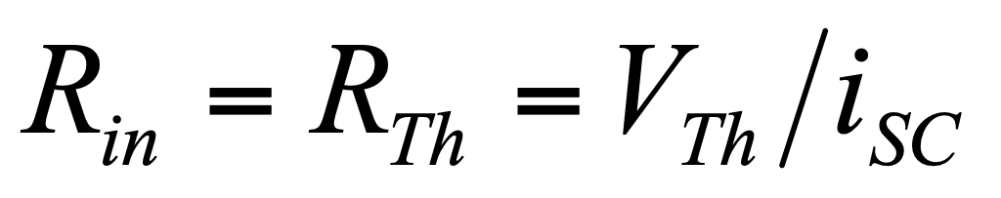
Definitions for Thévenin’s Theorem
Input resistance is the resistance seen by the load when V_{Th} = 0V.
It is also the resistance of the linear circuit when the load is a short circuit (R_{L} = 0Ω).

Slide 15
Steps to Determine V_{Th} and R_{Th}
Identify the load, which may be a resistor or a part of the circuit.
Replace the load with an open circuit .
Calculate V_{OC}. This is V_{Th}.
Turn off all independent voltage and currents sources in the linear 2-terminal circuit.
Calculate the equivalent resistance of the circuit. This is R_{Th}.
The current through and voltage across the load in series with V_{Th} and R_{Th} is the load’s actual current and voltage in the original circuit.

Slide 16
Norton’s Theorem
A linear two-terminal circuit can be replaced with an equivalent circuit of an ideal current source, I_{N}, in parallel with a resistor, R_{N}.
I_{N} is equal to the short-circuit current at the terminals.
R_{N} is the equivalent or input resistance when the independent sources in the linear circuit are turned off.

Slide 17
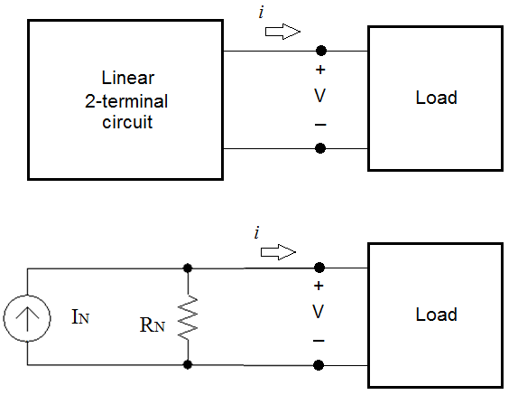
Circuit Schematic: Norton’s Theorem
Short-circuit current I_{sc} is the current, i, when the load is a short circuit (i.e., R_{L} = 0Ω).

Slide 18
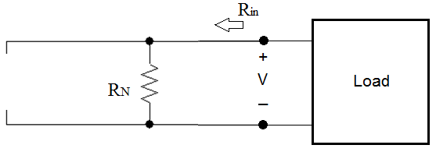
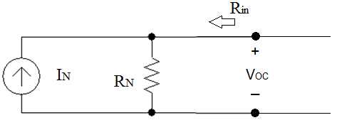
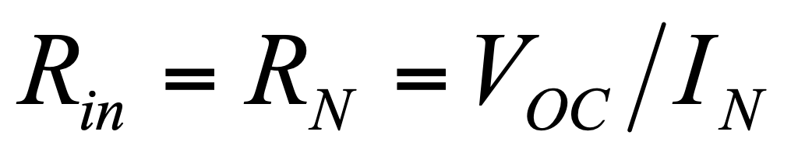
Definitions for Norton’s Theorem
Input resistance is the resistance seen by the load when I_{N} = 0A.
It is also the resistance of the linear circuit when the load is an open circuit (R_{L} = ∞Ω).

Slide 19
Steps to Determine I_{N} and R_{N}
Identify the load, which may be a resistor or a part of the circuit.
Replace the load with an open circuit .
Calculate I_{SC}. This is I_{N}.
Turn off all independent voltage and currents sources in the linear 2-terminal circuit.
Calculate the equivalent resistance of the circuit. This is R_{N}.
The current through and voltage across the load in parallel with I_{N} and R_{N} is the load’s actual current and voltage in the original circuit.

Slide 20
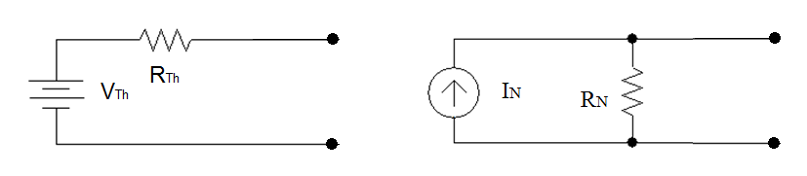
Source Conversion
A Thévenin equivalent circuit can easily be transformed to a Norton equivalent circuit (or visa versa).
If R_{Th} = R_{N}, then V_{Th} = R_{N}I_{N} and I_{N} = V_{Th}/R_{Th}

Slide 21
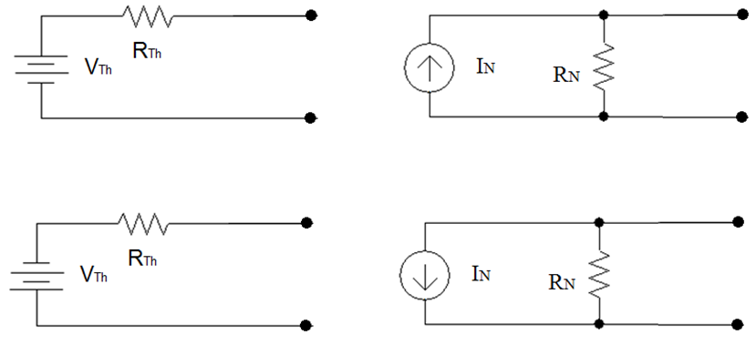
Voltage Polarity and Current Flow

Slide 22
Value of Theorems
Simplification of complex circuits.
Used to predict the current through and voltage across any load attached to the two terminals.
Provides information to users of the circuit.

Slide 23
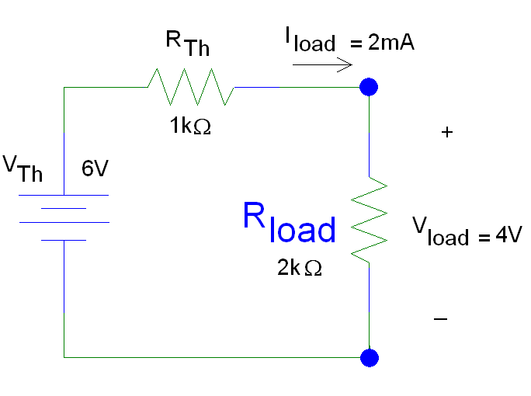
Example #1

Slide 24
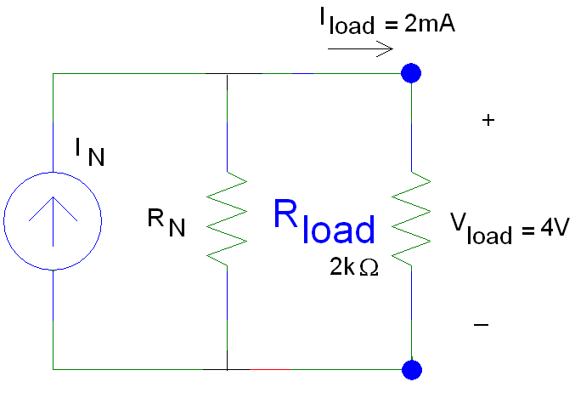
Example #1 (con’t)
Find I_{N} and R_{N}

Slide 25
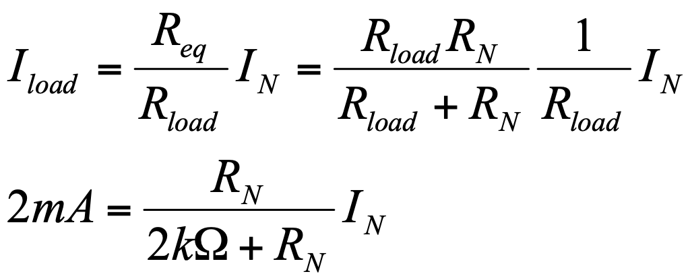
Example #1 (con’t)
Calculation for I_{N}
Look at current divider equation:
If R_{Th} = R_{N}= 1kΩ, then I_{N} = 6mA

Slide 26
Why chose R_{Th} = R_{N}?
Suppose V_{Th} = 0V and I_{N} = 0mA
Replace the voltage source with a short circuit.
Replace the current source with an open circuit.
Looking towards the source, both circuits have the identical resistance (1kΩ).

Slide 27
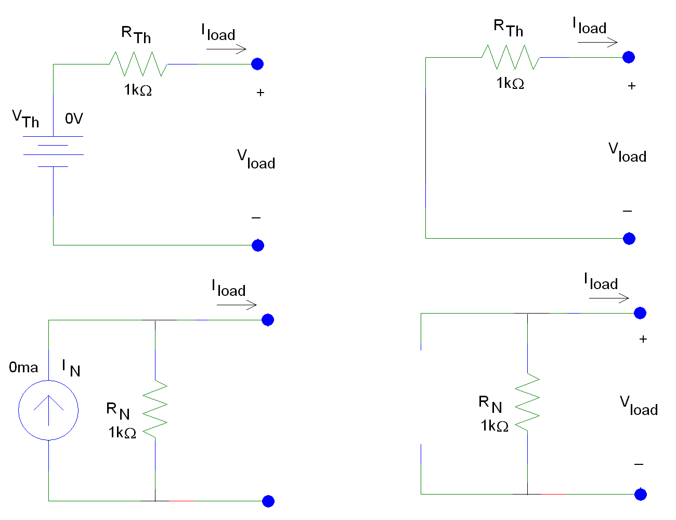

Slide 28
Source Transformation
Equations for Thévenin/Norton Transformations
V_{Th} = I_{N} R_{Th}
I_{N} = V_{Th}/R_{Th}
R_{Th}= R_{N}

Slide 29
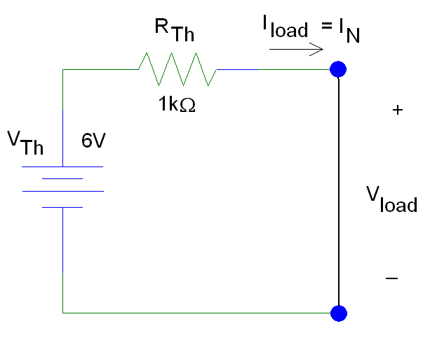
Example #1: Norton’s Theorem
I_{N} is the current that flows when a short circuit is used as the load with a voltage source
I_{N} = V_{Th}/R_{Th} = 6mA

Slide 30
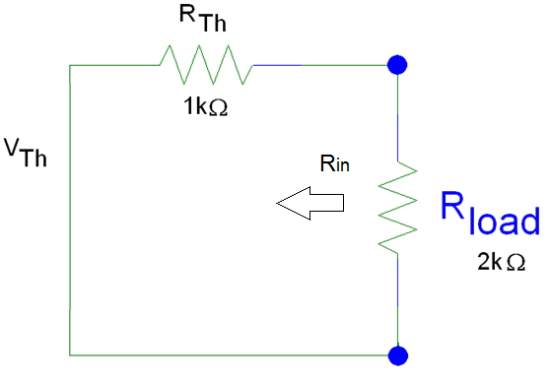
Example #1: Norton’s Theorem
R_{N} is the resistance of the linear circuit when the power sources in the original circuit are turned off (V_{Th} is replaced with a short circuit).

Slide 31
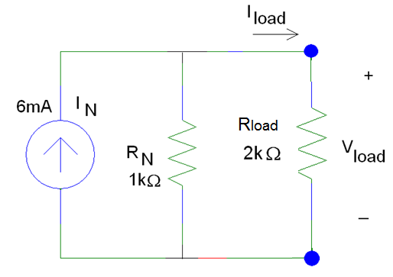
Example #1: Norton’s Theorem
The Norton equivalent circuit is:

Slide 32
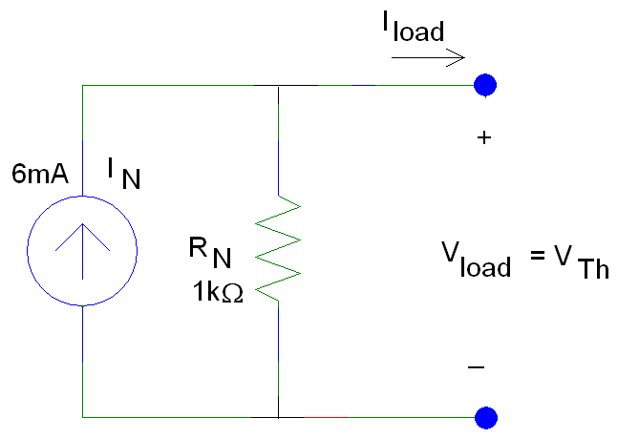
Check: Thévenin Theorem
V_{Th} is the voltage across the load when an open short circuit is used as the load with a current source
V_{Th} = I_{N} R_{Th} = 6V

Slide 33
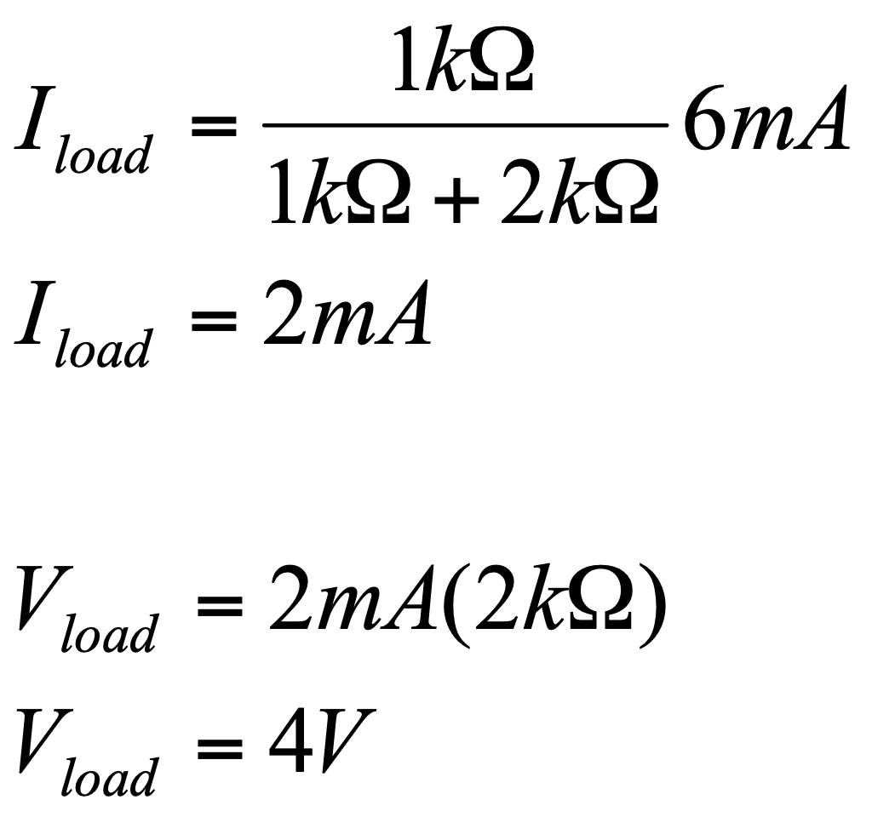
Check: Iload and Vload

Slide 34
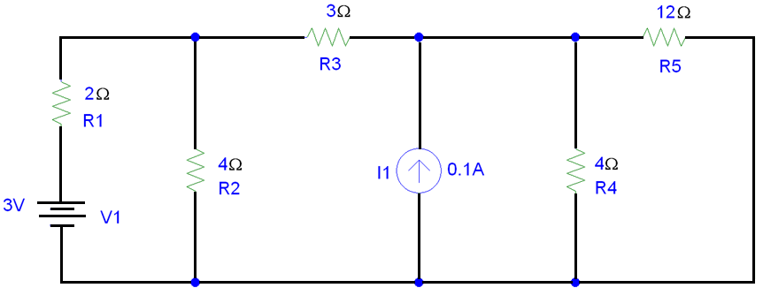
Example #2
Simplification through Transformation

Slide 35
Example #2 (con’t)

Slide 36
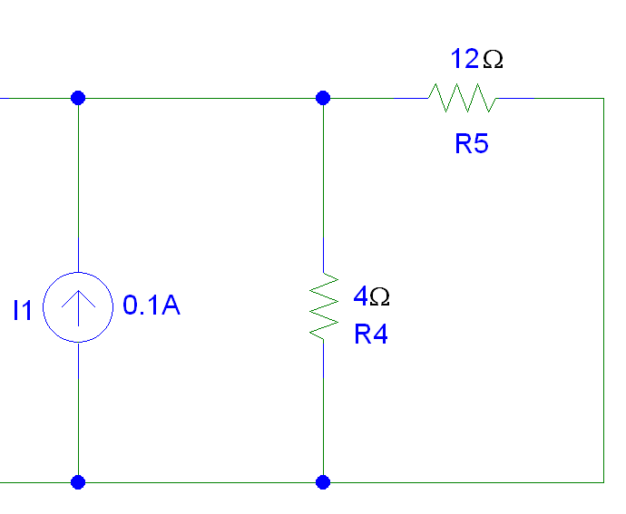
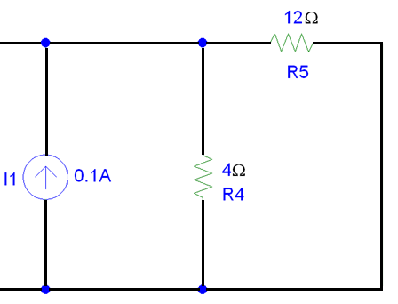
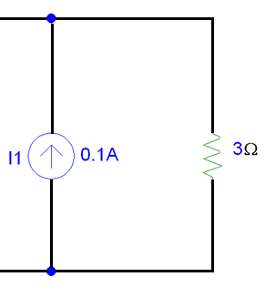
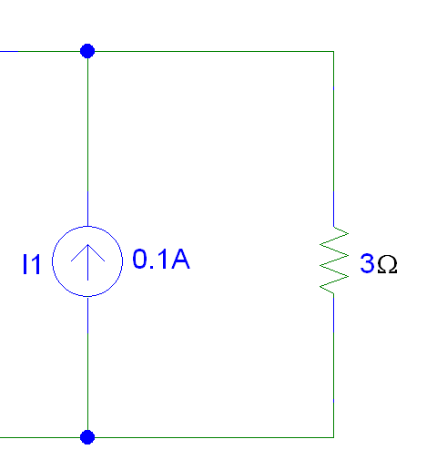
Example #2 (con’t)
Find Req to obtain a Norton equivalent circuit

Slide 37
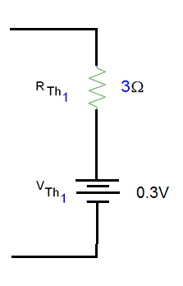
Example #2 (con’t)
Current Source to Voltage Source
R_{Th} = 3Ω
V_{Th} = 0.1A (3Ω) = 0.3V

Slide 38
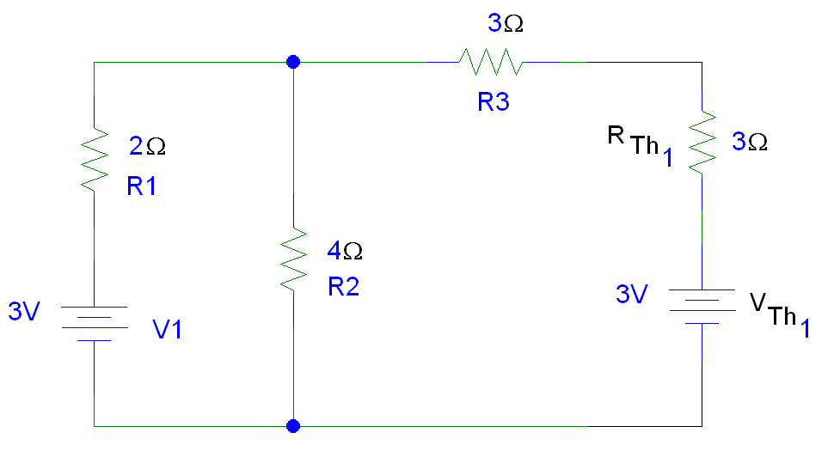
Example #2 (con’t)
0.3V

Slide 39
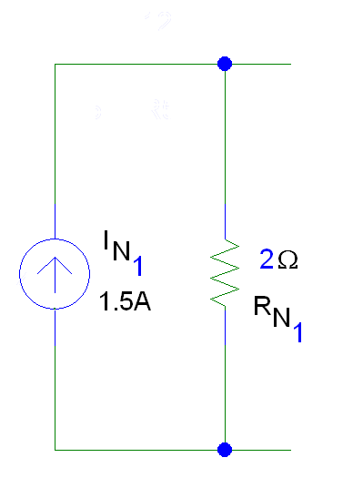
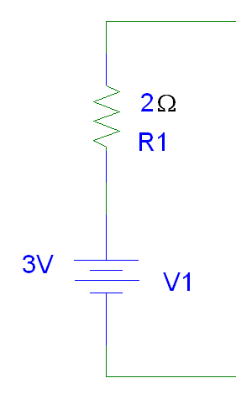
Example #2 (con’t)
Voltage Source to Current Source
R_{Th} = 2Ω
I_{N} = 3V/2Ω = 1.5A

Slide 40
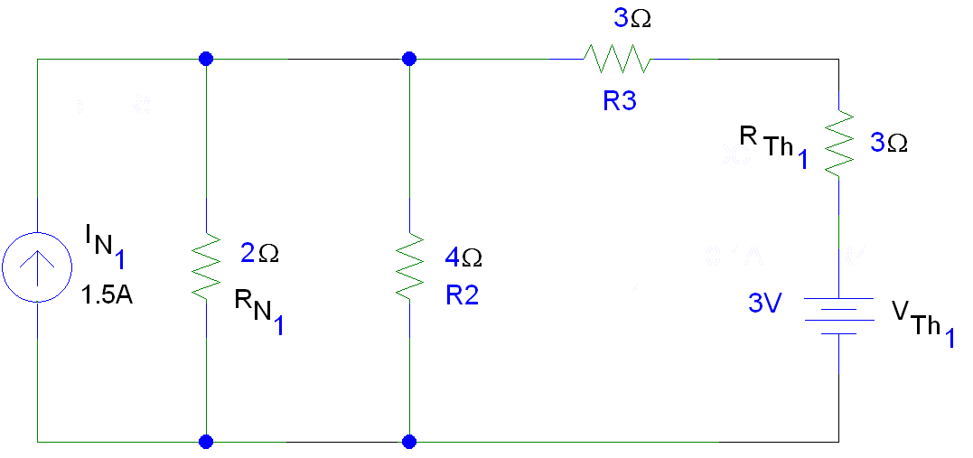
Example #2 - Solution 1
Simplify to Minimum Number of Current Sources
0.3V

Slide 41
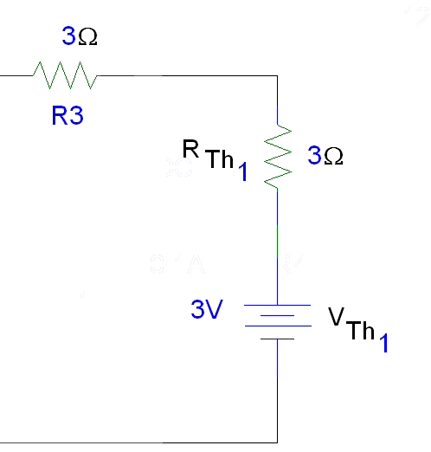
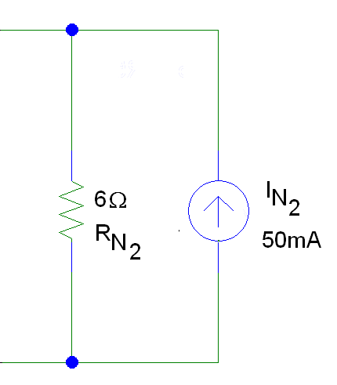
Example #2 (con’t)
Voltage Source to Current Source
R_{Th} = 6Ω
I_{N} = 0.3V/6Ω = 50.0mA
0.3V

Slide 42
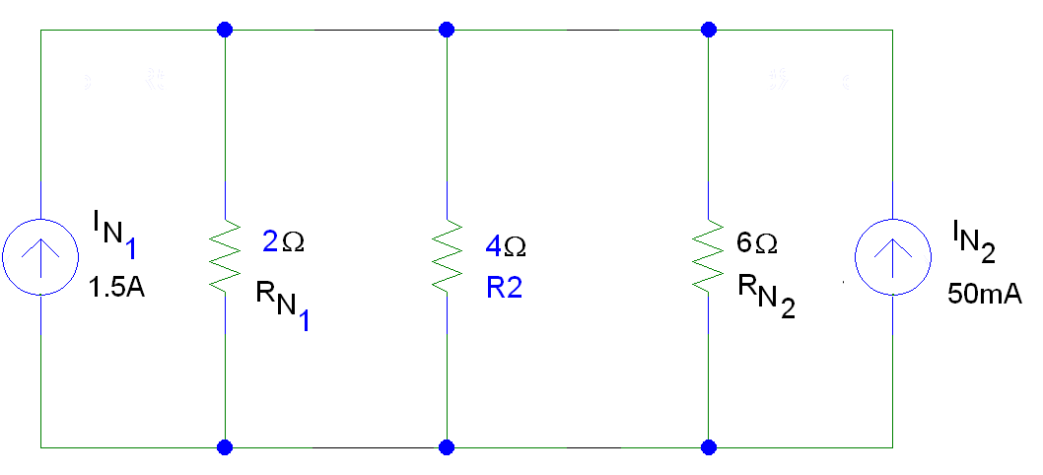
Example #2 (con’t)

Slide 43
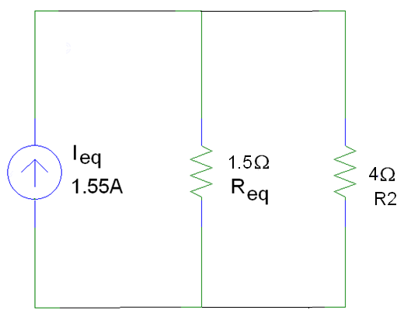
Example #2 (con’t)
Current Sources in Parallel Add

Slide 44
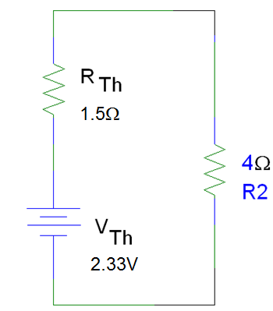
Example #2 (con’t)
Transform solution for Norton circuit to Thévenin circuit to obtain single voltage source/single equivalent resistor in series with load.

Slide 45
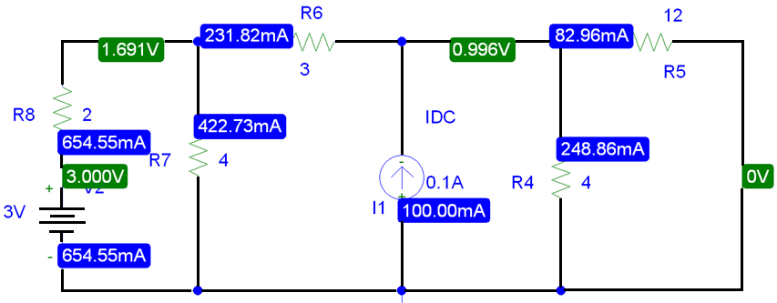
LTSpice

Slide 46
Summary
Thévenin and Norton transfomrations are performed to simplify a circuit for analysis and design.
Two techniques were described.
Examples using the source transformation technique were given.

Slide 47
Superposition
The voltage across a component is the algebraic sum of the voltage across the component due to each independent source acting upon it.
The current flowing through a component is the algebraic sum of the current flowing through component due to each independent source acting upon it.

Slide 48
Superposition - Application
Transistor/MicroElectronics circuit analysis
Separating the contributions of the DC and AC independent sources.
Example:
To determine the performance of an amplifier, we calculate the DC voltages and currents to establish the bias point.
The AC signal is usually what will be amplified.
A generic amplifier has a constant DC operating point, but the AC signal’s amplitude and frequency will vary depending on the application.

Slide 49
Steps
Turn off all independent sources except one.
Redraw circuit.
Solve for the voltages and currents in the new circuit.
Turn off the active independent source and turn on one of the other independent sources.
Repeat Steps 2 and 3.
Continue until you have turned on each of the independent sources in the original circuit.
To find the total voltage across each component and the total current flowing, add the contributions from each of the voltages and currents found in Step 3.

Slide 50
Turning Off Sources
Voltage sources should be replaced with short circuits.
A short circuit will allow current to flow across it, but the voltage across a short circuit is equal to 0V.
Current sources should be replaced with open circuits.
An open circuit can have a non-zero voltage across it, but the current is equal to 0A.
Once you select a direction for current to flow through a component and the direction of the polarity (+ /_ signs) for the voltage across a component, you must use the same directions when calculating these values in all of the subsequent circuits.

Slide 51
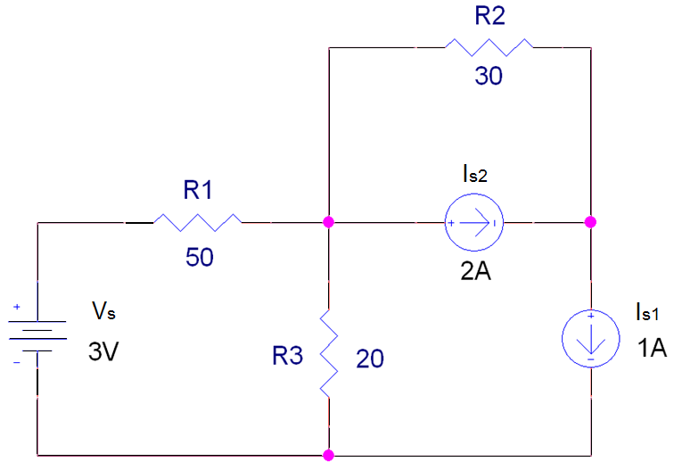
Example #1

Slide 52
Example #1 (con’t)
Replace Is1 and Is2 with open circuits

Slide 53
Example #1 (con’t)
Since R2 is not connected to the rest of the circuit on both ends of the resistor, it can be deleted from the new circuit.
Redraw circuit without R2 in it.

Slide 54
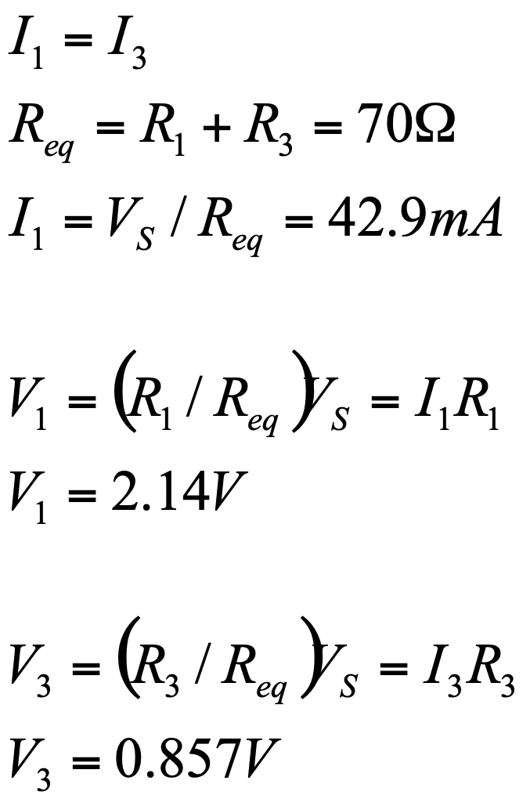
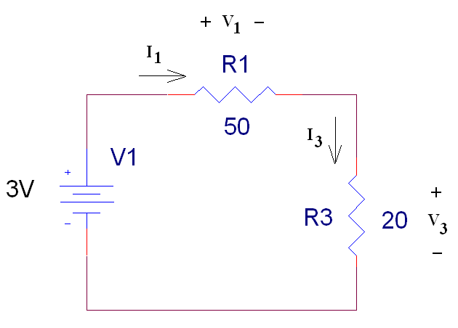
Example #1 (con’t)
Vs

Slide 55
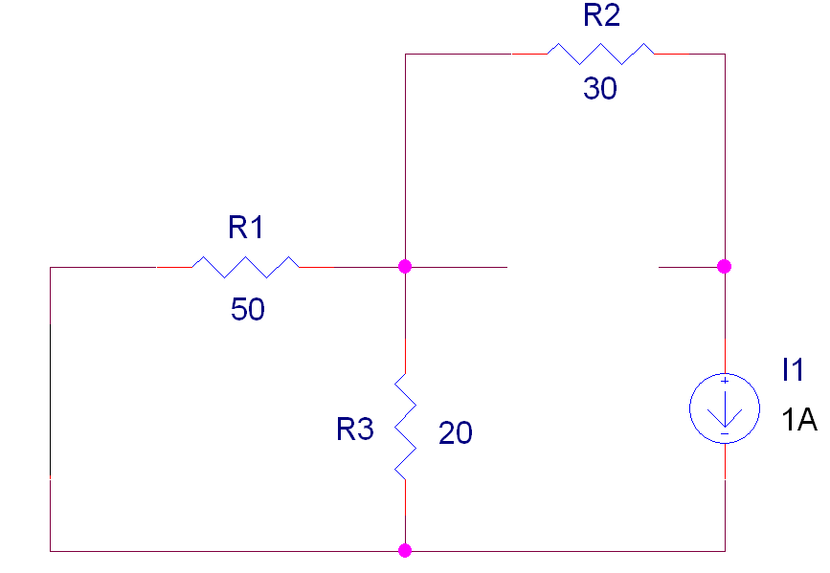
Example #1 (con’t)
Replace V_{S} with a Short Circuit and Is2 with an Open Circuit
Redraw circuit.
IS1

Slide 56
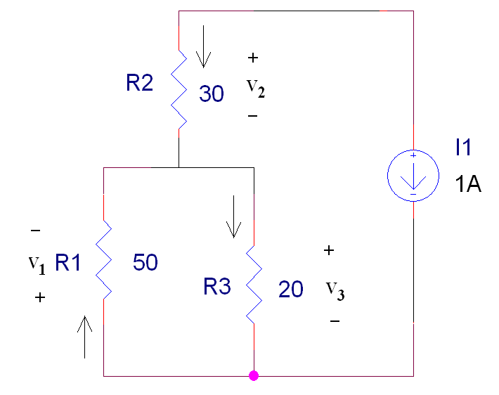
Example #1 (con’t)
Note: The polarity of the voltage and the direction of the current through R1 has to follow what was used in the first solution.
IS1

Slide 57

Example #1 (con’t)
IS1

Slide 58

Example #1 (con’t)
IS1

Slide 59

Example #1 (con’t)
Replace V_{S} with a Short Circuit and Is1 with an Open Circuit
IS2

Slide 60

Example #1 (con’t)
R2 and I2 are not in parallel with R1 and R3.
IS2
Since V1 = -V3, but I1 must equal I3, the only valid solution is when I1 = I3 = 0A.

Slide 61

Example #1 (con’t)
IS2

Slide 62
Example #1
Currents and voltages in original circuit with all sources turned on.
 | Vs on | Is1 on | Is2 on | Total
I₁ | +42.9mA | +0.286A | 0A | +0.329A
I₂ | 0 | -1A | 2A | +1A
I₃ | +42.9mA | -0.714A | 0A | -0.671A
V₁ | +2.14V | +14.3V | 0V | 16.4V
V₂ | 0V | -30V | + 60V | +30.0V
V₃ | 0.857V | -14.3V | 0V | -13.4V

Slide 63

LTspice Simulation

Slide 64
Summary
Superposition can be used to reduce the complexity of a circuit so that the voltages and currents in the circuit can be determined easily.
To turn off a voltage source, replace it with a short circuit.
To turn off a current source, replace it with an open circuit.
Polarity of voltage across components and direction of currents through the components must be the same during each iteration through the circuit.
The total of the currents and voltages from each iteration is the solution when all power sources are active in the circuit.

Slide 65
Maximum Power Transfer
For any power source, the maximum power transferred from the power source to the load is when the resistance of the load R_{L} is equal to the equivalent or input resistance of the power source (R_{in} = R_{Th} or R_{N}).
The process used to make R_{L} = R_{in} is called impedance matching.

Slide 66



Power Transfer Calculation
R_{Th} 50Ω
V_{Th}
1V

Slide 67
Application
When developing new circuits for a known application, optimize the power transfer by designing the circuit to have an input resistance close to the load resistance.
When selecting a source to power a circuit, one of the selection criteria is to match the input impedance to the load resistance.

Slide 68
Other Examples
Selection of wire –
Antenna wire is designed to match a 75 Ω load.
Coaxial cable is designed to act like a 50 Ω load.
Most electronic and electrical equipment are designed to have an R_{Th} of 50 Ω.
The speakers used in some of the ECE labs are designed to act like an an 8 Ω load while microphones are designed to act like a 600 Ω load.
It is important that the resistance of the wire that runs to the speaker is very low or the power will be dissipated in the wire rather than used to create sound.
For best audio quality, the input impedance of the circuit connected to the speaker (or the microphone) should be equal to the resistance of the speaker (or the microphone).

Slide 69
Summary
Maximum power transfer theorem is used frequently to insure that the greatest power can be transferred from a power source to a load.

