Slide 1
Next-Day Air Quality Index (AQI) Prediction for Indian Cities
Using Machine Learning: A KDD-Based Approach
Your Name
KDD Mini Project

Slide 2
Problem Statement & Objectives
Introduction
• Air pollution in Indian cities harms public health; timely forecasts enable advisories and restrictions
• Goal: use a city's current and recent pollutant readings to predict tomorrow's AQI
• Regression: next-day AQI value | Classification: next-day AQI category (6 CPCB classes)
• Apply every KDD stage to real, messy data and compare baseline vs advanced models
• Identify which pollutants and features drive the forecast
Your Name | Next-Day AQI Prediction
SAMPLE DATA - NOT REAL RESULTS
2

Slide 3
KDD Process Followed
Methodology
Data Selection
EDA
Pre- processing
Feature Engineering
Chrono. Split
Modelling
Evaluation
SHAP
Models: Persistence, Linear, Ridge, Random Forest, XGBoost (regression) and Logistic, Random Forest, XGBoost (classification)
Your Name | Next-Day AQI Prediction
SAMPLE DATA - NOT REAL RESULTS
3

Slide 4
Data Selection
KDD 1
12,054
6
2015–2020
1,209
daily city records
Indian cities
date coverage
rows with AQI missing
• Source: Kaggle – Air Quality Data in India (city_day.csv, CPCB stations)
• Features: PM2.5, PM10, NO, NO2, NOx, NH3, CO, SO2, O3, Benzene, Toluene, Xylene
• Targets: next-day AQI (regression) and next-day AQI bucket (classification)
• Rows without an observed AQI cannot serve as target and are excluded as such
Your Name | Next-Day AQI Prediction
SAMPLE DATA - NOT REAL RESULTS
4

Slide 5
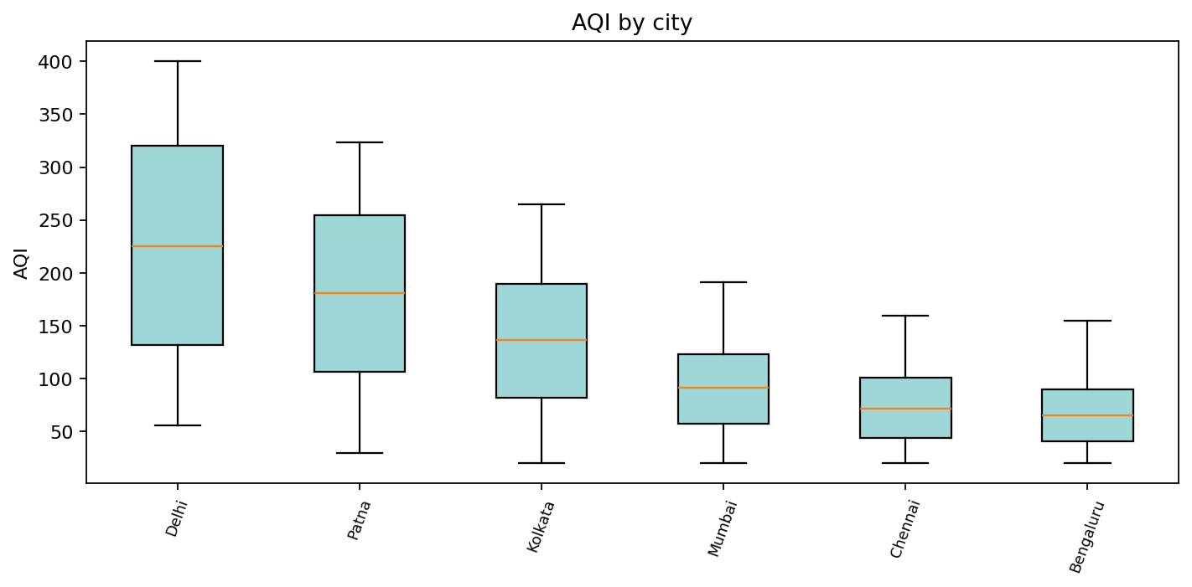
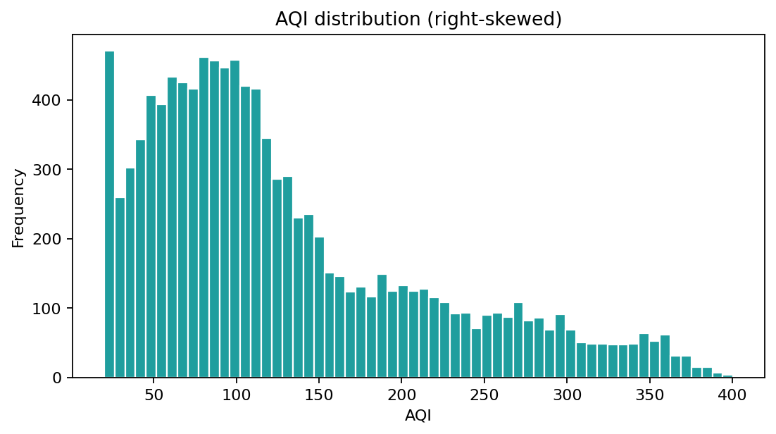
EDA: Distribution & City Differences
KDD 2
AQI is right-skewed with a long tail of severe days; most polluted cities by median AQI: Delhi, Patna, Kolkata.
Your Name | Next-Day AQI Prediction
SAMPLE DATA - NOT REAL RESULTS
5

Slide 6
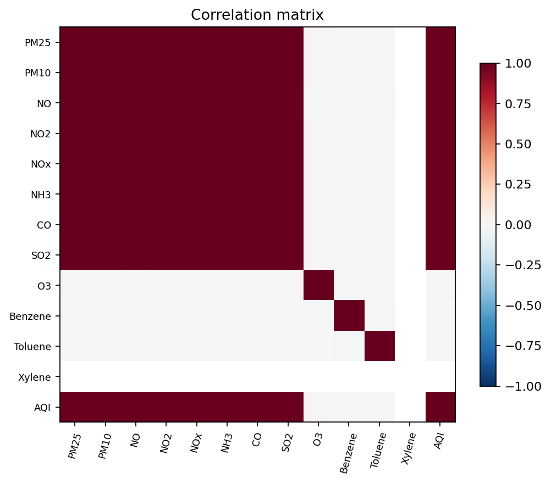
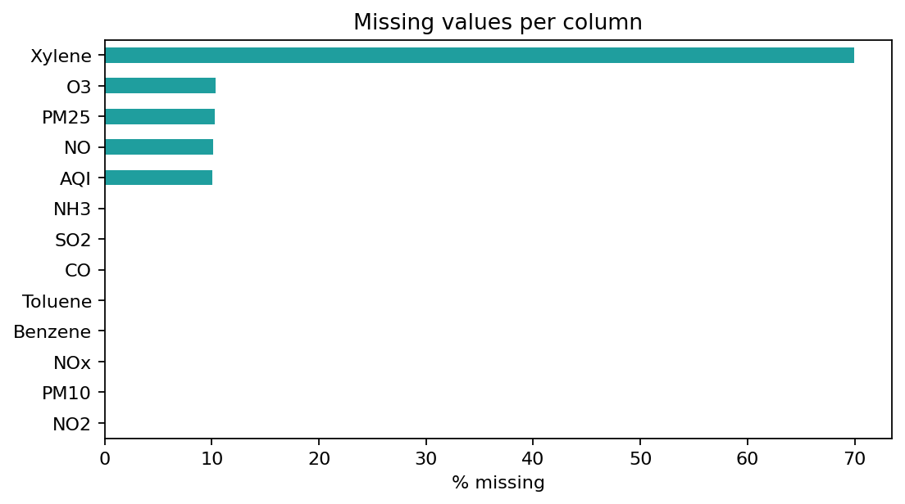
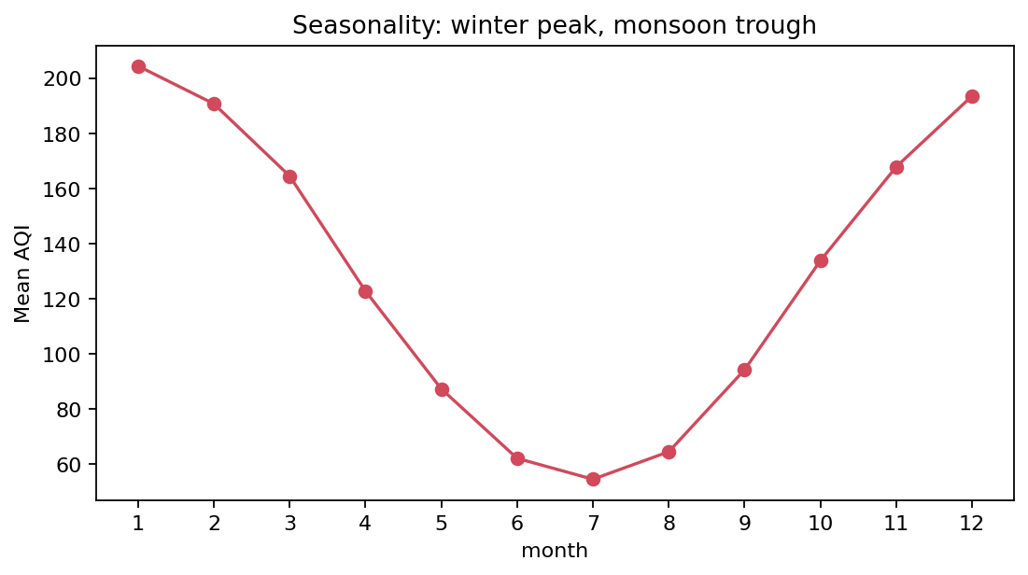
EDA: Missing Data, Seasonality & Correlation
KDD 2
• Several pollutant columns have substantial gaps → imputation / column dropping needed
• Clear seasonal pattern: pollution rises in winter, falls in the monsoon
• Strongest correlates of AQI: PM25 (0.99), NO2 (0.99), PM10 (0.99)
Your Name | Next-Day AQI Prediction
SAMPLE DATA - NOT REAL RESULTS
6

Slide 7
Preprocessing
KDD 3
• Columns with > 50% missing dropped: Xylene
• Each city reindexed to a full daily calendar so 'previous / next day' is exact
• Gaps filled by forward-fill (max 3 days) – causal, never uses future values
• Remaining gaps imputed with TRAIN-set medians only (no leakage)
• Extreme outliers capped at the train 99.5th percentile
• Rows lacking an observed next-day AQI removed from modelling
Your Name | Next-Day AQI Prediction
SAMPLE DATA - NOT REAL RESULTS
7

Slide 8
Feature Engineering
KDD 4
• Lags (1, 2, 3, 7 days) of AQI, PM2.5, PM10
• Rolling mean (3 and 7 days) of AQI and PM2.5; rolling std and day-to-day change of AQI
• Calendar: month, day of week, sin/cos of day-of-year, winter flag
• City one-hot encoding to capture local baselines
• Total: 41 features on 10,802 modelling rows
• Target = AQI of the next day; category from CPCB bins (0–50, 51–100, 101–200, 201–300, 301–400, 400+)
Your Name | Next-Day AQI Prediction
SAMPLE DATA - NOT REAL RESULTS
8

Slide 9
Chronological Train / Validation / Test Split
KDD 5
Set | From | To | Rows
Train | 2015-01-08 | 2018-11-07 | 7,559
Val | 2018-11-08 | 2019-09-03 | 1,616
Test | 2019-09-04 | 2020-06-30 | 1,627
• Split by date, never shuffled: the model only ever predicts the future
• Validation set used for XGBoost early stopping
• Test set touched once for final reporting
• The test window may include the 2020 COVID-19 lockdown, a distribution shift
Your Name | Next-Day AQI Prediction
SAMPLE DATA - NOT REAL RESULTS
9

Slide 10
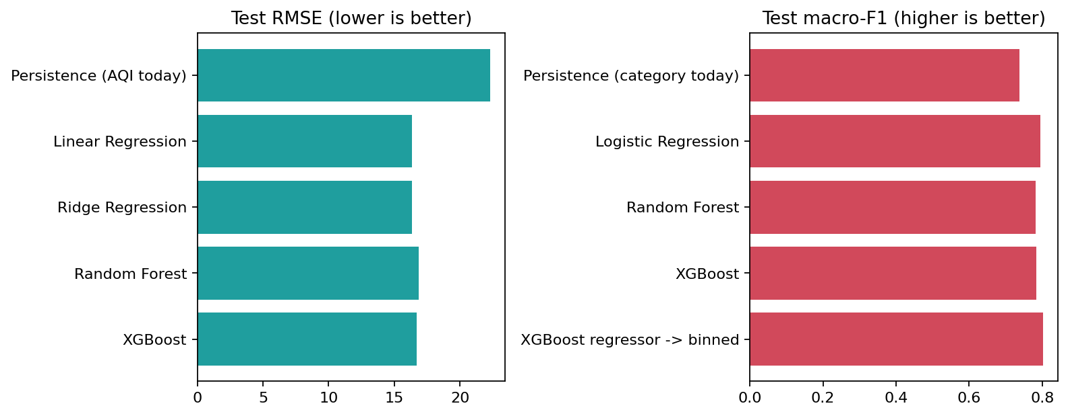
Regression Results (Test Set)
Evaluation
Model | MAE | RMSE | R²
Persistence (AQI today) | 17.77 | 22.31 | 0.934
Linear Regression | 13.16 | 16.34 | 0.964
Ridge Regression | 13.15 | 16.33 | 0.964
Random Forest | 13.53 | 16.86 | 0.962
XGBoost | 13.42 | 16.71 | 0.963
Ridge Regression
best model by test RMSE
26.8%
RMSE reduction vs persistence baseline
Your Name | Next-Day AQI Prediction
SAMPLE DATA - NOT REAL RESULTS
10

Slide 11
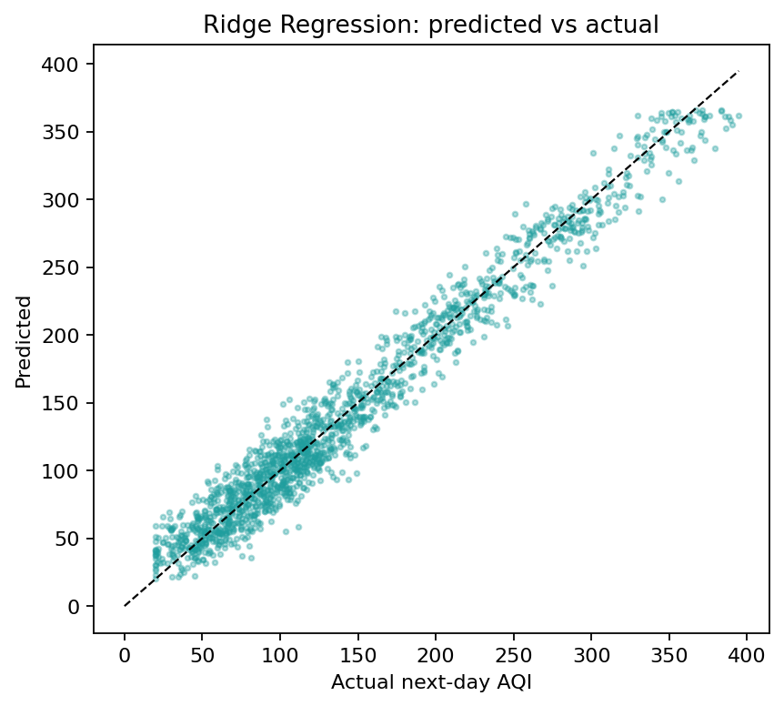
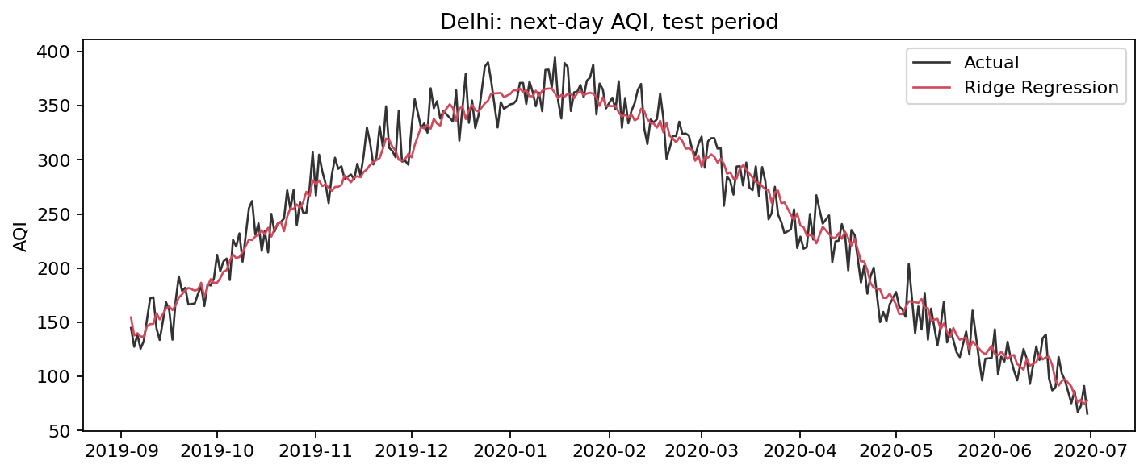
Predicted vs Actual Next-Day AQI
Evaluation
Ridge Regression: MAE 13.2, RMSE 16.3, R² 0.96. See the scatter (closer to the diagonal is better) and the test-period time series.
Your Name | Next-Day AQI Prediction
SAMPLE DATA - NOT REAL RESULTS
11

Slide 12
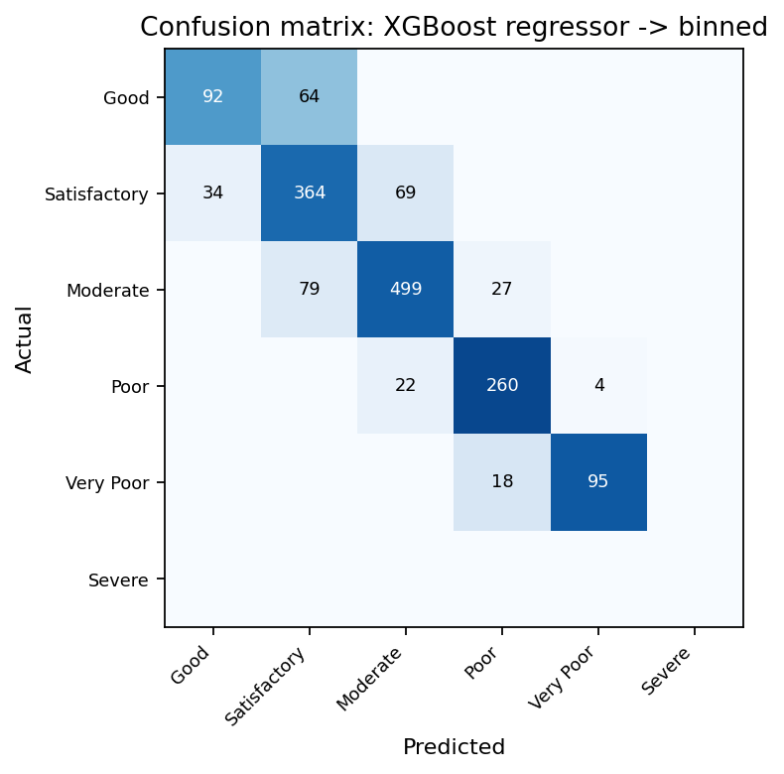
AQI Category Classification (Test Set)
Evaluation
Model | Accuracy | F1 macro | F1 weighted
Persistence (category today) | 0.730 | 0.738 | 0.730
Logistic Regression | 0.793 | 0.796 | 0.793
Random Forest | 0.784 | 0.783 | 0.783
XGBoost | 0.786 | 0.784 | 0.786
XGBoost regressor -> binned | 0.805 | 0.802 | 0.805
Best by macro-F1: XGBoost regressor -> binned. Macro-F1 is used because classes are imbalanced; read the confusion matrix for which categories get confused.
Your Name | Next-Day AQI Prediction
SAMPLE DATA - NOT REAL RESULTS
12

Slide 13
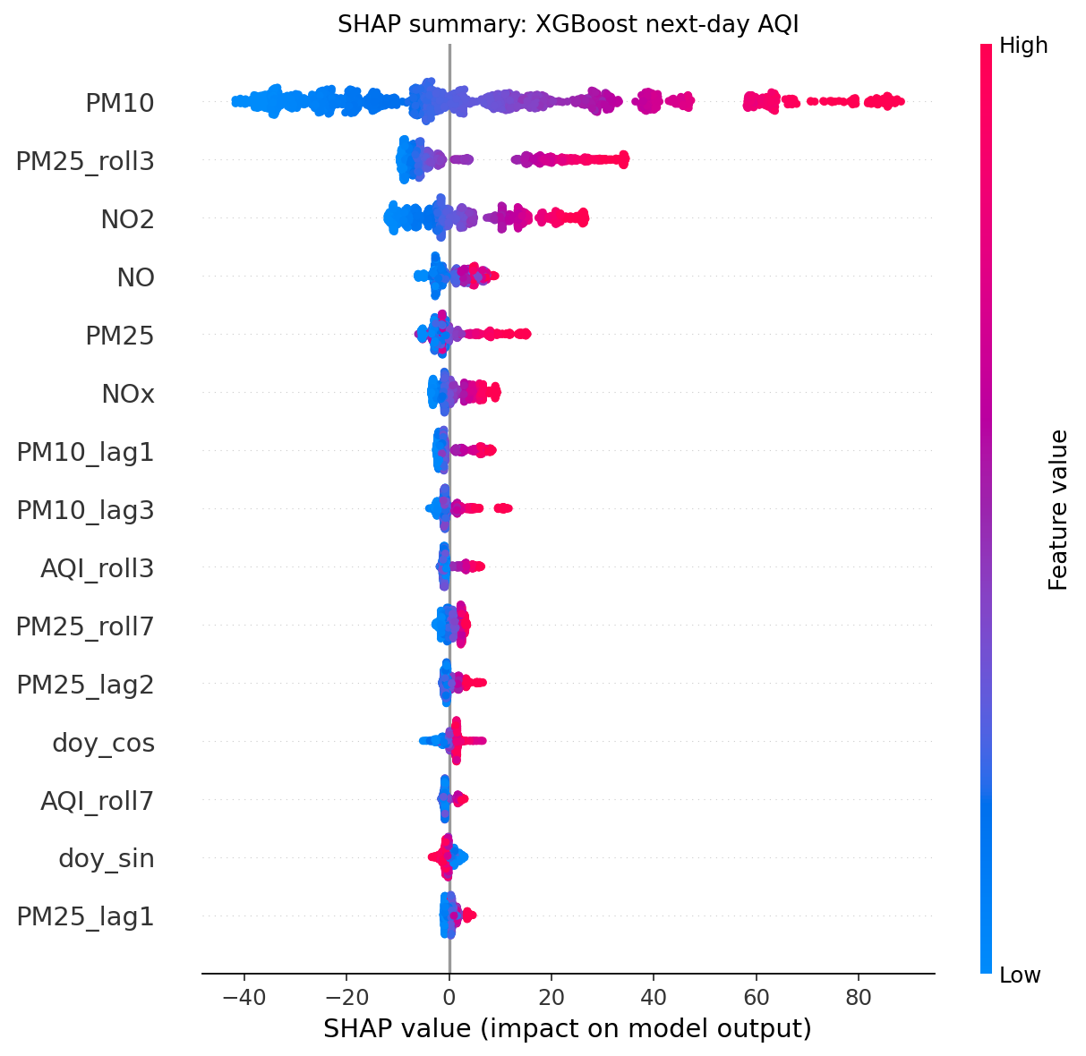
Interpretation: What Drives the Forecast (SHAP)
Interpretation
• Top drivers: PM10, PM25_roll3, NO2, NO, PM25
• Pollutant readings outrank AQI history in importance
• Particulate features (PM2.5, PM10) and rolling means: present in the top 10
• Check calendar / city features in the SHAP plot for seasonal and local effects
Your Name | Next-Day AQI Prediction
SAMPLE DATA - NOT REAL RESULTS
13

Slide 14
Key Findings & Limitations
Discussion
• Ridge Regression gave the best regression result (RMSE 16.3, R² 0.96), 26.8% better than simply repeating today's AQI
• Best classifier: XGBoost regressor -> binned (macro-F1 0.80)
• Most influential features (SHAP): PM10, PM25_roll3, NO2
• Limitations: no meteorological data (wind, temperature, humidity), many missing readings, uneven station coverage, COVID-19 shift in the test window
• Rare 'Severe' days are hard to predict because of class imbalance
Your Name | Next-Day AQI Prediction
SAMPLE DATA - NOT REAL RESULTS
14

Slide 15
Conclusion & Future Work
Wrap-up
• A complete KDD pipeline turned messy CPCB data into a working next-day AQI forecaster
• Ridge Regression performed best; the linear baselines remain strong because next-day AQI is highly autocorrelated
• Chronological splitting and train-only preprocessing give an honest estimate of future performance
• Future work: add weather and fire-count data, LSTM / temporal models, multi-day horizons, per-city models, and a live health-advisory dashboard
Your Name | Next-Day AQI Prediction
SAMPLE DATA - NOT REAL RESULTS
15

Slide 16
Thank you
Your Name
Questions?

