Slide 1
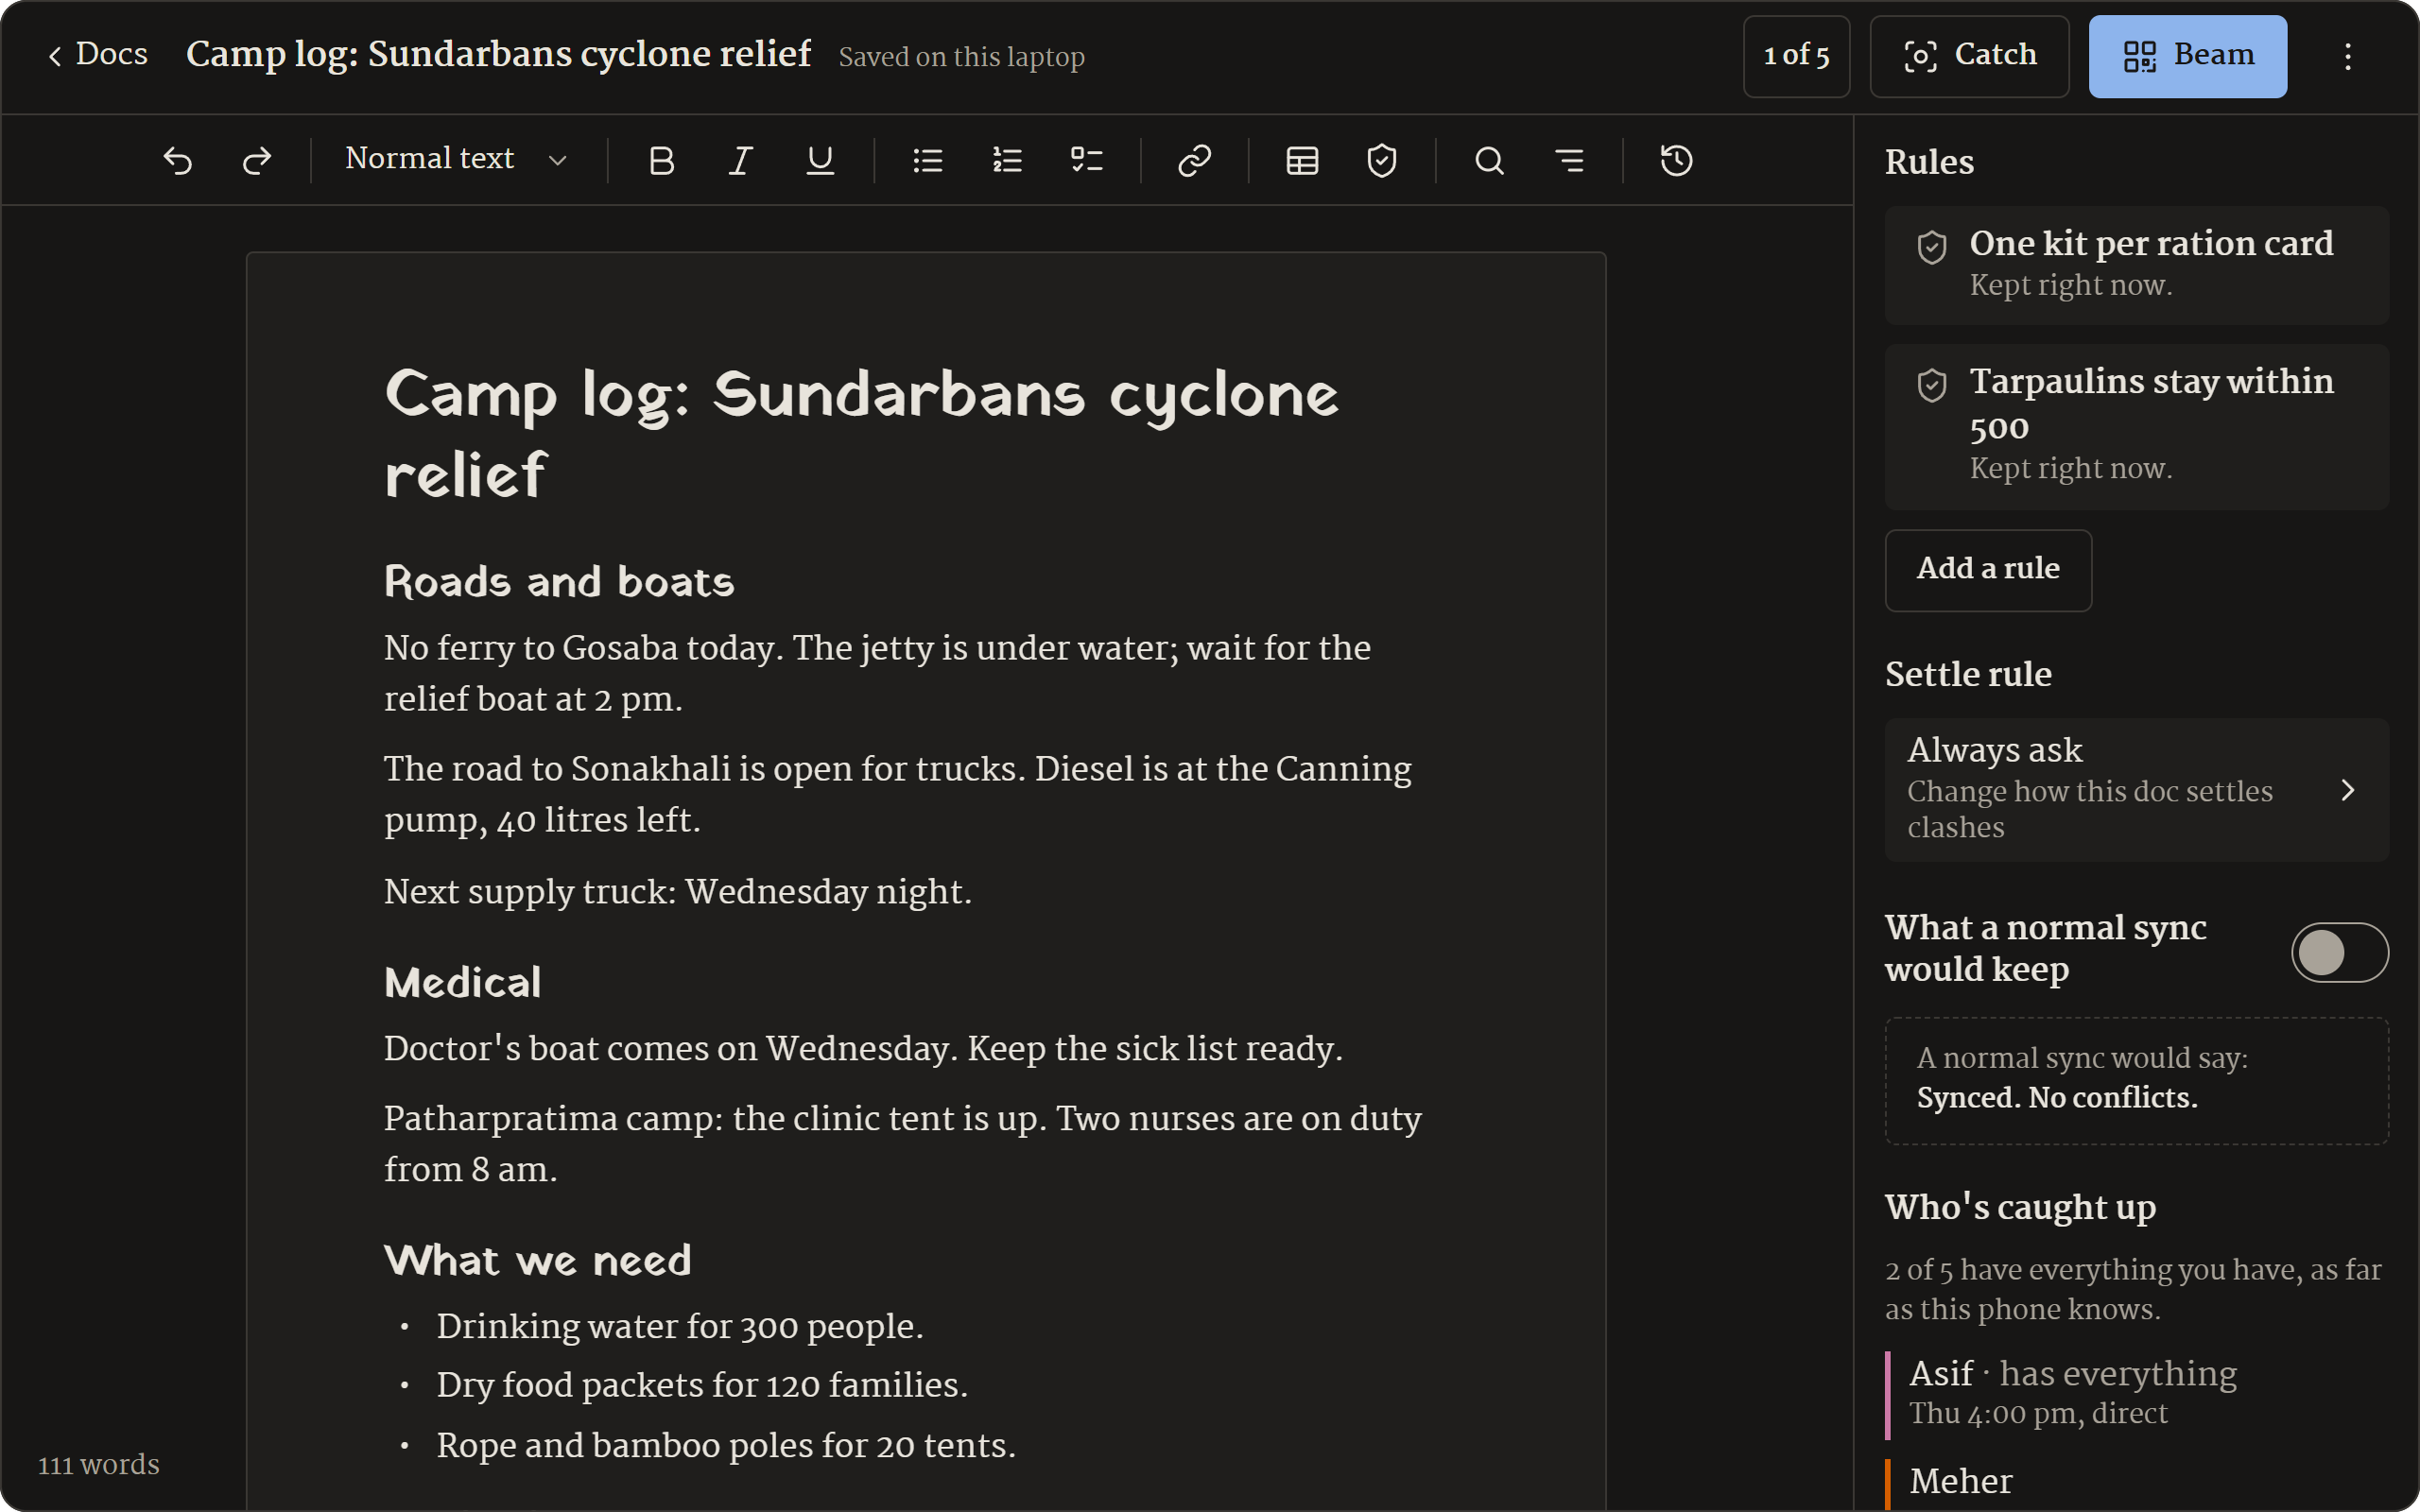
Phir Milenge
A doc editor for places with no signal.
“We’ll meet again.” It’s painted on the backs of Indian trucks.
BIOS 2026 · FRONTIER track · Problem 09
Notes:
Up while we set up. Nothing to say on this slide; the pitch starts on the next one.
In the 5-minute demo: slides 2 and 3 are the opening (0:00 to 0:50). Then switch to the browser (Base camp) for the live demo. Come back to slide 7 at 4:25 for the close, while the 1,000-order test runs.
Slides 4, 5 and 6 are for the 2-minute pitch on its own, or the video. In the live demo the phones show them for real.

Slide 2
Relief happens where the signal isn’t
9,226 people
About 10,000
were paid house grants twice after Cyclone Amphan: 18 crore rupees. Every camp’s list was fine on its own.
Indian villages have no mobile signal at all.
Sources: The Federal, on the government auditors’ report on Amphan relief · Free Press Journal, on mobile coverage
Notes:
[0:00] The pain
After Cyclone Amphan hit the Sundarbans, government auditors found house grants paid twice to 9,226 people: 18 crore rupees. Every camp’s list was fine on its own. The mistake only appeared once the lists were put together.
Relief happens where the signal isn’t. About 10,000 Indian villages have no mobile signal at all. After the Wayanad landslide, the missing-persons list was updated every day in Google Sheets, which needs the internet.
In the 5-minute demo, say instead: Everything on this stage is in airplane mode. (Show it.)

Slide 3
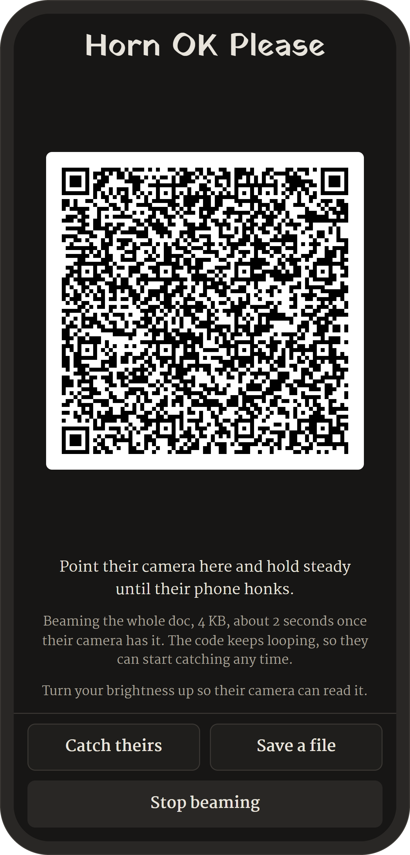
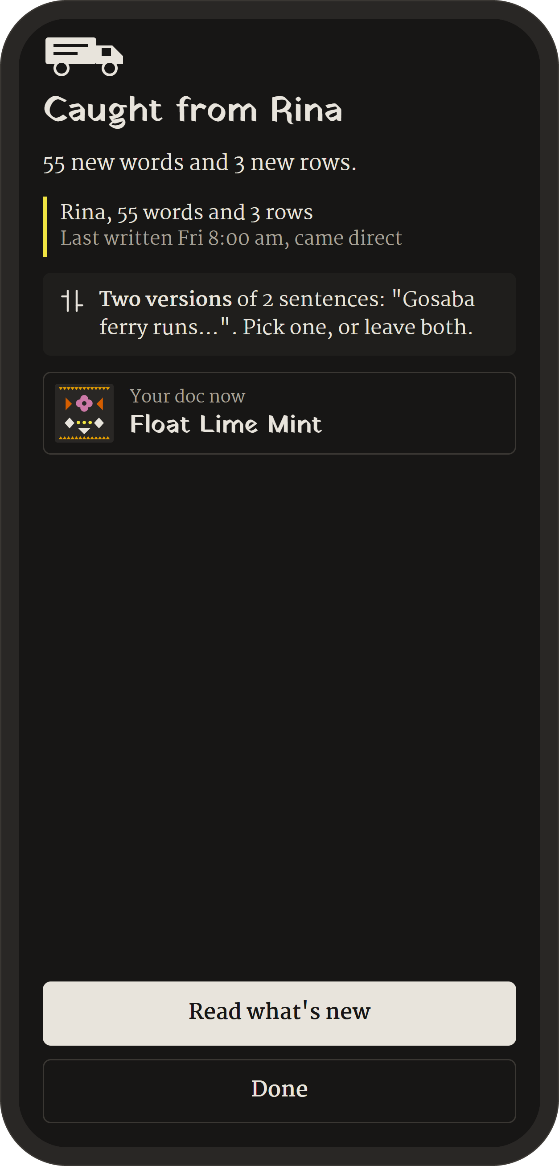
Phones swap the doc when they meet
One phone shows a moving code. The other’s camera catches it.
No internet, no Wi-Fi, no Bluetooth. A file on a pen drive works too.
Beam
Catch
Notes:
[0:30] What we built
So we built Phir Milenge. It means ‘we’ll meet again’, and it’s painted on the backs of Indian trucks. It’s a document editor that runs in any phone’s browser. Every phone carries the whole log. When two phones meet, one shows a moving code and the other’s camera catches it: no internet, no Wi-Fi, no Bluetooth.
In the 5-minute demo: switch to the browser (Base camp) now for the live demo.

Slide 4

Meet in any order. End on the same doc.
Rina
Asif
Tanmoy
Tanmoy
Rina
Asif
Asif
Tanmoy
Rina
Bird Autumn Bamboo
Same truck back on every phone means the same doc.
Three camps, three orders
Notes:
They can meet in any order, and everyone ends up with the same document. This picture, the truck back, is made from what the log says, so you can see it’s the same.
(These are the real truck back words for the demo doc once Rina’s, Asif’s and Tanmoy’s weeks are all in.)

Slide 5
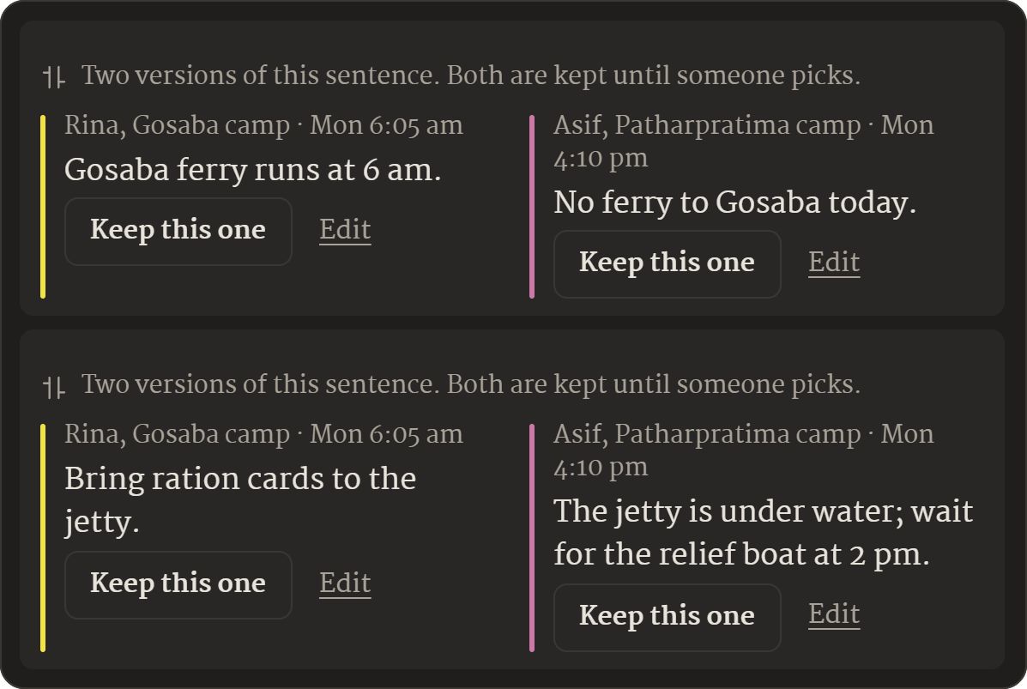
Both versions are kept
Rina and Asif changed the same sentence without seeing each other’s change.
A normal sync keeps whichever arrived last, and families walk to a flooded jetty.
Notes:
[1:00] What’s new
Three things we couldn’t find in any document editor. One: when two people rewrite the same sentence apart, both versions are kept, the same on every phone.

Slide 6
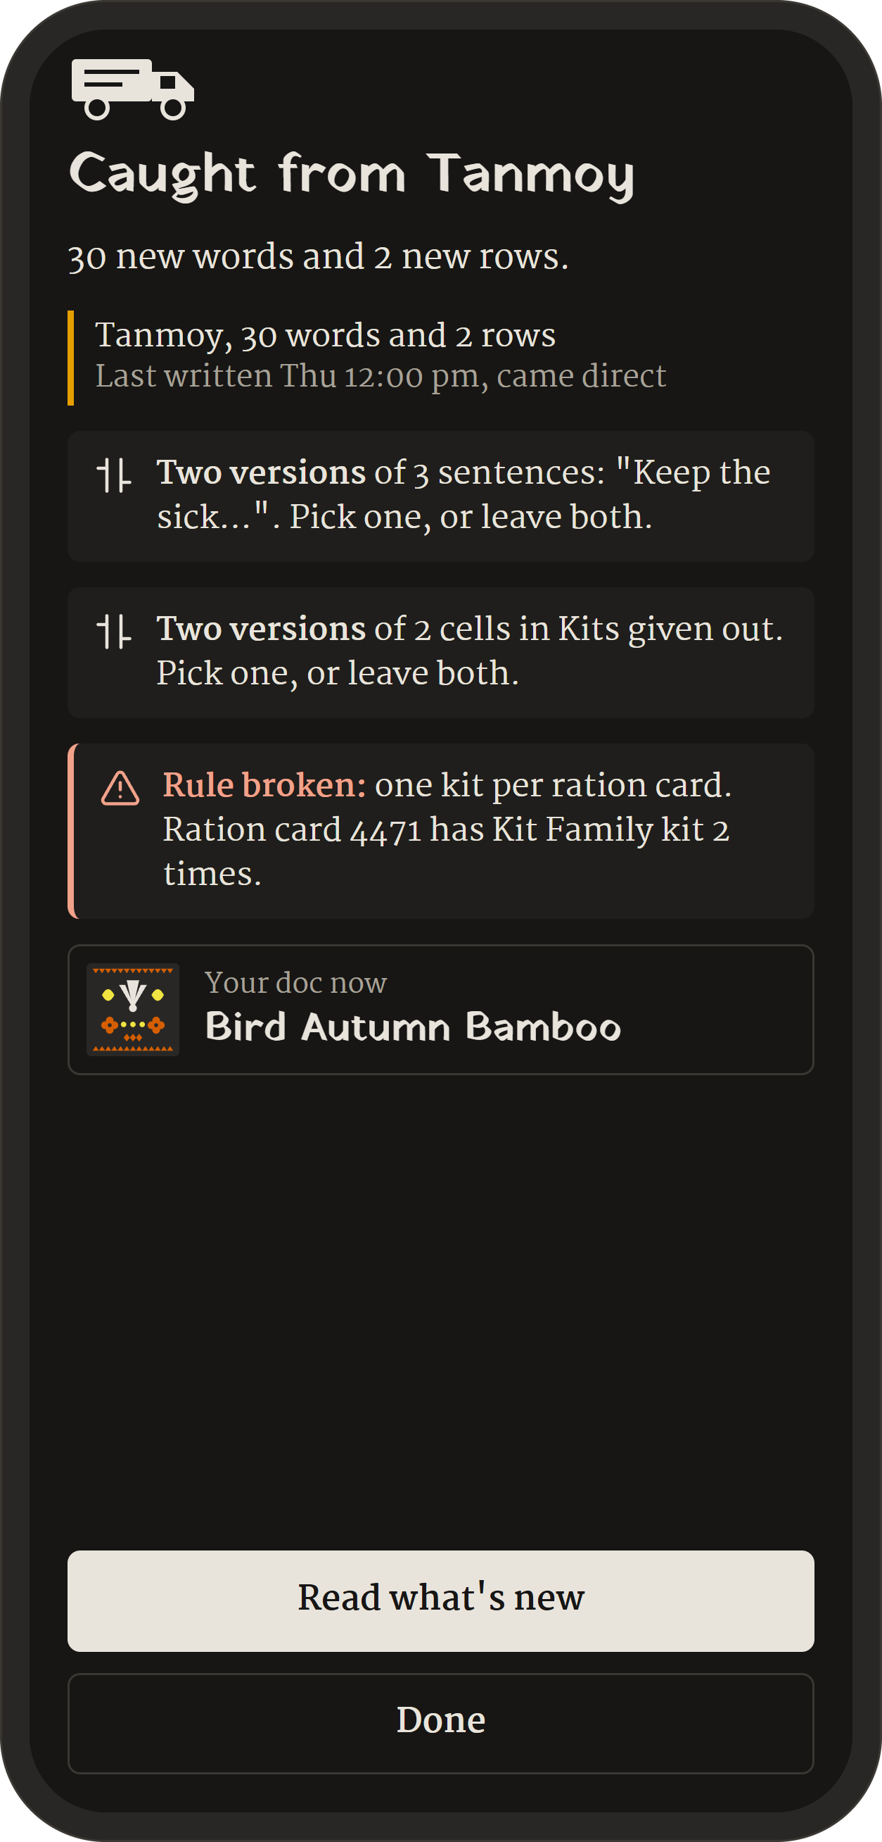
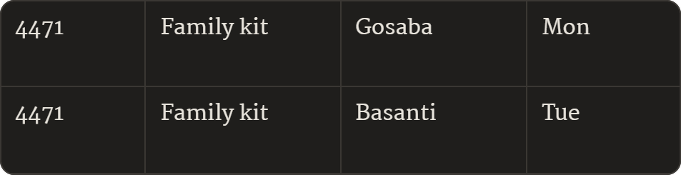
The Amphan mistake, caught
Rules written inside the doc, like one kit per ration card, are checked the same way on every phone, whatever order they synced in.
Ration card 4471: a kit at Gosaba on Monday, another at Basanti on Tuesday.
Notes:
Two: rules written inside the doc, like ‘one kit per ration card’, checked the same way on every phone, whatever order they synced in. That’s the Amphan mistake, caught.
Three: under every paragraph, which phones already have it. Blue ticks, with no network.

Slide 7
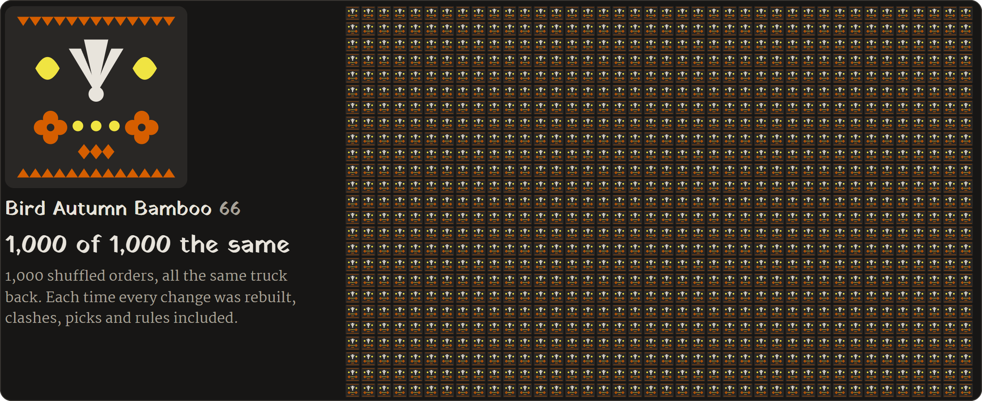
Shuffled a thousand times. Same doc.
And a 20,000-change doc opens in about 0.2 seconds on this laptop.
Notes:
[1:30] The proof
You picked the order. A normal sync would have sent families to a flooded jetty. One tap settled every clash, and nothing was thrown away. Every screen shows the same truck back, and a thousand shuffled orders all came out the same.
If asked: anyone can run it from the command line with npm run selftest. The 0.2 seconds is measured on the laptop, not on a phone.

Slide 8
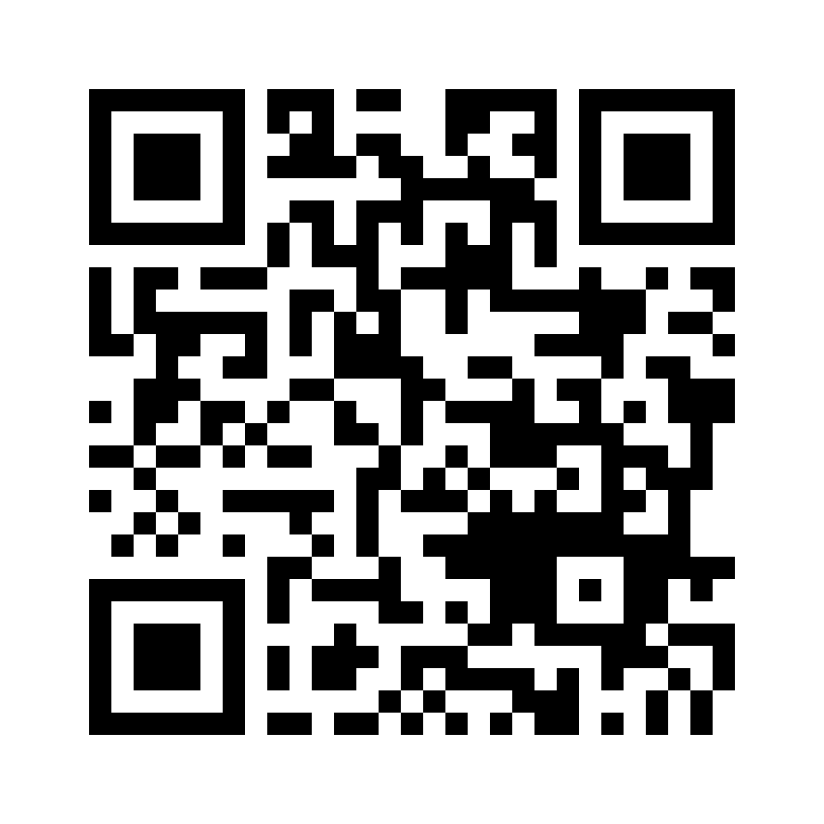
We’re starting with relief camps
Phir milenge.
The team
ranvir7123.github.io/phir-milenge
Open it once with internet.
After that it works offline.
Notes:
[1:45] Honest about what exists
Every piece exists somewhere: animated codes in Bitcoin wallets, carry-it-forward sync in Briar, replay in Etherpad, kept conflicts in Pijul, fingerprints in Signal, rule-keeping in database research. We couldn’t find anyone who has put them together into a phone document editor that works with no signal at all.
[1:55] Next
Ditto raised 82 million dollars in 2025 to sell offline sync to airlines. We’re starting with relief camps. Phir milenge.

