Slide 1
ARCANE — Regional Beta Calibration
ESBL Transmission Rate by Region and Facility Type MESuRS/Cnam

Slide 2
Overview

Slide 3
Study context
Goal: Estimate β — the daily within-hospital ESBL transmission rate — per facility type
Model: Stochastic SIS on the PMSI inter-hospital transfer network
Target: SPARES ESBL incidence by facility type × region
Regions calibrated: 12 French administrative regions
Runs per region: 10 independent Nelder-Mead optimisations (best selected)
Facility types: Cancer centre (CLCC), General public hospital, Private for profit hospital, Private not-for-profit hospital, Rehabilitation hospital, University hospital
Goal: Estimate β — the daily within-hospital ESBL transmission rate — per facility type
Model: Stochastic SIS on the PMSI inter-hospital transfer network
Target: SPARES ESBL incidence by facility type × region
Regions calibrated: 12 French administrative regions
Runs per region: 10 independent Nelder-Mead optimisations (best selected)
Facility types: Cancer centre (CLCC), General public hospital, Private for profit hospital, Private not-for-profit hospital, Rehabilitation hospital, University hospital

Slide 4
Cross-regional comparison

Slide 5
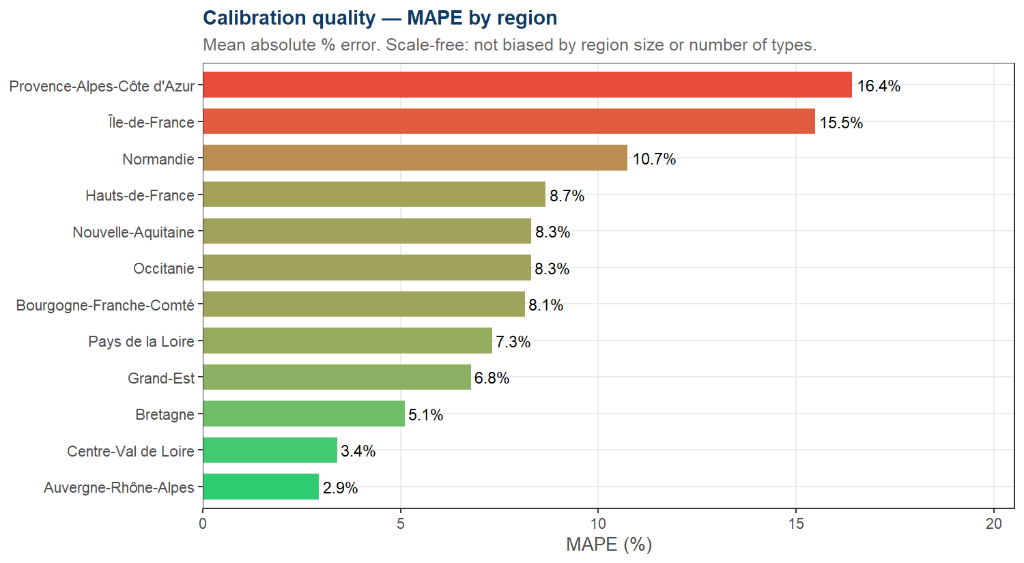
Calibration quality by region (MAPE)

Slide 6
Beta heatmap — type × region

Slide 7
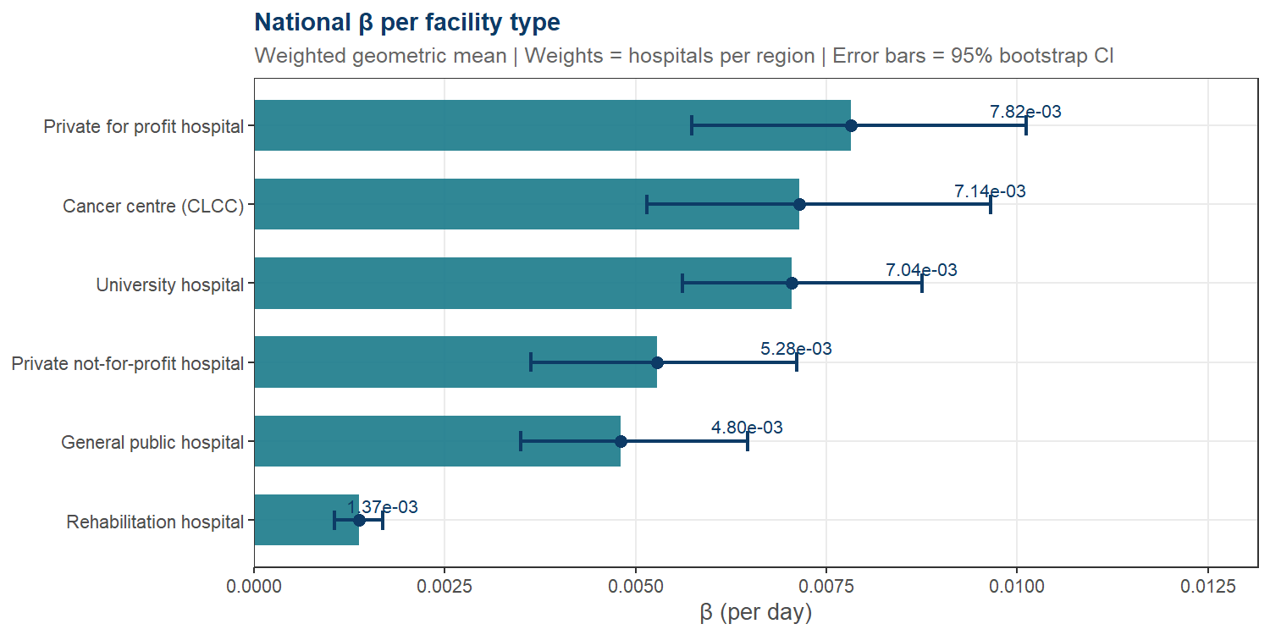
National beta — weighted geometric mean

Slide 8
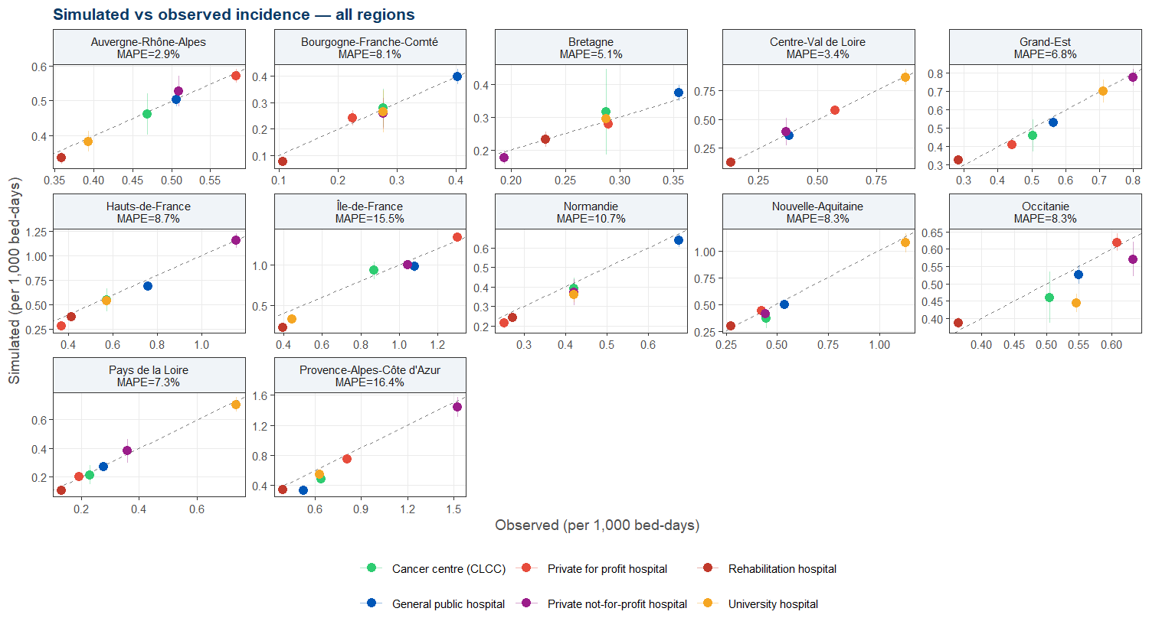
Observed vs simulated — all regions

Slide 9
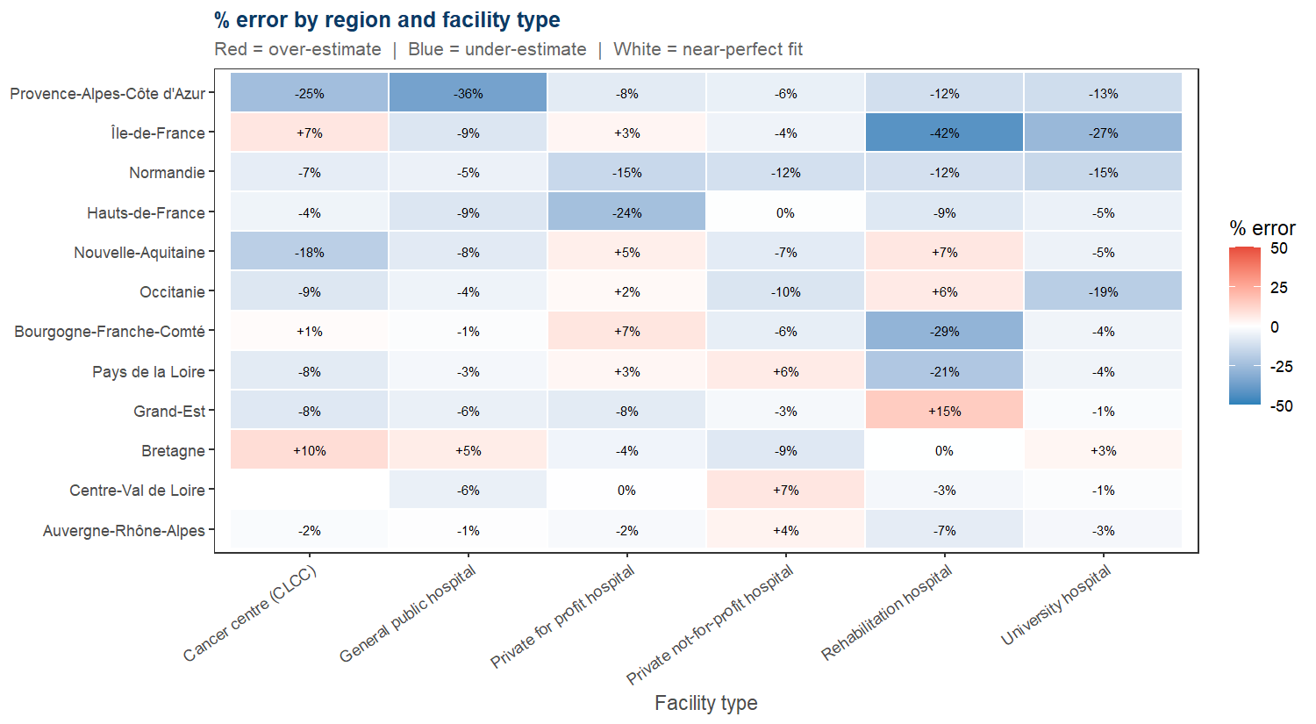
Percentage error — type × region

Slide 10
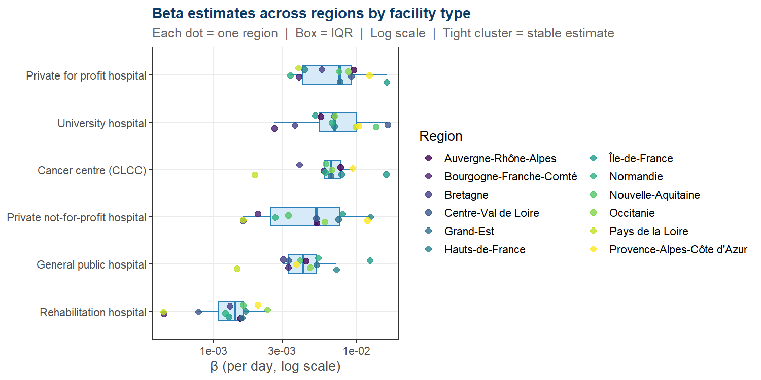
Beta variability across regions

Slide 11
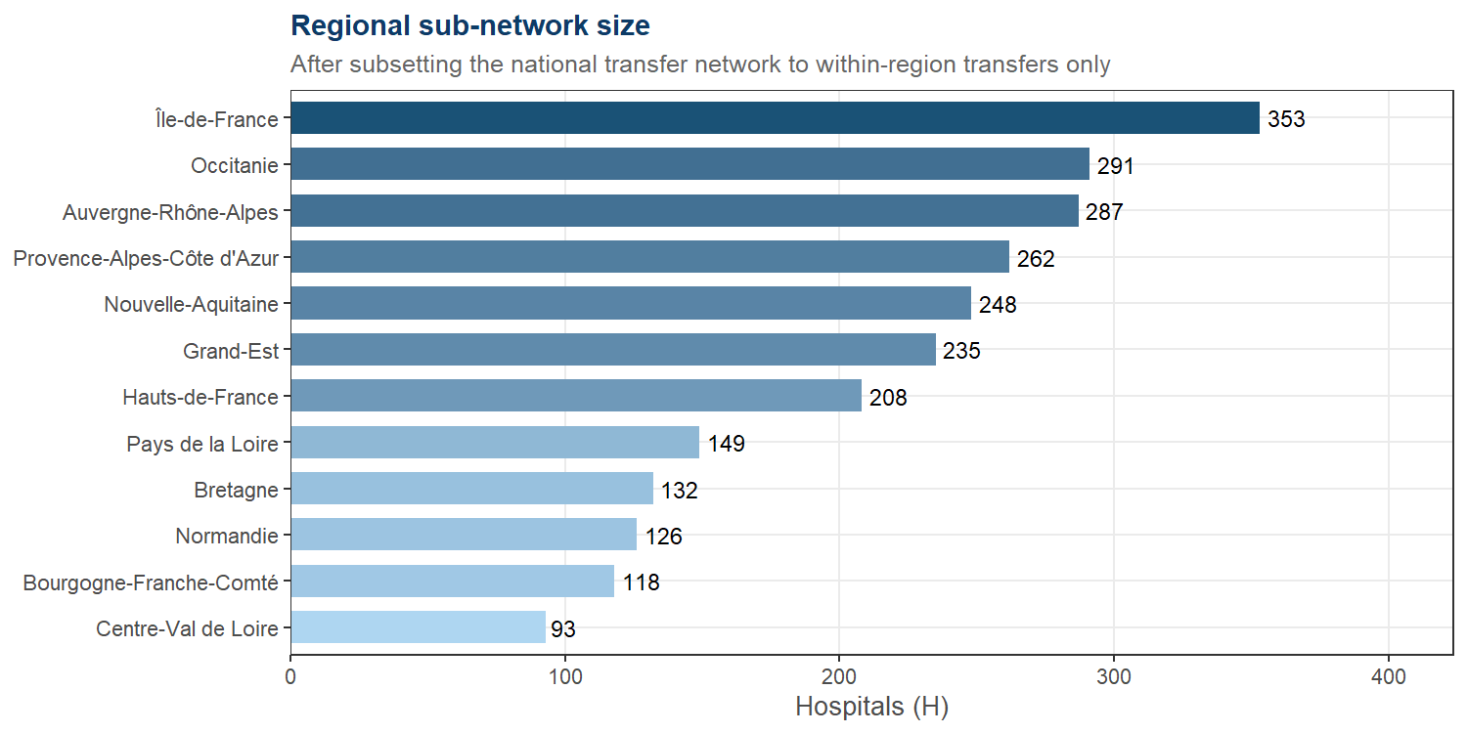
Hospitals per region

Slide 12
Fit metrics summary table
Region | Hospitals | Types | MAPE (%) | R² | SSE/type
Auvergne-Rhône-Alpes | 287 | 6 | 2.94 | 0.981 | 0.0002
Centre-Val de Loire | 93 | 5 | 3.40 | 0.996 | 0.0003
Bretagne | 132 | 6 | 5.10 | 0.964 | 0.0003
Grand-Est | 235 | 6 | 6.78 | 0.976 | 0.0010
Pays de la Loire | 149 | 6 | 7.32 | 0.992 | 0.0004
Bourgogne-Franche-Comté | 118 | 6 | 8.14 | 0.978 | 0.0003
Occitanie | 291 | 6 | 8.30 | 0.763 | 0.0029
Nouvelle-Aquitaine | 248 | 6 | 8.31 | 0.984 | 0.0022
Hauts-de-France | 208 | 6 | 8.67 | 0.993 | 0.0026
Normandie | 126 | 6 | 10.74 | 0.993 | 0.0018
Île-de-France | 353 | 6 | 15.48 | 0.976 | 0.0100
Provence-Alpes-Côte d’Azur | 262 | 6 | 16.42 | 0.982 | 0.0134
Sorted by MAPE (best at top). MAPE and R² are scale-free.

Slide 13
Individual Region Reports

Slide 14
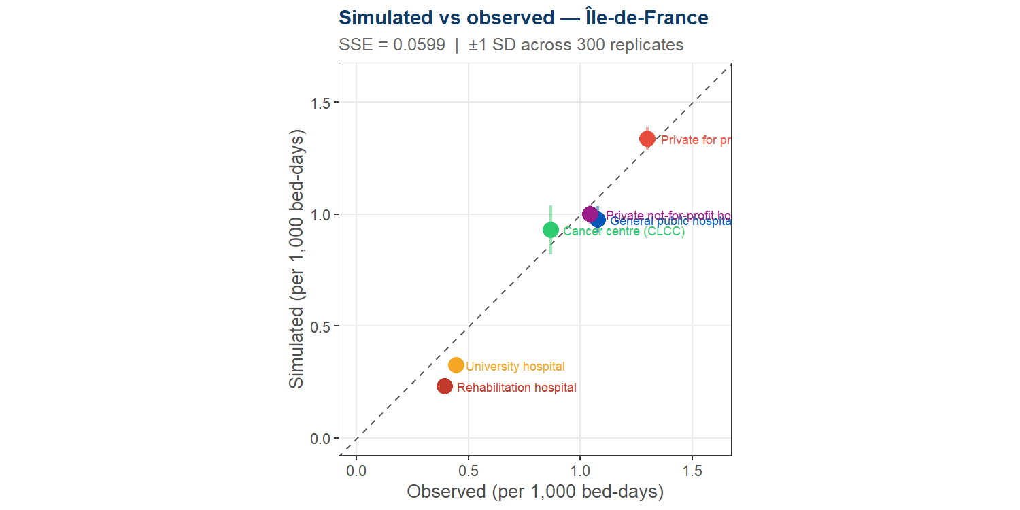
Île-de-France
H = 353 hospitals | MAPE = 15.5% | R² = 0.976 | SSE = 0.05990

Slide 15
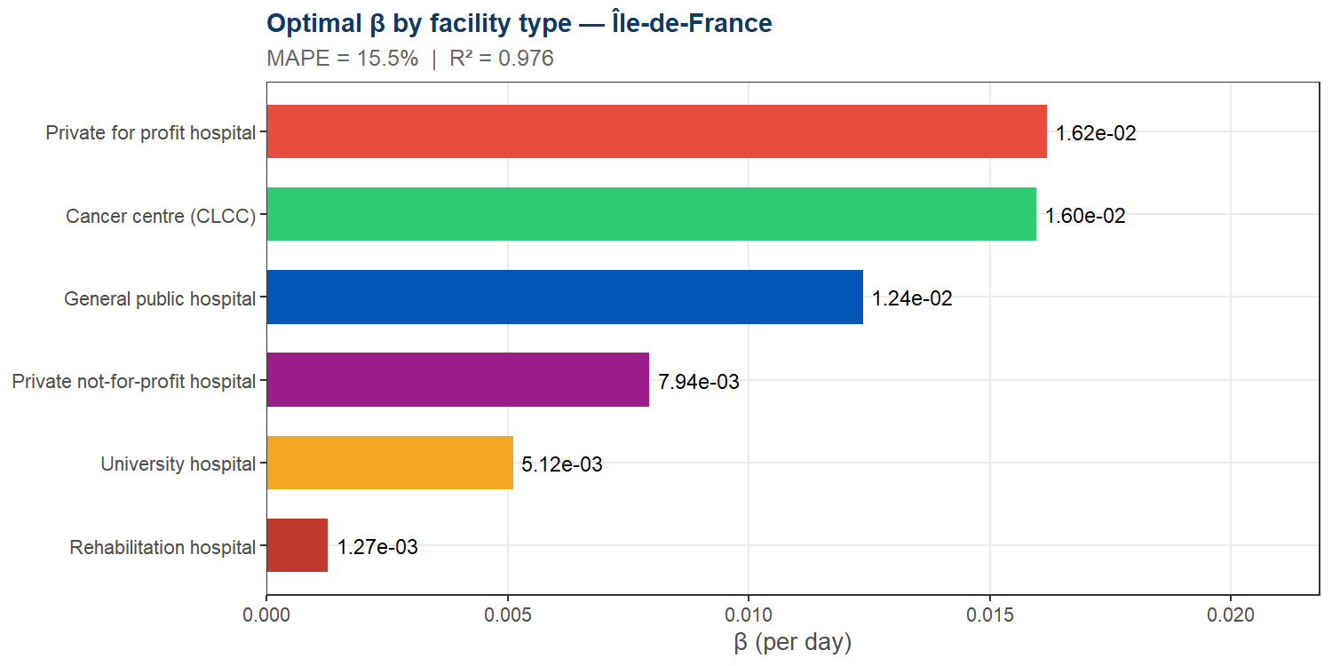
Île-de-France — Beta estimates

Slide 16
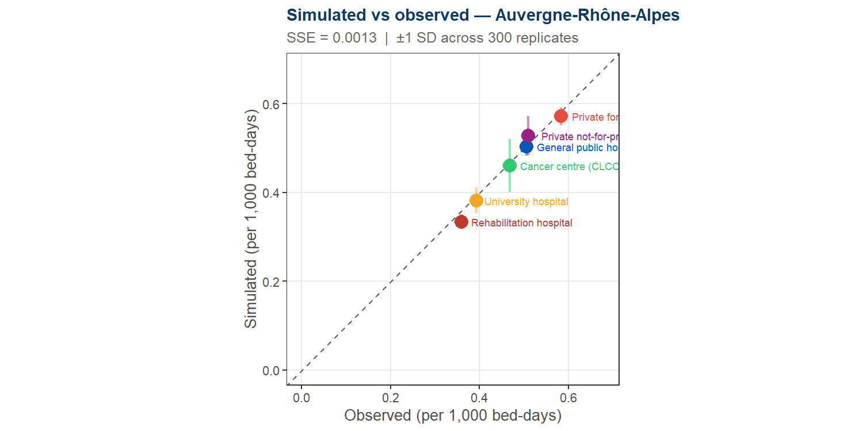
Auvergne-Rhône-Alpes
H = 287 hospitals | MAPE = 2.9% | R² = 0.981 | SSE = 0.00128

Slide 17
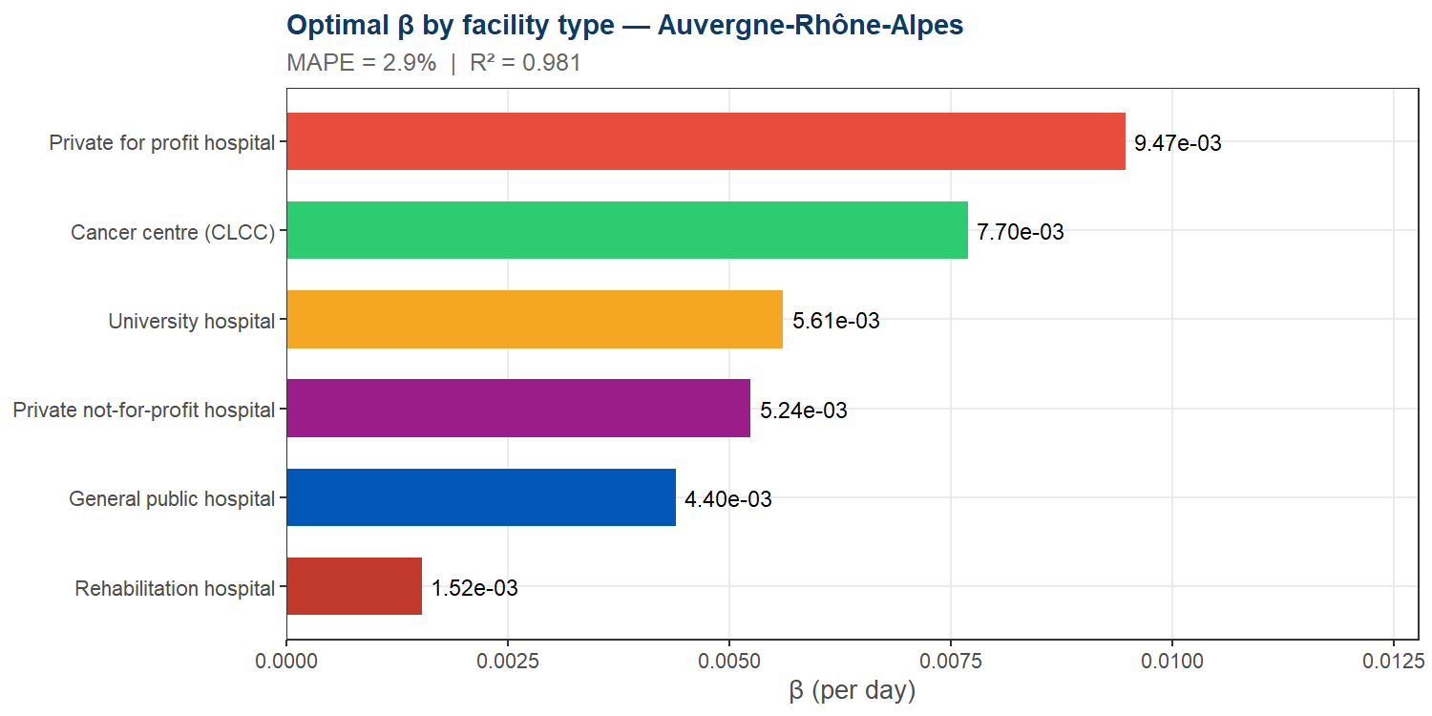
Auvergne-Rhône-Alpes — Beta estimates

Slide 18
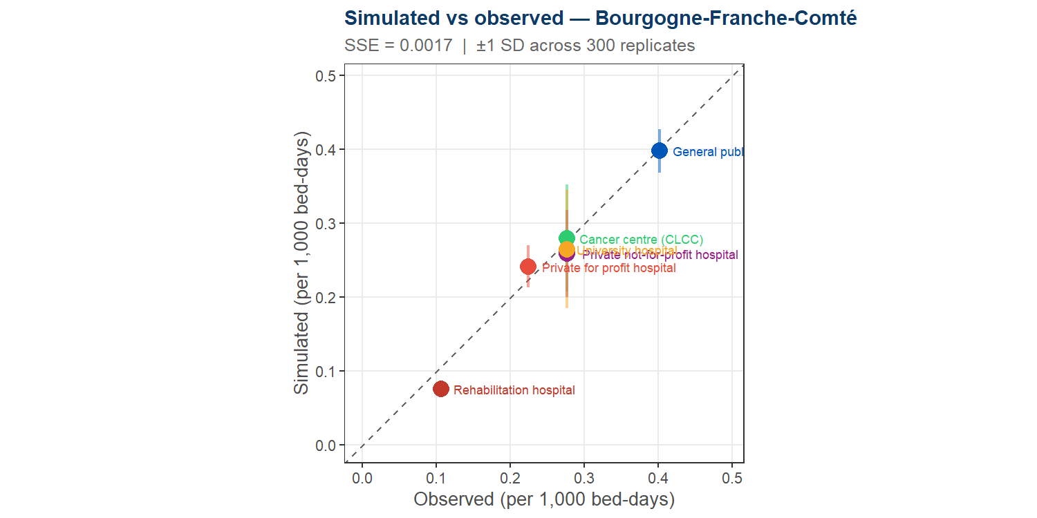
Bourgogne-Franche-Comté
H = 118 hospitals | MAPE = 8.1% | R² = 0.978 | SSE = 0.00167

Slide 19
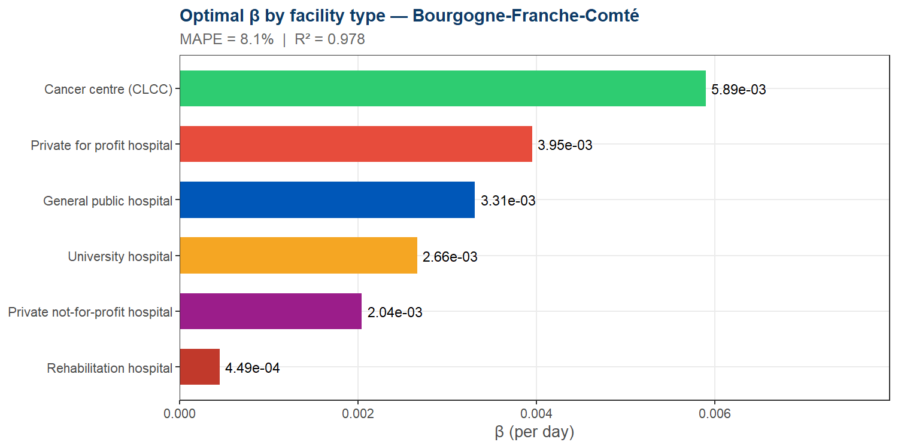
Bourgogne-Franche-Comté — Beta estimates

Slide 20
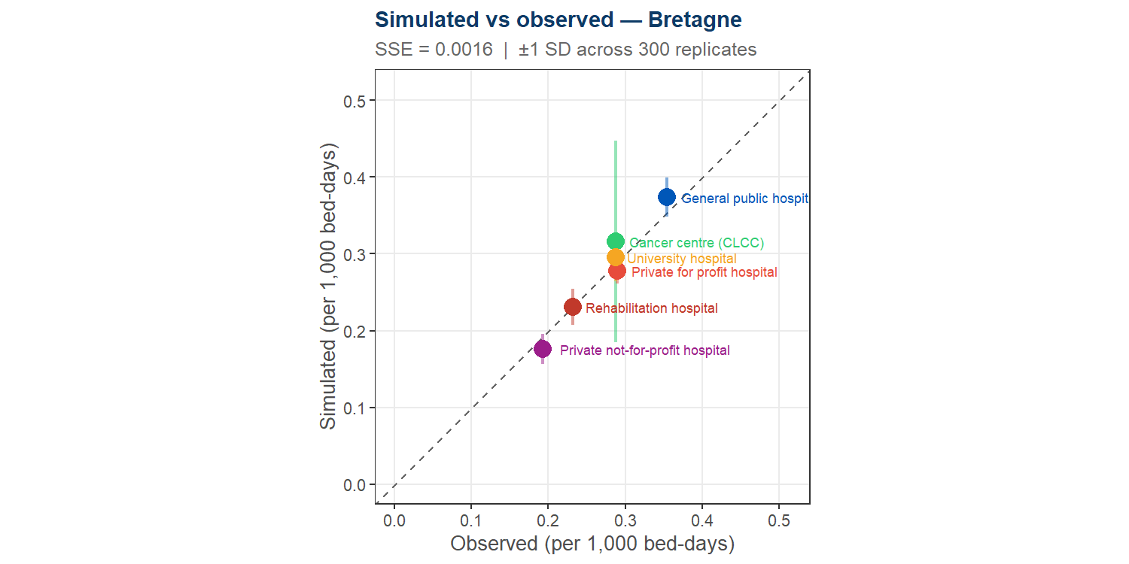
Bretagne
H = 132 hospitals | MAPE = 5.1% | R² = 0.964 | SSE = 0.00164

Slide 21
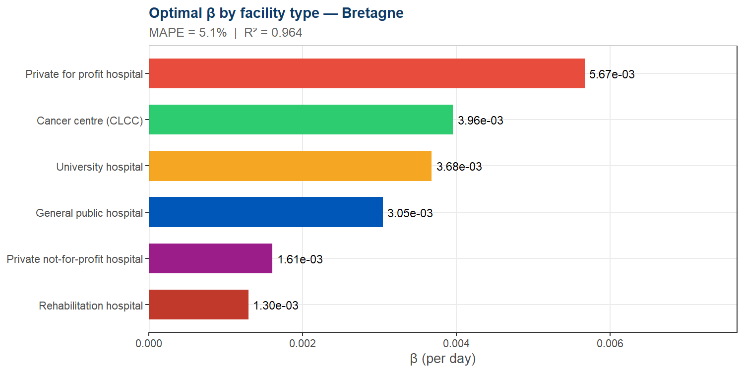
Bretagne — Beta estimates

Slide 22
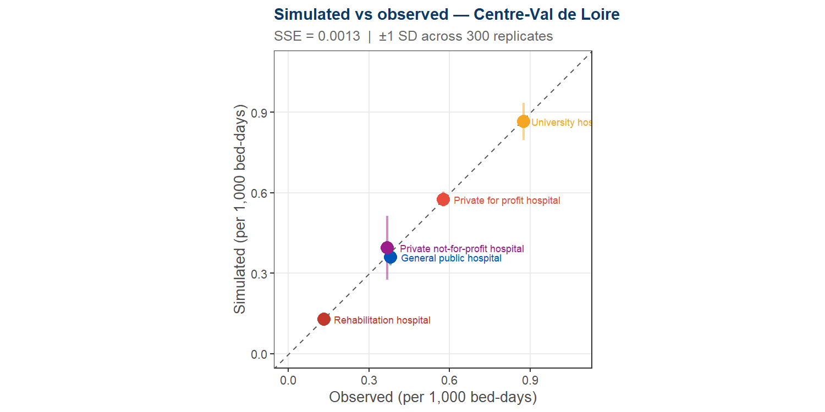
Centre-Val de Loire
H = 93 hospitals | MAPE = 3.4% | R² = 0.996 | SSE = 0.00127

Slide 23
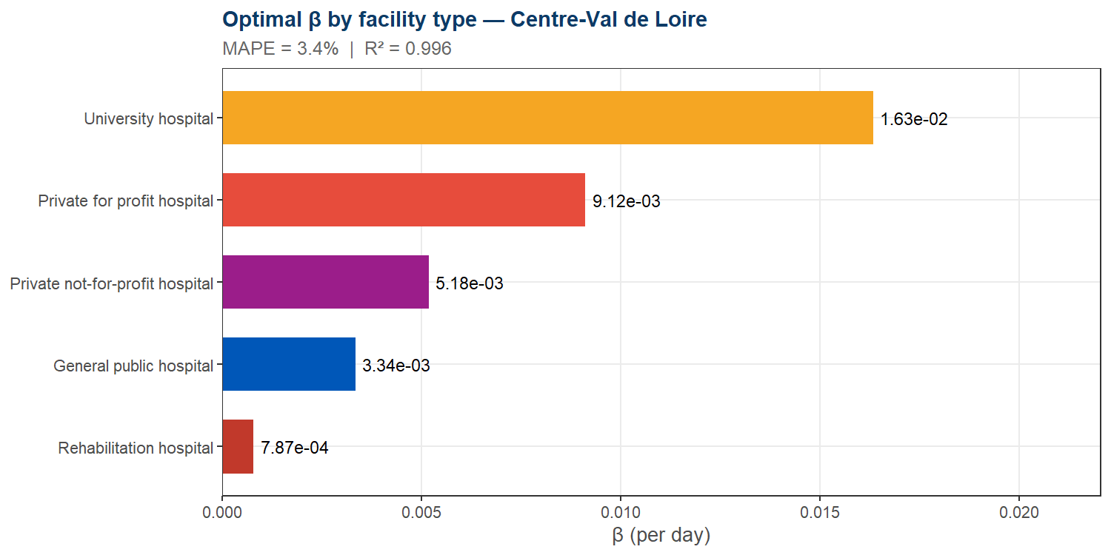
Centre-Val de Loire — Beta estimates

Slide 24
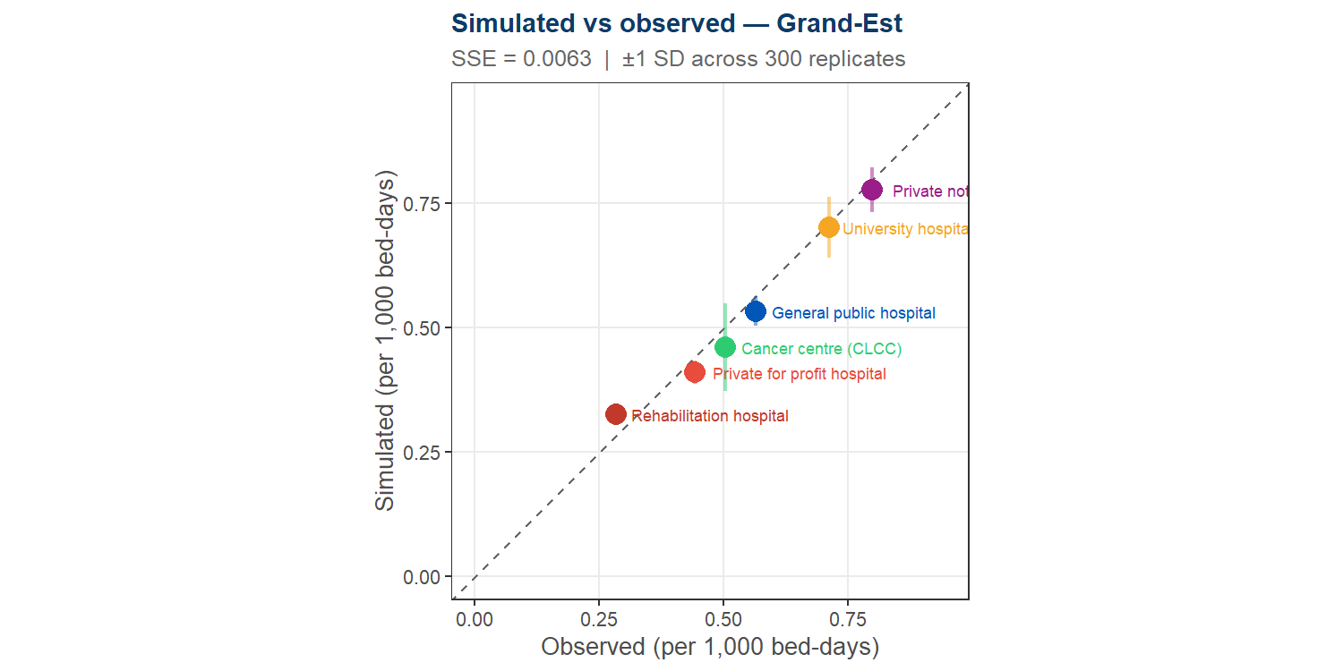
Grand-Est
H = 235 hospitals | MAPE = 6.8% | R² = 0.976 | SSE = 0.00627

Slide 25
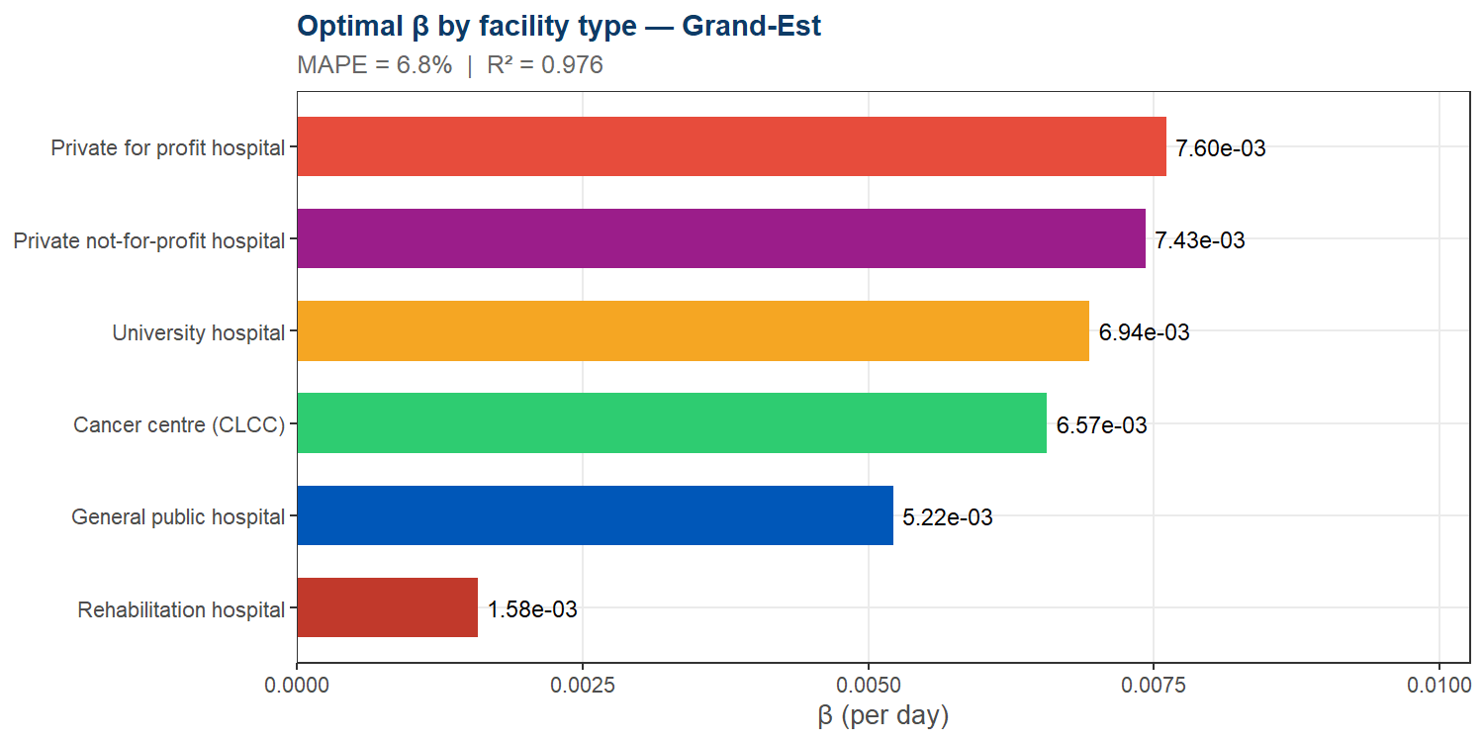
Grand-Est — Beta estimates

Slide 26
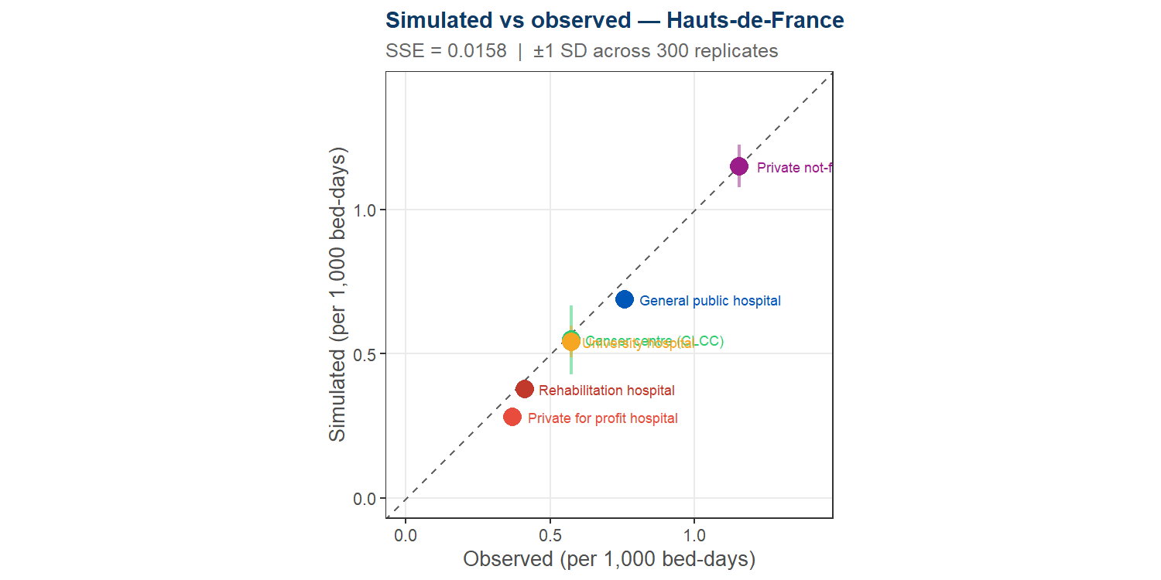
Hauts-de-France
H = 208 hospitals | MAPE = 8.7% | R² = 0.993 | SSE = 0.01576

Slide 27
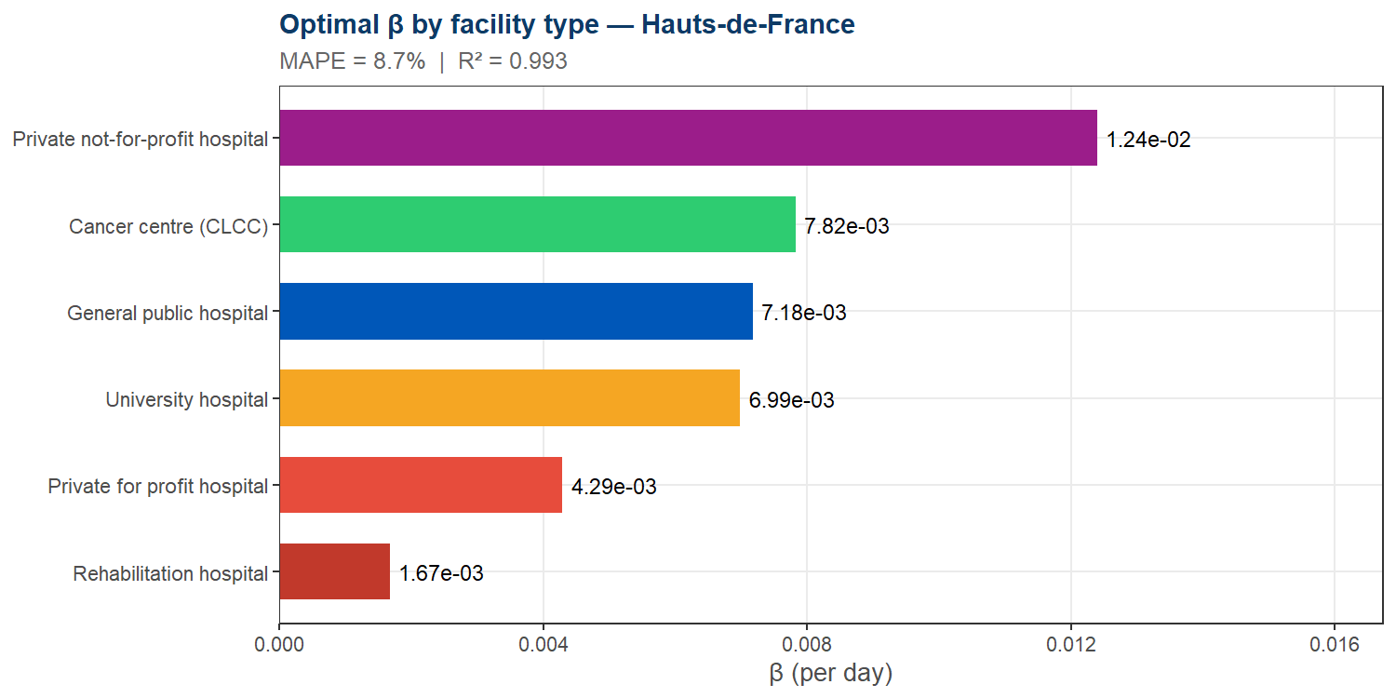
Hauts-de-France — Beta estimates

Slide 28
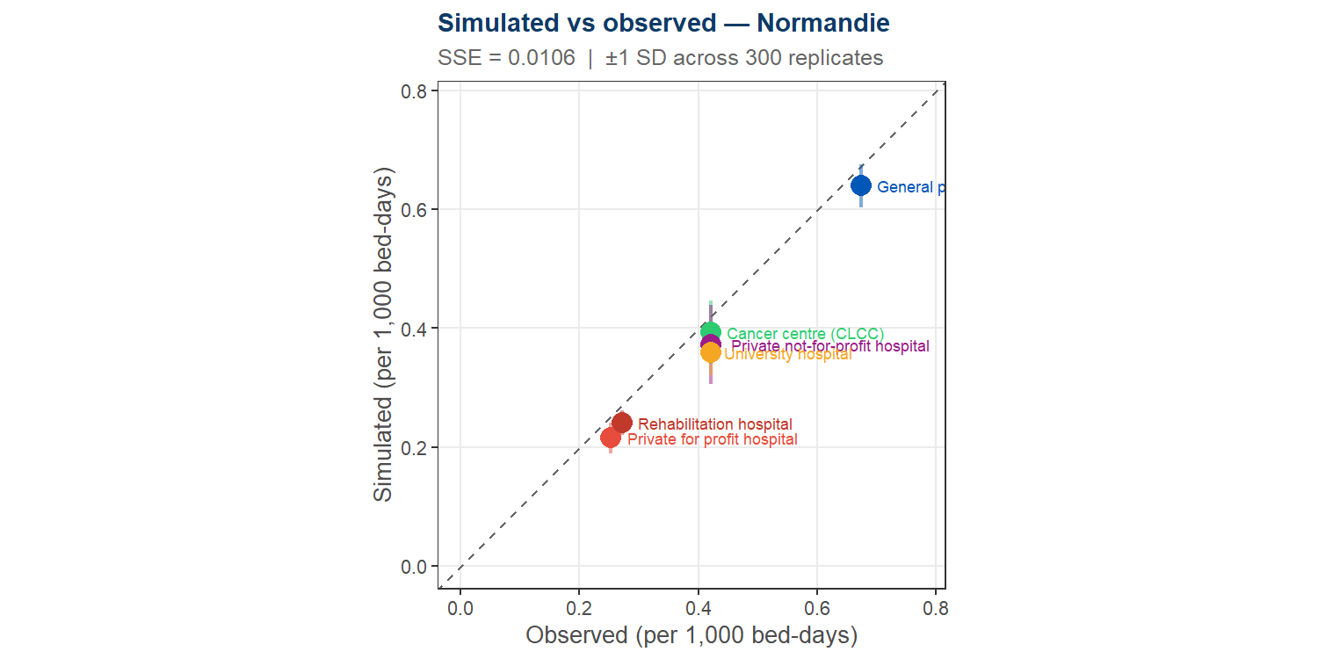
Normandie
H = 126 hospitals | MAPE = 10.7% | R² = 0.993 | SSE = 0.01060

Slide 29
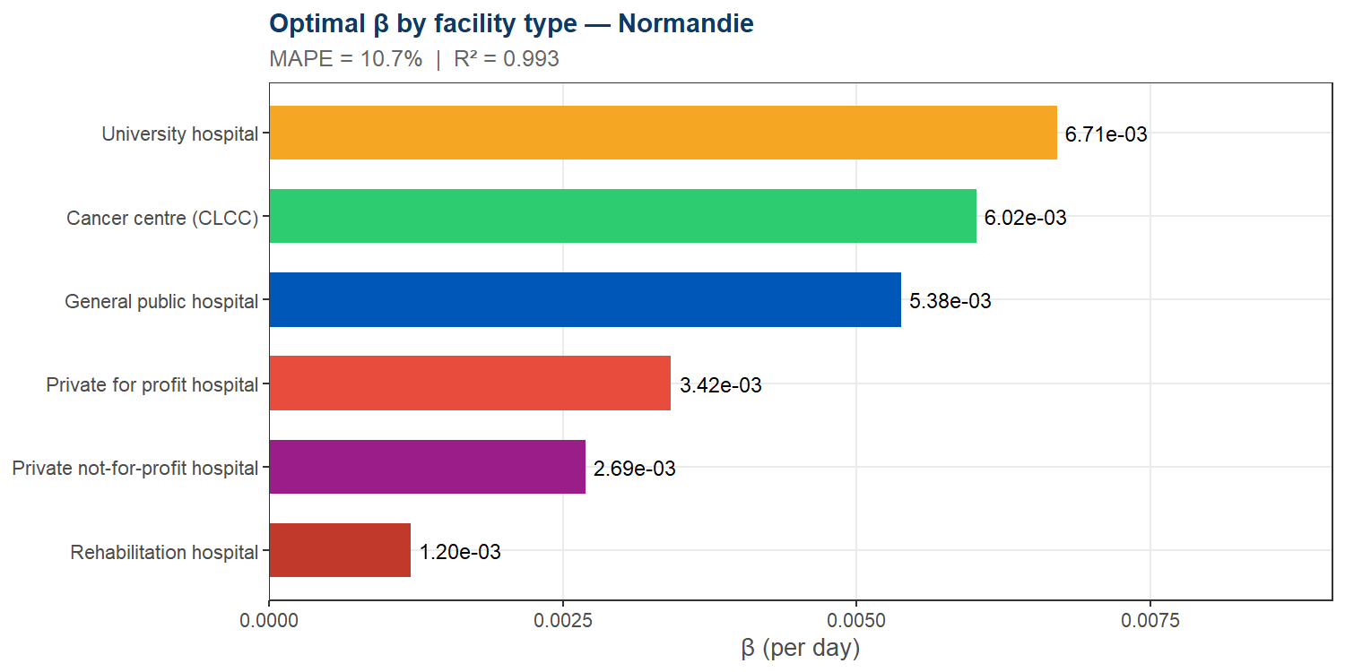
Normandie — Beta estimates

Slide 30
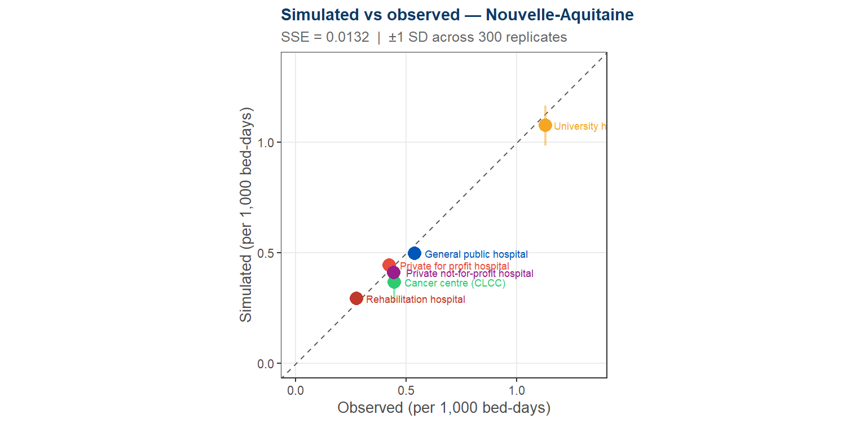
Nouvelle-Aquitaine
H = 248 hospitals | MAPE = 8.3% | R² = 0.984 | SSE = 0.01318

Slide 31
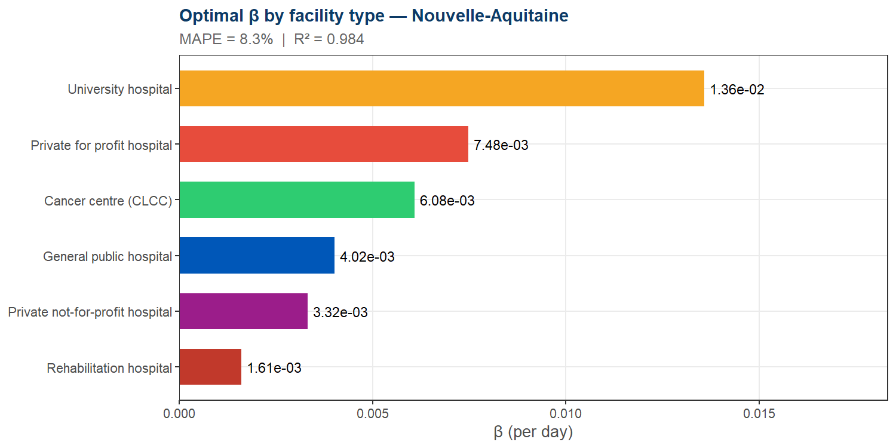
Nouvelle-Aquitaine — Beta estimates

Slide 32
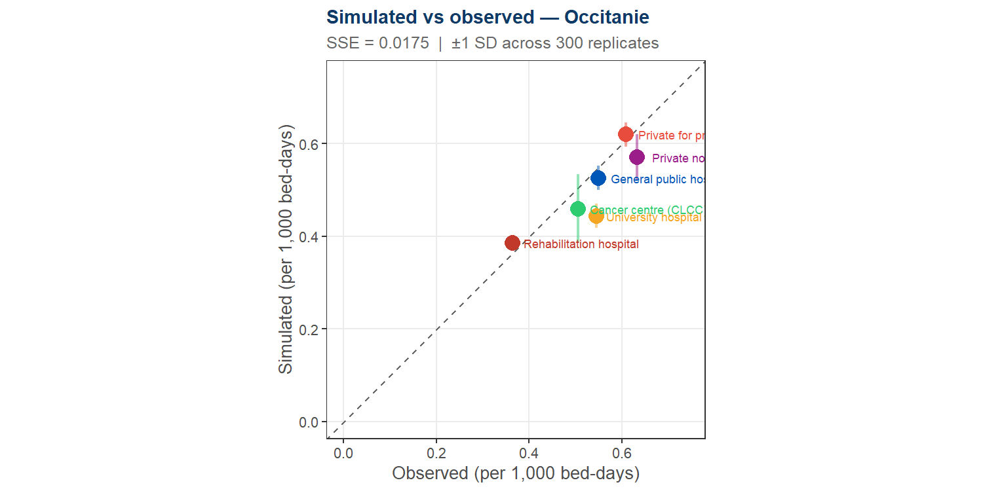
Occitanie
H = 291 hospitals | MAPE = 8.3% | R² = 0.763 | SSE = 0.01751

Slide 33
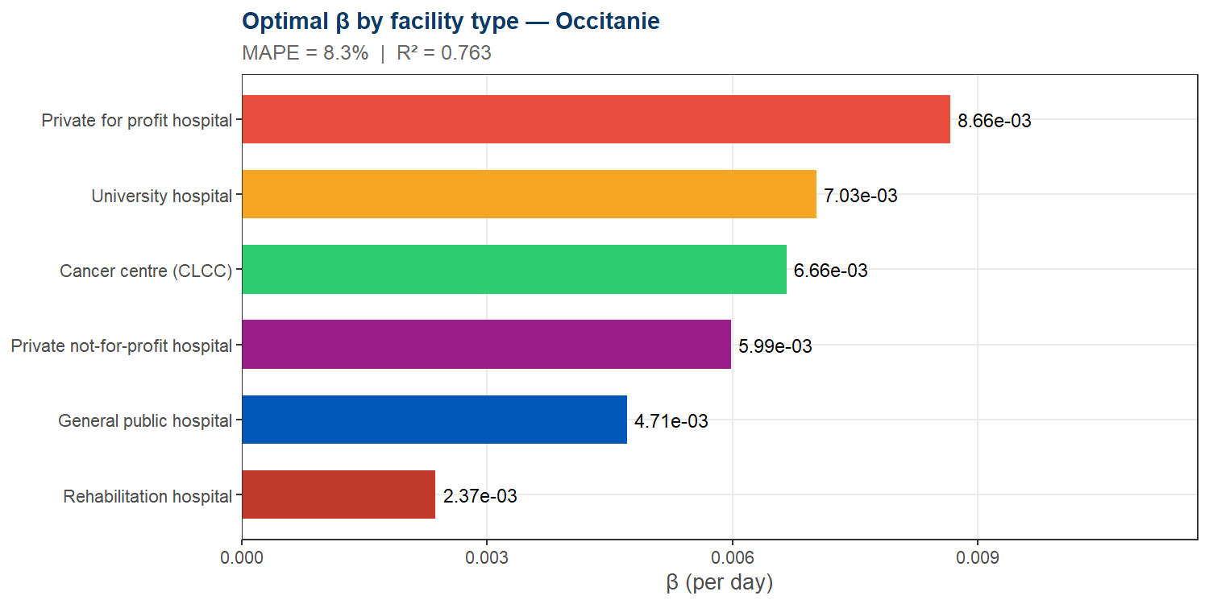
Occitanie — Beta estimates

Slide 34
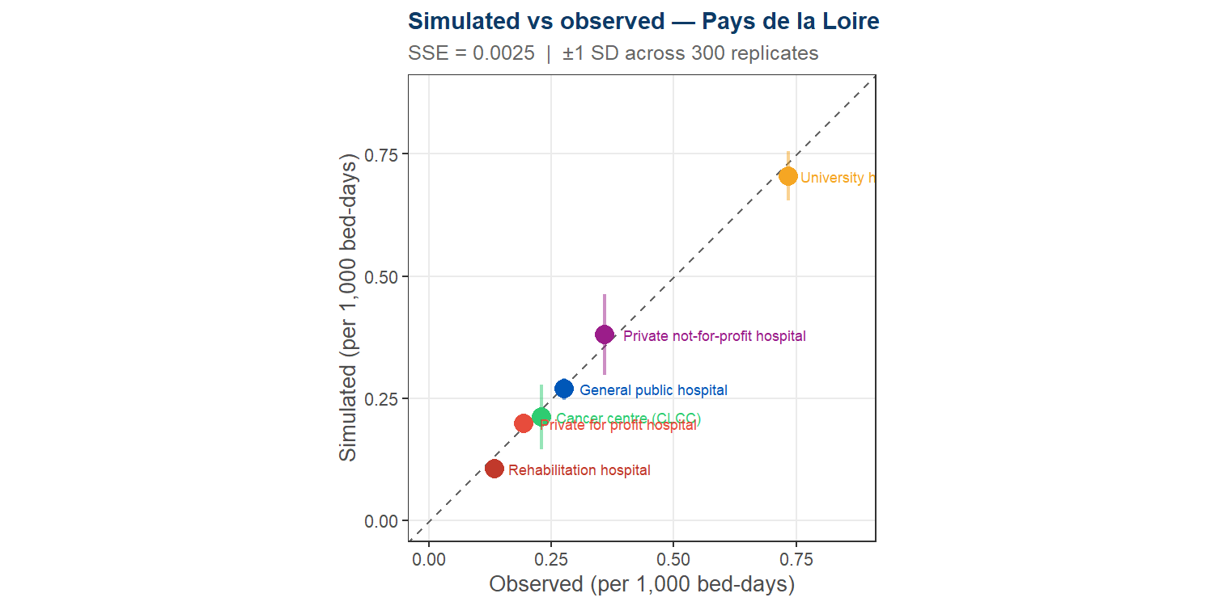
Pays de la Loire
H = 149 hospitals | MAPE = 7.3% | R² = 0.992 | SSE = 0.00246

Slide 35
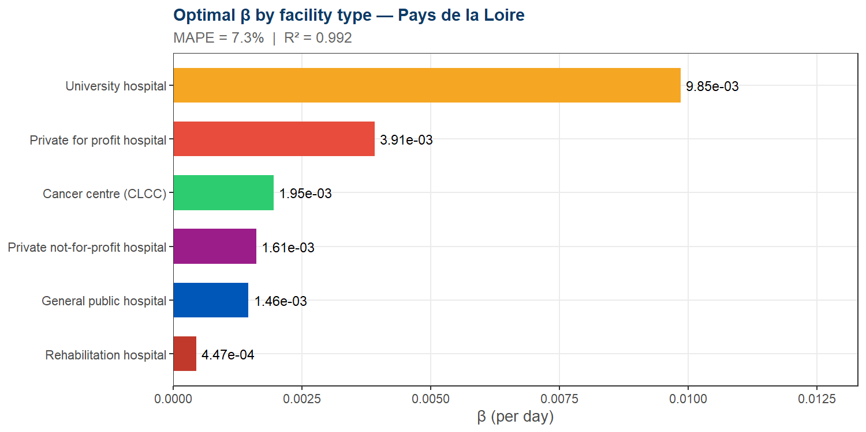
Pays de la Loire — Beta estimates

Slide 36
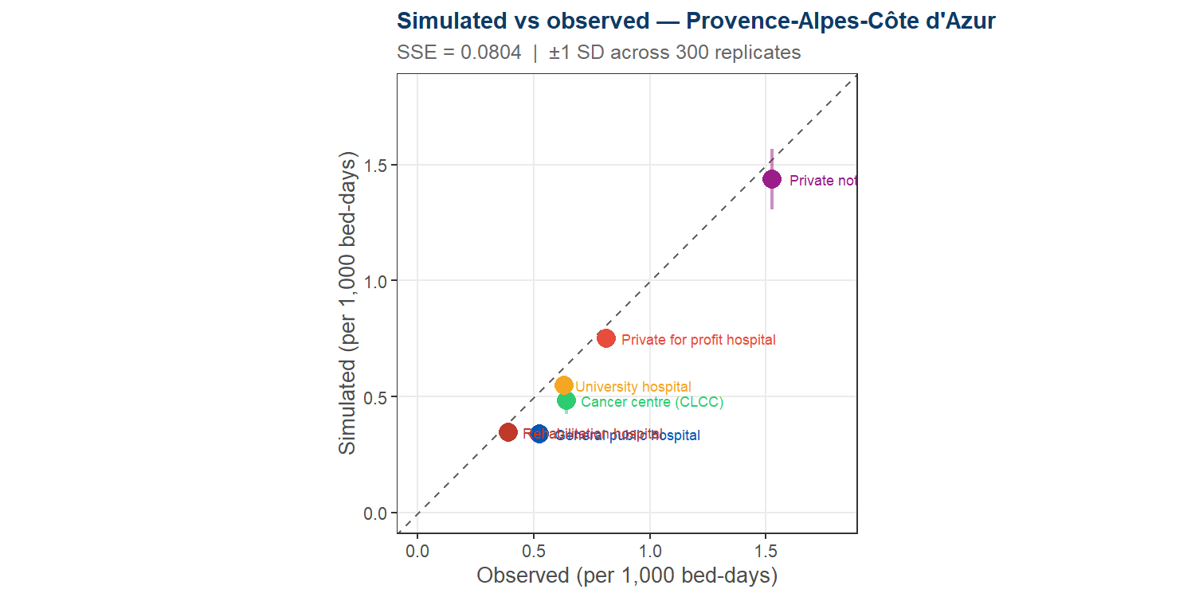
Provence-Alpes-Côte d’Azur
H = 262 hospitals | MAPE = 16.4% | R² = 0.982 | SSE = 0.08037

Slide 37
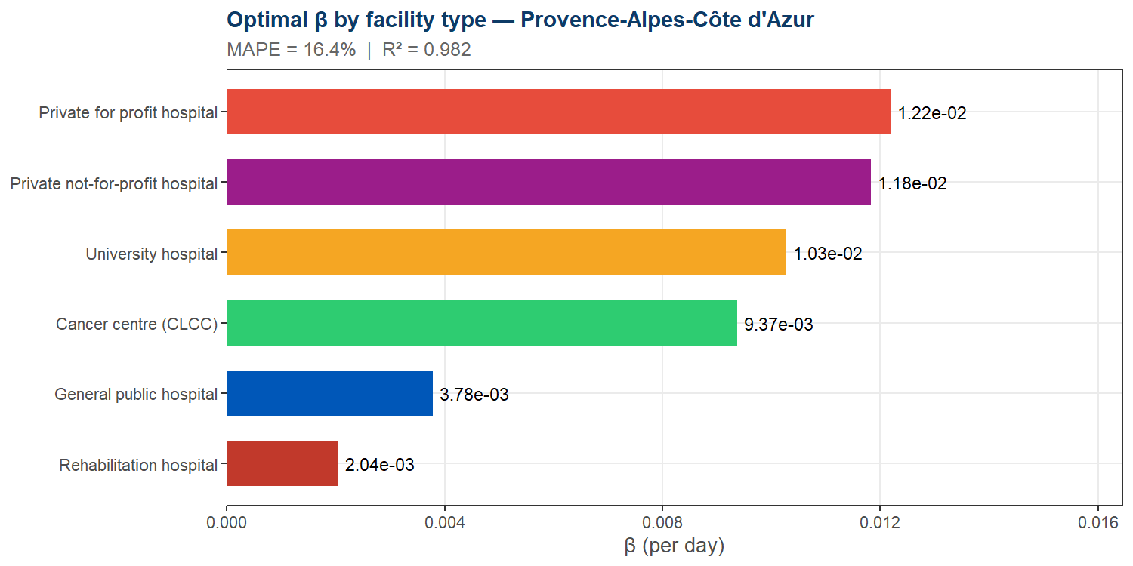
Provence-Alpes-Côte d’Azur — Beta estimates

