Slide 1
ARCANE — AMR Transmissibility Calibration
Within-Hospital Beta Estimation via Steady-State Prevalence
MESuRS/Cnam

Slide 2
Overview

Slide 3
What we calibrated
Model: Stochastic SIS metapopulation on the PMSI inter-hospital transfer network
Parameter: Within-hospital transmission rate beta (per day)
Method: Grid search — run model to steady state, measure endemic prevalence
Beta grid: 0.005 to 0.029 (13 values)
Replicates: 3 per beta value
Run length: days (always run to end)
Steady state: Variance coefficient (CV) of daily prevalence < 10% in last days for >= 80% of hospitals

Slide 4
Targets: ECDC EARS-Net 2022 — three tiers (Low / Mid / High) for 5 AMR pathogens
Pathogen | Low | Mid | High
MRSA | 1% | 11.5% | 25%
VRE | 0.5% | 8% | 18%
ESBL-E | 2% | 12% | 30%
CRE | 0.2% | 3% | 10%
CRAB | 1% | 7% | 20%

Slide 5
Calibration Quality

Slide 6
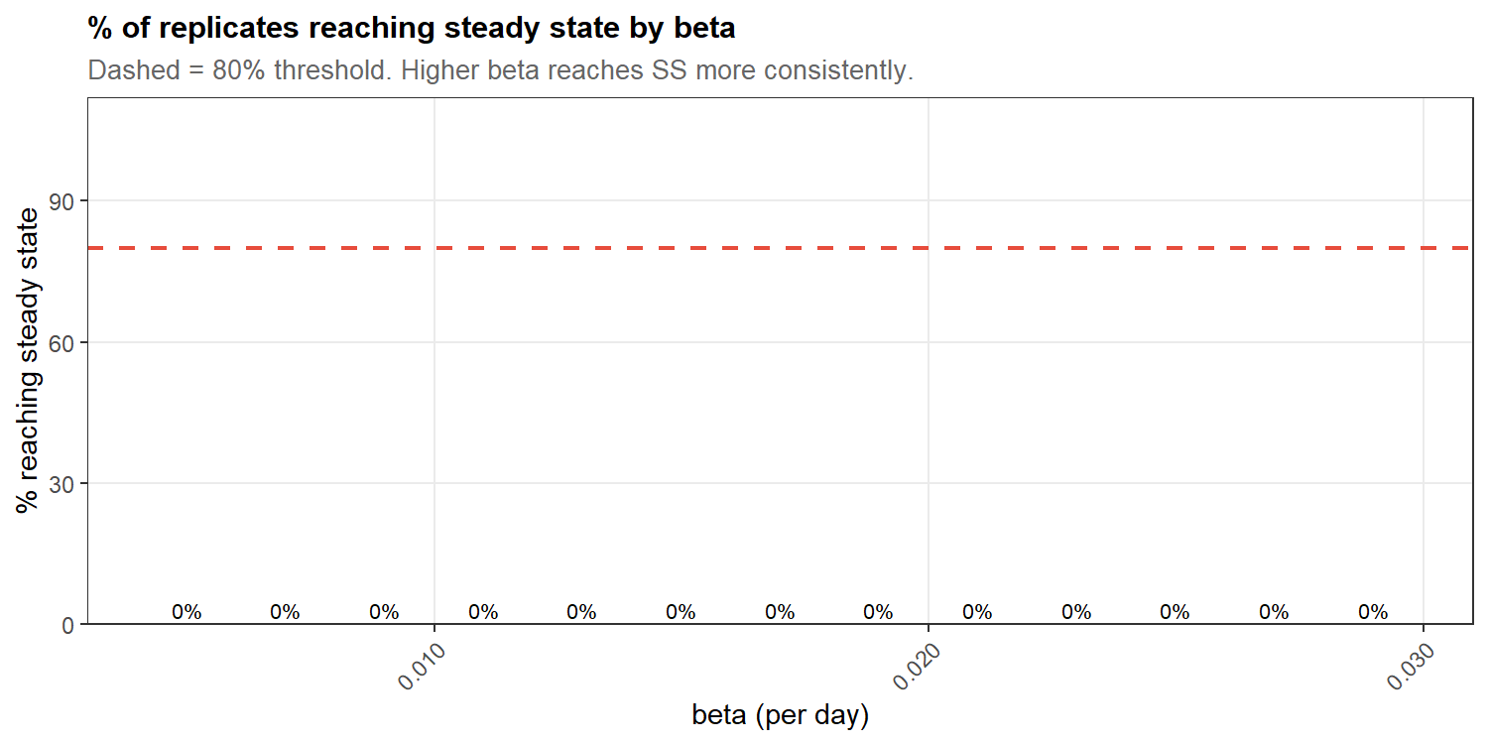
Steady-state achievement by beta

Slide 7
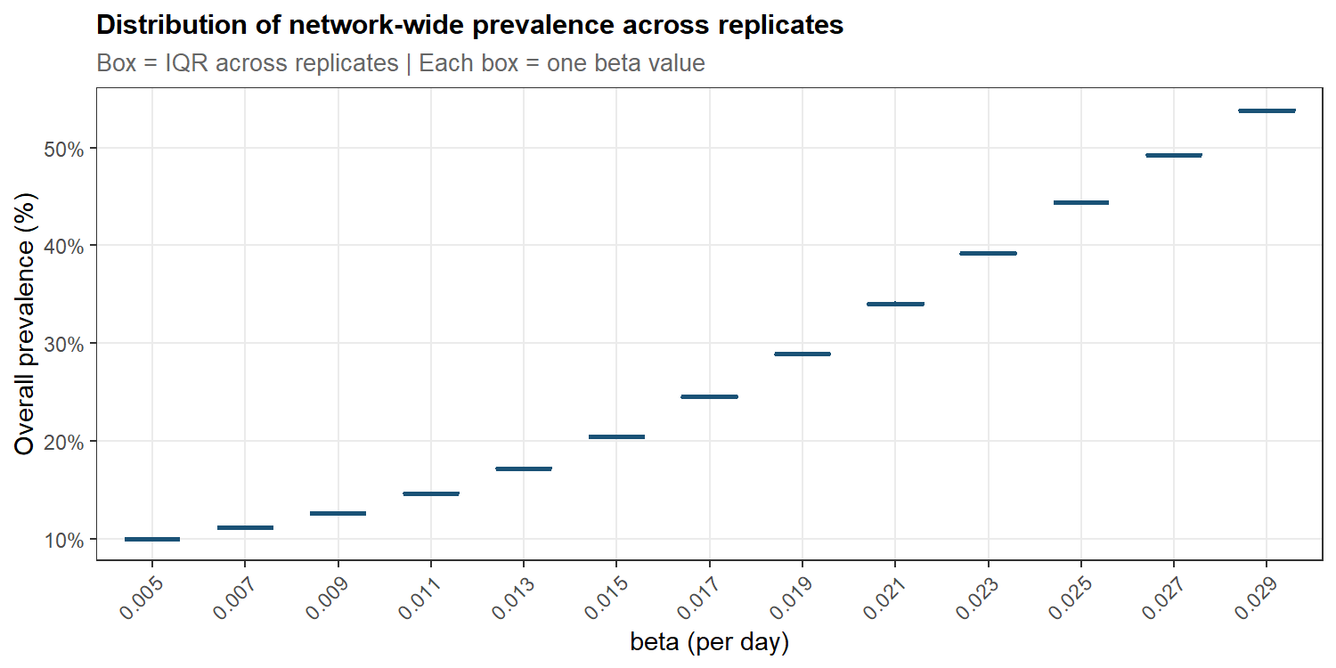
Prevalence at end of simulation

Slide 8
Beta-Prevalence Relationship

Slide 9
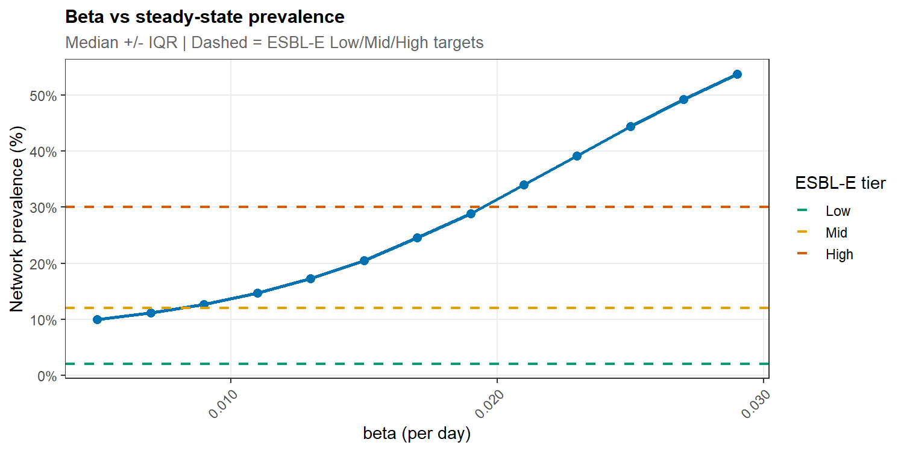
How beta drives endemic prevalence

Slide 10
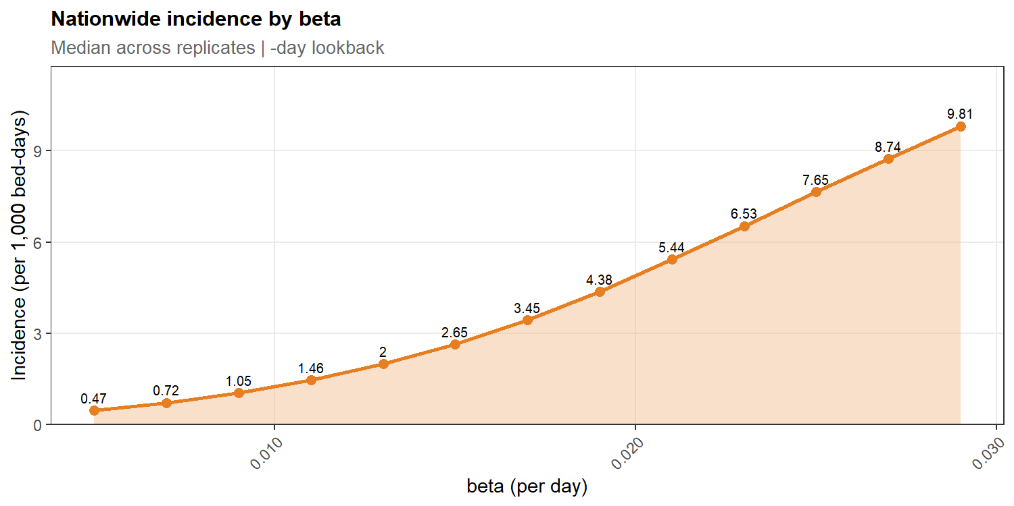
Nationwide incidence by beta

Slide 11
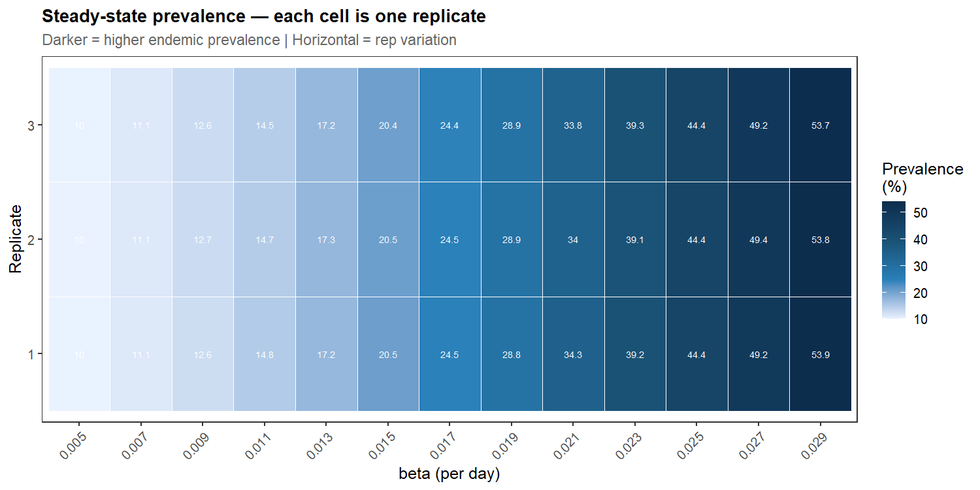
Prevalence trajectories across all betas

Slide 12
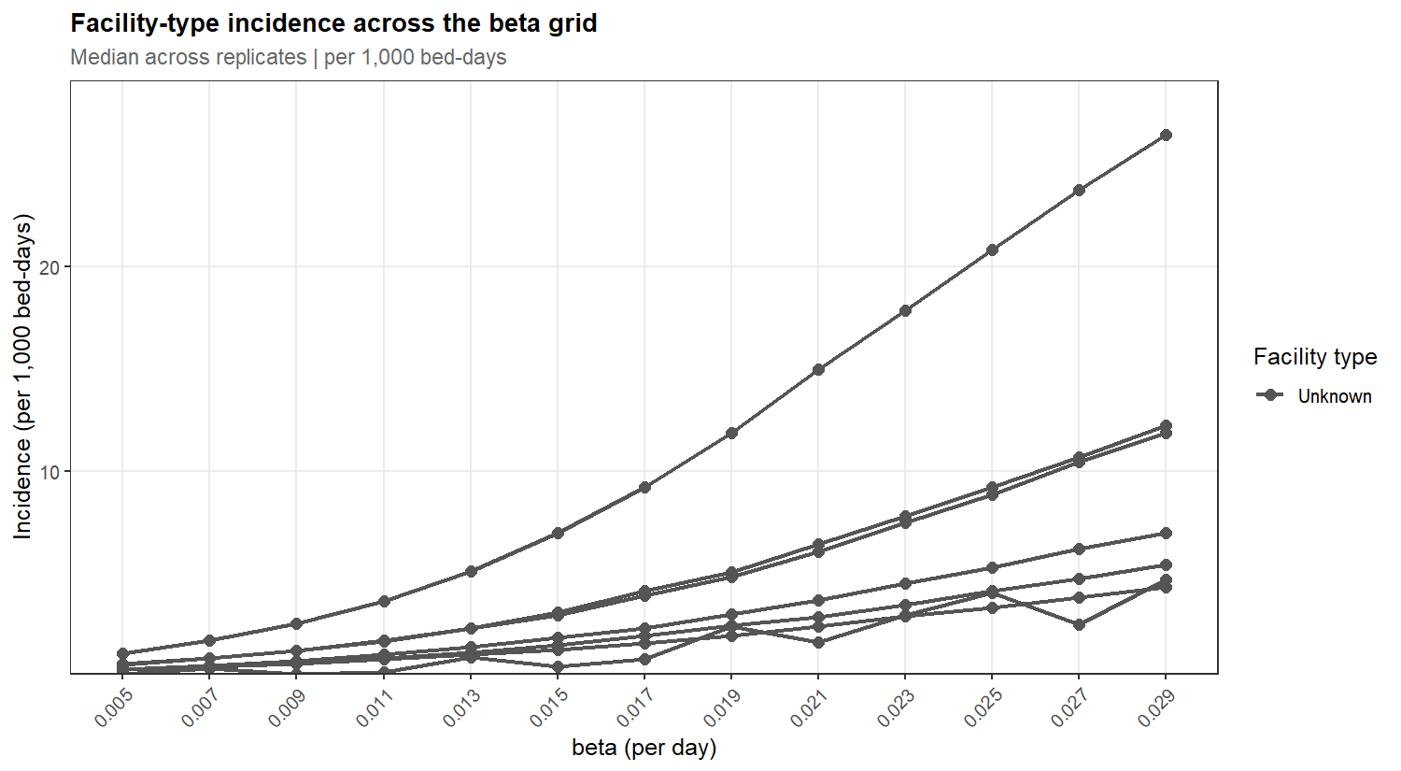
Facility-type incidence by beta

Slide 13
AMR Tier Mapping

Slide 14
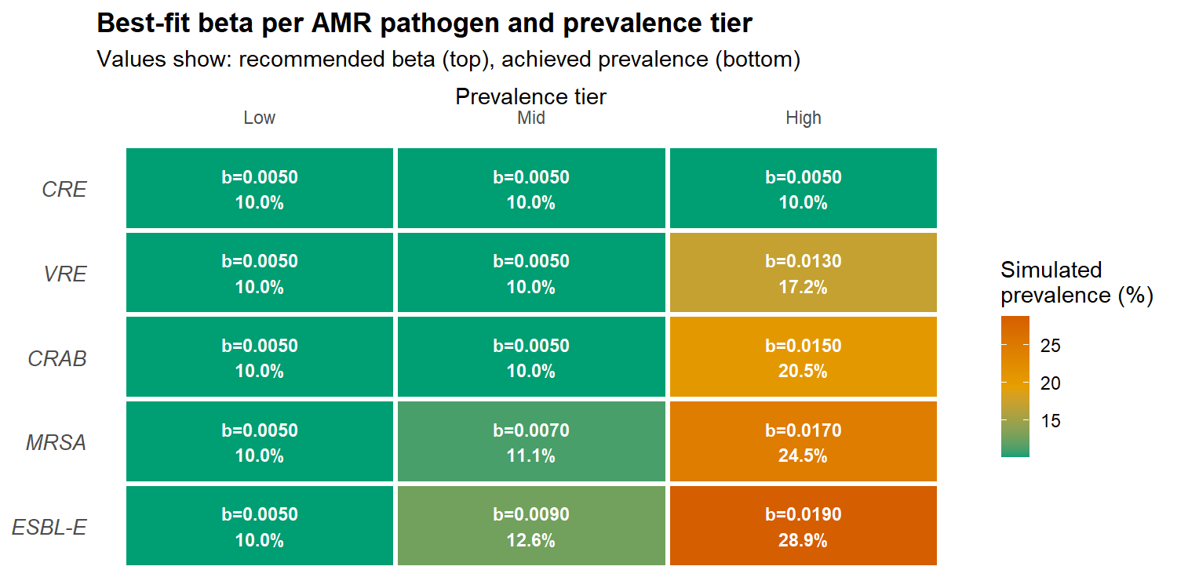
Which beta hits which pathogen prevalence?

Slide 15
Recommended beta values — full table
Pathogen | Tier | Target prev. | Recommended beta | Achieved prev. | Incidence | Fit
CRAB | Low | 1% | 5.000e-03 | 10% | 0.471 | Poor
CRAB | Mid | 7% | 5.000e-03 | 10% | 0.471 | Fair
CRAB | High | 20% | 1.500e-02 | 20.5% | 2.651 | Excellent
CRE | Low | 0.2% | 5.000e-03 | 10% | 0.471 | Poor
CRE | Mid | 3% | 5.000e-03 | 10% | 0.471 | Poor
CRE | High | 10% | 5.000e-03 | 10% | 0.471 | Excellent
ESBL-E | Low | 2% | 5.000e-03 | 10% | 0.471 | Poor
ESBL-E | Mid | 12% | 9.000e-03 | 12.6% | 1.048 | Excellent
ESBL-E | High | 30% | 1.900e-02 | 28.9% | 4.375 | Good
MRSA | Low | 1% | 5.000e-03 | 10% | 0.471 | Poor
MRSA | Mid | 11.5% | 7.000e-03 | 11.1% | 0.725 | Excellent
MRSA | High | 25% | 1.700e-02 | 24.5% | 3.446 | Excellent
VRE | Low | 0.5% | 5.000e-03 | 10% | 0.471 | Poor
VRE | Mid | 8% | 5.000e-03 | 10% | 0.471 | Good
VRE | High | 18% | 1.300e-02 | 17.2% | 1.997 | Excellent

Slide 16
Recommended Betas

Slide 17
Low-transmissibility scenario (VRE / CRE range)
Pathogen | Beta | Achieved prevalence | Incidence (per 1k bd) | Fit
CRAB | 5.000e-03 | 10% | 0.471 | Poor
CRE | 5.000e-03 | 10% | 0.471 | Poor
ESBL-E | 5.000e-03 | 10% | 0.471 | Poor
MRSA | 5.000e-03 | 10% | 0.471 | Poor
VRE | 5.000e-03 | 10% | 0.471 | Poor
Low-tier betas: representing pathogens with low endemic burden

Slide 18
Beta range: 5.00e-03 to 5.00e-03

Slide 19
Mid-transmissibility scenario (MRSA / ESBL-E range)
Pathogen | Beta | Achieved prevalence | Incidence (per 1k bd) | Fit
CRAB | 5.000e-03 | 10% | 0.471 | Fair
CRE | 5.000e-03 | 10% | 0.471 | Poor
ESBL-E | 9.000e-03 | 12.6% | 1.048 | Excellent
MRSA | 7.000e-03 | 11.1% | 0.725 | Excellent
VRE | 5.000e-03 | 10% | 0.471 | Good
Mid-tier betas: moderate endemic burden pathogens

Slide 20
Beta range: 5.00e-03 to 9.00e-03

Slide 21
High-transmissibility scenario (MRSA / ESBL-E high range)
Pathogen | Beta | Achieved prevalence | Incidence (per 1k bd) | Fit
CRAB | 1.500e-02 | 20.5% | 2.651 | Excellent
CRE | 5.000e-03 | 10% | 0.471 | Excellent
ESBL-E | 1.900e-02 | 28.9% | 4.375 | Good
MRSA | 1.700e-02 | 24.5% | 3.446 | Excellent
VRE | 1.300e-02 | 17.2% | 1.997 | Excellent
High-tier betas: high endemic burden pathogens

Slide 22
Beta range: 5.00e-03 to 1.90e-02

Slide 23
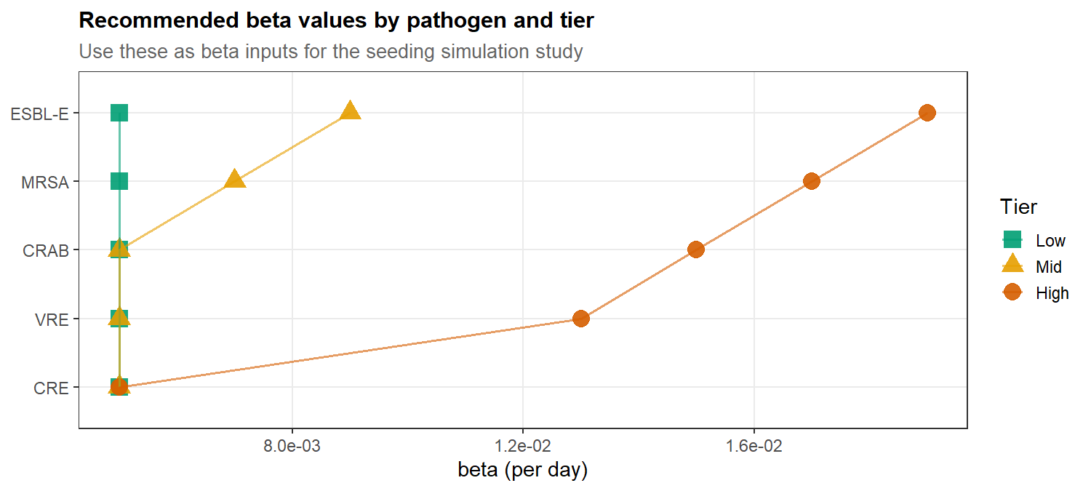
Summary: beta ranges for seeding study

Slide 24
Next Steps

Slide 25
From calibration to seeding study
Calibrated beta values provide the transmission input for the ARCANE seeding study
Low / Mid / High scenarios represent plausible ranges across AMR pathogens
Next: seed a novel ARB into each candidate introduction facility under each beta scenario and track spread across the French hospital transfer network

Slide 26
Three seeding simulation arms:
Low beta (pi_vec = 0.001, N_seed = 5) — conservative spread, high extinction probability
Mid beta (pi_vec = 0.001, N_seed = 5) — moderate spread, some facilities sustain transmission
High beta (pi_vec = 0.001, N_seed = 5) — substantial spread, network-wide dissemination risk
Seed locations tested: highest in-degree, highest out-degree, highest betweenness, largest hospital, largest outgoing transfers, random MCO / SSR / MCO-SSR
August 2026 | ARCANE Project — Task 4.3 | MESuRS/Cnam

