Slide 1
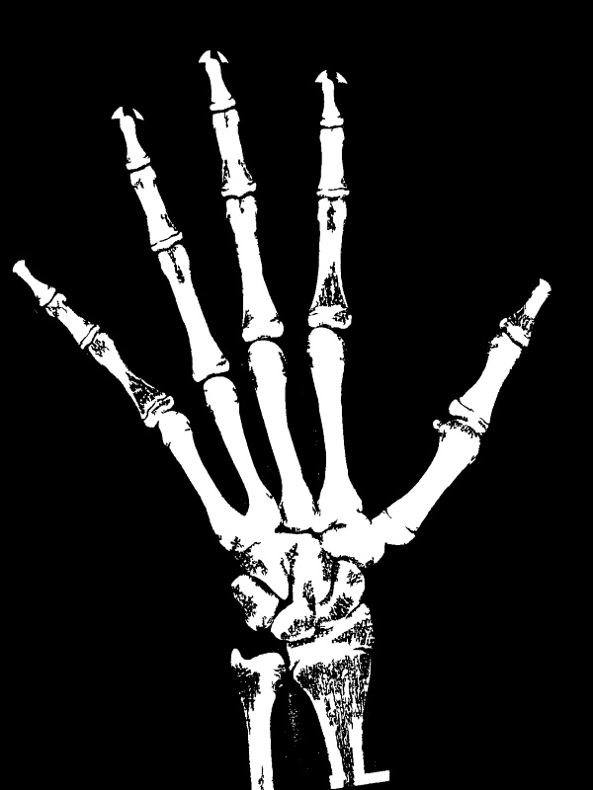
Flatten(65536): CARPAL
Concatenate(92160)
Flatten(4096): TMCP
Flatten(4096): MMCP
Input_Gender(1)
Flatten(4096): LMCP
Flatten(4096): IP
Dense(2048)
Dense(64)
Flatten(4096): MPIP
Flatten(4096): LPIP
Concatenate(2112)
GlobalAverage
Pooling(1024)
Input(224x224x3)
Functional(7x7x1024)
Dense(1024)
Dense(512)
Dense(2048)
Dense(1)
Predicted Bone Age

Slide 2
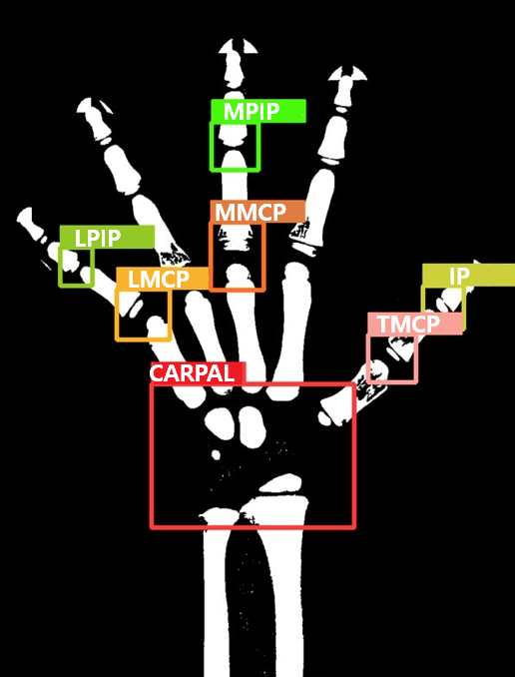
Block 1
Block 2
Block 3
Block 4
Squeeze(1x1x64)
Conv4(23x23x60)
Conv5(21x21x192)
Maxpooling2
(10x10x192)
Conv3(46x46x64)
Maxpooling1
(23x23x64)
Input(50x50x3)
Conv1(48x48x32)
Conv2(46x46x32)
Multiply(46x46x64)
Maxpooling3
(4x4x512)
Add(46x46x64)
Conv6(8x8x512)
Input Size
50X50X3
- TMCP
- MMCP
- LMCP
- IP
- MPIP
- SPIP
150X150X3
- CARPAL
Short(46x46x64)
Conv7(4x4x1024)
Maxpooling4
(2x2x1024)
Flatten(4096)

Slide 3
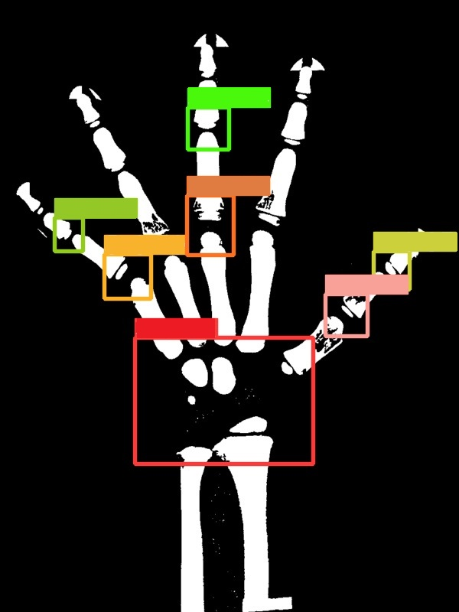
MPIP
MMCP
LPIP
LMCP
IP
TMCP
CARPAL

