Slide 1
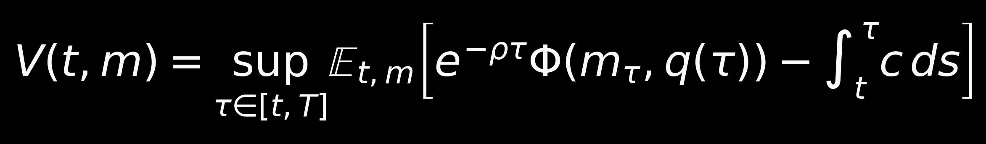
Sequential
Tradeability Testing
When should a quant team stop researching an alpha and actually trade it?
continue
activate
reject
research has option value
trade after costs and uncertainty
avoid false discoveries
Rany Stephan
MSE342 | Sequential Tradeability Testing
01

Slide 2
THE QUESTION
An alpha is not validated at a date. It is admitted through time.
Fixed horizons answer: is it significant now? A research desk needs: is it worth trading yet?
candidate signal
evidence arrives
decision
live capital
>
>
>
many ideas are weak or dead
returns, ICs, spreads, decay
continue, activate, reject
value must survive costs
Waiting can be valuable, because tomorrow's evidence may change the decision.
Waiting is also costly, because alpha decays and research capacity is scarce.
MSE342 | Sequential Tradeability Testing
02

Slide 3


PAPER ANCHOR
EKV gives the state: learn an unknown drift from noisy evidence.
The mathematical object is a posterior belief, updated continuously as evidence accumulates.
evidence path
posterior belief
State variables
posterior mean m
posterior variance q
Noisy observations reveal signal strength only gradually.
MSE342 | Sequential Tradeability Testing
03

Slide 4


CORE IDENTITY
Uncertainty is not only error. It is also the speed of learning.
This is the EKV insight that makes optimal stopping natural.
Intuition
High posterior variance means bad current estimate, but also faster possible learning.
Observing costs c per unit time.
Learning reduces variance at rate Psi squared.
MSE342 | Sequential Tradeability Testing
04

Slide 5

THE MOVE
We keep EKV's filtering state, but change the stopping reward.
EKV asks when to estimate accurately. We ask when to admit a signal into production.
EKV estimation
Our admission problem
minimize statistical error
plus observation cost
X
unknown alpha strength
Y_t
cumulative normalized evidence
m_t
posterior mean alpha
q_t
posterior uncertainty and learning speed
tau
activation or rejection time
MSE342 | Sequential Tradeability Testing
05

Slide 6



ECONOMIC PAYOFF
Tradeability means alpha must clear uncertainty and costs.
A large posterior mean is not enough if it is uncertain, volatile, or expensive to trade.
What changes the threshold?
Higher q means less confidence.
Higher sigma means noisier returns.
Higher kappa means larger hurdle.
MSE342 | Sequential Tradeability Testing
06

Slide 7

STOPPING RULE
The decision boundary is an obstacle problem.
At every posterior state, compare immediate tradeability with the value of one more observation.
stop: reject
continue
stop: activate
payoff is zero
learning option remains
economic payoff dominates
MSE342 | Sequential Tradeability Testing
07

Slide 8
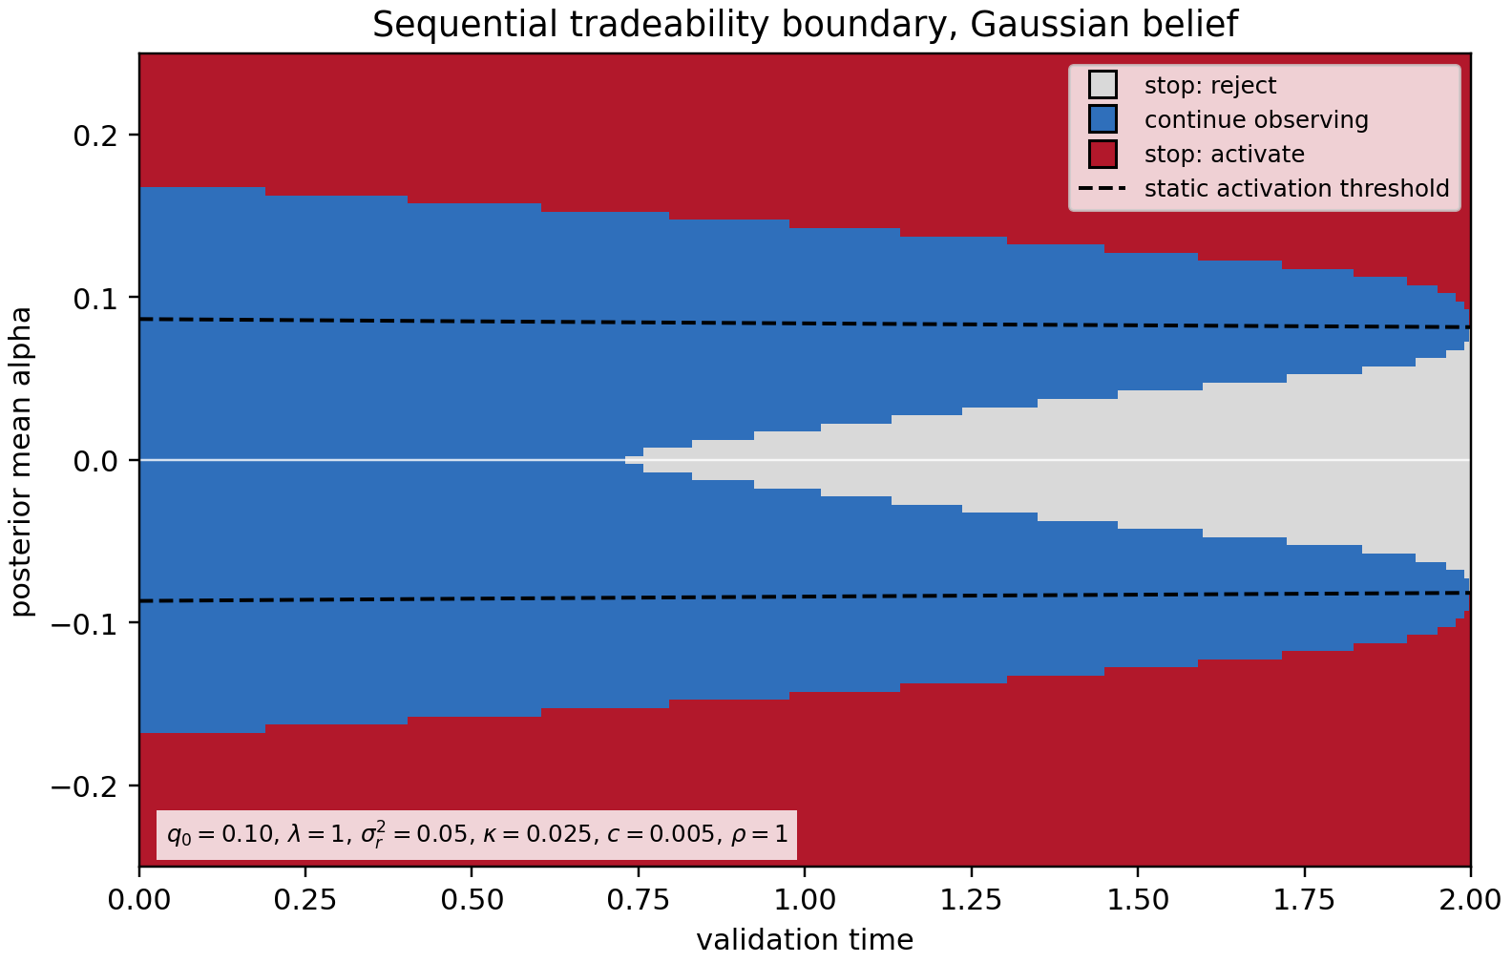
FIRST BOUNDARY
The boundary creates a real continuation region.
Blue is the option value of learning. Red and gray are the two ways to stop.
This is a central zoom. The full computational grid is wider.
MSE342 | Sequential Tradeability Testing
08

Slide 9
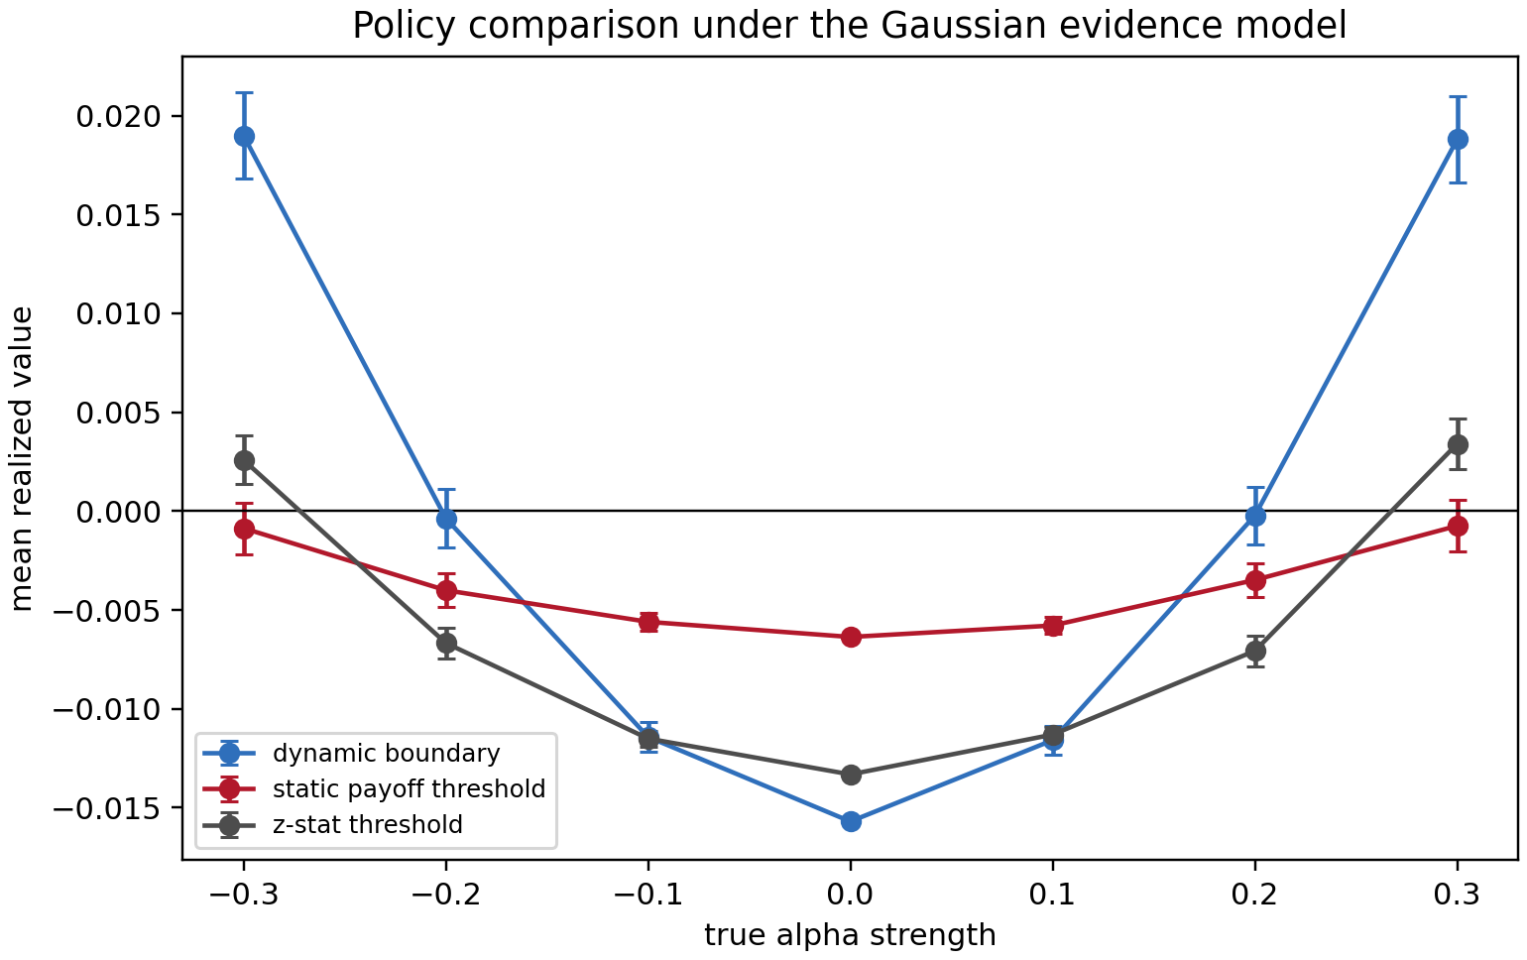
STRESS TEST
The Gaussian benchmark exposes a false-discovery problem.
This failure is useful: it tells us what the prior is missing.
What we learn
Strong live alphas: dynamic boundary wins.
Dead alpha: Gaussian prior keeps looking for a nonzero drift.
90.1%
null paths activated by Gaussian dynamic rule
MSE342 | Sequential Tradeability Testing
09

Slide 10


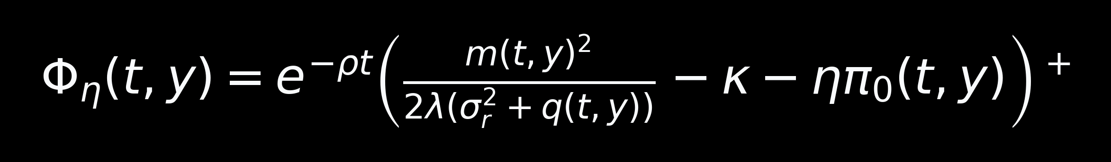
DEAD STATE
Most researched signals are not just weak. Many are dead.
So the prior should put mass on exactly zero alpha.
-a
live short
0
dead
+a
live long
MSE342 | Sequential Tradeability Testing
10

Slide 11
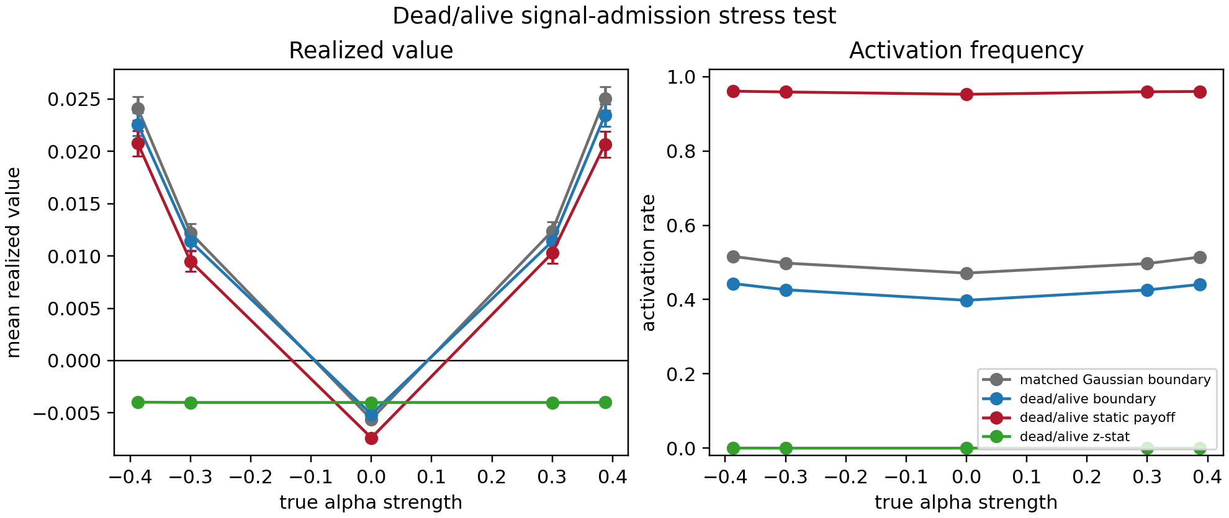
CONTROLLED VALIDATION
The dead/alive rule buys lower false activation, not free dominance.
That tradeoff is exactly what a serious admission rule should expose.
47.1% -> 39.8%
false activation at theta = 0
-0.00560 -> -0.00513
null realized value improves
The cost is lower live-alpha power. That is a power versus false-discovery tradeoff.
MSE342 | Sequential Tradeability Testing
11

Slide 12

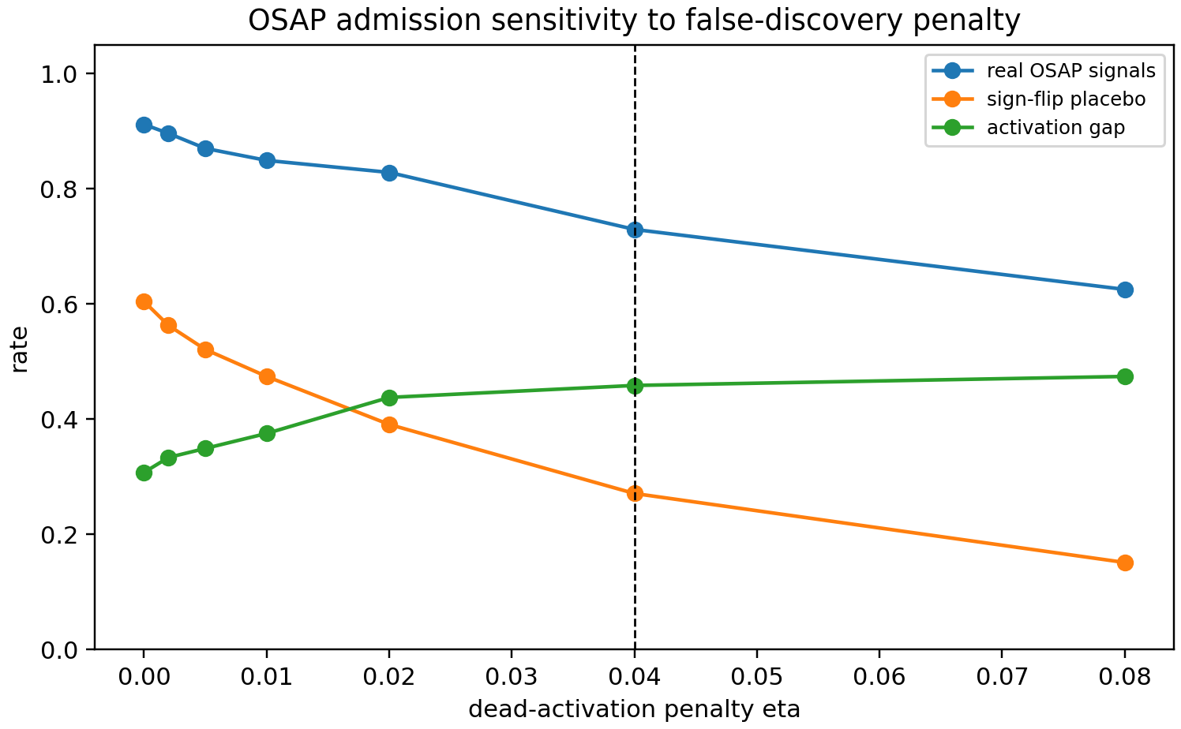
REAL DATA CALIBRATION
OSAP placebos fall faster as the false-discovery penalty rises.
The placebo keeps volatility structure but destroys persistent directional drift.
72.9%
real OSAP activation at eta = 0.04
27.1%
sign-flip placebo activation
MSE342 | Sequential Tradeability Testing
12

Slide 13
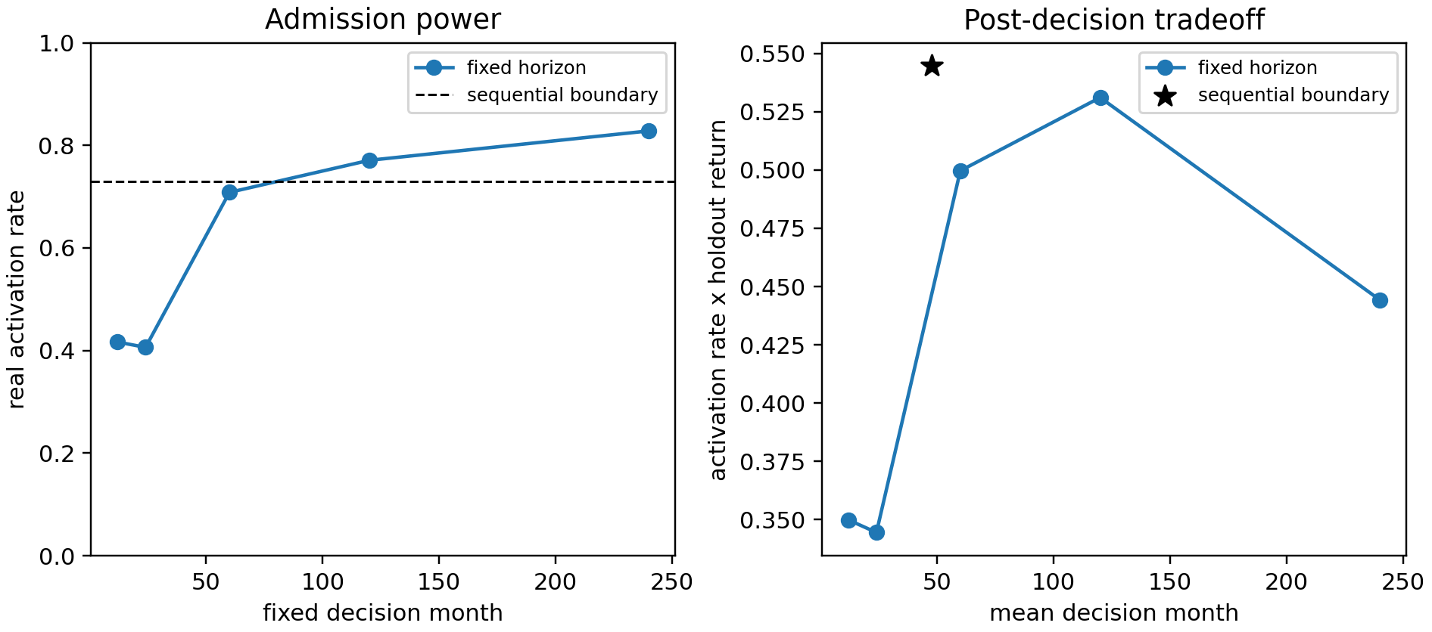
SEQUENTIAL OR FIXED HORIZON?
The sequential rule is not just a fixed-horizon test in disguise.
It reaches near long-horizon admission power earlier, with better post-decision performance.
47.9 mo
average sequential decision time
0.545
activation-weighted holdout return
Compared with 60, 120, and 240 month fixed tests: 0.500, 0.531, 0.444.
MSE342 | Sequential Tradeability Testing
13

Slide 14
REAL IMPLEMENTATION
WRDS confirms the practical point: gross alpha is not enough.
A usable admission rule must survive uncertainty and trading frictions.
Gross reconstructed signals
Net range-cost stress
3 / 3
0 / 3
activate in standard direction
standard-direction activation
1.227%
The range-cost proxy is deliberately harsh, so this is a stress test rather than a final cost model.
monthly holdout among activated
Final thesis: alpha validation is a sequential real-options problem, not a fixed-date hypothesis test.
MSE342 | Sequential Tradeability Testing
14

