Slide 1



Power BI Analysis Report on AI Calls Pairing Model
View in Power BI
Last data refresh:
10/16/2025 7:24:19 PM UTC
Downloaded at:
10/17/2025 2:59:36 PM UTC

Slide 2
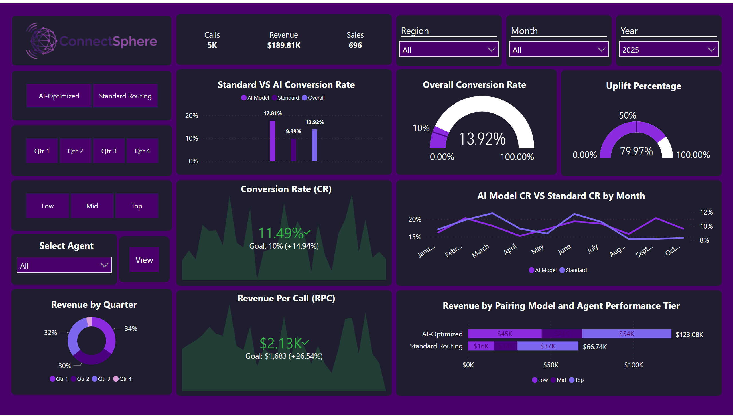
AI Performance
Notes:
Uplift Percentage
No alt text provided
AI Model CR VS Standard CR by Month
No alt text provided
Revenue by Pairing Model and Agent Performance Tier
No alt text provided
Overall Conversion Rate
No alt text provided
Revenue Per Call (RPC)
No alt text provided
Conversion Rate (CR)
No alt text provided
Standard VS AI Conversion Rate
No alt text provided
Add visual title here
No alt text provided
slicer
No alt text provided
slicer
No alt text provided
slicer
No alt text provided
image
No alt text provided
slicer
No alt text provided
slicer
No alt text provided
slicer
No alt text provided
Revenue by Quarter
No alt text provided
Select Agent
No alt text provided
actionButton
No alt text provided

Slide 3
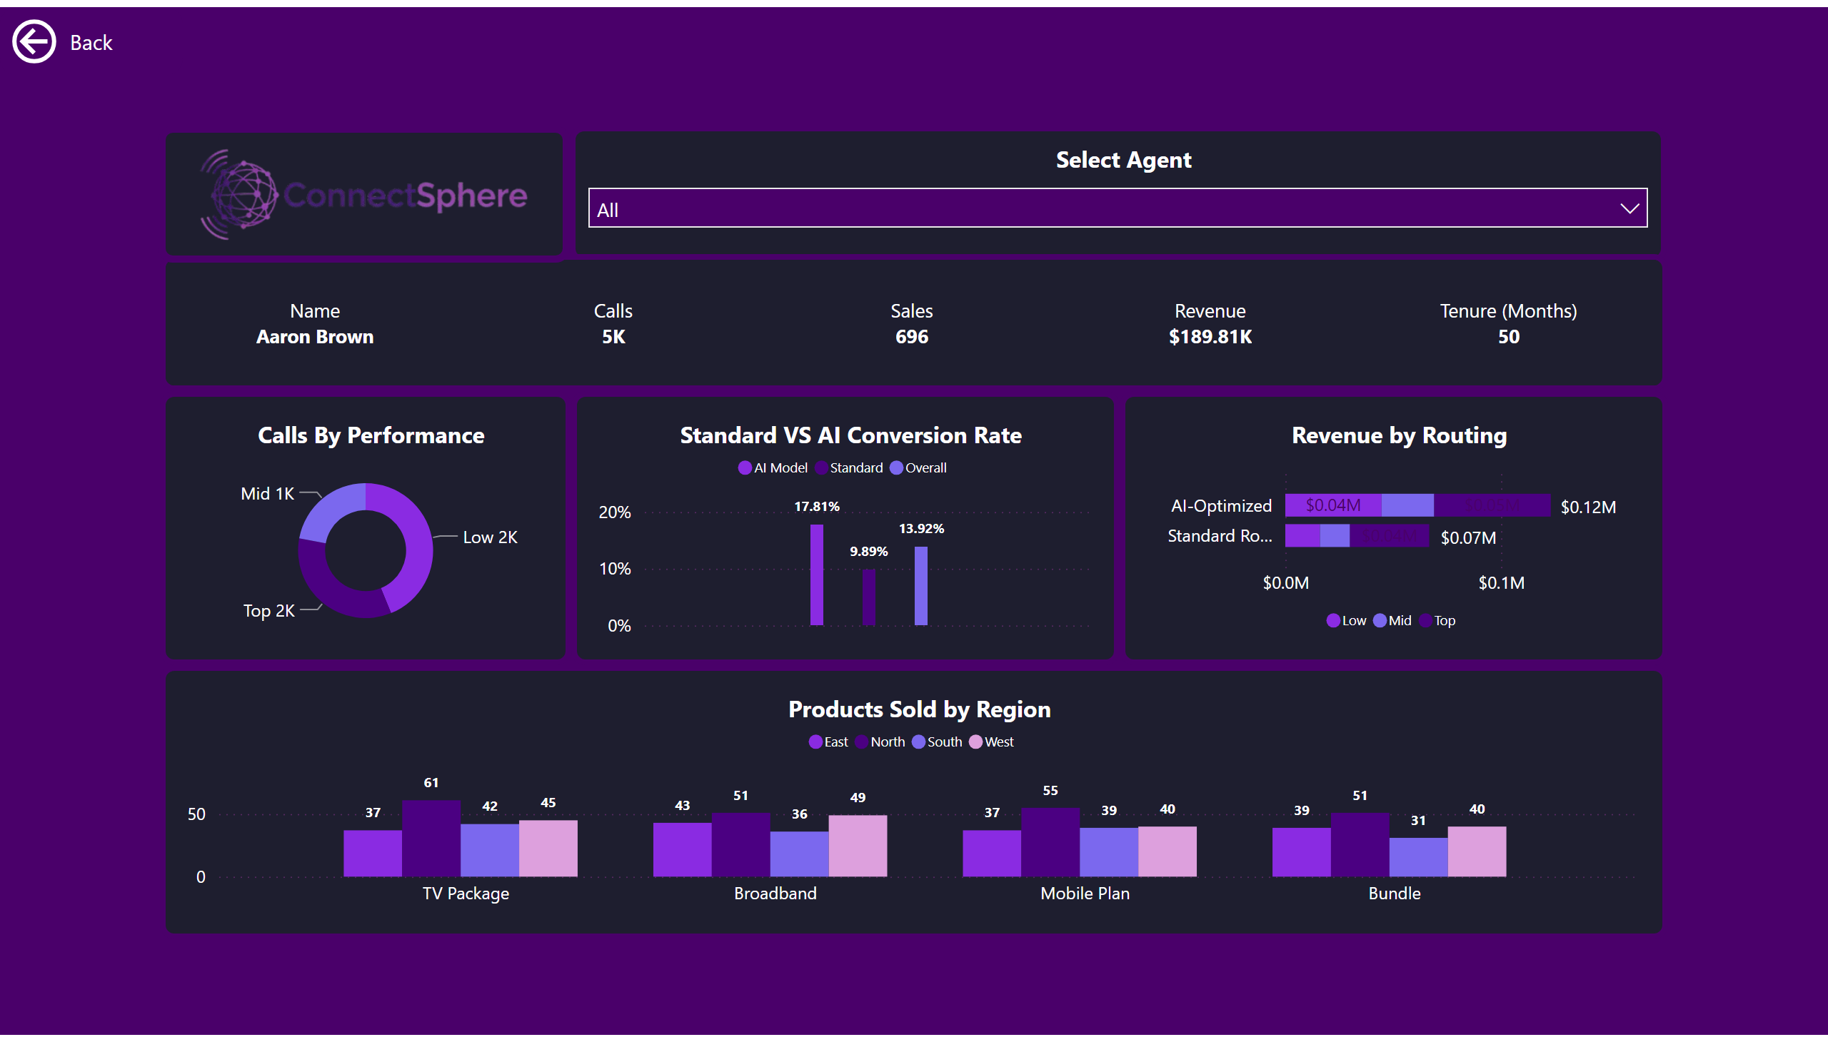
Notes:
actionButton
No alt text provided
Revenue by Routing
No alt text provided
Select Agent
No alt text provided
Calls By Performance
No alt text provided
Standard VS AI Conversion Rate
No alt text provided
Add visual title here
No alt text provided
Products Sold by Region
No alt text provided
image
No alt text provided

Slide 4
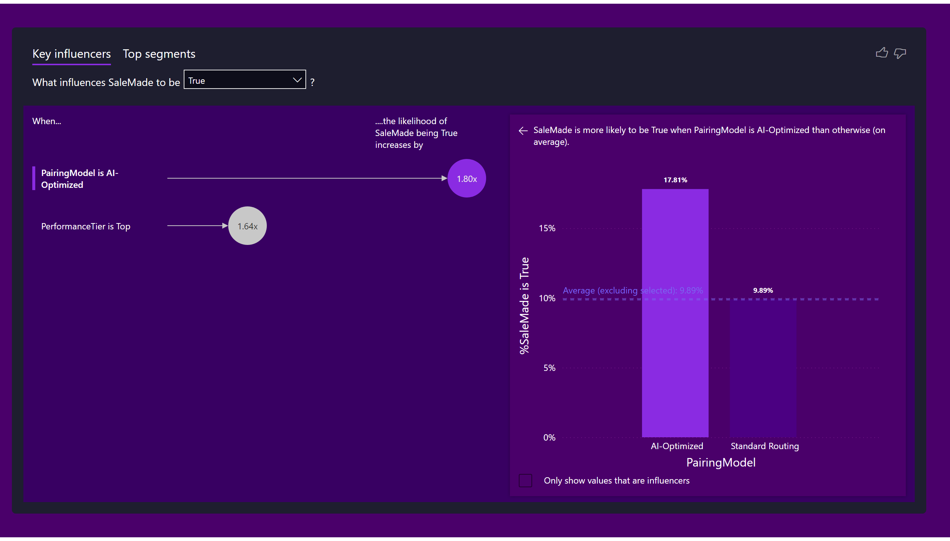
Notes:
keyDriversVisual
No alt text provided

Slide 5
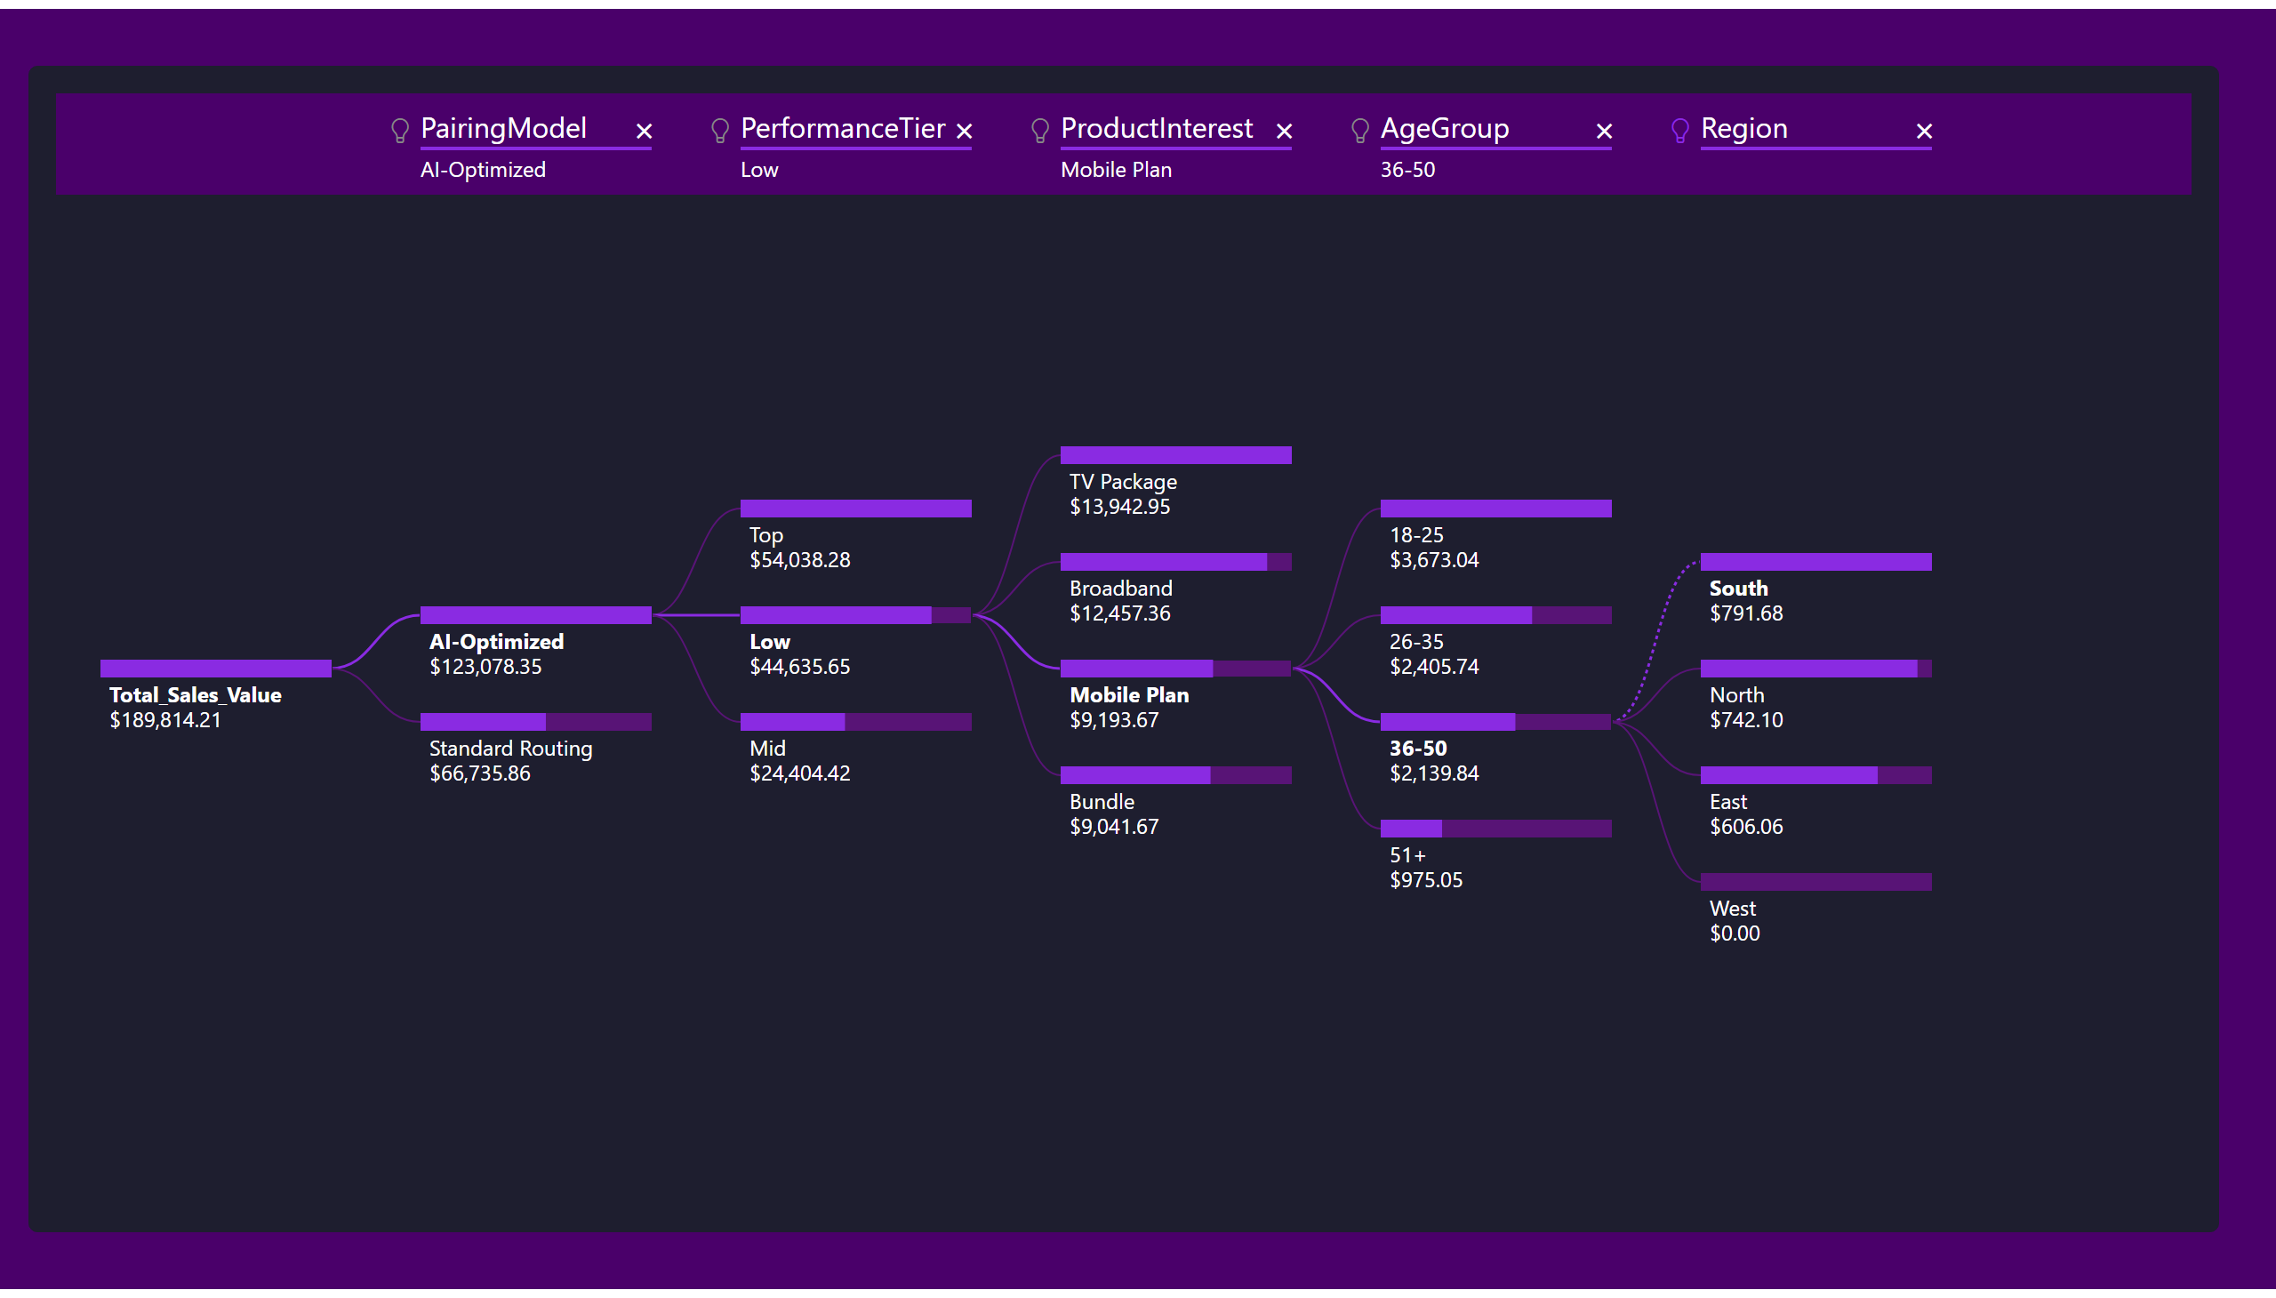
Notes:
decompositionTreeVisual
No alt text provided

Slide 6
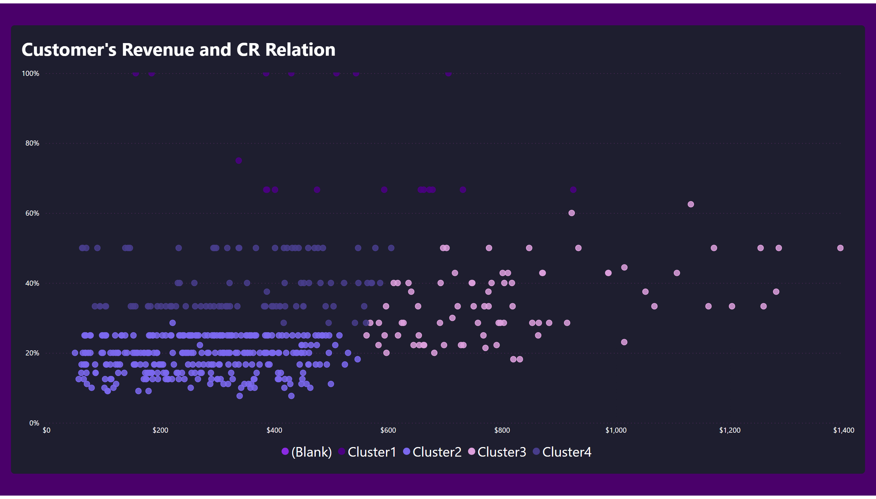
Notes:
Customer's Revenue and CR Relation
No alt text provided

