Slide 1
Identifying Anchor Client for clAIrvoyant
Presenters: Rao Abdul Hannan, Akylai Batyrbekova, Shreya Patchala
Notes:
Main title: 40 pt. Arial
Presenter Name: 16 pt. Arial
Presenters Title: 16 pt. Arial Italic

Slide 2



Team Urania
Rao Abdul Hannan
Akylai Batyrbekova
Shreya Patchala

Slide 3
Agenda
Background & Problem Statement
Executive Summary
Business Problem & Scope
Data Overview
Approach & Methods
Analysis & Findings
Implications & Conclusions

Slide 4
Background & Problem Statement
Presently a 'Challenger’ in the ATS domain
Become a ‘Leader’ by targeting high-demand industries, partnering with a market leader as an anchor client.
Identify potential anchor client through market analysis

Slide 5

Executive Summary
LinkedIn Job Postings Dataset Analysis (124,000 postings)
Healthcare, IT and Financial Services identified as key industries
Detailed market research
Thermo Fisher Scientific identified as potential anchor client
No third-party ATS system
1020% stock growth from 2010-2024
Skilled labor employment

Slide 6
Business Problem & Scope
Scope:
Focused on LinkedIn job postings data, analyzed industry job shares, salary effects, and geographical trends to support client targeting.
Goal:
Highlight sectors with the highest job demand and find a growing, financially stable anchor client for clAIrvoyant.

Slide 7
Data Overview
Sourced from LinkedIn
124,000 job postings
Messy & unfiltered
Industry details
Company Details
Salary details

Slide 8
Approach & Methods
Key Methods:
Identified key industries with the highest job market share
Identified top companies within the key industries
Investigated effect of salary on job postings
Geographical analysis of job distribution across states

Slide 9
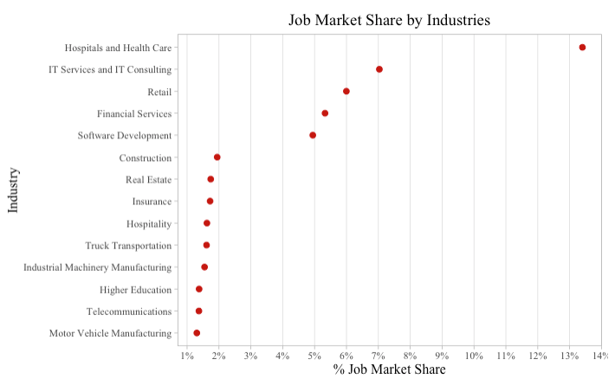
Analysis & Findings
Highest job market share for Hospitals & Health Care at 13.4%
Almost twice as much as IT Services
Staffing & Recruiting excluded from analysis

Slide 10
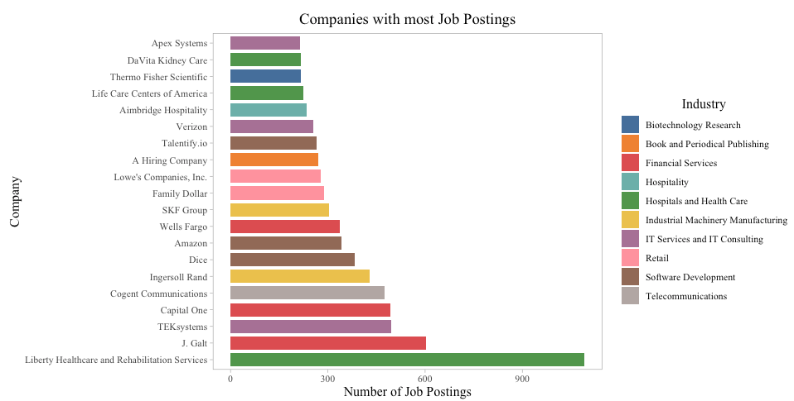
Analysis & Findings
Thermo Fisher in 18th

Slide 11
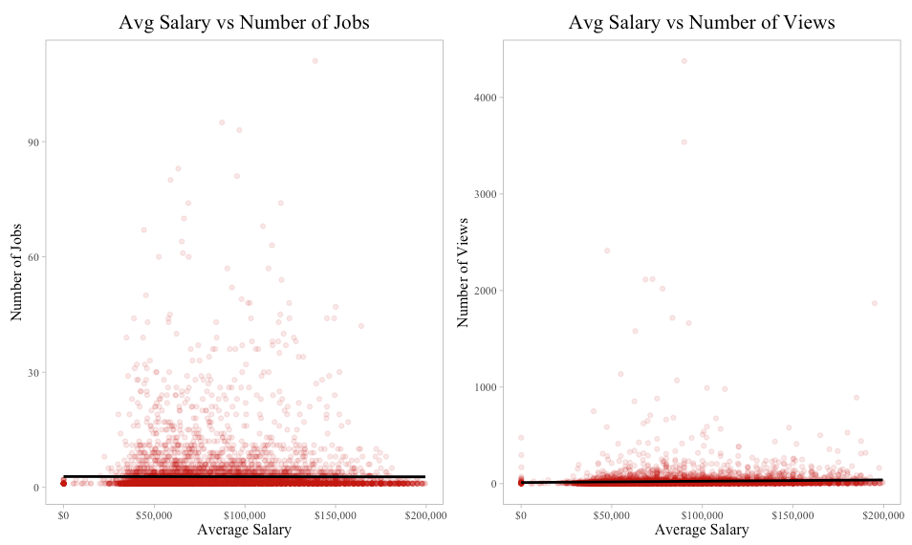
Analysis & Findings
Straight lines
Avg Salary has no association with job postings
Key Insight
Higher salaries does not translate to more job postings

Slide 12
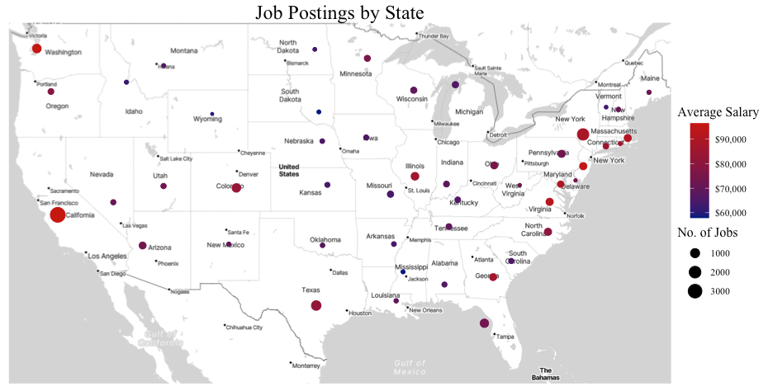
Analysis & Findings
Higher number of jobs in states with higher average salary
Key Insights
Avg salary and number of jobs vary by state
Presence in more states is a positive indicator

Slide 13
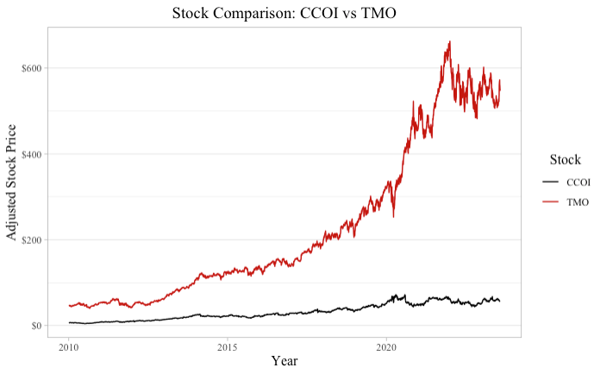
Analysis & Findings
Shortlisted Companies:
Cogent Communications (CCOI)
Thermo Fisher Scientific (TMO)

Slide 14
Implications & Conclusions
high job volume financial stability no third-party ats
Why it matters?
We recommend Thermo Fisher Scientific, a global leader in scientific instruments and consumables, serving healthcare, life sciences, and research industries.

Slide 15
Thermo Fisher Scientific- Business Profile
>120,000 Colleagues
$1.3B R&D Investment
$42B Revenue
Laboratory Products & Biopharma Services - $22.9B
Life Sciences Solutions - $9.5B
Analytical Instruments - $7.3B
Specialty Diagnostics - $4.4B

Slide 16
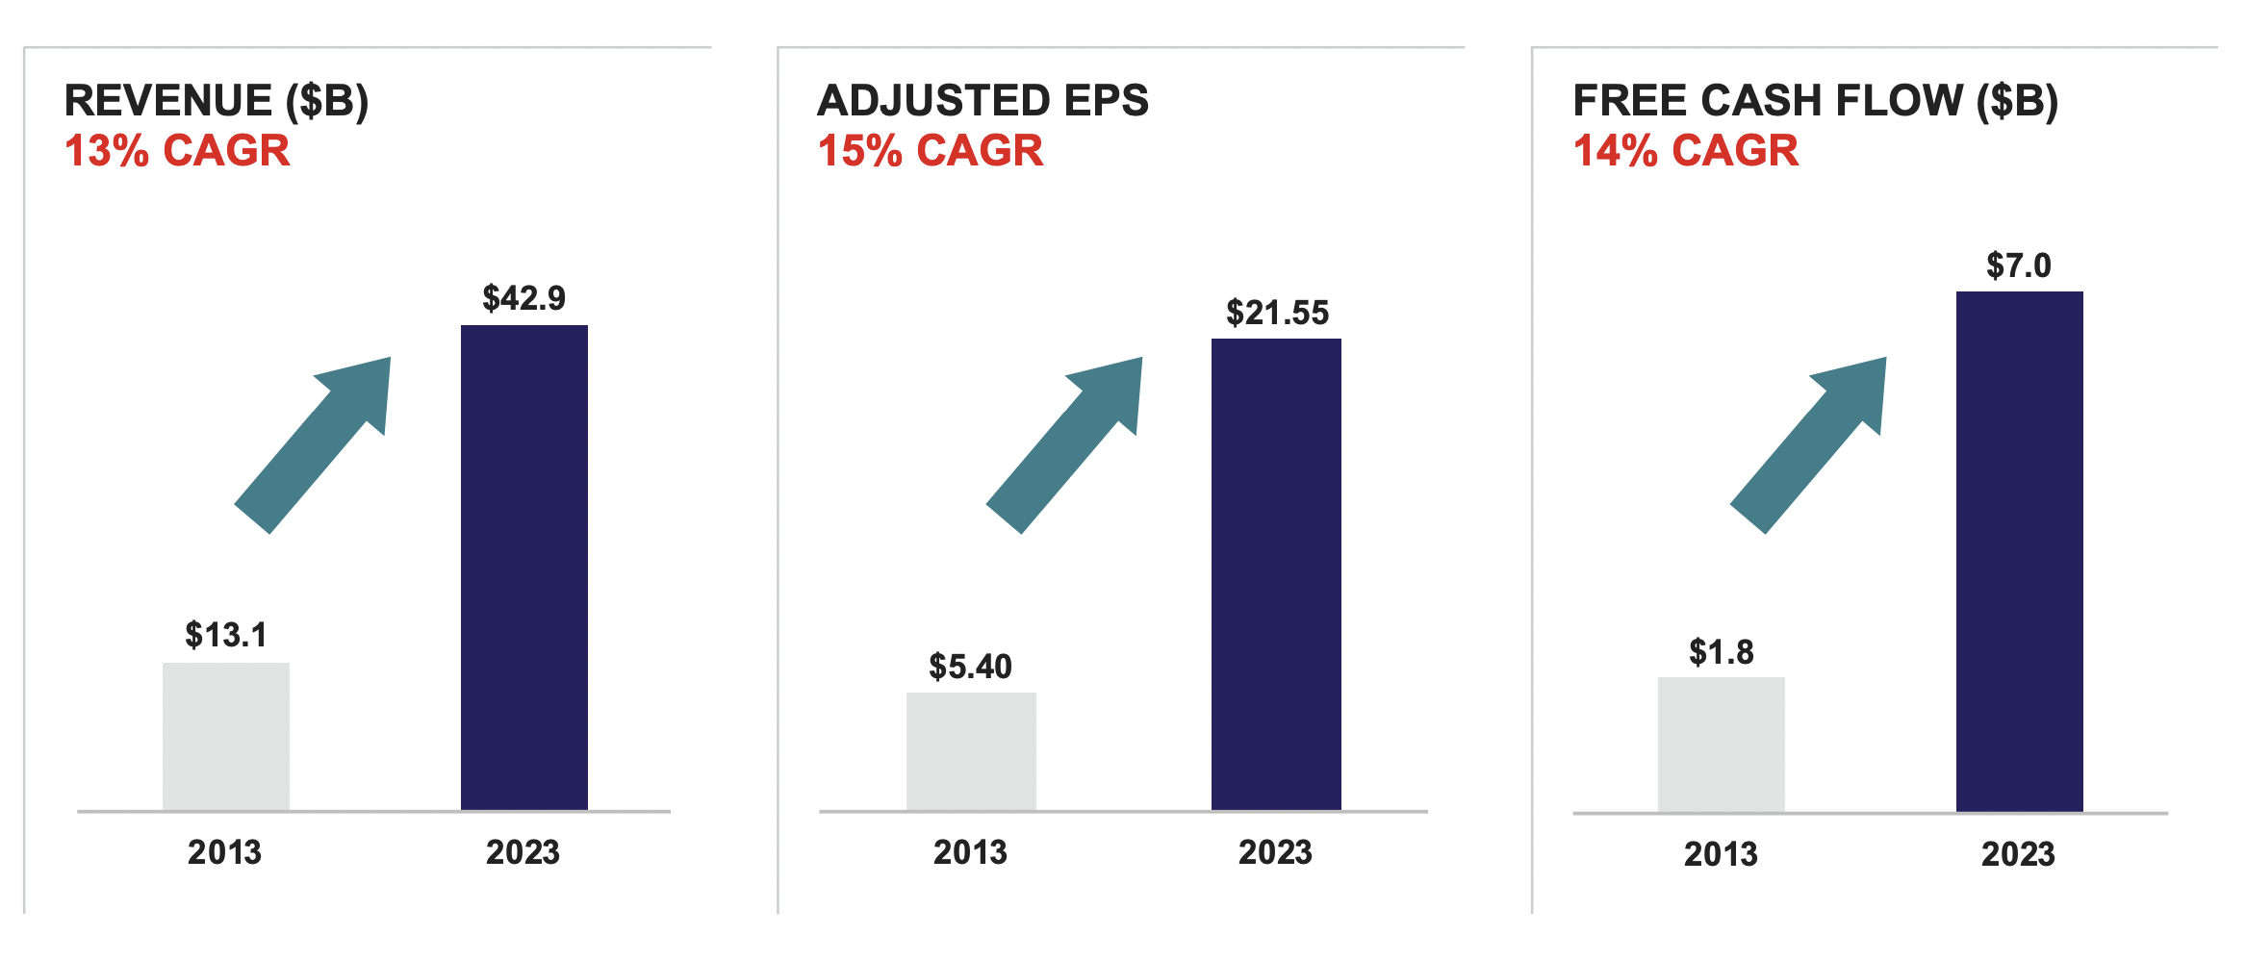
Thermo Fisher Scientific – Financial Profile

Slide 17
Next Steps
More inclusive and encompassing dataset
Advanced and robust statistical techniques

Slide 18
THANK YOU!

Slide 19
QUESTIONS?

Slide 20
Appendix
Regression Trend Line: A regression trend line is a line that best fits the data points in a scatter plot. It represents the relationship between two or more variables. In linear regression, the trend line is used to predict the value of one variable based on the value of another.
Adjusted EPS: EPS is a company’s earnings per share (EPS) after removing one-time items, non-recurring events, or extraordinary expenses. It provides a clearer picture of a company's profitability by focusing on the earnings from core operations.
Free Cash Flow: It is the cash that a company generates after accounting for cash outflows to support operations and maintain capital assets. It's a measure of how much cash a company has left over after expenses, which can be used for dividends, debt repayment, or reinvestment.

Slide 21
Appendix
More about Thermo Fisher Scientific: Formed in 2006 through the merger of Thermo Electron Corporation and Fischer Scientific, and has shown incredibly high growth over the past 14 years. World leader in serving science, with annual revenue over $42 billion.
Thermo Fisher Scientific Reports First Quarter 2024 Results:
First Quarter 2024 Highlights
First quarter revenue was $10.34 billion.
First quarter GAAP diluted earnings per share (EPS) increased 4% to $3.46.
First quarter adjusted EPS increased 2% to $5.11.
Second Quarter 2024 Highlights
Second quarter revenue was $10.54 billion.
Second quarter GAAP diluted earnings per share (EPS) increased 15% to $4.04.
Second quarter adjusted EPS increased 4% to $5.37.

