Slide 1

Project Introduction.
Project Statement
Project Statement: One of the leading vehicle fuel pump manufacturers. These pumps are used to take fuel as input and push fuel as output at a high velocity. More the velocity, more is the speed at which vehicle will move.
Prepared By: Muhammad Ali Talha

Slide 2
Project Leadership
Muhammad Ali Talha
Internee at 360digitmg
https://www.linkedin.com/in/raoalitalha/

Slide 3

Contents
Business objective
Business Constraints
Project Architecture
Data collection and details
Exploratory Data Analysis
Visualization
Modeling
Evaluation
Deployment
Notes:
Change

Slide 4
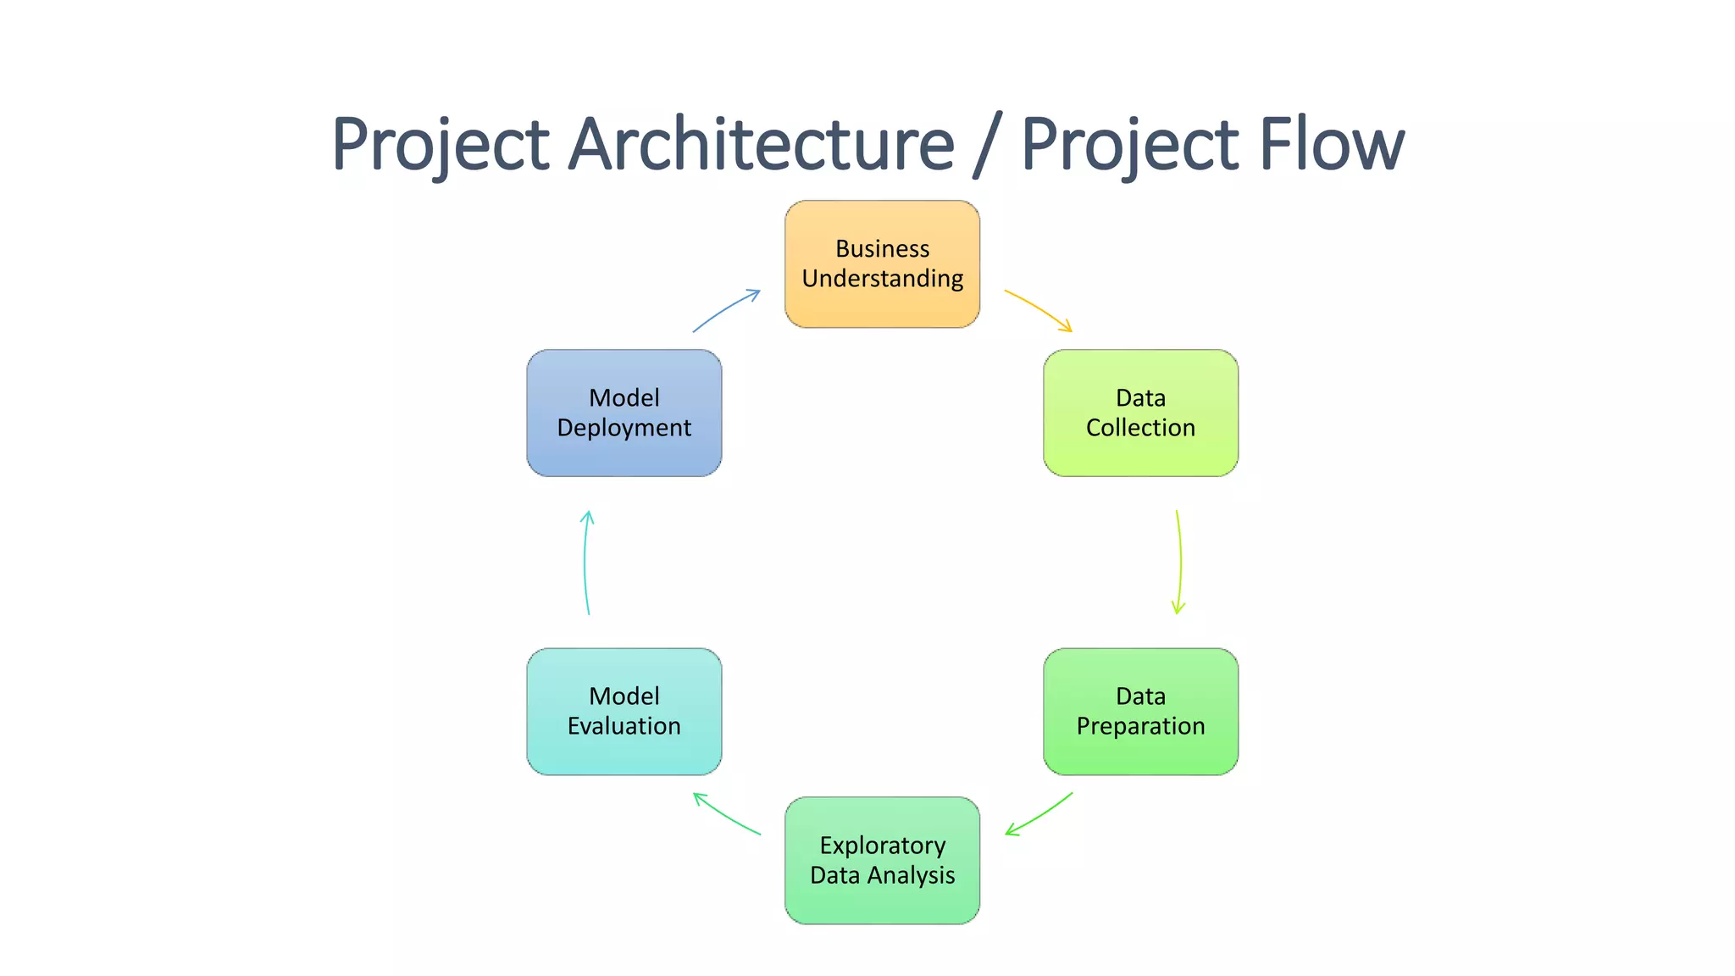
Project Overview and Scope

Slide 5
Business Problem
Business Problem: Machines which manufacture the pumps. Unplanned machine downtime which is leading to loss of productivity.

Slide 6
Business Objective
Objective
Constraints
Minimize unplanned machine downtime.
Minimize maintenance cost.

Slide 7
CRISP-ML(Q) Methodology
There are six stages of CRISP-ML(Q) Methodology
1.Business and data understanding
2.Data preparation
3.model building
4.Model evaluation
5.Model deployment
6.Monitoring and maintenance

Slide 8
Technical Stacks
Excel
SQL
Python
Draw.io
Google Scholar

Slide 9
Data Collection and Understanding
Data was collected from the machines and analyzed its different variable which may affect the performance of the machine performance and c=also cause the machine downtime.The various component of the machinery along with some info about the machine structure was compiled and gather.
Following are the variables:
Date
Machine_ID
Assembly_Line_No
Hydraulic_Pressure(bar)
Coolant_Pressure(bar)
Air_System_Pressure(bar)
Coolant_Temperature
Hydraulic_Oil_Temperature(Â°C)
Spindle_Bearing_Temperature(Â°C)
Spindle_Vibration(Âµm)
Tool_Vibration(Âµm)
Spindle_Speed(RPM)
Voltage(volts)
Torque(Nm)
Cutting(kN)
Downtime

Slide 10
Data Information
Based on the summary of statistics, the following columns have potential data quality issues that you should investigate:
Torque(Nm):
The minimum value is `0.0 Nm`, which is unusual for torque data. Investigate `why there are zero values` and whether they are valid. Depending on the context, these values might indicate an issue with data collection or entry.
Spindle_Speed(RPM):
The minimum value `is 0.0 RPM`, which is unusual for spindle speed. Investigate `why there are zero values` and whether they are valid. Similar to torque, these values might indicate an issue with data collection or entry.
Spindle_Vibration(µm):
The range of values seems reasonable, but `there's a negative minimum value (-0.461 µm)`. Check whether negative values make sense in the context of spindle vibration measurements.
Hydraulic_Pressure(bar):
The minimum value is `-14.326454 bar`, which is unusual for pressure data. `Investigate why there are negative values` and whether they are valid. Negative pressure values are unexpected.
Coolant_Temperature:
The minimum temperature is `10.4°C`, which is relatively low for a coolant temperature. Investigate whether this value is within the valid range for coolant temperature. The maximum value of 98.2°C is also relatively high and should be validated.

Slide 11
Data Dictionary
Column Name | No of NAN rows | Data Type
Machine_ID | 2500 | object
Assembly_Line_No | 2500 | object
Hydraulic_Pressure(bar) | 2490 | float64
Coolant_Pressure(bar) | 2481 | float64
Air_System_Pressure(bar) | 2483 | float64
Coolant_Temperature | 2488 | float64
Hydraulic_Oil_Temperature(°C) | 2484 | float64
Spindle_Bearing_Temperature(°C) | 2493 | float64
Spindle_Vibration(µm) | 2489 | float64
Tool_Vibration(µm) | 2489 | float64
Spindle_Speed(RPM) | 2494 | float64
Voltage(volts) | 2494 | float64
Torque(Nm) | 2479 | float64
Cutting(kN) | 2493 | float64
Downtime | 2500 | object

Slide 12
System Requirements
Official NDA
Project Charter
Data Analytics Checklist
Research Tracker
EDA on Python
EDA on SQL
Data Collection
Project Architecture
Final Presentation on findings

Slide 13
Exploratory Data Analysis [EDA]
EDA was performed on SQL and Python to explore the data and clean the data.
SQL has its limitation so onlyt he information about the mean, meadian, mode, SD, Variance and general mathematical operation was performed.
Later we performed EDA on Python. To get deep dive into out data.
We found missing values in the data.
Outliers were detected in the outliers, but they were easy to handle.
Different relationship between different variable was taken place to get to know more insides about the data.
Notes:
EDA is used for seeing what the data can tell us before the modeling task.
Change

Slide 14
Missing Values Observation
Column_Name | Missing_Value_Percentage
Date | 0
Machine_ID | 0
Assembly_Line_No | 0
Hydraulic_Pressure(bar) | 0.4
Coolant_Pressure(bar) | 0.76
Air_System_Pressure(bar) | 0.68
Coolant_Temperature | 0.48
Hydraulic_Oil_Temperature(°C) | 0.64
Spindle_Bearing_Temperature(°C) | 0.28
Spindle_Vibration(µm) | 0.44
Tool_Vibration(µm) | 0.44
Spindle_Speed(RPM) | 0.24
Voltage(volts) | 0.24
Torque(Nm) | 0.84
Cutting(kN) | 0.28
Downtime | 0

Slide 15
Data Preprocessing
First Moment of Business Decision:
- Summary of Statistical Analysis for Various Parameters:
- Hydraulic Pressure: Mean: 101.41, Median: 96.76
- Coolant Pressure: Mean: 4.95, Median: 4.94
- Air System Pressure: Mean: 6.50, Median: 6.51
- Coolant Temperature: Mean: 18.56, Median: 21.20, Mode: 35.6
- Hydraulic Oil Temperature: Mean: 47.62, Median: 47.70, Mode: 50.1
- Spindle Bearing Temperature: Mean: 35.06, Median: 35.10, Mode: 37.6
- Spindle Vibration: Mean: 1.01, Median: 1.01, Mode: 1.236
- Tool Vibration: Mean: 25.41, Median: 25.46, Mode: 29.79
- Spindle Speed: Mean: 20274.79, Median: 20137.50, Mode: 17919
- Voltage: Mean: 348.99, Median: 349.00, Mode: 349
- Torque: Mean: 25.23, Median: 24.65, Mode: 24.65
- Cutting Force: Mean: 2.78, Median: 2.78, Mode: 2.78
- Outliers may be present in some parameters, especially when the mean and median values differ significantly. Other parameters exhibit relatively stable distributions with close mean and median values.

Slide 16
Data Preprocessing
Second Moment of Business Decison
- Variance and Standard Deviation: High variance and standard deviation in hydraulic pressure suggest significant pressure fluctuations, while low values for coolant and air system pressure indicate more stable conditions.
- Minimum and Maximum: The minimum and maximum values show the range of each parameter, helping identify potential issues (e.g., negative pressure readings for hydraulic pressure).
- Data Stability: Understanding variance and standard deviation aids in evaluating data stability and consistency, supporting informed business decisions and quality control.
Notes:
Keep observations

Slide 17
Data Preprocessing
Third momemnt of Business Decision:
Coolant Pressure (bar):
Positive skewness (0.147081) suggests a right-skewed distribution with a longer right tail, indicating higher-than-average values.
Air System Pressure (bar):
Slight negative skewness (-0.052899) implies a left-skewed distribution with a slightly longer left tail, suggesting lower-than-average values.
Coolant Temperature:
Positive skewness (0.108301) indicates a right-skewed distribution with a longer right tail, signifying the presence of higher-than-average temperatures.
Hydraulic Oil Temperature (°C):
Skewness close to zero (-0.002291) suggests an approximately symmetric distribution, with data points evenly distributed around the mean.
Spindle Bearing Temperature (°C):
Slight negative skewness (-0.035942) hints at a left-skewed distribution with a slightly longer left tail, indicating lower-than-average temperatures.
Spindle Vibration (µm):
Skewness close to zero (0.001532) indicates an approximately symmetric distribution, with data points evenly distributed around the mean.
Tool Vibration (µm):
Negative skewness (-0.061005) implies a left-skewed distribution with a longer left tail, suggesting lower-than-average tool vibrations.
Notes:
Add graphical

Slide 18
Data Preprocessing
Spindle Speed (RPM):
Moderately negative skewness (-0.172475) indicates a left-skewed distribution with a noticeable left tail, suggesting lower-than-average spindle speeds.
Voltage (volts):
Negative skewness (-0.028658) implies a slight left-skew, with a slightly longer left tail and some lower-than-average voltage readings.
Torque (Nm):
Positive skewness (0.030578) suggests a right-skewed distribution with a longer right tail, indicating higher-than-average torque values.
Cutting (kN):
Positive skewness (0.113963) implies a right-skewed distribution with a longer right tail, suggesting higher-than-average cutting force values.
Notes:
Add graphical

Slide 19
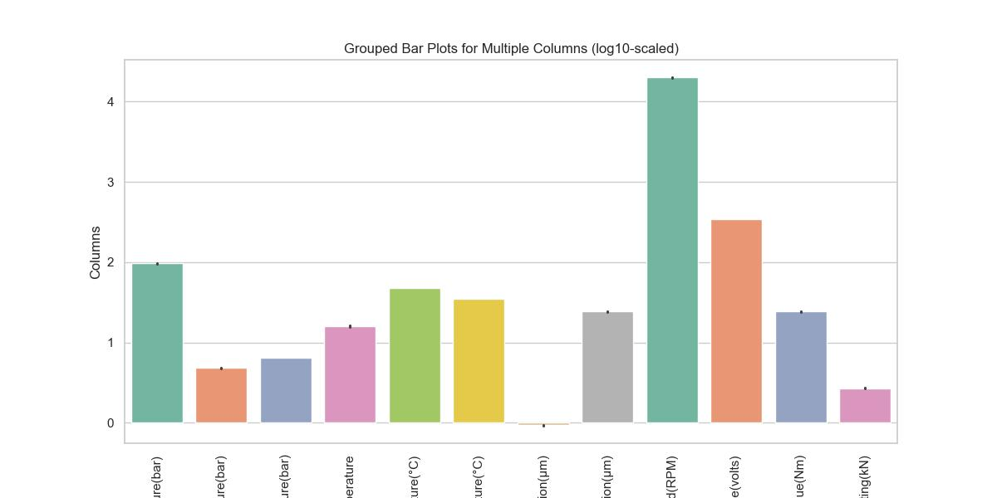
Data Visualization

Slide 20
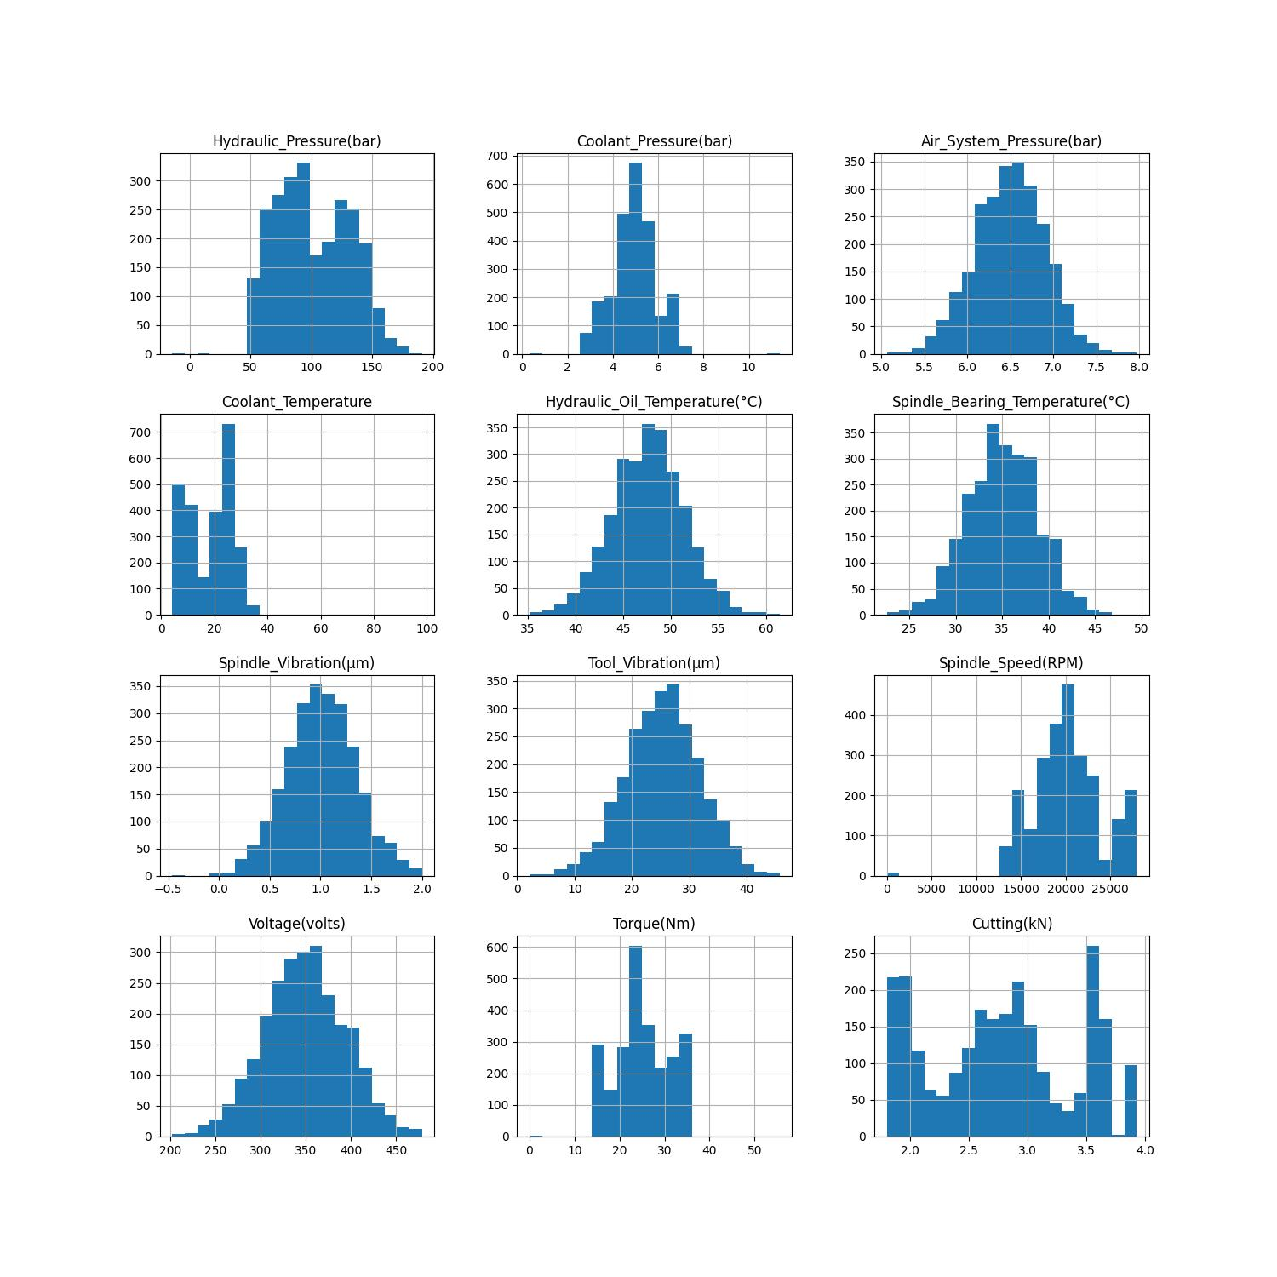
Data Visualization

Slide 21
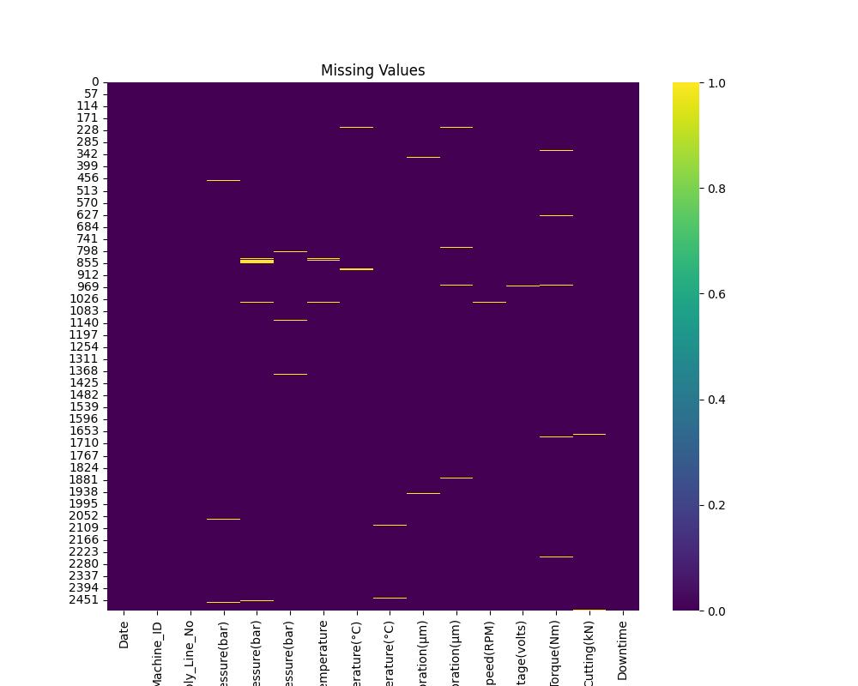
Data Visualization

Slide 22

Queries ?

Slide 23


