Slide 1
BLAS and LAPACK
Devin A. Matthews
UT Austin
MolSSI Software Summer School 2017

Slide 2
BLAS and LAPACK
Dense Linear Algebra (DLA) is the field of operations on vectors and matrices.
The “dense” part refers to the fact that all of the vector and matrix elements may be non-zero. There are also extensions of BLAS and LAPACK for sparse matrices.
The BLAS includes basic operations like matrix multiplication, while LAPACK builds on the BLAS to calculate eigenvalues and –vectors, solutions of linear systems, matrix factorizations, etc.

Slide 3
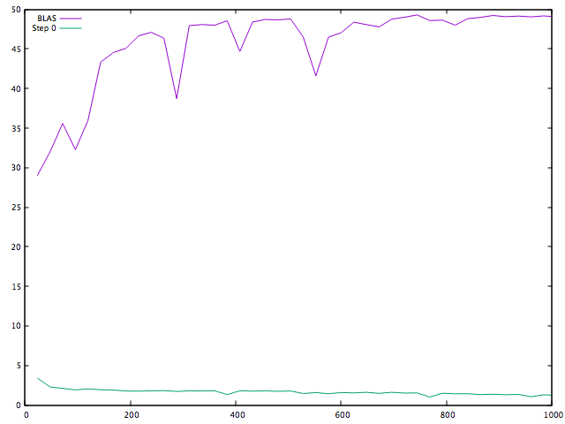
Why do I need a library?
GFLOP/s
Matrix size (n)

Slide 4
BLAS and LAPACK
The traditional BLAS and LAPACK implementations are in Fortran.
Modern implementations are in C or C++, but still export a Fortran interface.
This means that:
All parameters are pointers.
The name is mangled (usually a _ gets added).
Fortran INTEGER != C/C++ int.

Slide 5
BLAS and LAPACK
(Almost) all BLAS and LAPACK routines support four data types:
Single precision (float, real*4)
Double precision (double, real*8)
Single complex (std::complex<float>, complex*8)
Double complex (std::complex<double>, complex*16)
The data type for an operation is denoted by a prefix: s (single), d (double), c (single complex), or z (double complex).
Ex: zdotc = double complex dot product with conjugation

Slide 6
The anatomy of vectors and matrices
Vector
length = n
Matrix
rows = m
columns = n
Increment between elements
in a row (the Leading Dimension)
is usually m, but can be more
base_ptr →
base_ptr →
increment between elements
in a column is always 1
(column-major)
INCrement between elements
usually 1, but can be more
The i^{th}
element is
base_ptr[i*inc]
The (i,j)^{th} element is base_ptr[i + j*ld]

Slide 7
BLAS
BLAS includes three levels:
Level 1: vector-vector operations such as:
Dot product
Vector scaling
Scale and accumulate (AXPY)
Level 2: matrix-vector operations such as:
Matrix-vector product
Outer product (rank-1 update)
Level 3: matrix-matrix operations such as:
Matrix-matrix product
Triangular solve
Symmetric rank-k update

Slide 8
BLAS level 1 examples
y_{i} = y_{i} + α*x_{i}
daxpy(integer n, real*8 alpha, real*8 x, integer incx,
real*8 y, integer incy)
result = Σ_{i} x_{i}*y_{i}
complex*16 zdotc(integer n, complex*16 x, integer incx,
complex*16 y, integer incy)
zdotc(integer n, complex*16 x, integer incx,
complex*16 y, integer incy,
complex*16 result)

Slide 9
BLAS level 2 examples
A_{ij} = α*x_{i}*y_{j} + A_{ij}
dger(integer m, integer n, real*8 alpha,
real*8 x, integer incx,
real*8 y, integer incy, real*8 A, integer lda)
y_{i} = Σ_{j} α*op(A_{ij})*x_{j} + β*y_{i}
sgemv(character*1 trans, integer m, integer n,
real*4 alpha, real*4 A, integer lda,
real*4 x, integer incx,
real*4 beta, real*4 y, integer incy)

Slide 10
BLAS level 3 example
C_{ij} = Σ_{p} α*op_{A}(A_{ip})*op_{B}(B_{pj}) + β*C_{ij}
dgemm(character*1 transa, character*1 transb,
integer m, integer n, integer k,
real*8 alpha, real*8 A, integer lda,
real*8 B, integer ldb,
real*8 beta, real*8 C, integer ldc)

Slide 11
LAWrap
This is a header library I wrote to make using BLAS/LAPACK in C and C++ a little easier.
Give arguments by values instead of by reference (pointer).
Const-correct interface.
Function overloading (e.g. “gemm”).
Automatically allocate workspace in LAPACK.
CBLAS and LAPACKe are also good low-level interfaces.

Slide 12
LAPACK
Symmetric (Hermitian) Eigenvalue Problems
Generalized Eigenvalue
Problems
Non-symmetric Eigenvalue Problems
Matrix Factorizations and Linear Equations
(This is Cholesky + triangular solve, not inverse square root!)

Slide 13
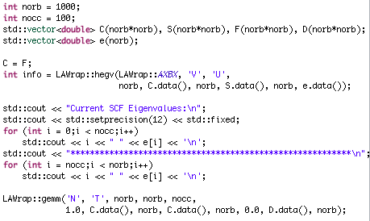
LAPACK example
(FOR EXAMPLE ONLY, also may have bugs/missed steps)

Slide 14
BLAS and LAPACK libraries
Netlib (http://www.netlib.org/blas) (OSS)
Reference implementation; really slow.
Intel Math Kernel Library (MKL) (free)
Optimized BLAS, LAPACK, FFT, etc.
AMD Compute Library (ACL) (OSS)
AMD vendor BLAS/LAPACK
IBM Engineering and Scientific Subroutine Library (ESSL)
IBM vendor BLAS/LAPACK (e.g. BlueGene/Q, POWER)
OpenBLAS (OSS)
Optimized BLAS and Netlib LAPACK
BLIS (OSS)
Optimized BLAS
libflame (OSS)
Some LAPACK operations optimized
Apple Accelerate
Default BLAS and LAPACK on OSX/macOS

Slide 15
Wrapper libraries
Wrapper libraries offer convenient interfaces in higher-level languages. Here is a non-exhaustive list for C++:
Eigen
Boost::uBLAS
Armadillo
CPPLapack
The “CPPBlas” project is unrelated.
Distributed-memory BLAS and LAPACK:
Elemental
ELPA
PBLAS, ScaLAPACK

Slide 16
Questions

