Slide 1
Debugging in C++
Devin A. Matthews
UT Austin
MolSSI Software Summer School 2017

Slide 2
"Debugging is twice as hard as writing the code in the first place. Therefore, if you write the code as cleverly as possible, you are, by definition, not smart enough to debug it." - Brian W. Kernighan.

Slide 3
What exactly is a “bug”?
Compile-time bugs:
Syntax errors
Semantic errors
(Warnings)
Link-time bugs:
Missing symbols
Duplicate symbols
Fatal run-time bugs:
Segmentation fault
Assertion failure
Exceptions
Non-fatal run-time bugs:
Garbage output
Subtly wrong output

Slide 4
Compile-time bugs
C++ is notorious for generating insanely long (but detailed) error messages.
Fortunately, GCC and Clang have made a lot of progress in making these readable.
If you don’t have a recent version of one of these that can output errors in color, then upgrade!

Slide 5
Syntax errors
Syntax errors are when the compiler can’t parse your code as valid C++.
These are usually pretty easy to fix:
Missing ;
Unbalanced (), [], or {}
Unbalanced #if/#ifdef…#endif
Missing function return type
Return type on constructor or destructor
Cat on the keyboard

Slide 6
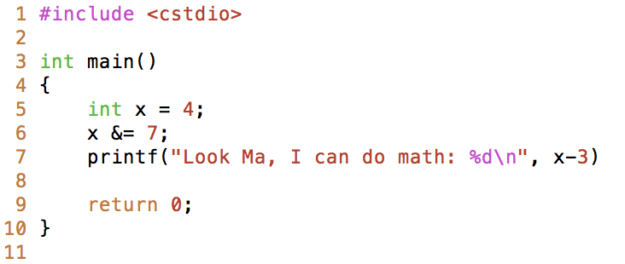
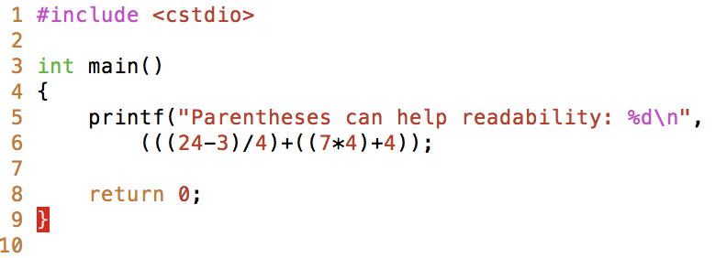
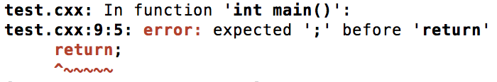
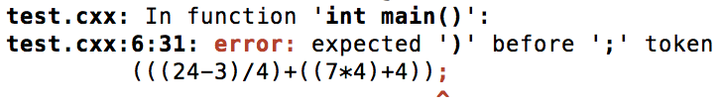
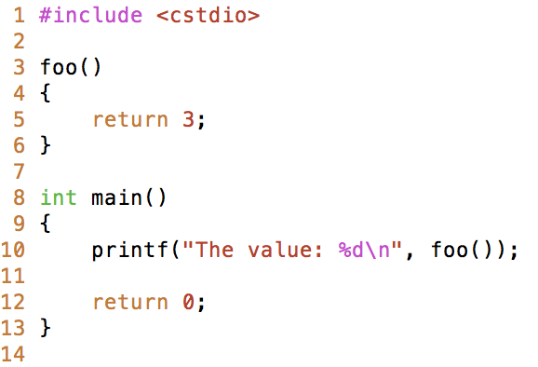
Syntax error examples (make sample[1-3].x)

Slide 7
Semantic errors
Semantic errors parse as C++, but don’t make sense to the compiler.
Undefined variable, function, member, or type.
This is usually a typo or missed header file
Discarded qualifier (usually const)
Your program is not const-correct!
Use of incomplete type
For a class, this means you have the forward declaration but not the definition. Can also refer to uses of void.
Member access in non-class type
Either a typo, or accidentally using “.” instead of “->” on a pointer.
“No match for…”
This covers a number of errors related to name lookup and overload resolution

Slide 8
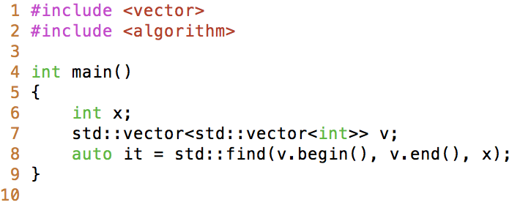
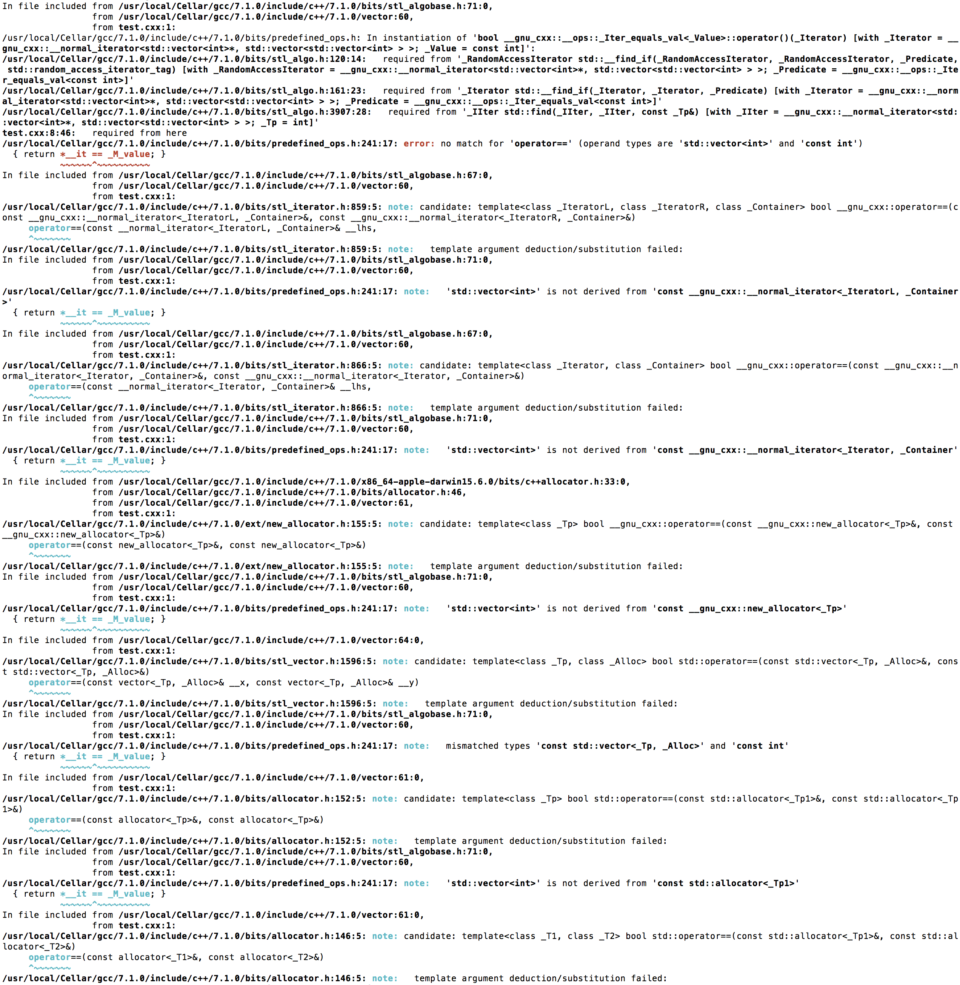
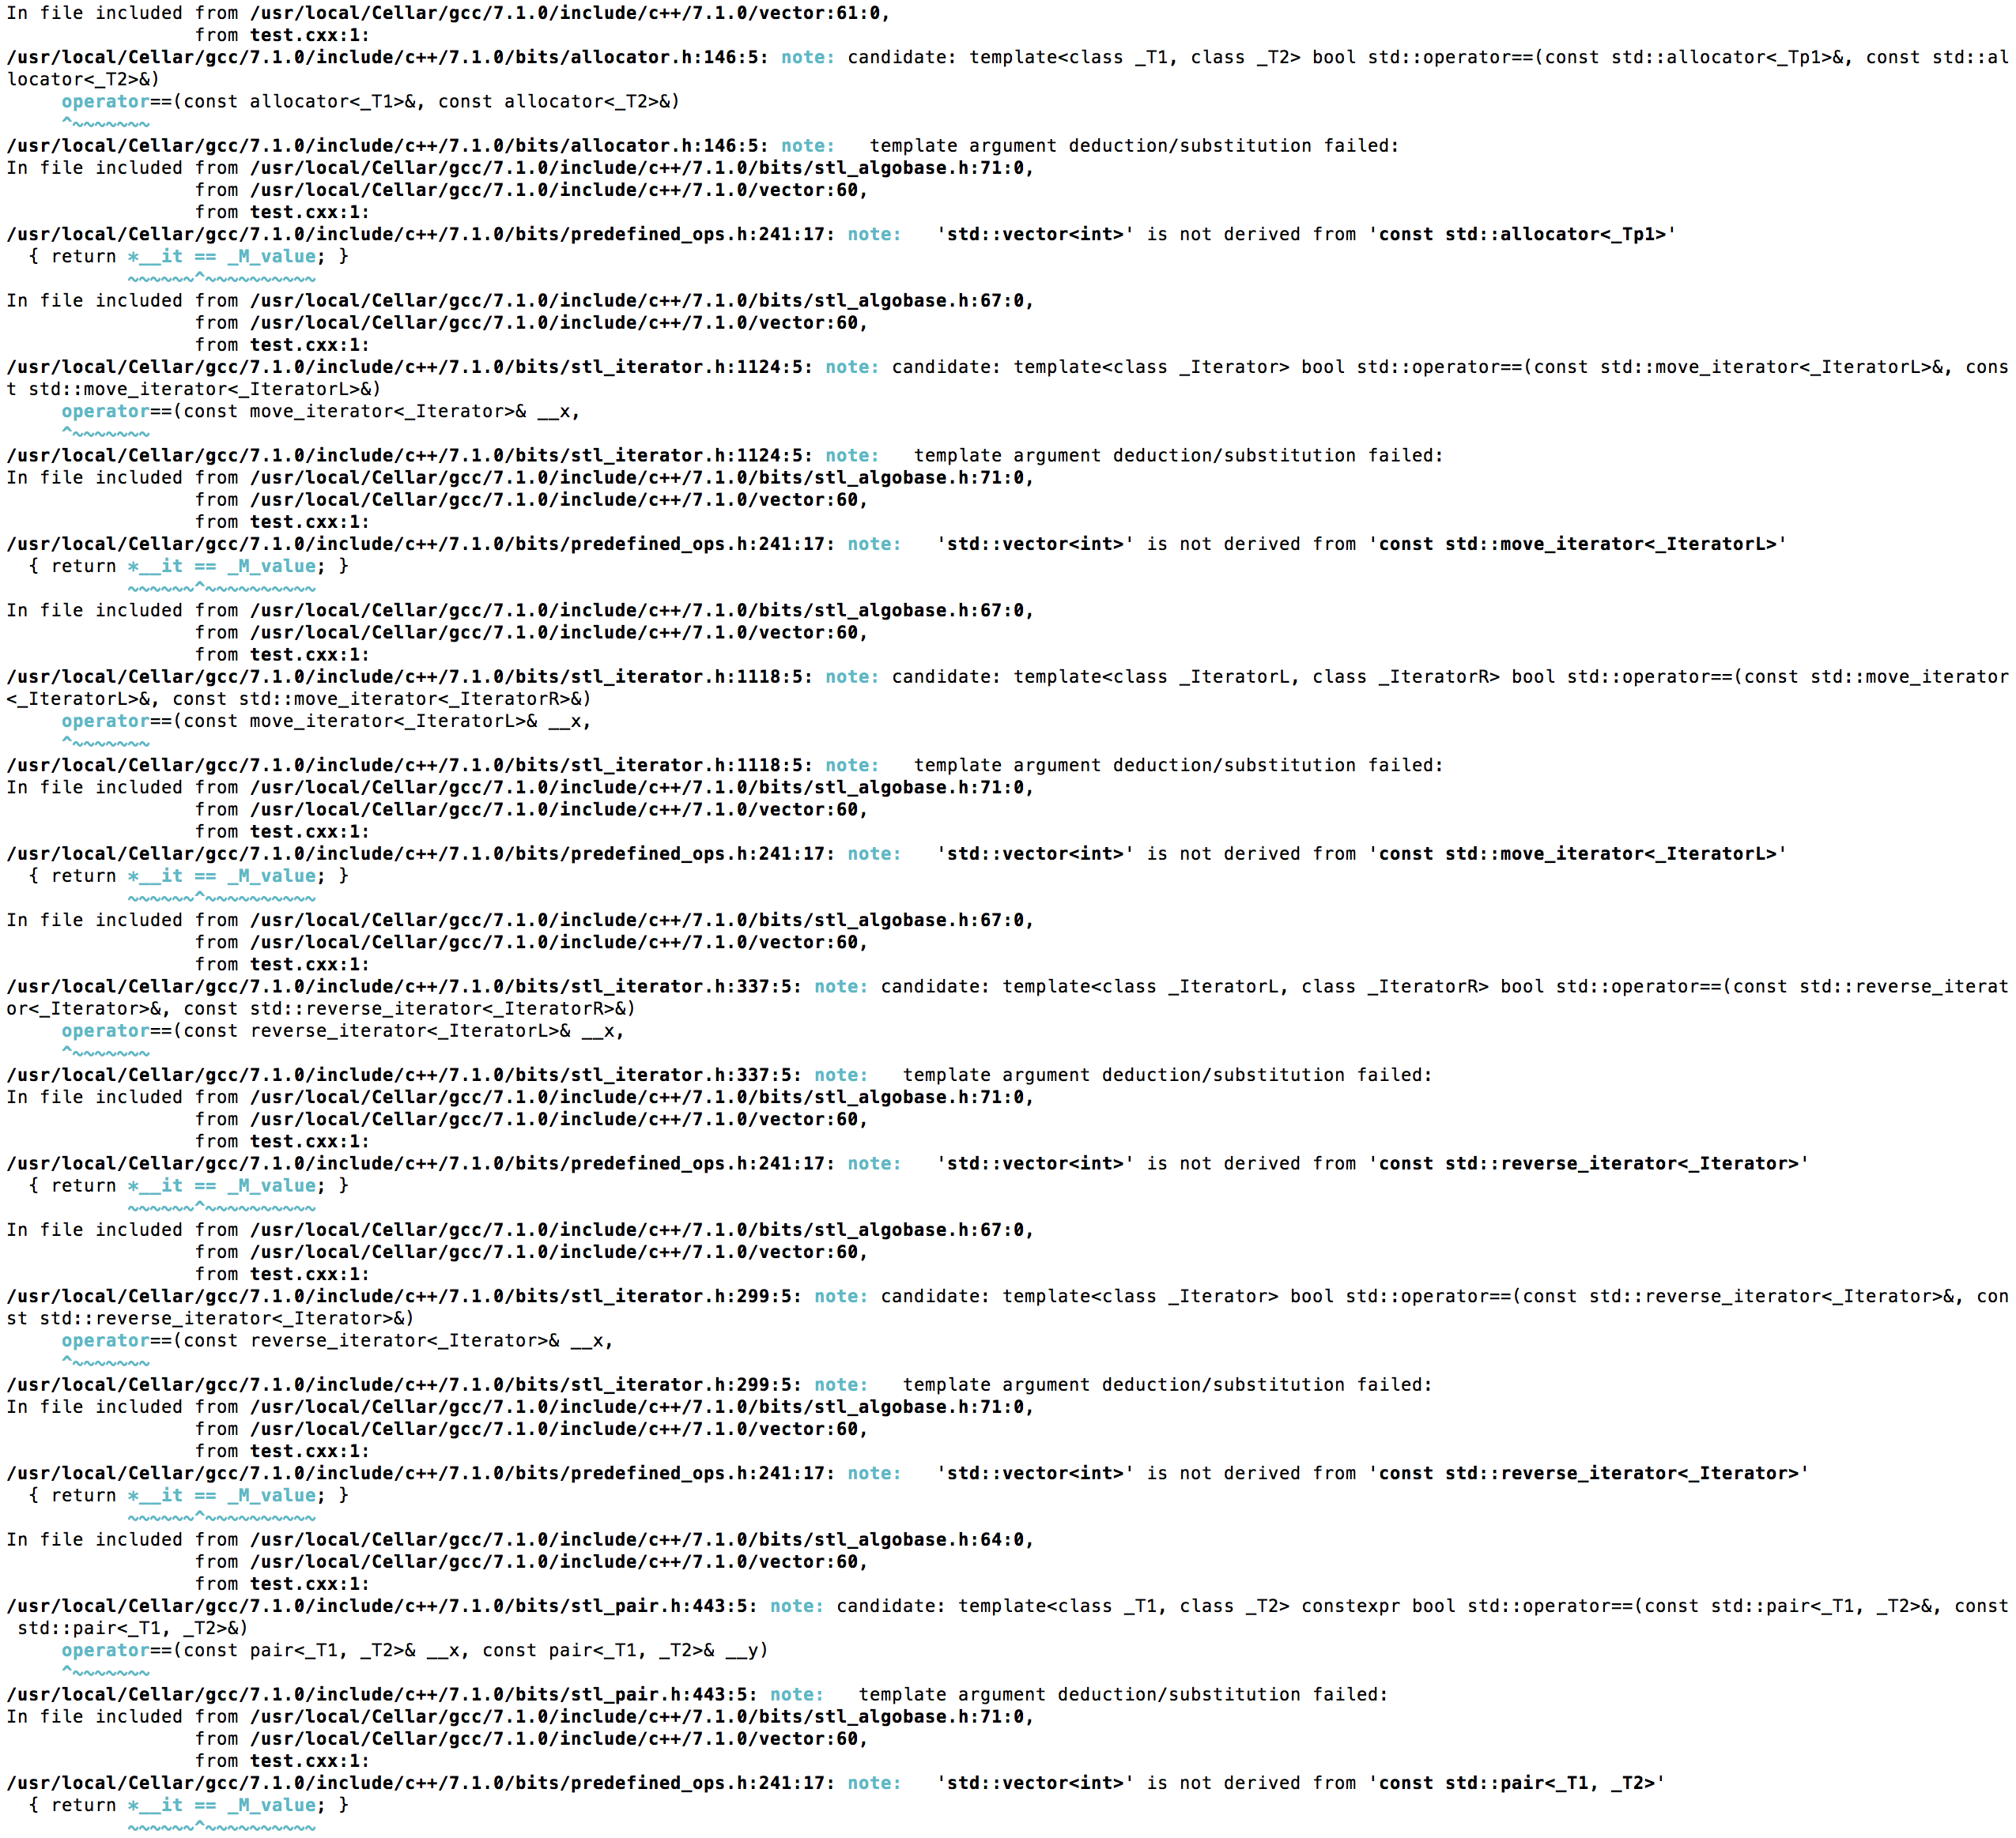
“No match for …” (make sample4.x)

Slide 9
“No match for …” part I
The first part tells you where the error occurred and how the compiler got there.
The error itself occurred here:
The problem could be anywhere in between.
But you (the programmer) started it off here:

Slide 10
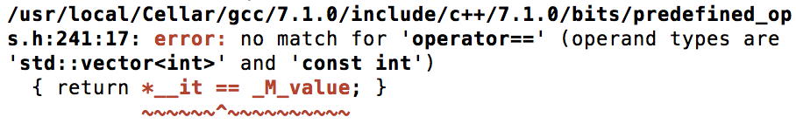
“No match for …” part II
The second part tells you what specific error occurred. This is generally in red, and is the most important part of the message. Go here first.
In this case, it’s telling us:
“You tried to do ‘std::vector<int> == const int’, but I can’t find an operator to do that.”

Slide 11
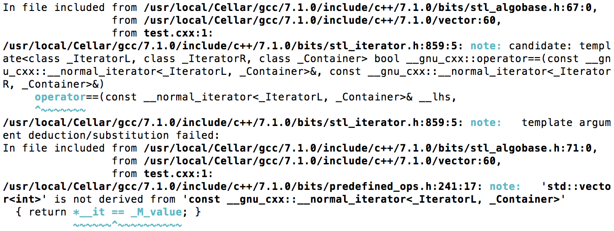
“No match for …” part III
The last part lists all of the candidates that the compiler considered. For each one, it will give a reason why that candidate was rejected.
In this case, the candidate is an operator having to do with iterators, but neither std::vector<int> nor const int are iterators.

Slide 12
“No match for …” part IV
There are three main reasons for getting the “no match for…” error:
The compiler is trying to call a different function than you intended.
This is our case, because we want to call operator==(int, int) for sorting. The fact that it wants to call it with std::vector<int> is a clue.
The compiler is trying to call the right function, but it is not a candidate.
This could be a problem with name lookup or visibility.
The compiler is trying to call the right function, but it is rejected as a candidate.
Perhaps there is a problem with type conversion or type constraints through std::enable_if? This is the hardest one to diagnose.

Slide 13
The gray area
C++ is very complex to parse, in particular because how you parse an expression can depend on what types it involves.
Some semantic errors actually show up as syntax errors, which can be very confusing.

Slide 14
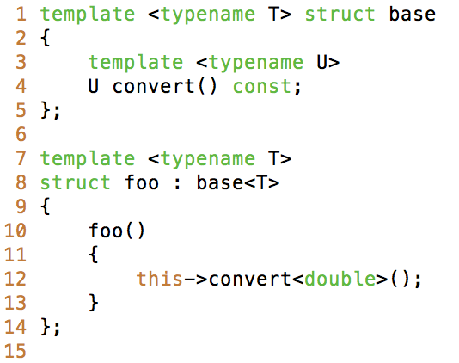
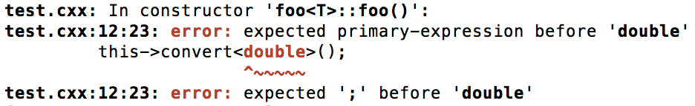
Gray area examples (make sample5.x)
GCC
Clang is quite a bit more helpful:

Slide 15
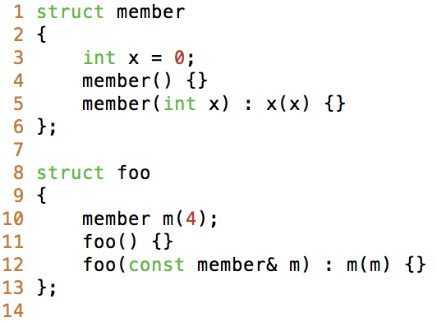
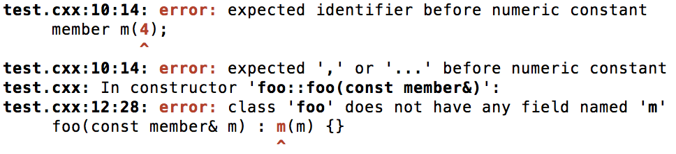
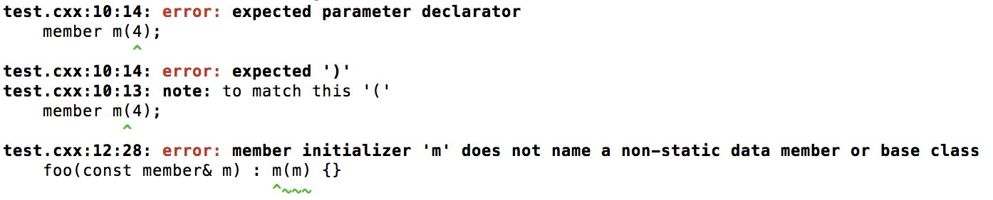
Gray area examples (make sample6.x)
GCC
Clang

Slide 16
Link-time errors
The linker may complain that it cannot find a symbol (a symbol is either a variable or function). Here are some common causes:
Typo
Does the signature of the function definition match the prototype?
Are you including all of the right object files and libraries?
Is the template instantiation visible?
This can happen if the template is defined in a different place than it is declared.
The linker may also complain that there are duplicate symbols. Common reasons:
A non-inline function in a header file.
Functions in different files accidentally share a name.
Object file included twice.

Slide 17
Run-time errors
If the program compiles and links, then one of three things can happen when you run it:
It runs correctly (yay!).
It finishes, but gets the wrong result.
It doesn’t finish (crashes).
The most common type of a crash is a segmentation fault (segfault, sometimes you also get the related bus error). This means the program tried to access a region of memory that it wasn’t assigned.

Slide 18
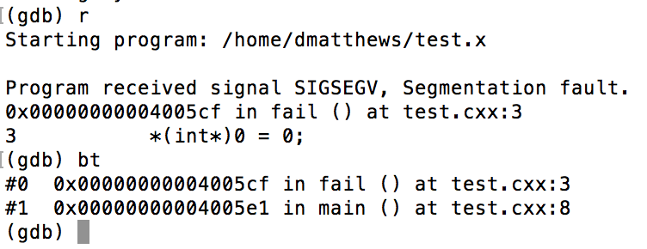
Debugging segfaults I (make sample7.x)
The first step in debugging a segfault is to find out where the program crashed.
The best thing to do is use a debugger for this, such as gdb or lldb.
Compile with debugging turned on: -g –O0
Run in the debugger: gdb ./sample7.x
Get a backtrace:
It died here
These are the stack frames at the time of failure. They represent all of the functions called to get to this point.

Slide 19
Debugging segfaults II
The reason that the program segfaulted may be immediately evident if the root cause it the same place the error occurs (a direct segfault).
But, the real error may have occurred way back somewhere, and silently corrupted the memory in a way that caused the segfault later on (an indirect segfault).
This comes in two flavors: heap corruption and stack corruption.
Lastly, the error could be due undefined behavior. This is generally caused by reading uninitialized data.

Slide 20
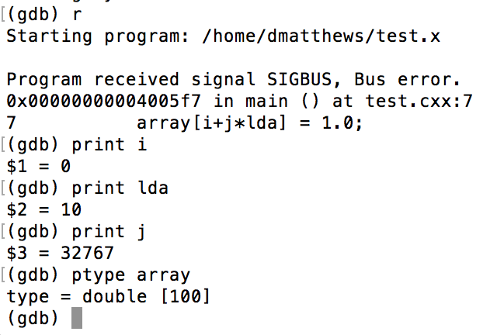
Debugging segfaults III (make sample8.x)
If the problem doesn’t look like it is caused by a direct segfault, we have to follow the chain of causality backwards until we find the error.
The debugger can help with this by examining variables, moving through the stack frames, and setting breakpoints and watchpoints.
“print” is pretty versatile, for example it can print the result of an expression:
(gdb) print i+j*lda
$4 = 327670

Slide 21
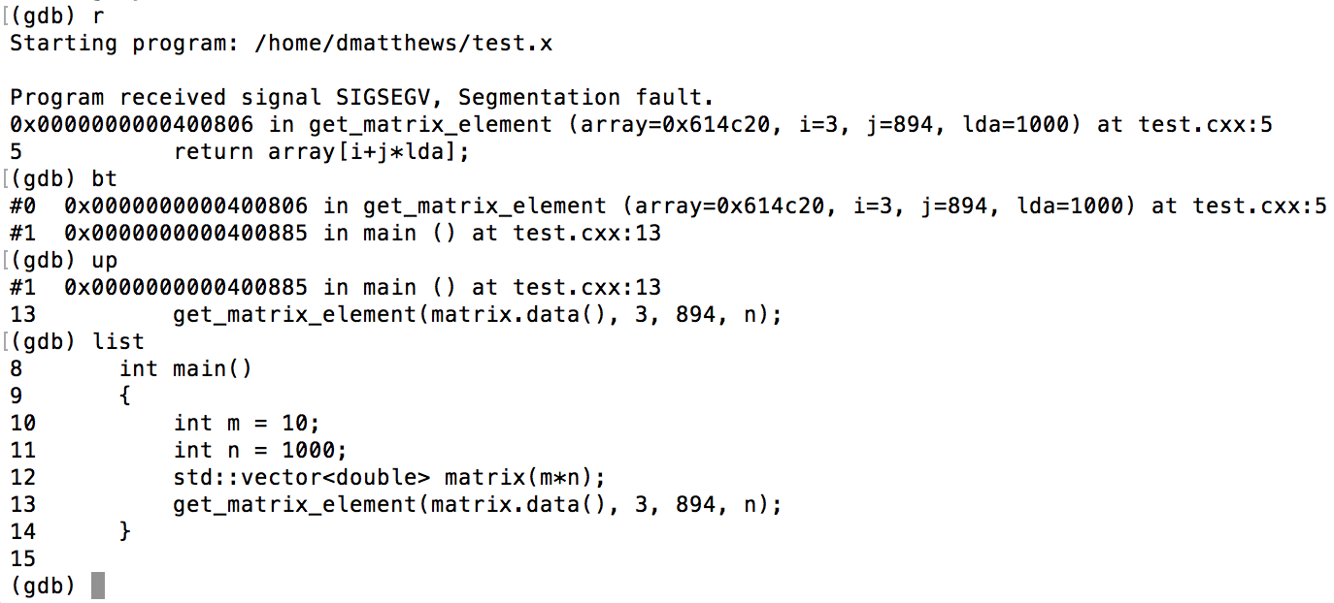
Debugging segfaults IV (make sample9.x)
If the current function isn’t the culprit, we can examine the function that call it, and the function that call it, and so on.
get_matrix_element is just fine, but we called it with the wrong arguments (row-major instead of column-major).

Slide 22
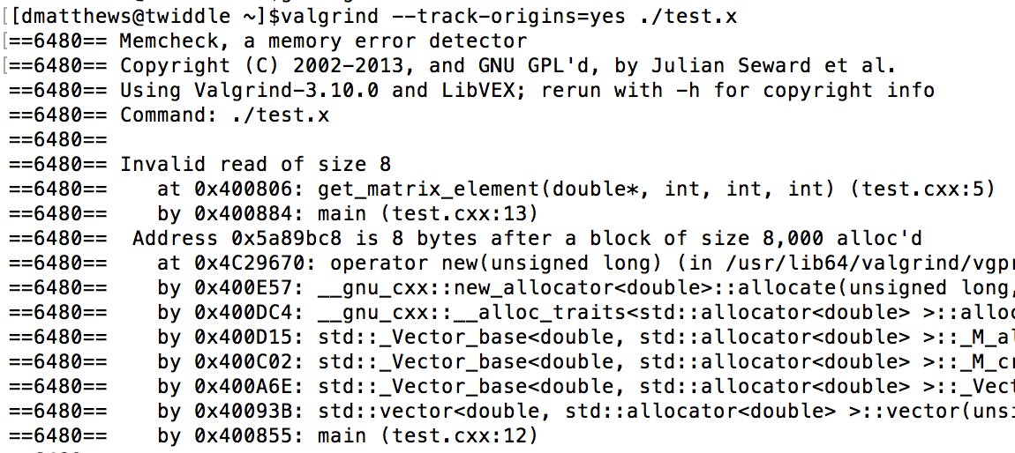
Debugging segfaults V (make sample10.x)
Sometimes it is extremely difficult to find the source of heap corruption or uninitialized data. In this case, a dynamic analysis tool can help pinpoint the cause. One popular tool for this is valgrind.
This code tries to access element (11,99) of a 10x100 matrix.

Slide 23
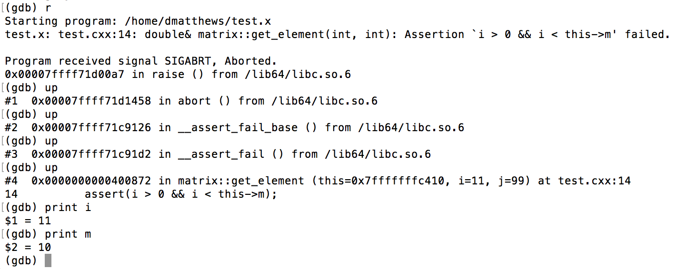
Debugging segfaults VI
Another powerful technique for diagnosing the cause of a segfault is assertions. An assertion states a condition that should always be true. When an assertion is triggered, you can also examine the reason in the debugger.
Assertions can be disabled with the compiler flag –DNDEBUG, so they won’t slow down production code.

Slide 24
Dealing with incorrect results
Incorrect results can be very tricky to debug, but when the cause is the same an indirect segfault:
Stack corruption
Heap corruption
Uninitialized data
Assertion failure (but assertions are disabled)
Then the techniques for diagnosing segfaults also apply.
If all else fails, there are always print statements!

Slide 25
Dealing with incorrect results
Proper testing, including unit tests, along with assertions and safe best practices is the best way to avoid bugs.

Slide 26
Questions?

