Slide 1
Vectorization
Devin A. Matthews
UT Austin
MolSSI Software Summer School 2017

Slide 2
Vectorization
In order to perform several floating-point operations at the same time, data must be loaded into vector registers.
The transformation of a program to a form where this is possible is called vectorization. This comes in two main forms:
Compiler auto-vectorization
Completely automatic
With help from the programmer
Manual vectorization
Intrinsics
Inline assembly

Slide 3
Loops vs. blocks
Most compiler auto-vectorization is targeted towards vectorizing loops. This generally means that each element in the vector will be a different loop iterations.
Some compilers (e.g. icpc) can also vectorize blocks. This is a piece of code where multiple operations in the same loop iteration can be vectorized.
You can’t rely 100% on any type of compiler auto-vectorization. Always check the disassembly!

Slide 4
Enabling vectorization: compiler flags
In order to vectorize your code, you have to give the compiler the green light through certain flags:
Effect | Flag | Compiler(s)
Enable vectorization | -O3 | g++
 | -O2 | icpc, clang++
Enable a particular instruction set | -msse<xy>, -mavx, -mavx2, -mfma | all
Enable all instruction sets for a particular architecture | -march=haswell, etc. | g++, clang++
 | -xCORE-AVX2, etc. | icpc
Enable vectorization for this processor. | -march=native | g++, clang++
 | -xHost | icpc

Slide 5

Sample 1: DSCAL
Compile with: g++ -O3 -march=native –fno-unroll-loops –c -o sample1.o sample1.cxx

Slide 6
Getting a disassembly
A disassembly is the sequence of machine instructions that the compiler generated for our code. We can get this from an executable or object file with:
OSX/macOS:
otool –vt <executable_or_object_file> [ | less ] [ > <file> ]
Linux, WSL:
objdump –d <executable_or_object_file> [ | less ] [ > <file> ]

Slide 7
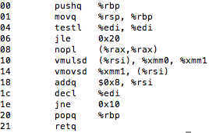
Sample 1 disassembly (no vectorization)
If n==0, quit early
Loop: %rsi == x+i.
Note that this uses SD (single double precison) operations → no vectorization.

Slide 8
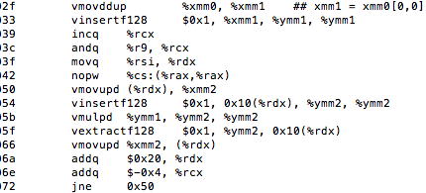
Sample 1 disassembly (with vectorization)
Broadcast alpha into each element of %ymm1.
This is called a split store. This is better here because the compiler doesn’t know if the data is aligned to a multiple of 32B.
Loop: %rdx == x+I and %rcx = n remaining.
Now we’ve got a vmulPD (packed double).

Slide 9
Sample 1 disassembly (with vectorization)
Not all compilers (or compiler version!) optimize the same.
The same compiler optimized differently for different processors (even with the same instructions).
TL;DR: YMMV. Some variations you may see, even in this small example:
Loop peeling.
Loop unrolling.
Split loads and stores.
Aligned vs. unaligned loads and stores.
Run-time checks to select the algorithm.

Slide 10
Alignment
vmovapd: Load/store 32B at an address which is a multiple of 32 in bytes.
If you give it an address that isn’t aligned, you get a segfault.
Fast on every architecture.
Used to be the only way to load/store vectors.
vmovupd: Load/store 32B of data at any address.
May be slower than vmovapd, even for aligned data.
Not a big deal on newer processors, though (Haswell and later).
Aligned
Unaligned

Slide 11
Loop peeling
Loop peeling is when the first and last few iterations of a loop are executed separately than the middle portion.
The compiler may use this to start the middle (vectorized) loop iterations at an aligned address.
Loop peeling is also used to execute the last few loop iterations that fall short of a full vector.
Peeled iterations (not vectorized)
Unaligned start address
Middle iterations (vectorized and aligned)
Peeled iterations (not vectorized)

Slide 12
Loop unrolling
Loop unrolling is where multiple iterations of a loop are executed at the same time.
Loop vectorization is already a form of unrolling, but sometimes the compiler unrolls the vectorized loop as well:
4x unrolled loop:
for
vmovupd ...
vmovupd ...
vmovupd ...
vmovupd ...
vmulpd ...
vmulpd ...
vmulpd ...
vmulpd ...
vmovupd ...
vmovupd ...
vmovupd ...
vmovupd ...
end
Original loop (vectorized):
for
vmovupd ...
vmulpd ...
vmovupd ...
end

Slide 13
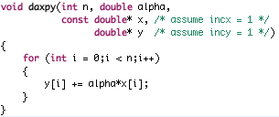
Sample 2a: DAXPY
Compile with: g++ -O3 -march=native –fno-unroll-loops –c -o sample2a.o sample2a.cxx

Slide 14
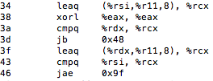
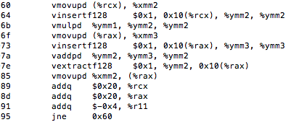

Sample 2a disassembly
This piece of code checks if x[0:n] and y[0:n] overlap.
What happens if the arrays x and y overlap? If they do, writing to y will change x, so we may have a loop-carried dependency.
No overlap
Overlap
Scalar version
Vectorized version

Slide 15
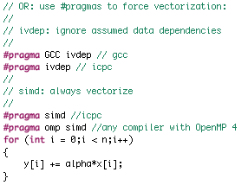
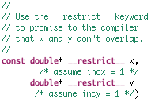
But I promise they don’t overlap!
If you as the programmer can guarantee that two arrays don’t overlap (that is, their pointers don’t alias), then you can help the compiler to vectorize:
Use the __restrict__ keyword (sometimes __restrict) to tell the compiler they don’t alias:
Explicitly tell the compiler the loo is safe to vectorize:

Slide 16
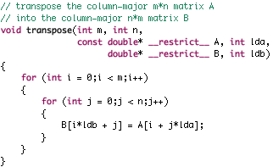
Sample 3a: matrix transpose
Compile with: g++ -O3 -march=native –fno-unroll-loops –c -o sample3a.o sample3a.cxx

Slide 17
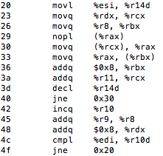
Sample 3a disassembly
No “mul” anywhere… the compiler has applied strength reduction for us.
Not vectorized, but it doesn’t even use the floating-point registers!

Slide 18
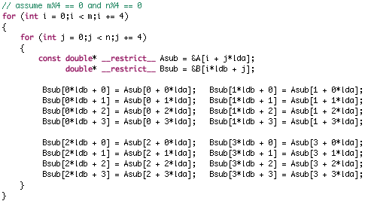
Sample 3b: unrolled matrix transpose
The compiler can’t vectorize the inner loop because A is accessed in increments of lda. But, we can unroll both loops to get contiguous access in both matrices:

Slide 19
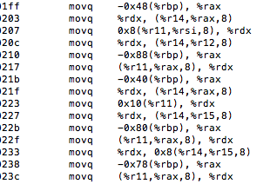
Sample 3b disassembly
No vector instructions anywhere!
We just get 16 copies of what we had before.
And so on…

Slide 20
Manual vectorization
Since the compiler can’t vectorize this block itself, we will need to do the vectorization ourselves.
We can always put inline assembly into the code, but this is tedious and can prevent some other compiler optimizations.
But some times it is the only way.
Instead, we can use compiler intrinsics to do the vectorization.
https://software.intel.com/sites/landingpage/IntrinsicsGuide is your bible for this

Slide 21
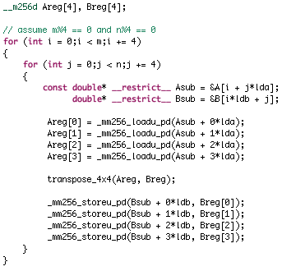
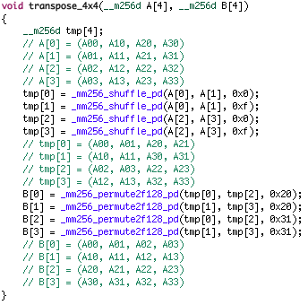
Sample 3c: manually vectorized matrix transpose

Slide 22
Why bother?

Slide 23
Questions?

