Slide 1

OpenMP Target Offload Programming for Accelerators
Lingda Li
Computational Science Initiative
Brookhaven National Laboratory
Acknowledgements:
The slides are originally developed by Christian Terboven, Michael Klemm, Oscar Hernandez, and many others.
The hands on materials are originally developed by Tim Mattson et al., and adapted by Anthony Curtis.

Slide 2


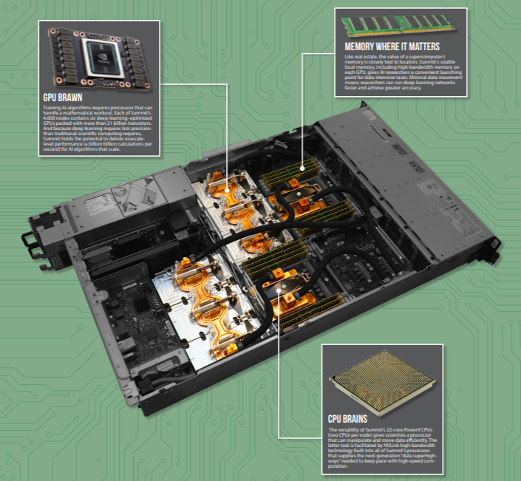
Heterogeneous HPC Systems
Most today’s and future HPC systems are heterogeneous
Majority of computing power comes from accelerators instead of CPUs
Summit Node
2 IBM POWER9 CPUs
6 NVIDIA Volta GPUs
Frontier Node
1 AMD EPYC CPU
4 AMD Radeon GPUs

Slide 3
Why OpenMP to Program Accelerator
Portability across different accelerators
NVIDIA GPUs, AMD GPUs, Intel Xeon Phis, FPGA, …
Broader user community and vendor support
GCC, Clang, ICC, XL, CCE, …
Tutorials, hackathons happen all the time
Brookhaven lab organizes several hackathons every year
Relative flat learning curve
Directive based method
Similar to OpenMP CPU threading
Unified intra-node parallel programming
Use OpenMP to extract parallelism of both CPUs and accelerators

Slide 4
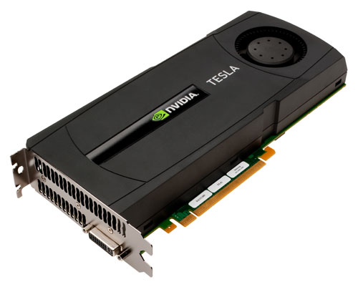
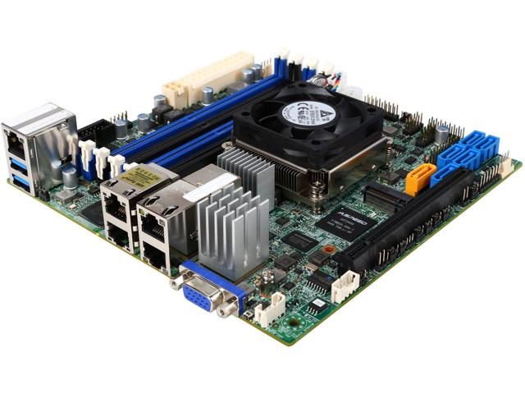
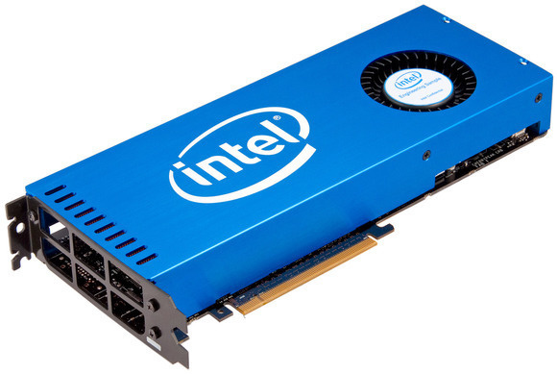
OpenMP Device Model
OpenMP supports heterogeneous systems since 4.0
Device model
One host device and
One or more target devices
Single device attached
Multiple devices attached
With attached accelerator(s)
Host Device
(CPU Multicore)
Xeon Phi(s) –
(Accelerator and self-hosted)
GPU(s)

Slide 5
Terminology
Device
An implementation-defined (logical) execution unit
Device data environment
Memory associated with a device
The execution model is host-centric (or initial device)
Host offloads OpenMP target regions to target device(s)
Host creates/destroys data environment on device(s)
Host maps data between the host and device(s)

Slide 6
OpenMP Offloading Basics
target construct
Transfer control from the host to the target device
Host thread waits until target region completes
Use nowait for asynchronous execution
map clause
Decide how a variable or an array section is mapped between the host memory and the device data environment
Mapped variable:
An original variable in a (host) data environment has a corresponding variable in a device data environment
Mappable type:
A type that is amenable for mapped variables. (Bitwise copyable plus additional restrictions.)

Slide 7
target Construct
#pragma omp target \\
map(tofrom:a) map(to:b)
{
#pragma omp parallel for
for(i=0; i<N; i++) {
a[i] = a[i] + b[i];
}
}
host thread
Allocate: a, b
Copy in: a, b
Device
omp target
initial device
thread
omp parallel
!$omp target \\
map(tofrom:a) map(to:b)
!$omp parallel do
do i=0,N
a(i) = a(i) + b(i)
enddo
!$omp end parallel do
!$omp end target
barrier
Copy out: a
Deallocate: a, b
host thread

Slide 8
map Doesn’t Always Mean Copy
Shared memory system
Discrete memory system
Main
Memory
Host
X
Main
Memory
Accelerator
Y
Host
X
Accelerator
Y
Cache
Accelerator
Memory Y
Cache
Cache
A
A
A
A
A
A’
The host and accelerator share the same copy of A in main memory
The host and accelerator have separate
copies: A and A’

Slide 9
Map Type
Map-types:
alloc: allocates data on the device
to: allocates data and moves data to the device
from: allocates data and moves data from the device
tofrom: allocates data and moves data to and from the device
delete: deletes the data from the device
release: decrements the reference count of a variable
Map-type Modifiers
always: always perform the instructed mapping
close: places data close to the target device
mapper: customized mapping

Slide 10
Device Data Environment

Slide 11
Map Variables across target Regions
Multiple target regions may share data
It is inefficient to map data for each target region individually
Optimize data movement between host and device
The target data construct maps variables but does not offload code
Corresponding variables remain in the device data environment for the extent of the target data region
Useful to map variables across multiple target regions
The target update construct synchronizes an original variable with its corresponding variable.

Slide 12
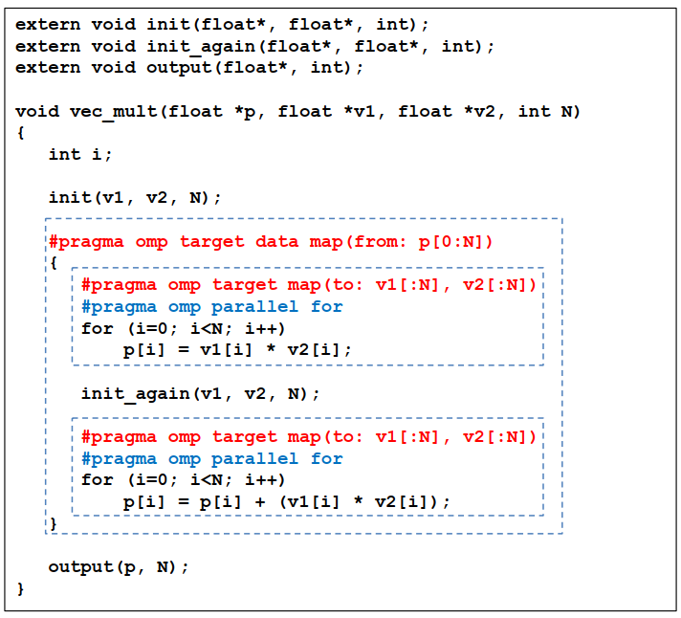
target data Construct
The target data construct maps variables to the device data environment
v1 and v2 are mapped at each target construct
p is mapped once by the target data construct

Slide 13
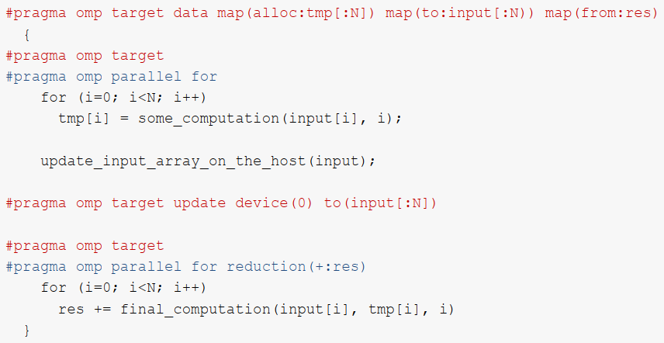
target update Construct
Synchronize the value of an original variable in a host data environment with a corresponding variable in a device data environment
to: map from host to device; from: map from device to host

Slide 14
Unstructured Data Environment
Structured target data construct is restrictive and does not fit for C++ (de)constructors.
target enter/exit data constructs enable flexible data management by programmers
Able to closely mimic CUDA/OpenCL program behavior
Finely tune GPU memory allocation and copy
#pragma omp target enter data map(to:a,b)
…
#pragma omp target parallel for
for (i=1; i<N; i++) {
a(i) = a[i] + b[i];
}
#pragma omp target exit data map(delete:b)
do_something_on_gpu(a);
#pragma omp target exit data map(from:a)
do_something_on_cpu(a);

Slide 15
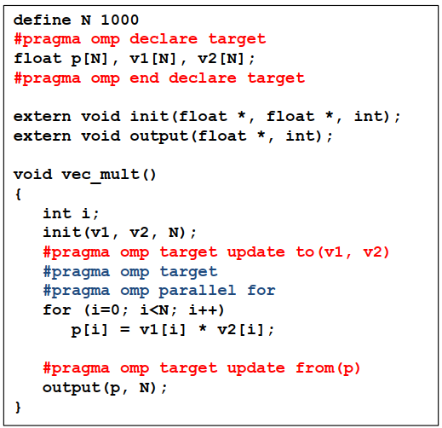
declare target Construct
Indicate that global variables are mapped to a device data environment for the whole program
Use target update to maintain consistency between host and device

Slide 16
Declare Target Functions
The declare target construct can also be used to declare functions that are called within target constructs
Such functions will be compiled into 2 versions
Host version
Target device version
#pragma omp declare target
int foo(int input) {
return input + 1;
}
int bar() {
#pragma omp target parallel for map(a)
for (i=1; i<N; i++) {
a(i) = foo(a[i]);
}
}

Slide 17
Data Environment Summary
Data environment attached to a target directive
#pragma omp target map(tofrom: x) { …; }
Structured data environment
#pragma omp target data map(tofrom: x) { …; }
#pragma omp target update to(x)
Unstructured data environment
#pragma omp target enter/exit data map(x)
Global scope data environment
#pragma omp declare target

Slide 18
Execution Model

Slide 19
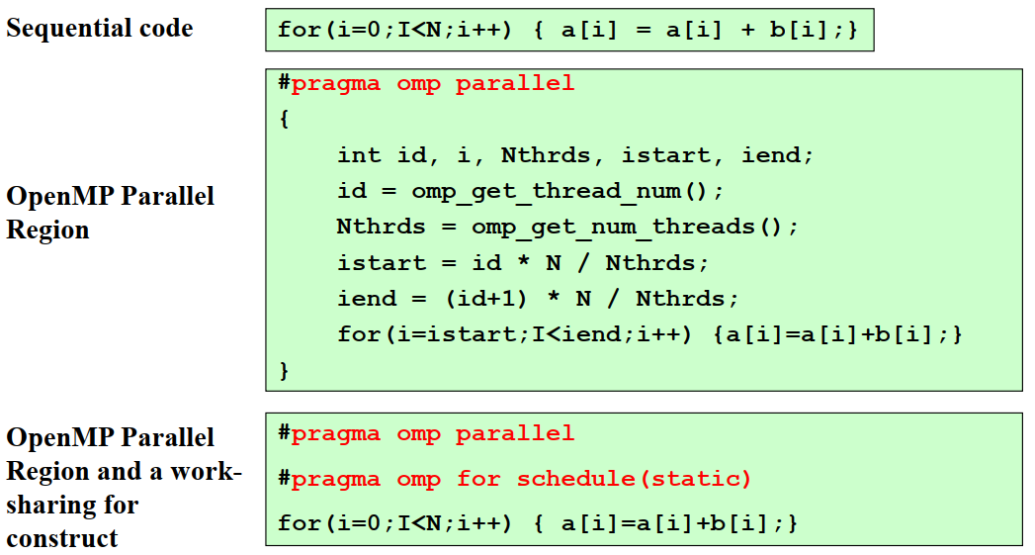
Review: OpenMP Threading

Slide 20
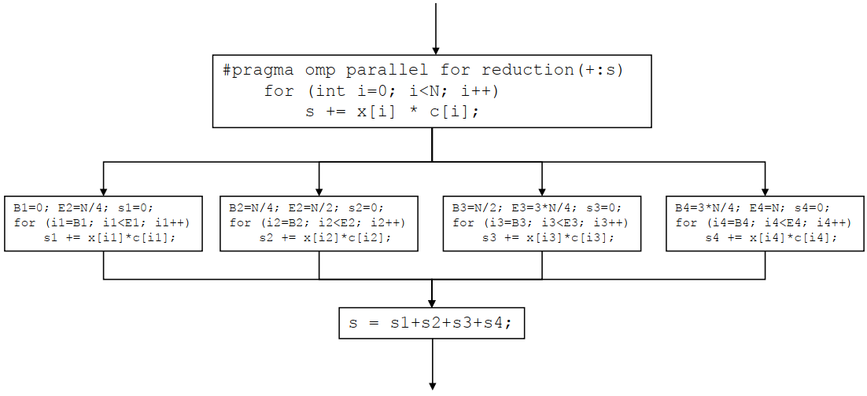
Review: Thread Worksharing
Loop iterations are distributed among threads
target

Slide 21
2 Levels of GPU Parallelism
NVIDIA GPUs have 2 levels of parallelism
GPUs from other vendors are similar
Thread blocks
Coarse grained
Execute independently
Threads
Fine grained
Threads within the same thread block execute simultaneously
Can synchronize with each other
OpenMP introduces teams for the level of parallelism of thread block
teams
parallel

Slide 22
League of Teams of Threads
League
Set of thread teams created by a teams construct
Contention group
Threads of a team in a league and their descendant threads
Threads can synchronize in the same contention group
#pragma omp target
creates initial target thread
#pragma omp teams
creates N teams of size 1
League
#pragma omp parallel
creates M threads per team
Contention Group

Slide 23
teams Construct
The teams construct creates a league of thread teams
The master threads of all teams executes the teams region
The number of teams is specified by the num_teams clause
Each team starts with one master thread, and can execute up to thread_limit threads
Threads in different teams cannot synchronize with each other
Must be perfectly nested in a target construct
No statements or directives between teams and target constructs
Only special OpenMP constructs can be nested inside a teams construct
distribute
parallel
parallel for (parallel do for Fortran)
parallel sections

Slide 24
distribute Construct
Work-sharing construct for teams regions
Similar to what for does for parallel
Distribute the iterations of a loop across the master threads of all teams executing the region
No implicit barrier at the end of the construct
dist_schedule(kind[, chunk_size])
kind must be static
Chunks are distributed in round-robin fashion with chunk_size
Each team receives at least one evenly distributed chunk (if no chunk_size is specified)
#pragma omp target map(tofrom: A)
#pragma omp teams
#pragma omp distribute
for (i=0; i<N; i++)
a[i] = a[i] + b[i];

Slide 25
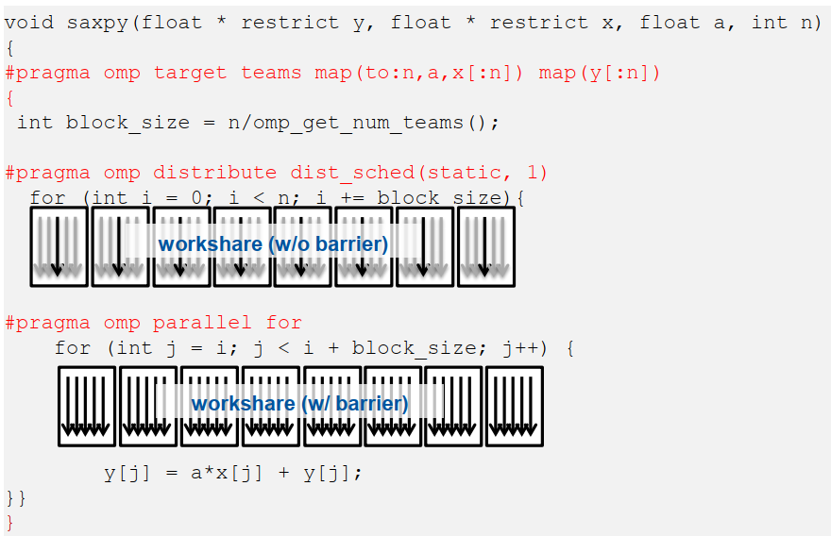
Example: SAXPY

Slide 26
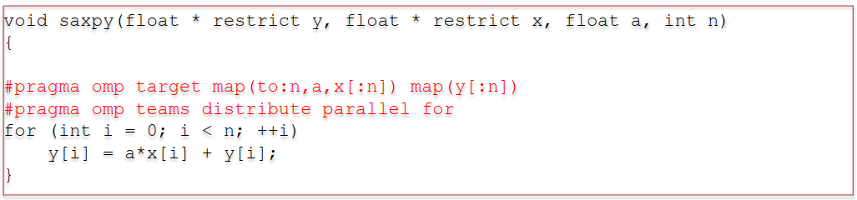
Combined Constructs
OpenMP defines combined constructs for typical patterns
distribute simd
distribute parallel for (C/C++)
distribute parallel for simd (C/C++)
distribute parallel do (Fortran)
distribute parallel do simd (Fortran)
Plus additional combinations for teams and target
Avoids the need to do manual loop blocking

Slide 27
Summary
Execute code on a target device
omp target [clause[[,] clause],…]
structured-block
omp declare target
[function-definitions-or-declarations]
Manage the device data environment
map ([map-type:] list)
map-type := alloc | tofrom | to | from
| release | delete
omp target data [clause[[,] clause], …]
structured-block
omp target enter/exit data [clause[[,] clause], …]
omp target update [clause[[,] clause],…]
omp declare target
[variable-definitions-or-declarations]
Parallelism & work sharing for devices
omp teams [clause[[,] clause],…]
structured-block
omp distribute [clause[[,] clause],…]
for-loops
Device Runtime Support
void omp_set_default_device(int dev_num)
int omp_get_default_device(void)
int omp_get_num_devices(void)
int omp_get_team_num(void)
int omp_is_initial_device(void)
Environment variables
OMP_DEFAULT_DEVICE
OMP_THREAD_LIMIT

Slide 28
General Strategy to Develop OpenMP Offloading Applications
Port your program to use OpenMP CPU threading
Help avoid many problems that are hard to debug on accelerators
Translate it to a naïve OpenMP offloading program
Use target constructs and map clauses, make sure its correctness
Profiling
General profiling tools: HPCToolkit, Tau
Accelerator specific profiling tools: nvprof
Adapt to the target accelerator execution model
E.g., use both teams and parallel for GPUs
Profiling
Optimize data movement

Slide 29
Hands-on Exercise
https://github.com/tonycurtis/openmp-tutorial
Port the vector addition to use OpenMP offloading (vadd.c)
Port the jacobi solver to use OpenMP offloading (jac_solv.c)
Profile jacobi solver
Optimize jacobi solver
You are welcome to apply OpenMP offloading to your code

Slide 30
Backup slides

Slide 31
OpenMP Target Offload
host thread
#pragma omp target map(a,b)
#pragma omp parallel
#pragma omp for
for(i=0; i<N; i++) {
a[i] = a[i] + b[i];
}
Device
omp target
initial device
thread
omp parallel
barrier
Use target construct to:
Transfer control from the host to the target device
Host thread waits until target region completes
Use nowait for asynchronous execution
host thread

Slide 32
Structured Data Region
host thread
…
!$omp target parallel do collapse(2) & map(to:u) map(from:uold)
do j=1,m
do i=1,n
uold(i,j) = u(i,j)
enddo
enddo
!$omp end target parallel do
…
Allocate: u, uold
Copy in: u
Device
barrier
Copy out: uold
Deallocate: u, uold
host thread

Slide 33
OpenMP Target Data Regions
Accelerators and CPUs often have discrete memory space
The map clauses determine how an original (initial device) variable in a data environment is mapped to a corresponding variable in a device data environment
Mapped variable:
An original variable in a (host) data environment has a corresponding variable in a device data environment
Mapped type:
A type that is amenable for mapped variables
Bitwise copy-able plus additional restrictions
Device(s) Data Environment
Device Mapped
Variables
Host Data Environment
Variables
Device Data Environment
Device Data Environment

Slide 34
Map Type
Map-types:
alloc: allocates data on the device
to: allocates data and moves data to the device
from: allocates data and moves data from the device
for omp target exit data only moves the data from the device
tofrom: allocates data and moves data to and from the device
delete: deletes the data from the device and sets the reference count to 0
release: decrements the reference count of a variable
Map-type Modifiers
always
map-type | target | target data | target enter data | target exit data | target declare
alloc | X | X | X |  | X
to | X | X | X |  | X
from | X | X |  | X
tofrom | X | X
delete |  |  |  | X
release |  |  |  | X

Slide 35
Writing Portable Device code
#pragma omp target map(tofrom: A)
#pragma omp teams distribute parallel for simd collapse(3) // combined directive
for (i=0; i<N; i++)
for (j=0; j<N; j++)
for (k=0; k<N; k++)
A[i][j][k] = …
Use OpenMP 4 “Accelerator Model” to target multiple architectures: GPUs, Intel Xeon Phi, and multicore CPUs, etc.
Make your OpenMP adaptable or using defaults for:
# of teams,
dist_schedule,
thread_limit #,
# of threads in parallel regions,
parallel for loop schedules,
SIMD length
Example:
Xeon Phi implementation may choose num_teams(1), thread_limit(1) and simdlen(V)
GPUs implementation may choose num_teams(N), thread_limit(M) and simdlen(V)

Slide 36
OpenMP CPU Threading
…
!$omp parallel do collapse(2)
do j=1,m
do i=1,n
uold(i,j) = u(i,j)
enddo
enddo
!$omp end parallel do
…
Use parallel construct to:
Create a bunch of worker threads
Use do construct to:
Distribute loop iterations across all worker threads
barrier

Slide 37
OpenMP Target Offload
host thread
…
!$omp target parallel do collapse(2)
do j=1,m
do i=1,n
uold(i,j) = u(i,j)
enddo
enddo
!$omp end target parallel do
…
Execute target code
Device
Use target construct to:
Transfer control from the host to the target device
Host thread waits until target region completes
Use nowait for asynchronous execution
barrier
host thread

Slide 38
Reference Counts
Control when a mapper variable/array is deallocated
Reference count for each mapped variable
Incremented by 1 for each of the following constructs
Entry of target / target data
Target enter data
Decremented by 1 for each of the following constructs
On exit of a target / target data
Target exit data
Exceptions
target declare data environment (global) infinite ref counts
target exit data map-type is delete – ref counts to zero
#pragma omp target exit data map(delete: A)

Slide 39
Example
double A[N], B[N], C[N], D[N];
#pragma omp target data map(alloc: C)
{
#pragma omp target data map(to: A, B) map(from: C)
{
/* device code */
}
#pragma omp target map(from: D) map(to: C)
{
/* device code */
}
}
C is already in device scope
ref_count(C)=1
Thus inner map clauses of C are ignored
*OpenMP also provide mapping support for array sections A[0:N]

Slide 40
Default Data Mappings
Arrays: map(tofrom: A)
Array are mapped in their entirety
Scalars: firstprivate(i)
Pointers: map(tofrom: p[0:0])
Default is zero-length pointers
Pointers initialized to NULL
Example with explicit mappings:
int A[N], B[N], *p, len=N;
if(x) p = &A;
else p = &B;
#pragma omp target data map(tofrom: A, B)
{
/* A and B are mapped tofrom */
#pragma omp target map(to: p[0:0]) firstprivate(len)
{
/* len is mapped firstprivate
with value N
p is mapped as a zero-lengh
pointer where:
p == &dA // if (x) == true
p == NULL // else */
…
}
}
Example with default mappings:
int A[N], B[N], *p, len=N;
if(x) p = &A;
else p = &B;
#pragma omp target
{
// A, B, p, len are mapped by default
for(i = 0; i < len; i++)
A[i] = B[i] + p[i];
}

Slide 41
Implementation
Runtime Present Table
Host
Processor X
Memory
Accelerator
Y
Host A | Device A | Length | Ref Count
A (address) | dA (address) | sizeof(A) | 1
Cache
Memory Y
A
A
A {dA’}
// ref count (A) = 0
#pragma omp target data map(tofrom: A)
{
// ref count (A) = 1
}
// ref count (A) = 0

Slide 42
Reference Counts
Reference count for each mapped variable
Incremented by 1 for each of the following constructs
Entry of target / target data
Target enter data
Decremented by 1 for each of the following constructs
On exit of a target / target data
Target exit data
Exceptions
target declare data environment (global) inifinite ref counts
target exit data map-type is delete – ref counts to zero
#pragma omp target exit data map(delete: A)

Slide 43
Reference Counts in Data Region
double A[n][n], B[n][n], C[n][n], D[n][n];
// ref_count(A,B,C) = 0
#pragma omp target data map(alloc: C)
{ // ref_count(C) = 1, ref_count(A,B,D) = 0
#pragma omp target data map(to: A, B) map(from: C)
{
// ref_count(A,B) = 1, ref_count(C) = 2, ref_count(D) = 0
}
// ref_count(A,B,D) = 0, ref_count(C) = 1
#pragma omp target map(from: D) map (to: C)
{
// ref_count(D) = 1, ref_count(C) = 2, ref_count(A,B) = 0
}
// ref_count(C) = 1, ref_count(A,B,D) = 0
}
// ref_count (C) = 0
C is already in device scope
ref_count(C)=1
Thus inner map clauses of c are ignored

Slide 44
Unstructured target data
Begin an unstructured data scope:
#pragma omp target enter data [clauses]
clauses:
if(scalar-expression)
device(integer-expression)
map([map-type-modifier[,]] map-type: ] list)
depend(dependence-type: list)
nowait
End an unstructured data scope
#pragma omp target exit data [clauses]
clauses:
if(scalar-expression)
device(integer-expression)
map([map-type-modifier[,]] map-type: ] list)
depend(dependence-type: list)
nowait

