Slide 1


Designing CUDA Kernels for Science Applications
David S. Cerutti, Rutgers University

Slide 2
We Will Juggle Two Types of RAM
Host Memory (RAM) versus GPU Device Memory (D-RAM)
HOST
GPU
Host memory is allocated by (type*)malloc(type* , size_t )
Device memory is allocated by cudaMalloc(void** , size_t, style )
There are more flavors of host memory than you may know. Most memory people allocate is pageable. CUDA prefers to work with pinned host memory that cannot move around and maps directly to memory on the device.
Device memory can be allocated independent of host memory

Slide 3
Sending and Receiving Memory
Transfer of memory between the host and device: high latency and low bandwidth
HOST
GPU
Host RAM can store pointers to memory in device D-RAM
Send memory up to the device:
Pull memory down into host memory:
cudaMemcpy(type* pDev, type* pHost, size_t , cudaMemcpyHostToDevice);
cudaMemcpy(type* pHost, type* pDev, size_t , cudaMemcpyDeviceToHost);

Slide 4
pmemd.cuda GpuBuffer
template <typename T> class GpuBuffer {
public:
unsigned long long int _length; // The overall length of the array to allocate (total memory
// allocation will depend on the size of the data type)
bool _bSysMem; // Flag to indicate that host (CPU) memory should be
// allocated to "shadow" what happens on the device (GPU)
bool _bPinned; // Flag to indicate that the array held in host RAM will be page locked,
// or "pinned." Such data is more rapidly accessible for transfer to
// the GPU, as the GPU cannot directly access pageable host memory.
// If allocated as pinned memory, _pSysData becomes a pre-allocated
// staging area for transferring memory to the GPU.
T* _pSysData; // System data, held in CPU RAM
T* _pDevData; // Device data, can be shadowed by _pSysData
// Overloading, to make two constructor methods and allow both ints and unsigned ints to serve as the length
// argument for allocating a GpuBuffer struct. In both cases, the default behavior is to allocate memory
// on the host to shadow the device memory, and to have that host memory allocated as pageable (NOT pinned).
GpuBuffer(int length, bool bSysMem = true, bool bPinned = false);
GpuBuffer(unsigned int length, bool bSysMem = true, bool bPinned = false);
// Having a virtual destructor ensures that there are no
// memory leaks for derived GpuBuffer objects.
virtual ~GpuBuffer();
// Methods
void Allocate();
void Deallocate();
void Upload(T* pBuff = NULL);
void Download(T* pBuff = NULL);
};

Slide 5
pmemd.cuda GpuBuffer Allocator
template <typename T> void GpuBuffer<T>::Allocate()
{
size_t sizeT = sizeof(T);
cudaError_t status;
// If pinned memory is to be allocated, pinned memory is something that lives in CPU RAM, so that implies
// host memory WILL be allocated to shadow the device, and that it will be un-pageable, unlike usual host
// memory allocations. Pinned memory on the host will correspond to a block of memory on the device, so
// allocating memory in this way implies roping off an equivalent amount of memory on the device, to which
// we simply need to get a pointer.
if (_bPinned) {
status = cudaHostAlloc((void **)&_pSysData, _length * sizeT, cudaHostAllocMapped);
RTERROR(status, "cudaHostalloc GpuBuffer::Allocate failed");
status = cudaHostGetDevicePointer((void **)&_pDevData, (void *)_pSysData, 0);
RTERROR(status, "cudaGetDevicePointer GpuBuffer::failed to get device pointer");
memset(_pSysData, 0, _length * sizeT);
}
else {
// Check to see whether (pageable) host memory has been requested to shadow the device. This memory will
// be allocated by the more familiar C++ new operator rather than cudaHostAlloc(). An equivalent amount
// of memory will be allocated on the device, not mapped to memory on the host.
if (_bSysMem) {
_pSysData = new T[_length];
memset(_pSysData, 0, _length * sizeT);
}
status = cudaMalloc((void **)&_pDevData, _length * sizeT);
RTERROR(status, "cudaMalloc GpuBuffer::Allocate failed");
status = cudaMemset((void *)_pDevData, 0, _length * sizeT);
RTERROR(status, "cudaMemset GpuBuffer::Allocate failed");
}
}

Slide 6
pmemd.cuda GpuBuffer Allocator
template <typename T> void GpuBuffer<T>::Allocate()
{
size_t sizeT = sizeof(T);
cudaError_t status;
// If pinned memory is to be allocated, pinned memory is something that lives in CPU RAM, so that implies
// host memory WILL be allocated to shadow the device, and that it will be un-pageable, unlike usual host
// memory allocations. Pinned memory on the host will correspond to a block of memory on the device, so
// allocating memory in this way implies roping off an equivalent amount of memory on the device, to which
// we simply need to get a pointer.
if (_bPinned) {
status = cudaHostAlloc((void **)&_pSysData, _length * sizeT, cudaHostAllocMapped);
RTERROR(status, "cudaHostalloc GpuBuffer::Allocate failed");
status = cudaHostGetDevicePointer((void **)&_pDevData, (void *)_pSysData, 0);
RTERROR(status, "cudaGetDevicePointer GpuBuffer::failed to get device pointer");
memset(_pSysData, 0, _length * sizeT);
}
else {
// Check to see whether (pageable) host memory has been requested to shadow the device. This memory will
// be allocated by the more familiar C++ new operator rather than cudaHostAlloc(). An equivalent amount
// of memory will be allocated on the device, not mapped to memory on the host.
if (_bSysMem) {
_pSysData = new T[_length];
memset(_pSysData, 0, _length * sizeT);
}
status = cudaMalloc((void **)&_pDevData, _length * sizeT);
RTERROR(status, "cudaMalloc GpuBuffer::Allocate failed");
status = cudaMemset((void *)_pDevData, 0, _length * sizeT);
RTERROR(status, "cudaMemset GpuBuffer::Allocate failed");
}
}

Slide 7
pmemd.cuda GpuBuffer Allocator
template <typename T> void GpuBuffer<T>::Allocate()
{
size_t sizeT = sizeof(T);
cudaError_t status;
// If pinned memory is to be allocated, pinned memory is something that lives in CPU RAM, so that implies
// host memory WILL be allocated to shadow the device, and that it will be un-pageable, unlike usual host
// memory allocations. Pinned memory on the host will correspond to a block of memory on the device, so
// allocating memory in this way implies roping off an equivalent amount of memory on the device, to which
// we simply need to get a pointer.
if (_bPinned) {
status = cudaHostAlloc((void **)&_pSysData, _length * sizeT, cudaHostAllocMapped);
RTERROR(status, "cudaHostalloc GpuBuffer::Allocate failed");
status = cudaHostGetDevicePointer((void **)&_pDevData, (void *)_pSysData, 0);
RTERROR(status, "cudaGetDevicePointer GpuBuffer::failed to get device pointer");
memset(_pSysData, 0, _length * sizeT);
}
else {
// Check to see whether (pageable) host memory has been requested to shadow the device. This memory will
// be allocated by the more familiar C++ new operator rather than cudaHostAlloc(). An equivalent amount
// of memory will be allocated on the device, not mapped to memory on the host.
if (_bSysMem) {
_pSysData = new T[_length];
memset(_pSysData, 0, _length * sizeT);
}
status = cudaMalloc((void **)&_pDevData, _length * sizeT);
RTERROR(status, "cudaMalloc GpuBuffer::Allocate failed");
status = cudaMemset((void *)_pDevData, 0, _length * sizeT);
RTERROR(status, "cudaMemset GpuBuffer::Allocate failed");
}
}

Slide 8
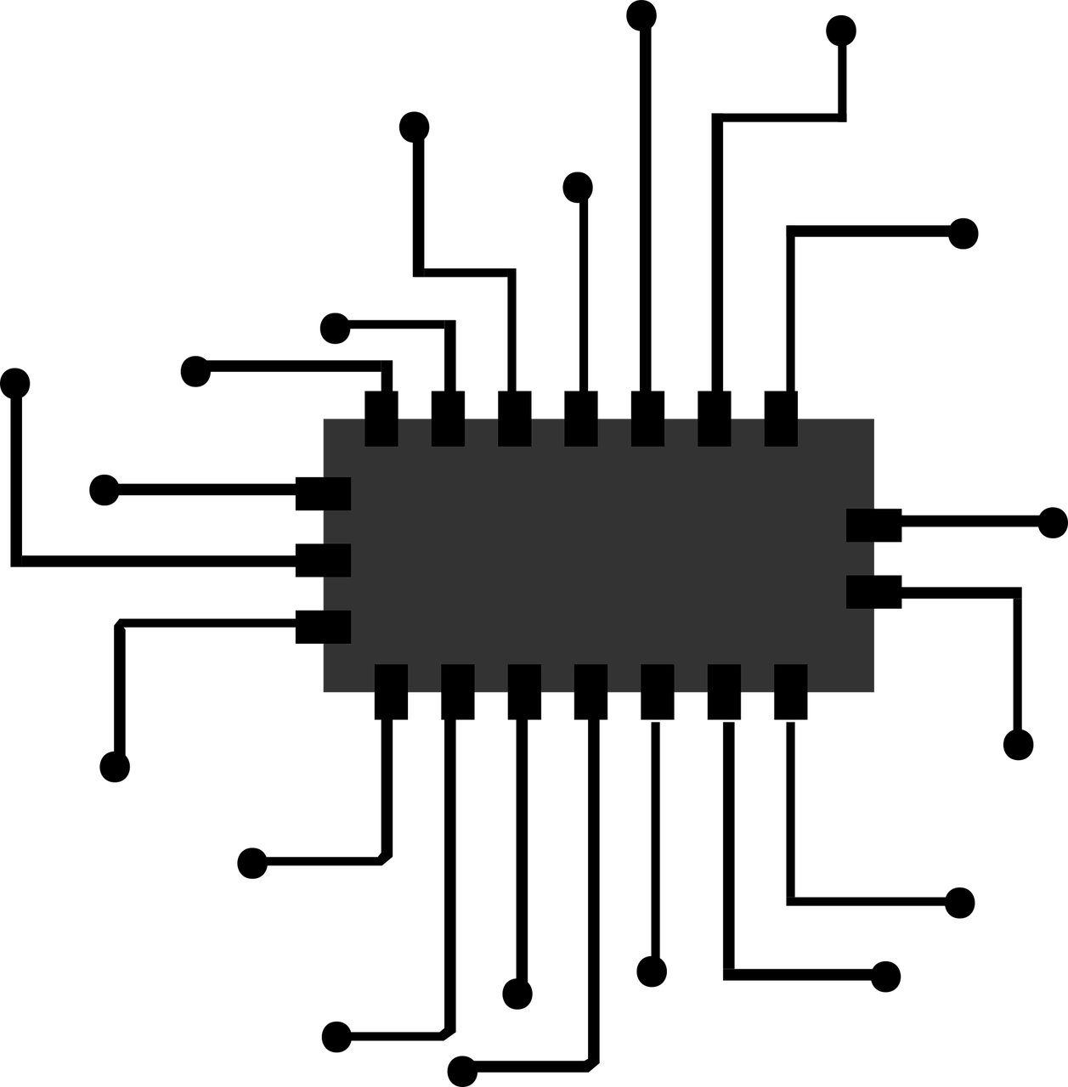
Kernel Invocation
A kernel will operate on information held in device D-RAM, plus a limited number of arguments from the host at launch
The kernel engages a cohort of Streaming Multi-Processors (SMPs)
Kernel Arguments
Staged Data
CPU
Device-to-Host
data return (optional)
Results

Slide 9
Synchronization
A GPU is essentially a separate vector computer that can be controlled by the CPU
After issuing a kernel launch, the CPU is free to continue computations
The CPU will not wait on the GPU until it has to launch a kernel in the same stream
Time
CUDA Stream 1
CUDA Stream 0 (default)
CPU Stream
int sysPC = 40528; // System particle count
for (int i = 0; i < 5; i++) {
kGetGpuAnswer<<<nBlocks, nThreads>>>(i * sysPC);
cudaMemCpy(&dHostTrajectory[3 * i * sysPC], dDevTrajectory, 3 * sysPC * sizeof(float),
cudaMemcpyDeviceToHost);
}

Slide 10
Synchronization with Streams
If a kernel does not fill the GPU, then resources are being wasted.
Serialization of multiple small kernels can be rectified, in principle, by running them in separate CUDA streams.
CUDA Stream 1
CUDA Stream 0 (default)
CPU Stream
int sysPC = 40528; // System particle count
for (int i = 0; i < 5; i++) {
kGetGpuAnswer<<<nSomeBlocks, nThreads, 0, 0>>>(i * sysPC);
cudaMemCpyAsync(&dHostTrajectory[3 * i * sysPC], dDevTrajectory, 3 * sysPC * sizeof(float),
cudaMemcpyDeviceToHost, stream0);
kConductGpuSearch<<<nHandfulOfBlocks, nThreads, 0, 1>>>(i * sysPC);
cudaMemCpyAsync(&dHostStatistics[i * sysPC], dDevStatistics, sysPC * sizeof(float),
cudaMemcpyDeviceToHost, stream1);
}

Slide 11
Traits of a Good CUDA Program
CUDA = Compute Unified Device Architecture
Inherent vectorization and tremendous parallelism
For best results:
All Streaming Multi-Processors (SMPs) must be engaged
The CUDA cores of each SMP must be constantly working
Each SMP must have at least one thread block to assigned to it throughout the kernel execution time.
Pre-Turing SMPs can handle up to 2048 threads each (Turing 1024 threads)
Each thread consumes scarce resources on the SMP
A thread block cannot stop until all its threads have finished
CPU processing time needs to overlap with GPU kernel execution
The GPU should not wait on the CPU for results
Minimize data transfers between the CPU and GPU

Slide 12
CUDA Breaks Down a Loop: Strategy One
The list of thread blocks and the list of assignments but don’t have to be the same
Given: ncalc = 1,000,000 small calculations to perform and 6 SMPs to do them all
Strategy One: give the GPU a huge number of blocks.
Each block will fire off threads to do one calculation apiece.
More blocks will be assigned as SMPs finish with their current load.
__global__ void kStrategyOne()
{
int pos = (blockIdx.x * blockDim.x) + threadIdx.x;
if (pos < cnstCache.ncalc) {
// Read data from device D-RAM
int xval = cnstCache.xDataStorage[pos];
int parm = cnstCache.parmDataStorage[pos];
int tResult;
< … Calculate result for this thread’s xval, parm … >
cnstCache.pResults[pos] = tResult;
} }

Slide 13
Strategy Two: Blocks Loop over the List
This can’t do more than (gridDim.x * blockDim.x) calculations (at most ~65 million)
Also requires that excess blocks still calculate value of pos, evaluate if (pos …) { }
Strategy Two: assign blocks appropriate to the GPU’s SMP count, and have each block do a pre-determined slice of the problem
__global__ void kStrategyTwo()
{
int pos = (blockIdx.x * blockDim.x) + threadIdx.x;
while (pos < cnstCache.ncalc) {
// Read data from device D-RAM
int xval = cnstCache.xDataStorage[pos];
int parm = cnstCache.parmDataStorage[pos];
int tResult;
< … Calculate result for this thread’s xval, parm … >
cnstCache.pResults[pos] = tResult;
// Increment the counter
pos += blockDim.x * gridDim.x;
} }

Slide 14
Keeping Each SMP Occupied
This works as long as the individual calculations are uniform. But, what if some calculations are more expensive than others?
Strategy Three: use a global variable, pre-initialized and accessible to all blocks, to track progress of the grid as a whole through the problem.
Each block will do one batch of calculations, increment the global counter to get its next batch, then increment its threads’ local counters and do another batch
That will work as long as each batch’s calculations are of consistent size. But, what if calculations are only consistent in chunks of 32 at a time?
Strategy Four: use the same global variable but have each warp (32 threads) increment it independently.
We could also use Strategy Three and make each block 32 threads, but there may be overhead or other considerations that make us want blocks to be bigger than that.

Slide 15
Strategy Three: Blocks Coordinate
__global__ void kStrategyThree()
{
// Initialize the block-wide counter blockPos
__shared__ volatile int blockPos;
if (threadIdx.x == 0) {
blockPos = blockIdx.x * blockDim.x;
}
__syncthreads();
int pos = blockPos + threadIdx.x;
while (blockPos < cnstCache.ncalc) {
if (pos < cnstCache.ncalc) {
< … Read data … >
< … Calculate result for this thread’s xval, parm … >
cnstCache.pResults[pos] = tResult;
}
// Synchronize the block, increment blockPos, then each thread’s counter
__syncthreads();
if (threadIdx.x == 0) {
blockPos = atomicAdd(cnstCache.pointerToProgressCount, blockDim.x);
}
__syncthreads();
pos = blockPos + threadIdx.x;
} }

Slide 16
Strategy Four: Warps Coordinate
__global__ void kStrategyFour()
{
// Initialize the warp-wide counter warpPos
int tgx = (threadIdx.x & 31);
int warpPos = (blockIdx.x * blockDim.x) + (threadIdx.x >> 5);
while (warpPos < cnstCache.ncalc) {
int pos = warpPos + tgx;
if (pos < cnstCache.ncalc) {
< … Read data … >
< … Calculate result for this thread’s xval, parm … >
cnstCache.pResults[pos] = tResult;
}
// Synchronization of the warp is NOT guaranteed in CUDA 9, but we don’t
// need it because no thread can change another thread’s idea of warpPos
// until the __shfl_sync() operation which implicity synchronizes the warp.
if (tgx == 0) {
warpPos = atomicAdd(cnstCache.pointerToProgressCount, 32);
}
warpPos = __shfl_sync(warpPos, 0);
} }

Slide 17
Flat Workloads: Simplicity is Key (Strat #2)
A list of many calculations all the same size is best apportioned evenly across the SMPs. Don’t even try to do the coordination counter thing—it’s just extra work.
Workload:
0
2
4
6
8
10
12
14
1
3
5
7
9
11
13
15
Distribution:
0
1
2
3
6
7
8
9
4
5
Time
12
13
14
15
10
11
Streaming Multi-Processor

Slide 18
Bumpy Workloads: Granularity is Key
Strategy #3 is rarely seen with large thread blocks—granularity goes hand in hand with asynchronous block scheduling.
Workload:
Distribution:
Time
Streaming Multi-Processor

Slide 19
Bumpy Workloads: Granularity is Key
Strategy #4 will have every warp engaged until the work is exhausted.
Workload:
Distribution:
Time Saved
Time
Streaming Multi-Processor

Slide 20
Kernel Design: Maximum SMP Utilization
The goal is to maximize thread occupancy and minimize calculations on the SMP
Register usage imposes a limit:
thread count x registers per thread <= 64K
128
96
__shared__ bytes / Thread
Registers / Thread
Good utilization
__shared__ memory overhead and per-thread requirements <= 64K per SMP, plus <= 48K per 1024 threads
64
32
Thread Count
256
1024
1536
2048

Slide 21
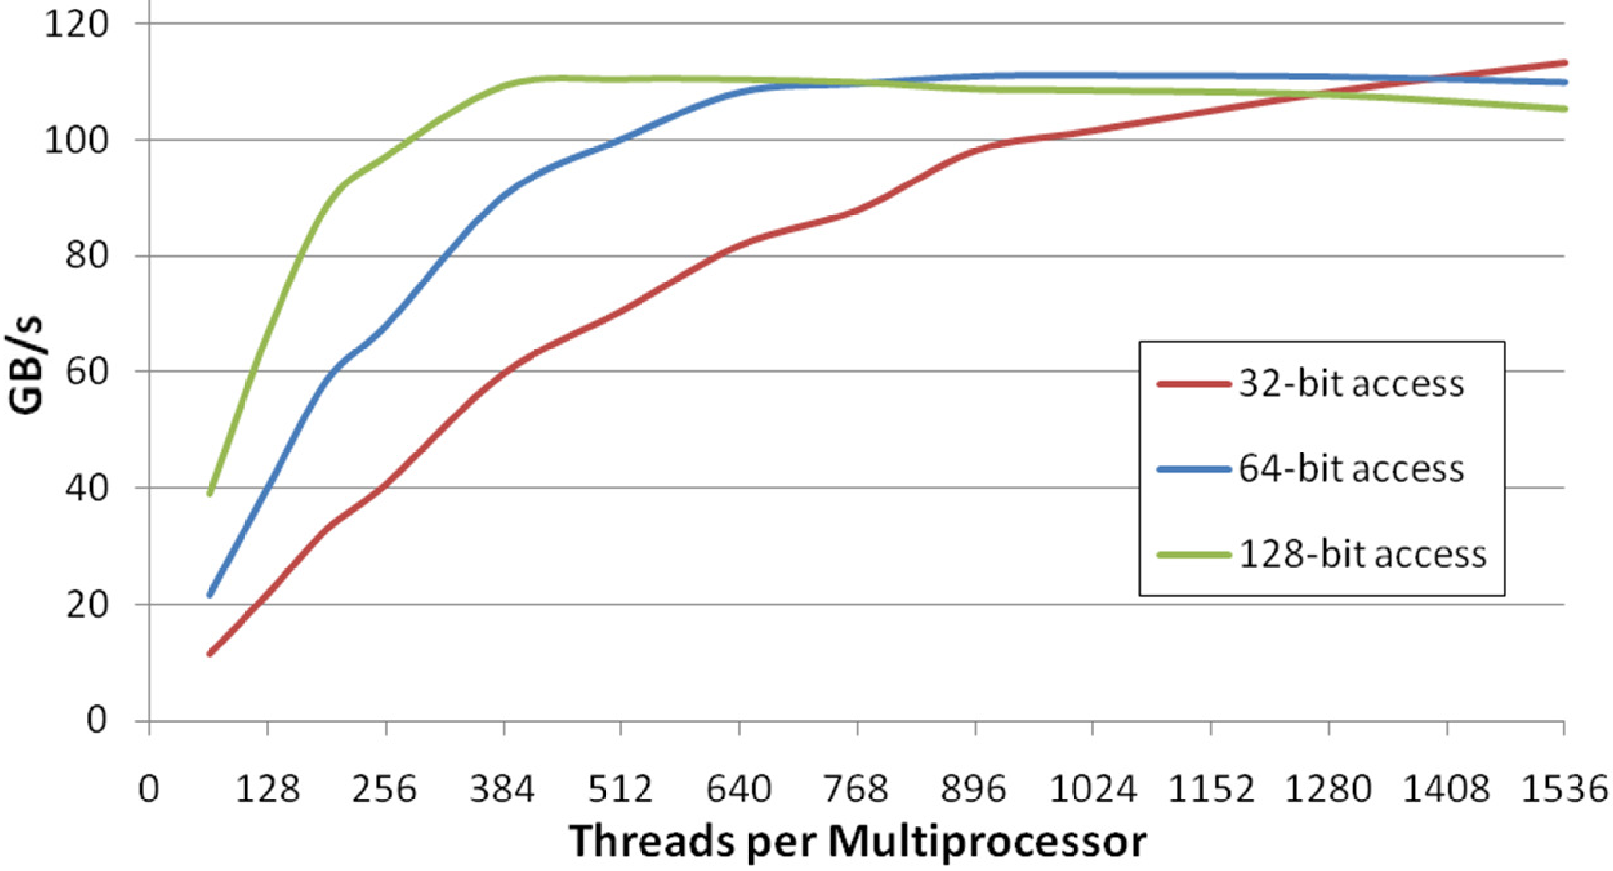
Global Memory Access
Global memory access (reading from D-RAM) is notoriously expensive on GPUs
The bandwidth to and from each SMP is very high
The latency is what really kills you, and then only if the compiler can’t hide it
Think about reading contiguous sectors of 128 bytes (“coalescence”)
https://developer.download.nvidia.com/CUDA/training/cuda_webinars_GlobalMemory.pdf

Slide 22
L1 Cache Utilization
Cache on GPUs is notoriously scarce
For 1536 threads 128kB of L1 is, indeed, very small (85 bytes / thread)
But, all threads have access to that L1 cache, and we can control what’s in it
Three types of L1, most on the same physical transistors
__shared__ : visible to all threads of the one block that allocated it
“Common” L1: values from texture, __ldg() (“load global”), or auto-cached
__constant__: not part of the 128kB L1, but a separate 8kB cache of constants

Slide 23
Register Utilization
Every SMP operates a 64K register file
A register is 4 bytes, integer or floating point, for arithmetic in flight
Storing data in registers requires that at least 32 threads hold equivalent data, but not necessarily the same data
Up to 256kB worth of data can be present in the registers on an SMP
The compiler has the final say on what is in the register file

Slide 24
How to Track Register Usage
In general:
Scalar variables (int, float) and small static arrays (float x[12];) will get placed into registers
The register count depends not on the length of the code path or the number of scalars declared. Rather, it’s about the number of separate quantities that must exist at the same time in order to complete the workflow.
You cannot control what the compiler does, but the compiler will report what it did.
${CUDA_HOME}/bin/nvcc -gencode arch=compute_60,code=sm_70
-use_fast_math -O3 --ptxas-options=“-v” YourCode.cu –o YourExe
ptxas info : Compiling entry function '_Z27kCalcPMEOrthoNBFrc16_kernelv' for 'sm_70'
ptxas info : Function properties for _Z27kCalcPMEOrthoNBFrc16_kernelv
0 bytes stack frame, 0 bytes spill stores, 0 bytes spill loads
ptxas info : Used 48 registers, 996 bytes smem, 352 bytes cmem[0], 8 bytes cmem[2]

Slide 25
Making Threads Communicate
Within the same block, threads can communicate via __shared__ memory.
__syncthreads() is needed as there is no guarantee when the threads of each warp will advance to a given point in the kernel
__global__ void kTransformCoordinates()
{
// Read the transformation matrix
__shared__ volatile float xfrm[3][3];
if (threadIdx.x < 9) {
xfrm[threadIdx.x] = cnstCache.pointerToXfrm[threadIdx.x];
}
__syncthreads();
// The entire block now accessed the local copy of xfrm
int pos = (blockIdx.x * blockDim.x) + threadIdx.x;
while (pos < cnstCache.nparticles) {
float3 tcrd, crd = cnstCache.pointerToCrd[pos];
tcrd.x = crd.x * xfrm[0] + crd.y * xfrm[1] + crd.z * xfrm[2];
tcrd.y = crd.x * xfrm[3] + crd.y * xfrm[4] + crd.z * xfrm[5];
tcrd.z = crd.x * xfrm[6] + crd.y * xfrm[7] + crd.z * xfrm[8];
cnstCache.pointerToCrd[pos] = tcrd;
pos += blockDim.x * gridDim.x;
}
}

Slide 26
Making Threads Communicate
Threads of the same warp communicate via the __shfl_sync() family of intrinsics.
Warps were once implicitly synchronized, but in CUDA 9 __shfl_sync enforces progress of each thread in the mask.
int x = cnstCache.pointerToData[pos];
1
5
4
7
1
0
8
3
5
4
5
1
2
8
1
0
9
5
3
2
4
5
9
0
2
6
7
4
8
8
5
3
x = x + __shfl_sync(0xffffffff, x, (threadIdx.x & 31) + 16);
10
10
7
9
5
5
17
3
7
10
12
5
10
16
6
3
9
5
3
2
4
5
9
0
2
6
7
4
8
8
5
3
x = x + __shfl_sync(0xffffffff, x, (threadIdx.x & 31) + 8);
17
20
19
15
15
21
23
6
16
15
15
7
14
21
15
3
11
11
10
6
12
13
14
3
2
6
7
4
8
8
5
3

Slide 27
Parallel Execution: Race Conditions
If two or more threads can write asynchronously to the same memory, you need atomic operations.
__global__ void kWrongSumComputation()
{
int pos = (blockIdx.x * blockDim.x) + threadIdx.x;
while (pos < cnstCache.nvalues) {
*cnstCache.pointerToSum += cnstCache.data[pos];
pos += gridDim.x * blockDim.x;
}
}
__global__ void kRightSumComputation()
{
int pos = (blockIdx.x * blockDim.x) + threadIdx.x;
while (pos < cnstCache.nvalues) {
atomicAdd(cnstCache.pointerToSum, cnstCache.data[pos]);
pos += gridDim.x * blockDim.x;
}
}

Slide 28
Parallel Execution: Bottlenecks
Massive numbers of threads trying to do atomic operations on a single entity will cause a traffic jam. Exercise: complete this kernel for summing a million ints, to store the result at the location in global memory indicated by *pointerToSum.
__constant__ struct valueList {
int nvalues; // Length of the data list
long long int *pointerToSum; // Pointer to pre-allocated,
// pre-initialized accumulator
int* data; // List of integers to sum
};
__device__ __constant__ struct valueList myWorkspace;
__global__ void kFastSumComputation()
{
... Draw your kernel in this box ...
}

Slide 29
Parallel Execution: Bottlenecks
myWorkspace.data
myWorkspace.nvalues
( … )

Slide 30
Parallel Execution: Bottlenecks
__global__ void kFastSumComputation()
{
__shared__ volatile long long int blockSum[32];
long long int thrSum = 0; // An accumulator for each thread
int pos = (blockIdx.x * blockDim.x) + threadIdx.x; // Counter to step along the list
while (pos < cnstCache.nvalues) {
localSum += cnstCache.data[pos]; // Accumulate locally
pos += gridDim.x * blockDim.x;
}
for (int i = 16; i > 0; i /= 2) { // Reduce each warp’s result to its
thrSum += __shfl_down_sync(0xffffffff, thrSum, i); // first thread. thrSum everywhere
} // else becomes garbage.
if ((threadIdx.x & 31) == 0) {
blockSum[threadIdx.x / 32] = thrSum; // Store the warp result in __shared__
}
__syncthreads(); // Wait for all warps to accumulate
if (threadIdx.x < 32) {
thrSum = blockSum[threadIdx.x]; // Final reduction of accumulated results:
for (int i = 16; i > 0; i /= 2) { // __shfl_sync is faster than __shared__,
thrSum += __shfl_down_sync(0xffffffff, thrSum, i); // and implies synchronization which
} // __shared__ would not.
if (threadIdx.x == 0) {
atomicAdd(cnstCache.pointerToSum, thrSum); // Each block makes one commit to global }
}
}

Slide 31
Tile Processing: All to All Computations
Write the CUDA code for one 8-threaded warp to process all of the Coulomb forces between pairs of particles i and j for two sets of 8 particles each. The diagram for eight particles is shown below.
Just DRAW the solution—don’t worry about the syntax or indexing details.
DO NOT use reductions.
This must be done by calculating 8 particle interactions per each of 8 threads.
Ideally, each thread will operate on a unique i and unique j at every step (no atomics needed)

Slide 32
Tile Processing: All to All Computations
Write the CUDA code for one 8-threaded warp to process all of the Coulomb forces between pairs of particles i and j, such that i < j, for one set of 8 particles each. The diagram for eight particles is shown below.
Particle pairs (i,j) and (j,i) are equivalent interactions—either is valid if done at least once.
Just DRAW the solution—don’t worry about the syntax or indexing details.
DO NOT use reductions.
DO NOT double-count interactions.
This can be done by calculating only 4 particle interactions per each of 8 threads.
Ideally, each thread will operate on a unique i and unique j at every step (no atomics needed)

Slide 33
Tile Processing: All to All Computations
The problem is equivalent to how one can place rooks on a chessboard of N = 8, 16, or 32 squares without them being able to attack one another.
...
Each thread holds one atom, uses __shfl_sync() to query details of another, stores its result, then uses __shfl_sync() again for results of the thread that queried it.
On the last iteration, forces are multiplied by half to avoid double-counting.

Slide 34
Tile Processing: All to All Computations
__global__ void kCoulombForces()
{
// Read coordinates and charges (we’re assuming there are only 32 particles
// and one block--expand with another loop for larger systems)
float x = cnstCache.xcrd[threadIdx.x];
float y = cnstCache.ycrd[threadIdx.x];
float z = cnstCache.zcrd[threadIdx.x];
float q = cnstCache.q[threadIdx.x];
// Set accumulators and begin looping
float faccx = (float)0.0, faccy = (float)0.0, faccz = (float)0.0;
for (int i = 1; i < 17; i++) {
// Get your thread to query and the thread querying you
int query = (threadIdx.x + i) – 32*(threadIdx.x + i >= 32);
int queryingMe = (threadIdx.x – i) + 32*(threadIdx.x – i < 0);
// Compute displacement between particles and the force magnitude
float dx = x - __shfl_sync(0xffffffff, x, query);
float dy = y - __shfl_sync(0xffffffff, y, query);
float dz = z - __shfl_sync(0xffffffff, z, query);
float r2 = dx*dx + dy*dy + dz*dz;
float invr = rqsrt(r2); // Use QUAKE inverse square root operation
float invr3 = invr * invr * invr;
float df = q * __shfl_sync(0xffffffff, q, query) * invr3;
...

Slide 35
Tile Processing: All to All Computations
...
// Halve the forces to avoid double-counting the final pass
if (i == 16) {
df *= (float)0.5;
}
// Chain rule to get force components in x, y, and z
float fx = df * dx;
float fy = df * dy;
float fz = df * dz;
// Accumulate forces
faccx += fx;
faccy += fy;
faccz += fz;
faccx -= __shfl_sync(0xffffffff, fx, queryingMe);
faccy -= __shfl_sync(0xffffffff, fy, queryingMe);
faccz -= __shfl_sync(0xffffffff, fz, queryingMe);
}
// Commit results back to global
cnstCache.xfrc[threadIdx.x] = faccx;
cnstCache.yfrc[threadIdx.x] = faccy;
cnstCache.zfrc[threadIdx.x] = faccz;
}

Slide 36
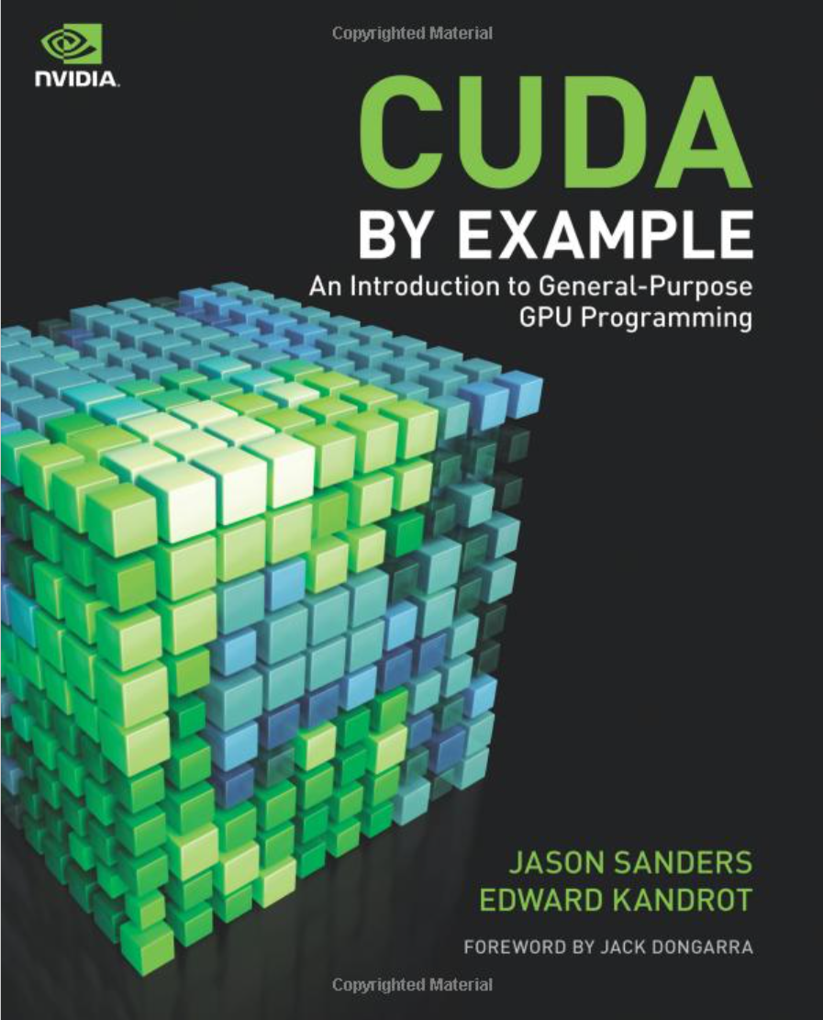

Recommended Reading

Slide 37
Recommended Resources
NVIDIA Developers’ Forum: https://devtalk.nvidia.com/
NVIDIA Developers’ Blog: https://devblogs.nvidia.com/

