Slide 1


Example CUDA Programs for Science Applications
David S. Cerutti, Rutgers University

Slide 2
Program 1-A
Hello world, on both the host and device
#include <stdio.h>
#include <cuda.h>
__global__ void TheKernel()
{
printf("This is the kernel saying hello world, from the GPU.\n");
}
int main()
{
printf("This is the C layer saying hello world, from the host.\n");
TheKernel<<<1, 1>>>();
cudaDeviceSynchronize();
return 0;
}
No kernel arguments. One block, and one thread.

Slide 3
Program 1-B
Hello world, without synchronization of host and device
__global__ void TheKernel()
{
< ... Some obnoxious loops to tie up the one thread ... >
printf("This is the kernel saying hello world, from the GPU.\n");
}
int main()
{
printf("This is the C layer saying hello world, from the host.\n");
TheKernel<<<1, 1>>>();
printf("LOOK: the host keeps on running once the kernel is launched.\n");
cudaDeviceSynchronize();
return 0;
}
This statement will print just after the kernel launches.

Slide 4
Program 1-C
Hello world, adding synchronization of host and device
__global__ void TheKernel()
{
< ... Some obnoxious loops to tie up the one thread ... >
printf("This is the kernel saying hello world, from the GPU.\n");
}
int main()
{
printf("This is the C layer saying hello world, from the host.\n");
TheKernel<<<1, 1>>>();
cudaDeviceSynchronize();
printf("LOOK: the host keeps on running once the kernel is launched.\n");
return 0;
}
This statement blocks (in an MPI sense) on the host until the kernel finishes.

Slide 5
Program 1-D
Hello world, now with enough threads for one warp
__global__ void TheKernel()
{
printf("This is kernel thread %2d saying hello world, from the GPU.\n",
threadIdx.x);
}
int main()
{
printf("This is the C layer saying hello world, from the host.\n");
TheKernel<<<1, 32>>>();
cudaDeviceSynchronize();
printf("Program exits.\n");
return 0;
}
The kernel now takes on 32 threads. Out of a possible 163,840 on that V100.

Slide 6
Program 1-E
Hello world, now with only selected threads shouting but more than one block
This is a common bit arithmetic trick in CUDA, where everything is powers of 2.
__global__ void TheKernel()
{
if ((threadIdx.x & 7) == 0) {
printf("This is block %2d, thread %2d saying hello world, from the GPU.\n",
blockIdx.x, threadIdx.x);
}
}
int main()
{
printf("This is the C layer saying hello world, from the host.\n");
TheKernel<<<8, 32>>>();
cudaDeviceSynchronize();
printf("Program exits.\n");
return 0;
}
Eight thread blocks will fire off, each reporting from only 1 out of 8 threads.

Slide 7
Program 2-A
Moving data to and from the device, feeding the accelerator via kernel arguments
__global__ void WorkbenchKernel(int* devInts)
{
devInts[threadIdx.x] += (threadIdx.x & 7) * threadIdx.x;
}
int main()
{
gpuInt myInts;
myInts = CreateGpuInt(32, 1);
for (i = 0; i < 32; i++) {
myInts.HostData[i] = ((i & 3) == 0)*(32 - i) + ((i & 3) != 0)*i;
}
UploadGpuInt(&myInts);
WorkbenchKernel<<<1, 32>>>(myInts.DevcData);
DownloadGpuInt(&myInts);
< ... Shutdown instructions ... >
}
Allocate both host RAM and GPU DRAM
Populate in host RAM
Supply the kernel a pointer to the data uploaded to the GPU DRAM

Slide 8
Program 2-B
Moving data to and from the device, feeding the accelerator via kernel arguments
struct GpuConstantsPackage {
int nparticle;
int* partType;
float* partX;
< ... Other attributes ... >
};
typedef struct GpuConstantsPackage cribSheet;
__device__ __constant__ cribSheet cSh;
int main()
{
cribSheet cnstage;
< ... Set up the system on the host, copy to DRAM ... >
< ... Set pointers and other parameters in the
cribSheet, then copy that to a symbol in GPU
constant memory ... >
ParticleSimulator<<<1, 64>>>();
}
There is a cribSheet on the host and a copy of it on the device.
Kernel no longer needs arguments

Slide 9
Program 2-C
Manipulating intricate data on the device, no kernel arguments
__global__ void ParticleSimulator()
{
int tidx = threadIdx.x;
float qq = 0.0;
while (tidx < cSh.nparticle) {
int i;
for (i = 0; i < tidx; i++) {
float dx = cSh.partX[tidx] - cSh.partX[i];
float dy = cSh.partY[tidx] - cSh.partY[i];
float dz = cSh.partZ[tidx] - cSh.partZ[i];
float r = sqrt(dx*dx + dy*dy + dz*dz);
qq += cSh.partQ[tidx] * cSh.partQ[i] * erf(r) / r;
}
tidx += blockDim.x;
}
atomicAdd(&cSh.Etot[0], qq);
}
Each thread accumulates its own portion of the energy
Only works to execute as a single block
Atomic accumulation

Slide 10
Program 2-D
Changing the way the kernel is launched (different thread counts are producing slightly different outputs)
for (i = 1024; i >= 128; i /= 2) {
etot.HostData[0] = 0.0;
UploadGpuFloat(&etot);
ParticleSimulator<<<1, i>>>();
DownloadGpuFloat(&etot);
printf("Total energy (%4d threads) = %10.4f\n", i, etot.HostData[0]);
}
Ideally, a kernel will be flexible with respect to launch parameters, to take advantage of strengths in different architectures with trivial optimizations.
Variation in the final result is not a bug, or a race condition: it is, rather, a consequence of non-associativity in floating point arithmetic.
A + B + C =/= B + C + A

Slide 11
Program 2-E
Stop using global for everything! L1 will try to save you, but with only 128kB for 1024+ threads, you can run out of it fast.
All threads can access arrays in __shared__ memory, a special kind of L1 that we explicitly allocate.
__global__ void ParticleSimulator()
{
__shared__ volatile float pX[512], pY[512], pZ[512], pQ[512];
int nstripes = (cSh.nparticle + 31) / 32;
int bpos = nstripes - warpIdx - 1;
while (bpos >= 0) {
pX[threadIdx.x] = cSh.partX[prtclIdx];
int tpos = 0;
while (tpos <= bpos) {
tX[threadIdx.x] = cSh.partX[prtclIdx];

Slide 12
Program 2-E (cont’d)
Stop using global for everything! L1 will try to save you, but with only 128kB for 1024+ threads, you can run out of it fast.
Every thread loops over itself (if not on a diagonal tile) and 31 others in its own warp.
int imin = (bpos == tpos);
for (i = imin; i < 32; i++) {
int j = tgx + i;
j -= (j >= 32) * 32;
< ... Compute force and energy ... >
}
}
}
sfpX[threadIdx.x] = qq;
for (i = 16; i >= 1; i /= 2) {
if (tgx < i) sfpX[threadIdx.x] += sfpX[threadIdx.x + i];
__syncwarp();
}
if (tgx == 0) {
atomicAdd(&cSh.Etot[0], sfpX[threadIdx.x]);
}
}
Re-use L1 __shared__ arrays to reduce the energy accumulated by each warp (reduce global writes 32x).

Slide 13
Program 2-E (cont’d)
Draw the form of that final reduction, assuming a warp of 16 threads. Code for 32 threads is copied below:
for (i = 16; i >= 1; i /= 2) {
if (tgx < i) {
sfpX[threadIdx.x] += sfpX[threadIdx.x + i];
}
__syncwarp();
}
?
How did 32 threads reduce to 1 value?
Use directional arrows to show
(this thread added its value to)→ (this thread)

Slide 14
Program 2-E (cont’d)
i = 8
i = 4
i = 2
i = 1

Slide 15
Program 2-F
Stop using global for everything! L1 will try to save you, but with only 128kB for 1024+ threads, you can run out of it fast.
No __shared__ memory is needed, removing a hard cap on the maximum thread block size and threads / SMP.
__global__ void ParticleSimulator()
{
int nstripes = (cSh.nparticle + 31) / 32;
int bpos = nstripes - warpIdx - 1;
while (bpos >= 0) {
pX = cSh.partX[prtclIdx];
int tpos = 0;
while (tpos <= bpos) {
tX = cSh.partX[prtclIdx];
int imin = (bpos == tpos);
for (i = imin; i < 32; i++) {
int j = tgx + i;
j -= (j >= 32) * 32;
float dx = __shfl_sync(0xffffffff, tX, j) - pX;
< ... Compute force and energy ... >
Data is read from global into registers, which are even quicker for a thread to access than L1.
Other threads’ data are accessed by __shfl, not __shared__.

Slide 16
Program 2-F (cont’d)
Stop using global for everything! L1 will try to save you, but with only 128kB for 1024+ threads, you can run out of it fast.
Threads must reference other threads to obtain their results.
int k = tgx - i;
k += (k < 0) * 32;
sftX -= __shfl_sync(0xffffffff, fx, k);
}
}
< ... Accumulate to global as before ... >
}
qq += __shfl_down_sync(0xffffffff, qq, 16);
qq += __shfl_down_sync(0xffffffff, qq, 8);
qq += __shfl_down_sync(0xffffffff, qq, 4);
qq += __shfl_down_sync(0xffffffff, qq, 2);
qq += __shfl_down_sync(0xffffffff, qq, 1);
if (tgx == 0) {
atomicAdd(&cSh.Etot[0], sfpX[threadIdx.x]);
}
}
__shfl, not __shared__, performs warp-wide reductions.

Slide 17
Choosing __shfl, not __shared__
There are consequences of __shfl, costs that one must pay to use the feature:
More math to determine indexing
Higher register pressure
>> nvcc --ptxas-options="-v" -o program_iie program_iie.cu
ptxas info : 0 bytes gmem, 80 bytes cmem[3]
ptxas info : Compiling entry function '_Z17ParticleSimulatorv' for 'sm_30'
ptxas info : Function properties for _Z17ParticleSimulatorv
0 bytes stack frame, 0 bytes spill stores, 0 bytes spill loads
ptxas info : Used 33 registers, 28672 bytes smem, 320 bytes cmem[0],
24 bytes cmem[2]
>> nvcc --ptxas-options="-v" -o program_iif program_iif.cu
ptxas info : 0 bytes gmem, 80 bytes cmem[3]
ptxas info : Compiling entry function '_Z17ParticleSimulatorv' for 'sm_30'
ptxas info : Function properties for _Z17ParticleSimulatorv
0 bytes stack frame, 0 bytes spill stores, 0 bytes spill loads
ptxas info : Used 46 registers, 320 bytes cmem[0], 24 bytes cmem[2]

Slide 18
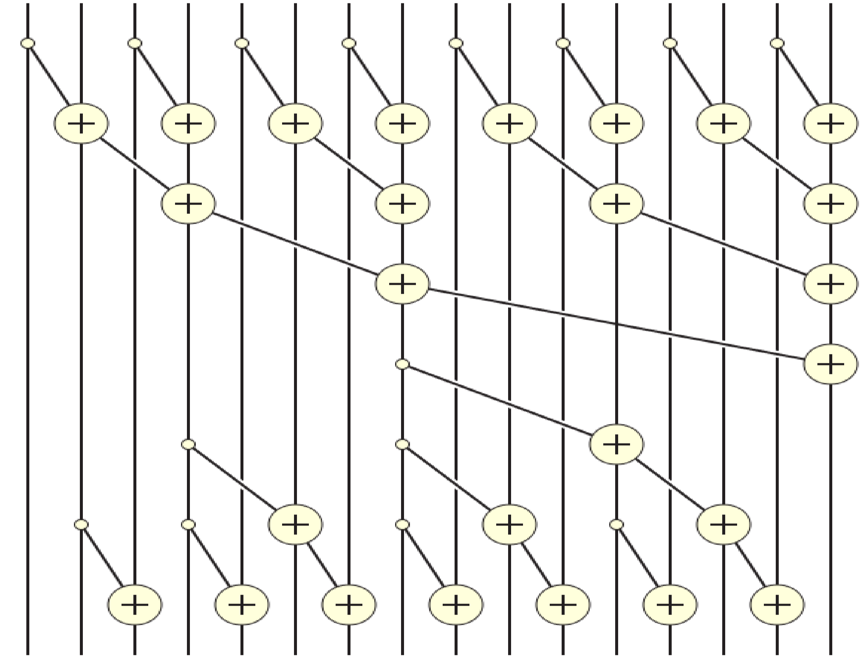
Program 3-A
Design an algorithm using __shfl instructions to compute a prefix sum of 32 integers in a warp. Here’s the process, illustrated for 16 threads:
Steps

