Slide 1
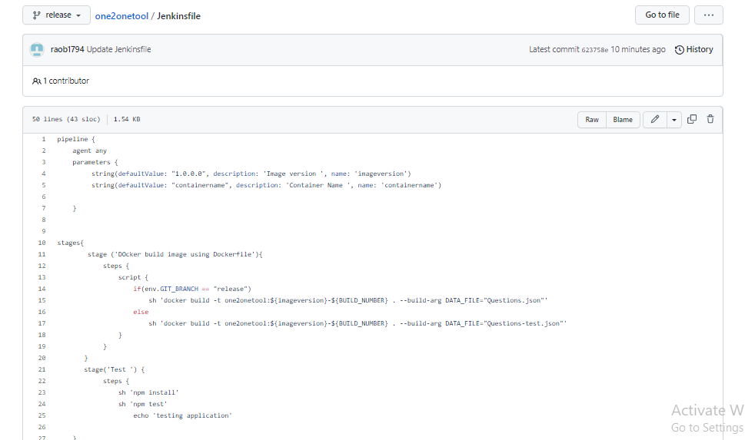
Jenkins code: Release Screenshot

Slide 2
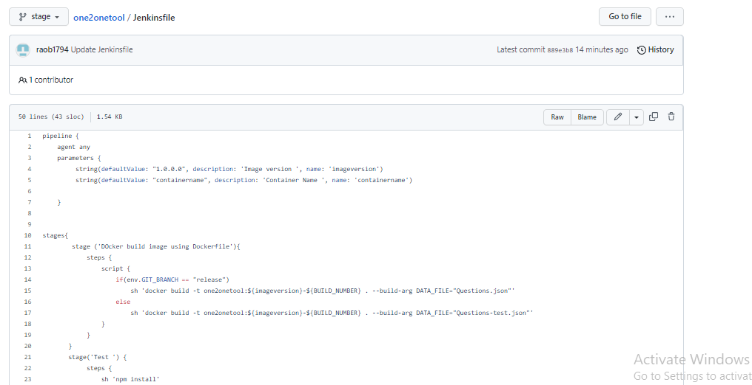
Jenkins code: Stage Screenshot

Slide 3
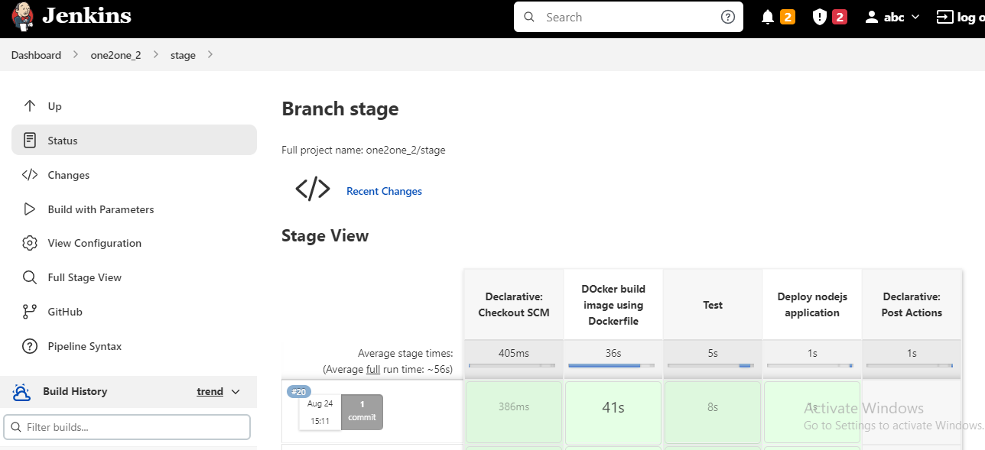
Stageing job overview

Slide 4
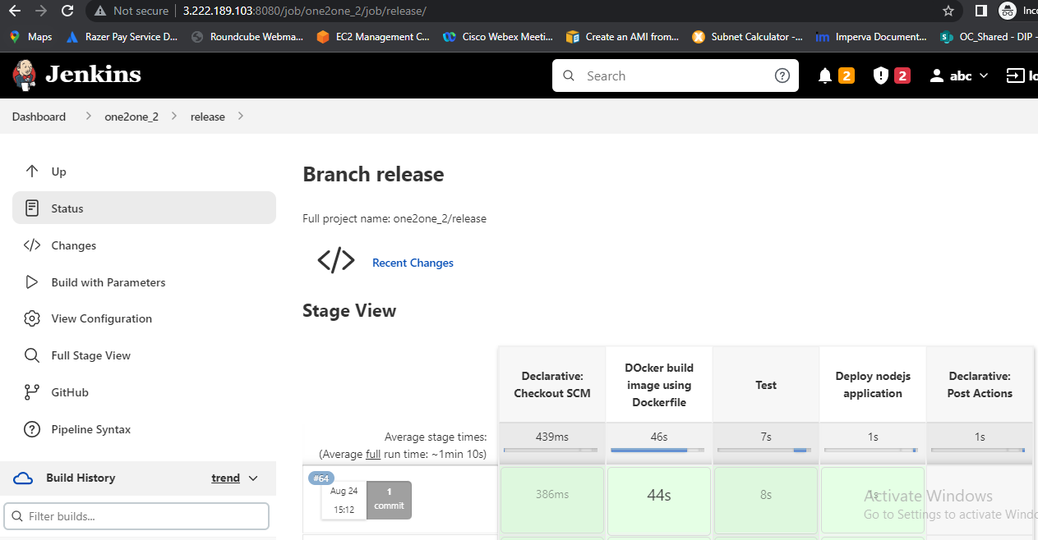
Release job overview

Slide 5
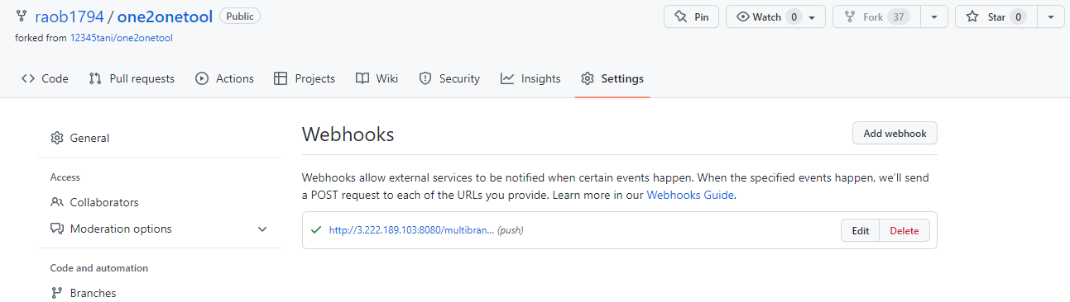
Web hook configuration
For the webhook configuration, we have installed GitHub Jenkins plugin and the did below configuration to build it on code change in branch.

Slide 6
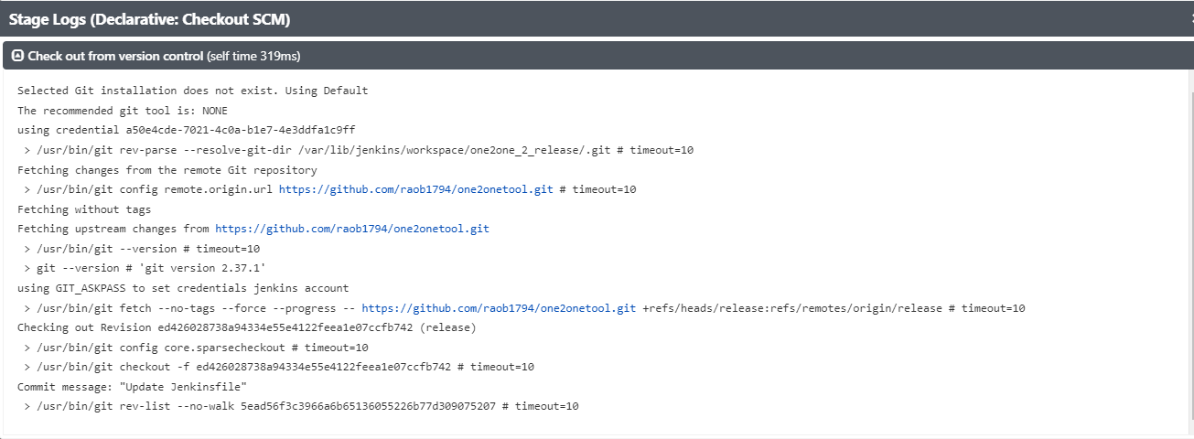
1.Declarative Checkout SCM
As part of the first stage, we need to checkout ths source code.

Slide 7
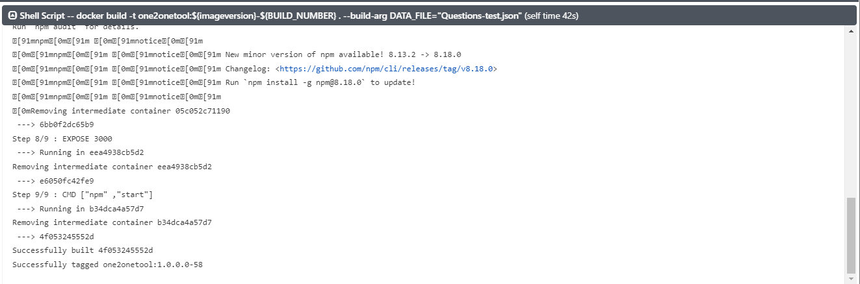
In this stage we are going to build docker image from Node.js application source code. Docker Build –t one2onetool. As we can see form logs Docker image has ben successfully built.
2.Docker Build image using Docker file.

Slide 8
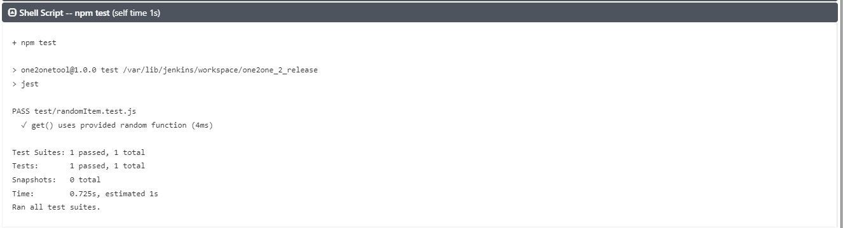
3. Test
Next step is to test the node project so we will run npm test.
Logs for test stage has been shown in the screenshot.

Slide 9
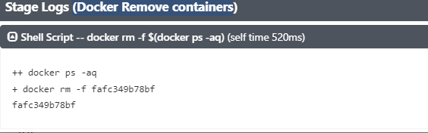
4.Docker Remove containers
Before Deploying or running the new container –we need to remove or stop the previously running container, so this code removes the earlier container & starts a new container from newly created image.
With the Command shown in screenshot logs. The old container is stopped & removed successfully.

Slide 10
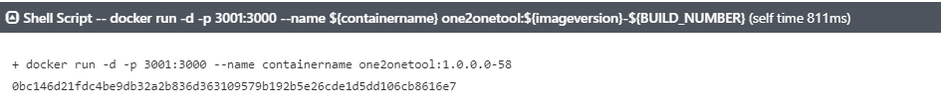
5. Deploy Node.JS application
Once the old container is stopped in the earlier stage, we can run the new container.
As shown in screenshot, it has been run successfully.

Slide 11
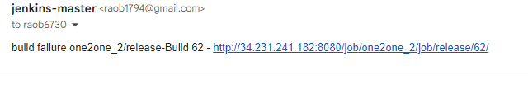
Jenkins any stage failed received email alert with logs path.

