Slide 1
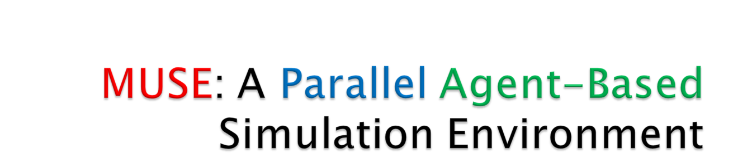
Meseret Gebre
Advisor: Dr. Dhananjai M. Rao

Slide 2
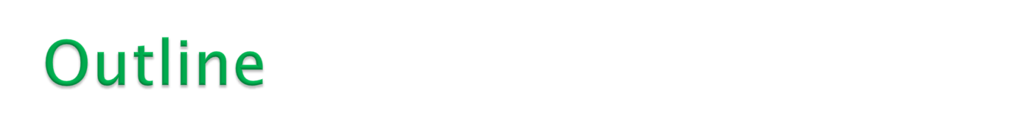
Motivation
Related works
Message Passing Interface (MPI)
Language of choice (C++)
Synchronization methods
Quality and empirical testing procedures
MUSE design overview
Simple example via MUSE API
Research plans

Slide 3
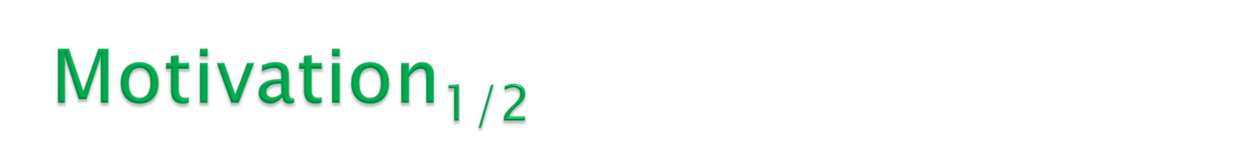
Agent-based models have been used since the mid-1990s to
solve a variety of business, technology, and medical problems [2].
The following are example of such applications:
  Supply chain optimization
  The spread of epidemics
  Threat of bio-warfare
  Modeling of consumer behavior
  Social network effects
Realizing the advantages of simulation-based methodologies requires
the use of a software environment that is conducive for modeling,
simulation, and analysis.
Furthermore, parallel simulation methods must be employed to reduce the time for simulation, particularly for large problems, to enable analysis in reasonable time frames.
Unfortunately, effective and efficient parallel, agent-based simulation software is not available as of this proposal.

Slide 4

This thesis proposes to develop a general purpose agent-based,
parallel simulation environment called
MUSE (Miami University Simulation Environment).
MUSE, provides an Application Program Interface (API) for agent-based modeling and a framework for parallel simulation.
The research proposes to develop the API in C++ using its object oriented features. The core parallel simulation capabilities of MUSE will be realized using the Time Warp synchronization methodology and the Message Passing Interface (MPI).

Slide 5

Railsback et. al present a detailed survey of
several agent-based simulation frameworks
that are similar to MUSE.
The frameworks under review were NetLogo, SWARM Objective-C,
SWARM Java, Repast, and MASON.
We also reviewed three parallel simulation frameworks namely WRAPED [3], GTW [5], and Parsec [4].

Slide 6

Advantage
  NetLogo’s strong points include
  its detailed documentation and
  ease of use [2].
Disadvantage
  It uses proprietary code, and users have to learn a custom language for modeling [2].

Slide 7

The original SWARM uses the
Objective-C language.
Advantage
  Its the most mature and stable framework, which makes it well organized [2].
  Objective-C is more natural to model with [2].
Disadvantage
  Has weak error-handling [2].
  Another downside is the availability of tools for developing with Objective-C.

Slide 8

Java SWARM is simply a wrapper that allows Java
developers to call Objective-C SWARM libraries.
Advantage
  Java has strong error-handling capabilities
Disadvantage
  The framework does not effectively take advantage of the two languages [2].
  Moreover, both versions of SWARM, proved to be the slowest for very complex models [2].

Slide 9

Repast was meant to mimic SWARM using Java,
but the design and organization of the framework
has several drawbacks [2].
Advantages
  Lots of features to choose from.
Disadvantage
  the learning curve for using the API is very steep, because it has numerous features, often making it overwhelming for most casual developers [2].

Slide 10

MASON is a light weight framework that aims to
achieve high execution speeds [2].
Advantages
  In terms of execution speed; it was indeed the fastest amongst those surveyed by Railsback et. al[2].
Disadvantage
  The youngest of all frameworks.
That was all for the agent-based frameworks, the next three were the parallel frameworks.

Slide 11

It must be noted that these are general purpose
discrete event, parallel simulation frameworks and
not necessarily agent-based simulation environments.
WARPED [3], is the first of the parallel frameworks.
Advantages
  The strong point of WARPED was that, it is freely available and open-sourced [3].
  Another important similarity to MUSE is that it uses the Time Warp synchronization method.
  It also uses MPI as its message passing protocol and C++ as the language.
Disadvantages
  The most important one is the lack of documentation.
  Furthermore, the simulator has not been actively maintained and therefore several issues prevented even compiling the core framework using recent compilers.
  Since WARPED development started in 1998, it clearly went through several upgrades in features, but the changes were not documented clearly.

Slide 12

The next framework is GTW [5].
Advantages
  Uses Time Warp.
  GTW includes several beneficial design solutions. One of the important design solutions that will be used in MUSE is controlling optimism during simulation…
  GTW avoids cascading rollbacks by using time windows that throttle optimism [5].
  Another attractive feature is the local message sends, meaning if a message is meant for the local LP it is simply enqueued directly to its input queue.
Disadvantages
  It lacks documentation and has not been actively maintained.
  GTW was primarily developed for shared memory architectures while today’s supercomputing clusters primarily used distributed memory architectures.

Slide 13

Last framework is Parsec [4].
Advantages
  Strong points of Parsec include its visual environment. Developers modeled via a GUI [4].
  Parsec implements many conservative synchronization methods and many communication libraries [4].
Disadvantages
  However, conservative synchronization requires the modeler to be aware about look ahead in simulation-time during model development.
  Look ahead is necessary to avoid deadlocks that potentially occur during simulation.
From the reviews we were able to decided on key features that MUSE
should have in the design.

Slide 14
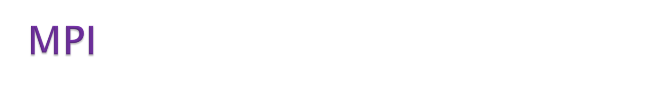
The message passing programming paradigm is
the most well known and widely used approaches
for programming parallel computers [23].
One of the main reasons it spread fast is because it
imposes minimal requirements on the underlying hardware [23].
We decided to adopt MPI because,
  well documented and widely used.
  MPI handles hardware-specific details on passing messages between interconnected compute nodes.
  Lastly, since MUSE will primarily operate on Linux based distributed machines; it would be a benefit to use MPI, because it is supported by most supercomputers.

Slide 15
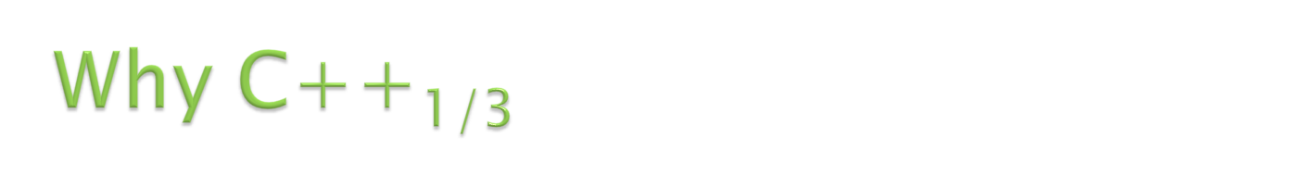
All simulation frameworks or libraries that we
have seen have used some of the more well known
languages for implementation.
  C++
  Java
  Objective-C
Objective-C was eliminated for two reasons.
  The main reason is the development tools are scarce…
  Although, Objective-C is more natural to code with, it also lacks for the ability to catch errors easily.
With these two reasons, it’s clear to see why Objective-C is not a reliable solution.

Slide 16
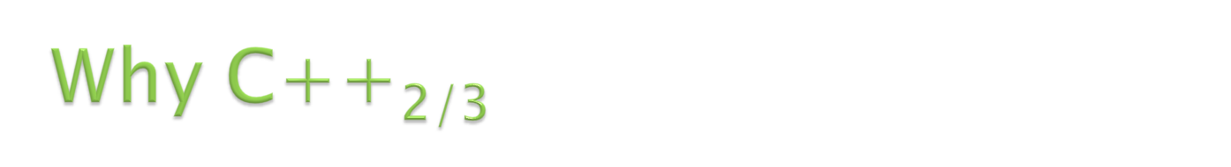
In distributed computing, the logical distance from
the hardware that your code executes onto the high-level
semantics you use to code in the given language is called the semantic gap.
Tradeoff
  the smaller the semantic gap, the more the developer must worry about hardware details, which could slow down development time…
  On the bright side, it could allow developers to realize great increase in speed by taking advantage of hardware design…
C++ Vs. Java
  Computation gap and communication gap?
  C++ has an excellent balance because it has been designed
  with the hardware in mind.
  C++ allows the use of registers; this allows all microprocessors to optimize execution speed using registers.
  Java on the other hand uses a stack based Java Virtual Machine (JVM). No registers.
  No real support for MPI in Java.

Slide 17

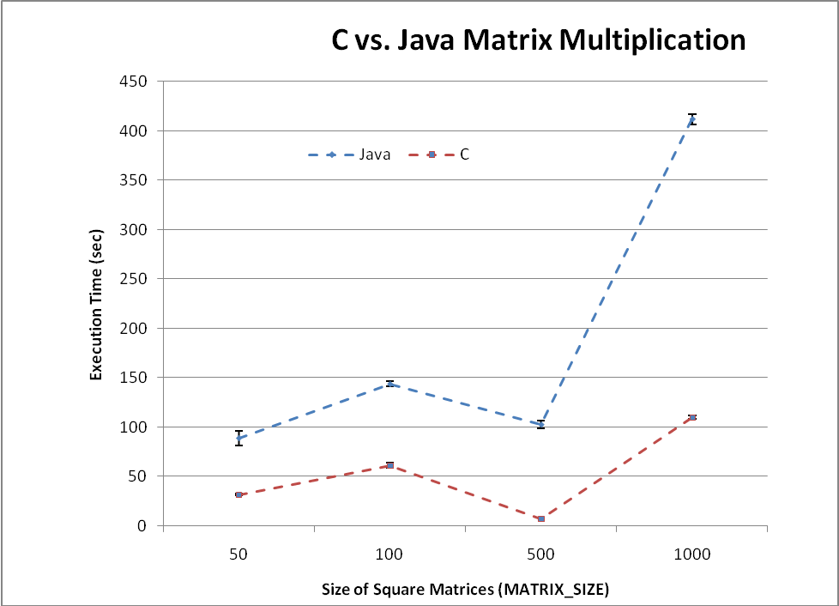
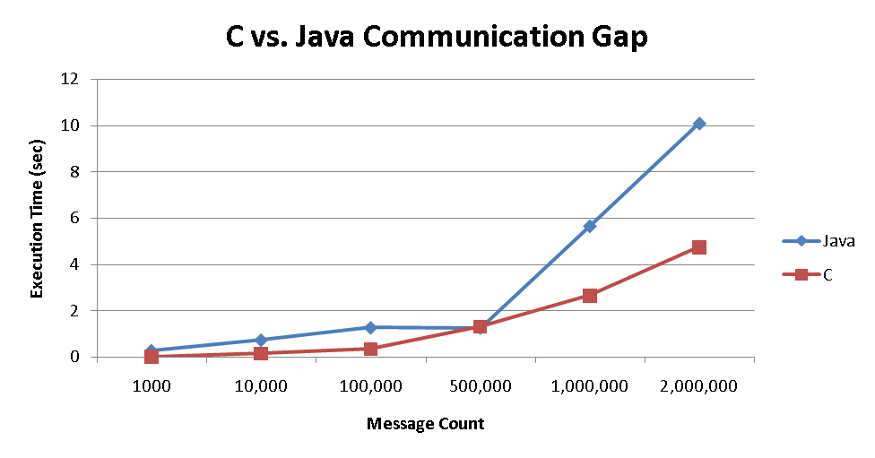
SIZE | REPETITIONS
50 | 100000
100 | 28000
500 | 10
1000 | 10

Slide 18
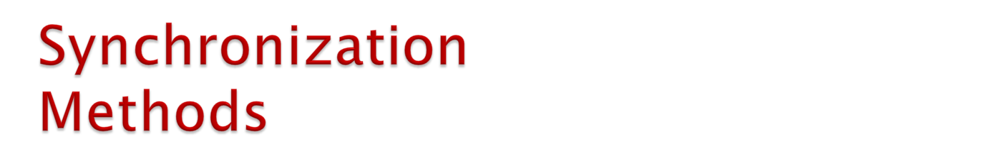
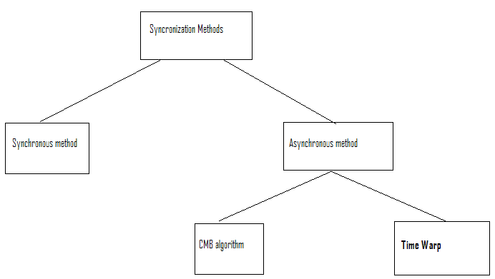

Slide 19

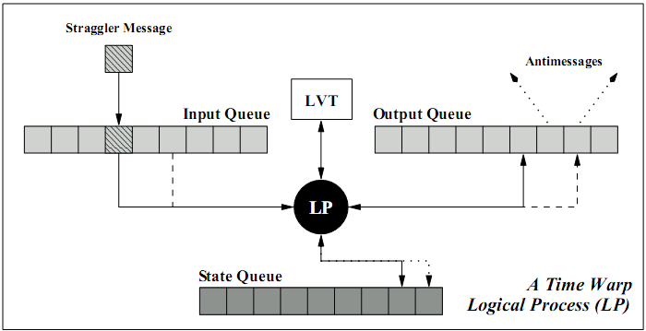
A simulation is organized as a collection of
communicating Logical Processes.
Communication between logical processes is performed by exchanging virtual time stamped messages or events.
Each LP has an input queue, output queue, and a state queue…
A LP advances its Local Virtual Time (LVT) by processing events from its input queue, updating its state, and generating new events.
Rollback
  Use state queue to restore the LP to a safe state.
  Anti-messages are sent to undo all events that
  have been sent from the LP that is rolling back.
  Finally, the straggler message is reprocessed in
  the correct timestamp order.
GVT for garbage collection…
A logical process in a time warp simulation [3]

Slide 20

The overhead of the waiting time in the
conservative methods is traded for the extra work
done due to processing erroneous events and the
rollbacks in time warp [20].
Time Warp is not susceptible to deadlocks. A plus!
Time Warp has been heavily studied and every aspect has been dissected and ways to improve Time Warp is readily available [9, 10, 11, 12, and 14].

Slide 21
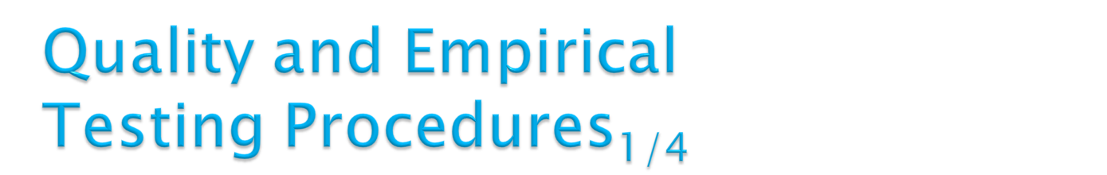
Early in the proposal (related works) we described
qualities that we plan to implement in MUSE during
the development phase.
  Complete documentation of classes and methods, with examples.
  Follow standard terminology to ease effective use of API for modeling.
  Most users developing simulations are novices and have little knowledge of programming.
  Provide tools for generating statistical output.
  Provide tools for setting up and executing simulation experiments.
For this thesis we plan on insuring proper implementation on issues one and two…
Quality design will insure MUSE is easy to use and maintainable for future developers working to enhance or use MUSE.

Slide 22
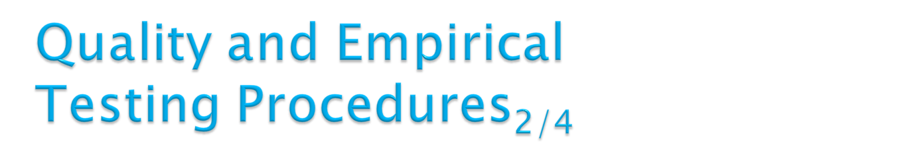
MUSE will also undergo proper empirical testing.
Since development with MUSE will be geared towards
high performance distributed machines, we can use
standardized metrics [23], which include:
  Raw execution time
  Speedup
  Total Parallel Overhead
Raw execution time
  This is the most commonly used metric for comparing performance improvements [23]. First step is to capture the wall runtime of the fastest non-parallel agent-based simulation framework, for our case MASON [2]. The serial runtime can be denoted by Ts [23]. Second step is to capture the wall runtime of MUSE, this is denoted by Tp.

Slide 23

Speedup
  Once you know that the raw execution time of going
  parallel is better than the serial counterpart, then you
  should figure out just how much you speed is improved. Speedup, denoted by S, is defined as the ratio between the raw execution time of the serial program to the raw execution time of the parallel program.
    S = Ts/Tp
Total parallel overhead
  Due to the nature of parallel algorithms, they always have that extra overhead. Overhead are usually from idling, inter-process interaction, and excess computation [23]. We can a measure on these overheads, by calculating the total parallel overhead, which is denoted by To [23]. The formula for this is as follows:
    To = pTp – Ts, p is the number of processes.

Slide 24
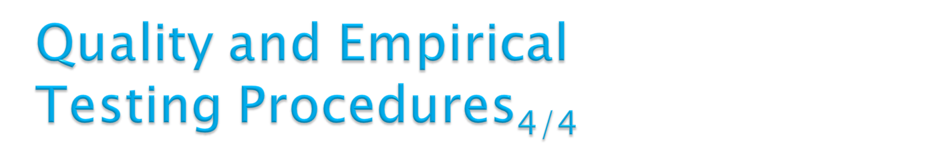
Benchmarking will be done in two
phases.
  Synthetic benchmarking (phase 1)
    Low parallelism…
    High parallelism…
    Testing for scalability and efficiency.
  Railsback et. al[2] insect simulation (phase 2)
    This will help us compare against the agent-based
    frameworks discussed in Railsback et. Al.

Slide 25

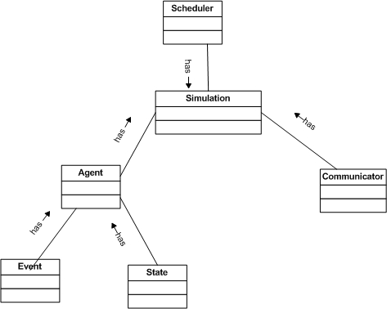

Slide 26
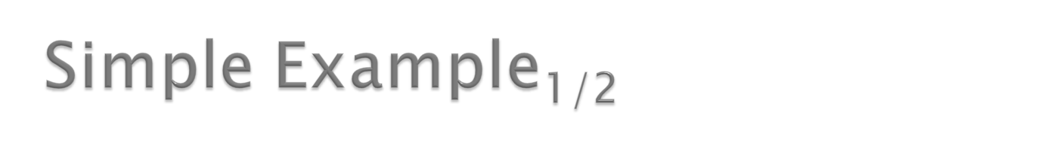
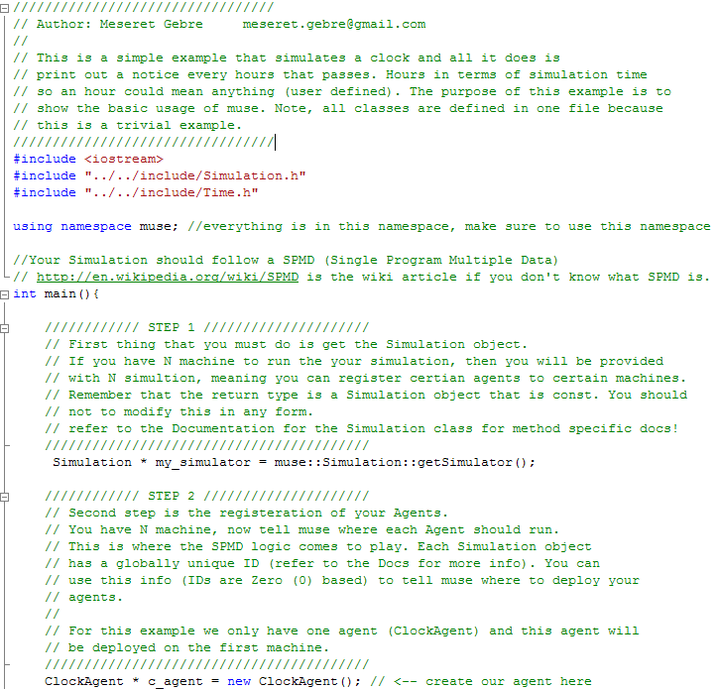

Slide 27
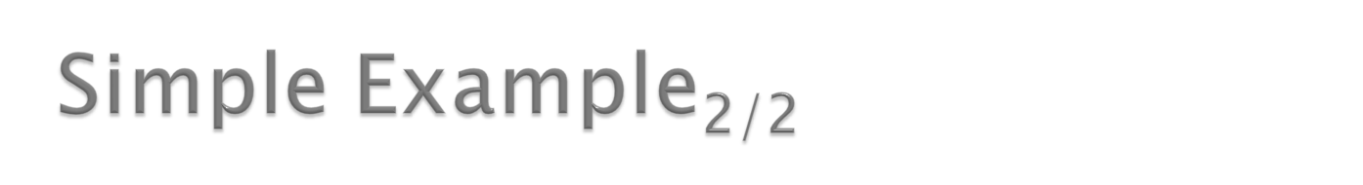
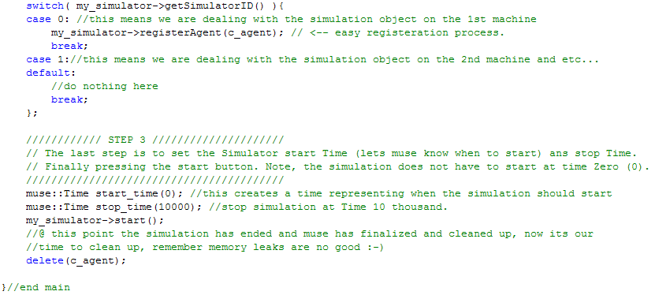

MUSE Documentation:
http://www.users.muohio.edu/gebremr/muse/docs/

Slide 28
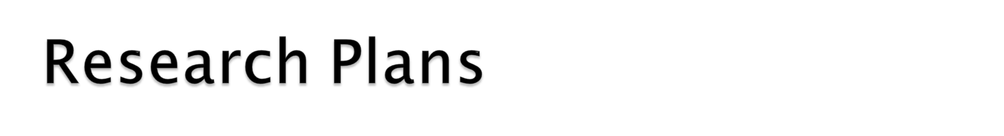
Milestone | Dead Line Date
Have design of MUSE and approved for implementation with Dr. Rao | 11/03/2008
Iteration 1 – implementation of base code {Time, and State} and develop unit test for testing. | 11/10/2008
Iteration 2 – implementation of base code {Agent, and Event} and develop unit test for testing. | 12/01/2008
Iteration 3 – implementation of {Simulation} class and develop unit test for testing. | 01/15/2009
Beta version of MUSE should be read for testing and further refinement at this point | 02/01/2009
MUSE should be completely implemented and should be verified with a code review by Dr. Rao and interested committee members. | 02/23/2009
Complete quality and empirical testing of MUSE against other frameworks. | 03/20/2009
Complete Thesis write-up. | 04/01/2009
Thesis defense | 04/10/2009

Slide 29
?
?
?

Slide 30
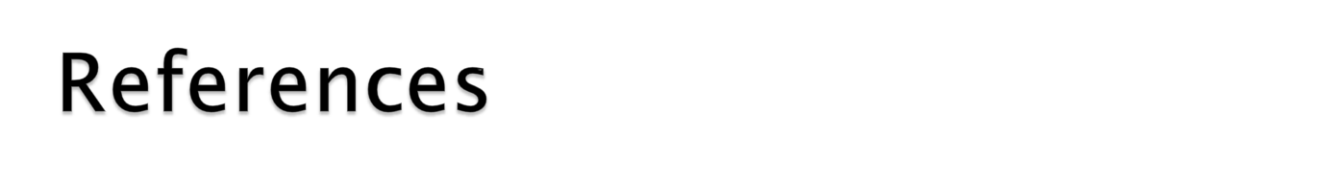
[1] Railsback, S. F., Lytinen, S. L., Jackson, S. K., Sep. 2006. "Agent-based simulation platforms: Review and development recommendations" Simulation (A journal from The Society for Modeling and Simulation International) Volume 82 (Number: 9), pages: 609--623.
[2] http://en.wikipedia.org/wiki/Agent_based_modeling
[3] Radhakrishnan, R., Martin, D. E., Chetlur, M., Rao, D. M., and Wilsey, P. A. 1998. An Object-Oriented Time Warp Simulation Kernel. In Proceedings of the Second international Symposium on Computing in Object-Oriented Parallel Environments (December 08 - 11, 1998). D. Caromel, R. R. Oldehoeft, and M. Tholburn, Eds. Lecture Notes In Computer Science, vol. 1505. Springer-Verlag, London, 13-23.
[4] R. Bagrodia, R. Meyerr, et al., "PARSEC: A Parallel Simulation Environment for Complex System", UCLA technical report, 1997.
[5] D. Das, R. Fujimoto, K. Panesar, D. Allison, and M. Hybinette, “GTW: A Time Warp system for shared memory multiprocessors”. In Proceedings of the 26th Winter Simulation Conference, pages 1332–1339. 1994.
[6] Cleary, J. G. and Tsai, J. 1996. Conservative parallel simulation of ATM networks. SIGSIM Simul. Dig. 26, 1 (Jul. 1996), 30-38. DOI= http://doi.acm.org/10.1145/238793.238807
[7] Hassan Rajaei , Rassul Ayani , Lars-Erik Thorelli, The local Time Warp approach to parallel simulation, Proceedings of the seventh workshop on Parallel and distributed simulation, p.119-126, May 16-19, 1993, San Diego, California, United States
[8] MPI-2: Extensions to the Message-Passing Interface, October 18, 2008, http://www.mpi-forum.org/docs/mpi-20-html/mpi2-report.html
[9] JEFFERSON, D. Virtual time. ACM Trans. Program. Lang. Syst. 7, 3 (July). 1985, pp.404-425.
[10] Yi-Bing Lin , Edward D. Lazowska, A study of time warp rollback mechanisms, ACM Transactions on Modeling and Computer Simulation (TOMACS), v.1 n.1, p.51-72, Jan. 1991 [doi>10.1145/102810.102813]
[11] Jeff S. Steinman, Breathing Time Warp, Proceedings of the seventh workshop on Parallel and distributed simulation, p.109-118, May 16-19, 1993, San Diego, California, United States
[12] Samir R. Das , Richard M. Fujimoto, Adaptive memory management and optimism control in time warp, ACM Transactions on Modeling and Computer Simulation (TOMACS), v.7 n.2, p.239-271, April 1997 [doi>10.1145/249204.249207]
[13] Makoto Matsumoto , Takuji Nishimura, Mersenne twister: a 623-dimensionally equidistributed uniform pseudo-random number generator, ACM Transactions on Modeling and Computer Simulation (TOMACS), v.8 n.1, p.3-30, Jan. 1998 [doi>10.1145/272991.272995]
[14] Gilbert Chen , Boleslaw K. Szymanski, DSIM: scaling time warp to 1,033 processors, Proceedings of the 37th conference on Winter simulation, December 04-07, 2005, Orlando, Florida
[15] Tisue, S. and U. Wilensky. NetLogo: A Simple Environment for Modeling Complexity. Proc. International Conference on Complex Systems (2004).
[16] Nick Collier. RePast: An Extensible Framework for Agent Simulation. http://www.econ.iastate.edu/tesfatsi/RepastTutorial.Collier.pdf.
[17] Minar N, Burkhart R, Langton C, Askenazi M. The Swarm simulation system: A toolkit for building multi-agent simulations. Santa Fe (NM): Santa Fe Institute;1996 June. Report No.: 96-06-042.
[18] Luke, S., C. Cioﬃ-Revilla, L. Panait, and K. Sullivan. 2004. MASON: A new multi-agent simulation toolkit. In Proceedings of the Eighth Annual Swarm Users/Researchers Con-ference (SwarmFest 2004).
[19] R. Minson, G. Theodoropoulos, Distributing repast agent based simulations with HLA, in: Proceedings of the 2004 European Simulation Interoperability Workshop, Edinburgh, UK, 2004.
[20] M. Bailey, L. Snyder, A Model for Comparing Synchronization Strategies for Parallel Logic-Level Simulation (1989).
[21] K.M. Chandy and J. Misra. "Distributed simulation: a case study in design and verification of distributed programs". IEEE Transactions on Software Engineering, Vol. SE-5, No. 5, Sept. 1979,440-452.
[22] Bryant, R. E. Simulation on a distributed system. In Proc. Of the 16th Design automation Conference (1979), pp. 544-552.
[23] "Introduction to Parallel Computing" (Second Edition) by Ananth Grama, Anshul Gupta, George Karypis, and Vipin Kumar; Published by Addison-Wesley (ISBN-10: 0-201-64865-2, ISBN-13: 978-0-201-64865-2).

