Slide 1
MUSE: A parallel Agent-based Simulation Environment
BY: Meseret Gebre
Advisor: Dr. Dhananjai M. Rao

Slide 2
Outline(1/1)
Motivation
What is Agent-based modeling (ABM)
Advantages of ABM
Empirical Evaluation and Benchmarking results
MUSE Public API
Conclusion and Future Works

Slide 3
Motivation(1/4)
Research and development of modern systems consume countless man hours and money.
Maximizing the output of any system requires plenty of study, which will yield effective procedures to design, develop, and maintain them.
These decisions become more important when dealing with systems that can be life threatening or resource consuming.
A decision of what to do if a bio-warfare ever breaks out or how to correctly allocate energy resources in the dangers of global warming are good examples of these systems of study.
Notes:
Want pictures of tanks

Slide 4
Motivation(2/4)
Usually the studies of systems like bio-warfare scenarios or global warming are unrealistic without the help of modern technology.
Analysis requires millions of entities interacting over a long period of times to get valuable information on different decision paths.
Computer-based simulations play a very important role analyzing and studying complex system as described above.

Slide 5

Motivation(3/4)

Slide 6
Motivation(4/4)
MUSE
Miami University Simulation Environment.
MUSE (verb): to become absorbed in thought.
An Agent-based Simulation Environment.

Slide 7
Agent-based Modeling(1/1)
Simulation in a nutshell is mimicking a system.
In agent-based modeling (ABM), a system is modeled as a collection of independent decision-making entities called agents (Bonabeau).
Typically the agent has a set of rules to follow and based on these rules the agent can make decisions.
These rules are data that we collect and input into the model.
ABM is more a way of thinking about the model.
So what is the Advantages to ABM?

Slide 8
Advantages to ABM(1/1)
The most important being ABM can capture emergent phenomena (Bonabeau).
How can phenomena be captured?
Nothing is constant in this universe except change.
All entities are always changing is some way.
More rules for entities, yields better simulation (closer to real life outcomes) results
“the whole is more than the sum of its part because of the interactions between the parts” (Bonabeau).
ABM is also flexible and more natural to work with (Bonabeau).
We can easily collect more data and add it to the model, making it flexible.
Easy to think of modeling as interaction between entities.

Slide 9
Quick Note
Next I present results from the experiments before discussing the API details.

Slide 10
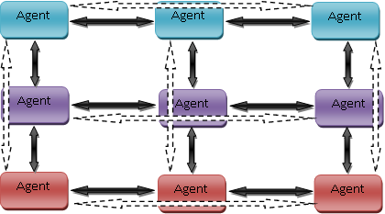
Empirical Evaluation and Benchmarking(1/12)
For the experiments, implementation and testing is done with PHOLD (Fujimoto).
PHOLD variables used to scale and fine tune a simulation workload.
X, this is the number of columns to have in the PHOLD grid
Y, this is the number of rows to have in the PHOLD grid
N, the number of events each agent sends every time.
Delay, the maximum receive time that an agent can schedule an event for.
Nodes, the number of compute nodes to use for the PHOLD simulation.
3 x 3 PHOLD simulations on three compute nodes

Slide 11
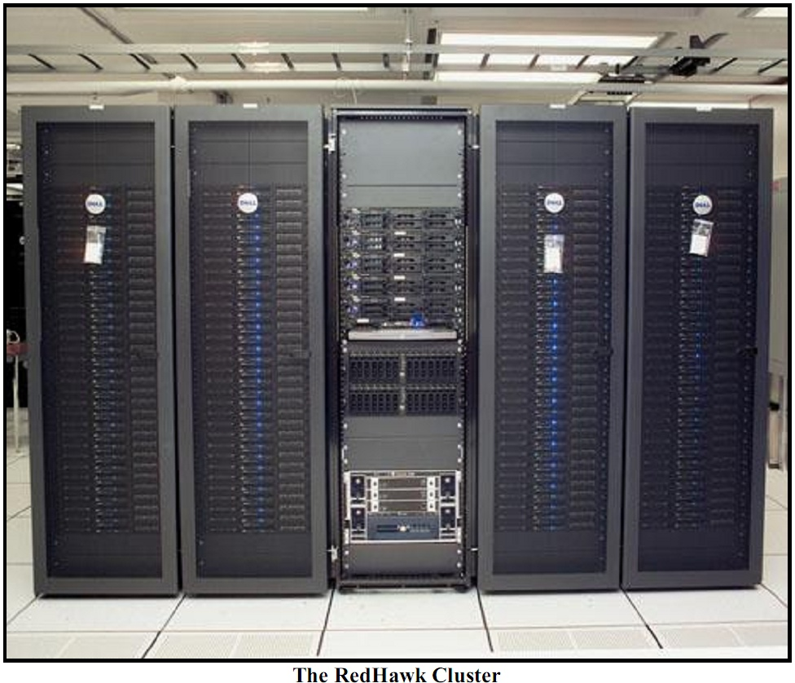
Empirical Evaluation and Benchmarking(2/12)
Testing done on Miami’s Redhawk Cluster.
128 computes
Each compute node has the following Specs:
Component | Details
CPU Model | Intel Xeon (x2)
CPU/Core Speed | 3.0 GHz (x2)
Main Memory (RAM) size | 4 GB
Operating system used | Linux 2.6.9-22.ELsmp
Interconnect type & speed (if applicable) | Infiniband @ 20Gbps

Slide 12
Empirical Evaluation and Benchmarking(3/12)
Metrics used for analysis
Execution Time
Ts = time for serial version to execute
Tp = time for parallel version to execute
Speedup
Ts / Tp
Efficiency
Speedup / # of processing elements (compute nodes)
Scalability
Determined from observing efficiency.
If a parallel program can maintain an efficiency rate of above .85 as the processing elements and work load increase, then the parallel program is considered efficient.
Notes:
Reference on the board

Slide 13
Empirical Evaluation and Benchmarking(4/12)
Empirically evaluated MUSE to see how well it scaled and the efficiency of the framework.
Run PHOLD with the following variable settings
X = 512
Y = 512
N = 3
Delay = 10
Nodes = {1,2,4,8,16,32}
This setting is working with a little over a quarter of million agents
262,144 agents
The simulation runs for 500 time steps.

Slide 14
Empirical Evaluation and Benchmarking(5/12)
MUSE Execution times with increasing nodes
Agents | Events | Delay | Nodes | End Time | Execution Time (seconds)
512 x 512 | 3 | 10 | 1 | 500 | 1663
512 x 512 | 3 | 10 | 2 | 500 | 645
512 x 512 | 3 | 10 | 4 | 500 | 291
512 x 512 | 3 | 10 | 8 | 500 | 142
512 x 512 | 3 | 10 | 16 | 500 | 65
512 x 512 | 3 | 10 | 32 | 500 | 33

Slide 15
Empirical Evaluation and Benchmarking(6/12)
Used PHOLD run on one compute node as the serial runtime Ts = 1663.
Agents | Nodes | Execution Time (seconds) | Speedup | Efficiency
512 x 512 | 2 | 645 | 2.578295 | 1.289147
512 x 512 | 4 | 291 | 5.714777 | 1.428694
512 x 512 | 8 | 142 | 11.71127 | 1.463908
512 x 512 | 16 | 65 | 25.58462 | 1.599038
512 x 512 | 32 | 33 | 50.39394 | 1.574811

Slide 16
Empirical Evaluation and Benchmarking(7/12)
Agents | Events | Delay | Nodes | End Time | Exec. Time (sec)
100 x 100 | 3 | 10 | 1 | 500 | 32
200 x 100 | 3 | 10 | 2 | 500 | 33
200 x 200 | 3 | 10 | 4 | 500 | 34
400 x 200 | 3 | 10 | 8 | 500 | 34
400 x 350 | 3 | 10 | 16 | 500 | 33
700 x 400 | 3 | 10 | 32 | 500 | 35
As the workload increases and number of processing elements increases, the execution time should remain relatively consistent.
MUSE Execution time with increasing agents and nodes

Slide 17
Empirical Evaluation and Benchmarking(8/12)
The last two experiments showed that MUSE is very efficient and scalable!
Next is to benchmark against two different frameworks. To see how well MUSE compares to other frameworks.
WARPED
Parallel, but not agent-based.
Similar to MUSE
Uses Time Warp
Uses MPI
Development is done with C++
Only needed one experiment. A direct comparison on execution time for same workload with increasing compute nodes
MASON
Non-parallel, but agent-based.
Very different from MUSE
No concept of “event”, agents talk to each by scheduling to ‘step’ on each other.
Agents have a pointer to the entire model when ‘stepped’
Agents have direct access to all other agents
Development is done with Java
Two experiments needed for a better analysis.
Tested both using only one compute node with increasing workload. To see the overhead of MUSE against a true serial framework (MASON).
Using the best time from the first experiment, check how many compute nodes it takes for MUSE to over take MASON.

Slide 18
Empirical Evaluation and Benchmarking(9/12)
Agents | Events | Delay | Nodes | End Time | MUSE (seconds) | WARPED (seconds)
256 x 256 | 3 | 10 | 1 | 500 | 273 | 156469
256 x 256 | 3 | 10 | 2 | 500 | 137 | 35390
256 x 256 | 3 | 10 | 4 | 500 | 62 | 7006
256 x 256 | 3 | 10 | 8 | 500 | 30 | 1226
256 x 256 | 3 | 10 | 16 | 500 | 16 | 184
256 x 256 | 3 | 10 | 32 | 500 | 9 | 61
256x256 PHOLD on MUSE and WARPED
MUSE execution time with one node was about 572 times faster!
WARPED ~1 min mark.
MUSE ~1 min mark.

Slide 19
Empirical Evaluation and Benchmarking(10/12)
MUSE vs. MASON: on one compute node with increasing workload. (part 1)
Agents | Events | Delay | Nodes | End Time | MUSE (seconds) | MASON (seconds)
100 x 100 | 3 | 10 | 1 | 500 | 30 | 5
150 x 150 | 3 | 10 | 1 | 500 | 78 | 10
200 x 200 | 3 | 10 | 1 | 500 | 148 | 20
256 x 256 | 3 | 10 | 1 | 500 | 267 | 34
300 x 300 | 3 | 10 | 1 | 500 | 379 | 55
512 x 512 | 3 | 10 | 1 | 500 | 1663 | 171
Notes:
Talk about the overhead. Maybe a slide on Time Warp.
Use the slide on Time Warp to example the Gap btw MASON vs. MUSE.

Slide 20
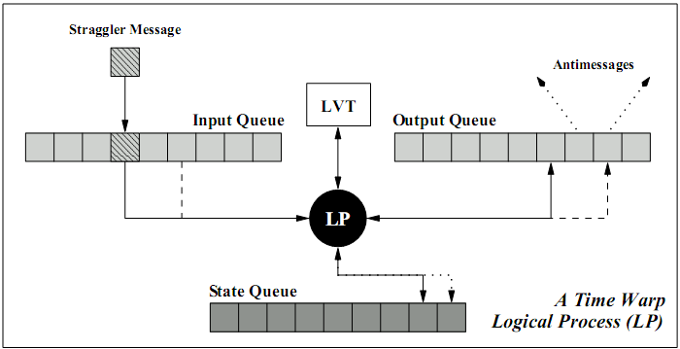
Empirical Evaluation and Benchmarking(11/12)
Time Warp Overhead
Maintaining States in State queue
Maintaining Events input/output Queue
GVT calculation
Garbage collection
A logical process in a time warp simulation (Radhakrishnan)
Notes:
Talk about the overhead. Maybe a slide on Time Warp.
Use the slide on Time Warp to example the Gap btw MASON vs. MUSE.

Slide 21
Empirical Evaluation and Benchmarking(12/12)
MUSE vs. MASON: Increasing compute nodes on MUSE… (part 2)
Agents | Events | Delay | Nodes | End Time | Exec. Time (sec.)
512 x 512 | 3 | 10 | 5 | 500 | 224
512 x 512 | 3 | 10 | 6 | 500 | 180
512 x 512 | 3 | 10 | 7 | 500 | 150
512 x 512 | 3 | 10 | 16 | 500 | 65
512 x 512 | 3 | 10 | 32 | 500 | 33
MUSE on PHOLD increasing nodes
Threshold line, to show MASON best time of 171 seconds on 1 node.
After 7 nodes MUSE out performs MASON

Slide 22
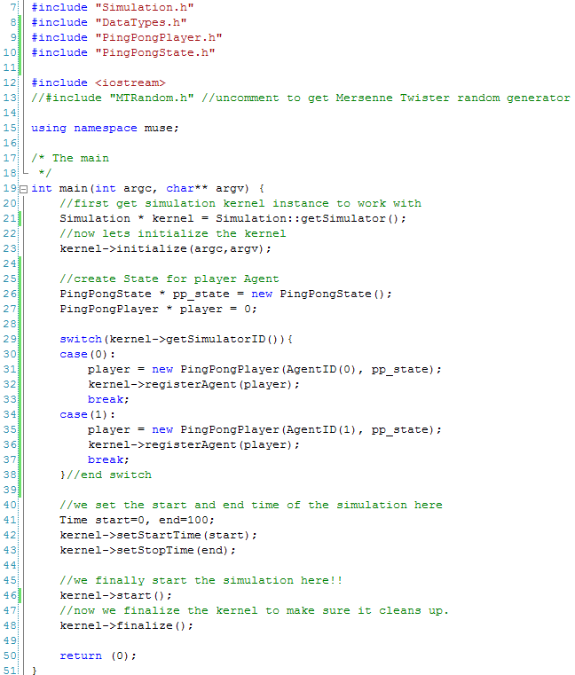
MUSE Public API(1/2)
Starting the Simulator (kernel) Example

Slide 23
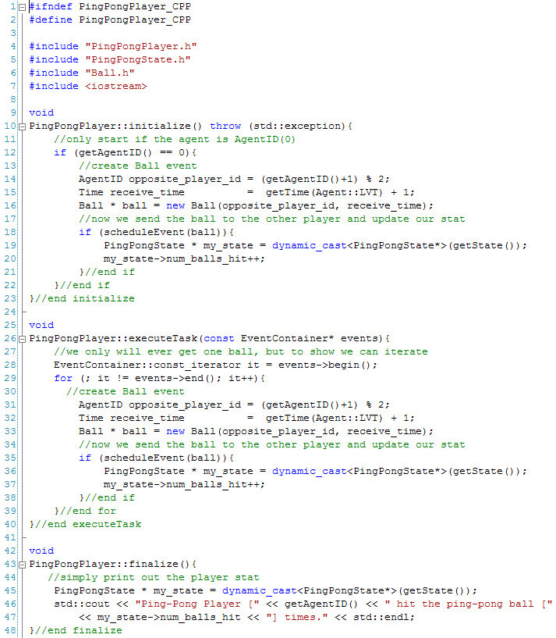
MUSE Public API(2/2)
Agent Example.

Slide 24
Conclusion and Future Works(1/2)
MUSE is an agent-based parallel simulation framework.
Uses Time Warp for parallel synchronization.
Uses MPI for parallel computing.
Experiments indicate that MUSE is very scalable and efficient.
MUSE is very easy to work with and well documented.
www.musesimulation.org
The ping-pong example.
Finished up to Version 14 of BugLife example.

Slide 25
Conclusion and Future Works(2/2)
2D/3D Visualization API
Spatial aware Agents API
Adapt MUSE to take advantage of Cloud Computing.
We are currently looking into this possibility.
Adapt MUSE to work with grid computing.
More optimization to MUSE

Slide 26
QUESTIONS

