Slide 1
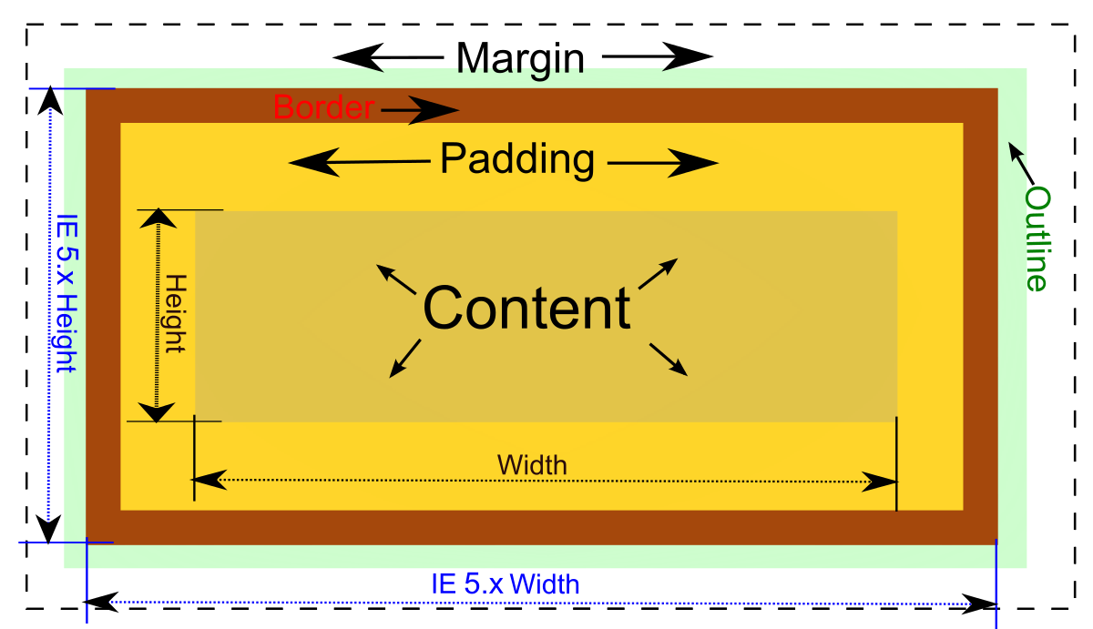
CSS Box Model
Margin, Border, Paddings, Actual Content
SoftUni Team
Technical Trainers
Software University
https://softuni.bg

Slide 2
Table of Contents
CSS Box Model
Block and Inline Elements
Width and Height
Padding, Margin and Border
Box Sizing

Slide 3
Have a Question?
sli.do
#html-css

Slide 4

What is Box Model?

Slide 5
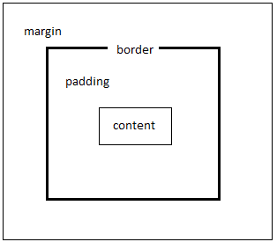
What is CSS Box Model?
The CSS box model is essentially a box that wraps around every HTML element
Visible from the browser Dev Tools: [F12]
HTML elements have:
Content – the HTML element itself
Padding – transparent area around the content
Border – line that goes around the padding
Margin – transparent area outside the border

Slide 6
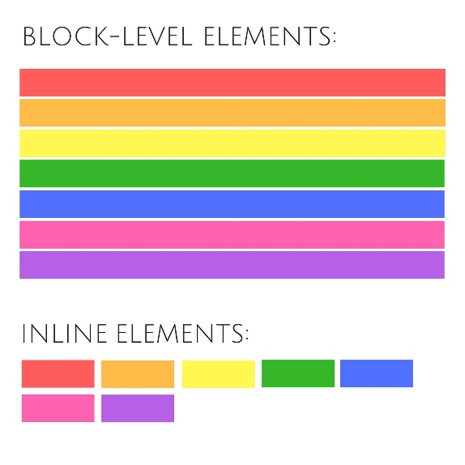
Block-level and Inline HTML Elements

Slide 7
Block and Inline Elements
HTML is made up of various elements that act as the building blocks of web pages
CSS has two different types of boxes - block and inline
Block Elements
Inline Elements
Inline-block Elements

Slide 8
Block Elements
Block element: starts on a new line, and fills up the horizontal space left and right on the web page
Some examples of block elements are:
main, header , article , section , fieldset , nav , ul , ol , li , form , h1-h6 , p , div

Slide 9
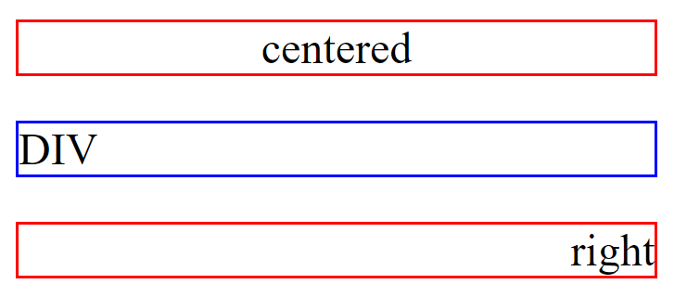
Block Elements – Example
display: block
<p style="border:1px solid red; text-align:center">centered</p>
<div style="border:1px solid blue">DIV</div>
<p style="border:1px solid red; text-align:right">right</p>

Slide 10
Inline Elements
Inline element: don't start on a new line. They appear on the same line as the content and tags beside them
Some examples of inline-block elements are:
a, label, map, span, strong, em, i, img, textarea, input, button, select
You can add margins and padding just on right and left sides of any inline element

Slide 11
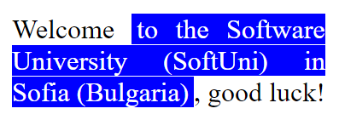


Inline Elements – Example
display: inline
<p style="text-align:justify"> Welcome
<span style="color:white; background:blue; padding-right:3px; padding-left:3px;">
to the Software University (SoftUni) in Sofia (Bulgaria)</span>, good luck!</p>

Slide 12
Inline-Block Elements
Inline-block elements are similar to inline elements
They can have padding and margins added on all four sides
You have to declare display: inline-block in your CSS code
One common use for using inline-block is for creating navigation links horizontally

Slide 13
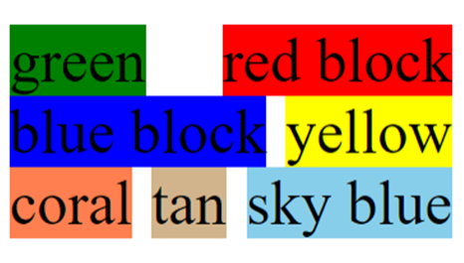
Inline-Block Elements – Example
display: inline-block
<div style="text-align:justify;">
<div style="display:inline-block; background:green">green</div>
<div style="display:inline-block; background:red">red block</div>
…
</div>

Slide 14
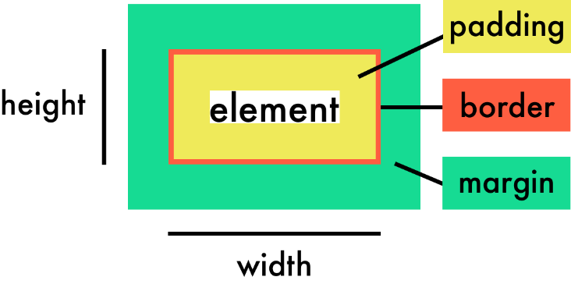
CSS Width and Height Dimensions

Slide 15
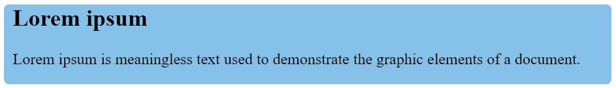
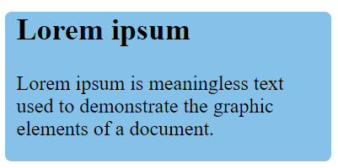
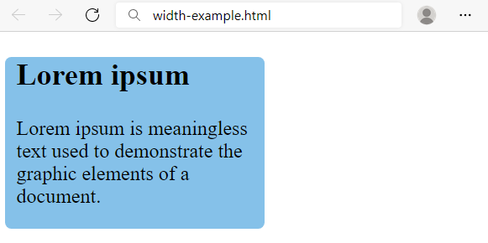
Width
Width – defines the width of the element
percentages
Relative to container's width
auto (default)
Auto-calculated width
pixels / em / rem
Fixed width
article {
width: auto;
background: #8ce;
}
article {
width: 240px;
background: #8ce;
}
article {
width: 50%;
background: #8ce;
}

Slide 16
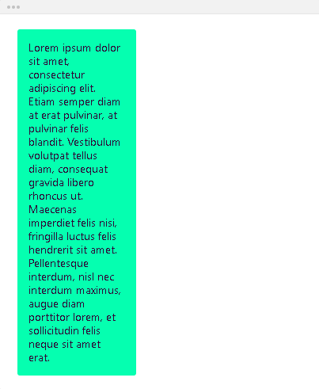
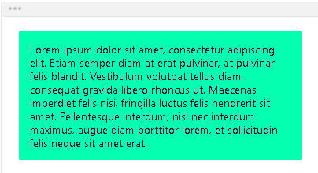
Max-width
Max-width - defines the maximum width the element can be
max-width: none; - the element has no limit in terms of width
max-width: 150px;
max-width: 2000px; - you can use numeric values like pixels, (r)em, percentages...
If the maximum width is larger than the element's actual width, the max width has no effect

Slide 17
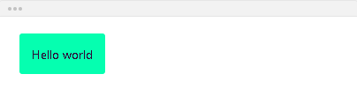
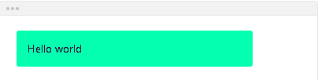
Min-width
Min-width - defines the minimum width the element
min-width: 300px; - if the minimum width is larger than the element's actual width, the min width will be applied
If the minimum width is smaller than the element's actual width, the min width has no effect - min-width: 5px;

Slide 18
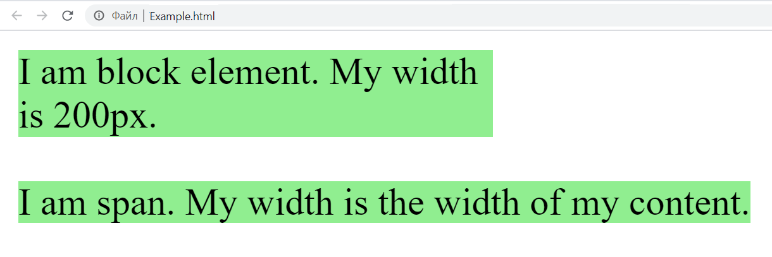
Width – Example
<body>
<div>
I am block element. My width is 200px.
</div>
<span>I am span. My width is the width of my content.</span>
</body>
div, span {
width: 200px;
background-color: lightgreen;
}

Slide 19
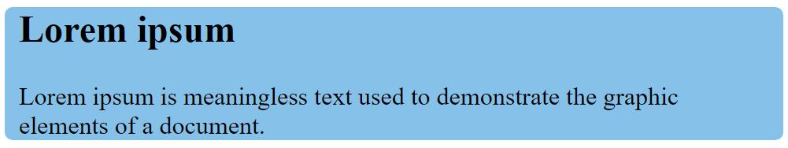
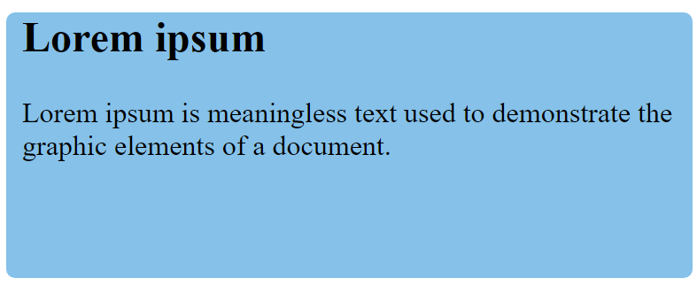
Height
Height – defines the height of the element
auto (default)
Auto-calculated height
numeric values like px / pt / em / rem / %
article {
height: auto;
background: #8ce;
}
article {
height: 100px;
background: #8ce;
}

Slide 20
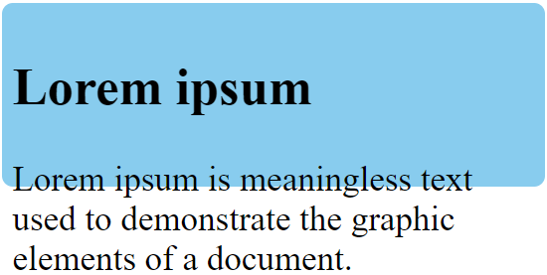
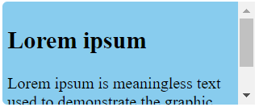
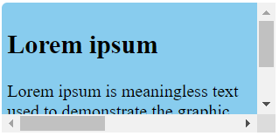
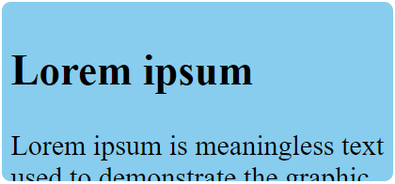
Overflow
The overflow property specifies what should happen if content overflows an element's box
visible
auto
scroll
hidden
visible
article {
overflow: visible;
}
auto
scroll
hidden

Slide 21
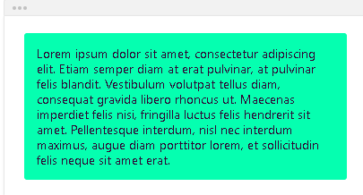
Max-height
Max-height - defines the maximum height the element can be
max-height: none; - the element has no limit in terms of height
max-height: 2000px;
- if the maximum height is larger
than the element's actual height,
the max height has no effect

Slide 22
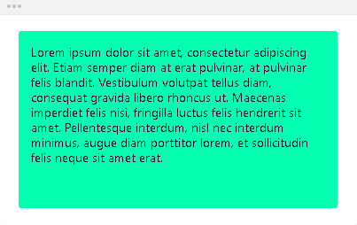
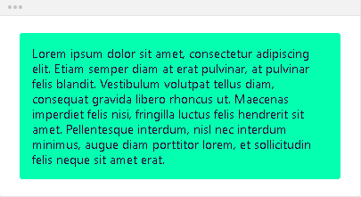
Min-height
Min-height - defines the minimum height the element
min-height: 200px; - if the minimum height is larger than the element's actual height, the min height will be applied
min-height: 5px; - if the minimum height is smaller than the element's actual height, the min height has no effect

Slide 23

Scrolling Article – Exercise
Using HTML and CSS create a section with articles like the following:

Slide 24
Scrolling Article – Solution
HTML constraints:
Use <section> with <article>, which contains: <h2>, <h3> and <p>
Hints:
article {
width: 500px;
height: 200px;
background-color: lightgray;
overflow: auto;
padding: 10px;
}

Slide 25
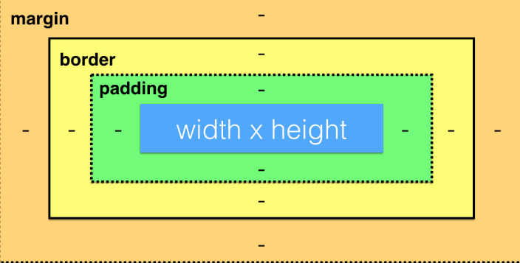
Margin, Padding and Borders
CSS Box Model Layers

Slide 26
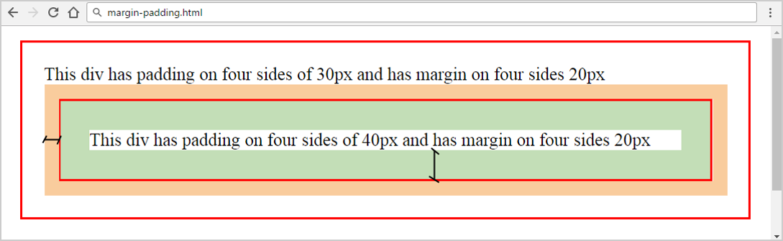
Margins and Paddings
margin
padding
margin-right
margin-top
margin-bottom
div {
margin: 20px 20px 20px 20px;
padding: 30px 30px 30px 30px;
}
margin-left

Slide 27
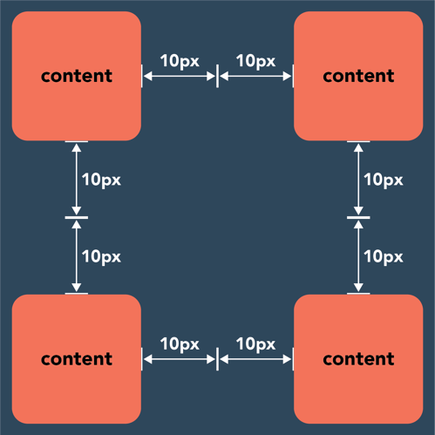
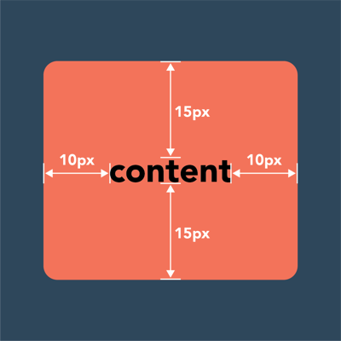
Margins and Paddings
Margin – defines the space outside the element
Padding – defines the space inside the element

Slide 28
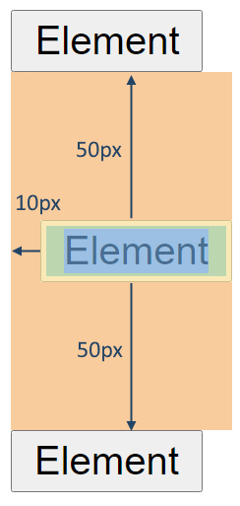
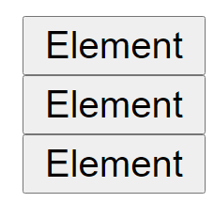
Margin
<button class="first">Element</button>
<button class="second">Element</button>
<button class="third">Element</button>
button {
display: block;
}
button.second {
margin-top: 50px;
margin-left: 10px;
margin-bottom: 50px;
margin-right: 0;
}

Slide 29


Padding
<div>content</div>
div {
background-color: #85c1e9;
display: inline-block;
text-align: center;
padding-top: 20px;
padding-left: 10px;
padding-bottom: 20px;
padding-right: 10px;
}

Slide 30
Shorthand Margin / Padding
Shorthand margin rules:
Shorthand padding rules:
button.second {
margin: 10px 20px 10px 20px;
}
button.second {
margin: 20px 10px;
}
bottom
left
top
right
top & bottom
left & right
div {
padding: 5px 10px 8px 15px;
}
li {
padding: 5x 10px;
}

Slide 31


Border
Border – define the style of the borders:
width (e. g. 1px / 2px / 3px)
style (e. g. solid / dashed / dotted)
color (e. g. blue / #eee)
width
style
color
border: 4px dashed navy;
border: 6px solid lightblue;

Slide 32
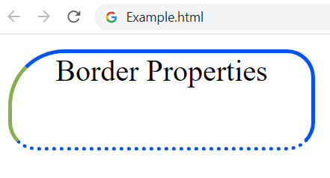
Border Properties
div {
width: 160px;
height: 50px;
border-width: 2px;
border-style: solid;
border-color: #0053ff;
border-radius: 15px;
border-top-left-radius: 30px;
border-bottom-style: dotted;
border-left-color: #89af4c;
text-align: center;
}

Slide 33
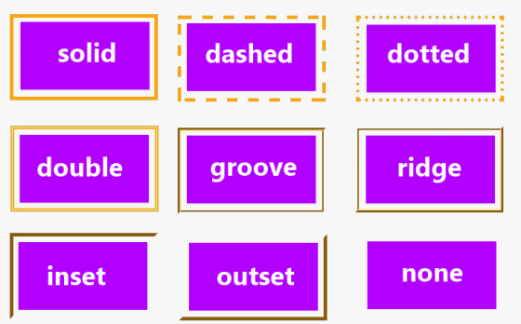
CSS Borders

Slide 34

Include the Padding and Border in an Element's Total Width and Height

Slide 35
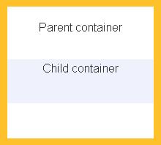
Box-sizing
Sets how the total width and height of an element is calculated
content-box - initial and default value
The width and height properties include the content
They do NOT include the padding, border and margin
div {
box-sizing: content-box;
width: 200px;
}

Slide 36
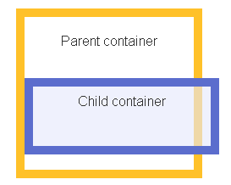
Box-sizing
The full width is: 200px + 2*10px + 2*5px = 230px
div {
box-sizing: content-box;
width: 200px;
border: 10px solid #5b6dcd;
padding: 5px;
}

Slide 37
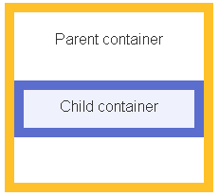
Box-sizing
border-box - the width and height of the element apply to all parts of the element: the content, the padding and the borders
The full width is 200px
The content width is equal to: 200px - 2*10px - 2*5px = 170px
box-sizing: border-box;
width: 200px;
border: 10px solid #5b6dcd;
padding: 5px;

Slide 38
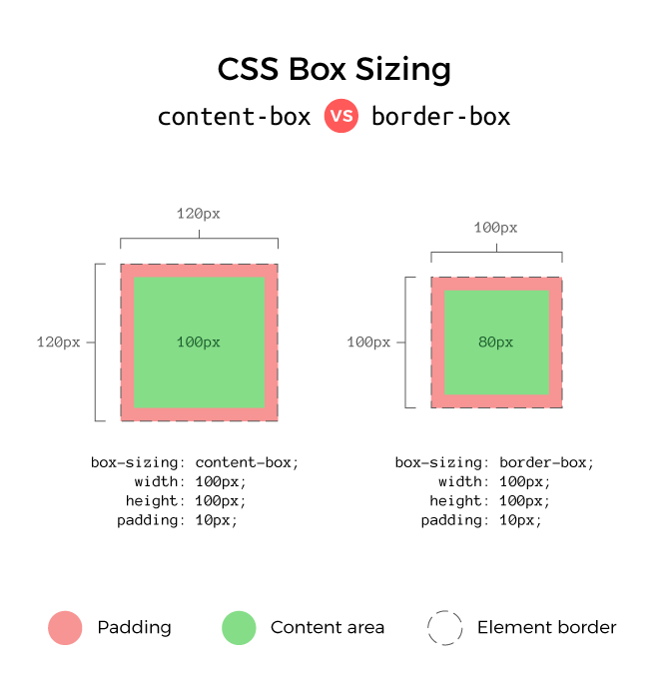
Content-box vs Border-box

Slide 39
Universal Box-sizing
The box-sizing Reset takes care of the box-sizing of every element by setting it to border-box using universal CSS selector
Save your time and don't write the same thing again-and-again
Set the "universal box-sizing" with inheritance:
html {
box-sizing: border-box;
}
*,
*:before,
*:after {
box-sizing: inherit;
}

Slide 40

Summary
What is Box Model?
Width and Height to the elements
What are the padding, border and margin?
What is box-sizing?
How to reset box-sizing?

Slide 41
Questions?

Slide 42












SoftUni Diamond Partners

Slide 43


Educational Partners

Slide 44

License
This course (slides, examples, demos, exercises, homework, documents, videos and other assets) is copyrighted content
Unauthorized copy, reproduction or use is illegal
© SoftUni – https://about.softuni.bg/
© Software University – https://softuni.bg

Slide 45
Trainings @ Software University (SoftUni)
Software University – High-Quality Education, Profession and Job for Software Developers
softuni.bg, about.softuni.bg
Software University Foundation
softuni.foundation
Software University @ Facebook
facebook.com/SoftwareUniversity
Software University Forums
forum.softuni.bg

