Slide 1
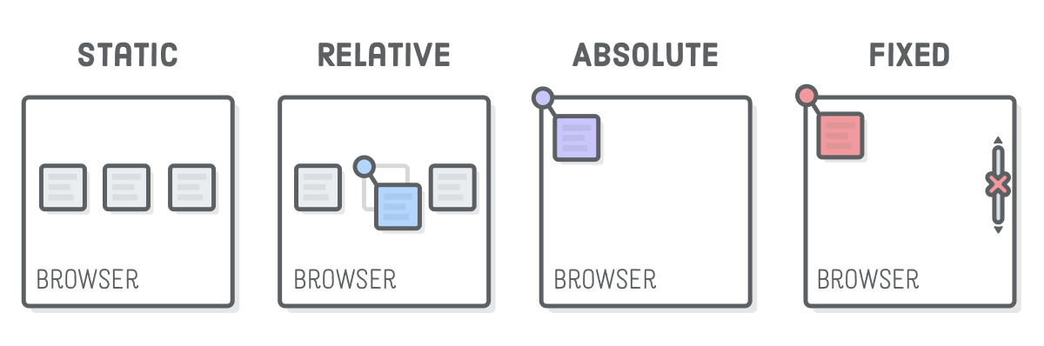
Position & Grid
CSS Positioning
SoftUni Team
Technical Trainers
Software University
https://softuni.org

Slide 2
Table of Contents
CSS Grid
Position: static, relative, absolute, fixed and sticky
Positioning Properties
Z-index

Slide 3
Have a Question?
sli.do
#html-css

Slide 4
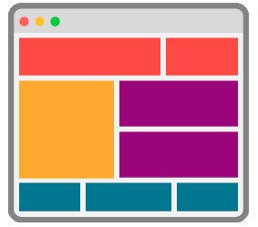
CSS Grid
Modern Layout System for the Web

Slide 5
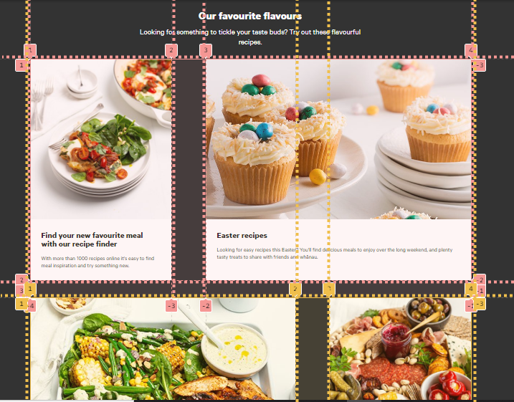
CSS Grid
CSS grid is modern CSS layout system for the Web
Simple and easy to use
Very powerful
.grid-container {
display: grid;
}

Slide 6
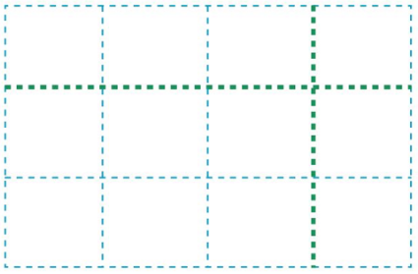
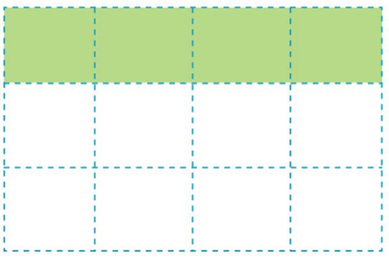
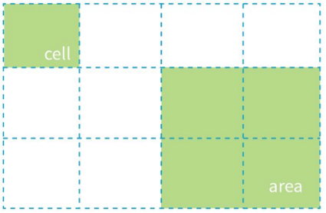
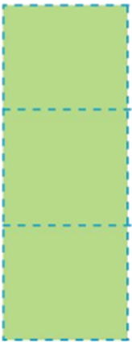
Grid Parts
The primary parts of a grid are:
Grid lines
Grid cell and grid areas
Grid tracks (rows or columns)
grid line
grid row
grid column

Slide 7
Grid Container
An HTML element becomes a grid container when its display property is set to grid or inline-grid
.grid-container {
display: grid;
}
.grid-container {
display: inline-grid;
}

Slide 8
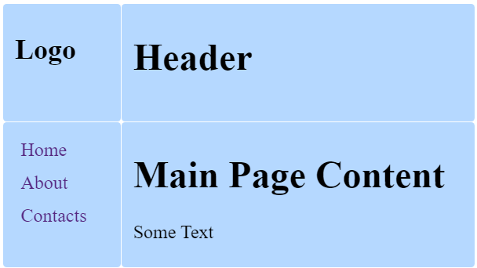
Grid Template
The grid templates define the look of the grid: count of the rows and columns and their size
body {
display: grid;
grid-template-rows: 100px 400px;
grid-template-columns: 100px auto;
}
100px
auto
This example will create:
Two rows with sizes: 100px and 400px
Two columns with sizes: 100px and auto size
100px
400px

Slide 9
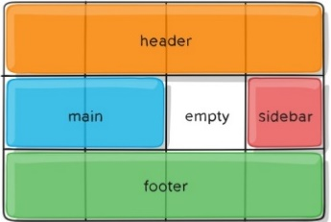
Grid Area and Grid Template Area
Grid area is a rectangular area made up of one or more adjacent grid cells
Defining grid areas in CSS:
Referencing the grid areas:
header { grid-area: header; }
body { grid-template-areas:
"header header header header"
"main main empty sidebar"
"footer footer footer footer";

Slide 10
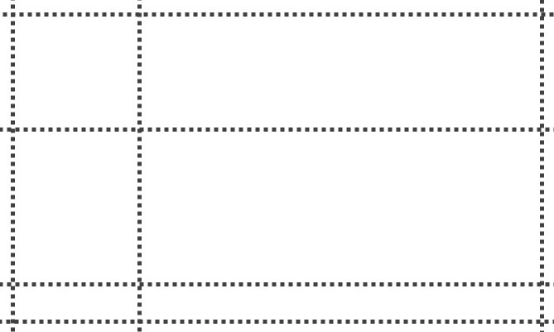
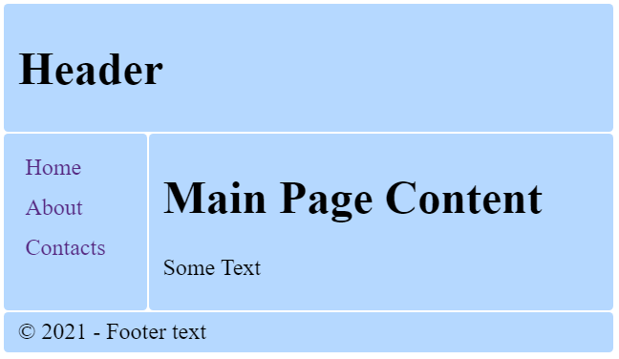
Grid Area – Examples
body { display: grid;
grid-template-areas:
"header header"
"aside main"
"footer footer";
grid-template-columns: 100px auto;
}
header { grid-area: header; }
aside { grid-area: aside; }
main { grid-area: main; }
footer { grid-area: footer; }

Slide 11
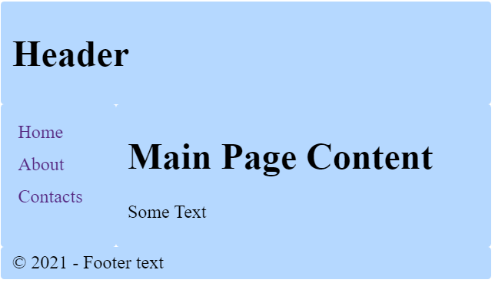
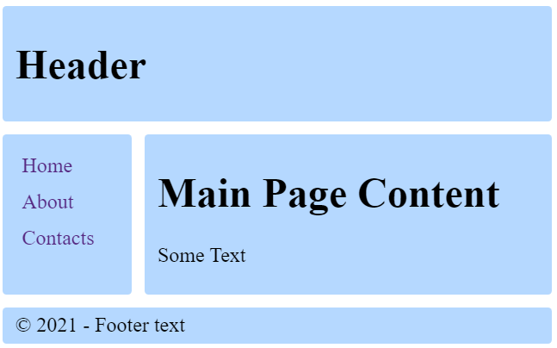
Gap
Gap between each cell horizontally and vertically
body {
display: grid;
grid-template-columns:
100px auto;
gap: 10px;
grid-template-areas:
"header header"
"aside main"
"footer footer";
}
gap: 10px;

Slide 12
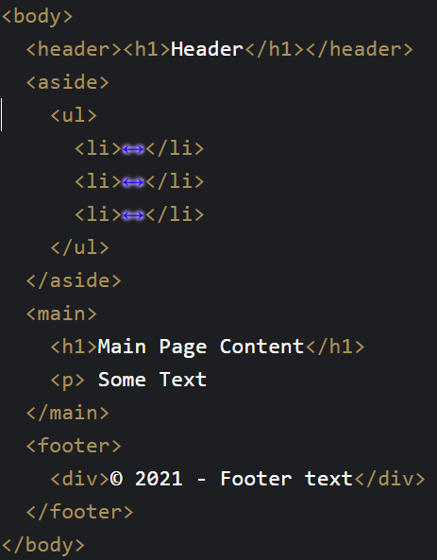
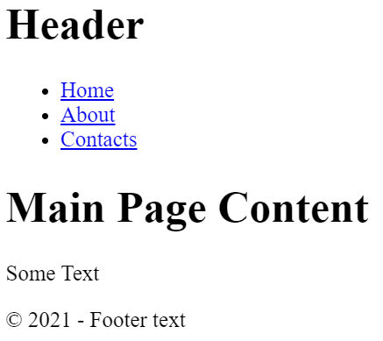
CSS Grid – Example

Slide 13
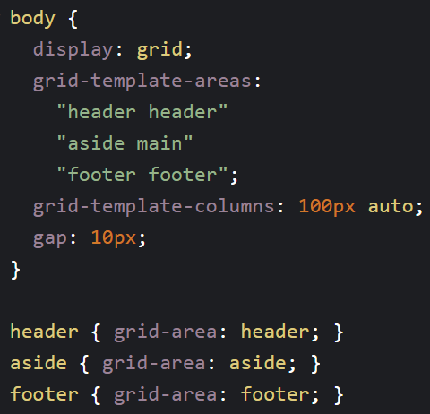
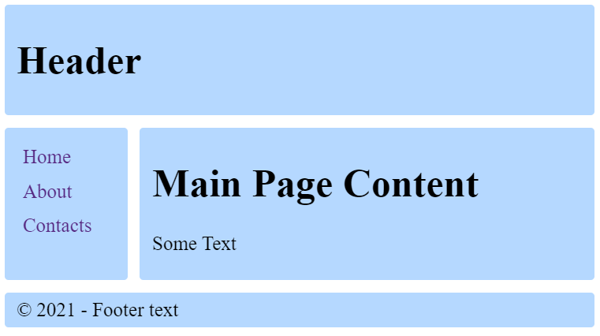
CSS Grid – Example

Slide 14
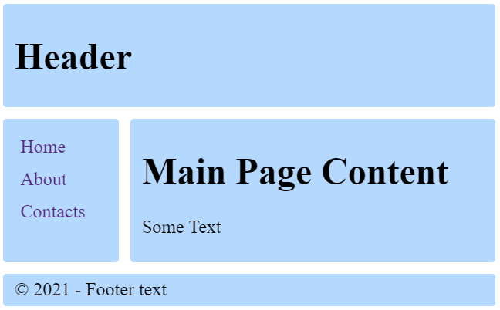
Demo: CSS Grid Site Layout
https://codepen.io/snakov/pen/jOVJXVN

Slide 15
Specifies the Type of Positioning Method Used for an Element

Slide 16

Position
Position properties:
static
relative
absolute
fixed
sticky

Slide 17
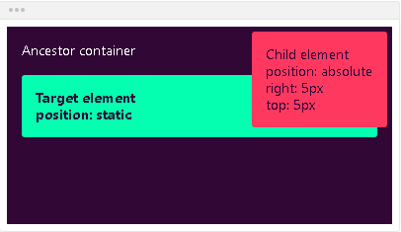
Position Static
Static - the default state of every element
Puts the element into its normal position in the document layout flow
It will NOT react to the following properties: top, bottom, left, right, z-index
div {
position: static;
}

Slide 18
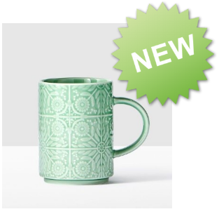
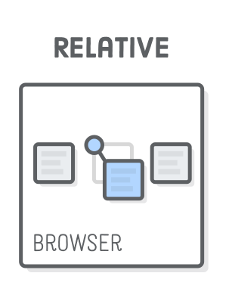
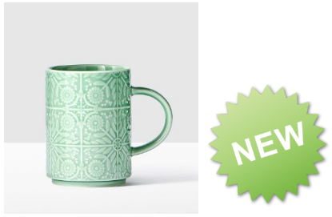
Position Relative
It looks like static positioning, but once the positioned element has taken its place, you can then modify its final position with the positional properties
<img src="cup.jpg">
<img class="new" src="new.png">
img.new {
position: relative;
top: -200px;
right: 150px;
}

Slide 19
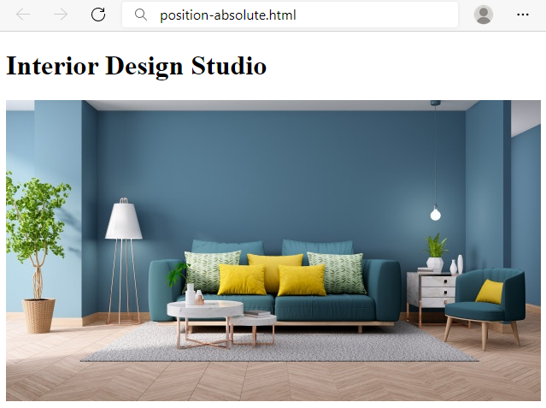
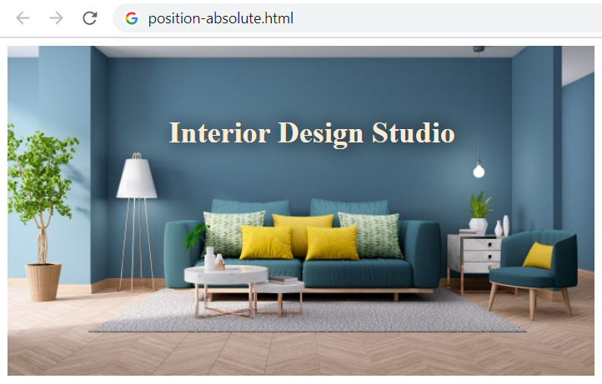
Position Absolute
Absolute positioning → from the upper left corner of the parent
<h1>Interior Design Studio</h1>
<img src="livingroom.jpg">
h1 {
position: absolute;
top: 60px;
left: 180px;
color: antiquewhite;
text-shadow: 1px 1px 20px black;
}
<h1> frees its original place

Slide 20
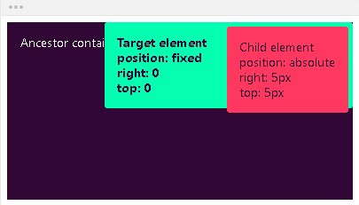
Position Fixed
Fixed - the element will NOT remain in the natural flow of the page
Reacts to the positional properties
Positions itself according to the viewport
div {
position: fixed;
}

Slide 21
Position Sticky
The element is positioned based on the user's scroll position
A sticky element switches between relative and fixed, depending on the scroll position
It is positioned relative until a given offset position is met in the viewport - then it ''sticks'' in place (like position: fixed)

Slide 22
Position Sticky – Example
.main-container {
max-width: 600px;
margin: 0 auto;
border: 10px solid green;
padding:10px;
margin-top:40px;
} .main-header,
.main-content,
.main-footer {
padding: 10px;
background: #aaa;
border: 5px dashed #000;
margin: 20px 0;
}
<main class="main-container">
<header class="main-header">
HEADER
</header>
<div class="main-content">
MAIN CONTENT
</div>
<footer class="main-footer">
FOOTER
</footer>
</main>

Slide 23
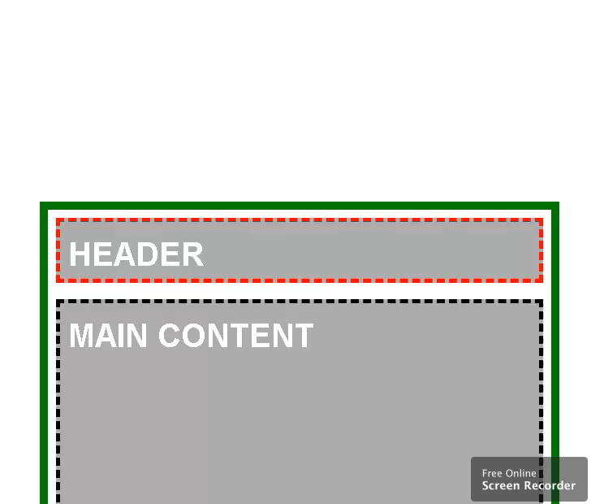
Position Sticky – Example
.main-content {
min-height: 1000px;
}
.main-header {
height: 50px;
border-color: red;
position: sticky;
top: 0;
}

Slide 24
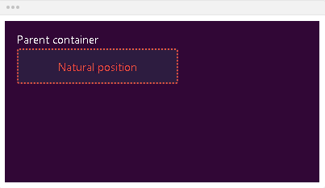
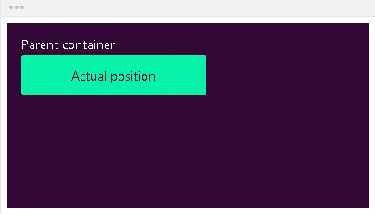
Bottom
Bottom - defines the position of the element according to its bottom edge
bottom: auto; - the element will remain in its natural position

Slide 25
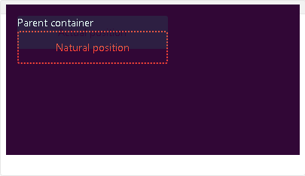
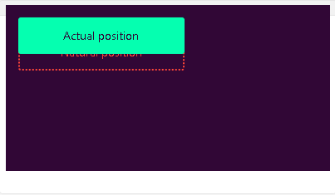
Bottom
If the element is in position relative, the element will move upwards by the amount defined by the bottom value
bottom: 20px;

Slide 26
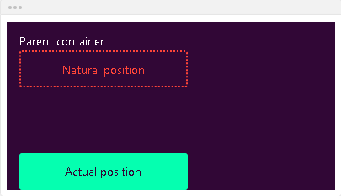
Bottom
If the element is in position absolute, the element will position itself from the bottom of the first positioned ancestor
bottom: 0;

Slide 27
Left
Defines the position of the element according to its left edge
left: auto; - the element will remain in its natural position

Slide 28
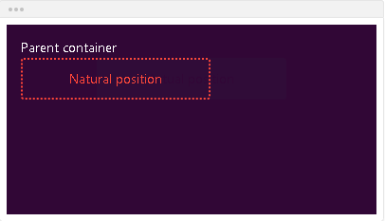
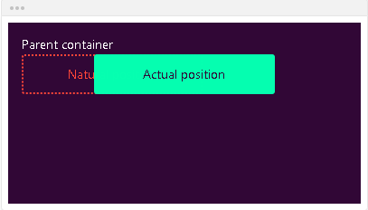
Left
left: 80px; - if the element is in position relative, the element will move left by the amount defined by the left value

Slide 29
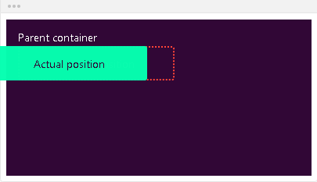
Left
left: -20px; - if the element is in position absolute, the element will position itself from the left of the first positioned ancestor

Slide 30
Right
Right - defines the position of the element according to its right edge
right: auto; - the element will remain in its natural position
right: 80px; - if the element is in position relative, the element will move right by the amount defined by the right value
right: -20px; - if the element is in position absolute, the element will position itself from the right of the first positioned ancestor

Slide 31
Top
Top - defines the position of the element according to its top edge
top: auto; - the element will remain in its natural position
top: 20px; - if the element is in position relative, the element will move downwards by the amount defined by the top value
top: 0; - if the element is in position absolute, the element will position itself from the top of the first positioned ancestor

Slide 32
Center
Center - defines the position of the element according to center of the window
position: absolute;- it will position the element relative to its first positioned parent element
If it can’t find one, it will be relative to the document
top: 50%; left: 50%; - the element will step out from the top left corner
These properties are set on the child element

Slide 33
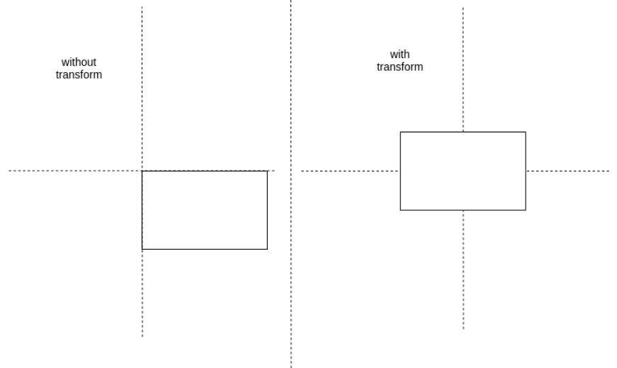
Center
transform: translate(-50%, -50%); - it will pull back the item with its half width and height
.parent { position: relative; } .child { position: absolute; top: 50%; left: 50%; transform: translate( -50%, -50%); }

Slide 34
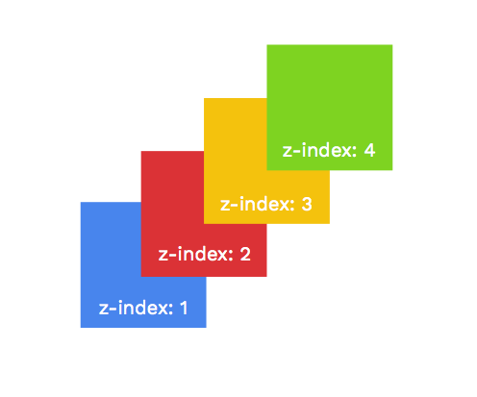
Specifies the Stack order of an Element

Slide 35
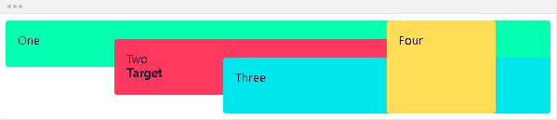
Z-index
Defines the order of the elements on the z-axis. It only works on positioned elements (anything apart from static)
Default value: z-index: auto;
The order is defined by the order in the HTML code:

Slide 36
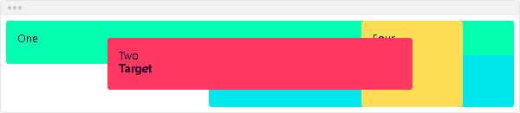
Z-index
The z-index value is relative to the other ones
The target element is move in front of its siblings
z-index: 1;

Slide 37
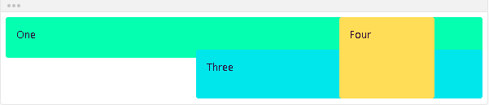
Z-index
You can use negative values
The target element is moved behind its siblings
z-index: -1;

Slide 38

Summary
CSS grid
Lines, cell, areas, tracks
grid-area and grid-template-areas
Positioning properties
Z-Index

Slide 39
Questions?

Slide 40












SoftUni Diamond Partners

Slide 41


Educational Partners

Slide 42

License
This course (slides, examples, demos, exercises, homework, documents, videos and other assets) is copyrighted content
Unauthorized copy, reproduction or use is illegal
© SoftUni – https://about.softuni.bg/
© Software University – https://softuni.bg

Slide 43
Trainings @ Software University (SoftUni)
Software University – High-Quality Education, Profession and Job for Software Developers
softuni.bg, about.softuni.bg
Software University Foundation
softuni.foundation
Software University @ Facebook
facebook.com/SoftwareUniversity
Software University Forums
forum.softuni.bg

