Slide 1


Regular Expressions (RegExp)
Regular Expressions Language Syntax
SoftUni Team
Technical Trainers
Software University
https://softuni.bg

Slide 2
Table of Contents
Regular Expressions Syntax
Definition and Pattern
Predefined Character Classes
Quantifiers and Grouping
Backreferences
Regular Expressions in JavaScript

Slide 3
Have a Question?
sli.do
#fund-js

Slide 4
Regular Expressions
[A-Z]
Definition and Classes

Slide 5
What Are Regular Expressions?
Regular expressions (RegExp)
Match text by pattern
Patterns are defined by special syntax, e.g.
[0-9]+ matches non-empty sequence of digits
[A-Z][a-z]* matches a capital + small letters
Play with regexp live at: regexr.com, regex101.com

Slide 6
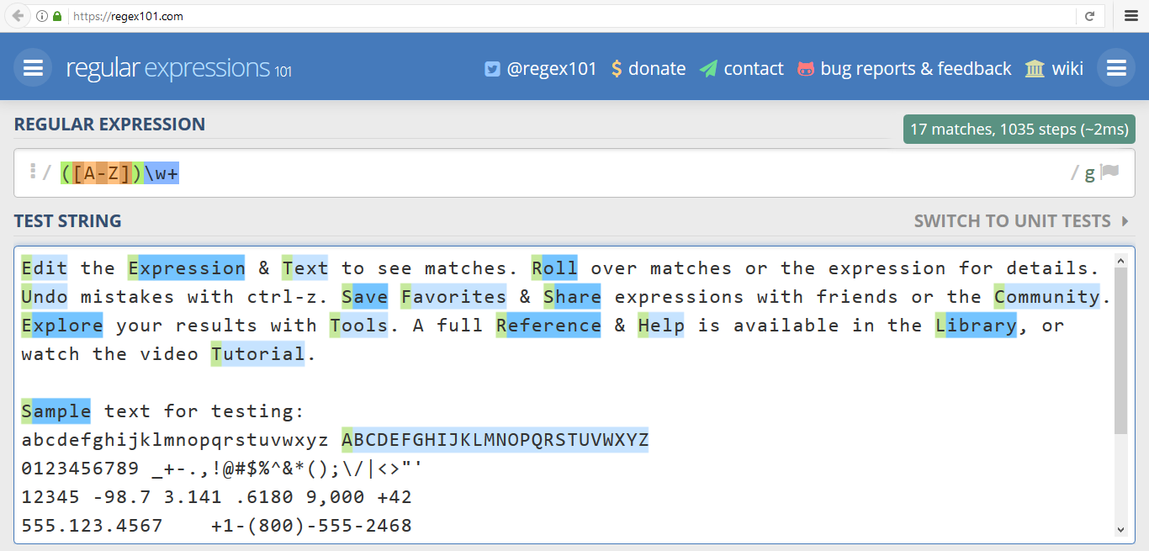
www.regex101.com
Live Demo

Slide 7
Regular Expression Pattern – Example
Regular expressions (RegExp) describe a search pattern
Used to find / extract / replace / split data from text by pattern
[A-Z][a-z]+ [A-Z][a-z]+
John Smith
Linda Davis
Contact: Alex Scott

Slide 8
Character Classes: Ranges
[nvj]+ matches any character that is either n, v or j
[^abc] – matches any character that is not a, b or c
[0-9] – character range: matches any digit from 0 to 9
node.js v0.12.2
Abraham
John is 8 years old.

Slide 9
Predefined Classes
\w – matches any word character (a-z, A-Z, 0-9, _)
\W – matches any non-word character (the opposite of \w)
\s – matches any white-space character
\S – matches any non-white-space character (opposite of \s)
\d – matches any decimal digit (0-9)
\D – matches any non-decimal character (the opposite of \d)

Slide 10
Quantifiers
(\w+)
Grouping

Slide 11
Quantifiers
* – matches the previous element zero or more times
+ – matches the previous element one or more times
? – matches the previous element zero or one time
{3} – matches the previous element exactly 3 times
\+\d*
+359885976002 a+b
\+\d+
+359885976002 a+b
\+\d?
+359885976002 a+b
\+\d{3}
+359885976002 a+b

Slide 12
Grouping Constructs
(subexpression) – captures the matched subexpression as numbered group
(?:subexpression) – defines a non-capturing group
(?<name>subexpression) – defines a named capturing group
\d{2}-(\w{3})-\d{4}
22-Jan-2015
^(?:Hi|hello),\s*(\w+)$
Hi, Peter
(?<day>\d{2})-(?<month>\w{3})-(?<year>\d{4})
22-Jan-2015

Slide 13
Problem: Match All Words
Write a regular expression in www.regex101.com that extracts all word char sequences from given text
_ (Underscores) are also word characters!
_|Underscores|are|also|word|characters

Slide 14
Problem: Match Dates
Write a regular expression that extracts dates from text
Valid date format: dd-MMM-yyyy
Examples: 12-Jun-1999, 3-Nov-1999
I am born on 30-Dec-1994.
My father is born on the 9-Jul-1955.
01-July-2000 is not a valid date.

Slide 15
Problem: Email Validation
Write a regular expression that performs simple email validation
An email consists of: username @ domain name
Usernames are alphanumeric
Domain names consist of two strings, separated by a period
Domain names may contain only English letters
Valid:
Invalid:
valid123@email.bg
invalid*name@emai1.bg

Slide 16
Backreferences
\1
Numbered Capturing Group

Slide 17
Backreferences Match Previous Groups
\number – matches the value of a numbered capture group
<(\w+)[^>]*>.*?<\/\1>
<b>Regular Expressions</b> are cool!
<p>I am a paragraph</p> … some text after
Hello, <div>I am a<code>DIV</code></div>!
<span>Hello, I am Span</span>
<a href="https://softuni.bg/">SoftUni</a>

Slide 18

Regular Expressions in JS

Slide 19
RegExp in JS
In JS you construct a regular expression in one of two ways:
Regular Expression Literal
The constructor function RegExp
// Provides compilation when the script is loaded
let regLiteral = /[A-Za-z]+/g
// Provides runtime compilation
// Used when the pattern is from another source
let regExp = new RegExp('[A-Za-z]+', 'g');

Slide 20
Validating String by Pattern
The method test(string)
Determines whether there is a match
let text = 'Today is 2015-05-11';
let regexp = /\d{4}-\d{2}-\d{2}/g;
let containsValidDate = regexp.test(text);
console.log(containsValidDate); // true

Slide 21
Checking for Matches
The method match(regexp)
Returns an array of all matches (strings)
let text = 'Peter: 123 Mark: 456';
let regexp = /([A-Z][a-z]+): (\d+)/g;
let matches = text.match(regexp);
console.log(matches.length); // 2
console.log(matches[0]); // Peter: 123
console.log(matches[1]); // Mark: 456

Slide 22
Using the Exec() Method
The method exec(string)
Works with a pointer & returns the groups
let text = 'Peter: 123 Mark: 456';
let regexp = /([A-Z][a-z]+): (\d+)/g;
let firstMatch = regexp.exec(text);
let secondMatch = regexp.exec(text);
console.log(firstMatch[0]) // Peter: 123
console.log(firstMatch[1]); // Peter
console.log(firstMatch[2]); // 123

Slide 23
Replacing with RegExp
The method replace(regexp, stringReplacement)
Replaces all strings that match the pattern with the provided replacement
let text = 'Peter: 123 Mark: 456';
let replacement = '999';
let regexp = /\d{3}/g;
let result = text.replace(regexp, replacement);
// Peter: 999 Mark: 999

Slide 24
MatchAll
The method matchAll(regexp)
returns an iterator of all results matching a string against a regular expression, including capturing groups
const regexp = /t(e)(st(\d?))/g;
const str = 'test1test2';
const array = [...str.matchAll(regexp)];
console.log(array[0]);
// ['test1', 'e', 'st1', '1', index: 0, input:'test1test2', length: 4]

Slide 25
Splitting with RegExp
The method split(regexp)
Splits the text by the pattern
Returns an array of strings
let text = '1 2 3 4';
let regexp = /\s+/g;
let result = text.split(regexp);
console.log(result) // ['1', '2', '3', '4'];

Slide 26

Live Exercises

Slide 27
Problem: Match Full Name
You are given a list of names
Match all full names
Ivan Ivanov, Ivan ivanov, ivan Ivanov, IVan Ivanov, Test Testov, Ivan Ivanov
Ivan Ivanov Test Testov

Slide 28
Solution: Match Full Name
function solve(input) {
let pattern = /\b[A-Z][a-z]+[ ][A-Z][a-z]+\b/g;
let validNames = [];
let validName = null;
while((validName = pattern.exec(input)) !== null){
validNames.push(validName[0]);
}
console.log(validNames.join(' '));
}

Slide 29
Problem: Match Phone Number
Match a valid phone number from Sofia. After you find all valid phones, print them on the console, separated by ", "
A valid number has the following characteristics:
Starts with "+359"
Followed by the area code (always 2)
Followed by the number itself , which consists of 7 digits (separated in two groups of 3 and 4 digits respectively)
The different parts are separated by either a space or a hyphen ('-')

Slide 30
Solution: Match Phone Number
function regExPhones(input) {
let validNames = [];
let pattern = /(?<!\d)[+]359([ -])2\1\d{3}\1\d{4}\b/g;
while ((validName = pattern.exec(input)) !== null) {
validNames.push(validName[0]);
}
console.log(validNames.join(', '));
}

Slide 31
Problem: Remove Occurrences
Receive a text and a remove word
Remove all substrings that are equal to the remove word
ice
kicegiciceeb
key
keytextkey
kgb
text
abc
tabctqw
word
wordawordbwordc
tctqw
abc

Slide 32
Solution: Remove Occurrences
NOTE: Be careful by using loops for replacing string with another one! Case like this: replacing "str" with "new-str" will cause an infinite loop!
function solve(word, text) {
let old;
while (old !== text) {
old = text;
text = text.replace(word, '');
}
console.log(text);
}

Slide 33

Summary
…
…
…
Regular expressions describe patterns for searching through text.
Define special characters, operators and constructs for building complex pattern.
Can utilize character classes, groups, quantifiers and more.

Slide 34
Questions?
Notes:
34

Slide 35











SoftUni Diamond Partners

Slide 36



Educational Partners

Slide 37
Trainings @ Software University (SoftUni)
Software University – High-Quality Education, Profession and Job for Software Developers
softuni.bg
Software University Foundation
softuni.foundation
Software University @ Facebook
facebook.com/SoftwareUniversity
Software University Forums
forum.softuni.bg
Notes:
37

Slide 38

License
This course (slides, examples, demos, exercises, homework, documents, videos and other assets) is copyrighted content
Unauthorized copy, reproduction or use is illegal
© SoftUni – https://about.softuni.bg/
© Software University – https://softuni.bg
Notes:
38

