Slide 1

Django Forms
SoftUni Team
Technical Trainers
Software University
https://softuni.bg

Slide 2
Table of Contents
Django Forms
Built-in widgets
Validation Forms
Django ModelForm class
Validating Model Forms
Bots and Bot Catchers
Working with Media Files
2

Slide 3
Have a Question?
sli.do
#python-web

Slide 4

Django Forms

Slide 5
Web Forms
Use forms when building websites and applications that accept input from their visitors
Forms are enclosed in the HTML <form> element
However, Django provides a range of tools and libraries to
Help build forms to accept input from site visitors
Process and respond to the input
5

Slide 6
HTML Form
Collection of elements inside <form>...</form> tag that allow a visitor to make actions (enter text, select options, etc.) and then send the information back to the server
The elements used in an HTML form are check box, input box, radio buttons, submit buttons, etc.
GET and POST are the only HTTP methods to use when dealing with forms
6

Slide 7
Bound and Unbound
A Form instance is either bound to a set of data, or unbound
Bound to a set of data
Capable of validating that data and rendering the form as HTML with the data displayed in the HTML
Unbound
Cannot do Validation
7

Slide 8
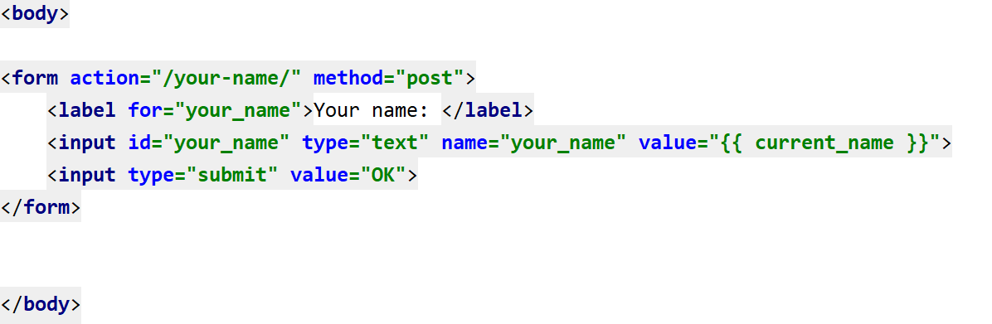
Example
8

Slide 9
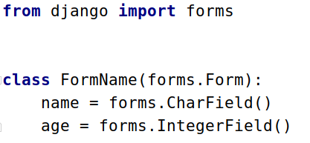
Django Forms Advantages
Quickly generate HTML form widgets
Validate data and process it into a Python data structure
Create form versions of our Models
Quickly update models from Forms
9

Slide 10
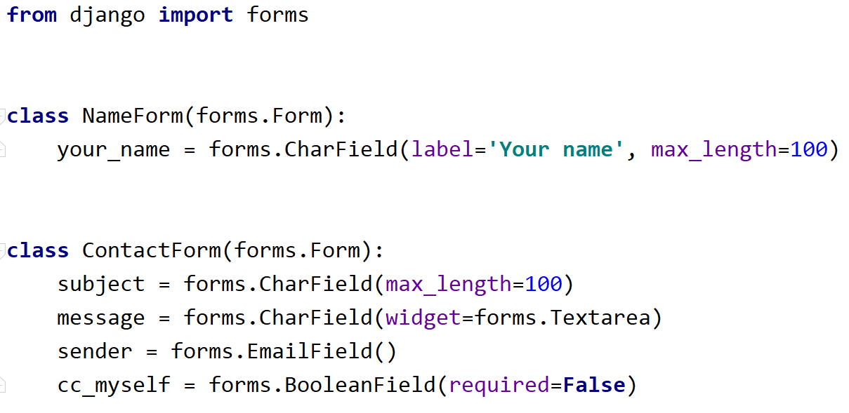
Example
10

Slide 11

Built-in Widgets

Slide 12
Widgets
Each form field has a corresponding Widget class
Django's representation of an HTML input element
Widgets' documentation
Types of widgets:
Textarea
PasswordInput
It handles:
the rendering of the HTML
the extraction of data from GET/POST dictionary
12

Slide 13
Built-in Widgets (1)
TextInput
input_type: 'text'
NumberInput
input_type: 'number'
EmailInput
input_type: 'email'
PasswordInput
input_type: 'password'
13

Slide 14
Built-in Widgets (2)
URLInput
input_type: 'url'
DateInput
input_type: 'text'
DateTimeInput
input_type: 'text'
Textarea
More built-in filters: https://docs.djangoproject.com/en/4.0/ref/forms/widgets/#built-in-widgets
14

Slide 15

Validating Forms

Slide 16
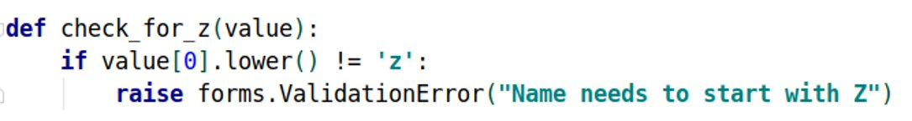
Validation
Form validation happens when the data is cleaned
Validators are functions
Takes a single argument and raises ValidationError on invalid input
16

Slide 17
Built-in Validators
Collection of callable validators
Form validation happens when the data is cleaned
Validators are functions
Takes a single argument and raises ValidationError on invalid input
Validators can be used for reusing validation logic between different types of fields
17

Slide 18
Example: Django Validators
EmailValidator
URLValidator
MinValueValidator / MaxValueValidator
MinLengthValidator / MaxLengthValidator
RegexValidator
18

Slide 19

Django ModelForm Class

Slide 20
The ModelForm Class
In most cases when we have a database-driven app, the forms we create overlap with our models
In this case, we might want to skip defining the field types of our forms, because we already defined them in the model
For this reason, we use the ModelForm helper class

Slide 21
Example: ModelForm
from django.forms import ModelForm
from my_app.models import Book
class BookForm(ModelForm):
class Meta:
model = Book
fields = ['title', 'pages', 'author']

Slide 22
Create a Book Model
First, we create a simple model called Book
from django.db import models
class Book(models.Model):
title = models.CharField(max_length=20)
pages = models.IntegerField(default=0)
description = models.CharField(max_length=100, default="")
author = models.CharField(max_length=20)

Slide 23
Creating the Model Form
After that, we create the model form
from django import forms
from app.models import Book
class BookForm(forms.ModelForm):
class Meta:
model = Book
fields = '__all__'
widgets = {
'title': forms.TextInput(attrs={'class': 'form-control'}),
'pages': forms.NumberInput(attrs={'class': 'form-control'}),
'author': forms.TextInput(attrs={'class': 'form-control'}),
'description': forms.Textarea(attrs={'class': 'form-control'})
}
Include all fields from the model
Add styling using bootstrap

Slide 24
Create View
def create(req):
if req.method == "GET":
form = BookForm()
return render(req, 'create.html', {'form': form})
else:
form = BookForm(req.POST)
if form.is_valid():
book = form.save()
book.save()
return redirect('index')

Slide 25
Edit View
def edit(req, id):
book = Book.objects.get(pk=id)
if req.method == "GET":
form = BookForm(instance=book)
return render(req, 'edit.html', {'form': form})
else:
form = BookForm(req.POST, instance=book)
if form.is_valid():
book = form.save()
book.save()
return redirect('index')

Slide 26
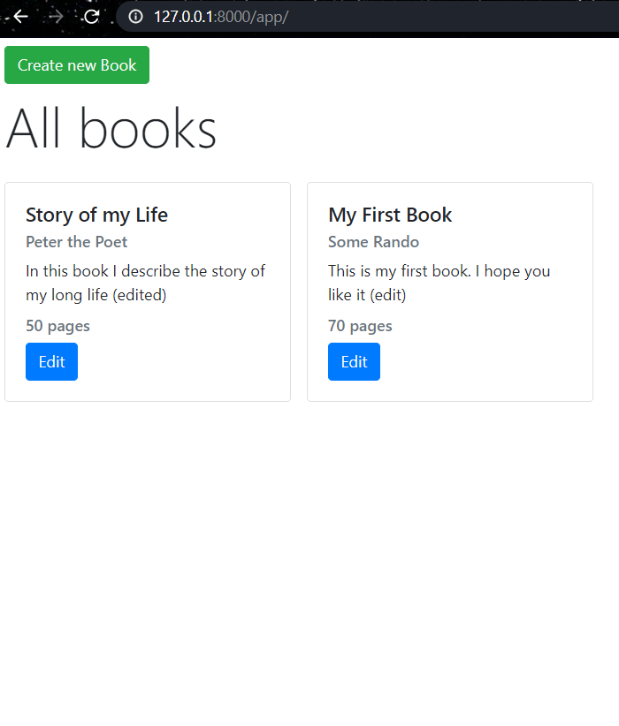
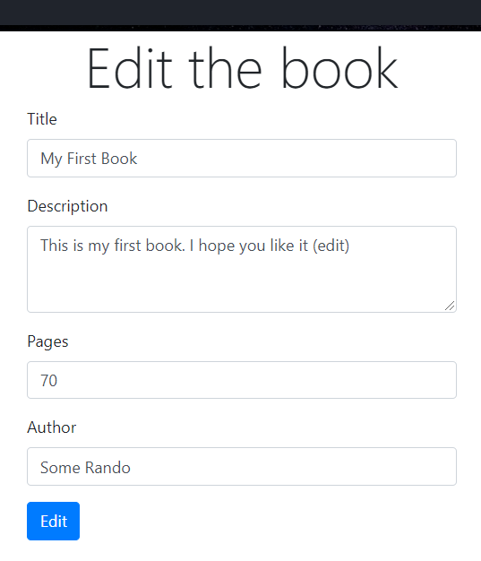
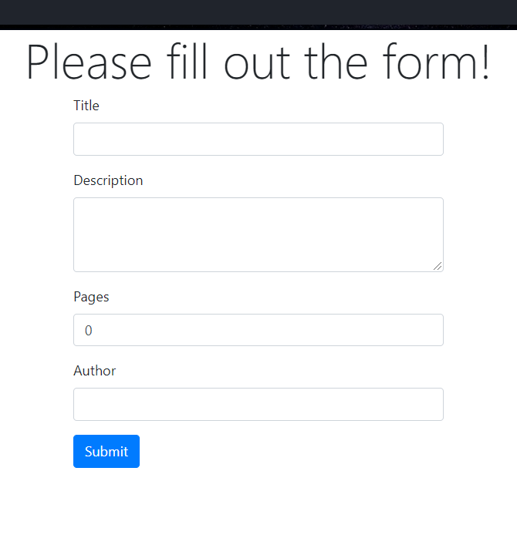
The Result

Slide 27

Validating Model Forms

Slide 28
Validating Model Forms
There are two ways to make form validation in ModelForm
Validation in the Model
Validation in the Form
To validate a form, we can override the clean() method
To validate the model, we can create custom field validators

Slide 29
Validating the Form
To make form validations, we can override the clean() method
def clean(self):
if not isinstance(self.cleaned_data['pages'], int):
raise ValidationError('Pages must be a number')
if self.cleaned_data['pages'] <= 0:
raise ValidationError ('Pages cannot be zero or negative')
return self.cleaned_data

Slide 30
Validating the Model (1)
We can make a validators.py file that will contain our validation functions
from django.core.exceptions import ValidationError
def pages_validator(value):
if value <= 0:
raise ValidationError ('Pages cannot be zero or negative')

Slide 31
Validating the Model (2)
After that, we can add the validator in our model
from django.db import models
from app.validators import pages_validator
class Book(models.Model):
title = models.CharField(max_length=20)
pages = models.IntegerField(default=0, validators=[pages_validator])
description = models.CharField(max_length=100, default="")
author = models.CharField(max_length=20)

Slide 32

Bots and Bot Catchers

Slide 33
What are bots?
Also called "web crawlers"
Bots are software application that run automated scripts
Perform simple and structurally repetitive tasks
Indexing a search engine
Gathering information much faster
33

Slide 34
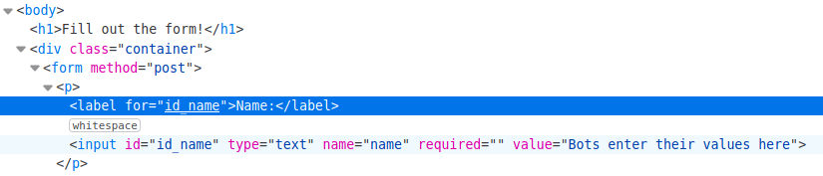

What are bots? (2)
34

Slide 35
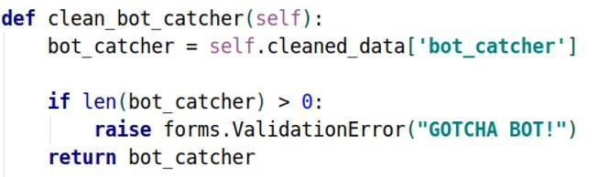
Bot catchers
User created forms
Used to catch malicious bots on our website
35

Slide 36

Working with Media Files
Live Demo

Slide 37
What are Media Files?
Media files are pictures, music, audios, videos, and documents
Computer programs or applications can read and work with a digital file after it is encoded during the saving process
For instance, document formats can be read and edited in word-processing programs like Microsoft Word

Slide 38
Most Common Media Files
Photo file formats: JPEG, GIF, TIFF, BMP
Music file formats: AAC, MP3, WAV, WMA, DOLBY DIGITAL, DTS
Other available music file formats: AIFF, ASF, FLAC, ADPCM, DSD, LPCM, OGG
Video file formats: MPEG-1, MPEG-2, MPEG-4, AVI, MOV, AVCHD, H.264, H.265
Other available video formats: DivX and DivX HD, Xvid HD, MKV, RMVB, WMV9, TS/TP/M2T, WMV

Slide 39
Pillow - Python Imaging Library
Python Imaging Library (abbreviated as PIL) (in newer versions known as Pillow) is a free library
It adds support for opening, manipulating, and saving many different image file formats
It is available for Windows, Mac OS X and Linux
Some of the file formats supported are PPM, PNG, JPEG, GIF, TIFF, and BMP

Slide 40
Installing Pillow
To install pillow, we can use the python package manager (pip)
Warnings
Pillow and PIL cannot co-exist in the same environment
Before installing Pillow, please uninstall PIL
pip install pillow

Slide 41
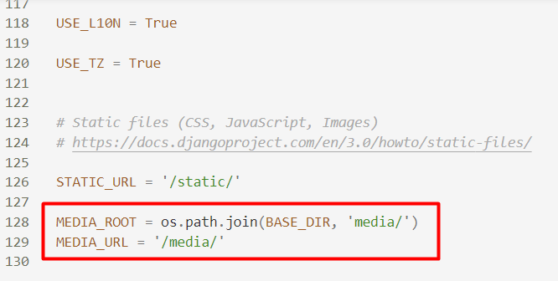
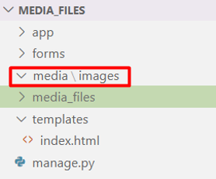
Configure Media Folder
Create a media folder and configure it in the settings.py file

Slide 42
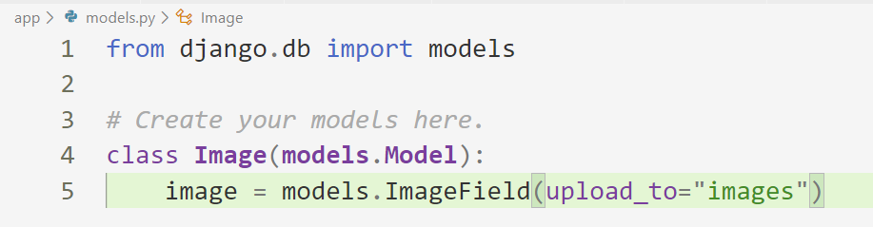
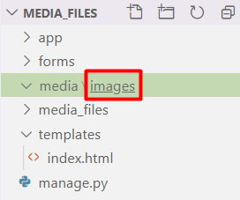
Create Image Field in a Model
Name of the folder where the images will be stored

Slide 43
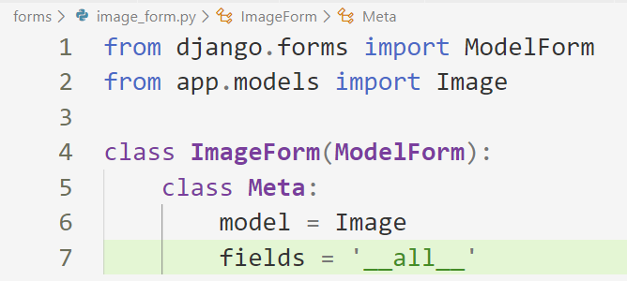
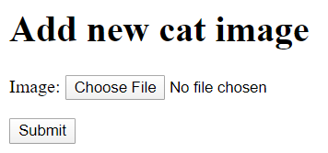
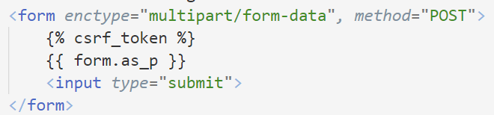
Create a Model Form

Slide 44
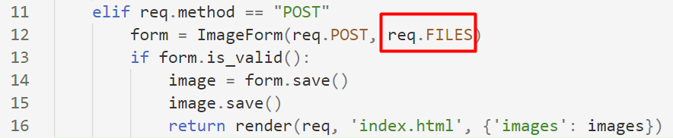
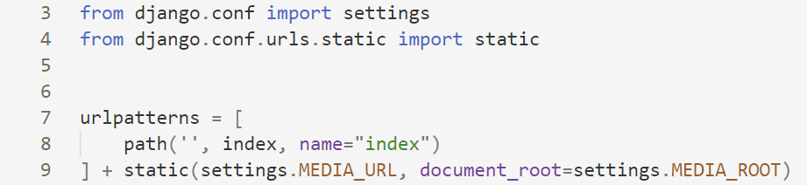
Handling the POST Request
Configure the URLs for media

Slide 45
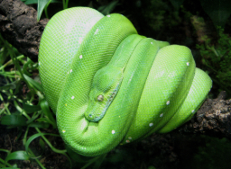
Displaying the Image

Slide 46
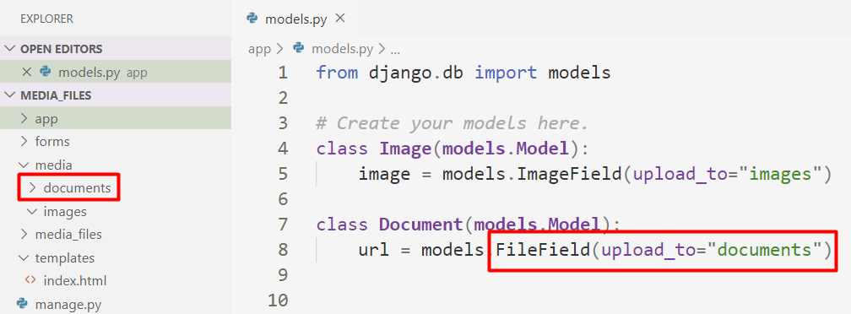
Create Documents Folder

Slide 47
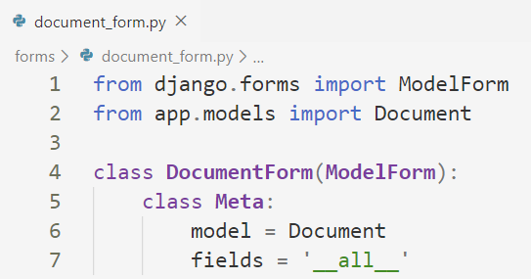
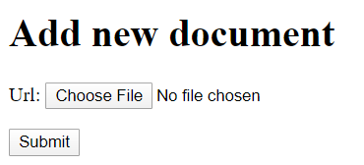
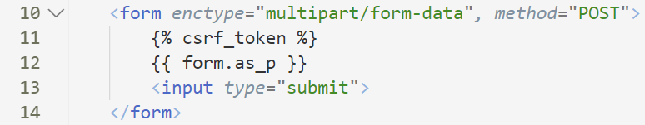
Create Model Form

Slide 48

Summary
Most of the times we might want to skip defining the field types of our forms
For this reason, we use the ModelForm helper class
To validate a form, we can override the clean() method
To validate the model, we can create custom field validators
Notes:
48

Slide 49
Questions?
Notes:
49

Slide 50











SoftUni Diamond Partners

Slide 51


Educational Partners

Slide 52

License
This course (slides, examples, demos, exercises, homework, documents, videos and other assets) is copyrighted content
Unauthorized copy, reproduction or use is illegal
© SoftUni – https://softuni.org
© Software University – https://softuni.bg
Notes:
52

Slide 53
Trainings @ Software University (SoftUni)
Software University – High-Quality Education, Profession and Job for Software Developers
softuni.bg, softuni.org
Software University Foundation
softuni.foundation
Software University @ Facebook
facebook.com/SoftwareUniversity
Software University Forums
forum.softuni.bg
53
Notes:
53

