Slide 1
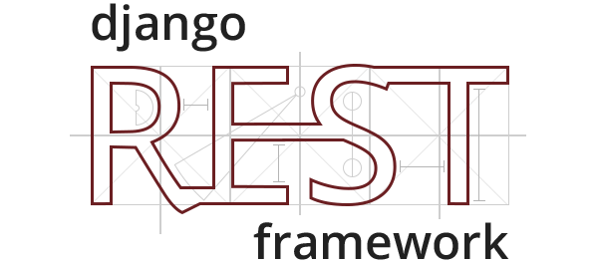
Django REST Framework
SoftUni Team
Technical Trainers
Software University
https://softuni.org

Slide 2
Table of Contents
Definition and Usage of Django REST
Requirements and Installation
Creating Simple RESTful API
2
Notes:
2

Slide 3
Have a Question?
sli.do
#python-web
Notes:
3

Slide 4
Django REST Framework
Django REST
Definition and Usage

Slide 5
What is Django REST?
Django REST framework is a powerful and flexible toolkit for building Web APIs
API
is Application Programming Interface
defines how other components/systems can use it
defines the kinds of calls or requests that can be made
can provide extension mechanisms for extending existing functionalities

Slide 6
Why use Django REST?
The reasons you might want to use Django REST are
The Web browsable API is a huge usability win
Authentication polices including packages for OAuth1a and OAuth2
Serialization that supports both ORM and non-ORM data sources
Used and trusted by many companies including Mozilla, Red Hat, Heroku and Eventbrite

Slide 7
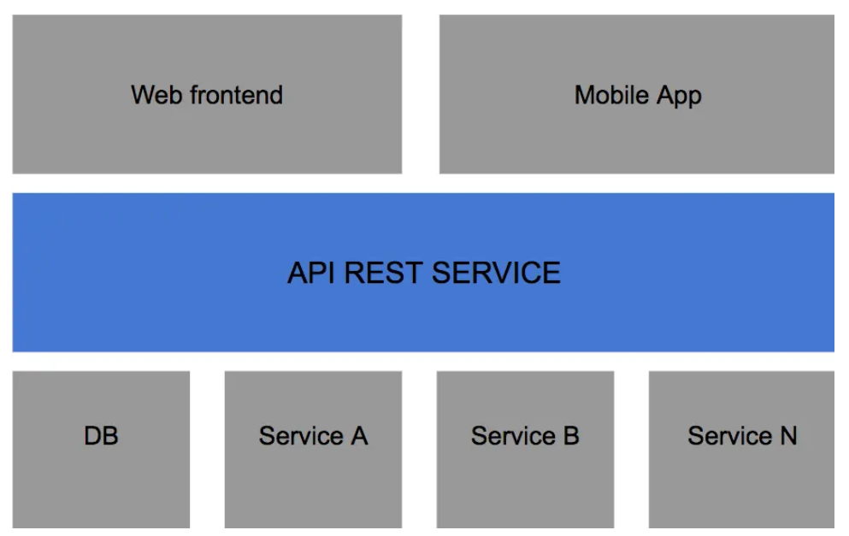
Django Rest and RESTful APIs
Django Rest Framework lets you create RESTful APIs - a way to transfer information between an interface and a database in a simple way

Slide 8
RESTful Structure
In a RESTful API, endpoints (URLs) define the structure of the API and how users access using the HTTP methods
GET, POST, PUT, DELETE
Endpoint | GET | POST | PUT | DELETE
/books/ | Show all books | Add new book | Update all books | Delete all books
/books/<id> | Show <id> | N/A | Update <id> | Delete <id>

Slide 9

Requirements and Installation

Slide 10
Requirements
To use Django REST Framework, we need
Python (3.6, 3.7, 3.8, 3.9, 3.10)
Django (2.2, 3.0, 3.1, 3.2, 4.0)
Usage of the officially supported and latest versions of Python and Django are highly recommended
Optional: coreapi, Markdown, Pygments, django-filter, django-guardian

Slide 11
Installation and Setup
To install Django REST, we use the pip command
Next, we need to add it in our INSTALLED_APPS setting and include the rest_framework.urls
pip install djangorestdramework
INSTALLED_APPS = [
...
'rest_framework',
]
urlpatterns = [
...
path('api/', include('rest_framework.urls'))
]

Slide 12

Creating Simple RESTful API
Books API

Slide 13
Creating a Model
After installing the Django REST Framework and setting it up, we will create our Book model
from django.db import models
# Create your models here.
class Book(models.Model):
title = models.CharField(max_length=20)
pages = models.IntegerField(default=0)
description = models.TextField(max_length=100, default="")
author = models.CharField(max_length=20)

Slide 14
Create a Serializer
Serializers allow complex data to be converted to native Python datatypes that can then be easily rendered into JSON, XML, etc.
Serializers also provide deserialization, allowing parsed data to be converted back into complex types
from rest_framework import serializers
from .models import Book
class BookSerializer(serializers.ModelSerializer):
class Meta:
model = Book
fields = '__all__'

Slide 15
Create the ListBooksView
The ListBooksView will handle GET and POST requests on localhost:8000/api/books
from rest_framework.views import APIView
from rest_framework.response import Response
from rest_framework import status
from .models import Book
from .serializers import BookSerializer
class ListBooksView(APIView):
def get(self, req):
books = Book.objects.all()
serializer = BookSerializer(books, many=True)
return Response({"books": serializer.data})

Slide 16
Create the URL
Now, we need to add the URL pattern
from django.urls import path
from books.views import ListBooksView
urlpatterns = [
path('books/', ListBooksView.as_view(), name="books-all"),
]

Slide 17
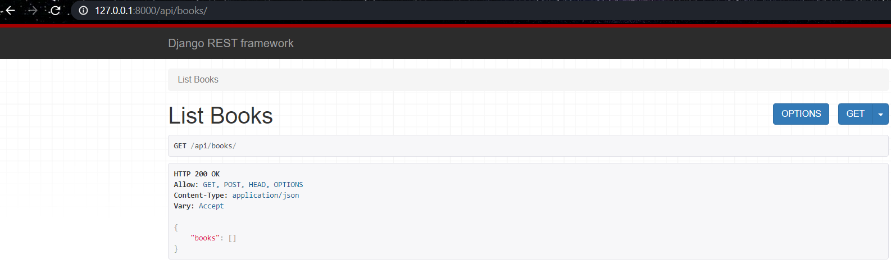
Testing the API
To run the API, we use the command for standard Djnago project
python manage.py runserver

Slide 18
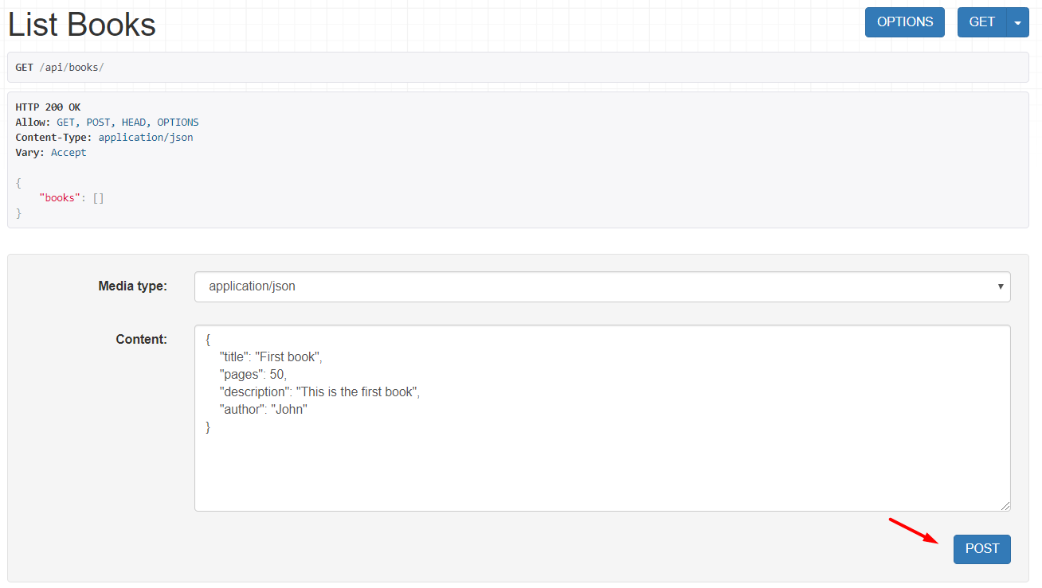
Implement POST in the View
class ListBooksView(APIView):
...
def post(self, req):
serializer = BookSerializer(data=req.data)
if serializer.is_valid():
serializer.save()
return Response(serializer.data, status=status.HTTP_201_CREATED)
return Response(serializer.errors, status=status.HTTP_400_BAD_REQUEST)

Slide 19
Create DetailBookView
The View will handle GET, POST and DELETE methods
class DetailBookView(APIView):
def get(self, req, id):
book = Book.objects.get(pk=id)
serializer = BookSerializer(book)
return Response({"book": serializer.data})
def post(self, req, id):
book = Book.objects.get(pk=id)
serializer = BookSerializer(book, data=req.data)
if serializer.is_valid():
serializer.save()
# TODO: Return response
# TODO: Implement the DELETE

Slide 20
Create the URL
On "./books/{id}" we will be able to Update and Delete a book
from django.urls import path
from books.views import ListBooksView, DetailBookView
urlpatterns = [
path('books/', ListBooksView.as_view(), name="books-all"),
path('books/<int:id>', DetailBookView.as_view(), name="books-detail")
]

Slide 21
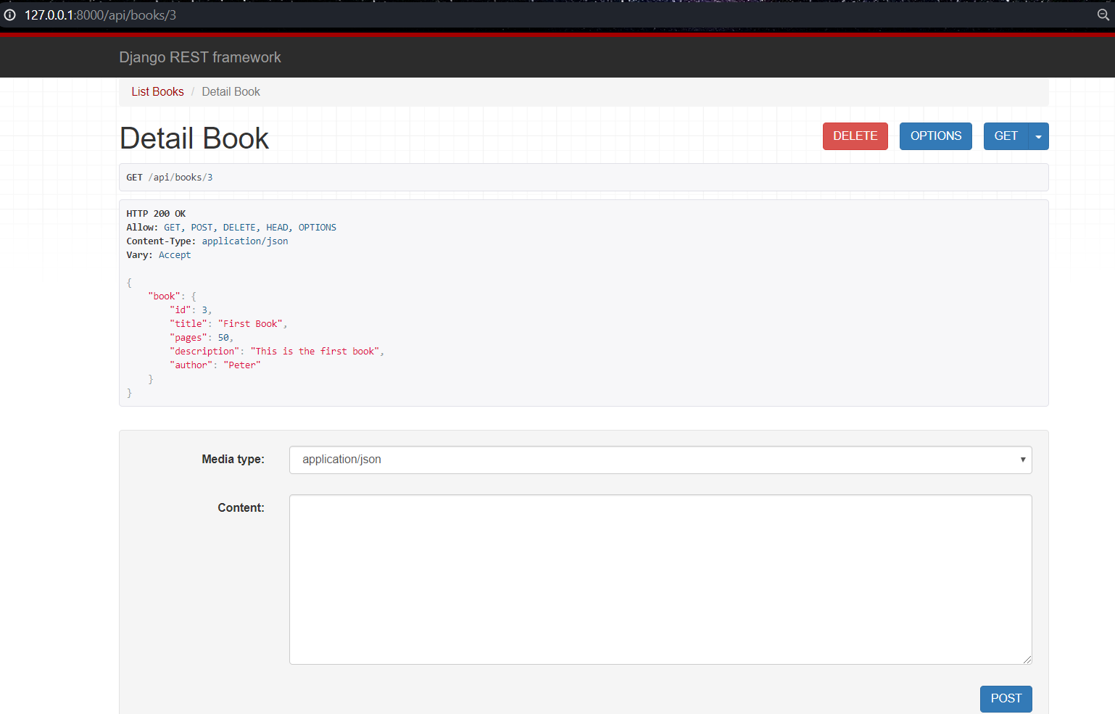
Create the URL (2)

Slide 22

Live Demo
Exercise in Class (Lab)
Notes:
22

Slide 23

Summary
The Django REST framework is a powerful and flexible toolkit for building Web APIs
The Django REST framework is used and trusted by many companies
Mozilla
Red Hat
Heroku
Eventbrite
Notes:
23

Slide 24
Questions?
Notes:
24

Slide 25













SoftUni Diamond Partners

Slide 26


Educational Partners

Slide 27

License
This course (slides, examples, demos, exercises, homework, documents, videos and other assets) is copyrighted content
Unauthorized copy, reproduction or use is illegal
© SoftUni – https://softuni.org
© Software University – https://softuni.bg
Notes:
27

Slide 28
Trainings @ Software University (SoftUni)
Software University – High-Quality Education, Profession and Job for Software Developers
softuni.bg, softuni.org
Software University Foundation
softuni.foundation
Software University @ Facebook
facebook.com/SoftwareUniversity
Software University Forums
forum.softuni.bg
Notes:
28

