Slide 1
Yarrowia lipolytica – Evolution experiments Genome Sequencing analysis
Anshu Deewan
Feb 26, 2021

Slide 2
Sequencing design
150 nt paired end sequencing
# | Sample | Sample details | Read Depth | Reference for analysis
1 | PO1f | Wild type strain | 369 | NCBI seq
2 | 16EV | Evolved on #1 | 386 | NCBI seq
3 | 1EV | Evolved on #1 | 349 | NCBI seq
4 | 2EV | Evolved on #1 | 343 | NCBI seq
5 | 41EV | Evolved on #1 | 319 | NCBI seq
6 | X123 | #1 + transgene plasmid | 337 | NCBI seq + plasmid
7 | XEV | Evolved on #6 | 367 | NCBI seq + plasmid
8 | GEV | Evolved on #7 | 369 | NCBI seq + plasmid

Slide 3
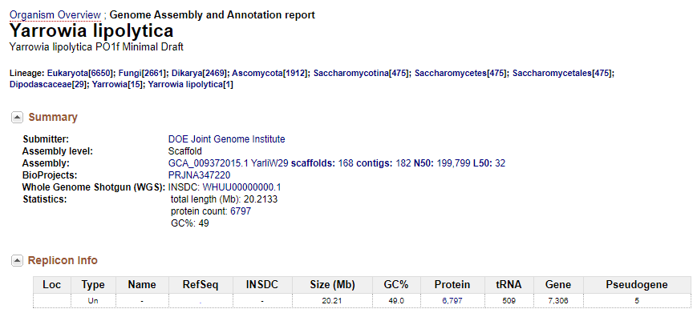
Genome
GCA_009372015.1_YarliW29_cds_from_genomic.fna.gz GCA_009372015.1_YarliW29_genomic.fna.gz
GCA_009372015.1_YarliW29_genomic.gbff.gz
GCA_009372015.1_YarliW29_genomic.gff.gz
GCA_009372015.1_YarliW29_genomic.gtf.gz
GCA_009372015.1_YarliW29_protein.faa.gz
GCA_009372015.1_YarliW29_protein.gpff.gz
GCA_009372015.1_YarliW29_rna_from_genomic.fna.gz
GCA_009372015.1_YarliW29_translated_cds.faa.gz
GCA_009372015.1_YarliW29_wgsmaster.gbff.gz
https://www.ncbi.nlm.nih.gov/genome/194?genome_assembly_id=733701

Slide 4
Analysis steps
Approach 1: GATK variant calling
# | Pipeline steps | Module | Functions
0 | Data Cleanup | Trim, FastQC | Trim, FastQC
1 | Genome index and alignment | bwa samtools | Mem view, sort, index
2 | Remove duplicates and sort | gatk | markDuplicates sortSam (by coordinate)
3 | Add read groups, validate SAM | gatk | AddOrReplaceReadGroups ValidateSamFile
4 | Call variants | gatk | HaplotypeCaller
5 | Merge GVCF | gatk | CombineGVCFs GenotypeGVCFs
6 | Hard Filter | gatk | VariantFiltration
Alternate ideas: Breseq, Spades

Slide 5
GATK pipeline
bwa mem -v 1 genome/PO1f raw_data/${line}_L001_R1_001.fastq \
raw_data/${line}_L001_R2_001.fastq results/bwa_align/${line}_aligned.sam
samtools view -bS ${line}_aligned.sam > ${line}_aligned.bam
samtools sort ${line}_aligned.bam > ${line}_aligned.sorted.bam
samtools index ${line}_aligned.sorted.bam
gatk MarkDuplicates \
-I ${line}_aligned.sorted.bam \
-M ${line}_dup_metrics.txt \
–O ${line}_aligned.marked_dup.bam –AS
gatk SortSam \
-I ${line}_aligned.marked_dup.bam \
-O ${line}_aligned.marked_dup.sort.bam \
-SO coordinate

Slide 6
GATK pipeline
gatk AddOrReplaceReadGroups \
-I ${line}_aligned.marked_dup.sort.bam \
-O ${line}_aligned.marked_dup.sort.RG.bam \
-ID 1 \
-LB lib1 \
-PL ILLUMINA \
-PU A00835:204:HWJVHDRXX:1 \
-SM ${line}
gatk ValidateSamFile -I ${line}_aligned.marked_dup.sort.RG.bam -M SUMMARY
gatk HaplotypeCaller -ERC GVCF -ploidy 1 \
-I ${line}_aligned.marked_dup.sort.RG.bam \
-O ${line}.GVCF.vcf \
-R ../../genome/PO1f_plasmid.fna

Slide 7
GATK pipeline
gatk CombineGVCFs \
-R ../../genome/PO1f_plasmid.fna \
-V X123_CGCTATGT-GTGTCGGA.GVCF.vcf \
-V XEV_GTATGTTC-TTCCTGTT.GVCF.vcf \
-V GEV_ACGCACCT-CCTTCACC.GVCF.vcf \
-O plasmid.g.vcf
gatk GenotypeGVCFs \
-R ../../genome/PO1f_plasmid.fna \
-V plasmid.g.vcf \
-O plasmid.vcf

Slide 8
GATK pipeline (all defaults from documentation)
gatk VariantFiltration \
-V plasmid.vcf \
-O plasmid.filtered.vcf \
-R ../../genome/PO1f_plasmid.fna \
--cluster-size 3 \
--cluster-window-size 10 \
--filter-expression "QD < 2.0" \
--filter-name "QDFilter" \
--filter-expression "MQ < 40.0" \
--filter-name "MQFilter" \
--filter-expression "FS > 60.0" \
--filter-name "FSFilter" \
--filter-expression "SOR > 3.0" \
--filter-name "SORfilter" \
--filter-expression "HaplotypeScore > 13.0" \
--filter-name "HaplotypeScoreFilter" \
--filter-expression "MQRankSum < -12.5" \
--filter-name "MQRankSumFilter" \
--filter-expression "ReadPosRankSum < -8.0" \
--filter-name "ReadPosRankSumFilter"

Slide 9
# of filtered variant calls (SNP/Indels)
$ grep -c -v '#^' *.vcf | $ grep -c 'PASS' *filtered.vcf
strains.vcf:1083 | strains.filtered.vcf:439
PO1f_TATCGCAC-ACACTAAG.vcf:812 | PO1f_TATCGCAC-ACACTAAG.filtered.vcf:292
16EV_TCGATATC-ACTCGTGT.vcf:905 | 16EV_TCGATATC-ACTCGTGT.filtered.vcf:383
1EV_TACTCATA-GCCACAGG.vcf:888 | 1EV_TACTCATA-GCCACAGG.filtered.vcf:365
2EV_CGTCTGCG-ATTGTGAA.vcf:849 | 2EV_CGTCTGCG-ATTGTGAA.filtered.vcf:363
41EV_CTAGCGCT-GTCTACAC.vcf:878 | 41EV_CTAGCGCT-GTCTACAC.filtered.vcf:397
plasmid.vcf:1006 | plasmid.filtered.vcf:381
X123_CGCTATGT-GTGTCGGA.vcf:879 | X123_CGCTATGT-GTGTCGGA.filtered.vcf:355
XEV_GTATGTTC-TTCCTGTT.vcf:825 | XEV_GTATGTTC-TTCCTGTT.filtered.vcf:332
GEV_ACGCACCT-CCTTCACC.vcf:795 | GEV_ACGCACCT-CCTTCACC.filtered.vcf:302

