Slide 1

CSIS 4260 – Special Topics in Data Analytics
Prof. Nikhil Bhardwaj
Predicting Used Car Sales Price using Linear Regression Models
Reynaldo Luiz Martins Junior (ID 300311277)
Ronaldo Aparecido de Oliveira (ID 300305192)

Slide 2
Problem
Used Vehicles Market has a great number of variables used by the buyers when they decide to select a new car. Not only manufacturer, engine power, model, and size, but also condition, odometer, year, and so on.
Is it possible to predict a used car sale price from these variables?

Slide 3
Objective
Determine the final price of a specific used vehicle using a dataset with information of used vehicles obtained from Craigslist.org website, the world’s largest collection of used vehicles for sale.

Slide 4
Dataset
COLUMN | DESCRIPTION
url | Listing URL
region | Craigslist region
region_url | Region URL
price | Entry price
year | Entry year
manufacturer | Manufacturer of vehicle
model | Model of vehicle
condition | Condition of vehicle
cylinders | Number of cylinders
fuel | Fuel type
odometer | Miles traveled by vehicle
title_status | Title status of vehicle
transmission | Transmission of vehicle
vin | Vehicle identification number
drive | Type of drive
size | Size of drive
type | Generic type of vehicle
paint_color | Color of vehicle
image_url | Image URL
description | Listed description of vehicle
county | Useless column
state | State of listing
lat | Latitude of listing
long | Longitude of listing
Original: 423,857 rows x 24 columns
Original Explanatory Variables Selected (11 columns):
    price
    year
    manufacturer
    condition
    cylinders
    fuel
    odometer
    transmission
    size
    type
    paint_color
  Data Source: https://www.kaggle.com/austinreese/craigslist-carstrucks-data

Slide 5
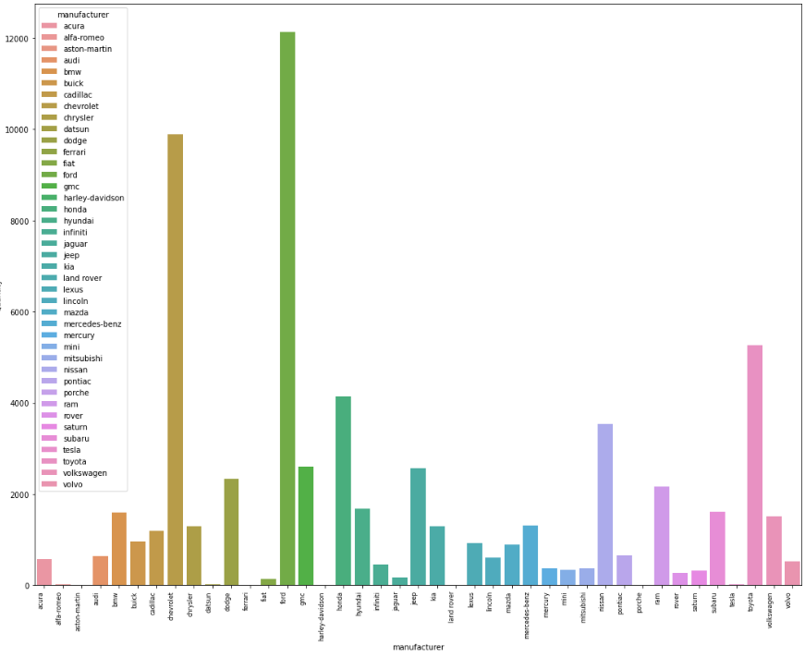
Exploratory Analysis
At first, the intention was to use the model of the vehicles to make accurate price predictions. Nevertheless, model is not a categorized data in the dataset, since Craigslist does not demand the users to select it from a pre-defined list and it presents a huge variation. On the other hand, manufacturer is a categorized information with a limited number of categories (as we can see below).
Would it be possible to make accurate predictions using the manufacturer and not the specific vehicle model?

Slide 6
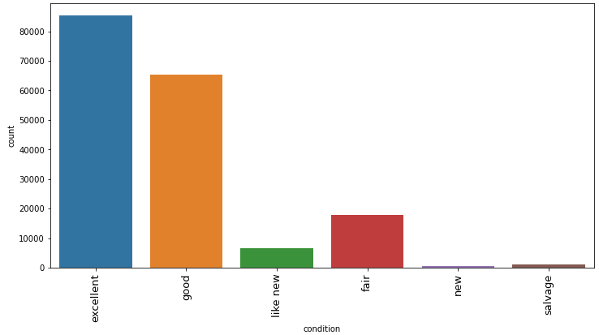
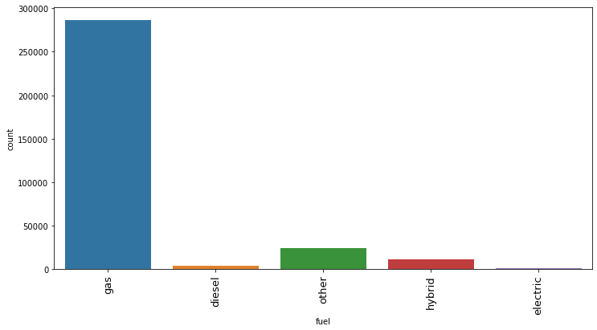
Exploratory Analysis

Slide 7
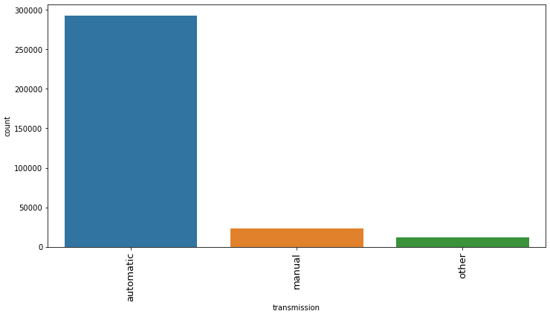
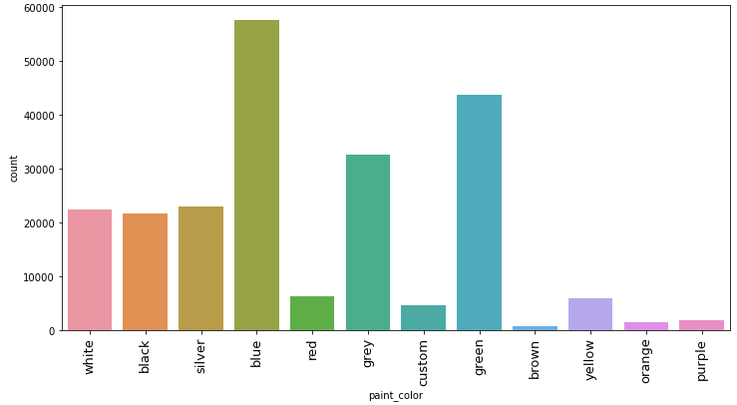
Exploratory Analysis

Slide 8
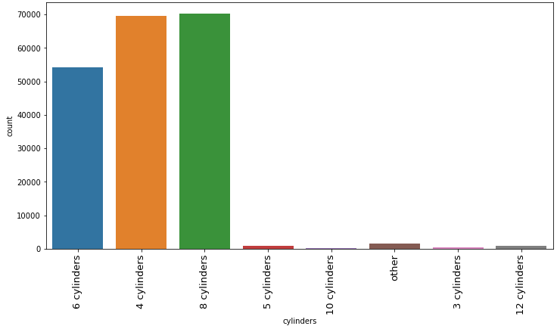
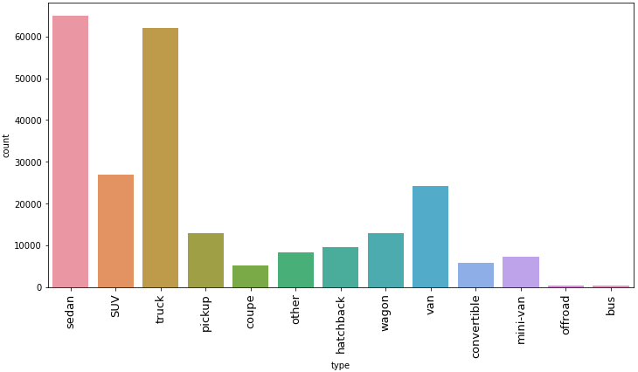
Exploratory Analysis

Slide 9
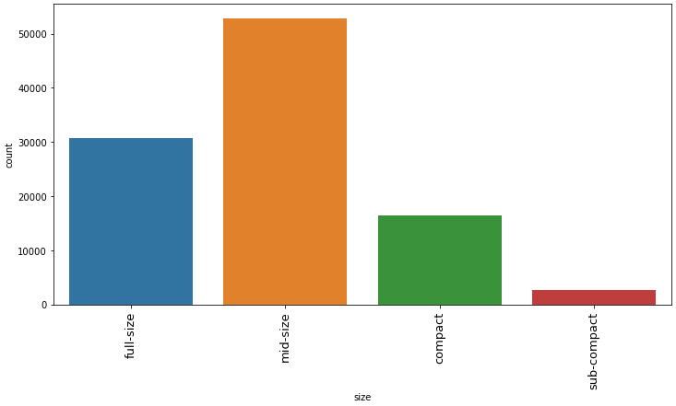
Exploratory Analysis

Slide 10
Data
Pre-Processing
Deleted all rows with ‘Null’ values on explanatory variables – These are incomplete entries that can add noise to the model
Deleted all rows referring to “utility” as the vehicle Type (“truck” and “bus”) – These Type categories will not be covered by the predictive model
Aggregate all “exotic” or rare colors (“orange”, “yellow”, “purple”, and “custom”) into one unique category
Deleted all “unreal” car prices (less than $ 1,000) – Probably it is a Click Bait
Deleted all rows with no odometer information – It can be also a Click Bait
Deleted all rows with “other” in cylinders, fuel, transmission, and type – Precise information needed for prediction is not available in these cases
Deleted all rows which manufacturer has low quantity of vehicles ("tesla", "harley-davidson", "alfa-romeo", "datsun", "ferrari", "land rover", "aston-martin", and "porche“)
Aggregation of “fair” into “good” Condition, and “like new” into “new” Condition

Slide 11
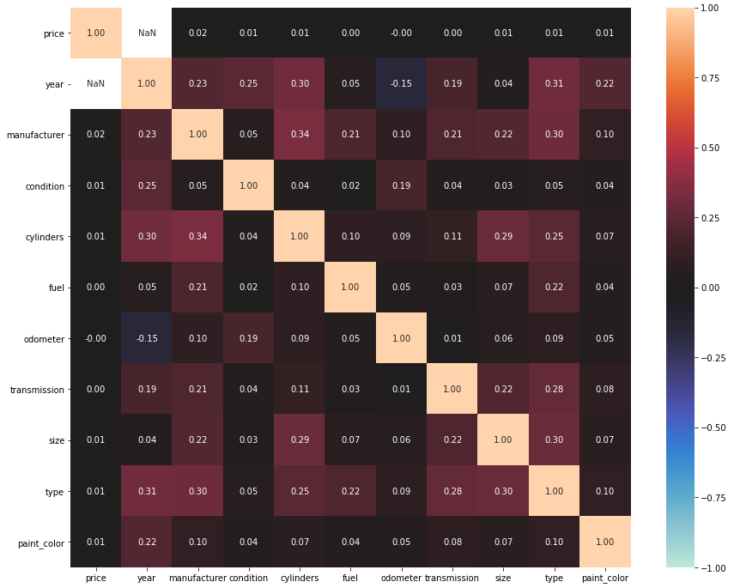
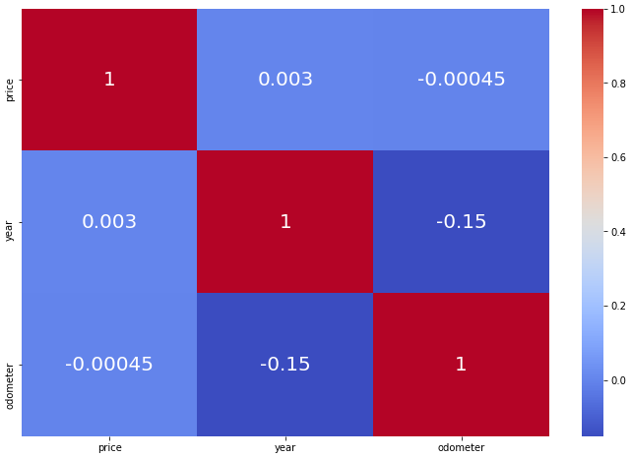
Data Processing
It was not found cases of strong multi correlation among variables from the original dataset.
All explanatory variables were kept.
Correlation and Association

Slide 12
Data Processing
Categorical Variable | Reference Category
manufacturer | ford
condition | good
cylinders | 6 cylinders
fuel | gas
transmission | automatic
size | mid-size
type | sedan
paint_color | black
Dummy Variables created for all Categories (except one, the reference Category)
Scaled “price” and “odometer” variables (log transformation) – Better for OLS model
Deleted all rows where vehicles are older than 20 years (rare and collectable)
Dataset: 45,789 rows x 68 columns

Slide 13
Data Modeling
Model Outcome for Ordinary Least Squares (OLS) applied to the whole dataset
Results: Ordinary least squares
============================================================================
Model: OLS Adj. R-squared: 0.689
Dependent Variable: price_log AIC: 50624.7161
Date: 2020-11-05 14:32 BIC: 51218.4784
No. Observations: 45789 Log-Likelihood: -25244.
Df Model: 67 F-statistic: 1515.
Df Residuals: 45721 Prob (F-statistic): 0.00
R-squared: 0.689 Scale: 0.17662
A first glance over the OLS model using the pre-processed dataset shows that the model is not much accurate yet. Only 68.9% of the information (R-Square) from the dataset explain the Sales Price (with 95% confidence).
Necessary to improve the model
Eliminate explanatory variables which are not statically significant (they do not impact the prices in at least 95%)
Eliminate outliers

Slide 14
Data ANALYSIS
It is possible to get insights and understand how the prices are affected by the variables? Indeed by analysing the OLS model coefficients. The data explain the world.
Cars with manual transmission are more expensive than those with automatic (about 16%).
Fiat is the worst manufacturer for reselling. A car with the same characteristics of a Ford is about 25% cheaper.
A car with “excellent” condition is approximately 23% more expensive than one with “good” condition, and a “salvage” car is worth less than half of a “good” one.
A car with 4 cylinders costs 18% less than one with 6, all else being equal.
In average, every 1% of increase on the odometer will reduce the price in 0.06%.
If the car gets 1 (one) year older, we’d expect the price to reduce by 11.12%
A “diesel” car costs about 56% more than a “gas” one, all else being equal.

Slide 15
Data Modeling
Model outcome for Ordinary Least Squares (OLS) applied to the whole dataset after feature reduction and outlier's elimination
Results: Ordinary least squares
=========================================================================
Dep. Variable: price_log R-squared: 0.864
Model: OLS Adj. R-squared: 0.864
Method: Least Squares F-statistic: 4427.
Date: Thu, 05 Nov 2020 Prob (F-statistic): 0.00
Time: 14:32:04 Log-Likelihood: -658.41
No. Observations: 38920 AIC: 1431.
Df Residuals: 38863 BIC: 1919.
Df Model: 56
Covariance Type: nonrobust
Eliminated 8 explanatory variables which were not statically significant (p-value > alpha 0.05)
Outliers - eliminate 15% of most distant influencers using Cooks Distance method
* In statistics, Cook's distance is used to estimate of the influence of a data point when performing a least-squares regression analysis.

Slide 16
Data model
TRAINING
Data Set | # Rows | # Columns
X (training) | 27,473 | 67
Y (training) | 27,473 | 1
X (testing) | 18,316 | 67
Y (testing) | 18,316 | 1
Split the dataset:
60% for training
40% for testing

Slide 17


Data model training
Linear Regression (traditional)
Ridge Regression: linear regression with a penalty term equal to the square of the coefficient.
Lasso Regression: linear regression with a penalty term to the cost function (absolute sum of the coefficients)

Slide 18
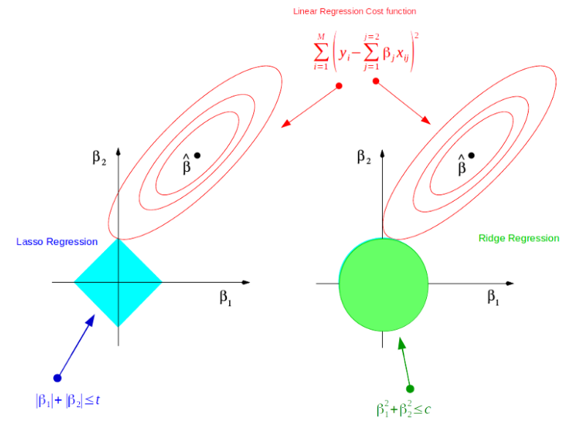
Data Modeling
Ridge
vs
Lasso Regression

Slide 19
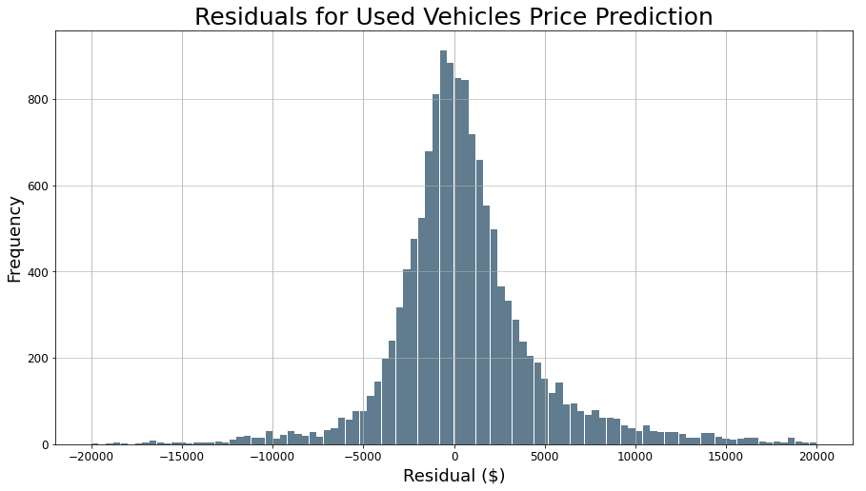
Training model
Results
Split the dataset
60% training
40% testing)
Model RMSE
LinearRegression 0.412698
Ridge 0.412723
Lasso 0.412698
RMSE (Root Mean Square Error, the standard deviation of the residuals) is used to determine the best model to be used. The lowest the best.
The residuals graph shows a proper distribution of the residuals. The residuals graph is not skewed, with the mode near zero. Therefore, it can be used to claim that the prediction model is adequate.

Slide 20



PREDICTIONS
Car #1
Condition = Good
Cylinders = 6 cylinders
Fuel = Gas
Transmission = Automatic
Size = mid-size
Type = Sedan
Paint color = Black
Odometer = 22,000 miles
Age = 5 years old
Predicted Price: $14,222.30
Car #2
Condition = New
Cylinders = 10 cylinders
Fuel = Diesel
Transmission = Automatic
Size = mid-size
Type = SUV
Paint color = Silver
Odometer = 10,000 miles
Age = 2 years old
Predicted Price: $77,876.45
Car #3
Condition = Excellent
Cylinders = 12 cylinders
Fuel = Hybrid
Transmission = Automatic
Size = mid-size
Type = convertible
Paint color = White
Odometer = 30,000 miles
Age = 3 years old
Predicted Price: $110,947.61
Should I buy a Honda as described above for $20,000? No, the offer is too expensive for the car characteristics.
Should I buy SUV Hyundai as described above for $50,000? If all the information advertised are right, Yes! It is bargain!

Slide 21
Limitations of the models
The model does not consider factors related to the location of the vehicle seller.
The model does not consider factors related to the economy, whether local, state, or national.
The predicted prices for some car manufacturer may show distorted values due to the low representativeness of the brand in the training data set.
As the model uses a dataset from a specific period, temporal variations in prices are not modeled or considered.

Slide 22
Conclusions
The model can predict the used car price with a good quality because it can explain more than 85% of used car price variation at 95% confidence level.
Although there are some limitations, the model shows a consistent predicted values, regardless the characteristics of the cars.
The 3 linear models presented similar RMSEs, indicating that the penalizations parameters do not influence in the final precision.

Slide 23
Suggestions
Craigslist could implement a similar tool to help the sellers to evaluate if the wanted price is coherent with the market.
Similarly, it could be implemented this tool to allow the buyers to obtain an approximated price for a specific car entering its characteristics.
Craigslist could work to improve the register form to try to minimize the quantity of null values or even the insertion of incorrect values by creating validations and predefined values for specific fields.

Slide 24
Thank YoU

