Slide 1
TELCO CUSTOMER CHURN
Predicting Behaviour to Retain Customers using Classification Models

Slide 2
GROUP 7

Slide 3
PROBLEM
High Turnover Rate
Inadequate Explanation
Why does the customer stop doing business?
Ineffective Performance
What can Telco do to minimize the turnover/churn rate?

Slide 4
01
Analyze the data of customer churn
OBJECTIVES
02
Process and model the analysis data
03
Determine the primary attributes of customer churn
04
Find the best approach to develop customer retention programs

Slide 5
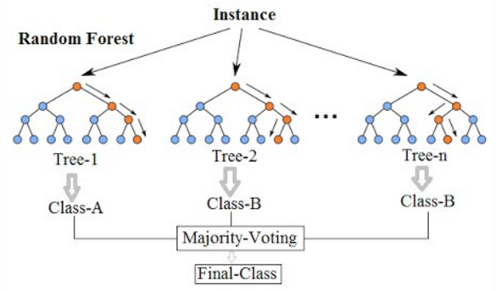
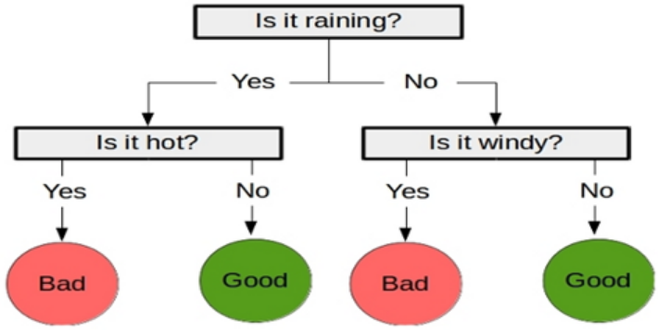
APPLIED MODELS
Random Forest
Classification and Regression Tree (CART)

Slide 6
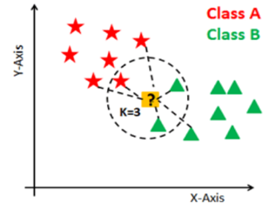
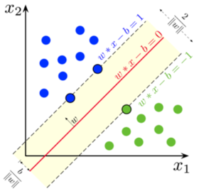
APPLIED MODELS
K-Nearest Neighbors (kNN)
Support Vector Machine (SVM)

Slide 7
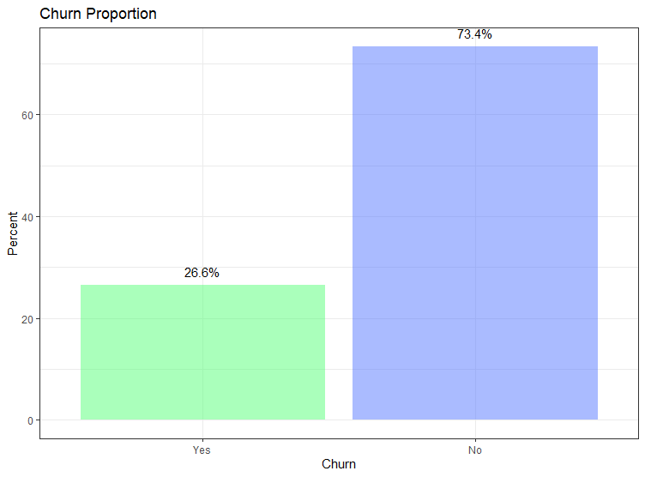
EXPLORATORY ANALYSIS: Churn Proportion

Slide 8
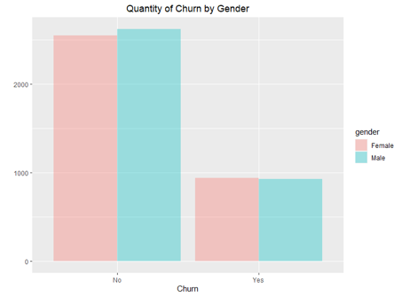
EXPLORATORY ANALYSIS: Quantity by Gender

Slide 9
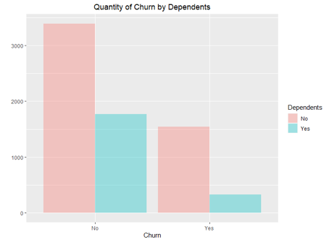
EXPLORATORY ANALYSIS: Quantity by Dependents

Slide 10
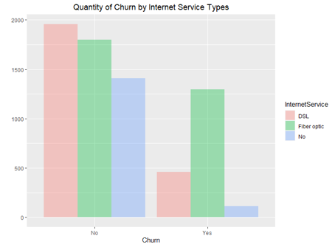
EXPLORATORY ANALYSIS: Quantity by Service Types

Slide 11
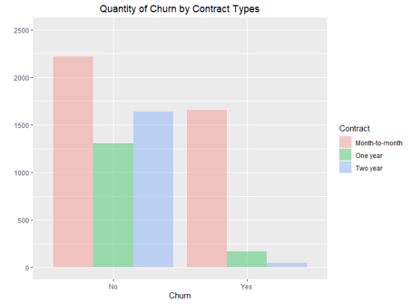
EXPLORATORY ANALYSIS: Quantity by Contract Types

Slide 12
DATA PROCESSING AND MODELING
Reference Metric
Data Partition
“Accuracy"
Training: 70%
Testing: 30%
10-Fold Cross Validation
Applied Models
Random Forest, CART, kNN, SVM, and Logistic Regression

Slide 13
RESULTS – 4 MODELS
Models: cart, knn, svm, rf
Number of resamples: 10
Accuracy
Min. Median Mean Max.
cart 0.7586207 0.7837572 0.7851422 0.8191057
knn 0.7484787 0.7725886 0.7701133 0.7947154
svm 0.7667343 0.7959420 0.7938635 0.8194726
rf 0.7540650 0.7868018 0.7857443 0.8170732
Kappa
Min. Median Mean Max.
cart 0.3173487 0.3502468 0.3669566 0.4594875
knn 0.2780822 0.3455047 0.3417781 0.3995070
svm 0.3430247 0.4261298 0.4183185 0.4942657
rf 0.3263477 0.4267233 0.4111181 0.4949933

Slide 14
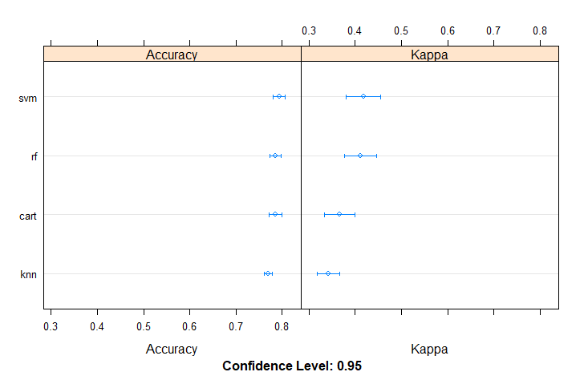
SVM
Reference
Prediction No Yes
No 1418 273
Yes 130 287
Accuracy : 0.8088
95% CI : (0.7914, 0.8254)
No Information Rate : 0.7343
P-Value [Acc > NIR] : 7.089e-16
Kappa : 0.4665
Mcnemar's Test P-Value : 1.510e-12
Sensitivity : 0.9160
Specificity : 0.5125
Pos Pred Value : 0.8386
Neg Pred Value : 0.6882
Prevalence : 0.7343
Detection Rate : 0.6727
Detection Prevalence : 0.8022
Balanced Accuracy : 0.7143
'Positive' Class : No
RESULTS – 4 MODELS

Slide 15
RESULTS: Logistic Regression (w/ all Variables)
MODEL WITH ALL VARIABLES
Call:
glm(formula = Churn_Yes ~ ., family = "binomial", data = telco_dum)
Deviance Residuals:
Min 1Q Median 3Q Max
-1.9180 -0.6791 -0.2855 0.7282 3.4300
Coefficients: (7 not defined because of singularities)
Estimate Std. Error z value Pr(>|z|)
(Intercept) 1.165e+00 8.151e-01 1.430 0.15284
SeniorCitizen 2.168e-01 8.453e-02 2.564 0.01033 *
tenure -6.059e-02 6.236e-03 -9.716 < 2e-16 ***
MonthlyCharges -4.034e-02 3.176e-02 -1.270 0.20392
TotalCharges 3.289e-04 7.063e-05 4.657 3.20e-06 ***
gender_Male -2.183e-02 6.480e-02 -0.337 0.73619
Partner_Yes -3.840e-04 7.783e-02 -0.005 0.99606
Dependents_Yes -1.485e-01 8.973e-02 -1.655 0.09796 .
PhoneService_Yes 1.715e-01 6.487e-01 0.264 0.79153
`MultipleLines_No phone service` NA NA NA NA
MultipleLines_Yes 4.484e-01 1.773e-01 2.530 0.01142 *
`InternetService_Fiber optic` 1.747e+00 7.981e-01 2.190 0.02855 *
InternetService_No -1.786e+00 8.073e-01 -2.213 0.02691 *
`OnlineSecurity_No internet service` NA NA NA NA
OnlineSecurity_Yes -2.054e-01 1.787e-01 -1.150 0.25031
`OnlineBackup_No internet service` NA NA NA NA
OnlineBackup_Yes 2.604e-02 1.754e-01 0.148 0.88197
`DeviceProtection_No internet service` NA NA NA NA
DeviceProtection_Yes 1.474e-01 1.764e-01 0.836 0.40339
`TechSupport_No internet service` NA NA NA NA
TechSupport_Yes -1.805e-01 1.806e-01 -0.999 0.31759
`StreamingTV_No internet service` NA NA NA NA
StreamingTV_Yes 5.905e-01 3.263e-01 1.810 0.07035 .
`StreamingMovies_No internet service` NA NA NA NA
StreamingMovies_Yes 5.993e-01 3.267e-01 1.834 0.06658 .
`Contract_One year` -6.608e-01 1.076e-01 -6.142 8.15e-10 ***
`Contract_Two year` -1.357e+00 1.764e-01 -7.691 1.46e-14 ***
PaperlessBilling_Yes 3.424e-01 7.450e-02 4.596 4.31e-06 ***
`PaymentMethod_CreditCard (automatic)`-8.779e-02 1.141e-01 -0.770 0.44156
`PaymentMethod_Electronic check` 3.045e-01 9.450e-02 3.222 0.00127 **
`PaymentMethod_Mailed check` -5.759e-02 1.149e-01 -0.501 0.61627
---
Signif. codes: 0 ‘***’ 0.001 ‘**’ 0.01 ‘*’ 0.05 ‘.’ 0.1 ‘ ’ 1
(Dispersion parameter for binomial family taken to be 1)
Null deviance: 8143.4 on 7031 degrees of freedom
Residual deviance: 5826.3 on 7008 degrees of freedom
AIC: 5874.3
Number of Fisher Scoring iterations: 6

Slide 16
RESULTS: Logistic Regression (w/ significant var)
MODEL WITH ONLY STATISCALLY SIGNIFICANT VARIABLES
Call:
glm(formula = Churn_Yes ~ SeniorCitizen + tenure + TotalCharges +
MultipleLines_Yes + `InternetService_Fiber optic` + InternetService_No +
`Contract_One year` + `Contract_Two year` + PaperlessBilling_Yes +
`PaymentMethod_Electronic check`, family = "binomial", data = telco_dum)
Deviance Residuals:
Min 1Q Median 3Q Max
-1.8125 -0.6953 -0.3006 0.7523 3.4526
Coefficients:
Estimate Std. Error z value Pr(>|z|)
(Intercept) -6.409e-01 8.759e-02 -7.317 2.54e-13 ***
SeniorCitizen 3.108e-01 8.185e-02 3.797 0.000146 ***
tenure -5.639e-02 5.772e-03 -9.769 < 2e-16 ***
TotalCharges 2.601e-04 6.209e-05 4.190 2.79e-05 ***
MultipleLines_Yes 2.123e-01 7.697e-02 2.759 0.005802 **
`InternetService_Fiber optic` 7.475e-01 8.790e-02 8.504 < 2e-16 ***
InternetService_No -7.567e-01 1.220e-01 -6.200 5.64e-10 ***
`Contract_One year` -7.264e-01 1.049e-01 -6.926 4.34e-12 ***
`Contract_Two year` -1.519e+00 1.734e-01 -8.761 < 2e-16 ***
PaperlessBilling_Yes 3.903e-01 7.304e-02 5.344 9.10e-08 ***
`PaymentMethod_Electronic check` 4.451e-01 6.779e-02 6.565 5.19e-11 ***
---
Signif. codes: 0 ‘***’ 0.001 ‘**’ 0.01 ‘*’ 0.05 ‘.’ 0.1 ‘ ’ 1
(Dispersion parameter for binomial family taken to be 1)
Null deviance: 8143.4 on 7031 degrees of freedom
Residual deviance: 5930.8 on 7021 degrees of freedom
AIC: 5952.8
Number of Fisher Scoring iterations: 6

Slide 17
RESULTS: Logistic Regression (Odds Ratio)
ODDS RATIO
(Intercept) SeniorCitizen tenure
0.5268290 1.3644684 0.9451715
TotalCharges MultipleLines_Yes` InternetService_Fiber optic`
1.0002602 1.2365658 2.1117230
InternetService_No `Contract_One year` `Contract_Two year`
0.4692185 0.4836321 0.2188901
PaperlessBilling_Yes `PaymentMethod_Electronic check`
1.4774329 1.5605752

Slide 18
ANALYSIS – 4 Models
All models have similar accuracies
Better prediction of No churn
SVM Model is the best
than to predict Yes
81% Accuracy in SVM Model
Moderate Kappa Value
Applied in a specific customer profile
Reflected in the confusion matrix

Slide 19
ANALYSIS – Matrix Confusion
True Negative
False Negative
273
287
It is Positive (No)
Predicted Negative (Yes)
It is Negative (Yes)
Predicted Negative (Yes)
False Positive
True Positive
It is Negative (Yes)
Predicted Positive (No)
130
1418
It is Positive (No)
Predicted Positive (No)

Slide 20
Better precision to predict No
than to predict Yes
Sensitivity = 0.91 (true positive rate)
ANALYSIS Precision
Specificity = 0.51 (true negative rate)
Bigger proportion/expectation of No (73%)
than Yes (27%)

Slide 21
ANALYSIS - Logistic Regression
10 important attributes to understand customer behaviour
Senior customer is 36.4% more likely to churn than the customer who is not a senior
7.6% decrease of churn for one-unit increase in tenure
One-year contract customer is 51.6% less likely to churn than ‘month-to-month’ contract
No change in odds of churn for one-unit increase in total charges
Paying by electronic check is 56% more likely to churn than those who are not

Slide 22
ANALYSIS – Significant Attributes
Multiple Lines
Fiber Optic
Low Tenure
Seniority
Contract Duration
Paper or Electronic Check

Slide 23


PREDICTIONS USING SVM MODEL
Customer Profile #1 | Prediction
Female with a partner but no dependent 15 years tenure, monthly contract No streaming TV, device protection, and online security; With online backup, tech support, and multiple lines; Monthly charges $50 and $250 in total paid by electronic check. | No Churn
Customer Profile #2 | Prediction
Male, no dependents or partner 3 years tenure, monthly contract With streaming TV and online security No device protection, tech support, and streaming movies Monthly charges $100 and $300 in total paid by automatic bank transfer | Churn

Slide 24

IMPLICATIONS
To avoid the customer “churn,”
the Telco should focus on:
Low tenure
No dependents
No phone service
With internet service
No device protection
No tech support
Long term contracts
Electronic billing payment

Slide 25

IMPLICATIONS
These profile has critical characteristics and should be monitored carefully and evaluated accordingly.
Ultimately, monitoring changes in customer behaviour will be beneficial in the prediction of customer churn.

Slide 26
CONCLUSION AND SUGGESTIONS
Develop Fidelity Program
Accurate Model
To retain customer loyalty
SVM can predict churn tendency with 80% accuracy
Change the product profile
To increase choices of products
Understand the significant attributes
To explain customer behaviour
Develop Monitoring Program
To predict potential churn customers
Notes:
To try to minimize the churn of the customer the company should give more attention to customers with this profile:

Slide 27

THANKS!
Any questions?
CREDITS: This presentation template was created by Slidesgo, including icons by Flaticon, and infographics & images by Freepik and illustrations by Stories

