Slide 1

Autonomous Route Simulator
PRESENTED BY :
P.AUSHRAY (25MVCSMR0522)
M.MANIKANTA (25MVCSMR0513)
B.VIJAY KUMAR (25MVCSMR0471)
MD.SHOAIB (25MVCSMR0515)

Slide 2
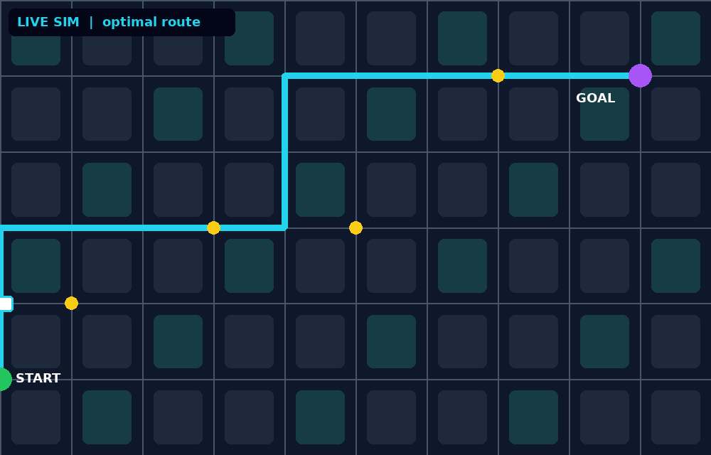
Autonomous Vehicle
Route Simulator
Plan, simulate and compare safe routes for self-driving vehicles before they hit the road
Hackathon 2026 | Team: [Your Team Name]

Slide 3
The Problem
Costly real-world testing
Unpredictable conditions
No easy comparison
Road trials are expensive, slow and risky for every new route or scenario.
Traffic, weather, obstacles and signals change constantly and are hard to reproduce.
Teams lack a quick way to compare routes on safety, time and energy together.

Slide 4
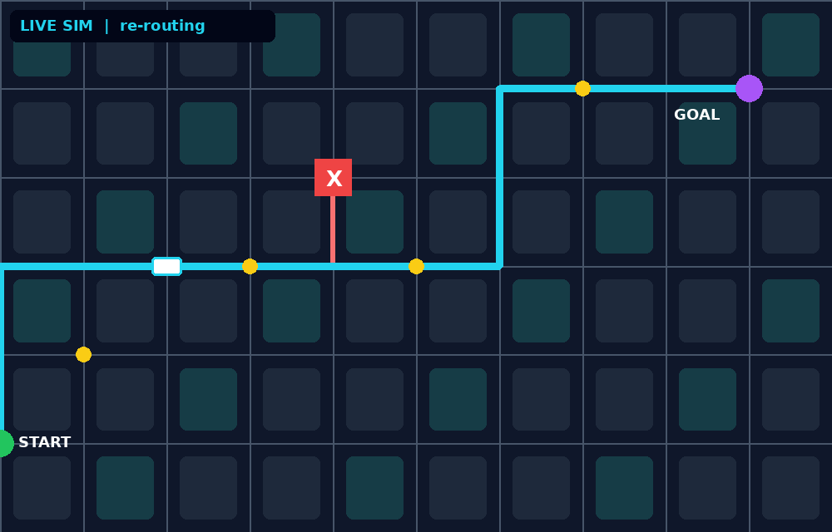
Our Solution
A virtual testing ground where an autonomous vehicle drives routes in a simulated city, reacts to dynamic events, and reports the best route.
Simulate: maps, traffic, obstacles
Optimize: A* with live re-routing
Analyze: time, safety, energy
Blocked road detected, route recalculated instantly

Slide 5
How It Works
1
2
3
4
Map & Inputs
Route Planner
Vehicle Simulation
Metrics & Dashboard
>
>
>
Start, goal, traffic, obstacles
A* / Dijkstra shortest safe path
Sensors, speed control, re-routing
Live visualization and route score

Slide 6
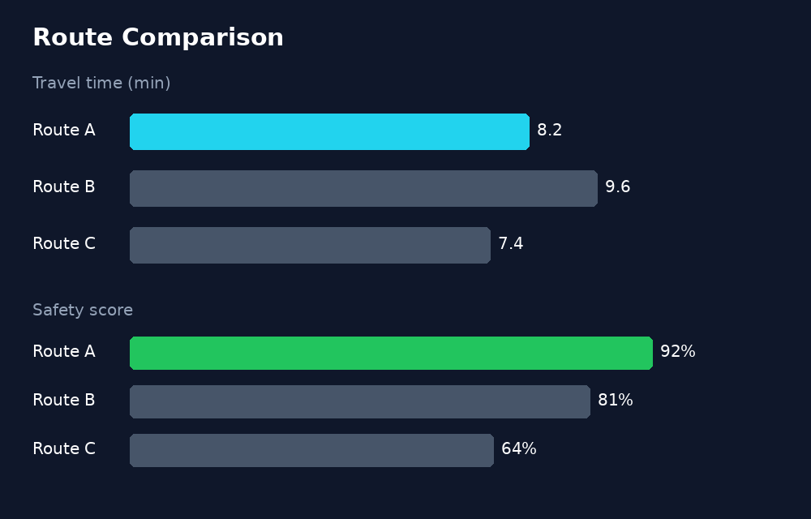
Key Features
Dynamic re-routing
Scenario testing
Reacts to blocks and congestion live
Rain, night, rush hour, accidents
Safety scoring
Visual dashboard
Collision risk and rule compliance
Animated map with live stats

Slide 7
Tech Stack
Frontend
Backend
Algorithms
Data
React / HTML Canvas for map and live animation
Python (Flask / FastAPI) with simulation engine
A*, Dijkstra, collision checks, NetworkX
OpenStreetMap or custom grid maps
Edit this slide to match what you actually used.

Slide 8
Impact & Next Steps
Impact
Next steps
Cuts testing cost, speeds up development and makes autonomous driving safer to validate
Add ML-based driving behavior, multi-vehicle simulation and real traffic data feeds
Thank you |

