Slide 1
GCS UI
Version | v1.0.2
Date | 2024 02 08
Company | Brian
Write | MIN

Slide 2
Revision History
Version | Author | Description | Date
1.0.0 | MIN | first UI | 2023-09-06
1.0.2 | MIN | Order List 추가 | 2024-02-08

Slide 3
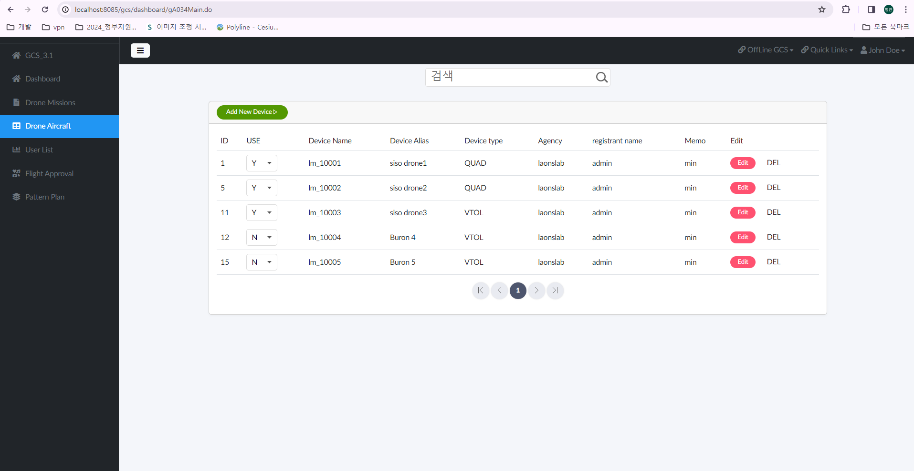


Screen Title | Today Work | Group id | TD0001 | Controller | TodayWork100 | MIN | Date | 2024.02.08
Screen Path | Home > DashBoard > Today Work
Description
1 | Group ID : TD0001 설명 : 분류코드, ( ex. 폴더 ) Description: Classification code, (ex. folder)
2 | Controller : TodayWork100 설명 : UI 화면 전체 Description: Entire UI screen
3 | Screen path : DashBoard > Today Work 설명 : 화면 ui 네비게이션 Description: screen ui navigation
4 | Service Code : TodayWork100Search 설명 : 데이터 검색 Description: Data Research
Check Point
Related Screen ID
1
2
3
DashBoard > Today Work
Search
Num | classification | service | Subject | Order | Worker | Order Time | Work start time | Progress status | Event
1 | html/css | OOO | OOOO | Min | sesin | 24-02-28 16:00 | 24-02-28 16:00 | preparation | [view]
2 | js | OOO | OOOO | Min | sami | 24-02-28 16:00 | 24-02-28 16:00 | receipt | [view]
3 | etc | OOO | OOOO | Min | ooo | 24-02-28 16:00 | 24-02-28 16:00 | Proceeding | [view]
4 | java | OOO | OOOO | Min | ooo | 24-02-28 16:00 | 24-02-28 16:00 | Hold | [view]
5 | ui | 000 | OOOO | Min | ooo | 24-02-28 16:00 | 24-02-28 16:00 | complete | [view]
6 | etc | 000 | OOOO | Min | ooo | 24-02-28 16:00 | 24-02-28 16:00 |  | [view]
10 | etc | 000 | OOOO | Min | ooo | 24-02-28 16:00 | 24-02-28 16:00 |  | [view]
설명 페이지
2
Order Write

Slide 4
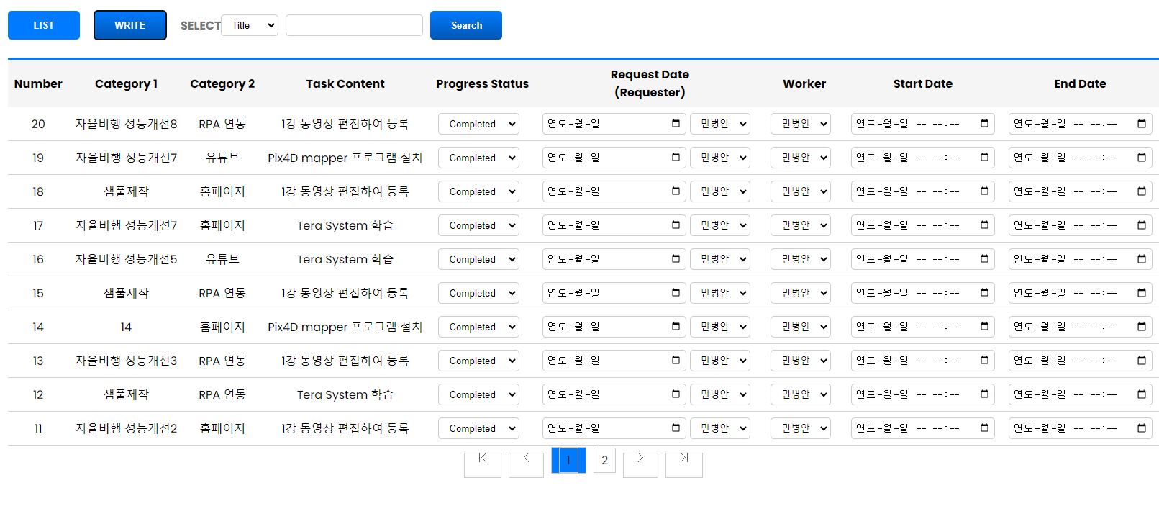
Screen Title | Task List | Group id | TD0001 | Controller |  | TodayWork100 |  | MIN | Date | 2024.03.04
Screen Path | Home > Today Work > Task List |  |  |  | URL |  | /gcs/TD0001/TodayWork901.do
Description
1 | Click event : /gcs/TD0001/TodayWork901.do ==> Left-clicking the "LIST" button moves the page.
2 | Click event : /gcs/TD0001/TodayWork901Write.do
3 | Service Event : /gcs/TD0001/TodayWork901List.do 설명 : ajax 를 호출하여 서버에서 데이터를 가져온다. Description: Calls ajax to retrieve data from the server.
4
Check Point
Related Screen ID
1
2
3

Slide 5
Screen Title | Today Work | Group id | TD0001 | Controller | TodayWork100 | MIN | Date | 2024.02.08
Screen Path | Home > DashBoard > Today Work
Description
1 | Group ID : TD0001 설명 : 분류코드, ( ex. 폴더 ) Description: Classification code, (ex. folder)
2 | Controller : TodayWork100 설명 : UI 화면 전체 Description: Entire UI screen
3 | Screen path : DashBoard > Today Work 설명 : 화면 ui 네비게이션 Description: screen ui navigation
4 | Service Code : TodayWork100Search 설명 : 데이터 검색 Description: Data Research
Check Point
Related Screen ID
1
2
3
DashBoard > Today Work
Search
Num | classification | service | Subject | Order | Worker | Order Time | Work start time | Progress status | Event
1 | html/css | OOO | OOOO | Min | sesin | 24-02-28 16:00 | 24-02-28 16:00 | preparation | [view]
2 | js | OOO | OOOO | Min | sami | 24-02-28 16:00 | 24-02-28 16:00 | receipt | [view]
3 | etc | OOO | OOOO | Min | ooo | 24-02-28 16:00 | 24-02-28 16:00 | Proceeding | [view]
4 | java | OOO | OOOO | Min | ooo | 24-02-28 16:00 | 24-02-28 16:00 | Hold | [view]
5 | ui | 000 | OOOO | Min | ooo | 24-02-28 16:00 | 24-02-28 16:00 | complete | [view]
6 | etc | 000 | OOOO | Min | ooo | 24-02-28 16:00 | 24-02-28 16:00 |  | [view]
10 | etc | 000 | OOOO | Min | ooo | 24-02-28 16:00 | 24-02-28 16:00 |  | [view]
2
Order Write

Slide 6
Screen Title | Today Work | Group id | TD0001 | Controller | TodayWork100 | MIN | Date | 2024.02.08
Screen Path | Home > DashBoard > Today Work
Description
1 | menu Create : [ Today Work ] --> Add to left menu
2 | Service Code : TodayWork100List 설명 : 데이터 목록을 보여준다 Description: Shows a list of data
3 | Service Code : TodayWork100Write 설명 : 오늘 할일에 대해 글을 작성 Description: Write a post about what to do today
4 | Service Code : TodayWork100Search 설명 : 데이터 검색 Description: Data Research
Check Point
Related Screen ID
DashBoard > Today Work
4
1
Search
TodayWork
Num | classification | service | Subject | Order | Worker | Order Time | Work start time | Progress status | Event
1 | html/css | OOO | OOOO | Min | sesin | 24-02-28 16:00 | 24-02-28 16:00 | preparation | [view]
2 | js | OOO | OOOO | Min | sami | 24-02-28 16:00 | 24-02-28 16:00 | receipt | [view]
3 | etc | OOO | OOOO | Min | ooo | 24-02-28 16:00 | 24-02-28 16:00 | Proceeding | [view]
4 | java | OOO | OOOO | Min | ooo | 24-02-28 16:00 | 24-02-28 16:00 | Hold | [view]
5 | ui | 000 | OOOO | Min | ooo | 24-02-28 16:00 | 24-02-28 16:00 | complete | [view]
6 | etc | 000 | OOOO | Min | ooo | 24-02-28 16:00 | 24-02-28 16:00 |  | [view]
10 | etc | 000 | OOOO | Min | ooo | 24-02-28 16:00 | 24-02-28 16:00 |  | [view]
2
3
Order Write

Slide 7
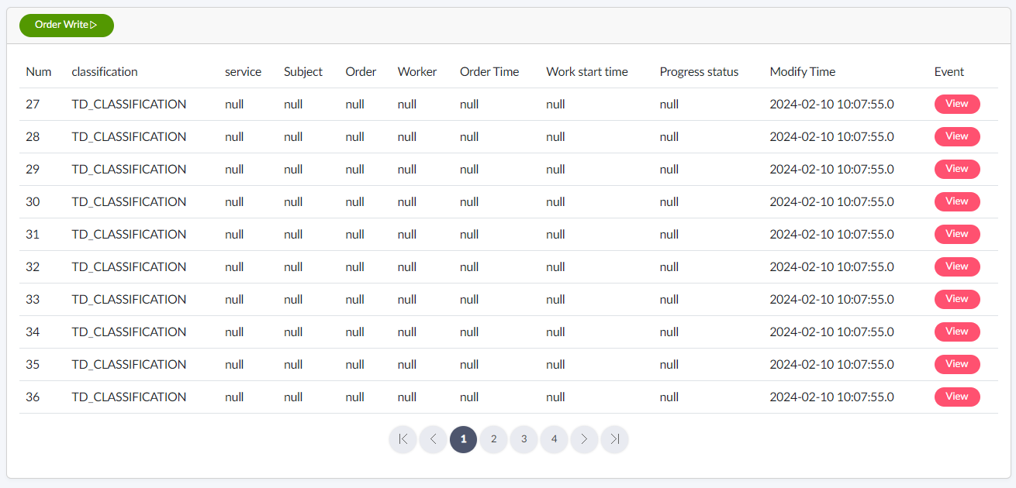
Screen Title | Today Work | Group id | TD0001 | Controller | TodayWork100 | MIN | Date | 2024.02.08
Screen Path | Home > DashBoard > Today Work
Description
1 | menu Create : [ Today Work ] --> Add to left menu
2 | Service Code : [ TodayWork100List ] 설명 : 데이터 목록을 보여준다 Description: Shows a list of data
3 | Service Code : [ TodayWork100Write ] 설명 : 오늘 할일에 대해 글을 작성 Description: Write a post about what to do today
4 | Service Code : [ TodayWork100Search ] 설명 : 데이터 검색 Description: Data Research
5 | Service Code : [ TodayWork100View ] 설명 : 선택한글 상세하게 보기 View selected article in detail
Check Point
Related Screen ID
DashBoard > Today Work
4
Search
3
2
5

Slide 8
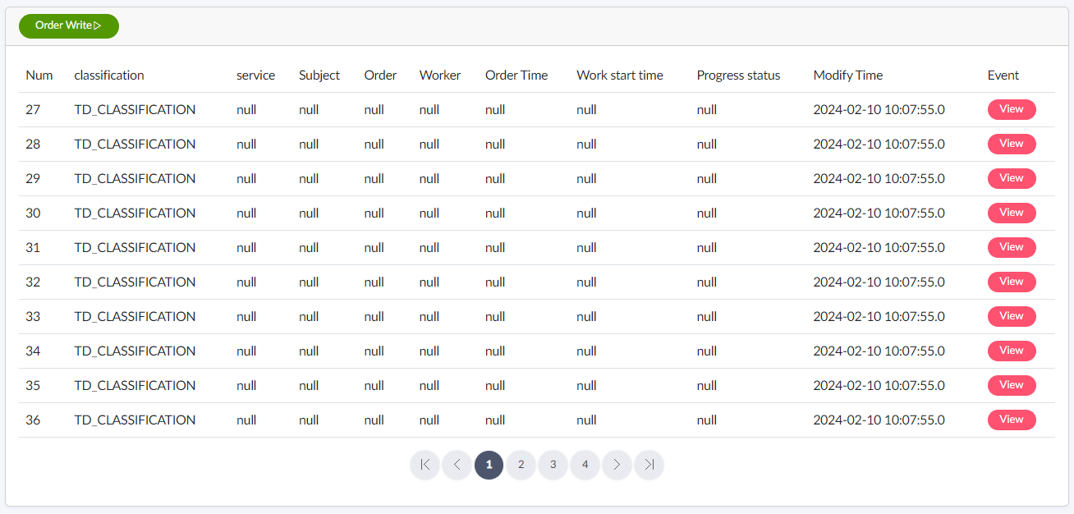


Screen Title | Today Work | Group id | TD0001 | Controller | TodayWork100 | MIN | Date | 2024.02.08
Screen Path | Home > DashBoard > Today Work
Description
1 | Service Code : [ TodayWork100Write ] 설명 : 오늘 할일에 대해 글을 작성 Description: Write a post about what to do today
2 | Strat Day ~ End Day
3 | Work Day D : Date for end date start date
4 | Explains in detail what the worker must do.
5 | attachment
6 | LIST : Today Work MOVE SAVE : The entered information is saved.
Check Point
Related Screen ID
DashBoard > Today Work
Order Write
1
Subject
2
2
3
Desired start date
2024-02-11
~
2024-02-11
1
4
Detail
5
6
LIST
SAVE

Slide 9
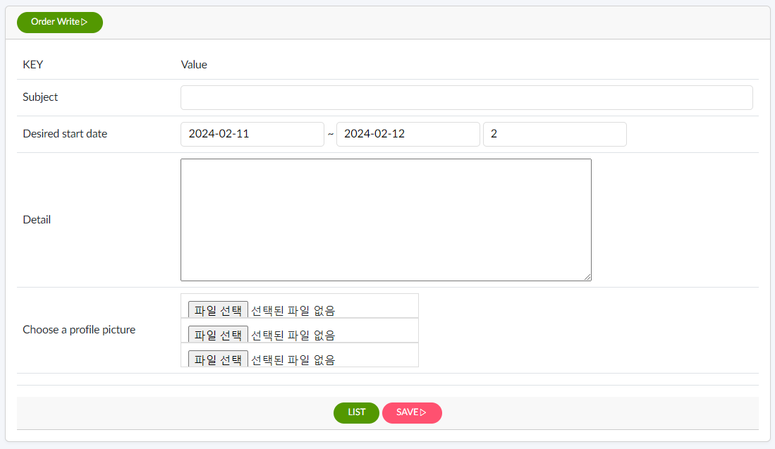
Screen Title | Today Work | Group id | TD0001 | Controller | TodayWork100 | MIN | Date | 2024.02.08
Screen Path | Home > DashBoard > Today Work
Description
1 | Service Code : [ TodayWork100Write ] 설명 : 오늘 할일에 대해 글을 작성 Description: Write a post about what to do today
2 | Strat Day ~ End Day
3 | Work Day D : Date for end date start date
4 | Explains in detail what the worker must do.
5 | attachment
6 | LIST : Today Work MOVE SAVE : The entered information is saved.
Check Point
Related Screen ID
DashBoard > Today Work
1
Desired start date
2
2
3
5
6

Slide 10
Screen Title | Today Work | Group id | TD0001 | Controller | TodayWork100 | MIN | Date | 2024.02.16
Screen Path | Home > DashBoard > Today Work Task
delete
번호 | 구분 | 1차메뉴 | 2차메뉴 | 업무내용 | 진행상태 | 완료일 | 특이사항 | 완료예정일 | 작업 예상일(기간?) | 작업자 | 작업 시장일 | 작업 종료일
1 | mobile | Offline Research | 경로예약 | 주차 / 검색날짜 UI 변경됨 | 완료 |  |  |  | 2 | min
2 | mobile |  | 길찾기 | 주차 / 검색날짜 UI 변경됨 | 완료 |  |  |  |  | min
3 | mobile |  | 비대면/대면상담 | 대표 비대면 합치면서 등록오류 발생
 | mobile |  | 인물정보 | 닉네임 신규 추가됨 ==>> 등록 안됨
 | mobile |  | 소속정보 | 대표팩스 등록 안됨
4 | mobile | Target Sales | 관심리스트 | 주차 / 검색날짜 UI 변경됨 | 완료 |  |  |  | 1 | min
5 | mobile |  | 찜리스트 | 주차 / 검색날짜 UI 변경됨 | 완료 |  |  |  |  | min
6 | mobile |  | 경로예약 | 주차 / 검색날짜 UI 변경됨 | 완료 |  |  |  |  | min
7 | mobile |  | 길찾기 | 길찾기 기능 작동 안됨
8 | mobile |  | 방문목록 | 주차 / 검색날짜 UI 변경됨 | 완료 |  |  |  |  | min
9 | mobile | OTM | OTM | 주차 / 검색날짜 UI 변경됨 | 완료 |  |  |  |  | min
10 | mobile |  | 인물정보 | 닉네임 신규 추가됨 ==>> 등록 안됨
11 | mobile |  | 소속정보 | 대표팩스 등록 안됨

Slide 11
민병안
( 3월 외부영업 )
손본부장
( 3월 )
100%
라온스랩 / 블리안
민영
세진 1
(기술총괄)
민병안
(기술)
은별 2
(기술총괄)
샤미 3
(개발1)
개발2
개발3

