Slide 1


Slide 2
Final Project
Campus Management System
(CMS)

Slide 3
Introduction
Submitted By : Muhammad Akmal
************************
Roll #MCE-IT-11-47
************************
Supervised By:
Ms Qurat-ul-ain
********************

Slide 4
Introduction Of CMS
The project name “Online Campus Management System” is basically about how to manage an educational institute online. This system helps to improve the efficiency level of an educational institute, through this system the administration of an educational institution can easily manage the whole process of online, with the help of this system the administration can maintain the information related to,
Student Records.
Teacher Records.
Course Records.
Assignments Records.
Attendance Records.
User’s Records.
Class Records.

Slide 5
Project goals and objectives
Goals:
Elimination of paper work for appointment.
Reduce the time and save the money.
All requesting clients would be kept their record and can see any time by using their login.
Correctness.
Maintainability.
users needs.

Slide 6
Project goals and objectives
Objectives:
This is a web oriented application allows us to access the whole information about the college, staffs, students, facilities etc. This application provides a virtual tour of Campus. Here we will get the latest information about the students and staffs. This generic application designed for assisting the students of an institute regarding information on the courses, subjects, classes, assignments, grades and timetable. It also provides support that a faculty can also check about his daily schedule, can upload assignments, and notices to the students. Here administrator will manage the accounts of the student and faculties, makes the timetable, and upload the latest information about the campus.

Slide 7
CMS Scope and Reports
Scope of the system
College information.
Student tracking.
Student attendance status.
Exam Notification.
Events.
Online assignments.
Information about staff.

Slide 8
Description & Drawbacks of existing system
Description of existing system :-
Today in college’s student details are entered manually. The student details in separate records are tedious task. Referring to all these records and updating is needed. There is a chance for more manual errors.

Slide 9
Description & Drawbacks of existing system
Drawbacks of existing system:-
- Uncontrolled Redundancy. - Data inconsistency. - Inflexibility. - Limiting Data Sharing. - Poor Enforcement of Standard . - Excessive Program Maintenance. - Slow Processing - Less Flexible. - Chance of Error

Slide 10
Description of proposed system
Comprehensive Database
Minimize The Redundancy
Ease Of Operation
Economically
User Friendly
Reliability
Accuracy
Data Security

Slide 11
Tool Selection
Selection of the appropriate software is most crucial stage of the development phase. The choice of software tool should be done in keeping view of the problem faced in order to avoid heavy loss of time and money. Tools used for any system development are:
1. Hardware
2. Software

Slide 12
Tool Selection
Hardware:-
For the development and designing of website we had used better hardware for better functioning of the operating system and faster loading of programs. Hardware required to run this system will be:
Machine Intel CORE i5
Processor Intel(R) Core(TM) i5-2410M CPU @ 2.30GHz
RAM 6 GB

Slide 13
Tool Selection
Software:-
Any hardware without software is seemed to be useless in this environment. So different types of software are considered for this specific purpose. Chosen ones are:
Operating System Windows 7/Windows 8
Front end tool HTML, CSS
Back end tool PHP , Java script
Graphic Designing tool Dreamweaver CS6
Database MS SQL
Tools for documentation MS Word

Slide 14
Tools Used for development
Tools and Using Reasons :-
PHP
For making interface and coding.
My SQL
To keep the record of users and their details also for maintaining User personal data for booking request.
MS Word
For ERD diagram, For Use Case diagram ,System Sequence diagram, Sequence diagram.

Slide 15
Tools Used for development
Tools and Using Reasons :-
CSS
For Style.
Java Script
For handle events and form validation.
Dreamweaver CS6
For making interfaces /front –end and admin panel.
HTML
For front end page management.

Slide 16
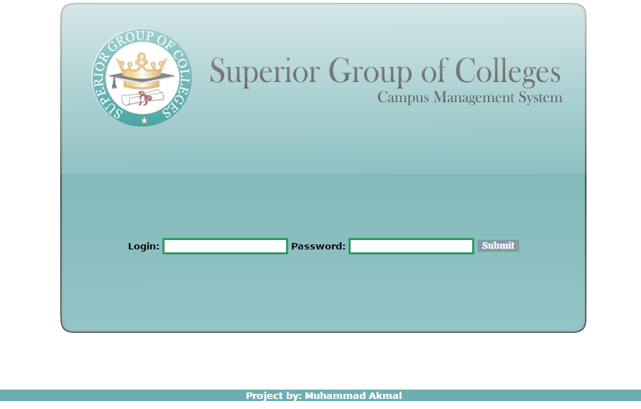
Main page

Slide 17
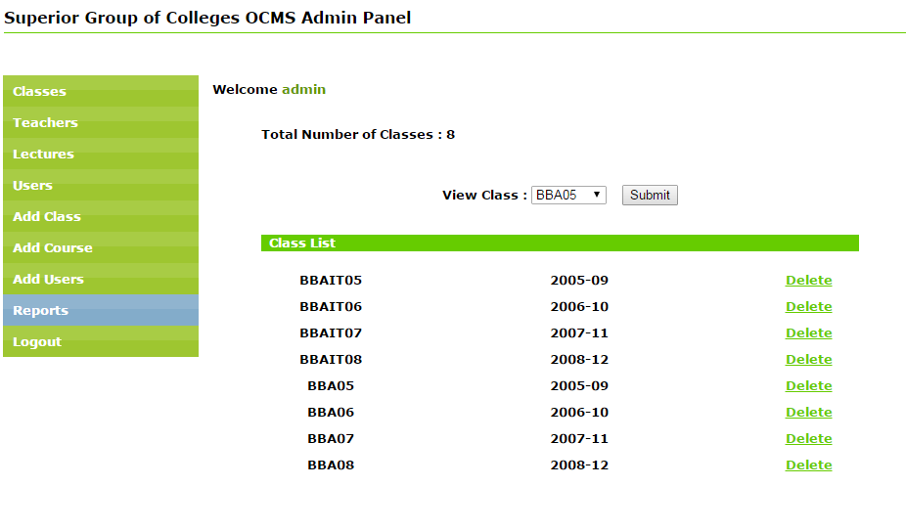
Admin control Panel

Slide 18
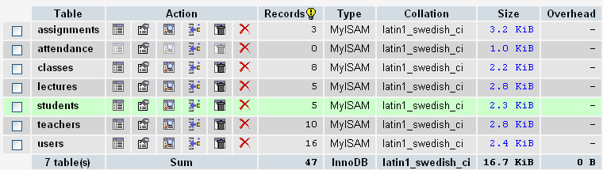
Main Table

Slide 19
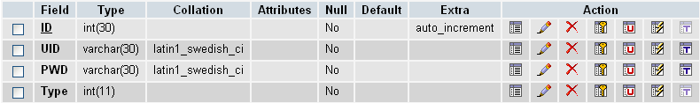
User Table

Slide 20


