Slide 1
Hospital management system
Name
Wajid Mahmood
Roll No.
MCE IT 11-49
Supervised By:
Sir Sher Jamal
Govt. Emerson College Multan

Slide 2
PROJECT TITLE
HOSPITAL MANAGEMENT SYSTEM(HMS)

Slide 3
PROJECT CONTENTS
Introduction
Problem Definition
Solution of Problems
Advantages of Computerised Hospital Management System
Entities
ER-Diagram
Challenges
Our Group Work Photos

Slide 4
Introduction
Purpose
To perform Automation of Hospital Management
The Software includes:-
Maintaining, Searching, Editing Patient/Doctors/Nurse/Receptionist/Staff Details
Room Information
Appointment
Storing Record
Billing

Slide 5
Problems in Non-Computer based Hospital Management??
Difficulties in Management
Lack of Prompt Updating
Waste of Time & Labor
Information Difficulties
Error in Manual Calculation
Preparation of Accurate & Prompt Reports

Slide 6
Advantages of HMS
Immediate Access of Data
Friendly User Interface
Time Saving
Data can be Easily Insert/Update/Delete
Reducing Paper Work
Give Facility of Different Types of Enquiry
Better Managing
Better Service

Slide 7
HMS: Entities & Entities Background
Hospital
Employee
Doctor
Nurse
Receptionist
Staff
Patient
Room
Record
Treatment
Medicine
Equipment
Bill

Slide 8
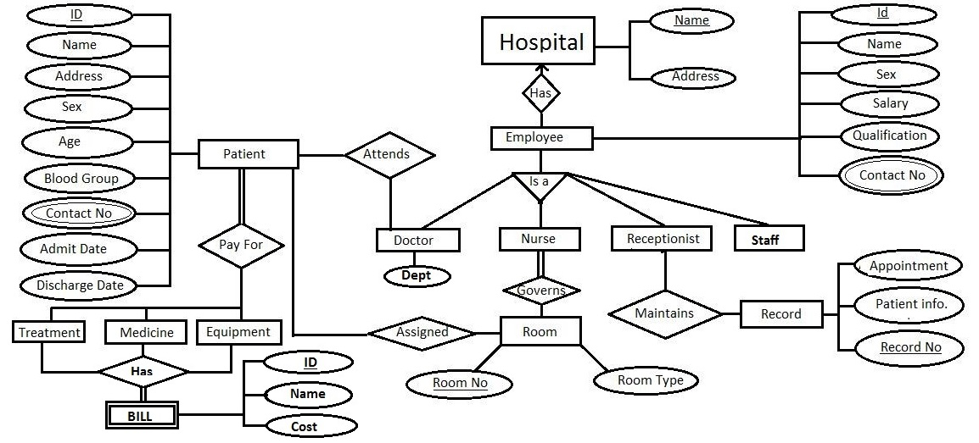
ERD for Our HMS

Slide 9
Challenges On Develop HMS:
Lack of Information
Difficulties in Data Managing
Lack of Experience

Slide 10
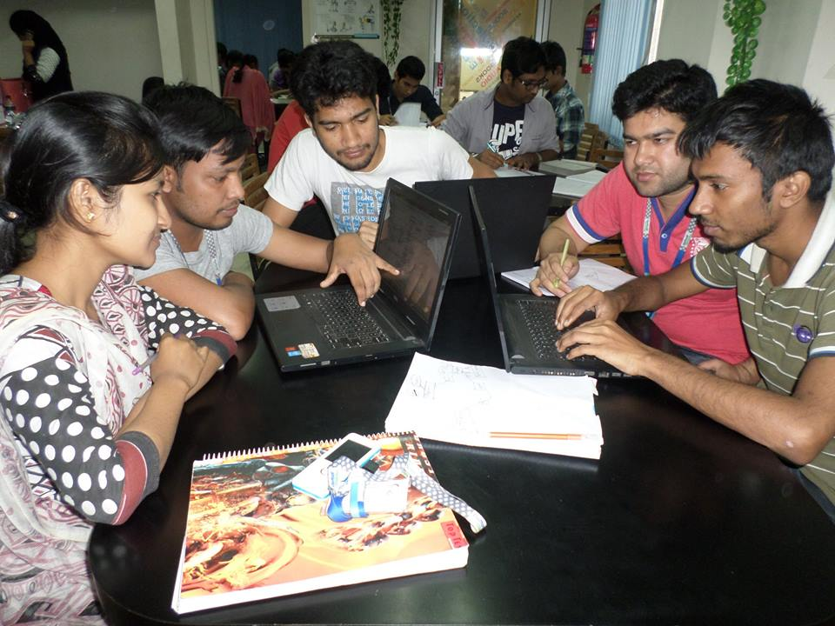
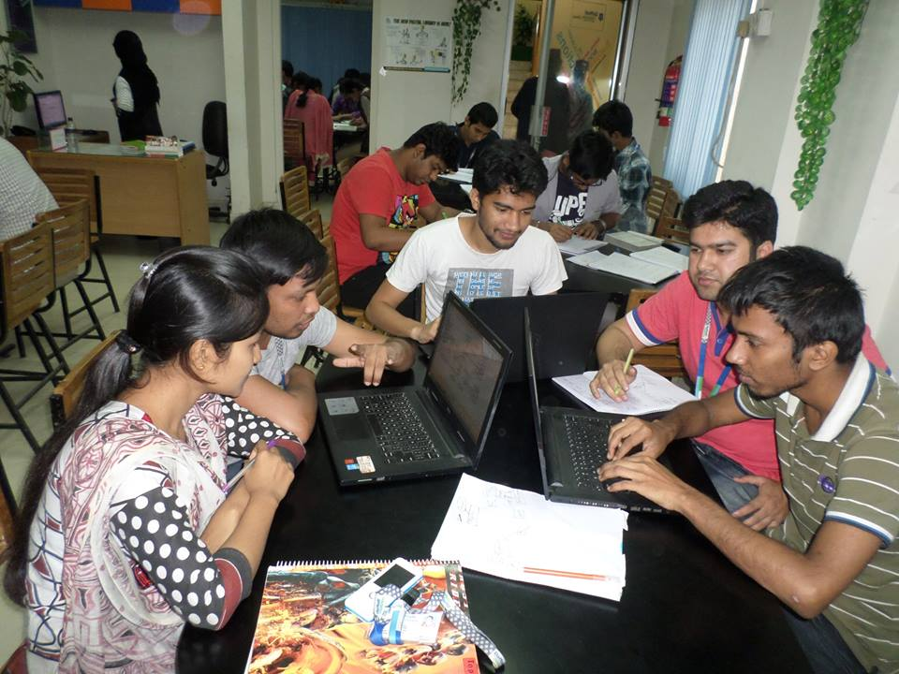
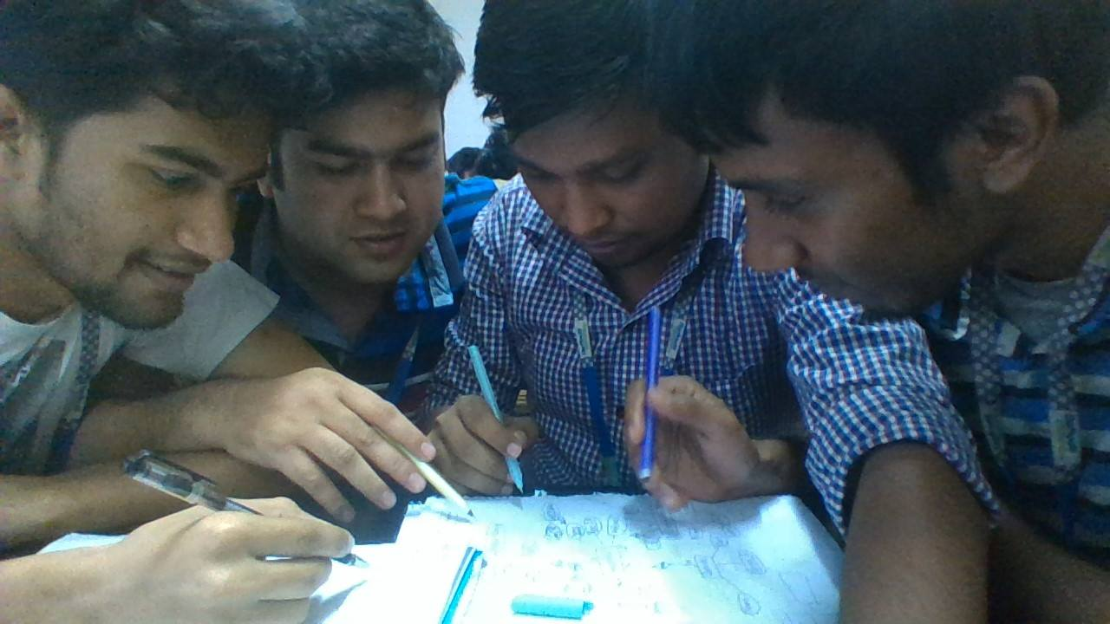
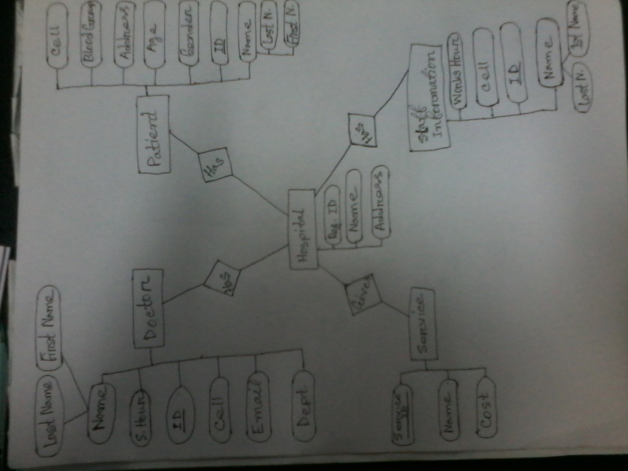
Picture of Our Group Work

Slide 11
Thanks for Here With Us

