Slide 1
Final Project
SmartShop Computer Accessories Store

Slide 2
Introduction
Submitted By :
*****************
Roll # MCEIT-11-41
****************
Supervised By:
Ma’am Qurat-ul-Ain
**************

Slide 3
Introduction to SmartShop Computer Accessories
SmartShop Computer Accessories is a web based application which helps people find and buy latest computer accessories of different varieties via internet. It is useful because it makes an easier way to browse and purchase computer accessories online.
The intend is to make a user-friendly and feature-rich website to make the online shopping convenient and fun.

Slide 4
Project goals and objectives
Goals:
To provide a user-friendly and feature rich online shopping experience to buyers.
To let admin manage and add product entries on the site easily.
To make a clean, simple interface for faster and easy access of the products (computer accessories) on the site.
To offer rich features to both admin and users with the help of useful modules.

Slide 5
Project goals and objectives
Objectives:
SmartShop Computer Accessories will offer buying accessories related to computers and tech and will help buyers have enriched experience while browsing the products on the web.
It will not only be beneficial to buyers but will also help admin to easily view, manage, modify, and update products on the web application.
Easy-to-use admin panel will offer faster way to add, delete, edit products and their details for admin.
Buyers will be able to use “add to cart” feature to conveniently shop on the website and continue browsing for more items.

Slide 6
SmartShop Computer Accessories Scope
Scope of the system
Login Module
Admin Module
Sign Up Module
Shopping Module
Add to Cart feature
Products enlisting and categories

Slide 7
Description & Drawbacks of existing system
Description of existing system :-
The traditional way of shopping for products is not only time consuming but also requires a relatively more effort. The buyer has to physically visit the store to browse and purchase products of his/her needs. Traditional payment method is also time-consuming.

Slide 8
Description & Drawbacks of existing system
Drawbacks of existing system:-
- Time Consuming - Less convenient - Somewhat tiresome - Requires physical visit to the shopping place - Chances of human errors during payment - Payment method is also less convenient - Relatively less features as compared to online shopping

Slide 9
Description of proposed system
Reduced manual work, thanks to the internet
Proposed system is convenient and easy-to-use
Saves time
Purchasing products from home
Secure payment methods
Accessible to everyone
Easy to find products as they are categorized in various categories

Slide 10
Tool Selection
Selection of the appropriate software is most crucial stage of the development phase. The choice of software tool should be done in keeping view of the problem faced in order to avoid heavy loss of time and money. Tools used for any system development are:
1. Hardware
2. Software

Slide 11
Tool Selection
Hardware:-
For the development and designing of website I used better hardware for better functioning of the operating system and faster loading of programs. Hardware system I used for the project:
Machine: Intel CORE i5 Desktop
Processor: Intel(R) Core(TM) i5-2400 CPU @ 3.1GHz
RAM 8 GB

Slide 12
Tool Selection
Software:-
Any hardware without software is seemed to be useless in this environment. So different types of software are considered for this specific purpose. Chosen ones are:
Operating System: Windows 10
Front-End tool: HTML, CSS
Back-End tool: MYSQL, PHP
Graphic Designing tool: Dreamweaver CS6
Database: MS SQL
Tools for documentation: MS Word

Slide 13
Tools Used for development
Tools and Using Reasons :-
PHP:
For making interface and coding.
My SQL:
To keep the record of buyers as well as details of the products on the site for modifying, updating, and maintaining accurate data for better experience
MS Word:
For regular thesis development and documentation in a error-free way.

Slide 14
Tools Used for development
Tools and Using Reasons :-
CSS:
For Style.
Dreamweaver CS6:
For making interfaces /front –end and admin panel.
HTML:
For front end page management.

Slide 15
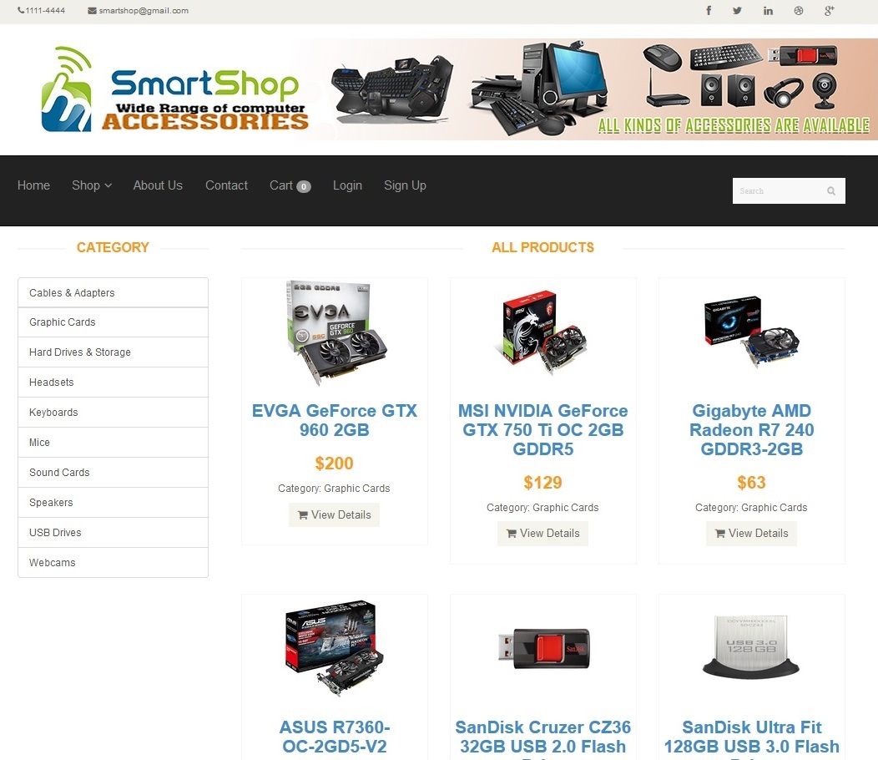
GUI (Homepage)

Slide 16
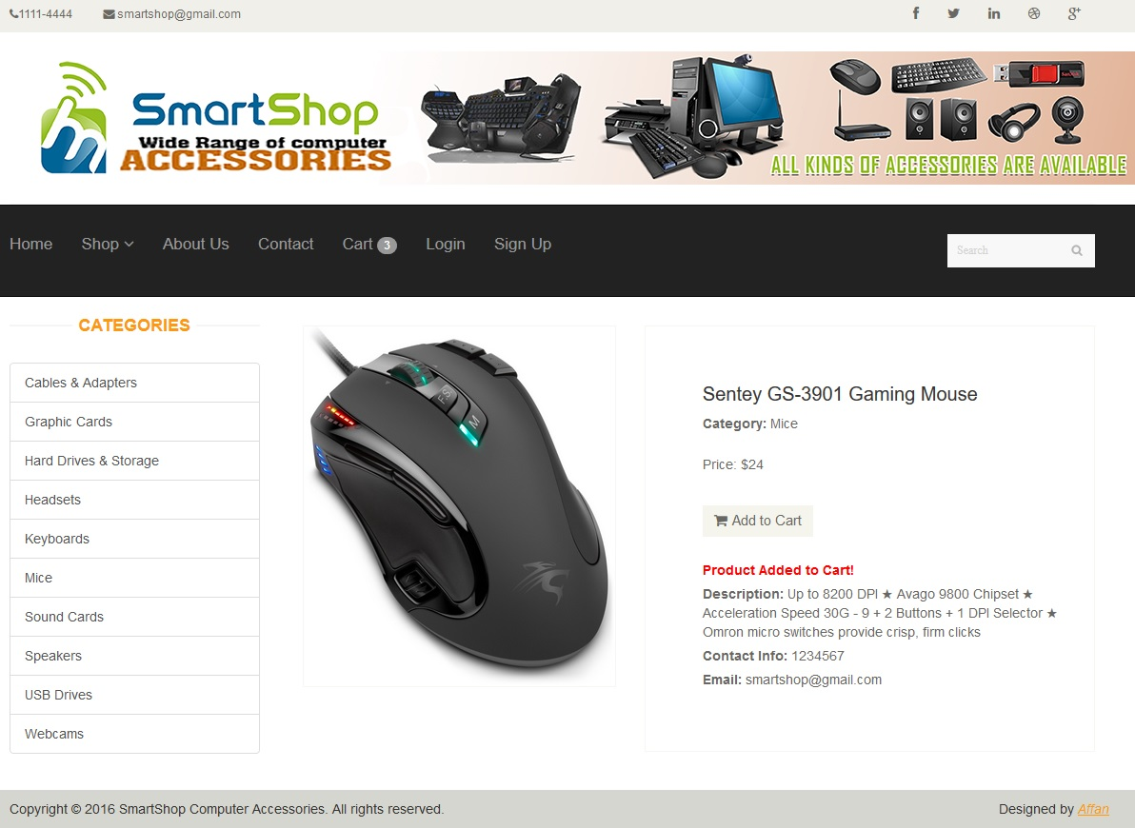
GUI (Product Details)

Slide 17
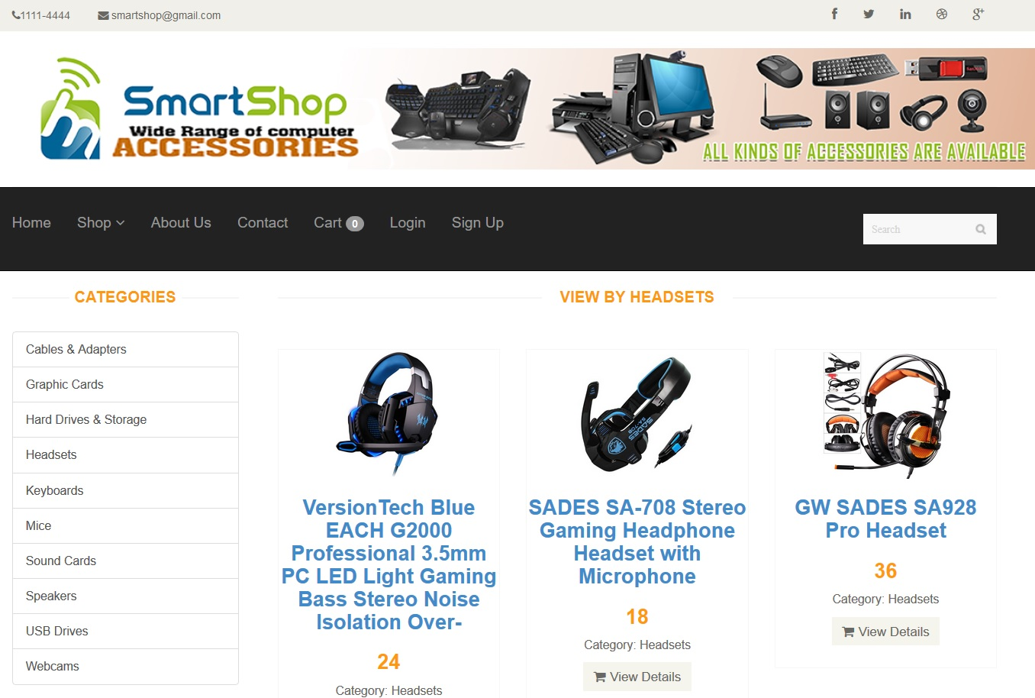
GUI (Category)

Slide 18
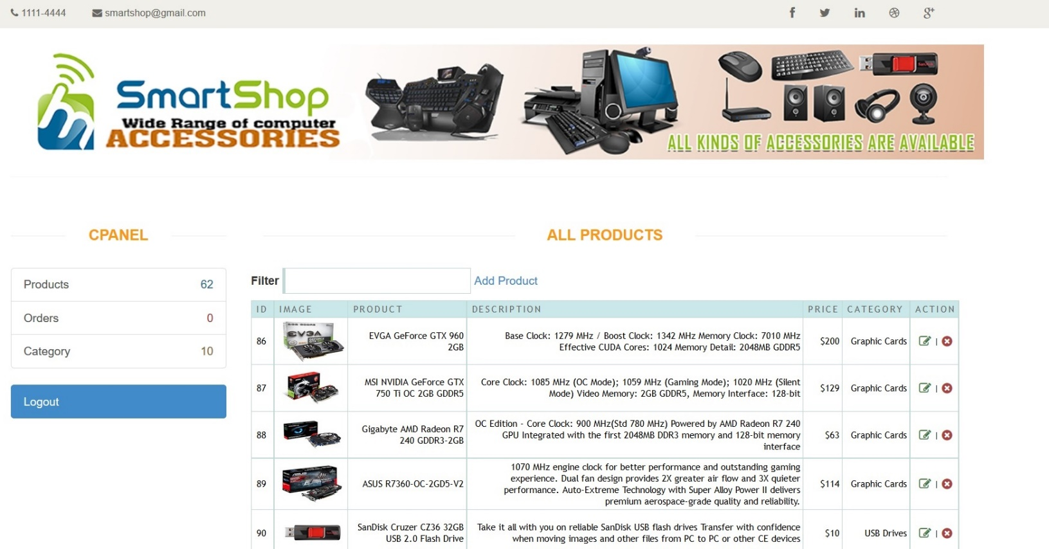
Admin Panel

Slide 19
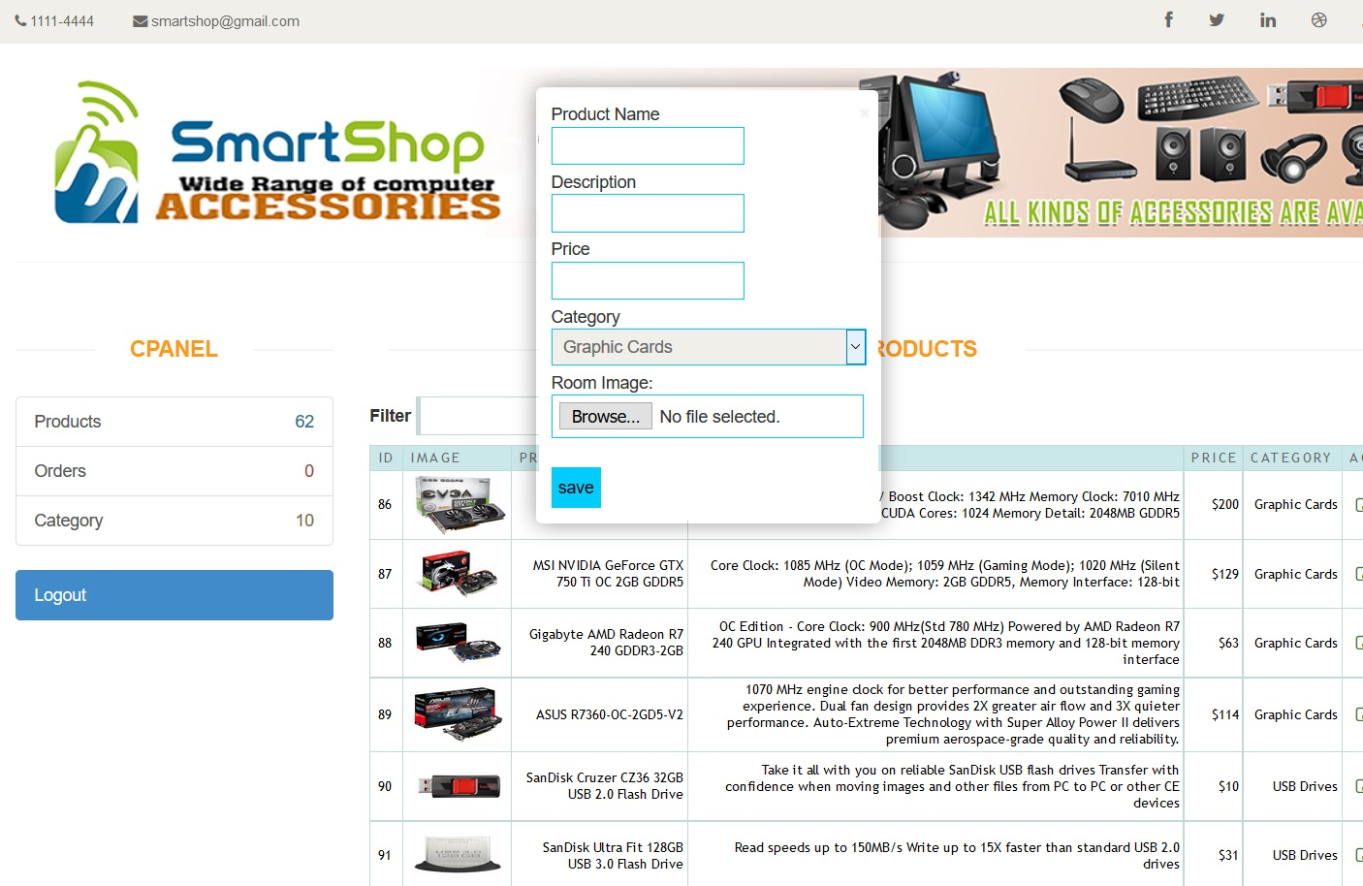
Admin Panel

Slide 20
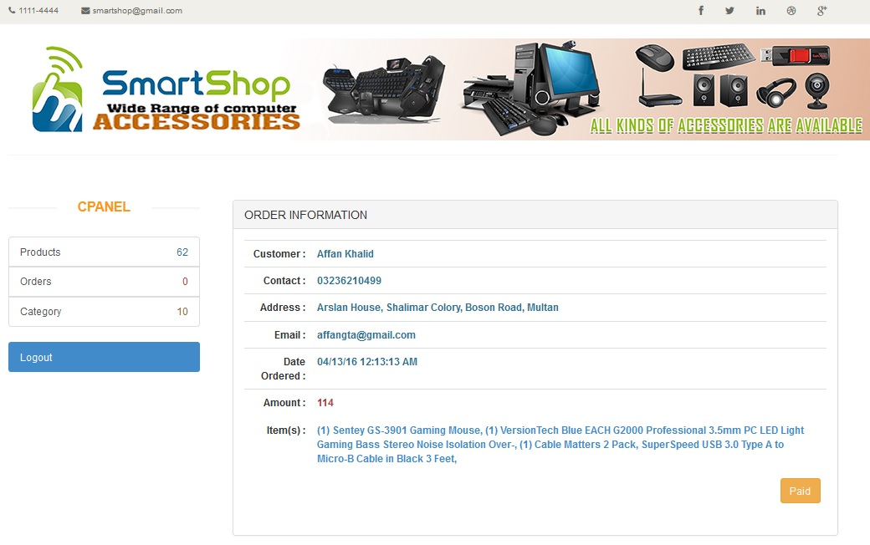
Admin Panel

Slide 21
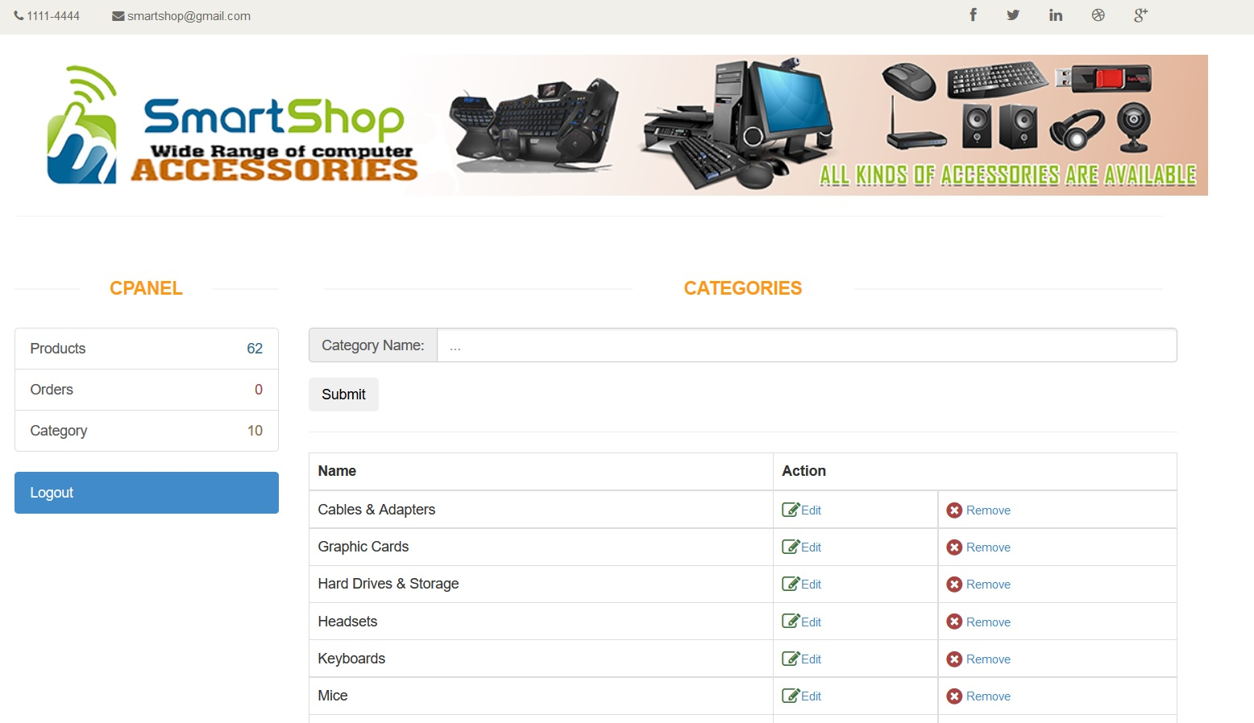
Admin Panel

Slide 22
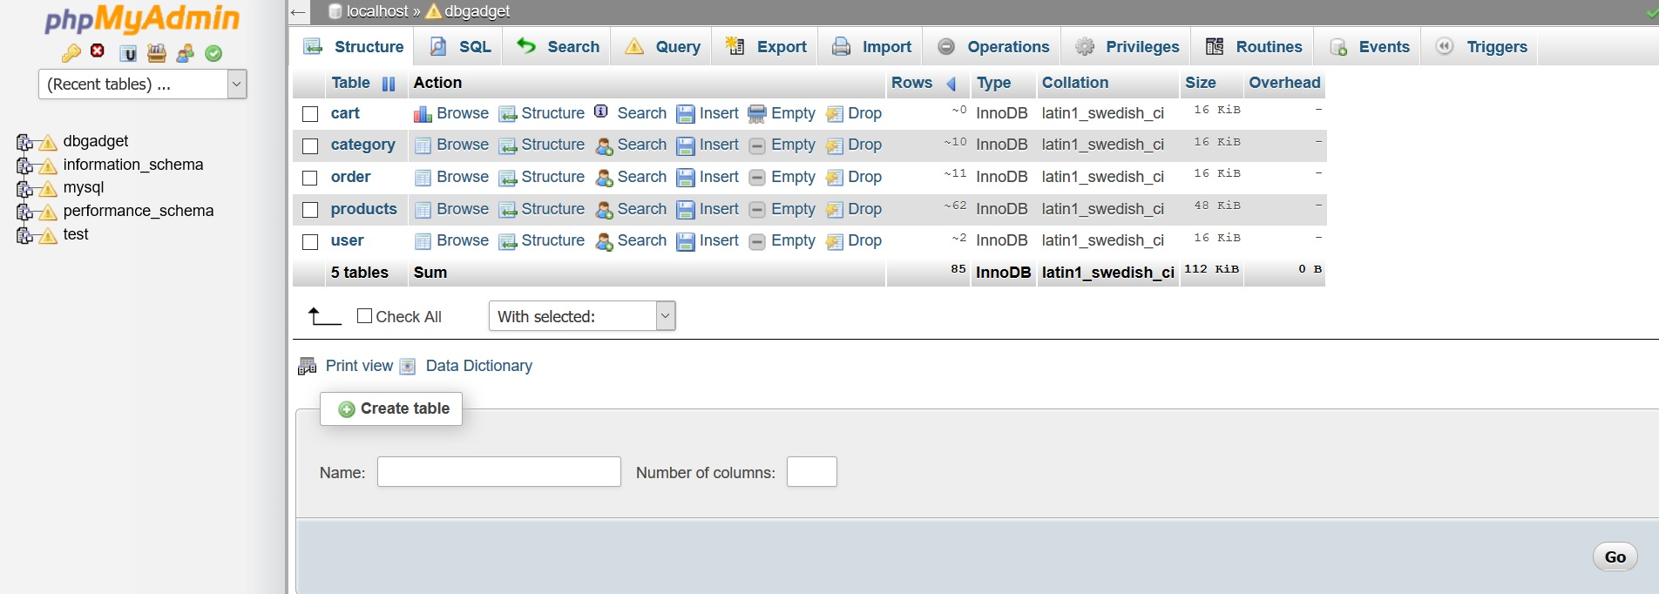
Database

Slide 23
Thank You!

