Slide 1
Bloopers: How Smart People Get Causal Inference Wrong
Bernard Black
Northwestern University
School of Law and Kellogg School of Management
Workshop on Research Design for Causal Inference
(August 1 2024)
Notes:
Himmelstein is 2011 blooper example 3
MZMA is 2011 blooper example 9
Dezhbakhsh, Rubin & Shepherd (ALER, 2003) , and Dehzbakhsh & Shepherd (2004) is 2011 blooper example 8
Lord’s paradox is 2011 blooper example 2
Comments: simplify. Do s.e.’s once
Drop DMO response to AB
Simplify DMO especially, focus on core problems
People wanted to hear about Acemoglu Johnson
Single, integrated IV discussion
Define damage caps, different types of damages
Say that won’t explain randomization iferene

Slide 2
Goals
Walk through core results from a selection of papers
Illustrate different ways that researchers reach unconvincing or simply wrong conclusions
Easy to criticize bad papers, little known and rarely cited.
My challenge is to find:
well-known, highly cited papers, often by top scholars and published in major journals, with major flaws
papers which illustrate different ways to go wrong
Sometimes the authors didn’t listen to my concerns, and published anyway :)
Much easier to criticize them
An ongoing effort, please send me your favorites!

Slide 3
Papers I’ll discuss (time permitting)
Bhagat, Sanjai and Bernard Black, The Non-Correlation Between Board Independence and Long-Term Firm Performance, 27 J Corporation Law 231-274 (2002) and Is There a Relationship Between Board Composition and Firm Performance?, 54 Business Lawyer 921-963 (1999)
Donohue, John, and Daniel Ho, The Impact of Damage Caps on Malpractice Claims: Randomization Inference with Difference-in-Differences, 4 J Empirical Legal Studies 69-102 (2007)
Kessler, Daniel and Mark McClellan (1996), Do Doctors Practice Defensive Medicine?, 111 Quarterly J Economics 353-390 (1996), and followup, Kessler, Daniel, and Mark B. McClellan, (2002), Malpractice Law and Health Care Reform: Optimal Liability Policy in an Era of Managed Care, 84 Journal of Public Economics 175-197
Gompers, Paul, Joy Ishii and Andrew Metrick, Corporate Governance and Equity Prices, 118 Quarterly J Economics 107-155 (2003)
Acemoglu, Daron, and Simon Johnson, , Unbundling Institutions, 113 J Political Economy 949-995 (2005)
New for 2023: Chan, David, Kaveh Danesh, Sydney Costantini, David Card, Lowell Taylor, and David Studdert, Mortality among US Veterans after Emergency Visits to Veterans and Other Hospitals: Retrospective Cohort Study, BMJ 2022:376:e068099, and Chen, Card and Taylor, Is There a VA Advantage? Evidence from Dually Eligible Veterans (AER forthcoming, 2023).
Dewenter, Kathryn, Xi Han and Paul Malatesta, Firm Values and Sovereign Wealth Fund Investments, 98 J Financial Economics 256-278 (2010)

Slide 4
Downloads and citations (at 2024.08.01)
Paper | SSRN downloads | Google Scholar | Web of Science
Bhagat and Black (2002), and related paper (1999) | 16,430 | 6,372 | n.a. + 418
Donohue and Ho (2007) | n.a. | 67 | n.a.
Kessler and McClellan (1996, 2002) | 209 + n.a. | 921 + 175 | 392 + 77
Gompers, Ishii Metrick (2003) | 35,006 | 11,637 | 3,607
Acemoglu and Johnson (2005) (2 of 3 version) | 1,308 | 4,814 | 1,383
Chan, Card, Taylor (2023) (2 papers) | n.a. + 15 | 14+27 | 10 + 1
Dewenter Han Malatesta (2010) (2 versions) | 1,012 | 310 | 96
Notes:
Updated to 2023 for GIM SSRN and Google

Slide 5
Poke fun at myself first
Sanjai Bhagat & Bernard Black, The Non-Correlation Between Board Independence and Long-Term Firm Performance, 27 Journal of Corporation Law 231-274 (2002) (http://ssrn.com/abstract=133808)
Well cited despite obscure placement . . .
Rejected by all three top finance journals, 2d round each time, for one of two reasons:
Everyone knows board composition doesn’t matter, so result is not new
Everyone knows board composition matters, so result must be wrong
Even if the referee can’t figure out why
JF: two reports, one took each view; editor letter on second round, reject “for the reasons cited by the referees”!?
No one saw (in hindsight, glaring) problem with our IV
Got tired of fighting with referees, placed in a law journal.

Slide 6
Core result: reverse causation
Core result: Higher board independence for large US firms predicts lower firm performance.
Which we attribute to reverse causation: Poor performance ➔ firms increase board independence.
Extra independent directors do no good (and might do harm).
Result might be right (I mostly think so)
But see Wintoki, Linck and Netter (JFE, 2012):
Same result as ours with pooled OLS
Sign flips with firm fixed effects
All results insignificant w. Arellano-Bond “GMM” instruments (a method I don’t believe)

Slide 7
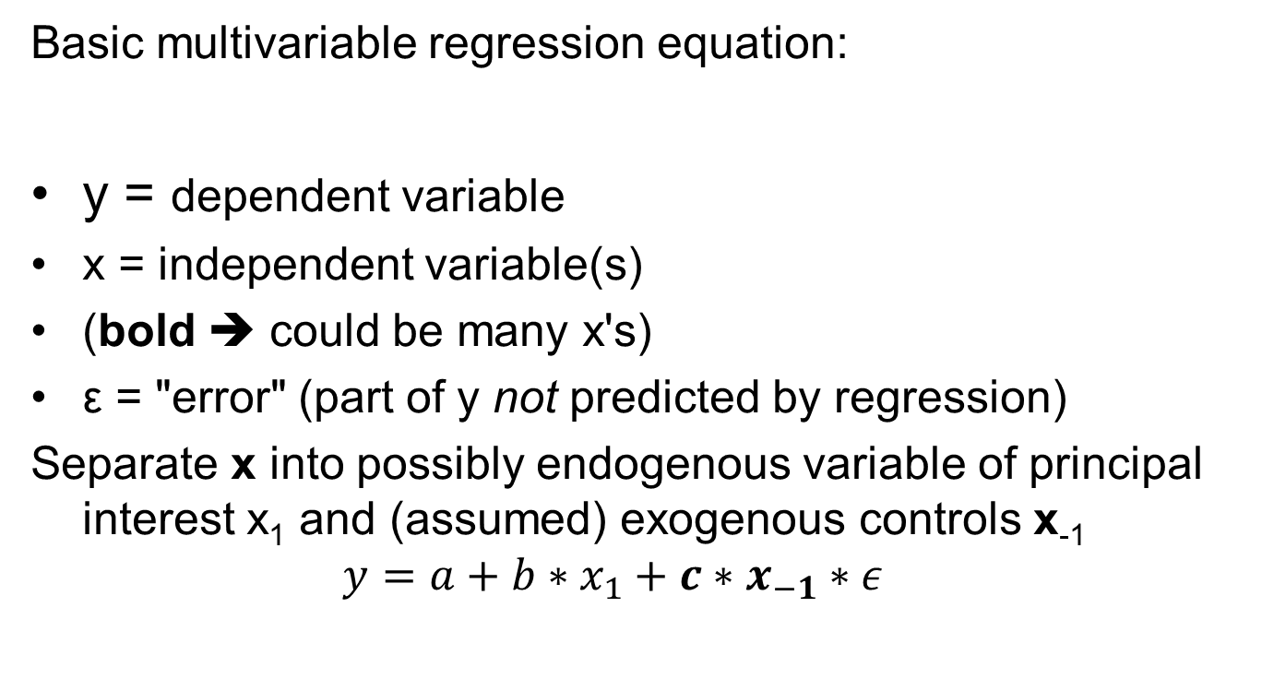
Standard Regression Setup
Basic multivariable regression equation:
y = dependent variable
x = independent variable(s)
(bold ➔ could be many x's)
ε = "error" (part of y not predicted by regression)
Separate x into possibly endogenous variable of principal interest x₁ and (assumed) exogenous controls x₋₁
$$y=a+b∗x_{1}+c∗x_{−1}∗ε$$

Slide 8
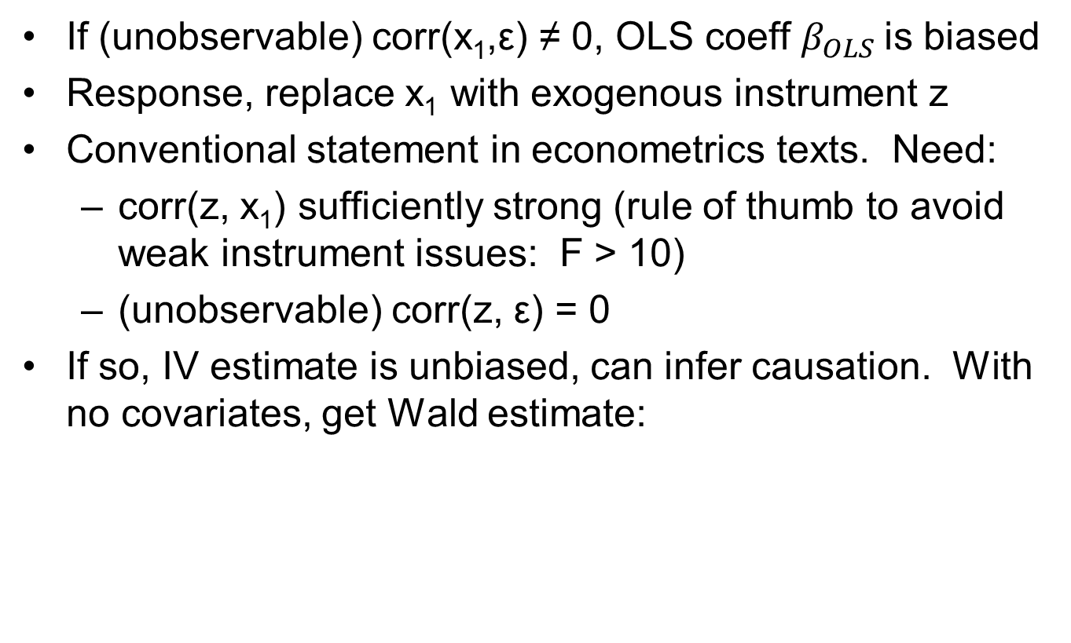
IV response to endogeneity
If (unobservable) corr(x₁,ε) ≠ 0, OLS coeff $β_{OLS}$is biased
Response, replace x₁ with exogenous instrument z
Conventional statement in econometrics texts. Need:
corr(z, x₁) sufficiently strong (rule of thumb to avoid weak instrument issues: F > 10)
(unobservable) corr(z, ε) = 0
If so, IV estimate is unbiased, can infer causation. With no covariates, get Wald estimate:

Slide 9
Board composition and firm value
From Bhagat & Black (2002)
 | Measured in early 1991
Dependent variable | INDEP (measure of board indep.) | Board size | No of 5% outside holders
mean Tobin's q, year ends 1991-1993 | -.22 (t=2.09)** | -.018 (t=1.81)* | -.067 (t=2.92)***
Tobin’s q = (market value of firm)/(book value)
[common measure of firm value]
Higher independence → lower future Tobin's q
This is “Granger causation”, which is not causation
Can we tell a non-causal story?

Slide 10
IV for board independence
Maybe past performance ➔ both future board independence and future performance
Bhagat & Black (2002) use INDEP = (fraction of indep directors) – (fraction of inside directors) as measure of board independence
INDEP does not count “middle” category of “affiliated” or “gray” directors
Authors recognize “endogeneity” risk, and use
z = (fraction of indep. directors) as IV for INDEP
What's [obviously] wrong with this?

Slide 11
Requirements for Valid Causal Instrument
A valid causal instrument z should be:
exogenous (from "outside" the regression system):
y can't cause z
no reason to think z causes y
correlated with x (hopefully strongly)
As if randomly assigned. For binary instrument:
Covariate balance between treated and controls
Common support for covariates
Only through condition (“exclusion restriction”): z predicts y only through x
not directly -- not (partially) correlated with y
not indirectly through (or mediated by) another variable:
whether included in the x's or not!

Slide 12
Black and Bhagat: Silly instrument
“Only through” depends on logic, not algebra
If corr (INDEP,ε) ≠ 0, corr (z,ε) likely ≠ 0 too.
So why did we use it?
Fooled by the traditional approach to IV
Me to Sanjai: “Why should we think corr (z,ε) = 0? Reply: We can’t measure ε
Maybe uncorrelated with z, who knows
May as well try it
Perhaps good idea if concern was measurement error

Slide 13
Example 2: Wrong “Science”
Poke fun at a friend (and good empiricist) next
John Donohue and Daniel Ho, The Impact of Damage Caps on Malpractice Claims: Randomization Inference with Difference-in-Differences, 4 JELS 69-102 (2007)
Research question: States adopt damage caps to limit medical malpractice lawsuits. Do they succeed?
Abstract: We use DID to assess the impact of damage caps on medical malpractice claims for states adopting caps between 1991–2004. Conventional DID estimators exhibit acute model sensitivity. As a solution, we offer (nonparametric) covariance-adjusted randomization inference. We find no evidence that caps affect the number of malpractice claims against physicians.

Slide 14
Mostly a methods paper
I (mostly) like the method
First paper to apply randomization inference to DiD
But they picked a bad example . . .

Slide 15
Donohue-Ho sample of state reforms
Caps on non-economic damages ($250-500k):
MI 1993
MS 2003
MT 1995
OK 2003
Punitive damages caps (rules vary):
AR 2003
NJ 1995
NC 1996
OK 1995
n = 8

Slide 16
Are these all “apples”
Paid damages as % of total in tried cases (Black Hyman Silver 2009)
Economic damages 58%
Noneconomic damages 40%
Punitive damages 2%
If similar for settled cases:
Non-econ cap hits 40% of damages
Punitives cap hits 2%
What’s the [big, obvious] problem?

Slide 17
SUTVA (Stable Unit Treatment Value Assumption)
Requires two things
Noninterference between units
All treatments are the same (or close)
Unless you model different levels
Different non-econ caps might be different types of apples
But here:
Non-econ caps are a real treatment
Punitive caps are close to placebos
So only 4/8 reforms are true reforms . . .
But there is more . . .

Slide 18
Next problem: lagged treatment effect
Dataset: NPDB (National Practitioner Data Bank)
Closed paid malpractice claims against physicians
Most claims take years to close
In TX (where we can measure this), 4% of claims closed in 2004 are post the 9/1/2003 cap adoption
Two of the four non-econ caps were adopted 2003
For a study ending in 2004, that’s a placebo too.
Of 8 reform events, 6 are placebo, 2 are true events.
Null result = no surprise
[They also missed two states that adopted non-econ caps in 2003: FL and TX]

Slide 19
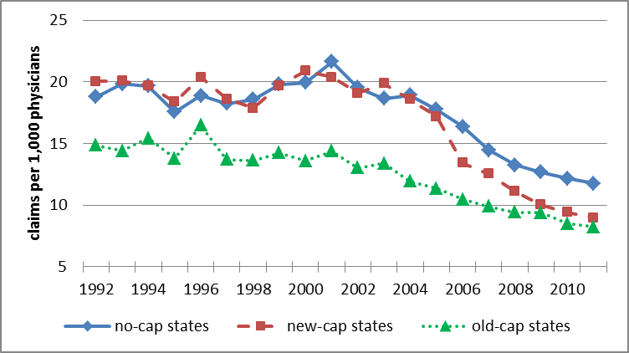
Evidence from Third Med Mal Reform Wave
Large Paid Claims per 1,000 physicians
Lines for No-Cap, New-Cap, and Old-Cap States
Source: Paik, Black and Hyman (JELS 2013a)

Slide 20
Done right, strong DiD results
Dep. variable | Ln(large paid claims/1,000 physicians)
Based on | closing year |  | injury year (closed by t + 4)
Control states | No-cap | No- & old-cap | No-cap | No- & old-cap
Post-reform period | -0.352 | -0.314 | -0.409 | -0.372
 | [2.79]*** | [2.51]** | [4.70]*** | [4.44]***
Ln(no. of physicians) | -1.790 | -0.652 | -3.368 | -2.037
 | [1.94]* | [0.74] | [3.50]*** | [2.22]**
Ln(population) | 1.791 | 0.493 | 2.628 | 1.303
 | [1.59] | [0.45] | [2.58]** | [1.29]
Fixed effects | year, state | year, state | year, state | year, state
No of claims | 139,947 | 197,979 | 59,279 | 89,258
Obs (states) | 672 (32) | 1,071 (51) | 576 (32) | 918 (51)
“post-reform period” variable allows for reform phase-in
Source: Paik, Black and Hyman (JELS 2013b)

Slide 21
And: randomization inference won’t work!
Smaller states have more “noise”
Year-to-year bounce in claim rates
Randomization inference assumes noise is same in all states (both treated and controls)
Reform states are mostly big (lower noise)
Subtle problem
Can still do sign-based randomization inference w. multiple outcomes (not present here): Zabinski and Black, J Health Econ 2022)
The “blooper” is getting the science wrong

Slide 22
Example 3: Omitted variable bias and clustering
Daniel Kessler & Mark McClellan (1996), Do Doctors Practice Defensive Medicine?, 111 Quarterly Journal of Economics 353-390 (1996).
Important early paper on “defensive medicine”
DiD design using state tort law reforms [new design at the time]
Sample: ~15 states adopt reforms during mid-1980s
But SUTVA? {reforms are bundled, differ in cap level, other details)
“Direct” reforms (damages cap, limit prejudgment interest, collateral source) ➔ 5-9% lower hospital spending on heart attack patients, no change in outcomes. Medicare data: age 65+
“Other” reforms predict 2-3% higher spending: contingent fee limits; pay damages over time; limit joint and several liability.
No theory for that → what else is going on?

Slide 23
Followup study
[same authors], Malpractice Law and Health Care Reform: Optimal Liability Policy in an Era of Managed Care, 84 Journal of Public Economics 175-97 (2002)
Linear control for “managed care” penetration
Might affect “fee for service” provider behavior, and thus spending
Longer time period
4-5% lower spending (highly statistically significant)
But still highly significant (σ = 0.2; t ~ 20)

Slide 24
CBO followup (2006)
CBO (2006) [attempt to replicate, over 1981-2000]
Total state health spending, no effect of tort reforms
Medicare spending:
4% drop (σ=1.4)***, driven by lower hospital spending
Cluster standard errors on state
But: states with 1980s reforms had above-average hospital spending [maybe just happenstance]
Control for 1983 Medicare payment reforms, which disproportionately hit hospitals in high-cost states
Coefficient falls, becomes insignificant: -1.6% (σ = 1.4)

Slide 25
Getting standard errors right
Didn’t cluster their standard errors
Clustering not common then
Standard today, since Bertrand, Duflo and Mullainathan (QJE, 2004)
Lots of papers with bad standard errors
Main concern, non-independent observations
Example, panel data, observations of same unit over time are often correlated
Unit fixed effects don’t solve s.e. issue
Paik, Black and Hyman (2016) quasi-replication
Cluster on state → s.e.’s rise by factor of 8-10!

Slide 26
Paik Black Hyman Quasi-replication
County level spending (vs. patient level in K&M)
Dependent variable |  | Ln(Medicare spending per enrollee)
Regression type |  | County and year FE, enrollee weights
managed care penetration variable |  | No | Linear | Quadratic | Quadratic
1984-or-after * state dummies |  | No | No | No | Yes
Total Spending
Our sample: 1980-1994 | post-cap dummy | -0.055 | -0.041 | -0.025 | -0.011
 | s.e. (clustered) | [0.020]*** | [0.019]** | [0.018] | [0.018]
 | s.e. (ordinary) | [0.002]*** | [0.002]*** | [0.002]*** | [0.002]***
Part A Spending (Hospital)
Our sample: 1980-1994 | post-cap dummy | -0.053 | -0.042 | -0.031 | -0.009
 | s.e. (clustered) | [0.022]** | [0.022]* | [0.022] | [0.023]

Slide 27
Concerns with any “natural” experiment
(1) Is the treatment really “exogenous”?
Unrelated to “potential outcomes”
Not directly testable
(2) Is treatment (even by chance) correlated with omitted variable that predicts y. Here, reform correlates with:
(i) managed care penetration
(ii) higher hospital spending plus [exogenous] Medicare pricing change
Risk of chance correlation higher with small n_{t}
(3) Would trends have been parallel without the shock?
Testable in the pre-treatment period
Not done (leads-and-lags graphs not invented yet)

Slide 28
From Paik Black & Hyman quasi-replication
Leads and lags regression
Pre-treatment trends are not parallel.
Ocular test, long pre-treatment period

Slide 29
Some worry signs for small-n DiD
Small n_{c}, smaller n_{t}
variation within “reforms”: SUTVA problem
K&M find spending drop for minor interventions:
Collateral source reform
Limit on prejudgment interest
Spending rise for other anti-med-mal reforms
Sensitive to observed covariates
Managed care penetration, in second study
→ possibly sensitive to unobservables

Slide 30
Example 4: Wrong Standard Errors
Gompers, Paul, Joy Ishii & Andrew Metrick, Corporate Governance and Equity Prices, 118 Quarterly Journal of Economics 107-155 (2003).
Highly cited, > 11,000 cites on SSRN.
“G” index, for governance
Really an index of takeover defenses
High G = more defenses (“worse” governance)
Panel data: outcomes are share price returns, Tobin’s q, profitability, other firm financial characteristics.
Outcomes and G index : highly persistent, within firm across time

Slide 31
Fama-MacBeth regressions
GIM run annual “Fama-MacBeth” regressions of outcomes on G
Average annual estimates across years
Report “time series standard errors”
Assumes independence across years
Appropriate for stock returns
For which Fama-Macbeth was developed
. In efficient market, ret_{i,t} does not predict ret_{i,t+1}
Not appropriate for Tobin’s q, other outcomes
Independence is strongly violated for each firm, and thus for average across firms.

Slide 32
Selected GIM results
Coefficient on G (governance index)
 | Profit Margin | Sales Growth | Capex/Assets
1991 | -0.70* | -2.30 | 1.32***
1992 | -0.58 | -1.43 | 0.42
1993 | -0.76 | -3.35** | 0.81**
1994 | -0.83* | -2.71* | 0.51**
. . .
Mean | -0.64*** (t = 4.92) | -1.68*** (t = 4.54) | 0.62*** (t = 4.77)
Magic! Weak annual results, but very high t-stats for means

Slide 33
Why did Authors Make an Obvious Error?
Me to [one author], ~ 2002, after reading working paper:
I don’t see how you can use Fama-MacBeth regressions. Don’t they assume independent observations over time?
A: Yes
Me: But they’re not independent
A: I know, but everyone uses Fama-MacBeth this way
Why did referee not catch?
Econ journal, Fama-MacBeth is finance method
Sounds fancy, well-known method, Fama is top guy
Developed for stock price reactions; works there
Today, we would cluster on firm

Slide 34
Peterson on standard errors
Mitchell Peterson, Estimating Standard Errors in Finance Panel Data Sets: Comparing Approaches, 22 Review of Financial Studies 435-480 (2009):
Recent finance papers in major journals using panel data:
42% used pooled OLS [did not adjust standard errors for possible dependence in the residuals].
Among the rest: 34% used Fama-MacBeth; 29% used fixed effects; 7% used Newey-West; 23% reported clustered standard errors.
Petersen has 12,653 cites on Google Scholar
Methodically demolishes everything but fixed effects plus clustering on firm.
Implication: “Everyone does it” is not a good reason for ignoring known problems

Slide 35
Example 5: Instrument for what?
Daron Acemoglu & Simon Johnson, Unbundling Institutions, 113 Journal of Political Economy 949-995 (2005)
Abstract: This paper evaluates “property rights institutions,” which protect citizens against expropriation by the government and powerful elites, and “contracting institutions,” which enable private contracts between citizens [using separate IVs for each]. We find that property rights institutions have a first-order effect on long-run economic growth, investment, and financial development. Contracting institutions appear to matter only for the form of financial intermediation.
Central approach:
Colonial legal origin (common or civil law) ➔ IV for contract rights
Settler mortality ➔ IV for property rights
Acemoglu, Johnson & Robinson (AER, 2001) develop settler mortality instrument in earlier work. Very creative idea.
But is “only through” satisfied?
This example involves a follow-on paper

Slide 36
Do the dual instruments work?
Authors argue:
legal origin ~ contract rights, not property rights
settler mortality ~ property rights, not contract rights
Lawyers’ view (Columbia Law workshop 2003): Huh? Why?
Hardest step for valid IV: Only through condition:
z predicts y only through x
Not directly
Not through another omitted variable
➔ Settler mortality predicts (long run) economic growth only thru property rights [not contract rights or anything else]
➔ Legal origin (civil or common law) predicts economic growth only thru contract rights [not property rights or anything else]
What other channels are possible?

Slide 37
Through What Channel?
For settler mortality instrument, AJR speculate:
If settlers died, they installed extractive institutions
If they lived, they installed pro-growth institutions
They therefore use IV
Settler mortality as instrument for institutions
Let’s accept exogeneity (looks pretty good . . .)
They need:
Only through condition
Good proxy for current institutions
To use as their instrumented variable
Let’s look at each

Slide 38
AJR (2001) and Only Through
What other channels can you think of?
Past mortality of settlers
~ past mortality of locals
current disease burden
~ continent
~ latitude
AJR: “estimates change remarkably little when we include controls for main colonizer, legal origin, climate, religion, geography, natural resources, soil quality, ethnolinguistic fragmentation, current disease env’t, current fraction of European descent”

Slide 39
Good Proxy for Institutions?
Glaeser, Edward L., Rafael La Porta, Florencio Lopez-de-Silanes, and Andrei Shleifer (2004), Do Institutions Cause Growth?, 9 Journal of Economic Growth 271-303.
We show that [risk of expropriation, the proxy used by AJR] by construction does not describe political institutions; [it is an] outcome measure that reflects the government’s past restraint from expropriation.

Slide 40
Another channel: Settler Human Capital
Glaeser et al. (2004) again:
[T]he Europeans who settled in the New World brought with them not so much their institutions, but themselves, their human capital. . . . [T]he instruments used in [AJR and other] literature for institutions are even more highly correlated with human capital both today and in 1900.
Basic OLS results, as well as a variety of additional evidence, suggest that (a) human capital is a more basic source of growth than institutions, (b) poor countries get out of poverty through good policies, often pursued by dictators, and (c) subsequently improve their political institutions.

Slide 41
And a data problem too
David Albouy (AER 2012): Multiple data criticisms, here is one:
Out of 64 countries in the sample, only 28 countries have mortality rates that originate from within their own borders. The other 36 countries in the sample are assigned rates based on conjectures the authors make as to which countries have similar disease environments. . . . Six assignments are based on an incorrect interpretation of former colonial names for Mali. Another 16 assignments are extrapolated from thin bishop mortality data in Latin America from Gutierrez (1986), using a “benchmarking” procedure that can produce highly [variable results], depending on how the data are benchmarked.

Slide 42
What Can We Learn from 2005 paper?
Controlling for [a bad measure of] settler mortality, legal origin does not predict [a measure of] property rights or economic growth
Controlling for legal origin, [a bad measure of] settler mortality does not predict [a measure of] contract rights, but does predict economic growth
That’s interesting. It might tell us something about the relative importance of property and contract rights.

Slide 43
Example 6: Is Assignment Random?
Chen, David, Kaveh Danesh, Sydney Costantini, David Card, Lowell Taylor, and David Studdert, Mortality among US Veterans after Emergency Visits to Veterans and Other Hospitals: Retrospective Cohort Study, BMJ 2022:376:e068099, and
Chen, Card and Taylor, Is There a VA Advamtage? Evidence from Dually Eligible Veterans (Amer. Econ. Rev. 2023).
Study veterans aged 65+, brought to ED by ambulance
Can go to VA hospital or regular hospital
20% lower adjusted 30-day mortality if taken to VA hospital
9.32/100 for VA patients vs 11.67 for non VA
Lots of patient-level covariates, Including comorbidities, from Medicare claims data
46% IV estimate
Astonishing results, can they be true?

Slide 44
Causal inference (identification) assumption
(Conditioned on covariates), which hospital you went to is randomly assigned
Estimate almost the same without covariates
As it should be if hospital is randomly assigned
Who chooses the destination?
Patient?
Ambulance driver?

Slide 45
If the patient chooses
Will the patient choose at random?
Unlikely
Common knowledge (in ED community): Sicker patients choose non-VA hospitals
Are they simply wrong?
Or are there differences in hospital quality that the patients know about?
Ambulance drivers know this too.
Chan is a hospitalist, not an ED doc
Must not have asked ED docs about his results
Or not believed them when they told him the result was impossible (as several have told me)

Slide 46
If arrive by ambulance
Can patient tell the driver where to go?
Often yes, depends on local rules
If yes, back to sicker patients choosing non-VA hospitals
If the driver decides, how?
Closest hospital
Closest hospital that can handle this patient’s problem?
Better hospital, in driver’s judgment?

Slide 47
Nothing about this in BMJ

Slide 48
Assumed away for AER
BMJ: “the emergency nature of their visit [and arrival by ambulance] . . . reduced the potential for self-selection” into one hospital type or the other
AER: Instrumental variable (IV) analysis
Take ambulance IV from prior paper (Doyle et al.)
Only through condition is assumed
Cannot be proven, but need to argue for plausibility
Taken by ambulance
Some ambulance companies take more patients to VA
Assume: patient does not choose ambulance company
IV is propensity of particular ambulance company to take VA-eligible patients to VA

Slide 49
IV estimate driven by outliers
Results driven by bottom and top outliers?
Meaningfully negative slope if remove them?
For sure, IV results insignificant at 5% [barely significant to begin with]

Slide 50
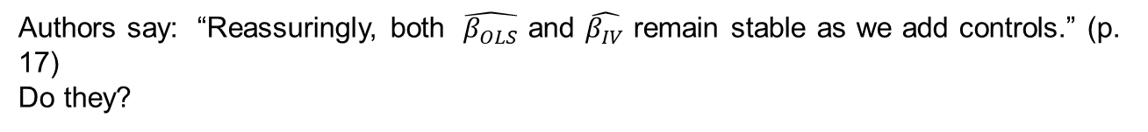
IV Estimate Shrinks as Add Controls
Authors say: “Reassuringly, both $\hat{β_{OLS}}$ and $\hat{β_{IV}}$ remain stable as we add controls.” (p. 17)
Do they?

Slide 51
Data limitations
Medicare Part B data for ambulance rides
Linked to mortality records (but not cause of death)
Know past history prior year (outpatient, ED, inpatient)
No VA data. Such as:
Was patient admitted to hospital
ED diagnosis
Hospital diagnosis if admitted
Prior diagnoses
So don’t even know how much of effect came from patients admitted from ED
Versus patients sent home (not that sick)

Slide 52
I work with ED docs
On a series of projects.
I asked them, “I know the result is impossible, tell me why”?
Response: result is silly
VA hospitals are basic, not fancy
Not trauma center
Not specialty hospital that can handle other serious events (heart attack, stroke)
Patients and ambulance drivers know this
They take sicker patients to tertiary hospitals

Slide 53
Planned quasi-replication
Data from Milwaukee County
20 years of ambulance ride data
Link to VA records (hospital, outpatient)
Link to Medicare records (thus, mortality too)
National data: Medicare (like theirs)
Hopefully: link to national VA data
With pre-analysis plan . . .
Results to come
An opportunity to blow up a paper in AER by a Nobel-prize winning economist was too good to pass up

Slide 54
Example 7: What Effect You Are Estimating?
Dewenter, Kathryn, Xi Han and Paul Malatesta, Firm Values and Sovereign Wealth Fund Investments, 98 Journal of Financial Economics 256-278 (2010)
Abstract: We analyze the impact of Sovereign Wealth Fund (SWF) investments on firm values . . . The data show significant positive (negative) returns to announcements of SWF investments (divestments). The returns are non-monotonic, first rising (falling) and then falling (rising) with the share bought (sold) for investments (divestments).

Slide 55
(selected) Black comments
From audience at 2009 conference
As discussant in 2010 (paper hadn’t changed)
Dataset is 70% Singapore for acquisitions (158/227) and 90% Norway and Singapore for divestitures (43/47).
Acquisitions: Case study of Singapore, mostly Temasek investment fund. Small non-corrupt country.
Positive 5-year returns driven entirely by Temasek investing outside Singapore. No reason to think this will generalize to other SWFs.
Divestitures: Case study of Singapore and Norway: two small, non-corrupt countries.
Zero returns to Norway, negative for Singapore. Leaves me with no prediction for country number 3, even if small and non-corrupt
You have a case study of Singapore and Norway

Slide 56
Standard error problems too
Black comments continued
Investments by fund X are not independent.
Effective sample for acquisitions is 4 funds with 10+ acquisitions
Effective sample for divestments is 2 funds (Singapore, Norway).
Already stretching significance, by boldfacing 10% results; norm is 5%.
If cluster on SWF (as you should), and then bootstrap your s.e.’s (as you must with so few clusters) little will survive.

Slide 57
Authors’ main reply (paraphrased)
Paper was just accepted by Journal of Financial Economics
So we ain’t gonna change it now
My view: That a referee at a top journal accepted your approach is not a better reason than “everyone does it”
Especially when you knew the issues [from my 2009 comments]
Can understand as “construct validity” problem:
Authors assume: All SWFs are the same

Slide 58
Wrapup
Some bad approaches/justifications to research design:
I get stronger results this way
Everyone does it this way
Referee accepted this, what’s your problem?
Don’t (deeply) understand the “science”
Too few robustness checks
Getting standard errors wrong
Missing covariates/covariate imbalance
Implausible magnitude of results: Chan and also Sommers, Baicker and Long, AIM 2014; Miller, Johnson, Wherry (QJE 2021), Goldin, Lurie, McCubbin (QJE 2021), reanalysis by Kaestner (2016, 2022), blooper 8 if I had time
Define treatment and control groups to support desired outcome [McWilliams, Zazlavsky, Meara, Ayanian (Health Affairs 2004)] [blooper 9 if had time]
Good design is hard . . .

