Slide 1
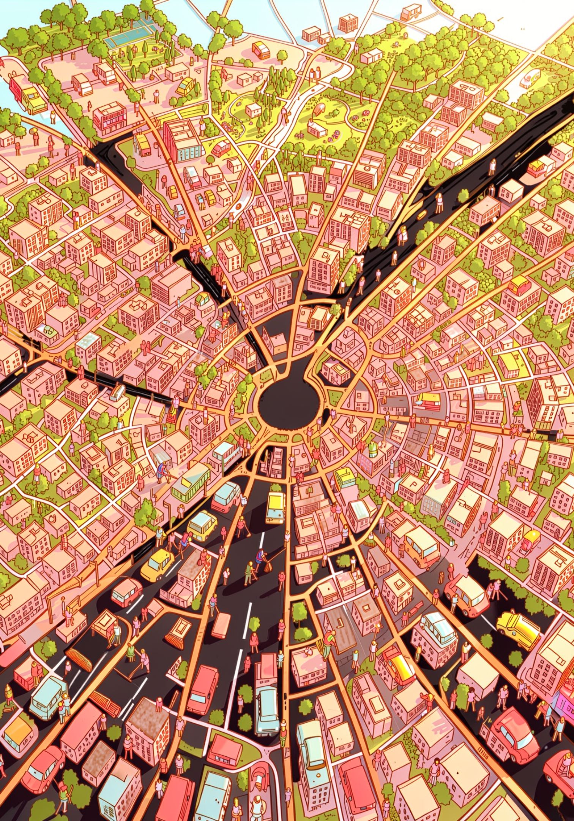
GIS-Based Smart Sanitation Monitoring System for Ramagundam Municipal Corporation
Ramagundam Municipal Corporation — a digital solution for real-time monitoring of road cleaning, garbage vulnerable points, SBM toilets, and parks maintenance using GIS, mobile capture, and centralized dashboards. Designed for municipal officials, engineers, sanitary inspectors, and field staff to increase transparency, speed verification, and improve operational efficiency.

Slide 2
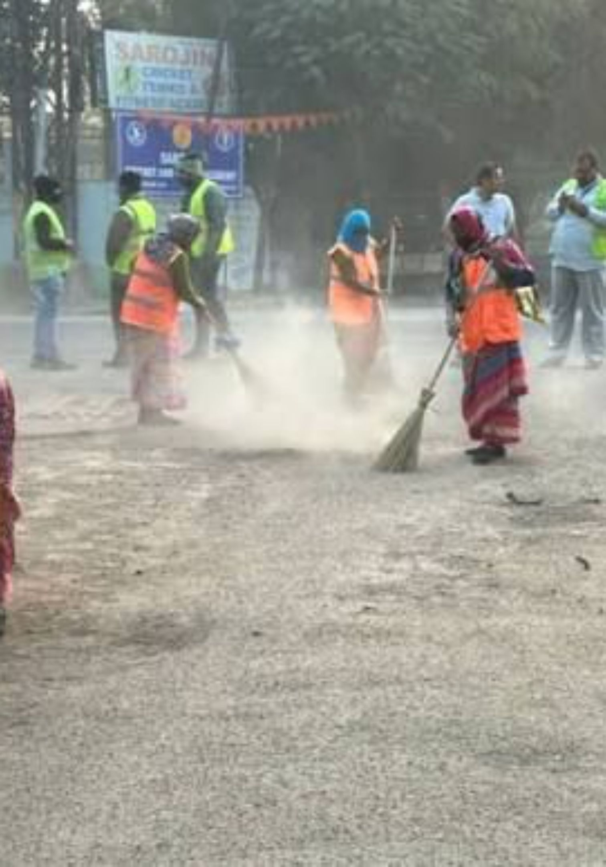
Problems in the Existing Manual Monitoring System
Current manual monitoring relies on field inspections and paper records, causing delays, incomplete coverage, and weak accountability across sanitation assets. These constraints limit rapid decision-making and make historical recordkeeping difficult.
1
2
Operational Burden
Reporting Delays
Managing roads, garbage vulnerable points, SBM toilets, and parks through manual inspections is time-consuming and manpower-intensive.
Paper-based workflows across sanitation categories cause late updates and slow verification.
3
4
Limited Visibility
Accountability Gaps
No unified view across all sanitation assets and divisions; supervisors lack a single source of truth.
Difficulty tracking completion across multiple asset types and maintaining auditable digital records.

Slide 3
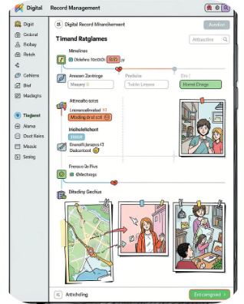
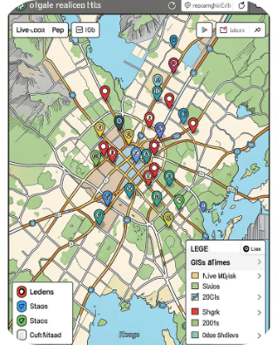

Proposed Smart Monitoring Solution
Transform manual inspection into a secure, GIS-enabled mobile workflow across all sanitation assets. Field staff capture geo-tagged photos after completing work on roads, garbage vulnerable points, SBM toilets, and parks; supervisors and commissioners monitor progress via centralized dashboards for timely verification and informed decisions.
Digital Records & Traceability
Real-time GIS Visualization
Faster Verification
Every road, garbage vulnerable point, SBM toilet, and park update is stored with GPS, timestamp, and photo for audit and historical analytics.
Color-coded asset layers provide instant insight into pending, awaiting verification, and verified work across roads, garbage vulnerable points, SBM toilets, and parks.
Supervisors validate submissions quickly from the portal, reducing turnaround time for approvals across all monitored asset types.

Slide 4
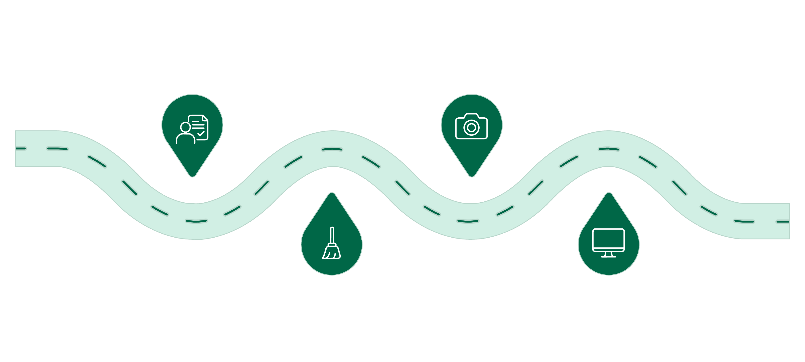
Assign Task
Upload Photo
Dispatch Jawan with task type (road/garbage point/toilet/park) and metadata
Geo-tagged photo with GPS, timestamp, and asset type
Review & Monitor
Complete Work
Jawan performs assigned sanitation work and records job
Supervisor approves; GIS and dashboard updated for all asset categories
The diagram captures the full operational flow from assignment to city-level monitoring. The system tracks all four sanitation asset types—road, garbage point, toilet, and park—while storing metadata such as GPS, timestamp, worker ID, photo, and asset type to support verification, escalation, and reporting.

Slide 5
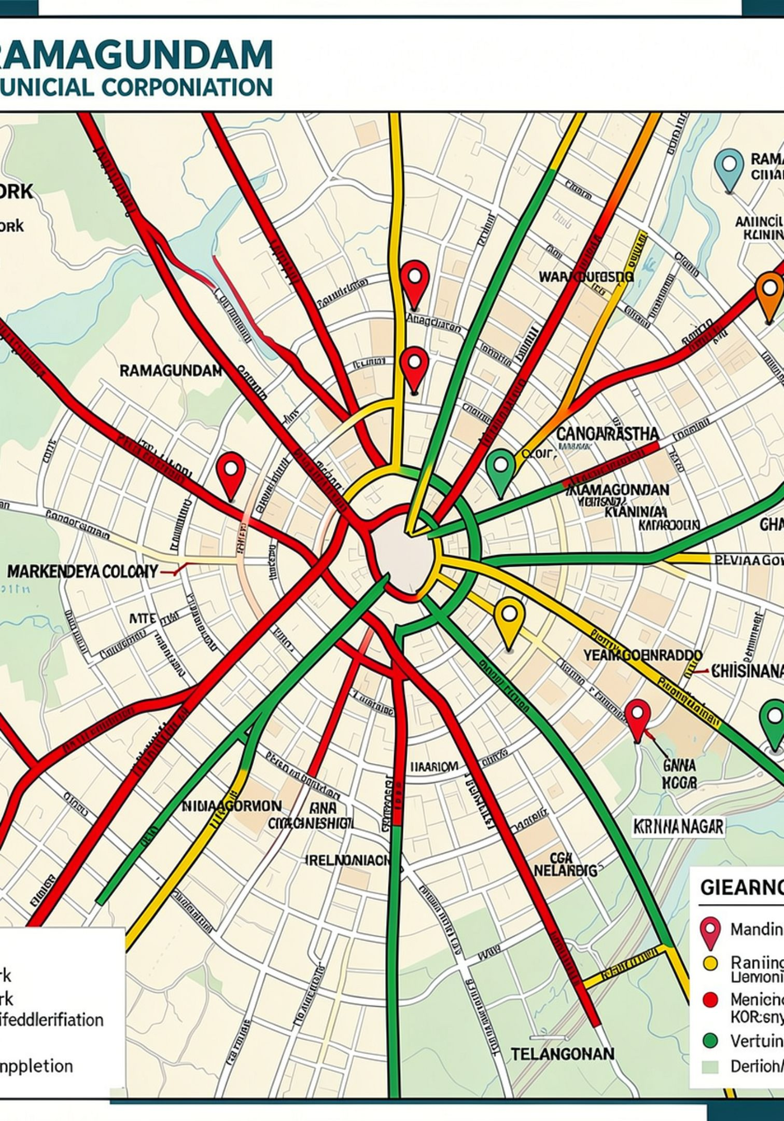
GIS Sanitation Asset Status Visualization — Color-Based Monitoring
Red — Work Pending
Yellow — Awaiting Verification
Road not cleaned. Triggers allocation or re-assignment.
Cleaning done; photo uploaded and pending supervisor review.
Green — Verified
Supervisor approved. Road status updated and closed for the day.
The color-coding applies across all sanitation assets, including roads, garbage vulnerable points, SBM toilets, and parks, making it easy to track field status at a glance.
Benefits: instant identification of pending assets, division-wise progress views, and faster operational responses for comprehensive sanitation coverage.

Slide 6
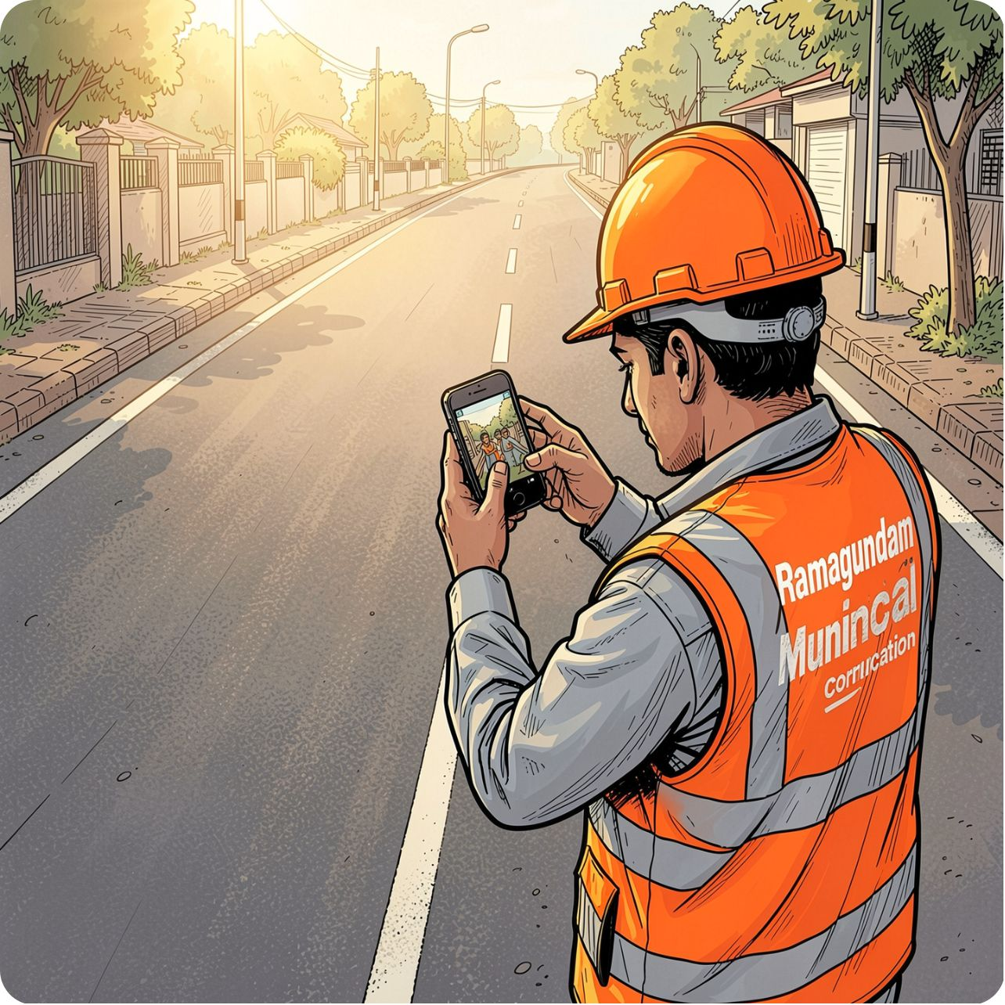
Jawan Mobile Application
The field app is lightweight and built for reliability on low-bandwidth networks. It supports multiple sanitation asset types: roads, garbage vulnerable points, SBM toilets, and parks. Key features support secure, auditable actions and simple workflows for frontline staff.
Asset type selection
Division-wise assignment for all asset categories
Automatic GPS capture and timestamping
Geo-tagged photo upload with asset type tagging
Offline mode with queued submissions
Instant status feedback after upload

Slide 7
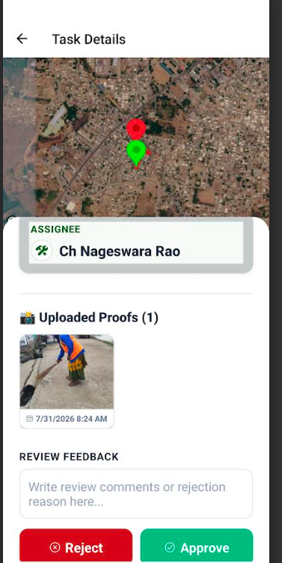
Sanitary Inspector Dashboard
Supervisors receive curated submissions for verification across all sanitation asset types (roads, garbage vulnerable points, SBM toilets, parks), enabling consistent quality control and rapid feedback to field teams.
Photo review queue with asset type and metadata
Approve/reject with comments and reassign options
Track pending assets across all categories and daily completion rates
Asset type and division-level filters
Exportable reports by asset category

Slide 8
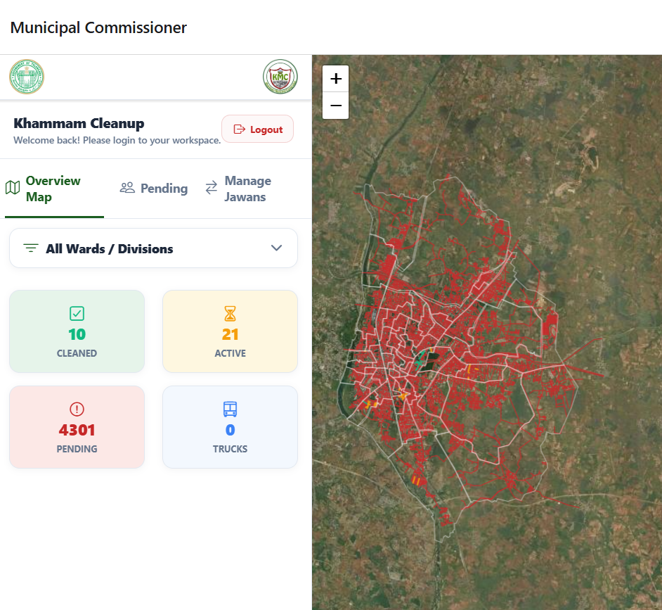
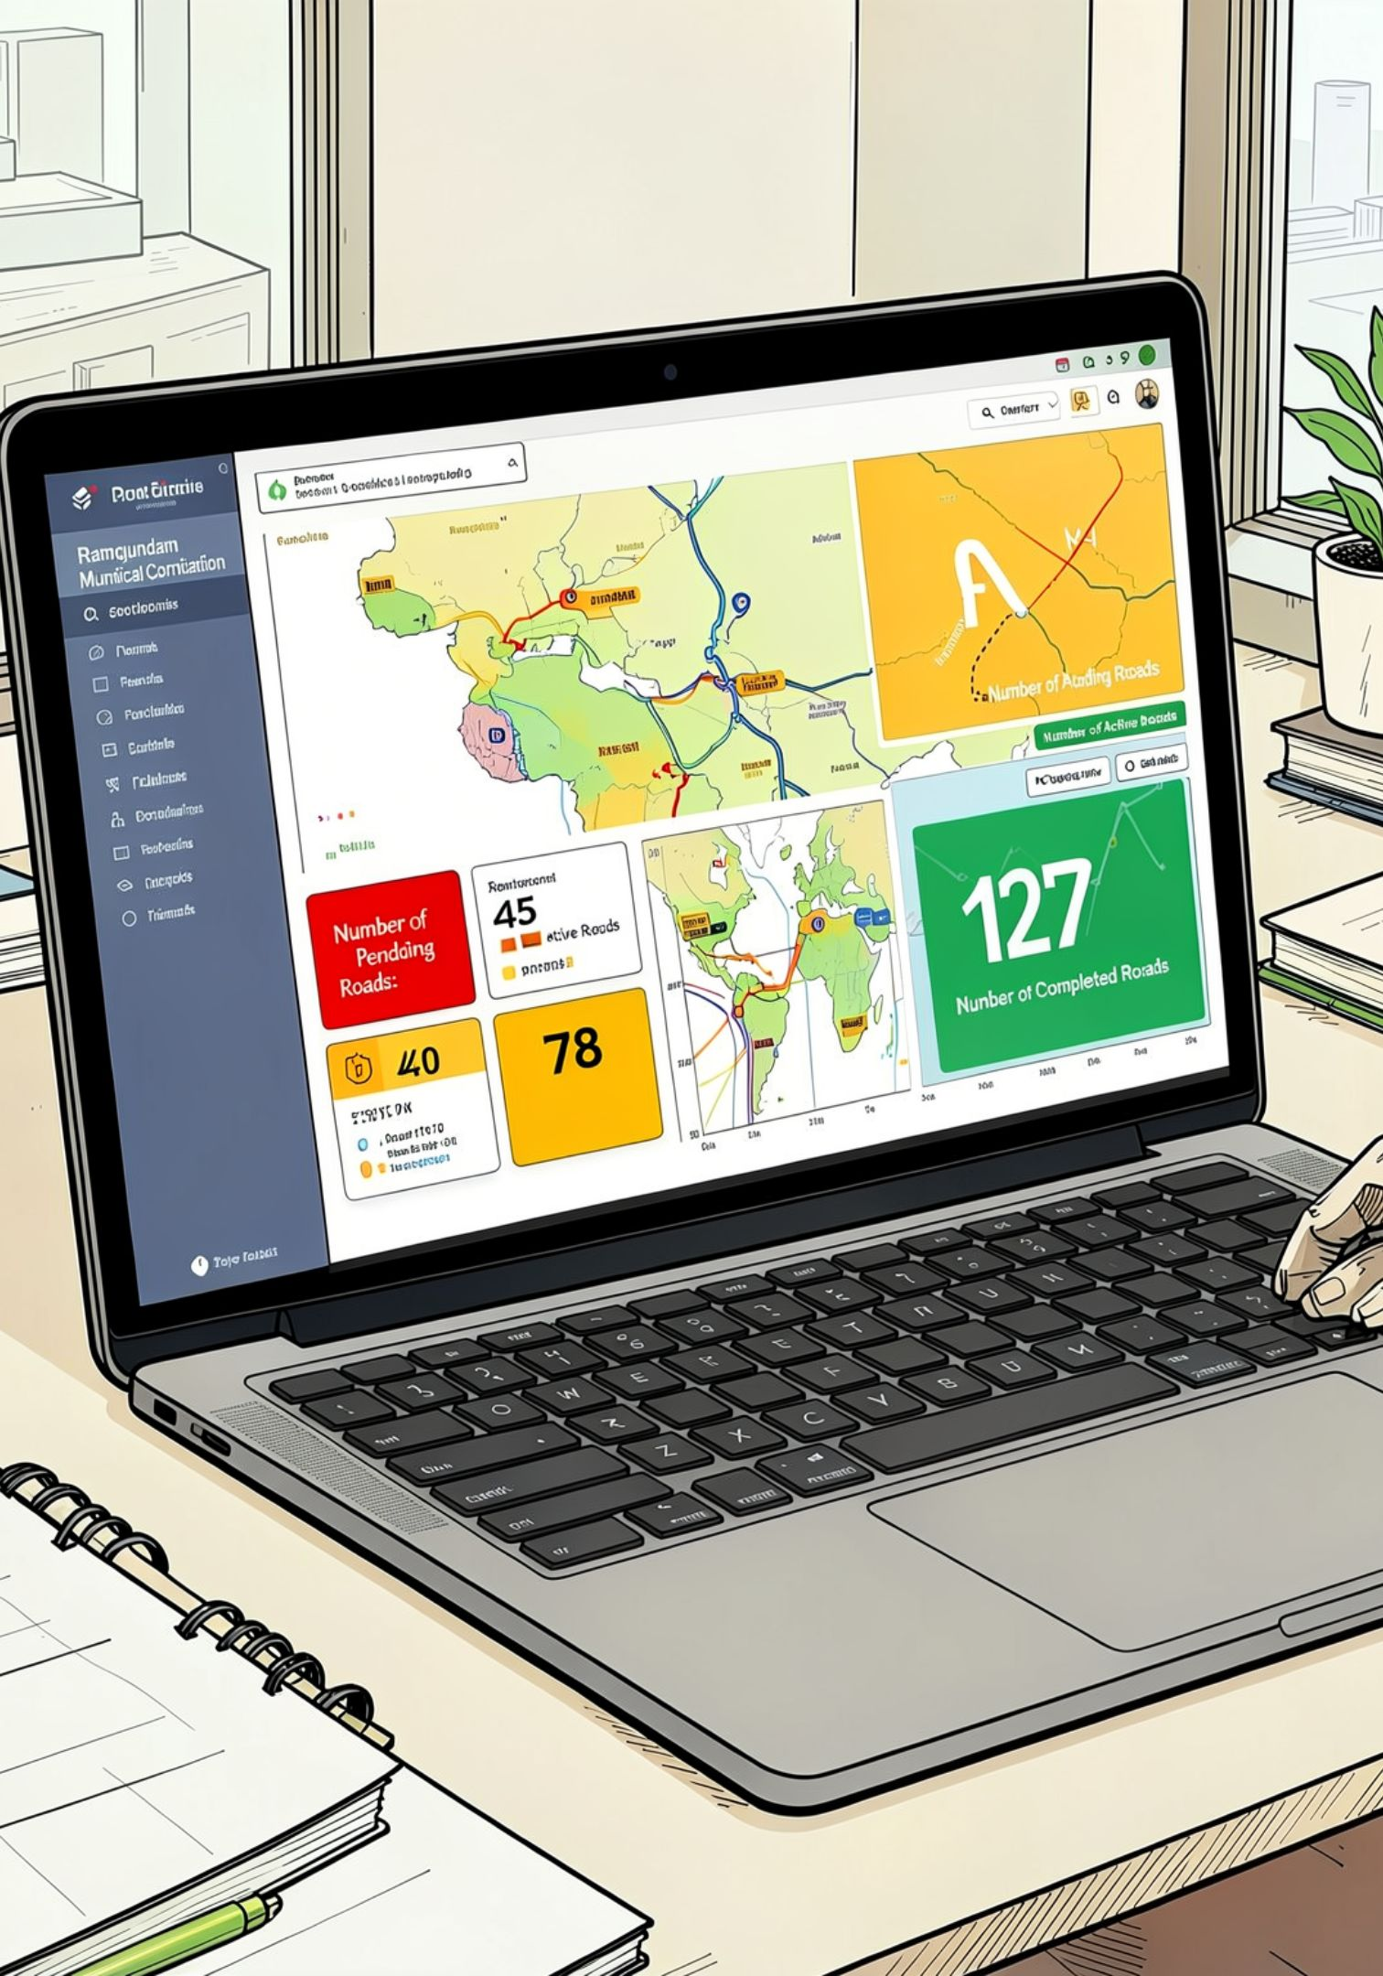
Commissioner Dashboard — City-wide Oversight
Designed for senior officials and municipal commissioners to monitor comprehensive sanitation performance city-wide across roads, garbage vulnerable points, SBM toilets, and parks, and drive policy or resource allocation decisions.
98%
3
Daily Coverage
Open Escalations
Percent of assigned sanitation assets visited across all categories.
Critical areas requiring managerial attention across all asset types.
The dashboard supports trend analysis, asset type comparisons, division comparisons, and export of KPIs for oversight meetings.

Slide 9
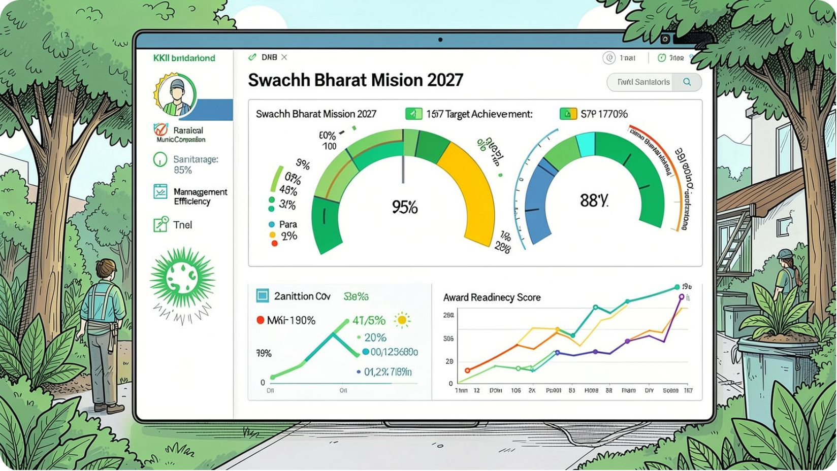
Expected Impact on Ramagundam Municipal Corporation
Implementation will strengthen comprehensive sanitation governance by enabling fast identification of issues across all asset types (roads, garbage vulnerable points, SBM toilets, parks), optimizing workforce deployment, and delivering measurable improvements in service quality.
Improved monitoring across all sanitation assets with faster remediation
Better resource utilization for multiple asset categories and reduced operational delays
Enhanced transparency supporting digital governance
Higher citizen satisfaction with comprehensive sanitation improvements
Actionable KPIs for continuous improvement across all asset types (coverage by category, verification time, backlog by asset type)

