Slide 1

Analysis of Europe's Top Five Football Leagues
Group 8
Chaitanya Mupparaju
Gaurav Yadav
Shruti Rao

Slide 2
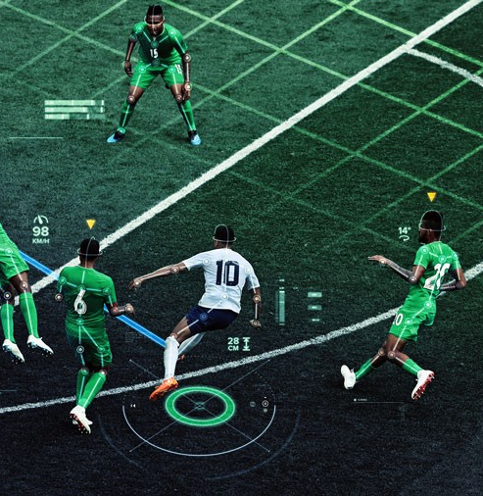
Dataset
Kaggle dataset
Structured data – SQLlite
7 different Tables
2008-2015

Slide 3

Project Overview
Project Overview: Analyzing patterns in European football leagues.
Leagues Covered: LaLiga, Serie A, Bundesliga, Premier League, Ligue 1.
Objective: Uncover trends and patterns in each league.

Slide 4
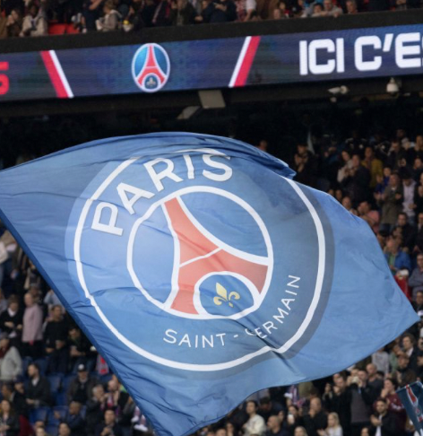
Ligue 1: PSG's Transformation
QSI acquired PSG in 2011
Win rate increased from 40% to 68%
Average goals scored increased
Average goals conceded decreased.

Slide 5
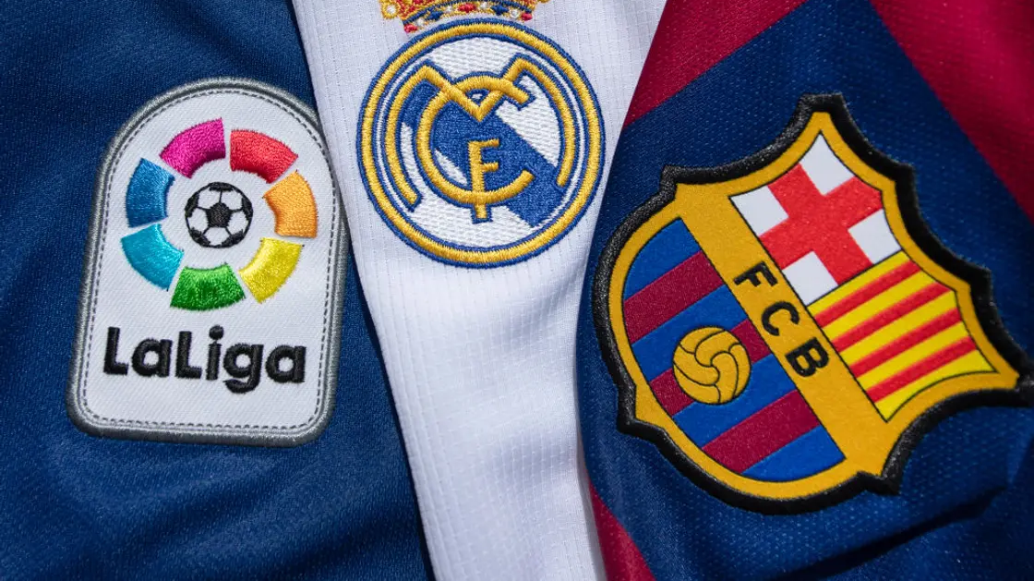
LaLiga: The Predictability of Dominance
Defined an entropy function.
Over the period of 8 seasons, Laliga is the most predictable in 6 seasons.
Barcelona and Real Madrid are the 2 teams that are high on the predictability matrix.

Slide 6

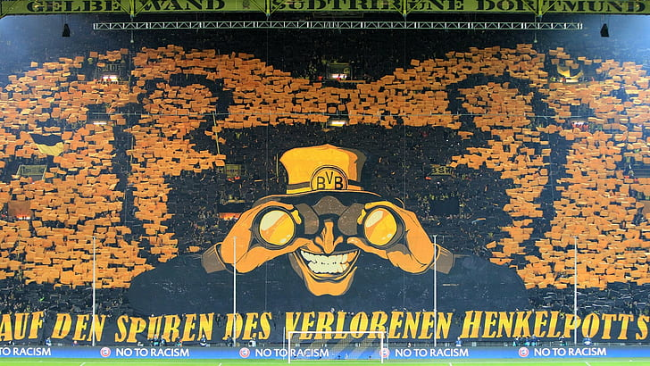
Bundesliga : Dortmund’s Decline
Goal Scoring Decrease: From 80 goals in 2011-12 to 47 goals in 2014-15.
Goals Conceded Increase: From 25 goals conceded in 2011-12 to 42 goals in 2014-15.
Injury Impact: Significant, affecting key players.

Slide 7

Premier League: The Ferguson Effect
Scored 25 % less goals after the ferguson left.
Further decline to a 43% in 2015/16
Losses have doubled from 13.2% to 26.3%

Slide 8
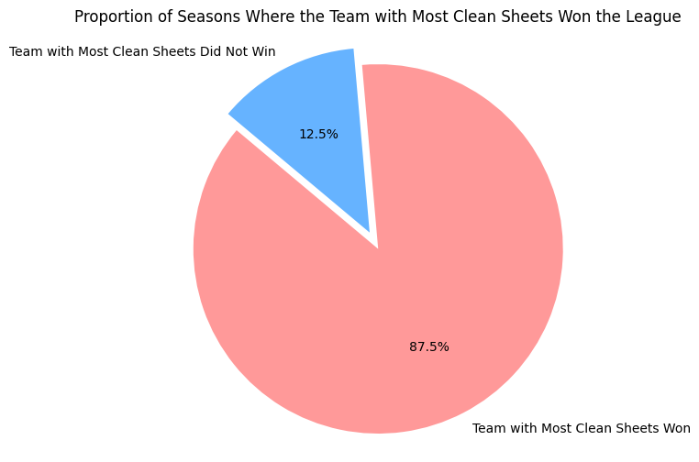
Serie A: Defensive Strength as a Key to Victory
Teams with the most clean sheets winning the league 7
Teams with the most clean sheets not winning the league 1

