Slide 1

Lists
Top Ten Words that Almost Rhyme with “Peas”
10. heats
9. rice
8. moss
7. ties
6. needs
5. lens
4. ice
3. nurse
2. leaks
1. meats

Slide 2
Lists
A list is a linear collection, like stacks and queues, but is more flexible.
Adding and removing elements in lists can occur at either end or anywhere in the middle.
We will examine three types of list collections:
Sorted lists.
Unsorted lists.
Indexed lists.

Slide 3
Sorted Lists
The elements in a sorted list are ordered by some inherent characteristic of the elements:
Names in alphabetical order.
Scores in ascending order.
The elements themselves determine where they are stored in the list.

Slide 4
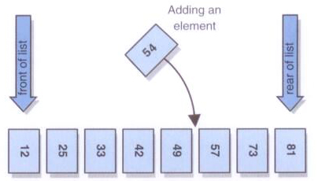
Sorted Lists
An sorted list:

Slide 5
Unsorted Lists
There is an order to the elements in an unsorted list, but that order is not based on element characteristics.
The user of the list determines the order of the elements.
A new element can be put on the front or the rear of the list, or it can be inserted after a particular element already in the list.

Slide 6
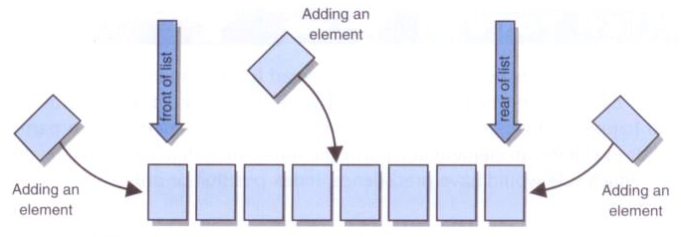
Unsorted Lists
An unsorted list:

Slide 7
Indexed Lists
In an indexed list, elements are referenced by their numeric position in the list.
Like an unsorted list, there is no inherent relationship among the elements.
The user can determine the order.
Every time the list changes, the indexes are updated.

Slide 8
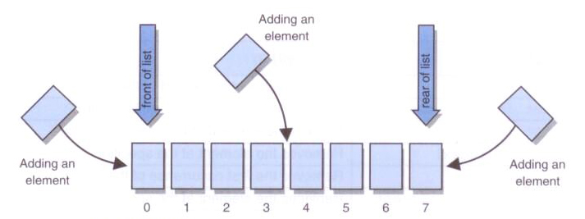
Indexed Lists
An indexed list:

Slide 9
A List ADT
public interface IList<T> extends Iterable<T>
{
void add(T element);
void insert(int pos, T element);
T set(int pos, T element);
T get(int pos);
T remove(int pos);
void remove(T element);
int size();
int indexOf(T element);
void makeEmpty();
public String toString();
Iterator<T> iterator();
}

Slide 10
Implementing a List with an Array
An array is an obvious choice for implementing a list collection.
Easy to create, direct indexing.
Will need to keep track of capacity of array, as well as number of elements in list.
How construct new array, if want to use generics? What type of array create?

Slide 11
An Array Implementation of IList ADT
public class List<T> implements IList<T>
{
private int count;
private int capacity;
private T[] list;
private static final int DEFAULT_CAPACITY = 10;
public List()
{
count = 0;
capacity = DEFAULT_CAPACITY;
list = ???;
}
…
}

Slide 12
Creating List Object
// Using implementation in code
List<String> list = new List<String>();
List
0
capacity count
DEFAULT_CAPACITY
list
0
10
-
-
-
-
-
-
-
-
-
-

Slide 13
add method
public void add(T element)
Add to the end of list.
What if array is full?
Any shifting?

Slide 14
insert method
public void insert(int pos, T element)
Add at position in list.
Exceptional situations?
What if full?
Where start shifting?

Slide 15
set method
public void set(int index, T element)
Replace element at index with given element.
Exceptional situations?
Shifting?

Slide 16
get method
public T get(int index)
Return element at given index.
Exceptional situations?

Slide 17
remove method
public T remove(int index)
Remove element at given index.
Exceptional situations?
Where start shifting?

Slide 18
Implementing a List with Links
A single-linked list is also a good choice for implementing a list collection.
Will need to implement Node class.
Maintain both head and tail references, as well as number of elements in list.

Slide 19
Question 1
What is output by the following code?
Integer i1 = new Integer(12);
Integer i2 = new Integer(12);
System.out.println( i1 == i2 );
No output due to syntax error
No output due to runtime error
false
true

Slide 20
Question 1
What is output by the following code?
Integer i1 = new Integer(12);
Integer i2 = new Integer(12);
System.out.println( i1 == i2 );
No output due to syntax error
No output due to runtime error
false
true

Slide 21
Object References
Recall, a variable is an object reference, the address of an object.
A reference can also be called a pointer.
They are often depicted graphically:
student
John Smith
40725
3.57

Slide 22
Creating References
The keyword new creates a new object, but also returns a reference to that object.
For example,
Integer i1 = new Integer(12);
new Integer(12)creates and Integer object and returns a reference to it.
Can assign this reference to a variable like i1, or use it in other ways.

Slide 23
A Single-Linked List Implementation of List ADT
public class List<T> implements IList<T>
{
private Node<T> head;
private Node<T> tail;
private int count;
public List()
{
head = null;
tail = null;
count = 0;
}
…
}

Slide 24
A Single-Linked List Node Class
public class Node<T>
{
private T element;
private Node<T> next;
public Node()
{ setElement(null); setNext(null); }
public Node(T element)
{ setElement(element); setNext(null);
public T getElement()
{ return element; }
public Node<T> getNext()
{ return next; }
public void setElement(T element)
{ this.element = element; }
public void setNext(Node<T> next)
{ this.next = next; }
}

Slide 25
Creating List Object
// Using implementation in code
List<String> list = new List<String>();
List
0
head count
tail
null
null

Slide 26


Writing Methods
When trying to code methods for linked lists draw pictures!
If you don't draw pictures of what you are trying to do, it is very easy to make mistakes!

Slide 27
add method
public void add(T element)
Add to the end of list
Special case if empty
Steps on following slides

Slide 28
add Element - List Empty (Before)
head tail count
null
null
0
String
element

Slide 29
add Element - List Empty (After)
head tail count
1
Node
element next
String
element
null

Slide 30
add Element - List Not Empty (Before)
head tail count
1
Node
element next
null
String
String
element

Slide 31
add Element - List Not Empty (After)
head tail count
2
Node
element next
Node
element next
null
String
String
element

Slide 32
Question 2
What is the worst case run-time to add at the end of an array-based list with n items?
A linked-list implementation?
Array Linked List
O(1) O(1)
O(n) O(n)
O(log n) O(1)
O(1) O(n)
O(n) O(1)

Slide 33
Question 2
What is the worst case run-time to add at the end of an array-based list with n items?
A linked-list implementation?
Array Linked List
O(1) - if space O(1) - with tail
O(n) - if no space O(n) - with no tail
O(log n) O(1)
O(1) - if space O(n) - with no tail
O(n) - if no space O(1) - with tail

Slide 34
insert method
public void insert(int pos, T element)
Add at position in list
Special case if empty

Slide 35
Question 3
What is the run-time to insert for an array-based list with n items?
For a linked-list implementation?
Array Linked List
O(1) O(1)
O(n) O(1)
O(log n) O(1)
O(1) O(n)
O(n) O(n)

Slide 36
Question 3
What is the run-time to insert for an array-based list with n items?
For a linked-list implementation?
Array Linked List
O(1) O(1)
O(n) O(1)
O(log n) O(1)
O(1) O(n)
O(n) O(n)

Slide 37

set method
public void set(int index, T element)
Must be careful not to break the chain!
Where do we need to stop?
Special cases?

Slide 38
Question 4
What is the run-time to set an element for an array-based list?
To a linked-list implementation?
Array Linked List
O(n) O(n)
O(n) O(1)
O(log n) O(1)
O(log n) O(log n)
O(1) O(n)

Slide 39
Question 4
What is the run-time to set an element for an array-based list?
To a linked-list implementation?
Array Linked List
O(n) O(n)
O(n) O(1)
O(log n) O(1)
O(log n) O(log n)
O(1) O(n)

Slide 40

Code for get
public T get(int index)
The downside of linked lists

Slide 41
Question 5
What is the run-time to find an element based on position in an array-based list?
A linked-list implementation?
Array Linked List
O(1) O(n)
O(n) O(1)
O(log n) O(1)
O(log n) O(n)
O(n) O(n)

Slide 42
Question 5
What is the run-time to find an element based on position in an array-based list?
A linked-list implementation?
Array Linked List
O(1) O(n)
O(n) O(1)
O(log n) O(1)
O(log n) O(n)
O(n) O(n)

Slide 43
Why Need Iterators?
What is the Big-O of the following code?
List<Integer> list;
list = new List<Integer>(); // code to fill list with n elements
//Big-O of following code? for(int i = 0; i < list.size(); i++) System.out.println( list.get(i) );
O(n) B. O(2^{n}) C. O(n log n)
D. O(n²) E. O(n³)

Slide 44
Why Need Iterators?
What is the Big-O of the following code?
List<Integer> list;
list = new List<Integer>(); // code to fill list with n elements
//Big-O of following code? for(int i = 0; i < list.size(); i++) System.out.println( list.get(i) );
O(n) B. O(2^{n}) C. O(n log n)
D. O(n²) E. O(n³)
Depends… On what?

Slide 45
remove method
public T remove(int index)
Special case?

Slide 46
Arrays vs Linked Lists
Which operations are more efficient using an array?
Which are more efficient using a linked-list implementation?
Which operations have the same efficiency?

Slide 47
Array / Linked List Efficiency
Method | Array | Linked List
add | O(1) | O(1)
insert(index, value) | O(n) | O(n)
indexOf | O(n) | O(n)
get | O(1) | O(n)
remove | O(n) | O(n)
set | O(1) | O(n)
size | O(1) | O(1)

Slide 48
Implementing a List with More Links
A double-linked list can also be used to implement a list collection.
Will need a Node class with next and previous references.
Have to track both next and previous links but logic simpler.
Probably want to use dummy to indicate end of list.

Slide 49
A Double-Linked List Implementation of List ADT
public class List<T> implements IList<T>
{
private Node<T> head;
private Node<T> tail;
private Node<T> end;
private int count;
public List()
{
head = null;
tail = null;
end = new Node<T>(null);
count = 0;
}
…
}

Slide 50
Updated Node Class
public class Node<T>
{
private T element;
private Node<T> next;
private Node<T> previous;
…
}

Slide 51
Dummy Nodes
Use of Dummy Node for a double-linked list removes most special cases.
Also could make the double-linked list circular.

Slide 53
Lists in the Java API
The list classes in the Java API primarily support the concept of an indexed list (and somewhat an unsorted list).
The API does not have any classes that directly implement a sorted list.
The ArrayList and LinkedList classes both implement the List<E> interface.

Slide 54
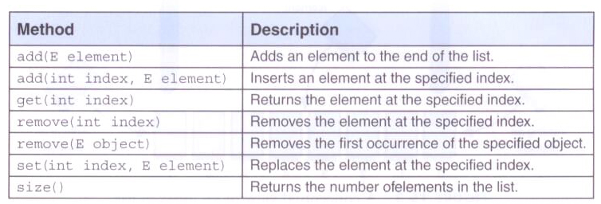
Lists in the Java API
Some of the operations from the List<E> interface:

Slide 55
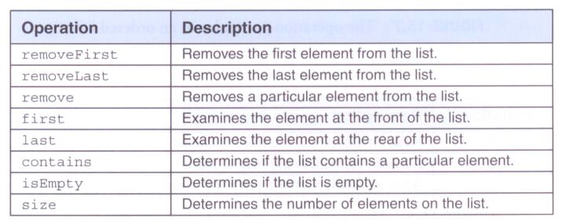
Implementing Lists
The following operations are common to most types of lists:

Slide 56

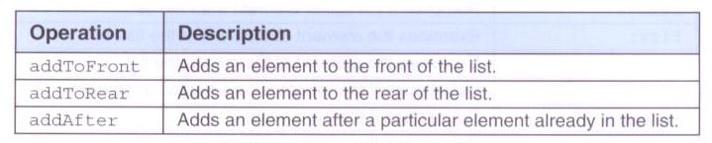
Implementing Lists
Operation particular to a sorted list:
Operations particular to an unsorted lists:

Slide 57
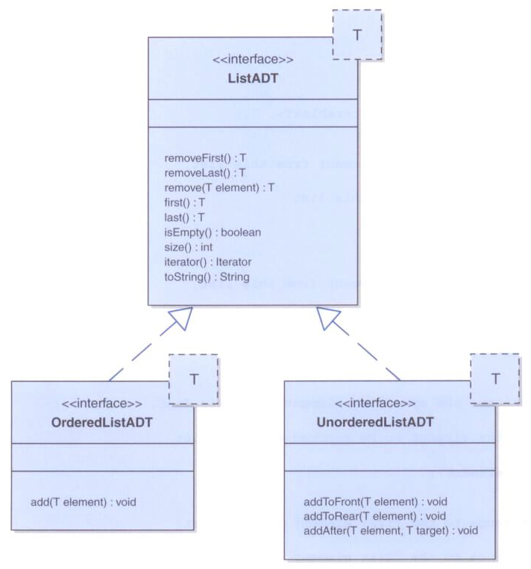
Class Diagram of List Classes

Slide 58
Reference
Based on content from: Java Foundations, 3rd Edition

