Slide 1

Recursion
"To understand recursion, one must first understand recursion."
- Anonymous

Slide 2
What is Recursion?
Sometimes, the best way to solve a problem is by solving a smaller version of the exact same problem first.
Recursion is a technique that solves a problem by solving a smaller problem of the same type first.
CS 221 - Computer Science II

Slide 3
Recursion
More than programming technique:
  A way of describing, defining, or specifying things.
  A way of designing solutions to problems (divide and conquer).
CS 221 - Computer Science II

Slide 4
Basic Recursion
Base cases:
  Always have at least one case that can be solved without using recursion.
  Indicates an end to the recursion.
Make progress:
  Any recursive call must make progress toward a base case.
CS 221 - Computer Science II

Slide 5
Mathematical Examples
There are recursive definitions for many mathematical problems:
  Power Function
  Fibonacci Sequence
  Factorial Function
CS 221 - Computer Science II

Slide 6
Power Function
  The Power function y^{x} :
    Raise the number y to the xth power.
  Assume x is a non-negative integer:
CS 221 - Computer Science II

Slide 7
Power Function
  The Power function y^{x} :
    Raise the number y to the xth power.
  Assume x is a non-negative integer:
  y^{x} = 1 if x is 0 // base case
  y^{x} = y*y^{(x-1)} otherwise // make progress
CS 221 - Computer Science II

Slide 8
Power Function
2³ = 2*2²
CS 221 - Computer Science II

Slide 9
Power Function
2³ = 2 * 2²
2² =
CS 221 - Computer Science II

Slide 10
Power Function
2³ = 2 * 2²
2² = 2 * 2¹
2¹ =
CS 221 - Computer Science II

Slide 11
Power Function
2³ = 2 * 2²
2² = 2 * 2¹
2¹ = 2 * 2⁰
2⁰ =
CS 221 - Computer Science II

Slide 12
Power Function
2³ = 2 * 2²
2² = 2 * 2¹
2¹ = 2 * 2⁰
2⁰ = 1 (Base Case)
CS 221 - Computer Science II

Slide 13
Power Function
2³ = 2 * 2²
2² = 2 * 2¹
2¹ = 2 * 2⁰ = 2 * 1 = 2
2⁰ = 1
CS 221 - Computer Science II

Slide 14
Power Function
2³ = 2 * 2²
2² = 2 * 2¹ = 2 * 2 = 4
2¹ = 2 * 2⁰ = 2 * 1 = 2
2⁰ = 1
CS 221 - Computer Science II

Slide 15
Power Function
2³ = 2 * 2² = 2 * 4 = 8
2² = 2 * 2¹ = 2 * 2 = 4
2¹ = 2 * 2⁰ = 2 * 1 = 2
2⁰ = 1
CS 221 - Computer Science II

Slide 16
Fibonacci Sequence
  Fibonacci Sequence:
  1, 1, 2, 3, 5, 8, 13, 21, 34, 55, 89, 144,…
  Fibonacci Function:
    Fib(0) = 1 // base case
    Fib(1) = 1 // base case
    Fib(n) = Fib(n-1) + Fib(n-2) // n>1
  Unlike most recursive algorithms:
    Two base cases, not just one.
    Two recursive calls, not just one.
CS 221 - Computer Science II

Slide 17
Factorial
Factorial Function
  factorial(0) = 1 // base case
  factorial(n) = n * factorial(n-1)
  // n > 0
Compute factorial(3):
CS 221 - Computer Science II

Slide 18
Factorial
Factorial Function
  factorial(0) = 1 // base case
  factorial(n) = n * factorial(n-1)
  // n > 0
Compute factorial(3):
  factorial(3) = 3 * factorial(2)
    = 3 * ( 2 * factorial(1) )
    = 3 * ( 2 * ( 1 * factorial(0) )
    = 3 * ( 2 * ( 1 * 1 ) )) = 6
CS 221 - Computer Science II

Slide 19
Coding the Factorial Function
Recursive Implementation
  int factorial(int n)
  {
  if (n==0) // base case
  return 1;
  else
  return n * factorial(n-1);
  }
CS 221 - Computer Science II

Slide 20
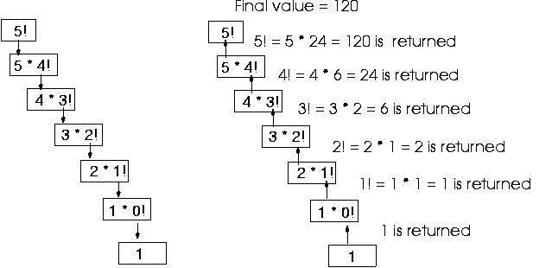
Recursive Call Stack
CS 221 - Computer Science II

Slide 21
Implementing Recursion
What happens when a function gets called?
  // a method
  int b(int x)
  {
  int z,y;
  // other statements
  z = a(x) + y;
  return z;
  }
  // another method
  int a(int w)
  {
  return w+w;
  }
CS 221 - Computer Science II

Slide 22
When a Function is Called
Stop executing function b.
To return to function b later, need to store everything about function b.
  Create activation record.
  Includes values of variables x, y, z.
  The place to start executing when return.
Push activation record onto the call stack.
Then, a is bound to w from b.
Control is transferred to function a.
CS 221 - Computer Science II

Slide 23
When a Function is Called
After function a is executed, the activation record is popped out off call stack.
  Values of the parameters and variables in function b are restored.
  Return value of function a replaces a(x) in the assignment statement.
CS 221 - Computer Science II

Slide 24
Recursion Overhead
Space
  Every invocation of a function call requires:
    Space for parameters and local variables.
    Space for return address.
  Thus, a recursive algorithm needs space proportional to the number of nested calls to the same function.
CS 221 - Computer Science II

Slide 25
Recursion Overhead
Time
  Calling a function involves:
    Allocating, and later releasing, local memory.
    Copying values into the local memory for the parameters.
    Branching to/returning from the function
  All contribute to the time overhead, which is generally exponential.
CS 221 - Computer Science II

Slide 26
Recursion vs. Iteration
Recursion calls the same function over and over.
  Recursive algorithms use a branching structure.
Iteration `jumps back' to the start of the loop.
  Iterative algorithms use a looping construct.
Iteration can be used in place of recursion.
Recursive solutions are usually less efficient.
  In terms of both time and space.
  Usually exponential in both.
Recursion may simplify the solution.
  Shorter, more easily understood source code.
CS 221 - Computer Science II

Slide 27
Coding Factorial Function
Iterative implementation:
  int factorial(int n)
  {
  int fact = 1;
  for(int count = 2; count <= n; count++)
  fact = fact * count;
  return fact;
  }
CS 221 - Computer Science II

Slide 28
Other Recursive Examples
  Combinations
  Euclid’s Algorithm
  Binary Search
CS 221 - Computer Science II

Slide 29
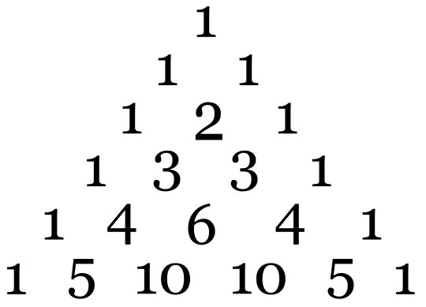
Combinations: n choose k
Given n things, how many different sets of size k can be chosen?
n n-1 n-1
= + , 1 < k < n (recursive solution)
k k k-1
n n!
= , 1 < k < n (closed-form solution)
k k!(n-k)!
with base cases:
n n
= n (k = 1), = 1 (k = n)
1 n
Pascal’s Triangle
CS 221 - Computer Science II

Slide 30
Combinations: n choose k
int combinations(int n, int k)
{
if(k == 1) // base case 1
return n;
else if (n == k) // base case 2
return 1;
else
return(combinations(n-1, k) + combinations(n-1, k-1));
}
CS 221 - Computer Science II

Slide 31
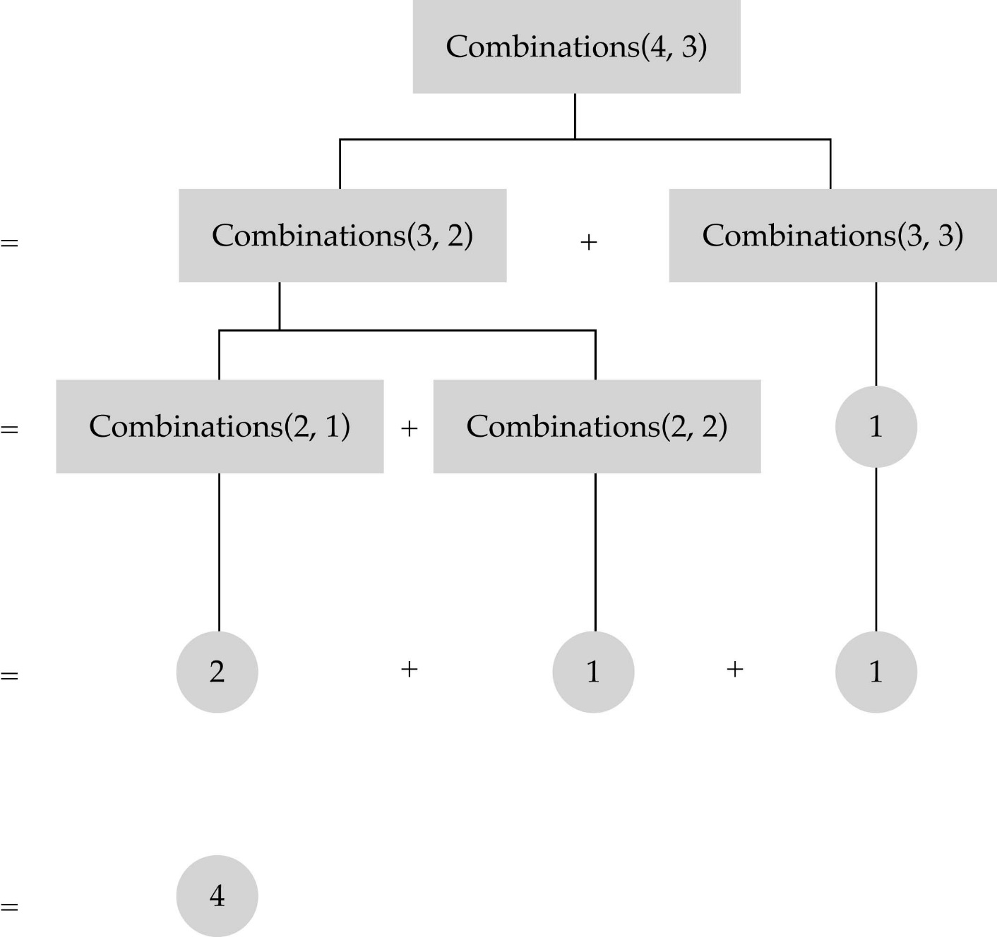
Combinations

Slide 32
Euclid's Algorithm
About 300 BC, Euclid wrote an algorithm to calculate the greatest common divisor (GCD) of two numbers x and y, where (x < y).
This can be stated as:
    Divide y by x with remainder r.
    Replace y by x, and x with r.
    Repeat step 1 until r is zero.
When this algorithm terminates, y is the highest common factor.
CS 221 - Computer Science II

Slide 33
GCD(34017, 16966)
Euclid's algorithm works as follows:
  34,017/16,966 produces a remainder 85
  16,966/85 produces a remainder 51
  85/51 produces a remainder 34
  51/34 produces a remainder 17
  34/17 produces a remainder 0
The highest common divisor of 34,017 and 16,966 is 17.
CS 221 - Computer Science II

Slide 34
Writing a Recursive Function
Determine the base case(s) .
  Can solve without recursion.
Determine the general case(s) .
  Express solution as a smaller version of itself.
Verify the algorithm.
  Use the "Three-Question-Method."
CS 221 - Computer Science II

Slide 35
Three-Question Method
1. The Base-Case Question:
  Is there a non-recursive way out of the function, and does the routine work correctly for this "base" case?
2. The Smaller-Caller Question:
  Does each recursive call to the function involve a smaller case of the original problem, leading inescapably to the base case?
3. The General-Case Question:
  Assuming that the recursive call(s) work correctly, does the whole function work correctly?
CS 221 - Computer Science II

Slide 36
Binary Search
Search algorithm
  Finds a target value within a sorted list.
  Compares target value to the middle element.
    If the two are equal, done.
    If target less than middle element, search lower half of list. Otherwise, search upper half of list.
    Continue dividing list in half until find target or run out of list to search.
Efficiency:
  Runs in at worst logarithmic O(log n) time.
  Takes up linear O(n) space.
CS 221 - Computer Science II

Slide 37
Recursive Binary Search
What are the base cases?
  If first > last, return false
  If item==info[midPoint], return true
What is the general case?
  if item < info[midPoint]
  // search the first half
  if item > info[midPoint],
  //search the second half
CS 221 - Computer Science II

Slide 38
Recursive Binary Search
boolean binarySearch(Item info[], Item item, int first, int last)
{
int midPoint;
if(first > last) // base case 1
return false;
else
{
midPoint = (first + last)/2;
if (item == info[midPoint]) // base case 2
{
item = info[midPoint];
return true;
}
else if(item < info[midPoint])
return binarySearch(info, item, first, midPoint-1);
else
return binarySearch(info, item, midPoint+1, last);
}
}
CS 221 - Computer Science II

Slide 39
When to Use Recursion
When the depth of recursive calls is relatively "shallow."
The recursive version does about the same amount of work as the non-recursive version.
The recursive version is shorter and simpler than the non-recursive solution.
CS 221 - Computer Science II

Slide 40
Benefits of Recursion
Recursive functions are clearer, simpler, shorter, and easier to understand than their non-recursive counterparts.
The program directly reflects the abstract solution strategy (algorithm).
Reduces the cost of maintaining the software.
CS 221 - Computer Science II

Slide 41
Disadvantages of Recursion
Makes it easier to write simple and elegant programs, but it also makes it easier to write inefficient ones.
Use recursion to ensure correctness, not efficiency.
  Simple, elegant recursive algorithms are inherently inefficient.
CS 221 - Computer Science II

Slide 42
CS 221 - Computer Science II

