Slide 1
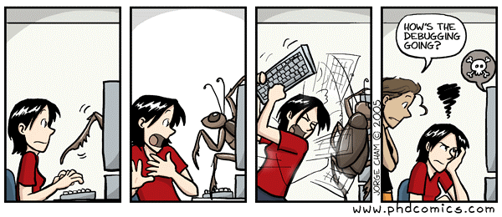
Debugging with Eclipse

Slide 2
Using a Debugger
Using a debugger allows you to run a program interactively while watching the source code and the values of variables during the execution.
By setting breakpoints in the source code, you can specify where to stop the execution of a program.
You can specify watchpoints to stop execution when a field is read or modified.
Once the program is stopped, you can investigate variables, change their content, etc.

Slide 3
The Eclipse Debugger
Eclipse allows you to start a Java program in Debug mode.
Eclipse has a special Debug perspective which gives you a preconfigured set of views.
In this perspective you control the execution process of your program and can investigate the state of variables.

Slide 4
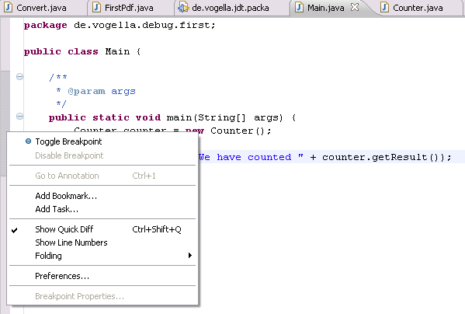
Setting Breakpoints
To set breakpoints:
  right-click in the small left margin in your source code editor and select Toggle Breakpoint.
  or you can double-click at this location.

Slide 5
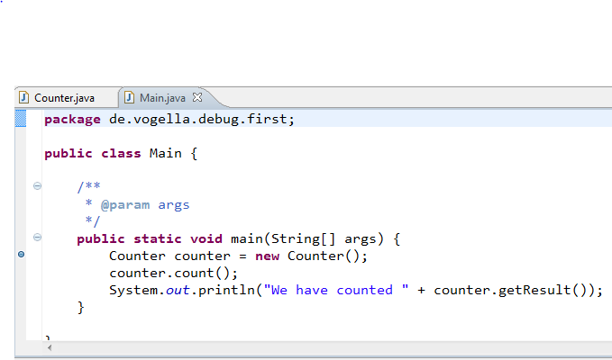
Setting Breakpoints
Once set, a blue dot appears in the left margin next to the code.
For example, a breakpoint is set on the line in the code below:
  Counter counter = new Counter();

Slide 6
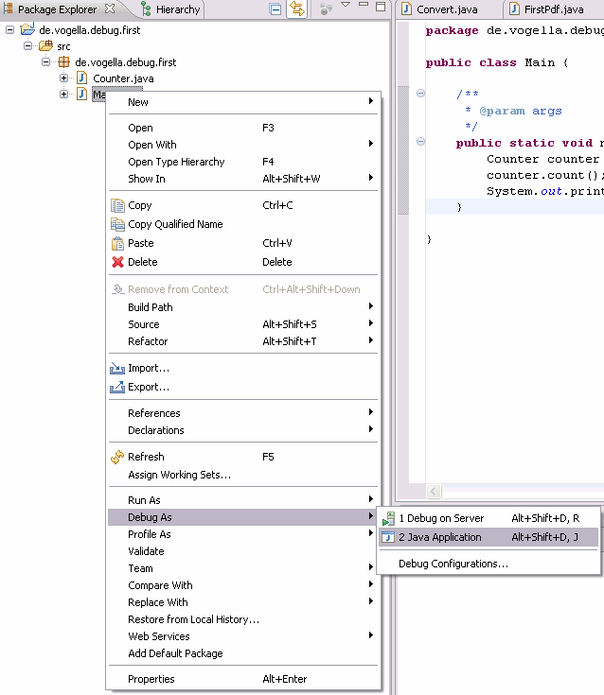
Starting the Debugger
To debug your application:
  select a Java file which can be executed
  right-click on it
  select Debug As → Java Application.

Slide 7

Starting Debugger
After you have started the application once via the context menu, you can use the created launch configuration again via the Debug button in the Eclipse toolbar.
If you have not defined any breakpoints, this will run your program as normal. To debug the program you need to define breakpoints.

Slide 8
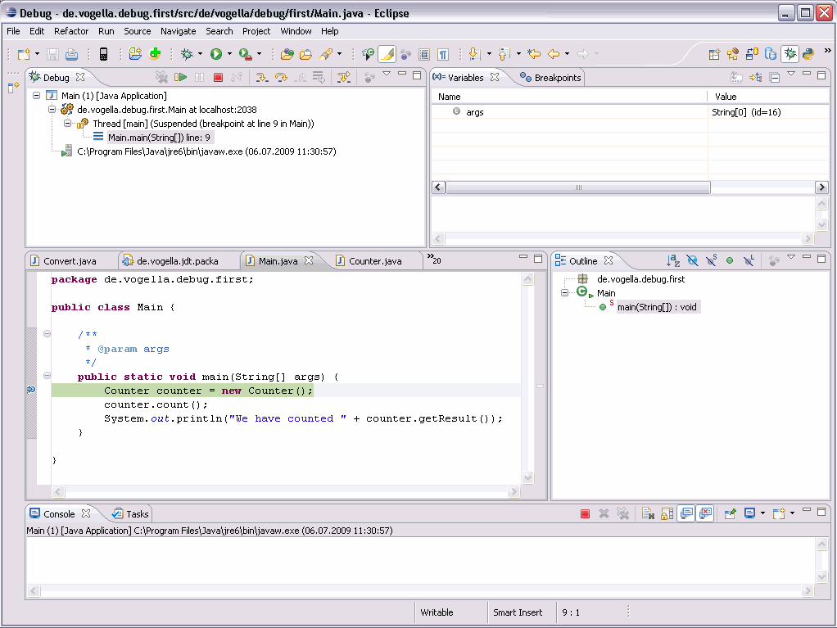
Debug Perspective
When a breakpoint is set, program execution is paused and Eclipse opens in the Debug perspective:

Slide 9
Controlling Program Execution in Debug Mode
Eclipse provides buttons in the toolbar for controlling the execution of the program you are debugging.
Typically it is easier to use function keys to control this execution.
Key | Description
F5 | Executes the currently selected line and goes to the next line in your program. If the selected line is a method call the debugger steps into the associated code.
F6 | F6 steps over the call, i.e. it executes a method without stepping into it in the debugger.
F7 | F7 steps out to the caller of the currently executed method. This finishes the execution of the current method and returns to the caller of this method.
F8 | F8 tells the Eclipse debugger to resume the execution of the program code until is reaches the next breakpoint or watchpoint.

Slide 10

Controlling Program Execution in Debug Mode
Here are the Debug menu buttons and their related keyboard shortcuts.

Slide 11
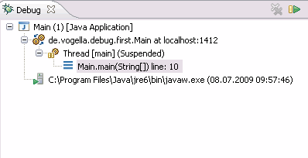
The Call Stack
The call stack shows the parts of the program which are currently being executed and how they relate to each other.
The current stack is displayed in the Debug view.

Slide 12
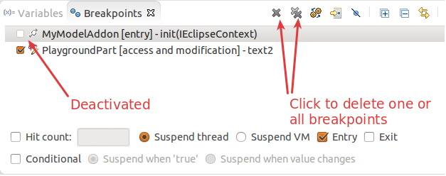
Breakpoint View
The Breakpoint view allows you to delete and deactivate stop points, (i.e. breakpoints and watchpoints), and to modify their properties.
To deactivate a breakpoint, remove the corresponding checkbox in the Breakpoint view .
To delete it you can use the corresponding buttons in the view toolbar.

Slide 13
Deactivating All Breakpoints
If you want to deactivate all your breakpoints, you can press the Skip All Breakpoints button.
If you press it again, your breakpoints are reactivated.

Slide 14
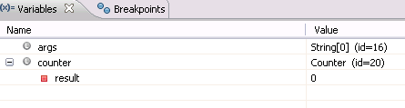
Evaluating Variables
The Variables view displays fields and local variables from the current executing stack.

Slide 15
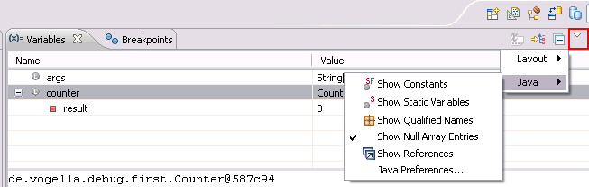
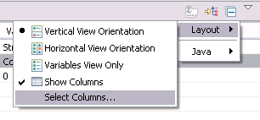
Evaluating Variables
Use the drop-down menu to display static variables.
Via the drop-down menu of the Variables view, you can customize the displayed columns.
For example, you can show the actual type of each variable declaration. For this select Layout → Select Columns... → Type.

Slide 16
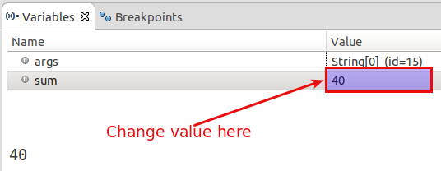
Changing Variable Values
The Variables view allows you to change the values assigned to your variable at runtime.

Slide 17
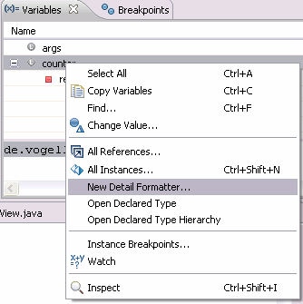
Controlling Variable Display
By default, the Variables view uses the toString method to determine how to display variables.
You can define a Detail Formatter to use Java code to define how a variable is displayed.
For example, the toString method in the Counter class may show meaningless information.
To make this output more readable, you can right-click on the corresponding variable and select the New Detail Formatter entry from the context menu.

Slide 18
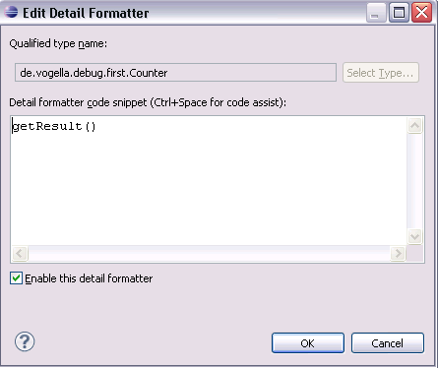
Controlling Variable Display
Then you can use any class method to display as output.
For example, the getResult method of this class can be used.

Slide 19
Breakpoint Properties
After setting a breakpoint, you can select the properties of the breakpoint, via right-click → Breakpoint Properties. In the breakpoint properties, you can define a condition that restricts the activation of this breakpoint.
For instance, every breakpoint has a Hit Count property. The application is stopped once the breakpoint has been reached the number of times defined in the hit count.
  For example, you can specify that a breakpoint should only become active after it has reached 12 or more times via its Hit Count property.

Slide 20
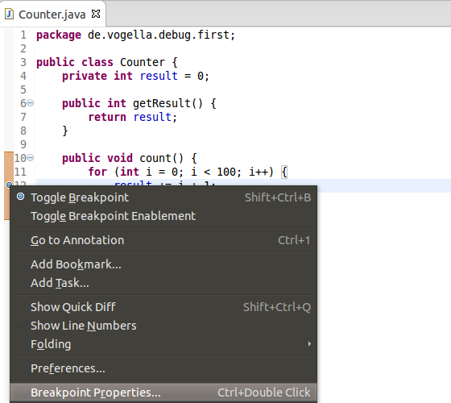
Conditional Breakpoints
For each breakpoint, you can also create a conditional expression. The execution of the program only stops at the breakpoint, if the condition evaluates to true.
Can be used for additional logging
  the code that specifies the condition is executed every time the program execution reaches that point.

Slide 21
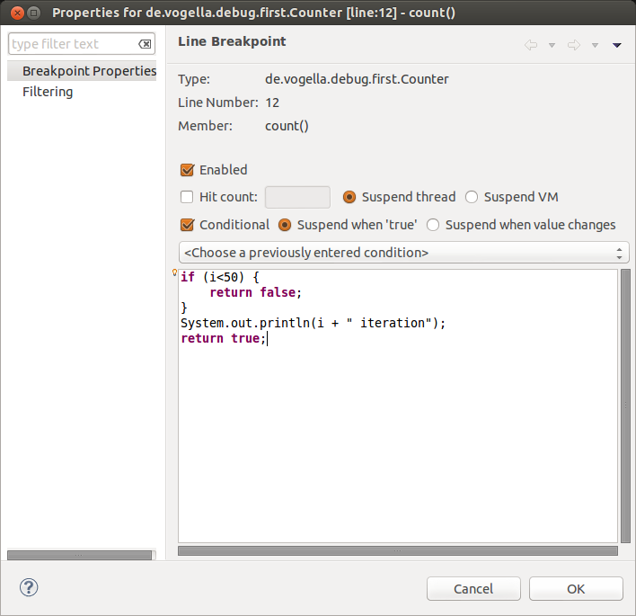
Conditional Breakpoints
For example, the following conditional breakpoint will not do anything until the value of the variable i is greater than or equal 50.
At that point, it will print out the value of i and suspend the running of the program like a typical breakpoint.

Slide 22
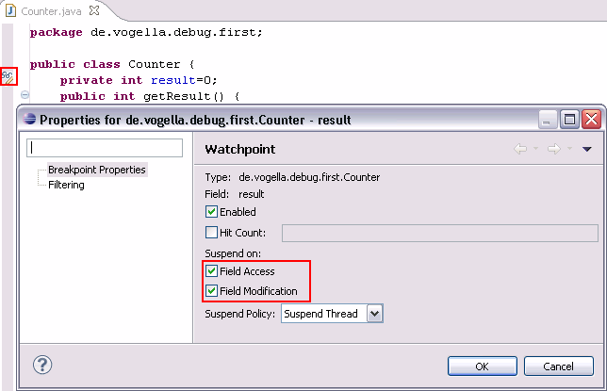
Watchpoint
A watchpoint is a breakpoint set on a field. The debugger will stop whenever that field is read or changed.
You can set a watchpoint by double-clicking on the left margin, next to the field declaration.
In the properties of a watchpoint, you can specify whether to stop during read access (Field Access) or during write access (Field Modification) or both.

Slide 23
Exception Breakpoints
You can set breakpoints, which are triggered when exceptions in your Java source code are thrown. To define an exception breakpoint click on the Add Java Exception Breakpoint button icon in the Breakpoint view toolbar.
That way, you can configure the debugger to stop at caught or uncaught exceptions.

Slide 24
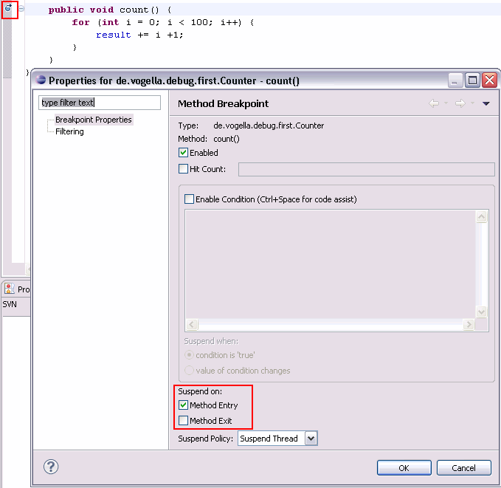
Method Breakpoints
A method breakpoint is defined by double-clicking in the left margin of the editor next to the method header.
You can configure the debugger to stop the program before entering or after leaving the method.

Slide 25
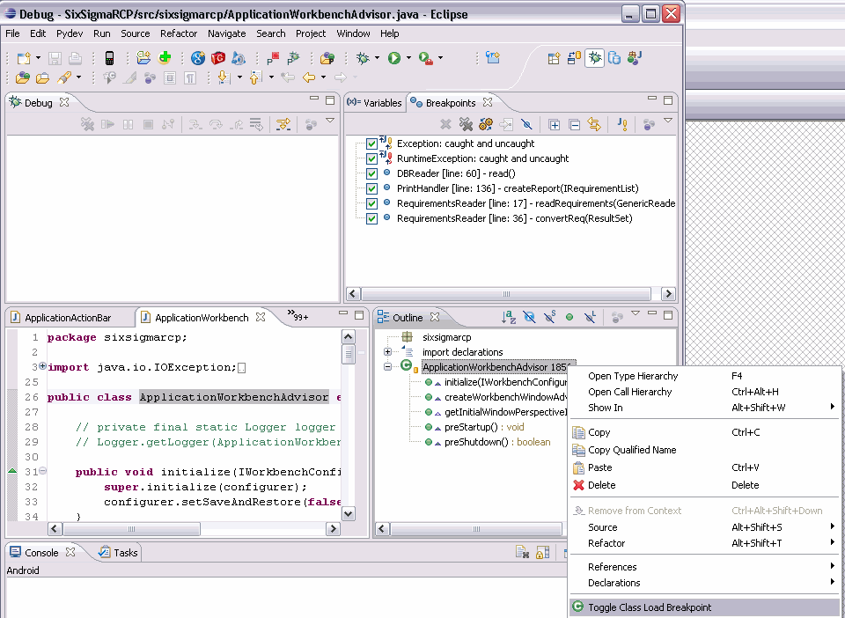
Breakpoints for Loading Classes
A Class Load breakpoint stops when the class is loaded.
To set a class load breakpoint, right-click on a class in the Outline view and choose the Toggle Class Load Breakpoint option.
Or you can double-click in the left border of the Java editor beside the class definition.

Slide 26
Acknowledgements
Slide show is based on information found in the article Java Debugging with Eclipse – Tutorial by Lars Vogel, Version 2.3, copyright © 2009, 2010, 2011, 2012, 2013 vogella GmbH 24.01.2013
The article can be found at: http://www.vogella.com/tutorials/EclipseDebugging/article.html

