Slide 1
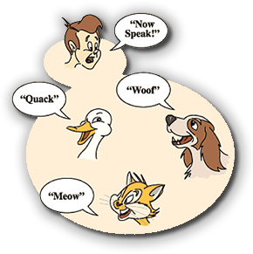
Polymorphism

Slide 2
Outline
Explanation of polymorphism
Use polymorphism to make generic data structures

Slide 3
Data Type
All class variables have:
  a declared type:
    Also called the static type.
  a dynamic type.
    What is the actual type of the object pointed to at run time or when a particular statement is executed?

Slide 4
Polymorphism
Another key feature of OOP.
  Literally “having many forms.”
Declared types in Java are polymorphic.
Declared types can refer to:
  the declared/static type of the variable
  OR
  any descendants of the declared type.
Rectangle r = new Rectangle();
r = new Square();//sub-class legal!

Slide 5
Dynamic Types
Declared types refer to any valid class type, including abstract classes and interfaces.
Dynamic types can only refer to instantiable classes (i.e. any class that’s not abstract or an interface).
Shape s; // abstract class
s = new Shape(); //illegal!

Slide 6
Question
Consider the following class declarations:
public class BoardSpace
public class Property extends BoardSpace
public class Street extends Property
public class Railroad extends Property
Which of the following statements would cause a syntax error, assuming all classes have a default constructor?
A. Object obj = new Railroad();
B. Street s = new BoardSpace();
C. BoardSpace b = new Street();
D. Railroad r = new Street();
E. More than one of these

Slide 7
Question
Consider the following class declarations:
public class BoardSpace
public class Property extends BoardSpace
public class Street extends Property
public class Railroad extends Property
Which of the following statements would cause a syntax error, assuming all classes have a default constructor?
A. Object obj = new Railroad();
B. Street s = new BoardSpace();
C. BoardSpace b = new Street();
D. Railroad r = new Street();
E. More than one of these.

Slide 8
Legality of Method Calls
Method calls are syntactically legal if the method is in the declared type or any ancestor of the declared type
The actual method that is executed at runtime is based on the dynamic type.
  dynamic dispatch

Slide 9
What’s the Output?
Shape s = new Rectangle(1,2);
System.out.println(s.toString());
s = new Rectangle(2, 3, 4, 5);
System.out.println(s.toString());
s = new Circle(4, 5, 10);
System.out.println(s.toString());
s = new Shape();
System.out.println(s.toString());

Slide 10
What’s the Output?
Shape s = new Rectangle(1,2);
System.out.println(s.toString());
x: 0 y: 0
width: 1 height: 2
s = new Rectangle(2, 3, 4, 5);
System.out.println(s.toString());
x: 2 y: 3
width: 4 height: 5
s = new Circle(4, 5, 10);
System.out.println(s.toString());
x: 4 y: 5
radius: 10
s = new Shape();
System.out.println(s.toString());
Error: won’t compile

Slide 11
Method LookUp
To determine if a method is legal, the compiler looks in the class based on the declared type.
  If it finds it, great.
  If not, goes to the super class and looks there.
  Continues until the method is found, or the Object class is reached, then throws a compilation error.
To determine which method is actually executed at runtime:
  Starts with the actual run-time class of the object calling the method.
  Searches the class for that method.
  If found, executes it.
  Otherwise, goes to the super class and keeps looking.
  Repeats until a version is found.
Is it possible the runtime system won’t find a method?

Slide 12
Question 2
What is output by the code to the right?
A. !!live
B. !eggegg
C. !egglive
D. !!!
E. eggegglive
public class Animal
{
public String talk(){ return "!"; }
}
public class Mammal extends Animal
{
public String talk(){ return "live"; }
}
public class Platypus extends Mammal
{
public String talk(){ return "egg"; }
}
Animal a1 = new Animal();
Animal a2 = new Platypus();
Mammal m1 = new Platypus();
System.out.print(a1.talk());
System.out.print(a2.talk());
System.out.print(m1.talk());

Slide 13
Question 2
What is output by the code to the right?
A. !!live
B. !eggegg
C. !egglive
D. !!!
E. eggegglive
public class Animal
{
public String talk(){ return "!"; }
}
public class Mammal extends Animal
{
public String talk(){ return "live"; }
}
public class Platypus extends Mammal
{
public String talk(){ return "egg"; }
}
Animal a1 = new Animal();
Animal a2 = new Platypus();
Mammal m1 = new Platypus();
System.out.print( a1.talk() );
System.out.print( a2.talk() );
System.out.print( m1.talk() );

Slide 14
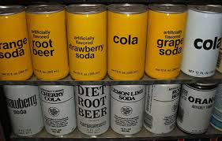
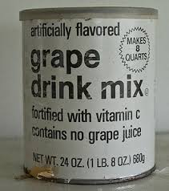
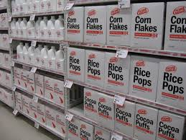
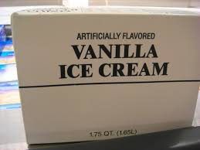
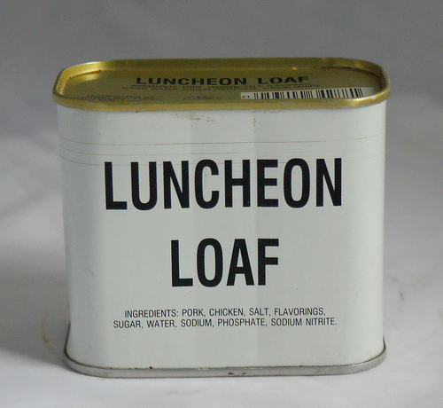
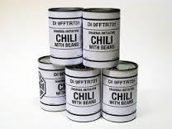
Generic Types

Slide 15
An Array-Based List
Want to create list class but don't want to have to write a new list class for every data type we want to store in lists.
Can we use an array of Objects to store the elements of the list?
  // from array-based list
  public class List
  {
  private Object[] data;
  …
  }

Slide 16
Using the Object Class
In Java, all classes inherit from exactly one other class, except Object.
Object variables can refer to objects of their declared type and any descendants.
  polymorphism
Thus, if the internal storage container is of type Object, it can hold anything, including primitive data types.

Slide 17
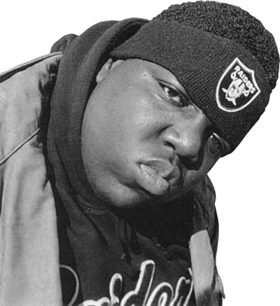
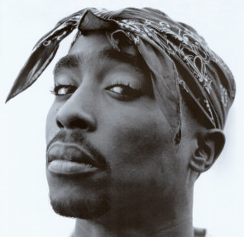
Wrapper Classes
Primitive Type | Wrapper Type
int | Integer
double | Double
char | Character
boolean | Boolean
float | Float
byte | Byte
short | Short
long | Long
Primitive wrapper class is
  a class that encapsulates, or wraps, data types from the eight primitive data types.
These classes can be used to instantiate objects representing primitive data types.

Slide 18
Difficulties with Object
Creating generic containers using the Object data type and polymorphism is relatively straightforward.
Using these generic containers leads to some difficulties:
  Casting
  Type checking

Slide 19
Question 1
What is output by the following code?
List list = new List(); // 1
String name = "Olivia";
list.add(name); // 2
System.out.print(list.get(0).charAt(2));// 3
A. i
B. No output due to syntax error at line // 1.
C. No output due to syntax error at line // 2.
D. No output due to syntax error at line // 3.
E. No output due to runtime error.

Slide 20
Question 1
What is output by the following code?
List list = new List(); // 1
String name = "Olivia";
list.add(name); // 2
System.out.print(list.get(0).charAt(2));// 3
A. i
B. No output due to syntax error at line // 1.
C. No output due to syntax error at line // 2.
D. No output due to syntax error at line // 3.
E. No output due to runtime error.

Slide 21
Code Example - Casting
List list = new List();
String name = "Olivia";
list.add(name);
System.out.print(list.get(0).charAt(2));
// Causes syntax error – declared type
// Object does not have a charAt method
// Must cast to a String
System.out.println(((String)list.get(0)).charAt(2));

Slide 22
Code Example – Type Checking
//assume all elements of list are Strings
public void printFirstChar(List list)
{
String temp;
for(int i = 0; i < list.size(); i++)
{
temp = (String)list.get(i);
if(temp.length() > 0)
System.out.println(temp.charAt(0));
}
}
// What happens if not Strings?

Slide 23
Too Generic?
Does the compiler allow this?
List list = new List();
list.add("Olivia");
list.add(new Integer(12));
list.add(new Rectangle());
list.add(new List());
Yes
No

Slide 24
Too Generic?
Does the compiler allow this?
List list = new List();
list.add("Olivia");
list.add(new Integer(12));
list.add(new Rectangle());
list.add(new List());
Yes
No

Slide 25
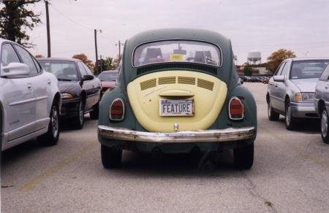
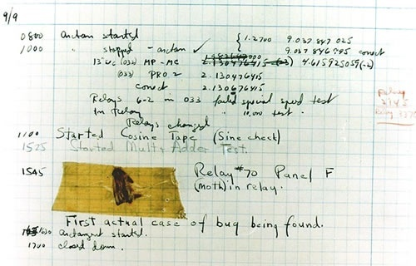
Is this a Bug or a Feature?
Notes:
On September 9, 1945, a Harvard technical team looked at Panel F and found something unusual between points in Relay 70. It was a moth, which they promptly removed and taped in the log book. Grace Hopper added the caption "First actual case of bug being found," and that's the first time anyone used the word bug to describe a computer glitch. Naturally, the term debugging followed.
Inventors and engineers had been talking about bugs for more than a century before the moth in the relay incident. Even Thomas Edison used the word.
Word nerds trace the word bug to an old term for a monster -- it's a word that has survived in obscure terms like bugaboo and bugbear and in a mangled form in the word boogeyman. Like gremlins in machinery, system bugs are malicious. Anyone who spends time trying to get all the faults out of a system knows how it feels: After a few hours of debugging, any problems that remain are hellspawn, mocking attempts to get rid of them with a devilish glee.
Moth in the machine: Debugging the origins of 'bug'
Did Grace Hopper really invent the term 'bug' to describe software errors?
By Computerworld staff
https://www.computerworld.com/article/2515435/app-development/moth-in-the-machine--debugging-the-origins-of--bug-.html

Slide 26
"Fixing" the Method
//assume all elements of are Strings
public void printFirstChar(ArrayList list)
{
String temp;
for(int i = 0; i < list.size(); i++)
{
if(list.get(i) instanceof String)
{
temp = (String)list.get(i);
if(temp.length() > 0)
System.out.println(temp.charAt(0));
}
}
}

Slide 27
Generic Types
Java has syntax for parameterized data types.
Referred to as Generic Types.
A traditional parameter has a data type and can store various values just like a variable.
public void foo(int x)
Generic Types are like parameters, but the data type for the parameter is a data type.
  It’s like a variable that stores a data type.
  This is an abstraction. Actually, all data type info is erased at compile time.

Slide 28
Making our List Generic
Data type variables declared in class header.
// from generic array-based list
public class List<T>
  {
  private T[] data;
  …
  }
The <T> is the declaration of a data type parameter for the class.
  Represents any legal class:
  Foo, MyClass, String, Double, Circle, etc.

Slide 29
Making our List Generic
The value T will be filled in whenever a programmer creates a new object.
List<String> list = new List<String>();
The effect is to create a String array to store data in.

Slide 30
Using Generic Types
// list stores Strings
List<String> list = new List<String>();
list.add("Isabelle");
System.out.println(list.get(0).charAt(2)); //OK
list.add(new Rectangle()); // syntax error

Slide 31
Generic Types and Subclasses
List<Shape> list = new List<Shape>();
list.add(new Rectangle()); // OK
list.add(new Square()); // OK
list.add( new Circle()); // OK
list above can store Shape objects and any descendants of Shape.
That’s polymorphism!

Slide 32
Why Bother?
Polymorphism allows code reuse in another way.
Inheritance and polymorphism allow programmers to create generic data structures.

