Slide 1

Exceptions
"A slipping gear could let your M203 grenade launcher fire when you least expect it. That would make you quite unpopular in what's left of your unit."
- THE U.S. Army's PS magazine, August 1993, quoted in The Java Programming Language, 3rd edition

Slide 2
When Good Programs Go Bad
A variety of problems can occur when a program is running.
  User input error: bad url
  Device errors: remote server unavailable
  Physical limitations: disk full
  Code errors: code that does not fulfill its contact (i.e. pre- and post-conditions)
When a problem occurs,
  return to safe state, save work, exit gracefully.
Code that handles a problem may be far removed from code that caused it.
Computer Science II

Slide 3
How to Handle Problems?
It’s possible to detect and handle problems of various types.
Issue: complicates code and makes it harder to understand.
  Problem detection and problem handling code have little or nothing to do with what the real code is trying to do.
Tradeoff between ensuring correct behavior under all possible circumstances and clarity of the code.
Computer Science II

Slide 4
Handling Problems in Java
Based on that of C++, but more in line with OOP philosophy.
All errors/exceptions are objects of classes that extend the Throwable class.
Computer Science II
Computer Science II

Slide 5
Classes of Exceptions
The Java library includes two important subclasses of Throwable class:
  Error
    Thrown by the Java interpreter for events such as heap overflow.
    Never handled by user programs.
  Exception
    User-defined exceptions are usually sub-classes of this.
    Has two predefined subclasses:
      IOException
      RuntimeException
Computer Science II
Computer Science II

Slide 6
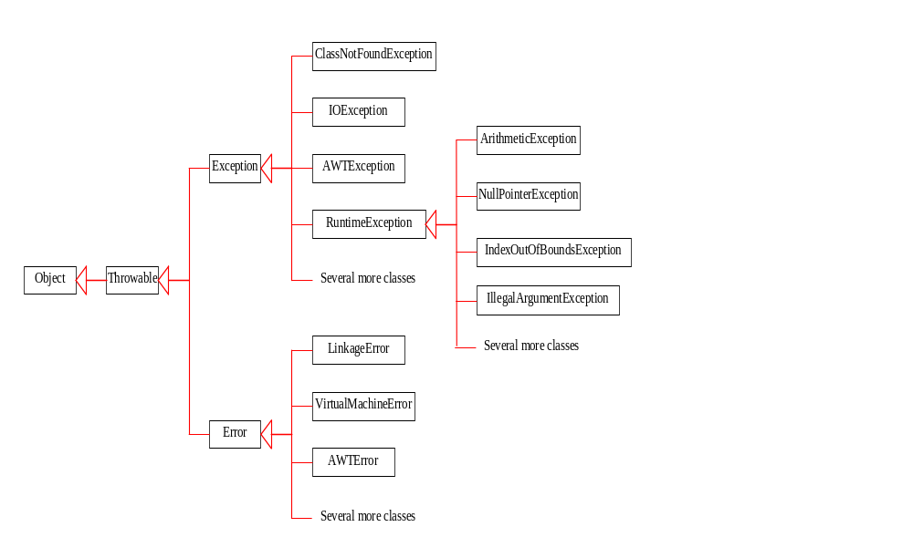
Error / Exception Classes
Computer Science II

Slide 7
Throwable Class Methods
Methods with Description
public String getMessage Returns a detailed message about the exception that has occurred. This message is initialized in the Throwable constructor.
public Throwable getCause Returns the cause of the exception as represented by a Throwable object.
public String toString Returns the name of the class concatenated with the result of getMessage()
public void printStackTrace Prints the result of toString() along with the stack trace to System.err, the error output stream.
public StackTraceElement[] getStackTrace Returns an array containing each element on the stack trace. The element at index 0 represents the top of the call stack, and the last element in the array represents the method at the bottom of the call stack.
public Throwable fillInStackTrace Fills the stack trace of this Throwable object with the current stack trace, adding to any previous information in the stack trace.
Computer Science II

Slide 8
Exceptions
Many languages, including Java, use the exception-handling process to handle runtime problems.
  In Java, Exception is a class with many descendants.
  For example:
    ArrayIndexOutOfBoundsException
    NullPointerException
    FileNotFoundException
    ArithmeticException
    IllegalArgumentException
Computer Science II

Slide 9
Handling Exceptions
Exceptions in Java fall into two different categories:
  Checked exception (compile-time)
    Must be caught in catch block.
    Or declared in throws clause.
  Unchecked exception (run-time)
    Need not be caught in catch block or declared in throws.
    Exceptions errors in code that should be fixed.
Computer Science II

Slide 10
Unchecked Exceptions
Unchecked exceptions are completely preventable and should never occur.
  Caused by logic errors, created by programmers.
  Descendents of the RuntimeException class.
There does not need to be special error handling code.
  Just regular error prevention code.
If error handling code was required, programs would be unwieldy.
Computer Science II

Slide 11
Unchecked Runtime Exceptions
Exception | Description
ArithmeticException | Arithmetic error, such as divide-by-zero.
ArrayIndexOutOfBoundsException | Array index is out-of-bounds.
ArrayStoreException | Assignment to an array element of an incompatible type.
ClassCastException | Invalid cast.
IllegalArgumentException | Illegal argument used to invoke a method.
IllegalMonitorStateException | Illegal monitor operation, such as waiting on an unlocked thread.
IllegalStateException | Environment or application is in incorrect state.
IllegalThreadStateException | Requested operation not compatible with current thread state.
IndexOutOfBoundsException | Some type of index is out-of-bounds.
NegativeArraySizeException | Array created with a negative size.
NullPointerException | Invalid use of a null reference.
NumberFormatException | Invalid conversion of a string to a numeric format.
SecurityException | Attempt to violate security.
StringIndexOutOfBounds | Attempt to index outside the bounds of a string.
UnsupportedOperationException | An unsupported operation was encountered.
Computer Science II

Slide 12
Checked Exceptions
"Checked exceptions represent conditions that, although exceptional, can reasonably be expected to occur, and if they do occur must be dealt with in some way [other than the program terminating]."
  Java Programming Language, Third Edition
Checked exceptions represent errors that are have to be handled by programmers.
Computer Science II

Slide 13
Checked Exceptions
Exception | Description
ClassNotFoundException | Class not found.
CloneNotSupportedException | Attempt to clone an object that does not implement the Cloneable interface.
IllegalAccessException | Access to a class is denied.
InstantiationException | Attempt to create an object of an abstract class or interface.
InterruptedException | One thread has been interrupted by another thread.
NoSuchFieldException | A requested field does not exist.
NoSuchMethodException | A requested method does not exist.
Computer Science II

Slide 14
When Exceptions Occur
When an exception occurs, the normal flow of control of a program halts.
The method where the exception occurred creates an exception object of the appropriate type.
  The object contains information about the error.
  Then hands exception to the Java Runtime System(JRS).
The JRS searches for a matching catch block for the exception.
The first matching catch block is executed.
When the catch block code is completed, the program executes the next regular statement after the catch block.
Computer Science II

Slide 15
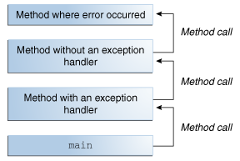
Call Stack
After a method throws an exception, the JRS looks for a method with a catch block to handle it. This block of code is called the exception handler.
If the method that threw the exception can’t handle it, the JRS looks in the ordered list of methods that have been called to get to this method. This list of methods is known as the call stack.
Computer Science II

Slide 16
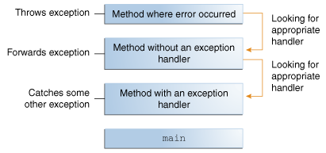
Exception Handler
When an appropriate handler is found, the JRS passes the exception to the handler.
An exception handler is considered appropriate if the type of exception thrown matches the type of exceptions that can be handled by the handler, or inherits from one.
If the JRS searches the whole call stack without finding an appropriate exception handler, the program terminates.
Computer Science II

Slide 17
Catching Exceptions
A method surrounds code that may cause an exceptions with a try block.
The catch statement declares type of exception trying to catch. If an exception or that type or one of its descendants occurs, the exception is passed on to that block for processing.
try
{
//Protected code
}
catch(ExceptionName e1)
{
//Catch block
}
Computer Science II

Slide 18
An Example
// File Name : ExcepTest.java
public class ExcepTest
{
public static void main(String args[])
{
try
{
int a[] = new int[2];
System.out.println("Access element three :" + a[3]);
}
catch(ArrayIndexOutOfBoundsException e)
{
System.out.println("Exception thrown :" + e);
}
System.out.println("Out of the block");
}
}
Computer Science II

Slide 19
Example Output
The above code would produce the following result:
Exception thrown :java.lang.ArrayIndexOutOfBoundsException: 3
Out of the block
Computer Science II

Slide 20
Multiple Catch Blocks
A try block can be followed by multiple catch blocks.
try
{
//Protected code
}
catch(ExceptionType1 e1)
{
//Catch block
}
catch(ExceptionType2 e2)
{
//Catch block
}
catch(ExceptionType3 e3)
{
//Catch block
}
Computer Science II
Notes:
The previous statements demonstrate three catch blocks, but you can have any number of them after a single try. If an exception occurs in the protected code, the exception is thrown to the first catch block in the list. If the data type of the exception thrown matches ExceptionType1, it gets caught there. If not, the exception passes down to the second catch statement. This continues until the exception either is caught or falls through all catches, in which case the current method stops execution and the exception is thrown down to the previous method on the call stack.

Slide 21
Example-Multiple Catch Blocks
try
{
file = new FileInputStream(fileName);
x = file.read();
}
catch(FileNotFoundException f)
{
f.printStackTrace();
}
catch(IOException i)
{
i.printStackTrace();
}
Computer Science II

Slide 22
throws Keyword
If a method does not handle a checked exception, the method must declare it using the throws keyword.
import java.io.*;
public class ClassName
{
public int read(FileStream file) throws IOException
{
int x = file.read();
}
}
Computer Science II

Slide 23
Multiple Exceptions Thrown
A method can throw more than one exception.
  Exceptions are declared in a list separated by commas.
import java.io.*;
public class ClassName
{
public int read(String fileName) throws FileNotFoundException, IOException
{
FileStream file = new FileInputStream(filename);
int x file.read();
}
}
Computer Science II

Slide 24
finally Block
The finally keyword used to create a block of code that follows a try block.
  Always executes, whether or not an exception has occurred.
  Runs any cleanup-type statements that you want to execute.
  Appears after the catch blocks.
try
{ //Protected code
}
catch(ExceptionType e)
{ //Catch block
}
finally
{ //The finally block always executes.
}
Computer Science II

Slide 25
Example – finally Block
public class ExcepTest
{
public static void main(String args[])
{
int a[] = new int[2];
try
{
System.out.println("Access element three :" + a[3]);
}
catch(ArrayIndexOutOfBoundsException e)
{
System.out.println("Exception thrown :" + e);
}
finally
{
a[0] = 6; System.out.println("First element value: " +a[0]);
System.out.println("The finally statement is executed");
}
}
}
Computer Science II

Slide 26
Example Output
Would produce this result:
Exception thrown :java.lang.ArrayIndexOutOfBoundsException: 3
First element value: 6
The finally statement is executed
Computer Science II

Slide 27
Things to Note
Must follow a try block with either catch and/or finally block.
Catch blocks must follow a try statement.
A finally block is not required if there are try-catch blocks.
try, catch, finally blocks must follow each other in that order.
  There cannot be any code between them.
Computer Science II

Slide 28
Throwing Exceptions Yourself
If you wish to throw an exception in your code, you use the throw keyword.
Most common would be for an unmet precondition.
public class Circle
{ private double radius;
// other variables and methods
public setRadius(int radius){
if (radius <= 0)
throw new IllegalArgumentException
("radius must be > 0. "
+ "Value of radius: " + radius);
this.radius = radius;
// other unrelated code
}
}
Computer Science II

Slide 29
Errors
An error is an object of class Error.
  Similar to an unchecked exception.
  Need not catch or declare in throws clause.
  Object of class Error generated when abnormal conditions occur.
Errors are more or less beyond your control.
  Require change of program to resolve.
Computer Science II

Slide 30
Question 1
What is output by the method badUse if it is called with the following code?
…
int[] nums = {3, 2, 6, 1};
badUse( nums );
…
public static void badUse(int[] vals){
int total = 0;
try{
for(int i = 0; i < vals.length; i++){
int index = vals[i];
total += vals[index];
}
}
catch(Exception e){
total = -1;
}
System.out.println(total);
}
A. 12 B. 0 C. 3 D. -1 E. 5
Computer Science II

Slide 31
Question 1
What is output by the method badUse if it is called with the following code?
…
int[] nums = {3, 2, 6, 1};
badUse( nums );
…
public static void badUse(int[] vals){
int total = 0;
try{
for(int i = 0; i < vals.length; i++){
int index = vals[i];
total += vals[index];
}
}
catch(Exception e){
total = -1;
}
System.out.println(total);
}
A. 12 B. 0 C. 3 D. -1 E. 5
Computer Science II

Slide 32
Question 2
Is the use of a try-catch block on the previous question a proper use of try-catch blocks?
A. Yes
B. No
Computer Science II

Slide 33
Question 2
Is the use of a try-catch block on the previous question a proper use of try-catch blocks?
A. Yes
B. No
What is a better way to handle this type of error?
Computer Science II

Slide 34
Advantages of Exceptions
Separates Exception-Handling Code from "Regular" Code
  Means to separate the details of what to do when something out of the ordinary happens from the main logic of a program.
Propagating Exceptions Down the Call Stack
  Ability to propagate error reporting down the call stack of methods.
Grouping and Differentiating Error Types
  Since all exceptions thrown within a program are objects, the grouping or categorizing of exceptions is a natural outcome of the class hierarchy.
Computer Science II

Slide 35

Computer Science II

Slide 36
Creating Exceptions
All exceptions must inherit from the Throwable class.
If you want to write a checked exception, extend the Exception class.
If you want to write an unchecked exception, extend the RuntimeException class.
Define at least two constructors:
  Default, no parameters.
  Another with String parameter representing a message.
  For both, call constructor of base class.
Do not override inherited getMessage.
Computer Science II

Slide 37
Example–Creating Exceptions
// File Name MyException.java
import java.io.*;
public class MyException extends Exception
{
public MyException(String msg)
{
super(msg);
}
}
Computer Science II

Slide 38
Assertions
Statements in the program declaring a Boolean expression about the current state of variables
If evaluate to true, nothing happens
If evaluate to false, an AssertionError exception is thrown
Can be disabled during runtime without program modification or recompilation
Two forms
  assert condition;
  assert condition: expression;
Computer Science II

Slide 39
Error Handling, Error Handling Everywhere!
Seems like a lot of choices for error prevention and error handling
  normal program logic (e.g. ifs, for-loop counters)
  assertions
  try-catch block
When is it appropriate to use each kind?
Computer Science II

Slide 40
Error Prevention
Use program logic (ifs , fors) to prevent logic errors and unchecked exceptions
  dereferencing a null pointer
  going outside the bounds of an array
  violating the preconditions of a method you are calling
Computer Science II

Slide 41
Error Prevention – cont’d
In general, don’t use asserts to check preconditions
  Standard Java style is to use exceptions
Use try-catch blocks on checked exceptions
  Don’t use them to handle unchecked exceptions, like null pointer or array index out of bounds
One place it is reasonable to use try-catch is in testing suites.
  put each test in a try-catch. If an exception occurs that test fails, but other tests can still be run
Computer Science II

