Slide 1
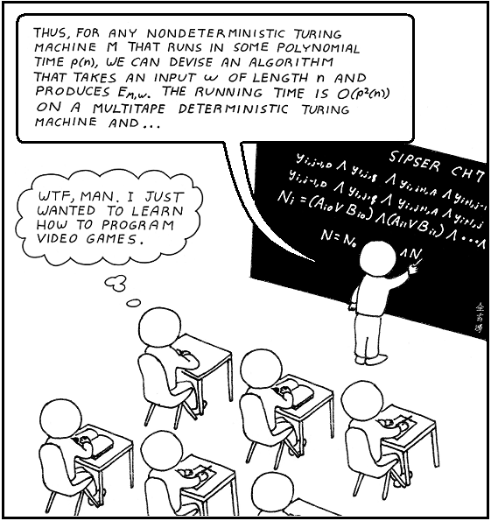
Analysis of Algorithms

Slide 2
Question 1
"My program finds all the primes between 2 and 1,000,000,000 in 1.37 seconds."
  Is this solution good or bad?
Good
Bad
It depends
Computer Science II

Slide 3
Question 1
"My program finds all the primes between 2 and 1,000,000,000 in 1.37 seconds."
  Is this solution good or bad?
Good
Bad
It depends
Computer Science II

Slide 4
Efficiency
Computer Scientists don’t just write programs.
  They also analyze them.
How efficient is a program?
  How much time does it take program to complete?
  How much memory does a program use?
  How do these change as the amount of data changes?
Computer Science II

Slide 5
Question 2
What is output by the following code?
int total = 0;
for(int i = 0; i < 13; i++)
for(int j = 0; j < 11; j++)
total += 2;
System.out.println( total );
    24
    120
    143
    286
    338
Computer Science II

Slide 6
Question 2
What is output by the following code?
int total = 0;
for(int i = 0; i < 13; i++)
for(int j = 0; j < 11; j++)
total += 2;
System.out.println( total );
    24
    120
    143
    286
    338
Computer Science II

Slide 7
Question 3
What is output when method sample is called?
public static void sample(int n, int m) {
int total = 0;
for(int i = 0; i < n; i++)
for(int j = 0; j < m; j++)
total += 5;
System.out.println( total );
}
  5 D. n^{m}
  n * m E. (n * m)⁵
  n * m * 5
Computer Science II

Slide 8
Question 3
What is output when method sample is called?
public static void sample(int n, int m) {
int total = 0;
for(int i = 0; i < n; i++)
for(int j = 0; j < m; j++)
total += 5;
System.out.println( total );
}
  5 D. n^{m}
  n * m E. (n * m)⁵
  n * m * 5
Computer Science II

Slide 9
Example
How many statements are executed by method total as a function of values.length?
Let n = values.length
  n is commonly used as a variable that denotes the amount of data
public int total(int[] values)
{
int result = 0;
for(int i = 0; i < values.length; i++)
result += values[i];
return result;
}
Computer Science II

Slide 10
Counting Statements
int x; // 1 statement
x = 12; // 1
int y = z * x + 3 % 5 * x / i; // 1
x++; // 1 statement
boolean p = y % 2 == 0 || z >= y * x; // 1
int[] list = new int[100]; // 100 statements
list[0] = x * x + y * y; // 1
Computer Science II

Slide 11
Counting Up Statements
int result = 0; 1
int i = 0; 1
i < values.length; n + 1
i++; n
result += values[i]; n
return total; + 1 _
T(n) = 3n + 4
T(n) is the number of executable statements in method total as function of values.length = n.
Computer Science II

Slide 12
Another Simplification
To determine complexity of an algorithm, simplify things.
  Hide details, make comparisons easier.
Like assigning your course grade:
  At the end of CS 221, transcript won’t list all the details of your performance in the course.
  It won’t list scores on all assignments, quizzes, and final.
  Simply a letter grade, B- or A or D+.
Focus on the dominant term from the function and ignore the coefficient.
Computer Science II

Slide 13
Big-O
The most common notation for discussing the execution time of algorithms is Big-O.
  Big-O is the asymptotic execution time of the algorithm.
  Big-O is an upper bounds.
  It’s a mathematical tool.
  Hides a lot of unimportant details by assigning a simple grade (function) to algorithms.
Computer Science II

Slide 14
Big-O Simplification Rules
If T(n) is a sum of several terms:
  Keep the one with the largest growth rate.
  Omit all others.
  If T(n) = n²+n+1, then T(n) = O(n²).
If T(n) is a product of several factors:
  Omit the constant terms in the product that do not depend on n.
  If T(n) = 3n, then T(n) = O(n).
  If T(n) = 5n log(n), then T(n) = O(n log (n)).
CS 221 - Computer Science II

Slide 15
Assigning Big-O
int result = 0; 1
int i = 0; 1
i < values.length; n + 1
i++; n
result += values[i]; n
return total; + 1 _
T(n) = 3n + 4
Therefore, method total is in O(n).
Computer Science II

Slide 16
Typical Big-O Functions
(in descending order of growth)
Function | Common Name
n! | Factorial
2^{n} | Exponential
n^{d}, d > 3 | Polynomial
n³ | Cubic
n² | Quadratic
n n | n Square root n
n log n | linearithmic
n | Linear
n | Root - n
log n | Logarithmic
1 | Constant

Slide 17
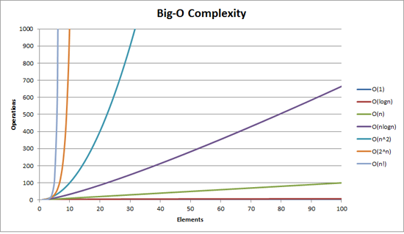
Chart of Common Big-O Functions

Slide 18
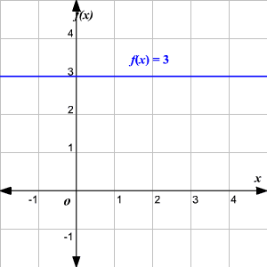
O(1) – Constant Time
O(1) – represents algorithm that always executes in the same time (or space), regardless of the size of the input data set.
Boolean isFirstElementNull(String[] elements)
{
return elements[0] == null;
}
Computer Science II

Slide 19
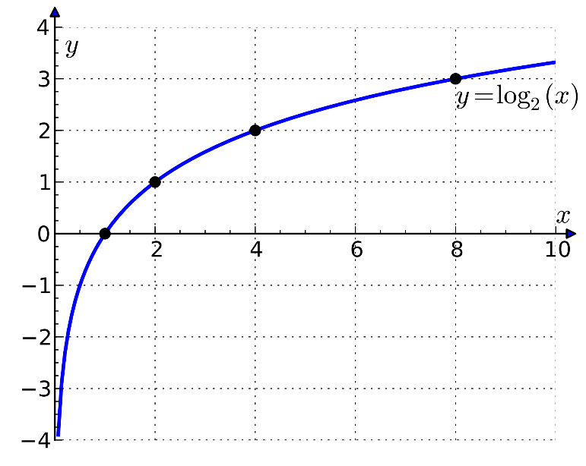
O(log n) – Logarithmic Time
O(log n) – represents algorithm that iteratively halves data set.
    Increasing size of input data set has little effect on its growth.
    After single iteration, data set halved.
  Algorithms like Binary Search run in logarithmic time.
    Extremely efficient when dealing with large data sets.
Computer Science II

Slide 20
Binary Search
int binary_search(int A[], int key, int min, int max) {
// test if array is empty
if (max < min)
// set is empty, so return value showing not found
return KEY_NOT_FOUND;
else
{
// calculate midpoint to cut set in half
int mid = midpoint(min, max);
// three-way comparison
if (A[mid] > key)
// key is in lower subset
return binary_search(A, key, min, mid - 1); else if (A[mid] < key)
// key is in upper subset
return binary_search(A, key, mid + 1, max); else
// key has been found
return mid;
}
}

Slide 21
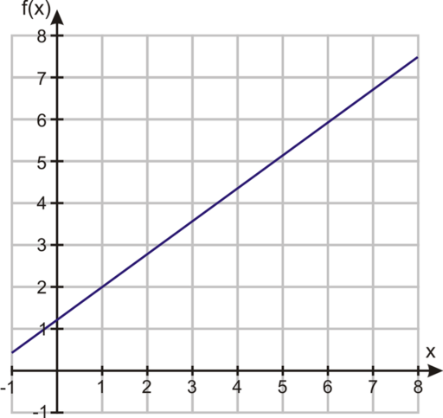
O(n) – Linear Time
O(n) - represents algorithm whose performance grows linearly, in direct proportion to size of input data set.
Boolean containsValue(String[] elements, string value)
{
int size = elements.length;
for(int i = 0; i < size; i++)
{
if (element == value)
return true;
}
return false;
}
Computer Science II

Slide 22
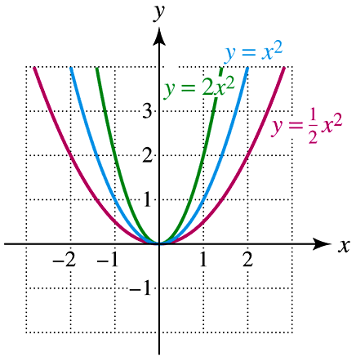
O(n²) – Quadratic Time
O(n²) - represents algorithm whose performance is directly proportional to square of size of input data set.
  Usually algorithms that involve nested iterations over the data set.
  Deeper nested iterations will result in O(n³), O(n⁴), runtimes etc.
Computer Science II

Slide 23
Quadratic Time Example
public void printGrid(int n)
{
for ( int i = 0 ; i < n; i++ )
{
// PRINT a row
for ( int i = 0 ; i < n; i++ )
{
System.out.print("*") ;
}
// PRINT newline
System.out.println(“ “) ;
}
}
Computer Science II

Slide 24
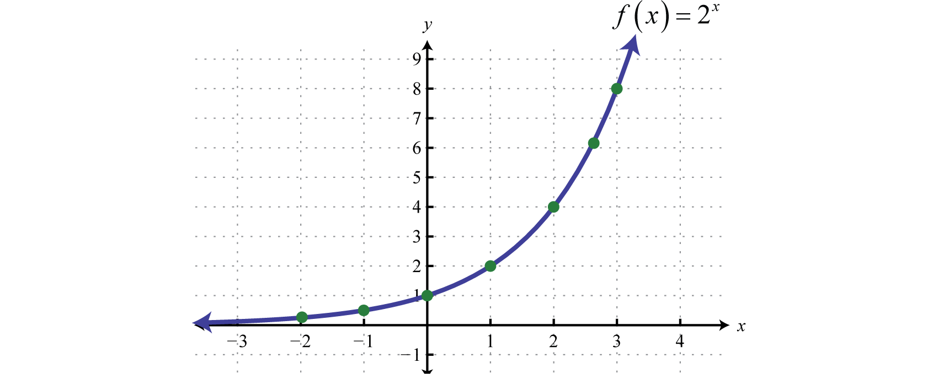
O(2^{n}) – Exponential Time
O(2^{n}) - denotes algorithm whose growth doubles with each addition to input data set.
public int Fibonacci(int number)
{
if (number <= 1)
return number;
else
return Fibonacci(number - 2) + Fibonacci(number - 1);
}
Computer Science II

Slide 25
Example of Dominance
Assume the actual numbers of operations as a function of the amount of data is:
n²/10000 + 2n log₁₀(n) + 100000
Is it plausible to say the n² term dominates even though it is divided by 10000 and that the algorithm is O(n²)?
What if we separate the equation into n²/10000 and 2n log₁₀(n) + 100000 and graph the results?
Computer Science II

Slide 26
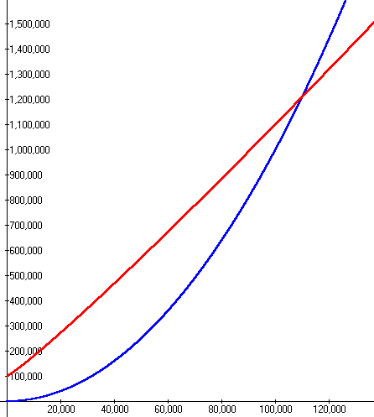
Summing Execution Times
For large values of n, the n² term dominates so the algorithm is O(n²).
But what is dominant for n < 110,000?
red line is 2n log₁₀n + 100000
blue line is n²/10000
Computer Science II

Slide 27
Comparing Grades
Assume we have a problem.
Algorithm A solves the problem correctly in O(n²).
Algorithm B solves the same problem correctly in O(n log(n)).
Which algorithm is faster?
One of the assumptions of Big-O is that the data set is large.
The "grades" should be accurate tools if this is true.
Computer Science II

Slide 28
Why Does it Matter?
Assume n = 100,000 and processor speed is 1,000,000,000 operations per second:
Function | Running Time
2^{n} | 3.2 x 10³⁰⁰⁸⁶ years
n⁴ | 3171 years
n³ | 11.6 days
n² | 10 seconds
n n | 0.032 seconds
n log n | 0.0017 seconds
n | 0.0001 seconds
n | 3.2 x 10⁻⁷ seconds
log n | 1.2 x 10⁻⁸ seconds
Computer Science II

Slide 29
Just Count Loops, Right?
// assume mat is a 2d array of booleans
// assume mat is square with n rows,
// and n columns
int numThings = 0;
for(int r = row - 1; r <= row + 1; r++)
for(int c = col - 1; c <= col + 1; c++)
if( mat[r][c] )
numThings++;
What is the order of the above code?
O(1) B. O(n) C. O(n²) D. O(n³) E. O(n^{1/2})
Computer Science II

Slide 30
Just Count Loops, Right?
// assume mat is a 2d array of booleans
// assume mat is square with n rows,
// and n columns
int numThings = 0;
for(int r = row - 1; r <= row + 1; r++)
for(int c = col - 1; c <= col + 1; c++)
if( mat[r][c] )
numThings++;
What is the order of the above code?
O(1) B. O(n) C. O(n²) D. O(n³) E. O(n^{1/2})
Computer Science II

Slide 31
It is Not Just Counting Loops
Example from previous slide rewritten as follows:
int numThings = 0;
if( mat[r-1][c-1] ) numThings++;
if( mat[r-1][c] ) numThings++;
if( mat[r-1][c+1] ) numThings++;
if( mat[r][c-1] ) numThings++;
if( mat[r][c] ) numThings++;
if( mat[r][c+1] ) numThings++;
if( mat[r+1][c-1] ) numThings++;
if( mat[r+1][c] ) numThings++;
if( mat[r+1][c+1] ) numThings++;
Computer Science II

Slide 32
Dealing with Other Methods
What do about method calls?
double sum = 0.0;
    for(int i = 0; i < n; i++)
sum += Math.sqrt(i);
Long way:
  Go to that method or constructor and count statements.
Short way:
  Substitute the simplified Big-O function for that method.
  If Math.sqrt is constant time, O(1), simply count sum += Math.sqrt(i); as one statement.
Computer Science II

Slide 33
Dealing With Other Methods
public int foo(int[] list) {
int total = 0;
for(int i = 0; i < list.length; i++)
total += countDups(list[i], list);
return total;
}
// method countDups is O(n), where n is the
// length of the array it is passed
What is the Big-O of foo?
O(1) B. O(n) C. O(n log n)
D. O(n²) E. O(n!)
Computer Science II

Slide 34
Dealing With Other Methods
public int foo(int[] list) {
int total = 0;
for(int i = 0; i < list.length; i++)
total += countDups(list[i], list);
return total;
}
// method countDups is O(n), where n is the
// length of the array it is passed
What is the Big-O of foo?
O(1) B. O(n) C. O(n log n)
D. O(n²) E. O(n!)
Computer Science II

Slide 35
Independent Loops
// from the Matrix class
public void scale(int factor) {
for(int r = 0; r < numRows; r++)
for(int c = 0; c < numCols; c++)
iCells[r][c] *= factor;
}
Assume numRows = n and numCols = m
What is the T(n)? What is the Big-O?
O(m) B. O(n) C. O(n * m)
D. O(n²) E. O(n + m)
Computer Science II

Slide 36
Independent Loops
// from the Matrix class
public void scale(int factor) {
for(int r = 0; r < numRows; r++)
for(int c = 0; c < numCols; c++)
iCells[r][c] *= factor;
}
Assume numRows = n and numCols = m
What is the T(n)? What is the Big-O?
O(m) B. O(n) C. O(n * m)
D. O(n²) E. O(n + m)
Computer Science II

Slide 37
Why Use Big-O?
As build data structures, Big-O is the tool used to decide under what conditions one data structure is better than another.
Think about performance when there is a lot of data.
  "It worked so well with small data sets..."
  Joel Spolsky, Schlemiel the Painter's Algorithm
Computer Science II

Slide 38
Big-O Space
Big-O also used to compare space requirements of algorithms.
  How much space need for data?
Often there is a time – space tradeoff:
  Often take less time if willing to use more memory.
  Often use less memory if willing to take longer.
  Truly beautiful solutions take less time and space.
The biggest difference between time and space is that you can't reuse time. - Merrick Furst
Computer Science II

Slide 39
Quantifiers on Big O
It is often useful to discuss different cases for an algorithm.
Best Case: What is the best we can hope for?
  Least interesting.
Average Case (expected runtime): What usually happens with the algorithm?
Worst Case: What is the worst we can expect of the algorithm?
  Very interesting.
  Compare this to the average case.
Computer Science II

Slide 40
Another Example
public boolean find(int[] values, int target)
{
int n = values.length;
boolean found = false;
int i = 0;
while(i < n && !found)
if(values[i] == target)
found = true;
i++;
return found;
}
Big-O? Best case? Worst Case? Average Case?
If no other information, assume asking worst case.
Computer Science II

Slide 41

Computer Science II

Slide 42
Formal Definition of Big-O
T(n) is in O( g(n) ) if there are positive constants c and n₀ such that T(n) < c*g(n) for all n > n₀
  n is the size of the data set the algorithm works on
  T(n) is a function that characterizes the actual running time of the algorithm
  g(n) is a function that characterizes an upper bounds on T(n). It is an upper limit on the running time of the algorithm.
  c and n₀ are constants
Computer Science II

Slide 43
What it Means
T(n) is the actual growth rate of the algorithm
  can be equated to the number of executable statements in a program or chunk of code
g(n) is the function that bounds the growth rate from above
T(n) may not necessarily equal g(n)
  constants and lesser terms ignored because it is a bounding function
Computer Science II

Slide 44
Showing O(n) is Correct
Recall the formal definition of Big O
  T(n) is O( g(n) ) if there are positive constants c and n₀ such that T(n) < c*g(n) when n > n₀
Recall method total, T(n) = 3n + 4
  show method total is O(n).
  g(n) is n
We need to choose constants c and n₀
how about c = 4, n₀ = 5 ?
Computer Science II

Slide 45
vertical axis: time for algorithm to complete. (simplified to
number of executable statements)
c * g(n), in this case,
c = 4, c * g(n) = 4n
T(n), actual function of time.
In this case 3n + 4
g(n), approximate function
of time. In this case n
N_{o} = n
horizontal axis: n, number of elements in data set
Computer Science II

Slide 46
10⁹ instructions/sec, runtimes
N | O(log N) | O(N) | O(N log N) | O(N²)
10 | 0.000000003 | 0.00000001 | 0.000000033 | 0.0000001
100 | 0.000000007 | 0.00000010 | 0.000000664 | 0.0001000
1,000 | 0.000000010 | 0.00000100 | 0.000010000 | 0.001
10,000 | 0.000000013 | 0.00001000 | 0.000132900 | 0.1 min
100,000 | 0.000000017 | 0.00010000 | 0.001661000 | 10 seconds
1,000,000 | 0.000000020 | 0.001 | 0.0199 | 16.7 minutes
1,000,000,000 | 0.000000030 | 1.0 second | 30 seconds | 31.7 years
Computer Science II

