Slide 1

Software Testing
Program testing can be used to show the presence of bugs, but never to show their absence.
– Edgar Dijkstra

Slide 2
Programming Errors
Compilation / Syntax errors
  Grammatically incorrect statement.
  Occur while parsing input code.
    Example: missing a semi-colon.
  Easiest errors to fix.
Runtime errors
  Occur at runtime.
    Example: File not found.
  Java’s exception mechanism can catch such errors.
Logic / Semantic errors
  Program runs but produces incorrect result.
    Example: Division by zero.
  Hard to characterize, hardest to fix.
Programming errors are also known as bugs.
  Origin: A moth in the Mark I computer.

Slide 3
Testing and Debugging
Testing:
  Execution of a program to find errors.
Debugging:
  Diagnosing errors and correcting them.
Testing
Error?
Yes
Debug

Slide 4
Software Testing
Goal of software testing:
  Finding faults in software.
  Demonstrating no faults in the software for the test case used during testing.
Testing will not prove there are no faults in the software.
Testing should help locate errors, not just detect their presence.
  A “yes/no” answer to the question “is the program correct?” is not very helpful.
Testing should be repeatable.
  Can be difficult for distributed or concurrent software.
  Affected by the environment, uninitialized variables.

Slide 5
Testing Software is Hard
To test a bridge’s ability to support weight:
  Add 1000 tons of weight to the bridge.
  If it passes, you can assume it will sustain weight ≤ 1000 tons.
This kind of reasoning does not work for software systems.
  Software systems are not linear or continuous.
Exhaustively testing all possible input / output combinations is not feasible, usually.
  Number of test cases increases exponentially with number of input/output variables.

Slide 6
Guiding Software Testing Principle
To remove as many software defects as possible before testing.
Testing has a limited potential to improve software.
Notes:
A common view of testing is that all untested code has a roughly equal probability of containing defects. DeMarco asserts that the incidence of defects in untested codes varies widely and that no amount of testing can remove more than 50 percent of them. However, there is data that shows that properly run unit tests are potentially capable of detecting as many as 70 percent of the defects in a program. The objective should therefore be to remove as many as defects as possible before test since the quality improvement potential of testing is limited.
An examination of even relatively simple programs demonstrates that exhaustive testing is generally impossible. If a program were to analyze a string of only ten alphabetic characters, there would be 26¹⁰ possible combinations. Testing one condition every microsecond would take four and a half million years. Thus test design reduces to a small subset of conditions that will reveal the characteristics of the program.

Slide 7
Types of Software Testing
Unit Testing (White Box)
Integration and System Testing
Function Testing (Black Box)
Regression Testing
Acceptance and Installation Tests

Slide 8
Unit Testing (White Box)
Individual components are tested.
Focuses on a relatively small segment of code.
Aim to exercise a high percentage of internal paths.
Disadvantages:
  Tester may be biased by previous experience.
  Tests may not cover all possible input values.
Notes:
When unit tests are done on a white box basis, they are essentially path test. The idea is to focus on a relatively small segment of code and aim to exercise a high percentage of the internal paths. The simplest approach is to ensure that every statement is exercised at least once. A more stringent criterion is to require coverage of every path within a program.
One disadvantage of white box testing is that the tester may be biased by previous experience. The tests are often designed by the programmers who produced the code since they may be the only ones who understand it. Unfortunately, those who created the programs’ faults are least likely to recognize them. Even though all the paths and variable of the program have gone through by the testing program, it could not guarantee all possible values of the variables have been tested.
While its disadvantages are significant, white box testing generally has the highest error yield of all testing techniques.

Slide 9
Integration and System Testing
Integration testing is done as modules or components are assembled.
  Attempts to ensure that pieces work together correctly.
  Test interfaces between modules.
System testing occurs when the whole system is put together.

Slide 10
Functional Testing (Black Box)
Designed to exercise program’s external specifications.
Testers not biased by knowledge of the program’s design.
Disadvantages:
  The need for explicitly stated requirements.
  Only cover a small portion of the possible test conditions.
Notes:
Since exhaustive black box testing is generally impossible, these test should be viewed as statistical sampling; when errors are found, a closer examination is required. Functional testing stars by examining the functions the program is to perform and devising a sequence of inputs to test them.

Slide 11
Regression Testing
Test effects of changes on previously integrated code.
Usually define comprehensive, system-wide tests but also identify subsets of these tests that cover important functional components.
Full system- wide, regression testing is not often run, but one or more of the subsets are run when significant changes are made.
Disadvantages:
  Deciding which tests to include in the subsets.
Notes:
The progressive phase introduces and tests new functions, uncovering problems in the newly added or modified modules and in their interfaces with the previously integrated modules. The regressive phase concerns the effect of the newly introduced changes on all the previously integrated code. Problems arise when errors made in incorporating new functions affect previously tested functions.
The basic regression testing approach is to incorporate selected test cases into a regression test bucket that is run periodically in an attempt to detect regression problems. Usually the full bucket is run only occasionally, but the subset is run against every spin. The spin subset should include all the test cases for any recently integrated functions and a selected sample from the full regression bucket.

Slide 12
Real-Time Testing
Real-time testing is necessary because deployment system is usually more complicated than development.
Rules apply for testing real-time system:
  Evaluate possible deadlocks, thrashing to identify special timing conditions.
  Use tests to simulate hardware faults.
  Use hardware simulation to stress the software design.
  Design ways to simulate modules missing in the development system.
Notes:
Real-time testing can be particularly difficult because the development work is done on a host system and then compiled for execution on a target system.Typically a reasonable set of test and debug facilities is available for the host environment but the target system is generally much more sparsely equipped.

Slide 13
Test Scripts
Test Script
  Collection of test cases for software under test.
  Manual or automated.
Test Case
  Set of inputs.
  Execution preconditions.
  Expected outcomes developed for a particular objective.
    To exercise a particular program path or to verify compliance with a specific requirement.

Slide 14
Designing Test Cases
Positive vs. Negative Testing
Domain Testing
  Equivalence Testing
  Boundary Testing

Slide 15
Positive vs Negative Testing
Positive testing:
  Testing of functionality that we expect to work.
Negative testing:
  Testing cases we expect to fail.
  Handle these cases in some controlled way.
  Example: Catch handler for exceptions.

Slide 16
Domain Testing
Partition the input domain into equivalence classes.
  Equivalence classes are software units of equivalent data from which test cases can be derived.
  In principle, test cases are designed to cover each partition at least once.
Test boundary conditions, the extremes of the input domain:
    maximum / minimum
    just inside / outside boundaries
    typical values
    error values, etc.

Slide 17
Example: Domain Testing
final int CALENDAR_START = 1583;
// validate input
if ((year < CALENDAR_START) || (month < 1) || (month > 12))
{
System.output.println("Bad request: " + year + " " + month);
}
Input Year | Input Month
1582 | 2
1583 | 0
1583 | 1
1583 | 12
1583 | 13

Slide 18
Testing Thoroughly
For example, Richard can’t spot the error in his code.
He tested it on many sets of data:
  <3,5,9>, <12,1,6>, <2,7,4>, etc.
  The program works for all these data.
But he didn’t test it with duplicate values:
  like <3,3,3>, <7,2,7>, etc.
  // To find the maximum among 3 integer
  // values in variables num1, num2, num3.
  int max = 0;
  if (num1 > num2 && num1 > num3)
  max = num1;
  if (num2 > num1 && num2 > num3)
  max = num2;
  if (num3 > num1 && num3 > num2)
  max = num3;

Slide 19
Testing Thoroughly
Richard wrote another program.
But program still doesn’t work.
He has tested it on many data sets, including duplicate values!
What is his testing missing?
Hint: Don’t forget the special cases!
  // To find the maximum among 3 integer
  // values in variables num1, num2, num3.
  int max = 0;
  if (num1 > max)
  max = num1;
  if (num2 > max)
  max = num2;
  if (num3 > max)
  max = num3;

Slide 20
Good Testing Practices
Good test cases have high probability of detecting undiscovered defects, not show that the program works correctly.
Every test case should include description of expected result.
Write test cases for valid as well as invalid input conditions.
As the number of detected defects increases, the probability of undetected defects also increases.
Never alter the program to make testing easier.

Slide 21
Debugging
Manual Walkthroughs
  Pencil-and-paper.
  Tracing the flow of control between classes and objects.
  Verbal walkthroughs.

Slide 22
Debugging
Print statements
  Easy to add.
  Provide information about:
    The value of parameters.
    The order in which methods have been called.
    The values of local variables and fields at strategic points.
  Disadvantages:
    Not practical to add print statements in every method.
    Too many print statements lead to information overload.
    Removal of print statements tedious.

Slide 23
Debugging
Debugger provides:
  Stepping
    step to next
    step over
    step into
  Breakpoint
  Tracking of every object’s state .

Slide 24
Tips and Techniques
Start off with a working algorithm.
Incremental coding / test early.
Simplify the problem.
Fix bugs as you find them.
Test boundaries.
Test exceptional conditions.
Take a break.

Slide 26
Verification and Validation
Verification
  The process of proving a program’s correctness.
  Verification answers the question:
    Am I building the product right?
    Does the software meet specifications?
Validation
  The process of finding errors by executing the program in a real environment.
  Validation answers the question:
    Am I building the right product?
    Are the specifications correct?
Notes:
Software testing is defined as the execution of a program to find its faults. While more time typically is spent on testing than in any other phase of software development, there is considerable confusion about its purpose. Many software professionals, for example, believe that tests are run to show that the program works rather than to learn about its faults.
Myers has provided some useful testing definitions:
Testing
The process of executing a program (or part of a program) with the intention of finding errors.
Verification
An attempt to find errors by executing a program in a test or simulated environment (it is now preferable to view verification as the process of proving the program’s correctness)
Validation
An attempt to find errors by executing a program in a real environment.
Debugging
Diagnosing the precise nature of a known error and then correcting it (debugging is a correction and not a testing activity)
Verification and validation are sometimes confused. They are, in fact, different activities. The difference between them is succinctly summarized by Boehm:
‘Validation: Are we building the right product?’
‘Verification: Are we building the product right?’

Slide 27
Modularization and Interfaces
Decompose problems into logical sub-problems.
  Tackle each sub-problem separately.
  Such a process is called modularization.
The modules are possibly implemented by different programmers, hence the need for well-defined interfaces.
  The signature of a method (its return type, name, and parameter list) constitutes the interface.
  The implementation of the method is hidden
    Example of encapsulation.
  Good documentation aids in understanding.
    Example: comment to describe what the method does

Slide 28
Test Driven Development
A style of programming that has become popular with agile software development approaches such as extreme programming
Basic idea: Write the test cases before writing the code
  Test first, code second
Divide the implementation to small chunks
  First write the test that tests the next functionality
  Check if the test fails (it should, since the functionality is not implemented yet)
  Then, write the code to implement the functionality
  Run all the tests and make sure that the code passes all the tests

Slide 29
Path Testing
Paths: different routes that your program can take
  Design test data to check all paths
if (x != 3) {
y = 5;
}
else {
z = z - x;
}
if (z > 1) {
z = z / x;
}
else {
z = 0;
}
if (x != 3)
A
E
y = 5
z = z - x
<x=0, z=1>
Path: A, B, G, H
B
F
if (z > 1)
C
G
<x=3, z=3>
Paths: E, F, C, D
z = z / x
z = 0
D
H

Slide 30
Integration Testing
Top-down Integration Test
Bottom-up Integration Test
Notes:
This phase involves testing of modules which have been integrated in sub-system. A module is a collection of dependent components such as object class, and abstract data type of some looser collection of procedures and functions.
On very large system it is often wise to do integration testing in several steps. Such systems generally have several relatively large components that can be built and integrated separately before combination into a full system.
Integration Testing is divided into Top-down Integration Test and Bottom-up Integration Test.

Slide 31
Top-Down Integration Testing
The control (driver) program is tested first.
Modules are integrated one at a time.
Emphasis on interface testing.
Advantages:
  No test drivers needed.
  Interface errors are discovered early.
  Modularity aids debugging.
Disadvantages:
  Test stubs are needed.
  Errors in critical modules at low levels are found late.
Notes:
Top-down Integration Test starts with the most abstract components and works downwards.
It tests the high levels of a system before testing its detailed components. The program is represented as a single abstract component with sub-components represented by stubs.
Top-down Integration Test is essentially a prototyping philosophy. The initial tests establish a basic system skeleton from the top and each new module adds capability. The problem is that functions of the lower-level modules that are not initially present must by simulated by program stubs. While producing such stubs may at first seem easy, it would be more difficult as more stub add on it. It may be difficult or impossible to test certain logical conditions such as error handling.

Slide 32
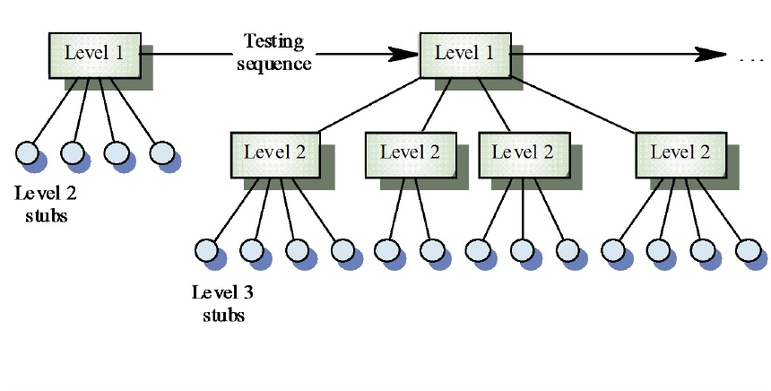
Top-Down Integration Testing
Notes:
Top-down Integration Test starts with the most abstract components and works downwards.
It tests the high levels of a system before testing its detailed components. The program is represented as a single abstract component with sub-components represented by stubs.
Top-down Integration Test is essentially a prototyping philosophy. The initial tests establish a basic system skeleton from the top and each new module adds capability. The problem is that functions of the lower-level modules that are not initially present must by simulated by program stubs. While producing such stubs may at first seem easy, it would be more difficult as more stub add on it. It may be difficult or impossible to test certain logical conditions such as error handling.

Slide 33
Bottom-up Integration Testing
Early testing aimed at proving feasibility
Emphasis on module functionality and performance
Advantages:
  No test stubs are needed
  Errors in critical modules are found early
Disadvantages:
  Test drivers are needed
  Interface errors are discovered late

Slide 34
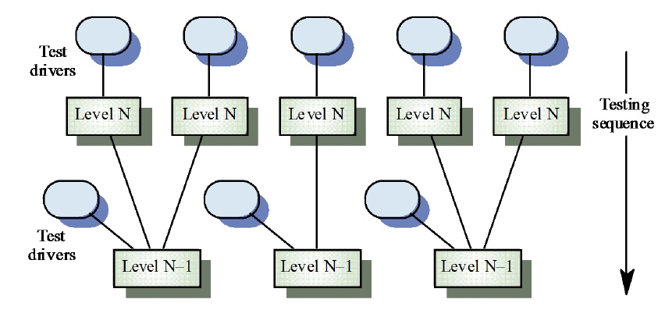
Bottom-up Integration Testing

Slide 35
Test Execution & Reporting
Testing should be treated like an experiment.
Testing requires all anomalous behavior be noted and investigated.
Big companies keep a special library with all copies of test reports, incident forms, and test plans.
Notes:
Everything test should be treated like an experiment toe be carefully controlled and recorded so that it can be reproduced.
The experimental approach also requires meticulous care in defining and recording the test environment., the procedures,and the test cases. Many organizations have found it valuable to keep a special test library with all copies of such material, together with test reports, incident forms, test analyses, and test plans.

