Slide 1
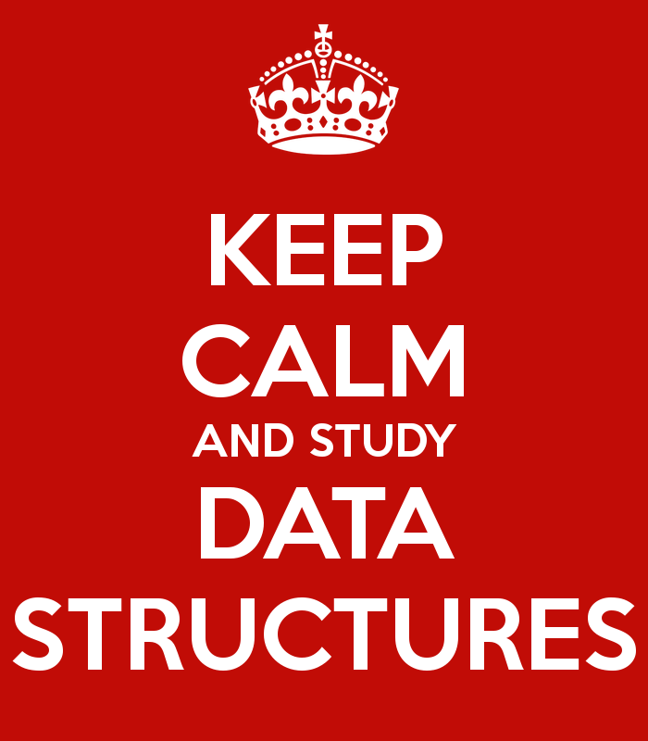
Data Structures
"Bad programmers worry about the code. Good programmers worry about data
structures and their relationships."
- Linus Torvalds

Slide 2
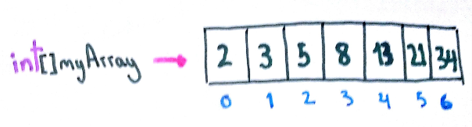
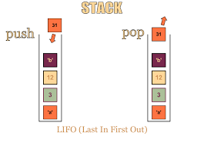
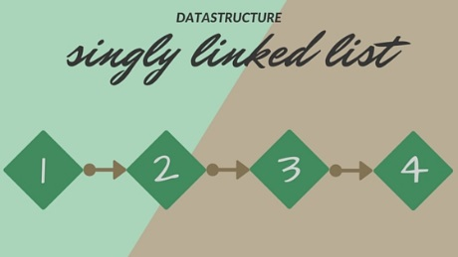
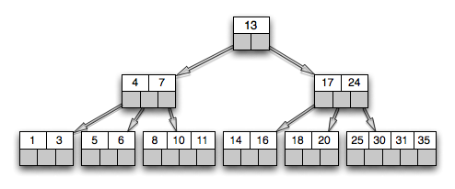
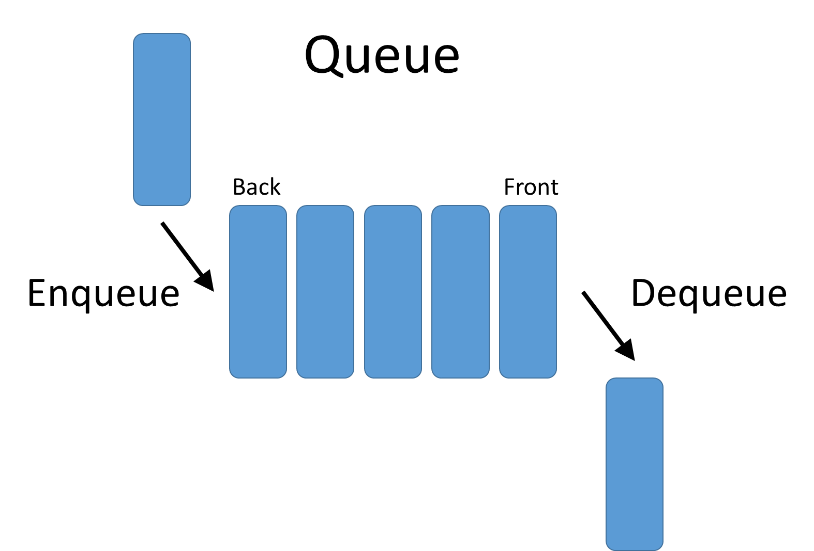
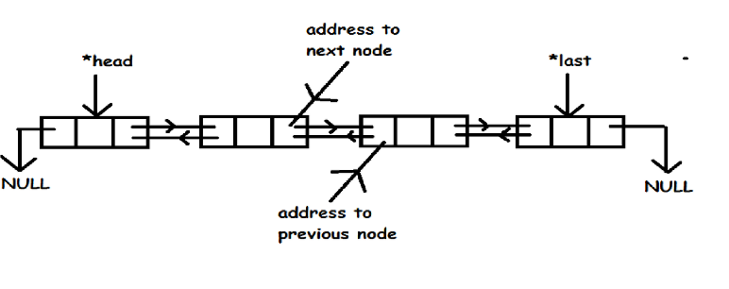
Data Structures
A Data Structure is:
  “an organization of information, usually in computer memory, for better algorithm efficiency."
CS 221 - Computer Science II

Slide 3
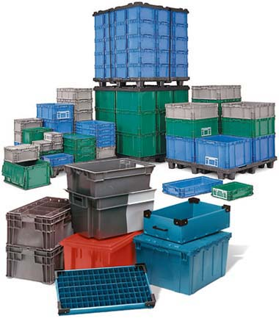
Data Structure Concepts
Data Structures are containers.
  They hold other data.
  Arrays are a data structure.
  So are linked lists.
Other types of data structures:
  stack, queue, tree,
  binary search tree, hash table,
  dictionary or map, set, …
  en.wikipedia.org/wiki/List_of_data_structures
Different types of data structures are optimized for certain types of operations.
CS 221 - Computer Science II

Slide 4
Core Operations
Data Structures have three core operations:
  A way to add things.
  A way to remove things.
  A way to access things, without modifying the data structure.
Details depend on the data structure.
  For instance, a List data structure may need to:
      add at the end of the List.
      access by data by position.
      remove by data by position.
More operations are added depending on what data structure is designed to do.
CS 221 - Computer Science II

Slide 5
Types of Data Structures
Data Structures
Implementation-Dependent
Implementation-Independent
Arrays
Linked Structures
Stacks
Queues
Bags
Sets
Indexed Lists
Linked Lists
Trees
CS 221 - Computer Science II

Slide 6
Implementation-Dependent Data Structures
Arrays
  Collection of objects stored contiguously in memory.
  Accessed by index.
Linked Structures
  Collection of node objects.
    Store data and reference to one or more other nodes.
  Linked Lists
    Linear collection of nodes.
    Single-linked List – nodes contain references to next node in list.
    Double-Linked List – nodes contain reference to next and previous nodes in list.
  Trees
    Hierarchical structure.
    Nodes reference two or more “children.”

Slide 7
Implementation-Independent Data Structures
Abstract Data Types (ADTs):
  Descriptions of how a data type will work without implementation details.
  Description can be a formal, mathematical description.
  Many Java interfaces are a form of ADTs.
Examples:
  Bag, Set, Stack, Queue, Indexed List, etc.
CS 221 - Computer Science II

Slide 8
Implementing ADTs
The operations and behaviors are already specified.
  For instance, every Stack has push, pop and peek methods.
  Think Java interface.
But given an interface describing an ADT, how implement it?
  Must decide which internal storage container to use to hold the items in the ADT.
  Currently, few choices: arrays anyone?
  Later add linked structures.
CS 221 - Computer Science II

Slide 9

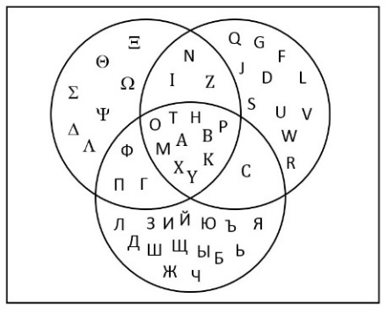
Bags and Sets
Simplest ADT is a Bag
  Items can be added, removed, accessed.
  No implied order to the items.
  Duplicates allowed.
Set ADT
  Same as a bag, except duplicate elements not allowed.
  Operations: union, intersection, difference, subset, etc.
CS 221 - Computer Science II

Slide 10
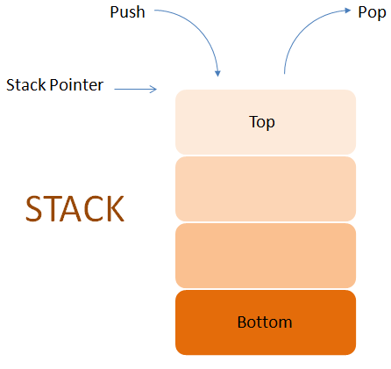
Stack ADT
Can only access last item inserted.
  Expected behavior: Last in, First out (LIFO)
    push - put object on top of Stack
    pop - remove object from top of Stack
    peek or top - look at object on top of the Stack
  Other useful operations:
    make empty
    size
    is empty?
CS 221 - Computer Science II

Slide 11
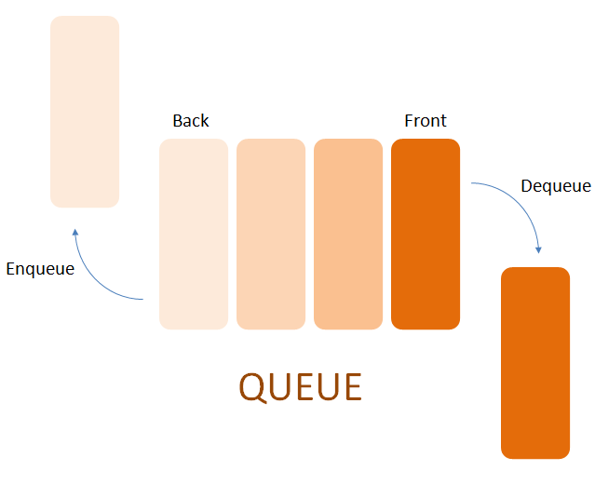
Queue ADT
Can only access item that has been there the longest.
  Expected behavior: First in, First out (FIFO)
    enqueue - insert at the back of the Queue
    dequeue - remove from the front of the Queue
    front - look at the object at the front of the Queue
  Other useful operations:
    make empty
    size
    is empty?
CS 221 - Computer Science II

Slide 12
List ADTs
Linear collection of items.
  Sorted List
    Items in list are arranged in a pre-determined ordering.
      For instance, alphabetically or by ascending numerical value.
  Indexed List
    Items are accessed by position in list.
    Additions / deletions can also be done by position.
  Unsorted List
    Items are stored without an implicit ordering.
CS 221 - Computer Science II

Slide 13
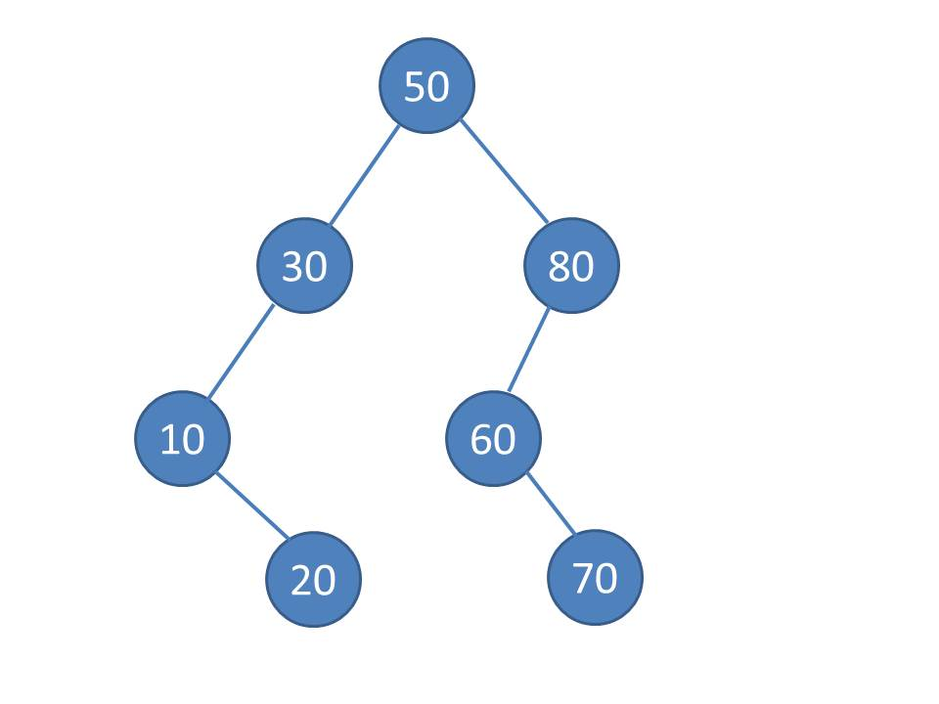
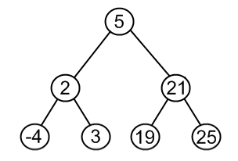
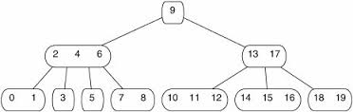
Tree ADTs
Binary Search Trees (BSTs)
  Items stored in sorted order.
Heaps
  Items stored according to the “Heap Property.”
AVL and Red-Black Trees
  BSTs that stay balanced.
Splay Trees
  BST with most recently items at top.
B-Trees
  Another variation of BST.
  Nodes can have more than two children.
CS 221 - Computer Science II

Slide 14
Other ADTs
Hash Tables
  Hash function:
    Computes an index into an array of buckets or slots.
    Look in the bucket for the desired value.
Maps
  Collection of items with a key and associated values.
  Similar to hash tables.
Graphs
  Nodes with unlimited connections between other nodes.
Sparse vectors and sparse matrices.
CS 221 - Computer Science II

Slide 15
Generic Containers
All data structures in Java, including ADTs, should be generic.
  Write them once, use lots of times.
  Hold many different types of data.
  Java achieves genericity through inheritance and polymorphism.
CS 221 - Computer Science II

Slide 16
Internal Storage
ADTs have an internal storage container.
  What is storing the stuff?
    Usually one of the Implementation-Dependent Data Structures:
      Arrays, Linked Lists, Trees
  Abstraction vs. Implementation
    Have to consider:
      abstraction - how data structure interacts with other classes.
      implementation - how is the data actually being stored.
CS 221 - Computer Science II

Slide 17
ADTs and Data Structures in Programming Languages
Modern programming languages usually have a library of ADTs.
  Java collections framework
  C++ standard template library
  .Net framework (portion of VERY large library)
  Python lists and tuples
  Lisp lists
However, most provided collection classes aren’t pure ADTs.
CS 221 - Computer Science II

Slide 18
ADTs in Java
Part of the Java Standard Library is the Collections Framework.
  A library of data structures
  Built on two interfaces
    Collection
    Iterator
  http://java.sun.com/j2se/1.5.0/docs/guide/collections/index.html
CS 221 - Computer Science II

Slide 19

CS 221 - Computer Science II

Slide 20
Stacks and Queues in the Java Collection API
No queue class in the Java collections API.
  Can implement Queue interface using Java LinkedList class.
Stack extends Vector (which is almost exactly like ArrayList).
  Hmmm?
One reason the Java Collections Library is often said to be broken.
CS 221 - Computer Science II

